Slide 1

Note: The data and information in this document is reflective of a hypothetical situation and client. This document is to be used for KPMG Virtual Internship purposes only.
Sprocket Central Pty Ltd
Data analytics approach
[Division Name] - [Engagement Manager], [Senior Consultant], [Junior Consultant]

Slide 2
Note: The data and information in this document is reflective of a hypothetical situation and client. This document is to be used for KPMG Virtual Internship purposes only.
Agenda
Introduction
Data Exploration
Model Development
Interpretation

Slide 3
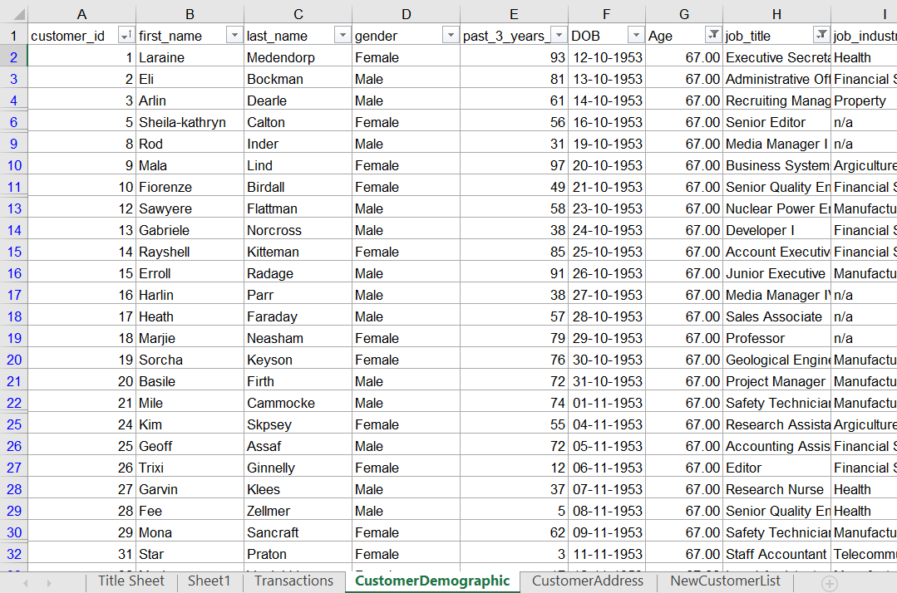
Note: The data and information in this document is reflective of a hypothetical situation and client. This document is to be used for KPMG Virtual Internship purposes only.
Introduction
To Understand and analyse which customers should be focused upon in order to generate revenue in future
The sheets considered for the targets are
CustomerDemographic
CustomerAddress
CustomerDemographic contains features like age, Gender, job Industry which are useful for us to know who are the targets.
CustomerAddress is important aspect to know the region upon which sales strategies should be applied.
Place any supporting images, graphs, data or extra text here.

Slide 4
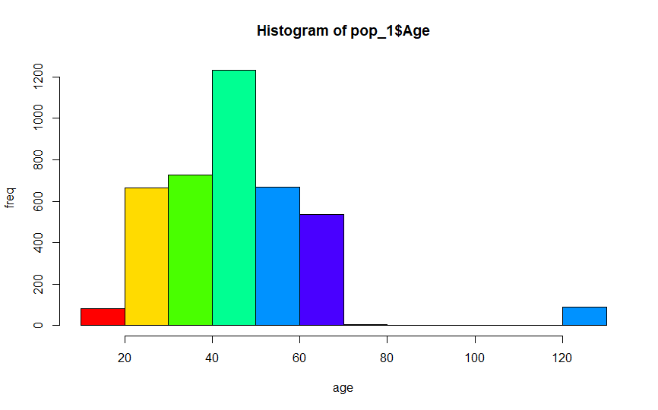
Note: The data and information in this document is reflective of a hypothetical situation and client. This document is to be used for KPMG Virtual Internship purposes only.
Data Exploration
Upon exploring the two sheets, we have analysed which type of customers can be targeted.
After exploring and visualising age we got the following data:
700 customers are of age 20-30 and 50-60
800 customers are age 30-40
Majority customers are of age 40-50
40-50 age group is the potential age group
Place any supporting images, graphs, data or extra text here.

Slide 5
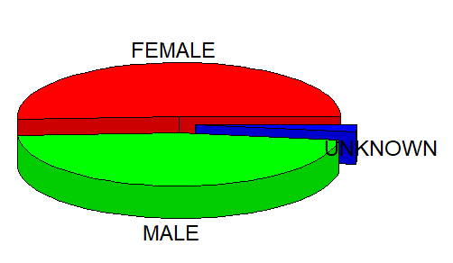
Note: The data and information in this document is reflective of a hypothetical situation and client. This document is to be used for KPMG Virtual Internship purposes only.
Data Exploration
Pie chart to check the gender distribution
After exploring and visualising gender of the previous customers we got the following information:
Approx. 55 percent of the customers are female
40 percent of the total customers are Male
Unknown gender carries just 5 percent of the total
Female customers are the potential targets.
Place any supporting images, graphs, data or extra text here.

Slide 6
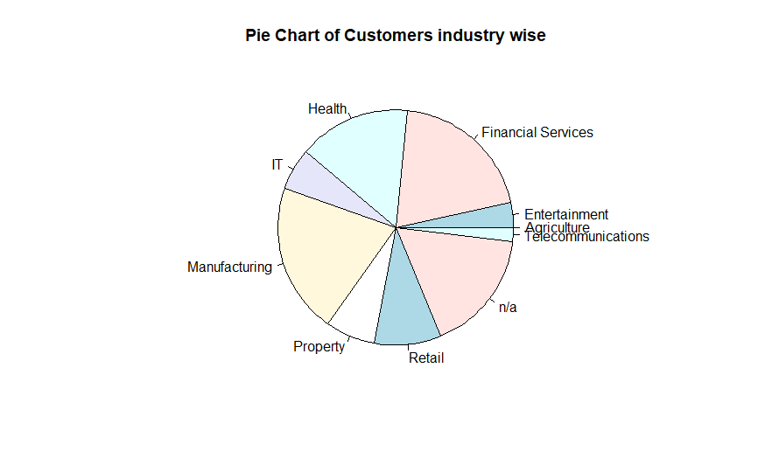
Note: The data and information in this document is reflective of a hypothetical situation and client. This document is to be used for KPMG Virtual Internship purposes only.
Data Exploration
Visualisation of where your customers work!
After exploring and visualising job industry of the customers we got the following information:
Majority of customers work in manufacturing sector.
Financial sector carries just little less weightage than the manufacturing sector
The third most important weightage is carried by customers who have not mentioned their work industry, so this is of no use to predict.
Customers who are working in the manufacturing industry are the potential targets.
Place any supporting images, graphs, data or extra text here.

Slide 7
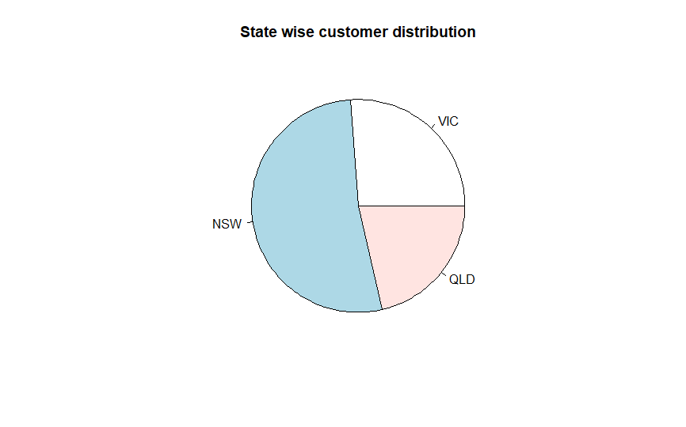
Note: The data and information in this document is reflective of a hypothetical situation and client. This document is to be used for KPMG Virtual Internship purposes only.
Data Exploration
A check on the geographical location of the customers
After exploring and visualising Locations of the previous customers we got the following information:
Customers come basically from 3 states, Victoria(VIC), New South Wales(NSW) and Queensland(QLD)
Majority of the customers are from NSW
VIC and QLD carries equal proportion
customers from New South Wales are the potential targets.
Place any supporting images, graphs, data or extra text here.

Slide 8
Note: The data and information in this document is reflective of a hypothetical situation and client. This document is to be used for KPMG Virtual Internship purposes only.
Model Building
Conclusion from data exploration
Upon carefully checking the data sets, we got the features to predict the future sales in order to check and find out future target customers are-
Age
Gender
Job industry
State
These traits of the customers will help you to make new marketing strategies on the basis of the above mentioned features.
Ideologies and thinking of different classes of people differs so grouping similar customers would be and ideal solution.
This will be cost and time effective.

Slide 9
Note: The data and information in this document is reflective of a hypothetical situation and client. This document is to be used for KPMG Virtual Internship purposes only.
Interpretation
Your potential customers would be-
Those who are of the age group 40-50.
Female as per gender exploration
Employees of Manufacturing Industries.
People living are New South Wales.
Prefer a combination of above 4 categories to find out top target customers.

Slide 10
Note: The data and information in this document is reflective of a hypothetical situation and client. This document is to be used for KPMG Virtual Internship purposes only.
Appendix

Slide 11
Note: The data and information in this document is reflective of a hypothetical situation and client. This document is to be used for KPMG Virtual Internship purposes only.
Appendix
This is an optional slide where you may place any supporting items.

