Slide 1

unilog enrichment engine
Evidence-first product intelligence for industrial commerce.
Six columns in. 252 out. Every value traceable to its source.
Team thExplorers · Shiwani Mishra · Saurabh Gupta · UniHack 2026
100%
field match vs organizer expected output (134 / 134)
1,000 / 1,000
input rows classified to a leaf template
77 tests
hermetic suite, ~2 s offline by default
$0.0004
compute per SKU on the rules path

Slide 2
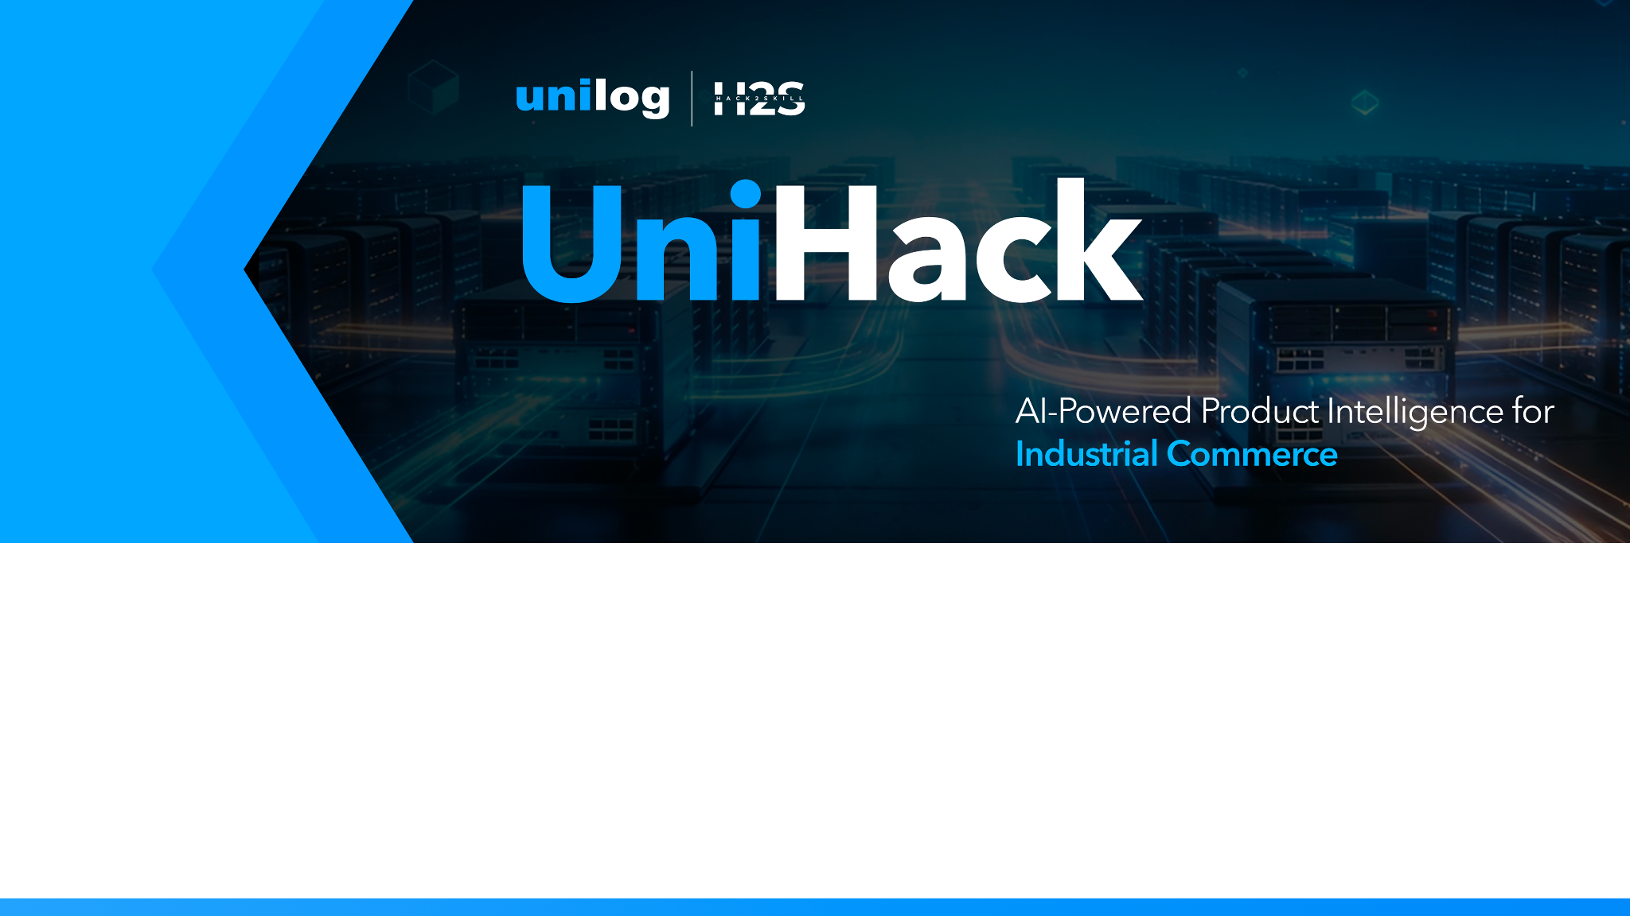
Team details
Team name: thExplorers
Team leader: Shiwani Mishra
Member: Saurabh Gupta

Slide 3
Brief about your solution
Distributors hand us six columns. We return a 252-column Unilog delivery record — every filled cell traced to a source URL.
Manufacturer-first sourcing (Amazon / eBay blocked) → identity → leaf classification → HTML / JSON-LD / PDF extraction → unit & LOV normalisation → five governed descriptions → validation. Rules do the work. An LLM is last-mile only, off by default. Blank beats invented.
100%
Reference field match PDSH4816AF · WDTS7024RZ
39.28
Avg fields filled across 1,000 rows
26
Manufacturer domains cited in provenance
$0.0004
Rules-path cost per SKU, zero APIs

Slide 4
How it enriches, stays accurate, and scales
01 Enrichment
Input analysis → de-dup merge → brand / MPN identity → leaf routing across 14 templates → manufacturer HTML, JSON-LD and PDF extraction → unit & LOV normalisation → five descriptions → 252-column delivery.
02 Accuracy & trust
100% vs the organizer expected output (63/63 and 71/71). Per-cell source URLs. High confidence requires external manufacturer evidence. Validators: LOV, char limits, UOM style, attribute sanity. Integrity tests ban fabricated defaults.
03 Scale
Stateless row pipeline, parallel workers, cache-first fetch under a hard network budget. SSE for live ops, CLI for millions of rows. Add a category = one JSON template. 1,000 rows offline in ~60 s.

Slide 5
Opportunities
How different is it from any of the other existing ideas?
How will it be able to solve the problem statement given?
USP of the proposed solution
Different
Most enrichment tools fill fields. Ours makes every filled cell auditable: a provenance drawer opens the exact source URL, and confidence bands say what a buyer can trust without re-checking.
USP
Audit-proof enrichment — every value verifiable in one click. Accuracy is scored field-by-field against the organizer’s own expected output, not claimed.
Fit
Manual work drops from research-per-SKU to review-by-exception. Rows without manufacturer evidence are flagged, never guessed. That is the trust bar a 100% accuracy target requires.

Slide 6
List of features offered by the solution
• 6-column input → 252-column CSV / XLSX, headers untouched
• Manufacturer-first sourcing; marketplace blocklist
• 14 leaf templates + generic industrial fallback
• Attribute slots filled only when evidence exists
• Per-value provenance JSON — source URL per cell
• Five description types inside character limits
• Marketing copy & features only from manufacturer pages
• Honest Actual Image flag — Yes only with mfr imagery
• Validators: LOV, limits, UOM, ecommerce block, sanity
• Confidence bands: high / medium / review, evidence-gated
• Live UI: enrich, catalog, evidence drawer, SSE batch
• Reference harness + 77 hermetic tests on every change

Slide 7
Process flow diagram or Use-case diagram
1 Ingest
6 columns, placeholders, dedupe merge — never drop
2 Identity
Brand aliases, DIB / E1, MPN prefix rules
3 Classify
Leaf routing across 14 category templates
4 Extract
HTML · JSON-LD · PDF cache-first fetch
5 Normalise
Units, LOV, canonical brand casing
6 Compose
5 governed descriptions + delivery asset names
7 Validate
Rules, confidence bands, integrity tests
8 Deliver
CSV / XLSX + per-cell provenance JSON
Fail-safe: every row is wrapped — a bad SKU never kills the batch.

Slide 8
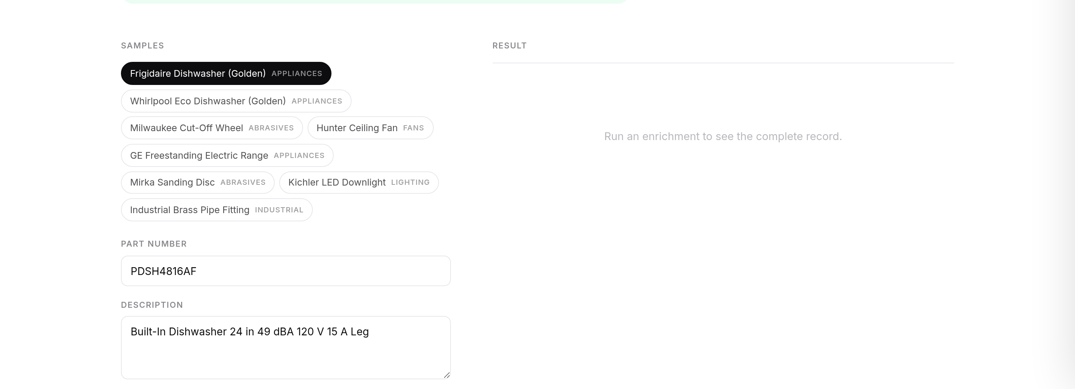
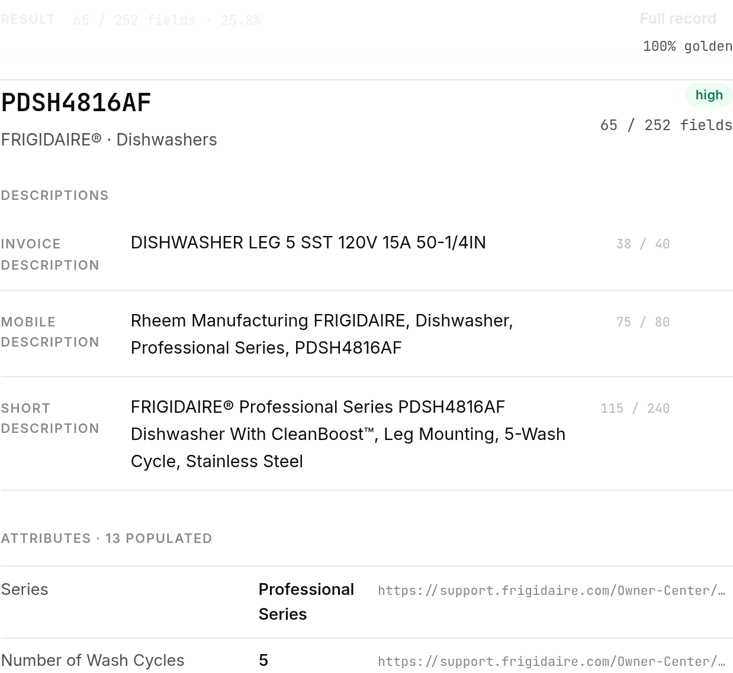
Wireframes/Mock diagrams of the proposed solution (optional)
Enrich workbench — six columns in
Result — Frigidaire PDSH4816AF, 100% vs reference

Slide 9
Architecture diagram of the proposed solution
Interface
FastAPI · SSE live stream · static web UI · CLI
Orchestration
pipeline.enrich_input_row — fail-safe per row · dedup merge · workers
Intelligence
identity/ resolver · classify/ templates · extract/ HTML-PDF-JSON-LD · optional LLM
Trust
validate/ LOV + limits + sanity · provenance map · confidence bands · reference harness
Delivery
CSV · XLSX · provenance JSON · batch reports
Uniform cache-first fetch: retry / backoff, atomic writes, TTL, UNILOG_FETCH_BUDGET. Playwright only on 403. UNILOG_LIVE_FETCH=0 kills the network.

Slide 10
Technologies used in the solution
Python 3.11
Pipeline core, typed modules
FastAPI + SSE
Upload, live stream, downloads
httpx + Playwright
Resilient fetch, 403 fallback
BeautifulSoup + extruct
HTML tables, JSON-LD, microdata
pdfplumber
Manufacturer PDF datasheets
openpyxl
Delivery-format XLSX
pytest × 77
Hermetic suite, offline default
Remotion + FFmpeg
Reproducible 3-minute demo film

Slide 11
Estimated implementation cost (optional)
Approach
Cost / SKU
Notes
Manual enrichment (offshore)
$5.00 – $15.00
Industry rate for research + entry
unilog — rules path
$0.0004
CPU only · 1,000 rows ≈ 60 s · zero API calls
unilog — LLM last-mile (worst)
$0.0204 max
Hard-capped calls / run · off by default
A 1M-SKU catalog: ~$400 compute on the rules path vs $5–15M manually — four orders of magnitude, with provenance a human can audit.

Slide 12
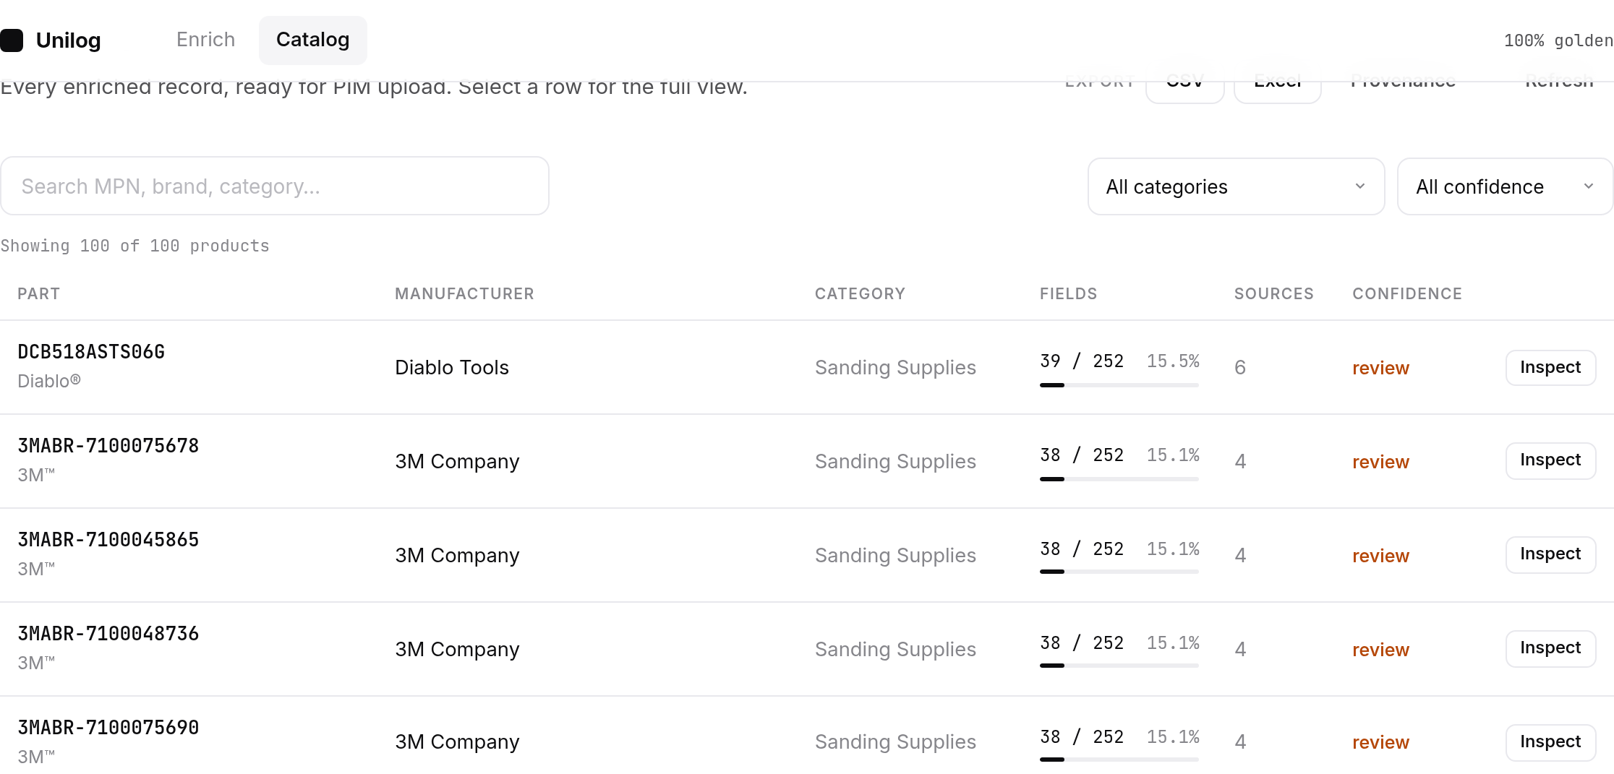
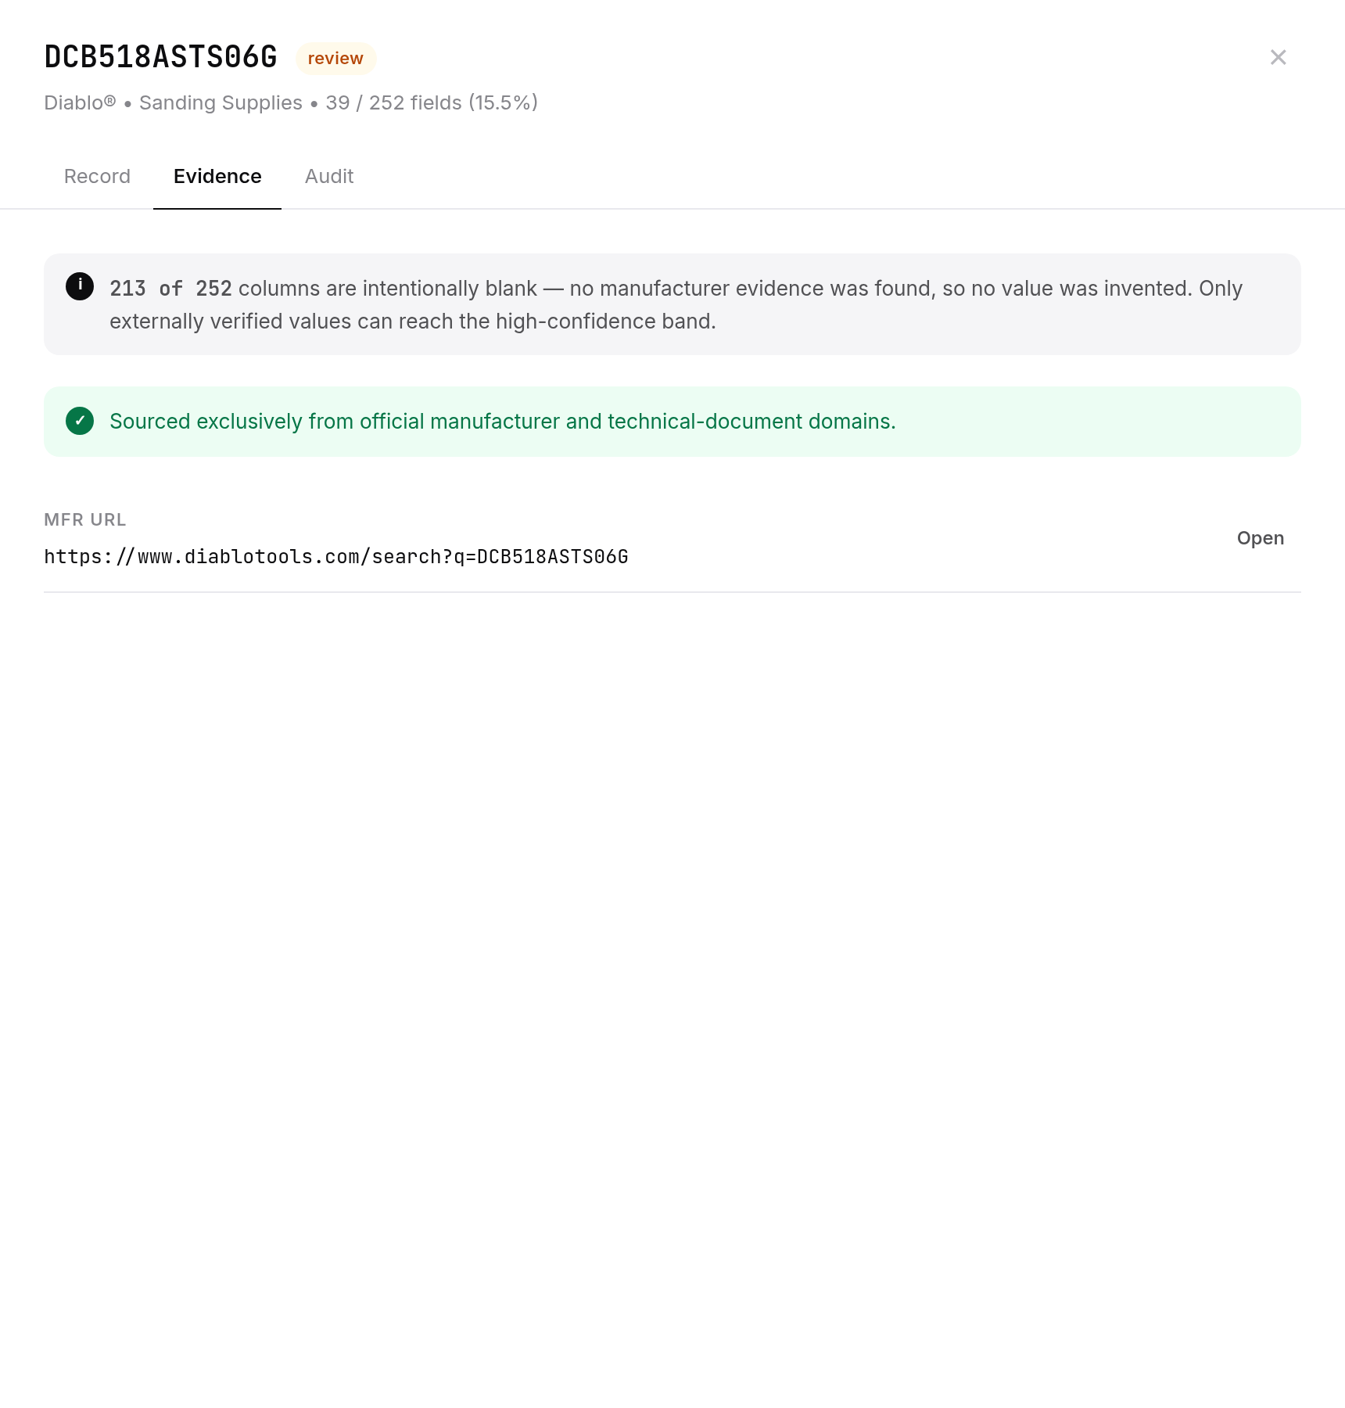
Snapshots of the MVP
Catalog — 1,000 enriched rows, ready for PIM
Evidence drawer — blank beats invented

Slide 13
Additional Details/Future Development (if any)
Organizer reference packs
Drop-in importer already ships. Real LOV (~161k), UOM standards, 27k brand list and the 200-row ground-truth scorer activate automatically.
Taxonomy at 14k scale
Embedding matcher over the full leaf index, sitting beside the current rule router.
Human review queue
Review-band rows land in a triage UI; approvers publish into a CX1-style PIM.
HyperScale agent fit
Packaged as a merchandising-agent accelerator: same provenance contract, streaming connector for distributor ERPs.

Slide 14
Provide links to your:
GitHub Public Repository
Demo Video Link (3 Minutes)
Working Prototype Link
GitHub public repository
https://github.com/shiwani42/unihack-product-enrichment
Demo video — 3 minutes
https://vimeo.com/1220615209
Working prototype
https://unilog-tau.vercel.app

Slide 15

thExplorers · Shiwani Mishra · Saurabh Gupta

