Slide 1
Introduction to Virtusa Agile Framework
Notes:
1

Slide 2
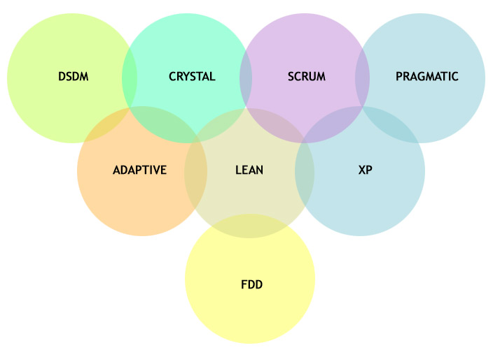
Agile software development focuses on adapting to change
GENERAL AGILE CONCEPTS
There is a significant number of agile methodologies in the market. Each of these methodologies has roots in a specific focus with the overall theme of agility.
What is Agile?
The ability to adapt:
To changing requirements
To changing circumstances
Notes:
2

Slide 3
AGILE DEVELOPMENT CONCEPTS
Agile development benefits, and why it works
Allows customer to prioritize and control requirements
Accelerates time-to-market by delivering quick incremental business value
Enhances collaboration and alignment between IT and the business
Reduces risks through incremental development
Improves visibility to progress through working software
Improves quality through frequent demos
Improves productivity through regular retrospection and refinement
Improves team morale through empowerment and increased collaboration
Overall, agile development improves customer satisfaction

Slide 4
Agile Planning and Execution
Notes:
4

Slide 5
Agile planning and execution
Product
Backlog
Time boxed
Daily Standup
Burn down
Sprint Planning
Sprint
Sprint Demo
Sprint Retrospective
Working
Software
Notes:
5

Slide 6
Sprint Planning Meeting
Goal of Sprint Planning Meeting:
For the team to make a good commitment around what it will deliver by the end of the Sprint
What’s a good commitment?
Clearly understood by all
Shared among the team
Achievable without sacrificing quality
Achievable without sacrificing sustainable pace
Attended by Program team, Iteration Team, Customer-proxy, Stakeholders
May require 1-2 hours for each week of Sprint duration
It involves
Calculating available hours for the Sprint
Creating the Sprint plan
Freezing the scope for the Sprint

Slide 7
Sprint Planning
Team understands the
details of what user stories
have been prioritized on
the Release Backlog
Team decides how
much productive
time it has available
during the Sprint
Team decides how
many User stories it
can commit to complete
during the Sprint
What’s on the
Customer’s
“shopping list”
How much “money”
do we have in our
bank account?
How many items on
the shopping list can
we afford to “buy”
with that “money”

Slide 8
Calculating Available hours
Team-members | Available Workdays in the Sprint | Average Available Hours per Day | Estimated Available Hours in the Sprint
TM1 | 10 | 6 | 60
TM2 | 8 | 6 | 48
TM3 | 9 | 6 | 54
TM4 | 10 | 5 | 50
TM5 | 10 | 6 | 60
TM6 | 9 | 7 | 63
 |  | Total available hours | 335
Team members give their input on how many days available during the Sprint
Team members give their input on how many hours available per day for the sprint
Also known as ‘Team capacity’

Slide 9
Creating Sprint Plan
Team takes the highest prioritized item from Product Backlog and breaks it into tasks
Team estimates how long the tasks will take
Story Points | User Story | Task List | Owner | Estimate | Total effort
12 | US12 | Task 1 | TM2 | 30 | 115
 |  | Task2 | TM4 | 35
 |  | Task3 | TM6 | 35
 |  | Task4 | TM2 | 15
9 | US9 | Task5 | TM5 | 42 | 69
 |  | Task6 | TM1 | 15
 |  | Task7 | TM4 | 12
8 | US2 | Task8 | TM6 | 30 | 50
 |  | Task9 | TM1 | 20
7 | US1a1 | Task10 | TM3 | 50 | 90
 |  | Task11 | TM1 | 25
 |  | Task12 | TM5 | 15
5 | US1a2 | Task13 | TM2 | 27 | 52
 |  | Task14 | TM4 | 25
Repeat the above two steps until the team capacity is met ~

Slide 10
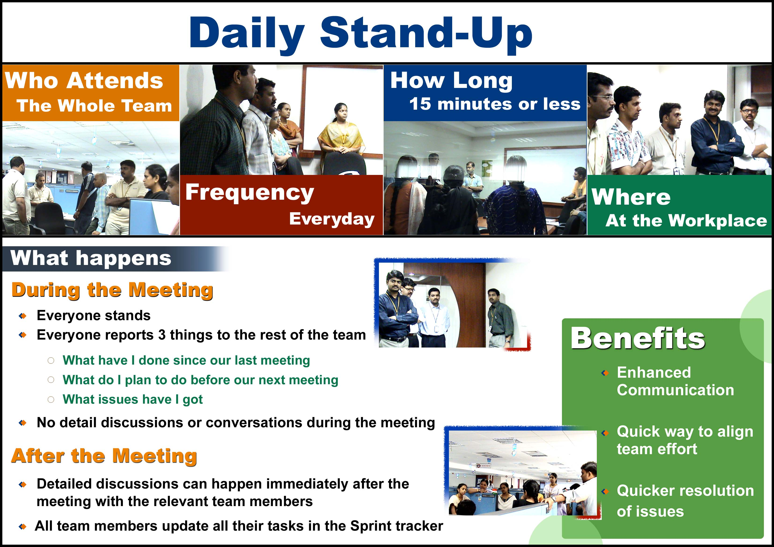

Slide 11
Project Tracking Artifacts
Sprint Backlog
Team updates the Sprint backlog or task tracker for ‘work to be done’ after the daily stand up
Tasks that were not attended get carried out as it is
Burn down
Burn down chart is updated based on the daily updates of the sprint backlog

Slide 12
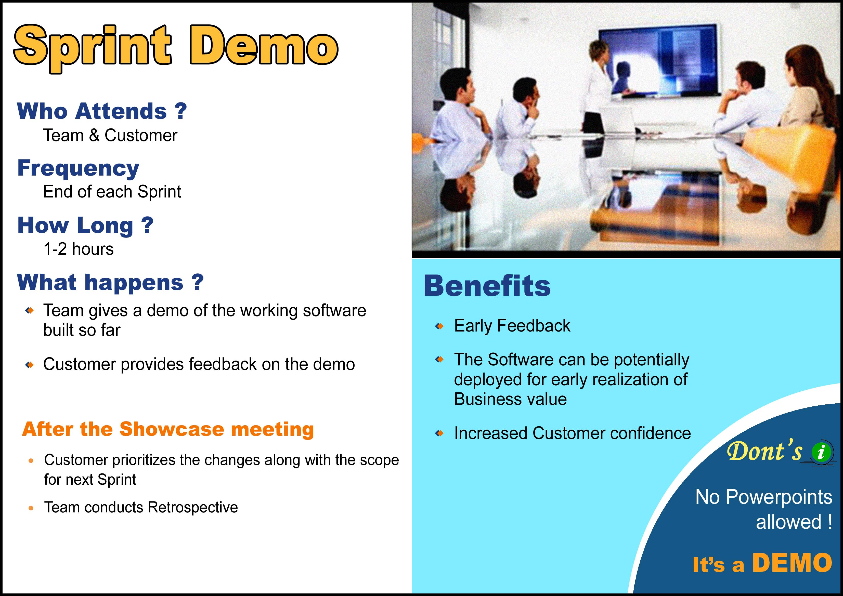
Sprint Demo

Slide 13
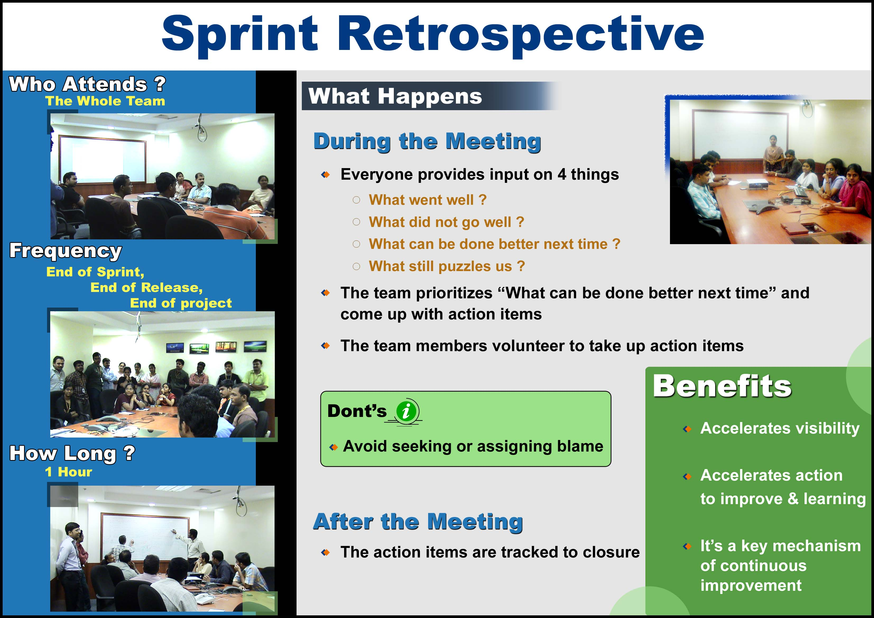
Sprint Retrospective

Slide 14
Managing Change

Slide 15
Managing Change
During a Sprint
Once team has committed, no changes to Sprint scope
No Changes to Deliverable
Details will emerge during Sprint, but no new work or substantially changed work
Customer can terminate the Sprint if necessary
No Changes to Sprint Duration
Sprint ends on planned date whether team has completed its commitment or not
Customer can make any changes to the remaining Product Backlog before the start of the next Sprint

Slide 16
High Level Size Estimation

Slide 17
Background
Plans are only as good as the estimates that the plans are based on, and
estimates always come second to actual. The real world has this horrible habit of destroying plans.
The customer has the right to an overall plan, to see progress and to be informed of schedule changes. Whereas the developer has the right to make and update his own estimates and to accept responsibility instead of having responsibility assigned to him.
Forecasting tomorrow’s weather is much more difficult than telling what the weather was like yesterday.
Don’t try to be too sophisticated; estimates will never be anything other than approximate, however hard you try.

Slide 18

Some definitions
Estimating User Stories
STORY POINT
It is an abstract
estimation unit
It indicates the size and
complexity of a User
Story relative to other
stories
PLANNING POKER GAME
A method derived from
Wideband Delphi method
to estimate as a team
The size of User Stories
is estimated in Story
points by playing a game!
VELOCITY
Velocity is the total number of story points that a team can deliver in a Sprint

Slide 19
Steps for Planning Poker Game
Everyone has cards: 1/2, 1, 2, 3, 5, 8, 13, 20, 50
The Team selects a medium sized User story and assigns 5 to that story
The Business Analyst reads out a User story
The team can get high level clarifications from the Customer or Customer proxy
Everyone selects and simultaneously shows cards which indicates the Ideal days required to develop & unit test the User Story
If estimates vary significantly, high and low estimators briefly explain
Repeat steps 4-6 until estimates stop converging
Decide estimate for User Story
Move to next User Story
If the estimates differ slightly, reach group consensus on one value. Follow the rule “Optimism wins” (team members whose optimism burned the team once will learn to temper that optimism).

Slide 20
Agile Requirements

Slide 21
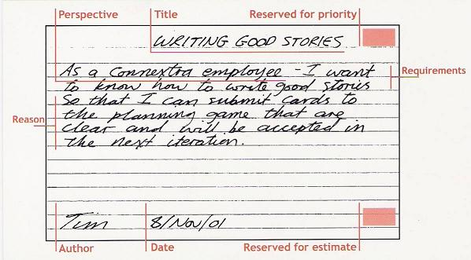
What is a User Story?
USER STORY
The User Story is the
basic unit of scope in an
Agile project
Describes the who, what,
why of a requirement
Describes real business
value
Test Scenarios
Story should be accepted by the development team
Should have a business value attached
Should satisfy INVEST criteria
Acceptance Criteria

Slide 22
Criteria for a good User Story
A good User Story should satisfy INVEST criteria
A good user story:
I Independent 
N Negotiable 
V Valuable / Vertical 
E Estimatable 
S Small / Sizable 
T Testable 

Slide 23
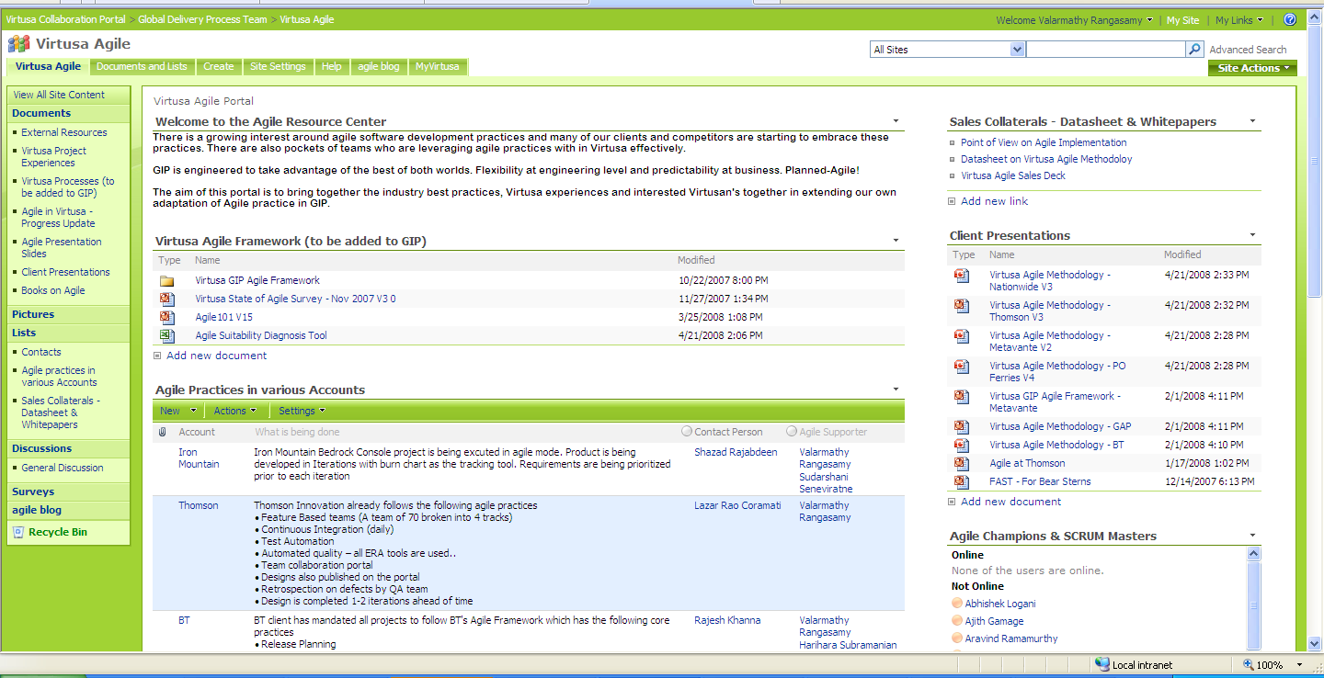
Agile Portal - Guidance
Marketing Collaterals –
Provides overview of the
Virtusa Global Agile Framework
Details of the Virtusa Global Agile Framework –
Agile Workshop Deck
Templates, Guidelines & Tools
Agile Initiative –
Progress Updates
All presentations to
the Clients so far
eBooks on Agile
Virtusa State of Agile
Survey Results
General Agile awareness
Information on various
accounts practicing Agile
Agile Suitability Diagnosis
Tool – Details available in the Marketing Collaterals
Agile Blog

Slide 24

USA UK INDIA SRI LANKA
www.virtusa.com
For more information, please contact: SalesInquiries@virtusa.com
"Virtusa" is a trademark of the company and a registered trademark in the EU and In India.
"Productization" is a service mark of the company and a registered service mark in the United States.
"vRule" is a service mark of the company.
© 2007 Virtusa Corporation ● Confidential
All Rights Reserved
Notes:
24

