Slide 1








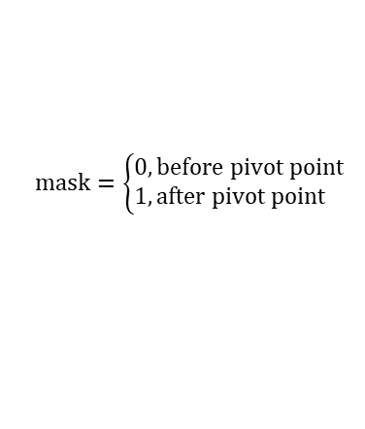



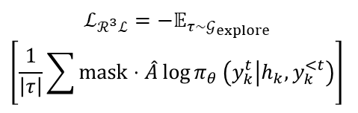


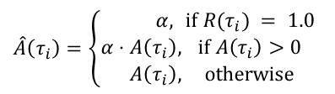
Language Feedback or Observation
From User/Environment
Turn 2 too verbose. I should use concise style and strict JSON output.
I should check item attributes and prices before purchasing to ensure they meet requirements at turn 3.
$$\hat{A}\left(τ_{i}\right)=\left\{\begin{aligned}α,&&if R(τ_{i}) = 1.0 \\ α⋅A\left(τ_{i}\right)&,&if A\left(τ_{i}\right)>0 \\ A\left(τ_{i}\right)&,&otherwise\end{aligned}\right.$$
Item details: [...]
Too verbose
Wrong format
$$R\left(τ_{i}\right)$$
$$A\left(τ_{i}\right)=R\left(τ_{i}\right)−\overline{R}$$
$$mask=\left\{\begin{aligned}0,&before pivot point \\ 1,&after pivot point\end{aligned}\right.$$
Turn 1
Turn 2
$$…$$
Turn 13
0.1
-0.4
-0.4
Turn 1
Reflect
Guidance
Retry
Policy
Model
Turn 2
$$…$$
Turn 7
0.6
0.1
$α⋅$0.1
Turn 1
$$ℒ_{ℛ^{3}ℒ}=−𝔼_{τ∼𝒢_{explore}}$$
$$\left[\frac{1}{\left|τ\right|}\sum{mask}⋅\hat{A}\log{π_{θ}}\left(y_{k}^{t} | h_{k},y_{k}^{<t}\right)\right]$$
Task
Turn 1
Turn 2
Turn 3
$$…$$
Turn 10
0.3
-0.2
-0.2
Turn 2
Guidance
Reflect
Training loss of $ℛ^{3}ℒ$
Retry
Turn 3
$$…$$
Turn 8
1.0
0.5
$$α$$
Turn 2
Reward
Advantage
Pivot Point
Positive
Preference Advantage
Language-Guided
Reflect-Then-Retry
Positive
Preference Optimization
Pivotal
Credit Assignment

