Slide 1
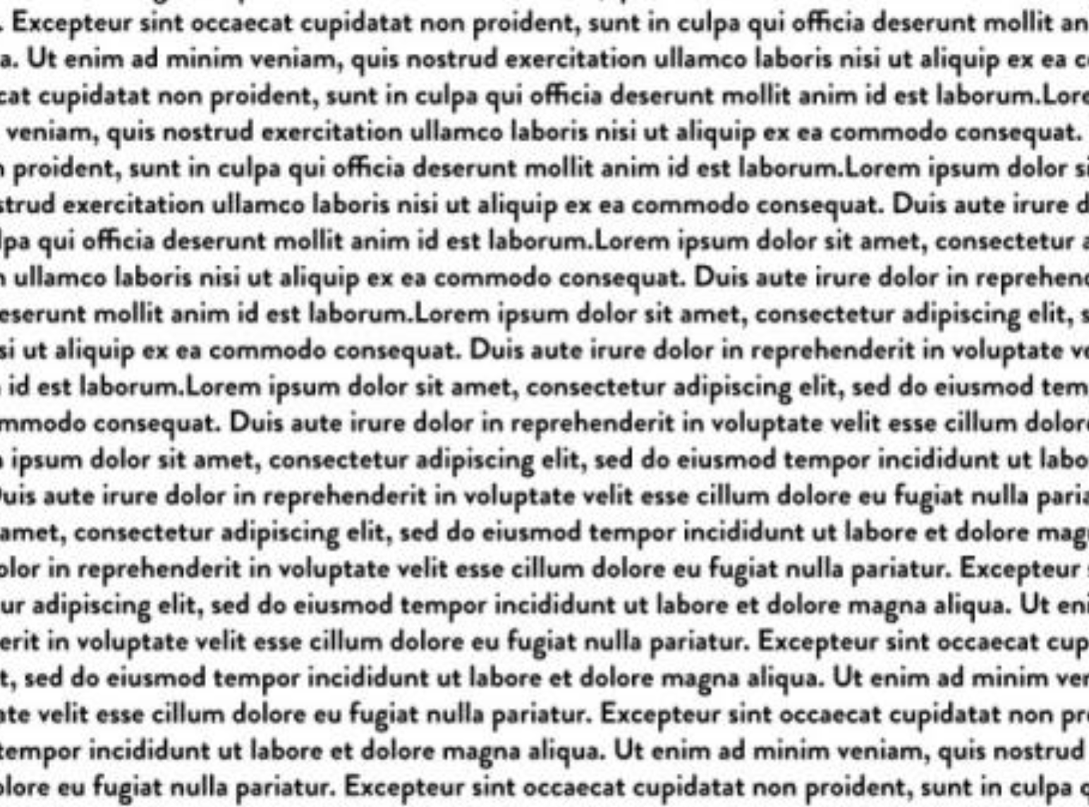





Question: How many seasons of Game of Thrones are there?
It premiered on HBO in the United States on April 17, 2011, and concluded on May 19, 2019, with 73 episodes broadcast over eight seasons.
Retriever
Relevant
George R. R. Martin planned for at least 10 seasons of 'Game of Thrones'. Jordan Potter. Mon 22nd Aug 2022 12.30 BST.
Irrelevant
Retrieved Passages
Passage Relevance Estimator
Merge all passages
as context directly
Eight seasons
LLM
10 seasons
Pay attention to useful passages

