Slide 1

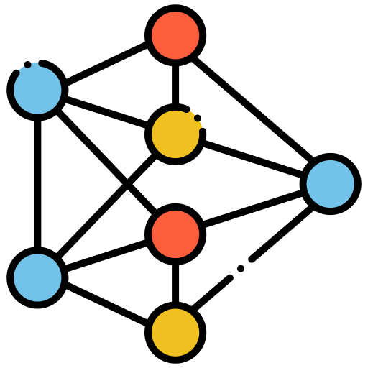
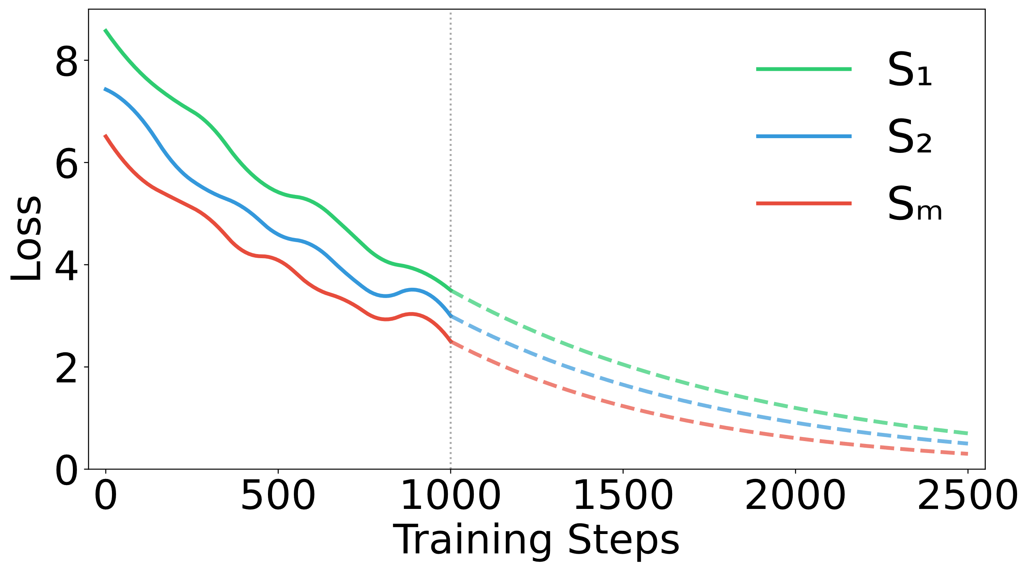

















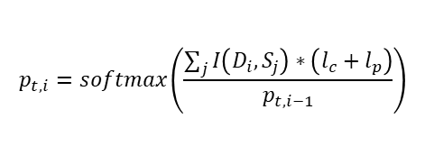





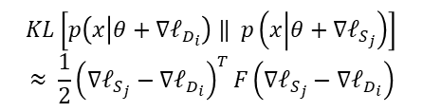




Step 1: Data Repartition
Step 2: Domain Impact Matrix
Step 3: Update Sampling Vector
$$𝒟_{1}$$
$$𝒟_{1}$$
$$𝒟_{1}$$
$$𝒟_{1}$$
0.07
0.12
$$…$$
0.26
$$𝒟_{2}$$
$$𝒟_{2}$$
$$…$$
$$…$$
$$𝒟_{2}$$
0.05
0.09
$$…$$
0.03
$$𝒟_{k}$$
$$𝒟_{k}$$
$$…$$
$$…$$
$$…$$
$$…$$
$$…$$
Last Mixture $p_{t−1}$
Updated Mixture $p_{t}$
$$𝒟_{k}$$
0.19
-0.06
$$…$$
0.11
$$p_{t,i}=softmax\left(\frac{\sum_{j}{I\left(D_{i},S_{j}\right)}∗\left(l_{c}+l_{p}\right)}{p_{t,i−1}}\right)$$
$$𝒟_{k}$$
Train Dataset $𝒟$
$$𝒟_{2}$$
$$S_{1}$$
$$S_{2}$$
$$…$$
$$S_{m}$$
Small Proxy
Model
K-means
Cluster
$$I\left(D_{i},S_{j}\right)$$
Downstream Tasks$𝒮$
$$KL\left[p\left(x | θ+∇ℓ_{D_{i}}\right) ‖ p\left(x | θ+∇ℓ_{S_{j}}\right)\right]$$
$$≈ \frac{1}{2}{\left(∇ℓ_{S_{j}}−∇ℓ_{D_{i}}\right)}^{T}F\left(∇ℓ_{S_{j}}−∇ℓ_{D_{i}}\right)$$
……
……
Current
Improvement $l_{c}$
Potential $l_{p}$
Random
Projection
$F≈𝔼\left(\left[∇log p\left(x | θ\right)⊙∇log p\left(x | θ\right)\right]\right)$
Gradient Vector

