Slide 1








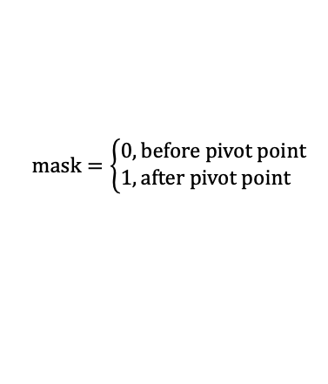



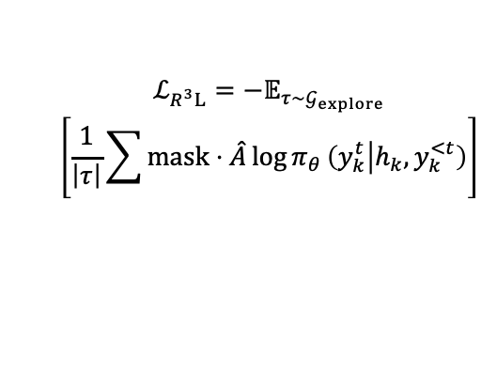


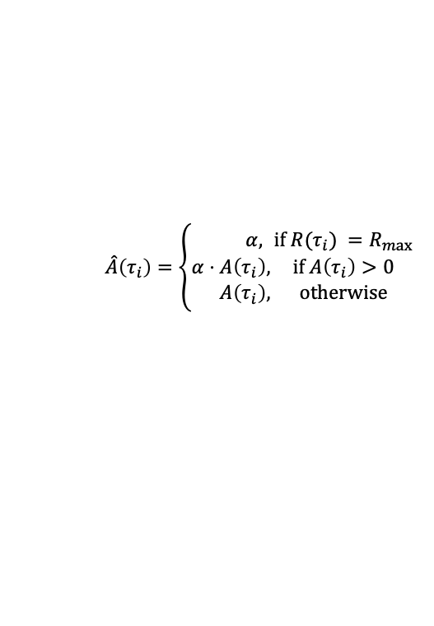
Language Feedback or Observation
From User/Environment
Reflect: Skipped item verification at (Pivot Point) Turn 2, leading to wrong purchase.
(Guidance) I should check item attributes and prices before purchasing to ensure they meet user requirements.
$$\hat{A}\left(τ_{i}\right)=\left\{\begin{aligned}α,&&if R(τ_{i}) =R_{max} \\ α⋅A\left(τ_{i}\right)&,&if A\left(τ_{i}\right)>0 \\ A\left(τ_{i}\right)&,&otherwise\end{aligned}\right.$$
Item details: [...]
Too verbose
Wrong format
$$mask=\left\{\begin{aligned}0,&before pivot point \\ 1,&after pivot point\end{aligned}\right.$$
Turn 1
Turn 2
$$…$$
Turn 13
0.1
-0.4
-0.4
Turn 1
Pivot Point=2
Reflect
$$R\left(τ_{i}\right)$$
$$A\left(τ_{i}\right)=$$
$$R\left(τ_{i}\right)−\overline{R}$$
Guidance
Retry
Policy
Model
Turn 2
$$…$$
Turn 7
0.6
0.1
$α⋅$0.1
Turn 1
$$ℒ_{R^{3}L}=−𝔼_{τ∼𝒢_{explore}}$$
$$\left[\frac{1}{\left|τ\right|}\sum{mask}⋅\hat{A}\log{π_{θ}}\left(y_{k}^{t} | h_{k},y_{k}^{<t}\right)\right]$$
Task
Turn 1
Turn 2
Turn 3
$$…$$
Turn 10
0.3
-0.2
-0.2
Turn 2
Reflect
Training loss of $R^{3}L$
Retry
Turn 3
$$…$$
Turn 8
1.0
0.5
$$α$$
Turn 2
Masked Share Prefix
Reward
Advantage
Amplified
Advantage
Pivotal Mask
Wrong Base Suffix
Language-Guided
Reflect-Then-Retry
Positive
Advantage Amplification
Pivotal
Credit Assignment
Correct Retry Suffix

