Slide 1


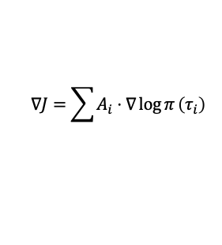




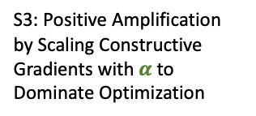












C1: Inefficiency by Stochastic Sampling and Passive Scalar Reward Learning
C3: Gradient Asymmetry: More “Avoid This” Than “Do This” Leading to Probability Dispersion
Standard GRPO
$$τ_{1}$$
failure
$$P(τ_{1})↓↓$$
$$τ_{2}$$
failure
$$P(τ_{2})↓$$
C2: Valid Prefix Penalized
$$τ_{3}$$
$$P(τ_{3})↓↓$$
S3: Positive Amplification by Scaling Constructive Gradients with $α$ to Dominate Optimization
failure
$$τ_{4}$$
success but inefficient
$$P(τ_{4})↑↑↑$$
$$∇J=\sum{A_{i}}⋅∇\log{π}\left(τ_{i}\right)$$
Our $R^{3}L$
$$τ_{1}$$
failure because …
$$P(τ_{1})↓↓↓$$
Reflect-Retry
$$τ_{1}’$$
success
$$P(τ_{2})↑↑↑↑↑$$
$$τ_{2}$$
success but inefficient due to …
$$P(τ_{3})↑↑↑$$
Reflect-Retry
$$τ_{2}’$$
success and efficient
$$P(τ_{4})↑↑↑↑↑↑$$
S1: Reflect-Retry for Active Exploration using Language Feedback to Diagnose Errors and Restart from Pivot
$$∇J=\sum{Mask_{i}⋅α_{i}⋅A_{i}}⋅∇\log{π}\left(τ_{i}\right)$$
S2: Pivotal Credit Assignment by Masking Shared Prefix and Updating Only Diverging Suffix

