Slide 1
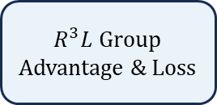




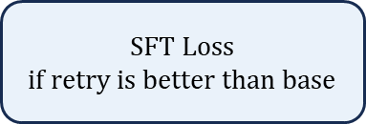




Turn 1
Turn 2’
$$…$$
Turn 13’
Turn 1
Turn 2
$$…$$
Turn 13
$R^{3}L$ Group Advantage & Loss
Pivot Point
Turn 1
Turn 2
Turn 3
$$…$$
Turn 10
Turn 1
Turn 2
Turn 3’
$$…$$
Turn 10’
Type 1: Base Exploration
Pivot Point
Type 4: Distillation Trajectory
SFT Loss
$$if retry is better than base$$
Reflect
Rebuild Retry Trajectory
Pivot Point
Turn 1
Turn 2
$$…$$
Turn 13
Reflect
Turn 1
Guidance
Turn 2’
$$…$$
Turn 13’
Guidance
Pivot Point
Pivot Point
Turn 1
Turn 2
Guidance
Turn 3’
$$…$$
Turn 10’
Turn 1
Turn 2
Turn 3
$$…$$
Turn 10
Reflect
Pivotal-based
Retry
Guidance
Pivot Point
Type 3: Retry Trajectory
Type 2: Reflection Trajectory

