Slide 1
Coughing detection project
Group: Andrew Miller, Wei Shi
Notes:
Hello, everyone. Today , Andrew and I are going to talk about our project, coughing detection.

Slide 2

Goals
Detect the cough events in a recorded voice sample.
Generate a report about the total number of events and the timestamp and duration of each event.
Notes:
Our goals are to Detect the cough events in a recorded voice sample.
And to Generate a report about the total number of events and the timestamp and duration of each event.

Slide 3
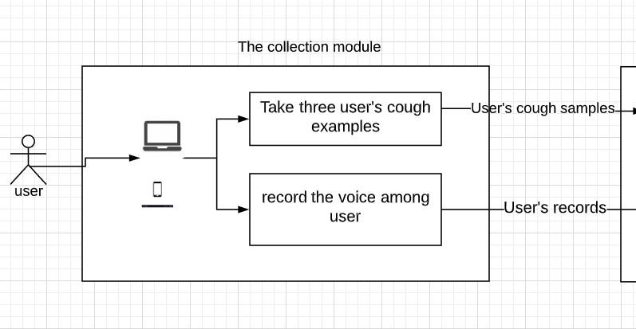
Design
Notes:
We use an android device to collect examples and target recordings. Upload those recordings to a computer.

Slide 4
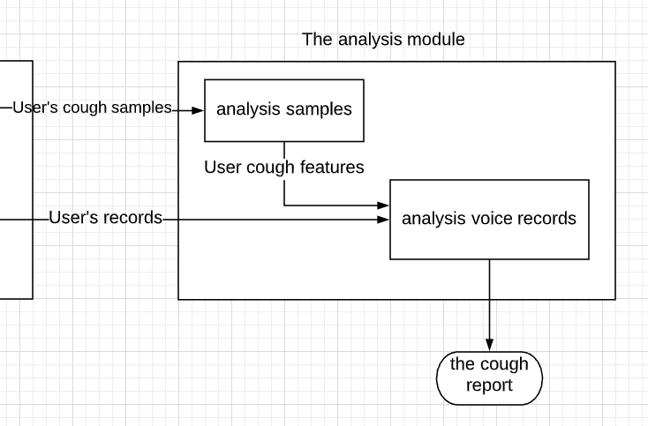
Design
Notes:
We analyze those examples and the target recording to generate a report. The original design was that we take 3 examples from every users. In practice, a general model can handle most cases. So, we don’t require 3 examples from users anymore.

Slide 5
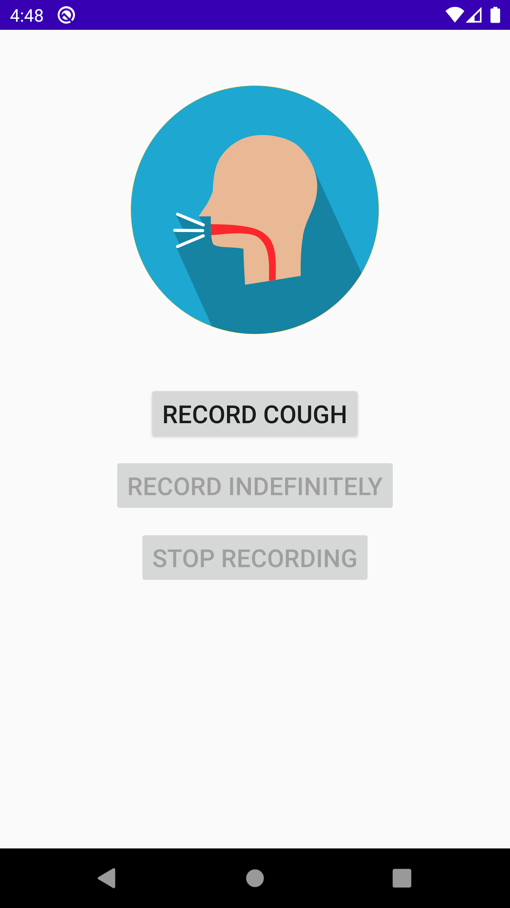
Collection Module
Notes:
This is our mobile application User interface. Later on, those examples and records will upload to a computer to analyze.

Slide 6
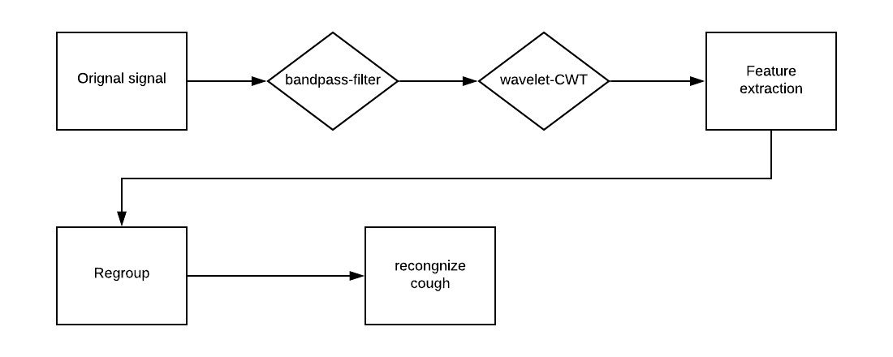
Analysis Module
Notes:
This is the process of the analysis. The first step is using filter to remove noise. Then, the signal will pass wavelet become a matrix of the correlated values.
Those steps we used the python libraries.
Next, we extract some interested areas or line segments from the matrix. Those line segments or areas may indicate a part of cough event
Then, we will combine some adjacent line segments or areas to a group which represent a completed cough event.
The last step is about compute the timestamp and the duration.

Slide 7
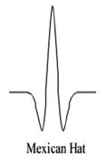
The Analysis module
Bandpass filter (5000,11000)
Wavelet CWT(Mexican Hat)
Notes:
Let’s go to the details. Mexican hat suits for detect a signal has a very high power.

Slide 8
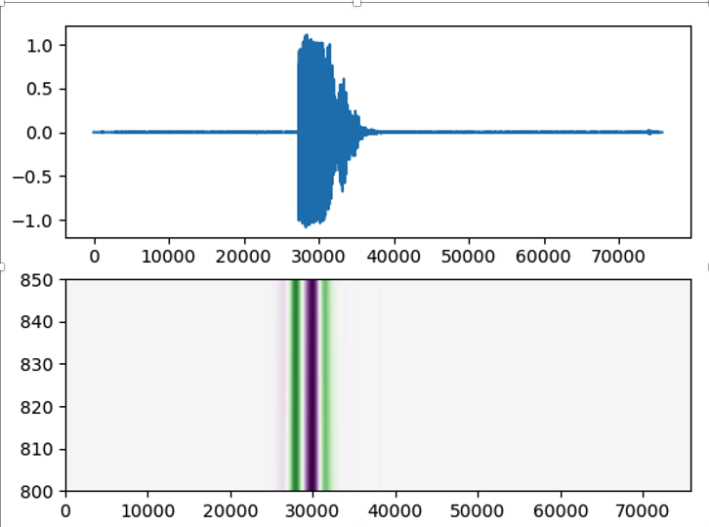
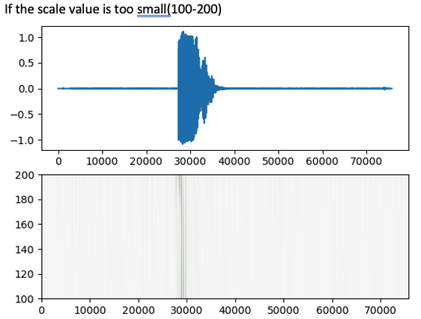
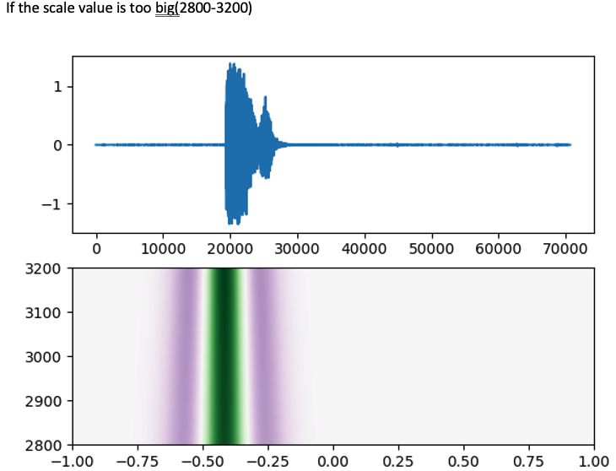
Scale
We use 800. Why?
The Original design was to randomly choose 9 scales from 800-900. Each scale will vote after the analysis. In practice, one scale is enough to yield a good result.
Notes:
We use 800. Why? Enter enter
The Original design was to randomly choose 9 scales from 800-900. Each scale will vote after the analysis. In practice, one scale is enough to yield a good result.

Slide 9
The Future extraction
000000000-----00+++++++0000-----000++++0000000
0 represents a point the correlated value in a range (-0.05,0.05)
+ represents a point the correlated value >0.05
- represents a point the correlated value <-0.05
To figure out that the start, ending, Max, Min value of line segment. The Feature threshold v>0.05 or v<-0.05
The function will return a list of triples [(start_index,end_index,max,min),(start_index,end_index,max,min)....]
Notes:
If you zoom in to a scale, you will have a line looks likes this.
0, which we don’t care.
+
-
This step focus on those line segments. When the line segment start, when is it end. The Max and Min correlated value.

Slide 10
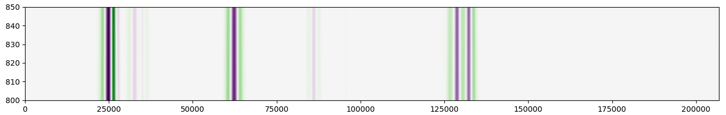
Regroup
Distance =500 to regroup. So that we know when the event started and how long is it exist.
Each group must have at least 3 segments.
Notes:
After we get some line segments, we need to know the line segment belong to this event or other event. Therefore, we need to regroup the line segments.
In this example, we will group those line segments together base on the distance of adjacent line segments. Now the distance is 500, In the other words, if two line segments is close than 500, they will be in a group.otherwise, they will assign to the different groups.
Notice that, each group must have at least 3 segments. If a group have one or two. We will drop it.
After regroup, we know the start of the event, the ending of the event, we can compute the timestamp, and the duration.
Next, Andrew will talk about our evaluation and show us a demo.

Slide 11
Evaluation
Tested 2 recorded samples to stress test the model.
T001.wav has 6 events, with regular background noise.
T002.wav has 5 events, with very heavy background noise.
All events were correctly detected and none of the background was detected.
Accuracy of the model was 100%.
Notes:
In order to evaluate the results of our system, we created 2 sample recordings to stress-test the model. The first sample recording, T001.wav, contains 6 cough events. This recording contains regular background noise with light music playing. The second sample recording, T002.wav, contains 5 cough events. This recording contains very heavy background noise with loud music playing. For both of these recordings, the analysis module correctly identified all of the coughs without any incorrect identification of the background noise as coughs. Due to these results, the accuracy of the model for these tests was 100%.

Slide 12
What if the model failed to detected events?
Change the wavelet (Mexican Hat)
Change the feature scale (800)
Change the feature threshold (v>0.05 or v<-0.05)
Change the maximum distance to group (500)
Adjust the range of the correlated value
Notes:
Next I will discuss what we could do if the model failed to detect any of the cough events. There are a list of parameters that can be changed to adjust the detection scheme. First we could change the analysis wavelet (as discussed we are currently using the mexican hat wavelet). Next, we could change the feature scale, which is currently at 800. We could also change the threshold at which we detect features, where v currently has to be greater than 0.05 or less than -0.05. Additionally, we could change the maximum distance to group features together (which is currently 500). This distance can be used to group short coughs in succession into a single cough. Lastly, we could adjust the range of the correlated value.

Slide 13
Demo
Notes:
I will now present a short demonstration showing the analysis module with the two sample recordings.

