Slide 1
An Attack-Based Evaluation Method for Differentially Private Learning Against Model Inversion Attack
CHEOLHEE PARK 1, DOWON HONG 1, AND CHANGHO SEO 2 1Department of Mathematics, Kongju National University, Gongju 32588, South Korea 2Department of Convergence Science, Kongju National University, Gongju 32588, South Korea
By Lingxiao Kong
2019/10/23
IEEE Access, 2019

Slide 2
Contents
Motivation
Contribution
Model construction
Thinking
Notes:
I will introduce it from the following four aspects

Slide 3
Motivation
Models based on deep neural networks have shown remarkable performance in various domains.
Deep learning models utilize massive amounts of data, and most of the datasets contain sensitive individual information, so there is a concern about privacy breaches.
Recently, privacy invasion attacks on the training dataset of a neural network model have been proposed.
Notes:
Machine learning technologies have progressed remarkably and are increasingly getting attention. In particular, models based on deep neural networks have shown remarkable performance in various domains such as face recognition, language representation, classification, etc. (e.g., [1]–[5]). These deep learning models utilize massive amounts of data, and most of the datasets contain sensitive individual information, so there is a concern about privacy breaches

Slide 4
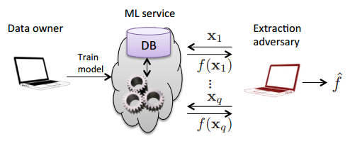

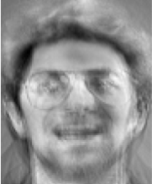

Model Inversion Attacks
In cloud-based machine learning services, users send input queries and MLaaS then returns confidence values corresponding to the inputs.
$$f_{\left(x\right)}^{′}$$
Attack recovers image of one individual
Training samples
By exploiting such systems that return confidence values corresponding to arbitrary inputs, it was revealed that an adversary can violate the privacy of training data.
Notes:
First, use the prediction interface provided by the machine learning platform to make a large number of prediction queries. Given an input sample x, they get the corresponding output f(x).When a large number of queries are made, the attacker USES x,f(x) to train an model that approximates the original model f, this process is extraction attacks. and then reverses the input of the original model based on the model, so that the attacker can recover the training data set of the original model
In cloudbased machine learning services, i.e., machine learning as a service (MLaaS), users send input queries and MLaaS then returns confidence values corresponding to the inputs. In cloudbased machine learning services, i.e., machine learning as a service (MLaaS), users send input queries and MLaaS then returns confidence
By exploiting such systems that return confidence values corresponding to arbitrary inputs, it was revealed that an adversary can violate the privacy of training data

Slide 5
Motivation
Differential privacy is a rigorous notion of privacy, and research on differentially private neural network models has been actively conducted.
Since differentially private mechanisms return plausible noisy results that make no statistical difference regardless of the presence or absence of any single entry in a dataset, it provides strong privacy for the entire dataset.
Notes:
Differential privacy [10], [11] is a rigorous notion of privacy, and research on differentially private neural network models has been actively conducted. Since differentially private mechanisms return plausible noisy results that make no statistical difference regardless of the presence or absence of any single entry in a dataset, it provides strong privacy for the entire dataset.
how to set appropriate privacy parameters to preserve differential privacy based on the resistance to privacy breach attacks in neural networks.

Slide 6
Contribution
Study the application of differential privacy as a countermeasure against privacy breach attacks in a neural network model.
In particular, this paper focus on model inversion attacks, which are among the most fatal privacy breach attacks.
Introduce a new attack performance metric, instead of survey-based approach, by leveraging a deep learning model, and capture the relationship between attack probability and the degree of privacy guarantee.
Notes:
To analyze the effectiveness of differentially private mechanisms against the model inversion attack,this paper Introduce a new attack performance metric, instead of survey-based approach, by leveraging a deep learning model, and capture the relationship between attack probability and the degree of privacy guarantee.

Slide 7
Model construction

Slide 8
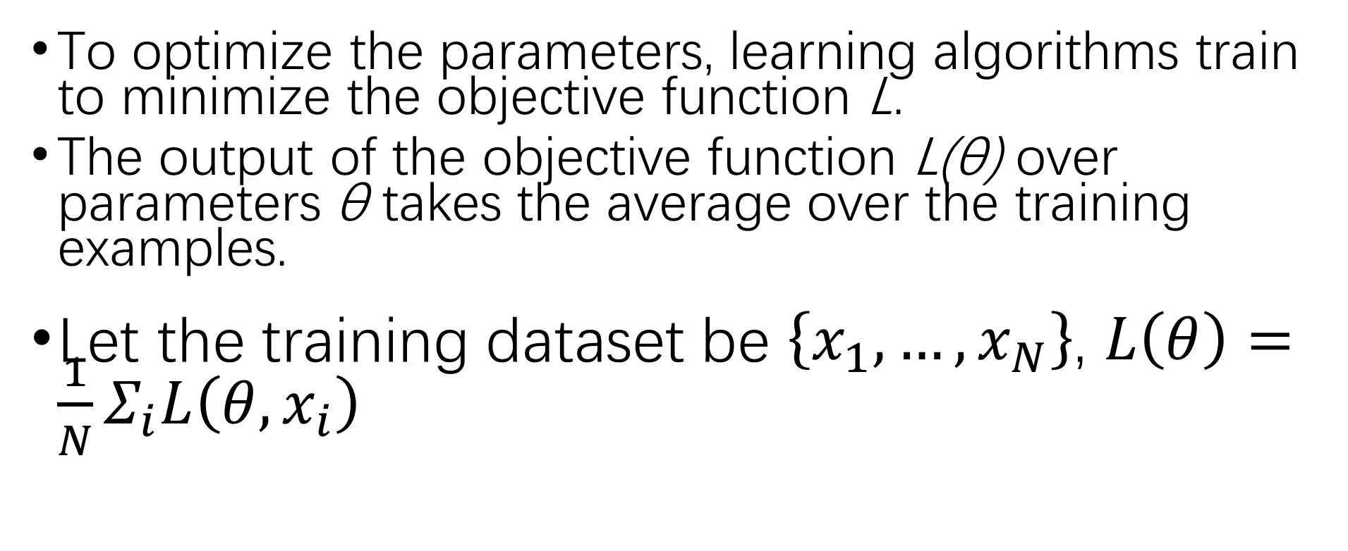
Neural Network Model
To optimize the parameters, learning algorithms train to minimize the objective function L.
The output of the objective function L(θ) over parameters θ takes the average over the training examples.
Let the training dataset be $\left\{x_{1},…,x_{N}\right\}$, $L\left(θ\right)=\frac{1}{N}Σ_{i}L\left(θ,x_{i}\right)$
Notes:
Objective functions of deep neural networks is usually a non-convex optimization problem and difficult to optimize.To optimize the parameters, learning algorithms train to minimize the objective function L (generally, loss function or cost function). The output of the objective function L(θ) over parameters θ takes the average over the training examples.

Slide 9

Neural Network Model
Mini-batch stochastic gradient descent (SGD) algorithm is the most common algorithm to optimizie a non-convex problem over a deep learning model.
In SGD, the optimizer sets mini-batch B by random sampling, computes gradient over the mini-batch B :
Then updates the parameters θ by descending gB associated with learning rate.
Notes:
In the context of optimizing a non-convex problem over a deep learning model, the mini-batch stochastic gradient descent (SGD) algorithm is the most common algorithm. In SGD, the optimizer sets mini-batch B by random sampling, computes gradient gB over the mini-batch

Slide 10
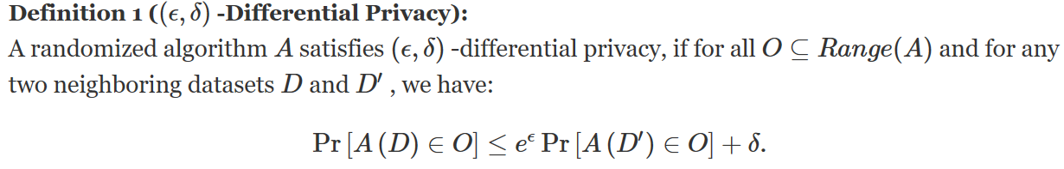
Differential Privacy
Differential privacy guarantees that a randomized algorithm behaves similarly on neighboring datasets.
Notes:
We say that two datasets D and D0 are neighboring if they differ in one entry.
Smaller values of ϵ will yield better privacy. Typically, ϵ is called a privacy budget or privacy cost. The basic definition of differential privacy is ϵ -differential privacy, which excludes the additive term δ . The notion of differential privacy means that the output value of a differentially private mechanism is not significantly changed in the record of any individual.

Slide 11
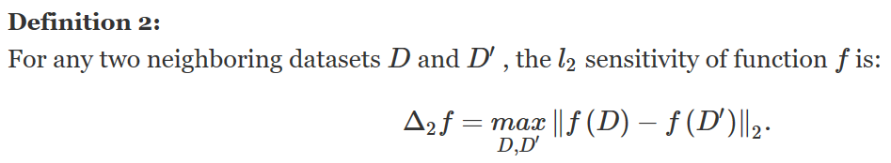

Differential Privacy
Differentially private mechanisms are defined in the context of sensitivity.
The Gaussian mechanism MG , which is one of the most common differentially private mechanisms, is defined by:
Notes:
The sensitivity of a function is related to how much the output should be perturbed to preserve differential privacy. The Gaussian mechanism MG , which is one of the most common differentially private mechanisms, is defined by:
where N(0,σ2) is the Gaussian distribution with mean 0 and standard deviation σ . If σ>2ln(1.25/δ)⋅Δ2f/ϵ and ϵ<1 , a single execution of the Gaussian mechanism fulfills (ϵ,δ) -differential privacy (the value of δ is preferred as smaller than 1/|D| ).

Slide 12
Differential Privacy For Deep Neural Networks
To minimize the privacy cost at each iteration，Abadi proposed a differentially private stochastic gradient descent algorithm, by combining Gaussian mechanisms with random sampling.
This paper focus on Abadi et al.’s basic DPSGD algorithm for the purpose of satisfying the differential privacy of the neural network model with a non-convex optimization problem within moderate privacy costs.
Notes:
As the most important point to meet differential privacy for non-convex problem is to minimize the privacy cost at each iteration. In this respect, Abadi et al. [19] proposed a differentially private stochastic gradient descent algorithm, by combining Gaussian mechanisms with random sampling.

Slide 13
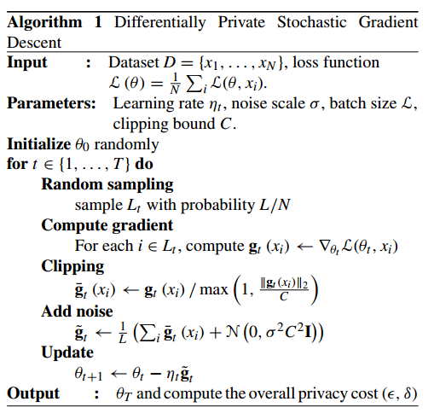
Differential Privacy Against Model Inversion Attack
Also，leverage moments accountant, where privacy costs are fine-tuned by considering the Gaussian mechanism with random sampling.
The moments accountant keeps track of a bound on the moments of the privacy loss, which is a random variable.
Notes:
First, a mini-batch is selected by random sampling with probability q D L=N, where L and N denote the size of mini-batch and dataset respectively. Then, the gradients of the loss function L with respect to the current model parameters θt are computed for each element in the mini-batch, and the computed gradients for each element are clipped by l2-clipping with clipping parameter C. At this point, Gaussian noise is added to the aggregated gradient to satisfy differential privacy before averaging. Note that, the clipping parameter C is a hyperparameter, and in our experimental scenario, we set the clipping parameter to 4, as in [19] (the highest accuracy was measured when C D 4, and see [19] for more details on choosing the clipping parameter). Finally, model parameters are updated using the noisy gradients with the learning step ηt. This procedure is iterated T times and the overall privacy cost for the final output model θT is calculated.

Slide 14
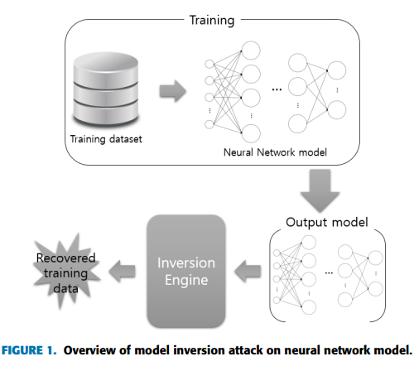
Model Inversion Attack Against Neural Network Model
By converting the attack into an optimization problem, the attacker optimizes an initial vector to find the input that minimizes the error between the predicted confidence value and the ideal output value.
This optimization can be performed simply by using a gradient descent algorithm.
As a result, the attacker can recover parts of information from the training dataset.
Notes:
The model inversion attack is a well-known attack in adversarial use of machine learning. Given a target model, an attacker can infer certain sensitive features of the training data through the attack. Fig. 1 shows an overview of the model inversion attack on a neural network model. By converting the attack into an optimization problem, the attacker optimizes an initial vector to find the input that minimizes the error between the predicted confidence value and the ideal output value. This optimization can be performed simply by using a gradient descent algorithm. As a result, the attacker can recover parts of information from the training dataset.

Slide 15
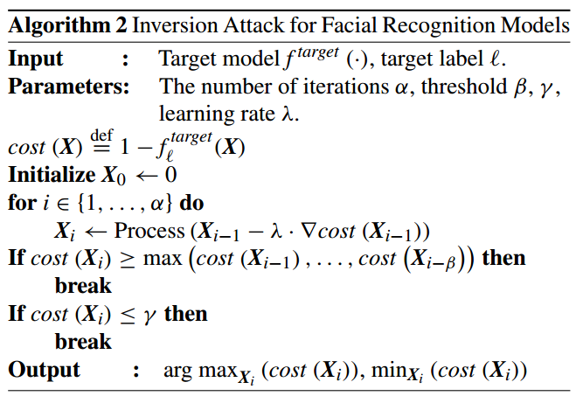
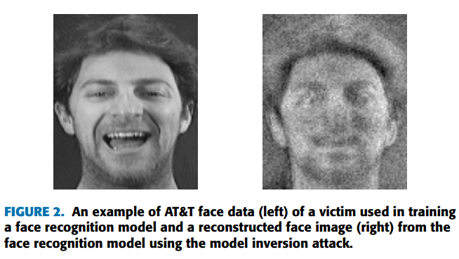
Model Inversion Attack Against Neural Network Model
Notes:
Let f target (⋅) be a given target model and ℓ be a given target class. Initially, the algorithm sets the cost function cost(X)=1− f target ℓ (X) , where f target ℓ (X) indicates the output confidence value of the target model corresponding to target class ℓ with respect to input X , and initializes the candidate input X that is to be optimized. Then it performs optimization through gradient descent within a given number of iterations until the cost of the candidate is not improved in β iterations or is less than the given threshold γ . Finally, the best candidate is returned. Note that Process(⋅) is a post-processing function that can execute various image manipulations. Fig. 2 shows a reconstructed example with an original face image in the AT&T face dataset

Slide 16
Attack Performance Metric
This paper leverage a deep learning model to evaluate the effectiveness of the attack.
Quantifying the efficacy of the model inversion attack can be converted into a classification problem.
It can be regarded as quantifying how many data is recognizable among the reconstructed data i.e., how many data have enough quality to be recognized among the reconstructed data.

Slide 17

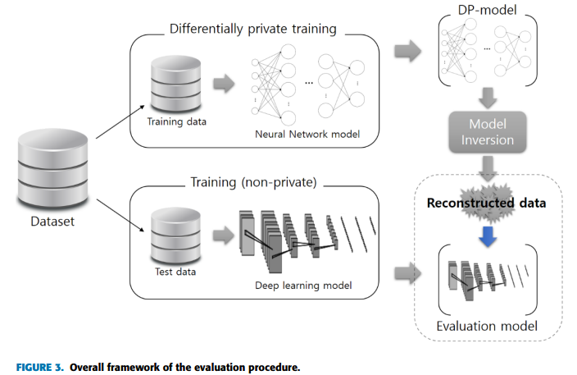

Attack Performance Metric
Let be a well-trained evaluation model that has the same classification problem as the target model
Then, a reconstructed image extracted from the model inversion attack corresponding to a given target label is evaluated over the evaluation model.
Then returns the label (or confidence vector) as it is most likely.
If the retuned label (or argmax of confidence vector) is equal to the given target label, the reconstructed image is considered to be recognizable.
Notes:
That is, the reconstructed image becomes the input of the evaluation model f eval(·) in the inference phase,
Fig. 3 presents the overall evaluation framework. First, we separate the entire dataset into training and test datasets. Next, we generate a differentially private model (DP-model) with Algorithm 1 and moments accountant, given privacy parameters and the training dataset. Note that this private model is the target model f target (⋅) of the model inversion attack and the test dataset can be used to check the performance of the target model. In parallel, we learn a deep learning model that serves as the evaluation model f eval (⋅) for attack performance over the test dataset. Then we conduct the model inversion attack for the target model and all classes of the dataset (e.g., all individual names). As a result, we can obtain reconstructed face data according to the number of classes. Finally, we evaluate whether these reconstructed face data are recognizable using the evaluation model f eval (⋅) , i.e., the reconstructed images become inputs of the well-trained evaluation model in the inference step.
For a given privacy parameter, the evaluation procedure (as shown in Fig. 3) is performed for 100 models, and the success rate and highest impact are calculated.

Slide 18
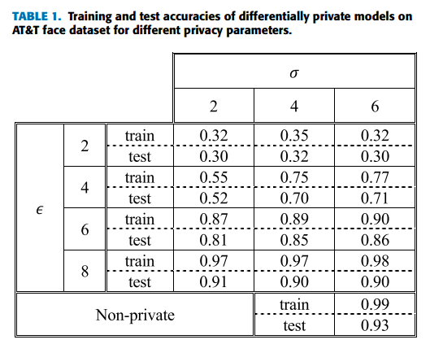
Experiments
1、Training Differentially Private Models
In a non-private scenario, the model achieved 99% accuracy in the training dataset and 93.5% accuracy in the test dataset.
The greater the budget, the better the performance.
Notes:
We learned the model with algorithm 1, and set sampling probability q D 0:1 and privacy parameters to D f2; 4; 6; 8g, δ D 10−3. Also, we derived the number of iterations for the fixed noise scales σ D f2; 4; 6g by Theorem 2 with the privacy parameters.In a non-private scenario, the model achieved 99% accuracy in the training dataset and 93.5% accuracy in the test dataset. Table 1 presents the performance of private models with different privacy budgets and noise scales. Naturally, the greater the budget, the better the performance. The best test performances were measured at 32%, 71%, 86%, and 91% when D 2, 4, 6, and 8, respectively.

Slide 19
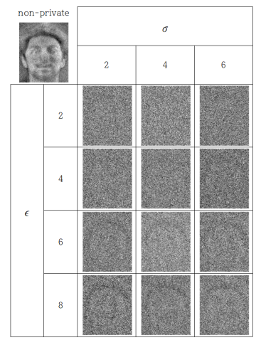
Experiments
2、Model Inversion Attack on Private Models
Compared with the reconstructed image extracted from the non-private model, it can be observed that the reconstructed data extracted from the differentially private model are more blurred.
However, as ϵ grows, it can be observed that information such as the outline of the face is revealed, and this information can be used to infer the individual.
Notes:
Fig. 4 presents reconstructed face images in each private model. Compared with the reconstructed image extracted from the non-private model, it can be observed that the reconstructed data extracted from the differentially private model are more blurred. At first glance, it seems enough to preserve an individual’s privacy. However, as ϵ grows, it can be observed that information such as the outline of the face is revealed, and this information can be used to infer the individual.

Slide 20
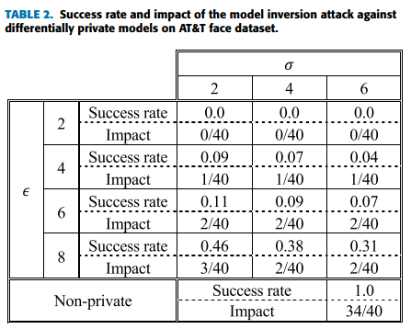
Experiments
3、Attack Performance
By using evaluation model, this paper evaluated the recognizability of the reconstructed data extracted from differentially private models.
Notes:
We evaluated the recognizability of the reconstructed data using an evaluation model that was learned over the test dataset with a size of 120 (three images per class), and achieved about 85% impact on the reconstructed dataset extracted from the non-private model (the success rate is 100% in a non-private scenario). By using this evaluation model, we evaluated the recognizability of the reconstructed data extracted from differentially private models. Table 2 shows the results. When ϵ=2,4 , it seems to be resistant to attack, but this is due to the low accuracy of the target (differentially private) model. When ϵ=6 (the accuracy of the differentially private model is above 80%), the maximum success rate was measured at 11% and at most two reconstructed data out of 40 images were correctly recognized by the evaluation model. When ϵ=8 , the success rates were measured relatively high, but the impacts were measured at 0.075 at most.

Slide 21
Thinking
The notion of differential privacy means that the output value of a differentially private mechanism is not significantly changed in the record of any individual.
Use differentially private stochastic gradient descent algorithm to resist other AI attack technologies like membership inference attack which is also aims at getting informations of training data.

Slide 22
THANKS

