Slide 1
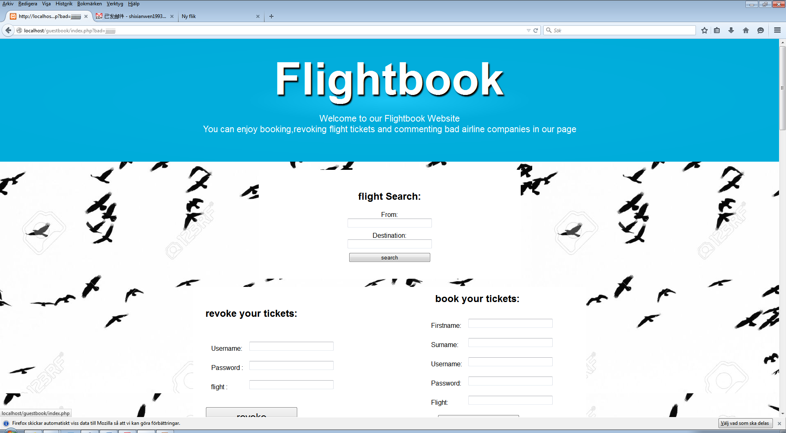
XML AND DATABASE
Shixian Wen

Slide 2
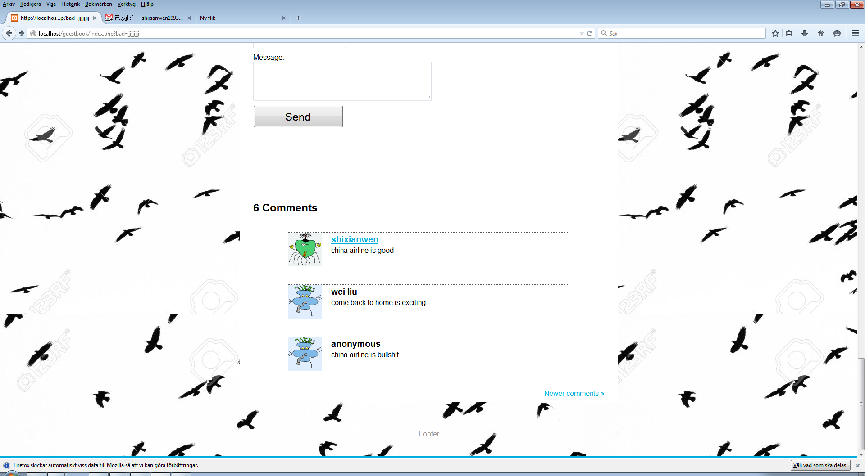
What technologies I have used
Xml technologies:
XML,NAMESPACE,XPATH,Xquery,XSLT,XSD,RSS
Web design:
CSS HTML PHP JAVASCRIPT
Database:
Mysql database

Slide 3
What functions of our website
Search flights
Book tickets
Revoke tickets
Enjoy the latest news of cnn
Leave comments
User

Slide 4
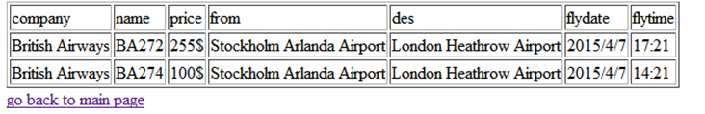
Search flights

Slide 5

Book tickets

Slide 6
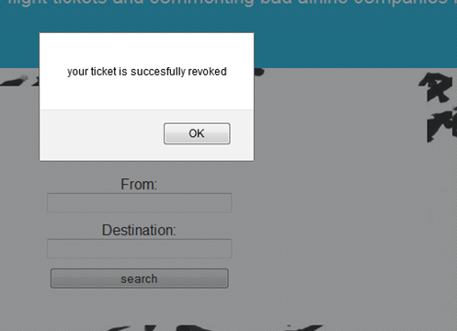
Revoke tickets

Slide 7

The latest CNN news

Slide 8

Leave comments

Slide 9
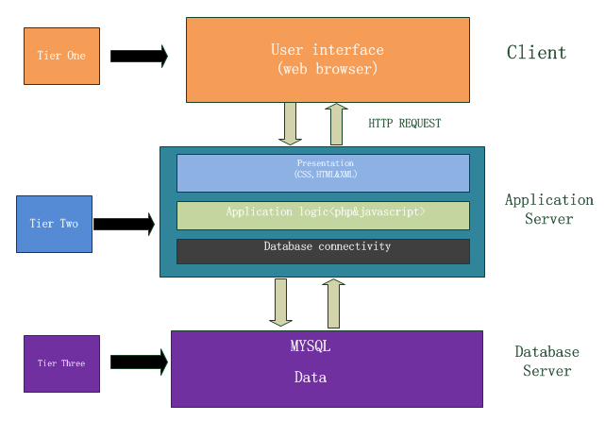
Overall system design

Slide 10
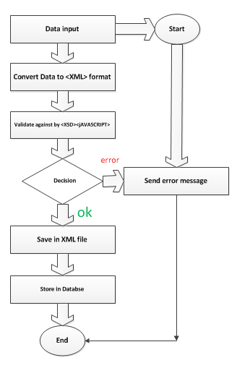
Data flow diagram

Slide 11
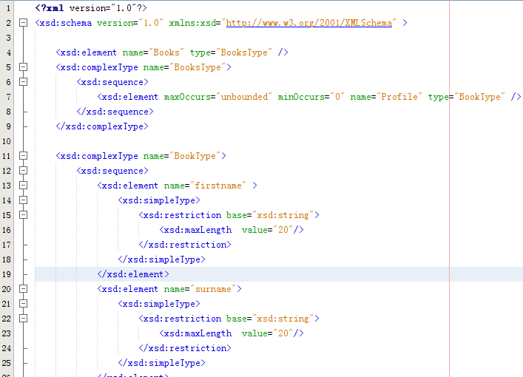
Books.xsd

Slide 12

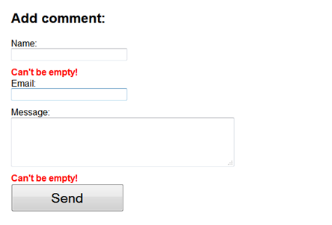
Validation error

Slide 13
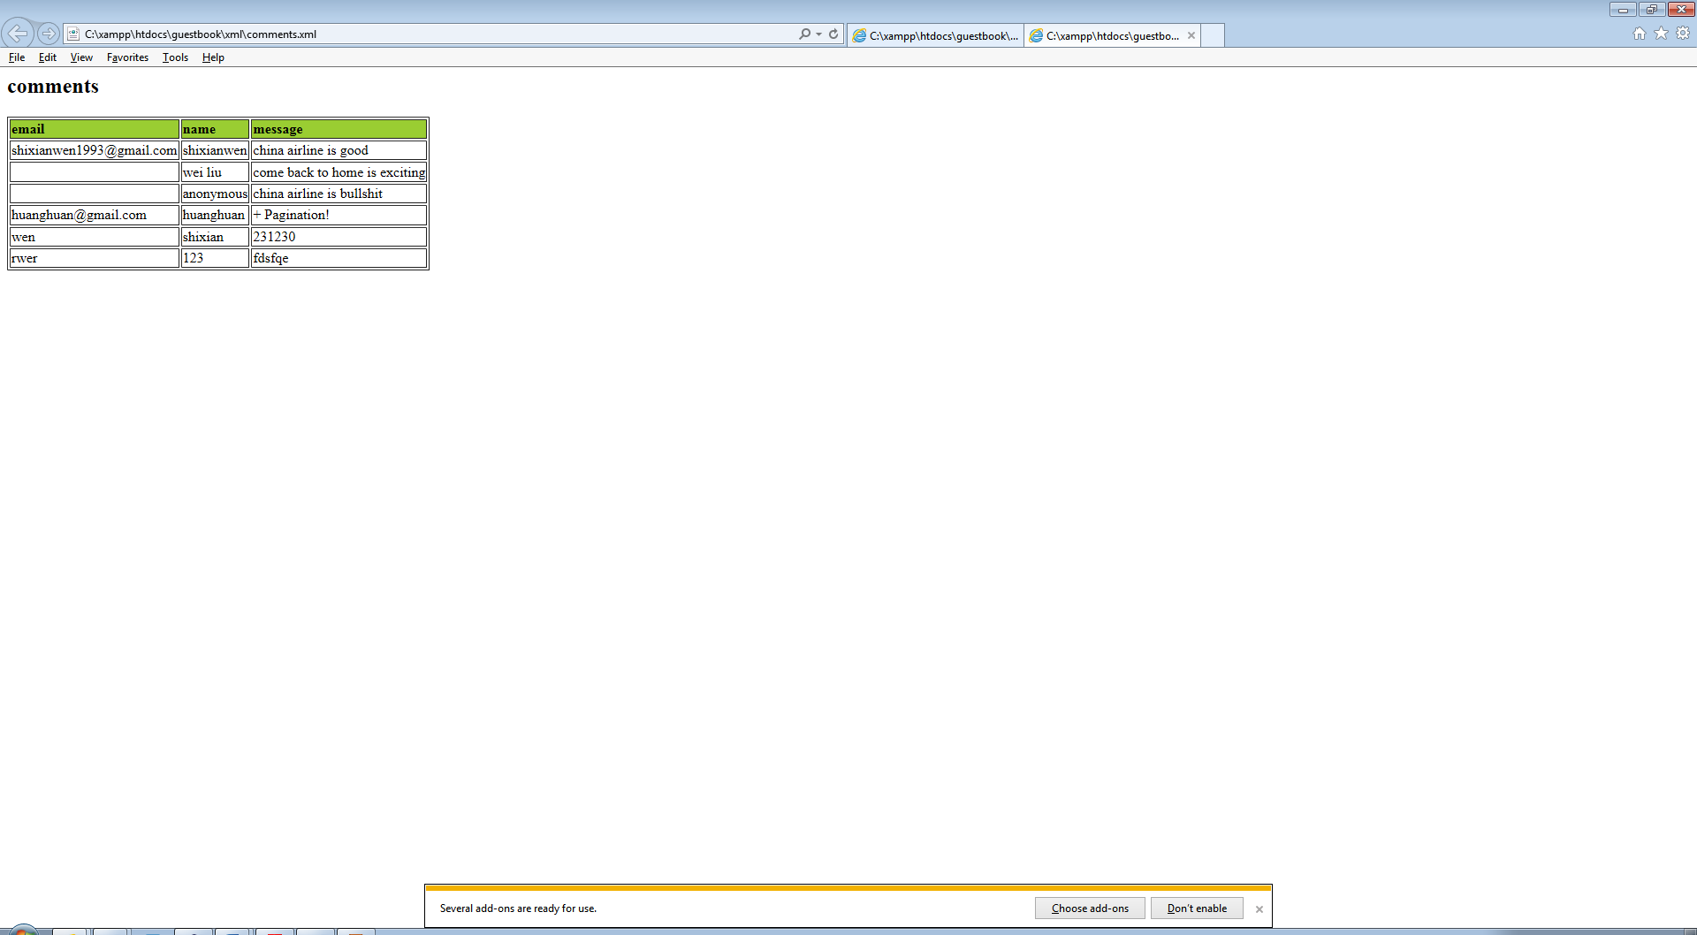
xslt

Slide 14
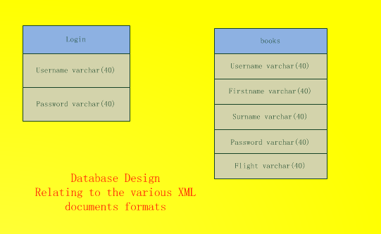
Database design

Slide 15
Gaps and similarities between xml technology and relational database models
The aim of RDBS is to store large amounts of data enabling efficient access and ensuring their consistency.
XML is intended to serve as a format for structuring and exchanging hypertext documents

Slide 16
Gaps and similarities between xml technology and relational database models
Structure:
Similarities:
1:Both XML documents and relational schemata are element types and attributes for xml as well as relations and attributes for RDBS.
2: The name of an XML attribute defined within a DTD or an XML Schema has to be unique within its element type, again similar to an RDBS attribute’s name which has to be unique within its relation.

Slide 17
Gaps and similarities between xml technology and relational database models
Structure:
difference
1:For each XML document, it is required that all component element types are rooted in a single element type. This is in contrast to RDBS, where part-of hierarchies cannot be realized by means of nesting since relations consist of atomic-valued attributes only.
2: schema information of an explicit schema specification is replicated within XML documents in that each element and each attribute value is annotated with the corresponding element type name and attribute name, respectively. The instance level of an RDBS is quite simpler, since values exclusively belong to attributes, which are in turn composed to tuples

Slide 18
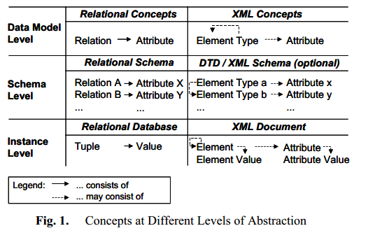
Gaps and similarities between xml technology and relational database models
Storing and retrieving data by finding suitable mapping

Slide 19
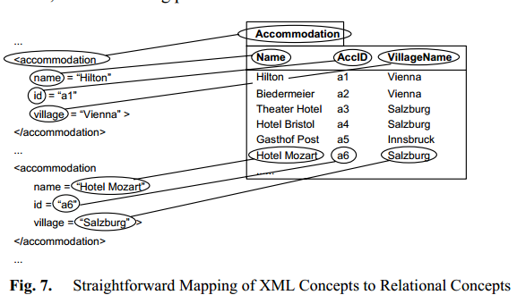
Straightforward mapping: neither always possible nor desirable due to data model heterogeneity and schema heterogeneity.

Slide 20
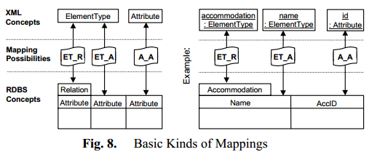
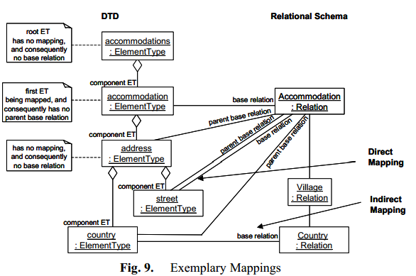
Basic kinds of mapping: have a base relation

Slide 21
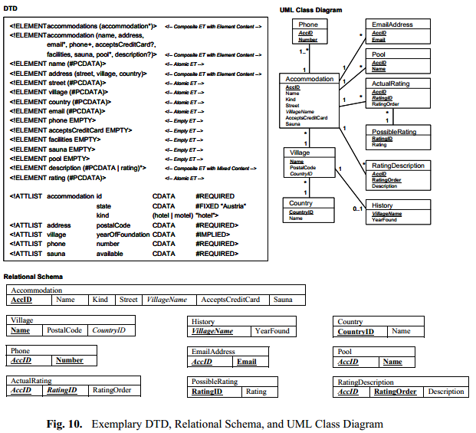
Reasonable mapping:

Slide 22
Further work
XML store locally -> not safe
Further goal is to use XML native database to save the XML files. The Application can easily access into the XML files by using the XML native database.

