Slide 1
REGRESSION METHODS: CONCEPTS & APPLICATIONS
LECTURE 1: SIMPLE LINEAR REGRESSION

Slide 2
Motivation
Objective: Investigate associations between two or more variables
What tools do you already have?
  t-test
    Comparison of means in two populations
  Chi-squared test
    Comparison of proportions in two populations
What will we cover in this module?
  Linear Regression
    Association of a continuous outcome with one or more predictors (categorical or continuous)
  Analysis of Variance (as a special case of linear regression)
    Comparison of a continuous outcome over a fixed number of groups
  Logistic and Relative Risk Regression
    Association of a binary outcome with one or more predictors (categorical or continuous)

Slide 3
Module structure
Lectures and hands-on exercises in R over 2.5 days
Day 1
  Simple linear regression
Day 2
  Model checking
  Multiple linear regression
  ANOVA
Day 3
  Logistic regression
  Generalized linear models

Slide 4
Outline: Simple Linear Regression
Motivation
The equation of a straight line
Least Squares Estimation
Inference
  About regression coefficients
  About predictions
Model Checking
  Residual analysis
  Outliers & Influential observations

Slide 5
Motivation: Cholesterol Example
Linear regression is concerned with a continuous outcome
Data: Factors related to serum total cholesterol (continuous outcome), 400 individuals, 11 variables
Our first goal:
  Investigate the relationship between cholesterol (mg/dl) and age in adults
> head(cholesterol)
ID DM age chol BMI TG APOE rs174548 rs4775401 HTN chd
1 1 74 215 26.2 367 4 1 2 1 1
2 1 51 204 24.7 150 4 2 1 1 1
3 0 64 205 24.2 213 4 0 1 1 1
4 0 34 182 23.8 111 2 1 1 1 0
5 1 52 175 34.1 328 2 0 0 1 0
6 1 39 176 22.7 53 4 0 2 0 0
Notes:
I added the bullet about “continuous outcome” and that cholesterol is the outcome we’re considering here

Slide 6
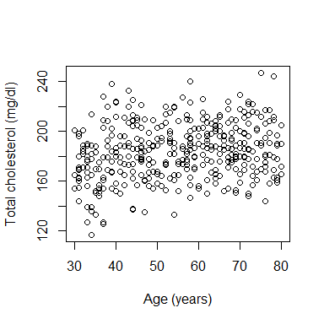
Motivation: Cholesterol Example

Slide 7
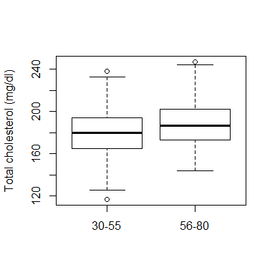
Motivation: Cholesterol Example
Is cholesterol associated with age?
  You could dichotomize age and compare cholesterol between two age groups
> group = 1*(age > 55)
> group=factor(group,levels=c(0,1), labels=c("30-55","56-80"))
> table(group)
group
30-55 56-80
201 199
> boxplot(chol~group,ylab=“Total cholesterol(mg/dl)”)

Slide 8
Motivation: Cholesterol Example
Is cholesterol associated with age?
  You could compare mean cholesterol between two groups: t-test
> t.test(chol ~ group)
Welch Two Sample t-test
data: chol by group
t = -3.637, df = 393.477, p-value = 0.0003125
alternative hypothesis: true difference in means is not equal to 0
95 percent confidence interval:
-12.200209 -3.638487
sample estimates:
mean in group 30-55 mean in group 56-80
179.9751 187.8945

Slide 9
Motivation: Cholesterol Example
Question: What do the boxplot and the t-test tell us about the relationship between age and cholesterol?
> t.test(chol ~ group)
Welch Two Sample t-test
data: chol by group
t = -3.637, df = 393.477, p-value = 0.0003125
alternative hypothesis: true difference in means is not equal to 0
95 percent confidence interval:
-12.200209 -3.638487
sample estimates:
mean in group 30-55 mean in group 56-80
179.9751 187.8945

Slide 10
Motivation: Cholesterol Example
Using the t-test:
  There is a statistically significant association between cholesterol and age
  There appears to be a positive association between cholesterol and age
    Is there any way we could estimate the magnitude of this association without breaking the “continuous” measure of age into subgroups?
  With the t-test, we compared mean cholesterol in two age groups, could we compare mean cholesterol across “continuous” age?

Slide 11
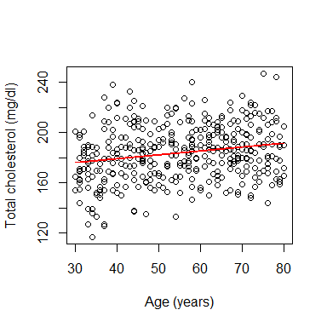
Motivation: Cholesterol Example
We might assume that mean cholesterol changes linearly with age:
Can we find the equation for a straight line
that best fits these data?

Slide 12
Linear Regression
A statistical method for modeling the relationship between a continuous variable [response/outcome/dependent] and other variables [predictors/exposure/independent]
  Most commonly used statistical model
  Flexible
  Well-developed and understood properties
  Easy interpretation
  Building block for more general models
Goals of analysis:
  Estimate the association between response and predictors
  or,
  Predict response values given the values of the predictors.
We will start our discussion studying the relationship between a response and a single predictor
  Simple linear regression model

Slide 13
The straight line equation
Y
A line can be described by two numbers
y = b₀ + b₁ x
X

Slide 14
The straight line equation
Y
b_{o} is the intercept: where the line crosses the y-axis when x=0
0
X

Slide 15
The straight line equation
Y
b₁ is the slope: the change in y corresponding to a
unit increase in x
x
x+1
X

Slide 16
The straight line equation
Y
b₁ is the slope: the change in y corresponding to a
unit increase in x
b₀+b₁(x+1)
Difference is b₁
b₀+b₁x
x
x+1
X

Slide 17
The straight line equation
Y
b₁ is the slope: the change in y corresponding to a unit
increase in x
The same across the entire line!
X

Slide 18
The straight line equation
Y
Two values of “x” 2 units apart will have a difference in
“y” values of 2*b₁
X

Slide 19
The straight line equation
Slope b₁ is the change in y corresponding to a one unit increase in x
Slope gives information about magnitude and direction of the association between x and y

Slide 20
The straight line equation
y
(b₁=0) No association between x and y
(values of y are the same regardless of x)
x
y
(b₁ > 0) Positive association between x and y
(values of y increase as values of x increase)
x
y
(b₁ < 0) Negative association between x and y
(values of y decrease as values of x increase)
x

Slide 21
Simple Linear Regression
We can use linear regression to model how the mean of an outcome Y changes with the level of a predictor, X
The individual Y observations will be scattered about the mean
We estimate a straight
line describing trend in
the mean of an outcome Y
as a function of predictor X

Slide 22
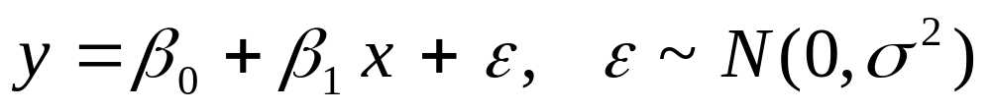
Simple Linear Regression
In regression:
  X is used to predict or explain outcome Y.
Response or dependent variable (Y):
  continuous variable we want to predict or explain
Explanatory or independent or predictor variable (X):
  attempts to explain the response
Simple Linear Regression Model:

Slide 23
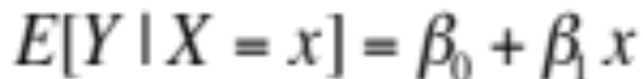
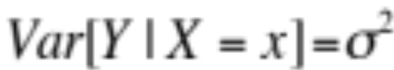
Simple Linear Regression
The model consists of two components:
Systematic component:
Mean population value of Y at X=x
Random component:
        Variance does not depend on x
β₁: slope
β₀:intercept

Slide 24
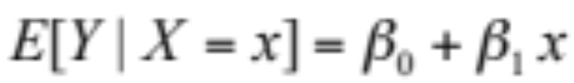
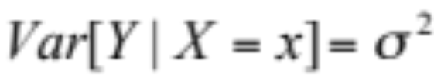
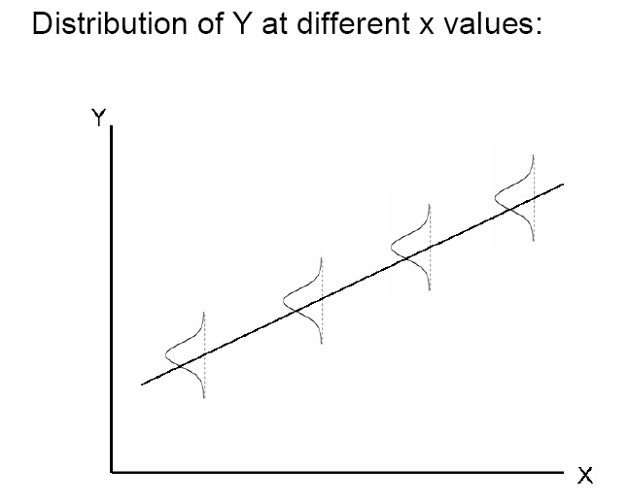
Simple Linear Regression: Assumptions
MODEL:
Compare with the boxplots for two age groups

Slide 25
Simple Linear Regression:
Interpreting model coefficients
Model: E[Y|x] = β₀+β₁x Var[Y|x] = σ²
Question: How do you interpret β₀?
Answer:
  β₀ = E[Y|x=0] , that is, the mean response when x=0
Your turn: interpret β₁!
Notes:
Mention centering x

Slide 26
Simple Linear Regression:
Interpreting model coefficients
Model: E[Y|x] = β₀+β₁x Var[Y|x] = σ²
Question: How do you interpret β₁?
Answer:
E[Y|x] = β₀ + β₁x
E[Y|x+1] = β₀ + β₁(x+1) = β₀ + β₁x+ β₁
E[Y|x+1] – E[Y|x] = β₁ independent of x (linearity)
i.e. β₁ is the difference in the mean response associated with a one unit positive difference in x

Slide 27
Example: Cholesterol and age
Recall: Our motivating example was to determine if there is an association between age (a continuous predictor) and cholesterol (a continuous outcome)
Suppose: We believe they are associated via the linear relationship E[Y|x] = β₀+β₁x
Question: How would you interpret β₁?
Answer:

Slide 28
Example: Cholesterol and age
Recall: Our motivating example was to determine if there is an association between age (a continuous predictor) and cholesterol (a continuous outcome)
Suppose: We believe they are associated via the linear relationship E[Y|x] = β₀+β₁x
Question: How do you interpret β₁?
Answer:
β₁ is the difference in mean cholesterol associated with a one year increase in age

Slide 29
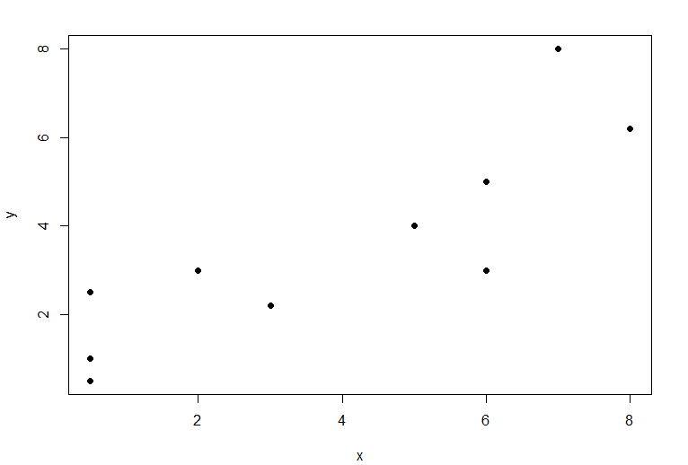
Least Squares Estimation
Question: How to find a “best-fitting” line?

Slide 30
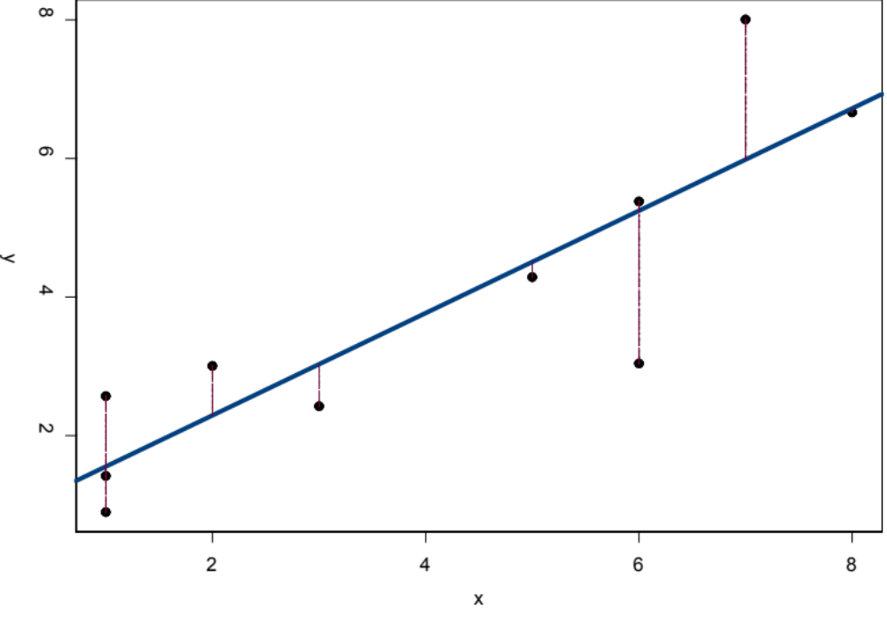
Least Squares Estimation
Question: How to find a “best-fitting” line?
Method: Least Squares Estimation
Idea: chooses the line that minimizes the sum of squares of the vertical distances from the observed points to the line.

Slide 31
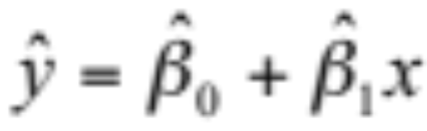
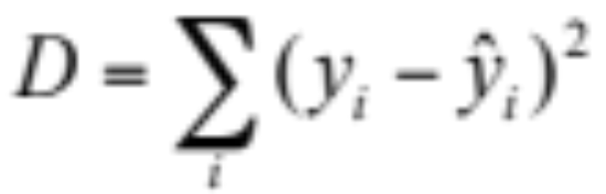
Least Squares Estimation
The least squares regression line is given by
So the (squared) distance between the data (y) and the least squares regression line is
We estimate β₀ and β₁ by finding the values that
minimize D
We can use these estimates to get an estimate of the variance about the line (σ²)

Slide 32
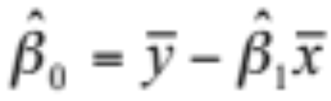
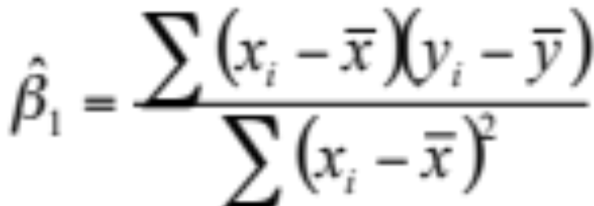
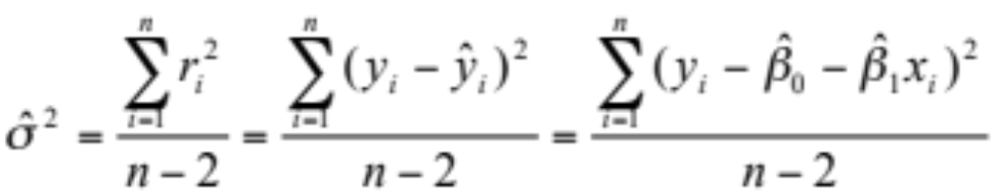
Least Squares Estimation
These values are:
We estimate the variance as:

Slide 33


Estimated Standard Errors
Recall that, when estimating parameters from a sample, there will be sampling variability in the estimates
This is true for regression parameter estimates
Looking at the formulas for and , we can see that they are just complicated means
In repeated sampling we would get different estimates
Knowledge of the sampling distribution of parameter estimates can help us make inference about the line
Statistical theory shows that the sampling distributions are Normal and provides expressions for the mean and standard error of the estimates over repeated samples

Slide 34
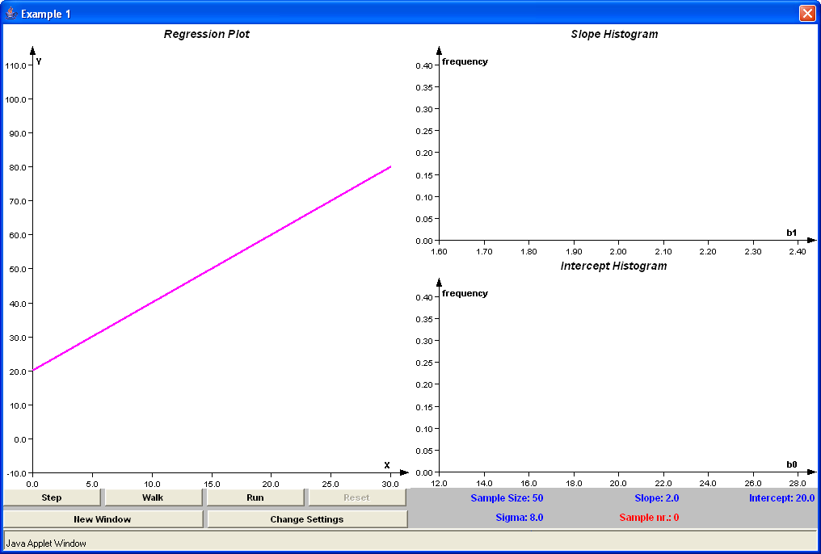
“Regression” -> “Histograms on Simple Linear Regression”
at https://lstat.kuleuven.be/newjava/vestac/
“true” regression line
Click here to simulate a data set

Slide 35
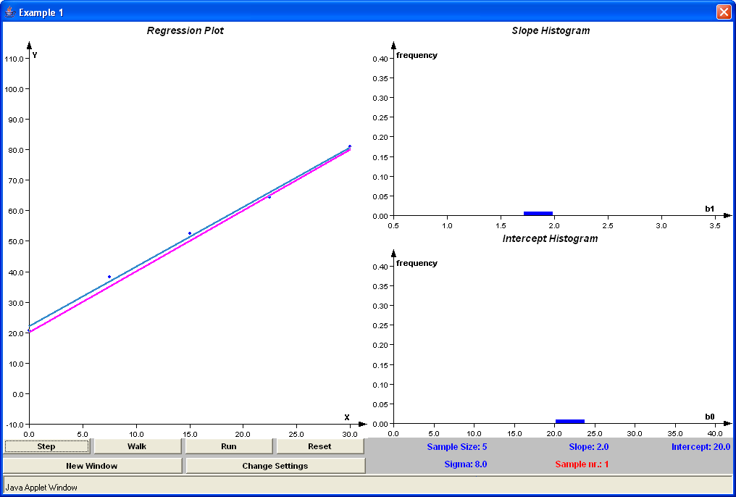

Slide 36
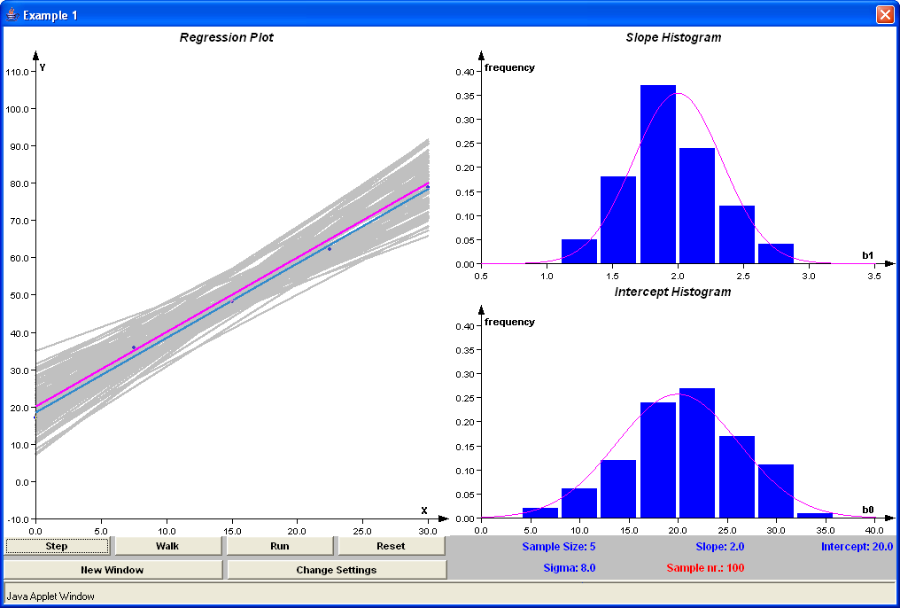
Sampling Distribution

Slide 37
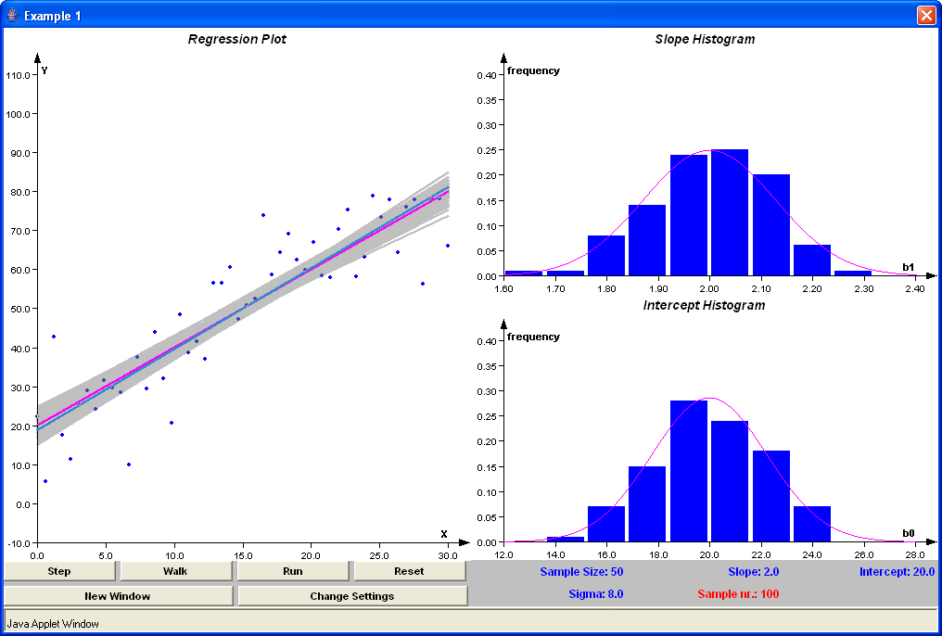
Sampling Distribution

Slide 38
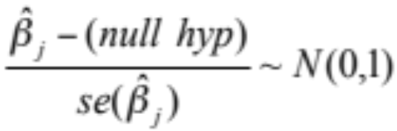
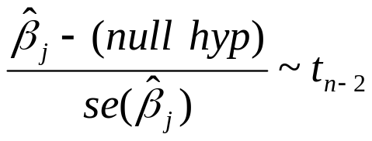
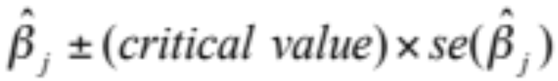
Inference
About regression model parameters
  Hypothesis testing: H₀: β_{j}=0 (j=0,1)
    Test Statistic:
      Large Samples:
      Small Samples:
  Confidence Intervals:
[Don’t worry about these formulae: we will use R to fit the models!]

Slide 39
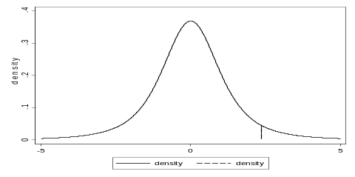

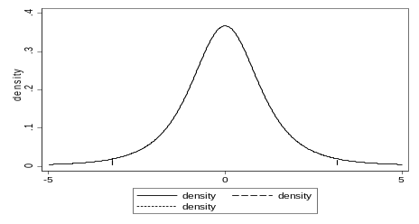
Inference: Hypothesis Testing
Null Hypothesis: β_{j} = 0
T=test statistic
Alternative P-Value
β_{j} > 0 P(t_{n-2} >T)
β_{j} < 0 P(t_{n-2} <T)
β_{j} ≠ 0 2P(t_{n-2} >|T|)
P-value
P-value
P-value

Slide 40
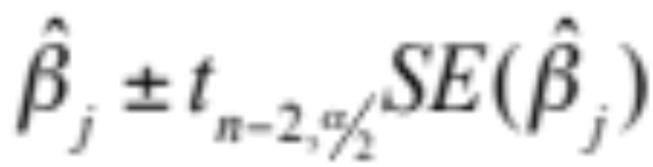
Inference: Confidence Intervals
100 (1-α)% Confidence Interval for β_{j} (j=0,1)
Gives intervals that (1- α)100% of the time will cover the true parameter value ( β₀ or β₁).
We say we are “(1- α)100% confident” the interval covers β_{j}.

Slide 41
Example:
Scientific Question: Is cholesterol associated with age?
> fit = lm(chol ~ age)
> summary(fit)
Call:
lm(formula = chol ~ age)
Residuals:
Min 1Q Median 3Q Max
-60.45306 -14.64250 -0.02191 14.65925 58.99527
Coefficients:
Estimate Std. Error t value Pr(>|t|)
(Intercept) 166.90168 4.26488 39.134 < 2e-16 ***
age 0.31033 0.07524 4.125 4.52e-05 ***
---
Signif. codes: 0 ‘***’ 0.001 ‘**’ 0.01 ‘*’ 0.05 ‘.’ 0.1 ‘ ’ 1
Residual standard error: 21.69 on 398 degrees of freedom
Multiple R-squared: 0.04099, Adjusted R-squared: 0.03858
F-statistic: 17.01 on 1 and 398 DF, p-value: 4.522e-05
> confint(fit)
2.5 % 97.5 %
(Intercept) 158.5171656 175.2861949
age 0.1624211 0.4582481

Slide 42
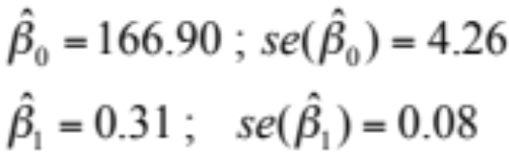
Example:
Scientific Question: Is cholesterol associated with age?
> fit = lm(chol ~ age)
> summary(fit)
Call:
lm(formula = chol ~ age)
Residuals:
Min 1Q Median 3Q Max
-60.45306 -14.64250 -0.02191 14.65925 58.99527
Coefficients:
Estimate Std. Error t value Pr(>|t|)
(Intercept) 166.90168 4.26488 39.134 < 2e-16 ***
age 0.31033 0.07524 4.125 4.52e-05 ***
---
Signif. codes: 0 ‘***’ 0.001 ‘**’ 0.01 ‘*’ 0.05 ‘.’ 0.1 ‘ ’ 1
Residual standard error: 21.69 on 398 degrees of freedom
Multiple R-squared: 0.04099, Adjusted R-squared: 0.03858
F-statistic: 17.01 on 1 and 398 DF, p-value: 4.522e-05
Estimates of the model
parameters and standard
errors
> confint(fit)
2.5 % 97.5 %
(Intercept) 158.5171656 175.2861949
age 0.1624211 0.4582481

Slide 43
Example:
Scientific Question: Is cholesterol associated with age?
> fit = lm(chol ~ age)
> summary(fit)
Call:
lm(formula = chol ~ age)
Residuals:
Min 1Q Median 3Q Max
-60.45306 -14.64250 -0.02191 14.65925 58.99527
Coefficients:
Estimate Std. Error t value Pr(>|t|)
(Intercept) 166.90168 4.26488 39.134 < 2e-16 ***
age 0.31033 0.07524 4.125 4.52e-05 ***
---
Signif. codes: 0 ‘***’ 0.001 ‘**’ 0.01 ‘*’ 0.05 ‘.’ 0.1 ‘ ’ 1
Residual standard error: 21.69 on 398 degrees of freedom
Multiple R-squared: 0.04099, Adjusted R-squared: 0.03858
F-statistic: 17.01 on 1 and 398 DF, p-value: 4.522e-05
95% Confidence
intervals
> confint(fit)
2.5 % 97.5 %
(Intercept) 158.5171656 175.2861949
age 0.1624211 0.4582481

Slide 44
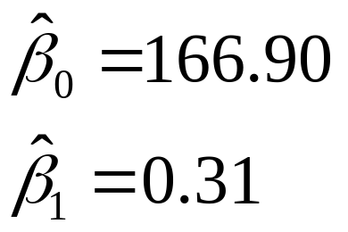


Example:
Scientific Question: Is cholesterol associated with age?
What do these model results mean in terms of our scientific question?
  Parameter estimates and confidence intervals:
95% CI: (158.5, 175.3)
95% CI: (0.16, 0.46)
  : The estimated average serum cholesterol for someone of age = 0 is 166.9
!?
  Your turn: What about ?
Notes:
Again mention centering of X

Slide 45
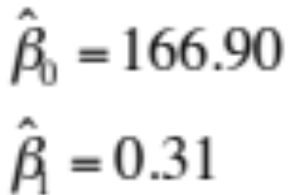

Example:
Scientific Question: Is cholesterol associated with age?
What do these models results mean in terms of our scientific question?
  Parameter estimates and confidence intervals:
  Answer: : mean cholesterol is estimated to be 0.31 mg/dl higher for each additional year of age.
  Question: What about the confidence intervals?
95% CI: (158.5, 175.3)
95% CI: (0.16, 0.46)

Slide 46
Example:
Scientific Question: Is cholesterol associated with age?
What do these models results mean in terms of our scientific question?
  Parameter estimates and confidence intervals:
  Answer: 95% CIs give us a range of values that will cover the true intercept and slope 95% of the time
    For instance, we can be 95% confident that the true difference in mean cholesterol associated with a one year difference in age lies between 0.16 and 0.46 mg/dl
95% CI: (158.5, 175.3)
95% CI: (0.16, 0.46)

Slide 47
Example:
Scientific Question: Is cholesterol associated with age?
Presentation of the results?
  The mean serum total cholesterol is significantly higher in older individuals (p < 0.001).
  For each additional year of age, we estimate that the mean total cholesterol differs by approximately 0.31 mg/dl (95% CI: 0.16, 0.46). Or:
  For each additional 10 years of age, we estimate that the mean total cholesterol differs by approximately 3.10 mg/dl (95% CI: 1.62, 4.58).
    Note:
      Emphasis on slope parameter (sign and magnitude)
      Confidence interval
      Units for predictor and response. Scale matters!

Slide 48
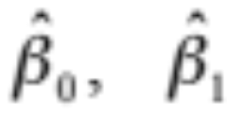

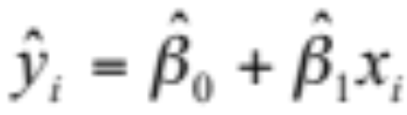

Inference for predictions
Given estimates we can find the predicted value, for any value of x_{i} as
Interpretation of :
  Estimated mean value of Y at X = x_{i}
  Be Cautious: This assumes the model is true.
  May be a reasonable assumption within the range of your data.
  It may not be true outside the range of your data!

Slide 49
y
Be careful of extrapolating
True model
x
Observed values of x
No data in this range!
Would you use the regression line to
“extrapolate”??

Slide 50
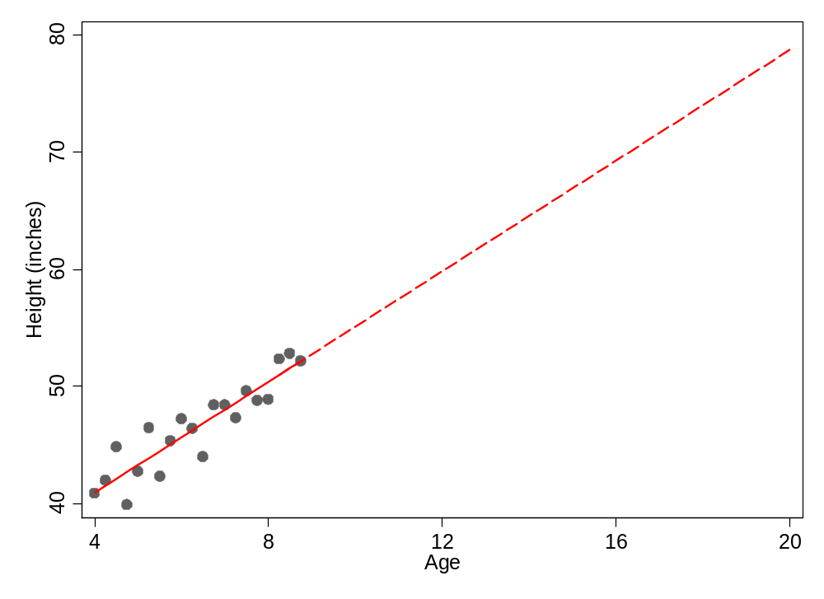
Be careful of extrapolating
It would not make sense to extrapolate height at age 20 from a study of girls aged 4-9 years!

Slide 51
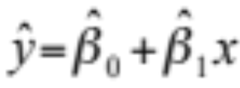
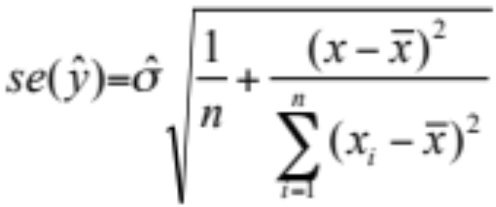

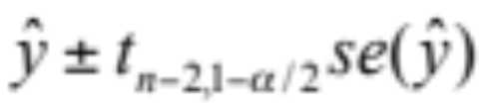
Prediction
Prediction of the mean E[Y|X=x]:
  Point Estimate:
  Standard Error:
    Note that as x gets further from , variance increases!
  100 (1-α)% confidence interval for E[Y|X=x]:

Slide 52
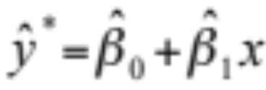
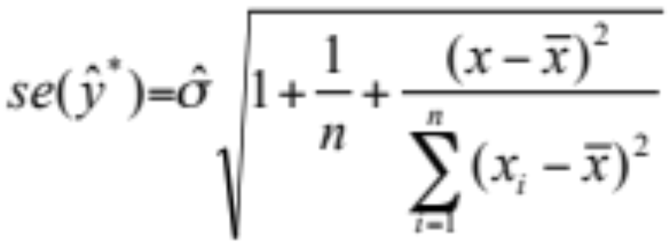
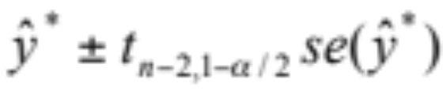
Prediction
Prediction of a new future observation, y*, at X=x:
  Point Estimate:
  Standard Error:
  100 (1-α)% prediction interval for a new future observation:
    Standard error for the prediction of a future observation is bigger:
    It depends not only on the precision of the estimated mean, but also on the amount of variability in Y around the line.

Slide 53
Cholesterol Example: Prediction
Prediction of the mean
> predict.lm(fit, newdata=data.frame(age=c(46,47,48)), interval="confidence")
fit lwr upr
1 181.1771 178.6776 183.6765
2 181.4874 179.0619 183.9129
3 181.7977 179.4392 184.1563
> predict.lm(fit, newdata=data.frame(age=c(46,47,48)), interval="prediction")
fit lwr upr
1 181.1771 138.4687 223.8854
2 181.4874 138.7833 224.1915
3 181.7977 139.0974 224.4981
Prediction of a new observation

Slide 54
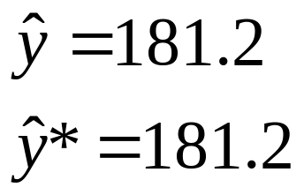


Example:
Scientific Question: Is cholesterol associated with age?
Let’s interpret these predictions
  For x = 46
  Question: How do our interpretations for and differ?
95% CI: (178.7, 183.7)
95% CI: (138.5, 223.9)

Slide 55
Example:
Scientific Question: Is cholesterol associated with age?
Let’s interpret these predictions
  For x = 46
  Question: How do our interpretations for and differ?
  Answer: The point estimates represent our predictions for the mean serum cholesterol for individuals age 46 ( ) and for a single new individual of age 46 ( )
95% CI: (178.7, 183.7)
95% CI: (138.5, 223.9)

Slide 56
Example:
Scientific Question: Is cholesterol associated with age?
Let’s interpret these predictions
  For x = 46
  Question: Why are the confidence intervals for and of differing widths?
95% CI: (178.7, 183.7)
95% CI: (138.5, 223.9)

Slide 57
Example:
Scientific Question: Is cholesterol associated with age?
Let’s interpret these predictions
  For x = 46
  Question: Why are the confidence intervals for and of differing widths?
  Answer: The interval is broader when we make a prediction for a cholesterol level for a single individual because it must incorporate random variability around the mean.
  Note: Unlike confidence intervals, the formula for the prediction interval depends on the normally assumption regardless of sample size.
95% CI: (178.7, 183.7)
95% CI: (138.5, 223.9)

Slide 58
Exercise
Let’s put some of the concepts we have been discussing into practice
Open up the Labs file and R Studio and follow the directions to load the class data set and install the R packages you will need for this module
Work on Exercises 1-3
  Try each exercise on your own
  Make note of any questions or difficulties you have
  At 1:30PT we will meet as a group to go over the solutions and discuss your questions
Notes:
ADD TO LAB SOLUTIONS FOR EXERCISE 2
lines(BMI, fit1$fitted.values)

