Slide 1
REGRESSION MODELS
MULTIPLE LINEAR REGRESSION

Slide 2
Outline: Multiple Linear Regression
Motivation
Model and Interpretation
Estimation and Inference
Interaction

Slide 3
Motivation
The response or dependent variable, Y, may depend on several predictors not just one!
Multiple regression is an attempt to consider the simultaneous influence of several variables on the response
This may be with the goal of an unbiased estimate of association or for better prediction

Slide 4
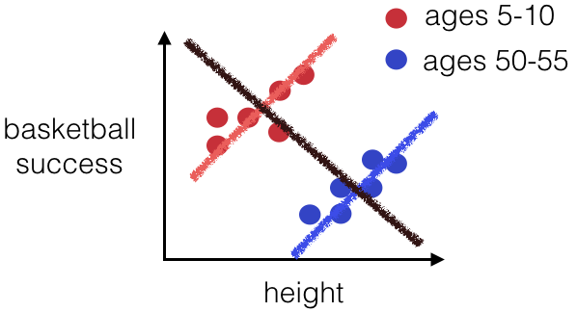
Motivation
Why not fit multiple separate simple linear regressions?
  If the goal is to estimate the association between the response and a predictor of interest, a confounder can make the observed association appear
    stronger than the true association,
    weaker than the true association, or
    even the reverse of the true association
How can we address this:
  We can adjust for the effects of the confounder by adding a corresponding term to our linear regression
If the goal is prediction of the response, we may be able to improve prediction by including additional variables in the regression model

Slide 5
Motivation: Cholesterol Example
Data
Our goal:
  Investigate the relationship between age (years), BMI (kg/m²) and serum total cholesterol (mg/dl)
> head(cholesterol)
ID DM age chol BMI TG APOE rs174548 rs4775401 HTN chd
1 1 74 215 26.2 367 4 1 2 1 1
2 1 51 204 24.7 150 4 2 1 1 1
3 0 64 205 24.2 213 4 0 1 1 1
4 0 34 182 23.8 111 2 1 1 1 0
5 1 52 175 34.1 328 2 0 0 1 0
6 1 39 176 22.7 53 4 0 2 0 0

Slide 6
Motivation
In general, the multiple regression equation can be written as follows:
We use multiple variables when:
  The predictor variable is categorical with more than two groups
  We need polynomials, splines or other functions to model the shape of the relationship(s) accurately
Estimating association:
  We want to adjust for confounding by other variables
  We want to allow the association to differ for different values of other variables (interaction)
Prediction: we use multiple variables if we think more than one variable will be useful in predicting future outcomes accurately

Slide 7
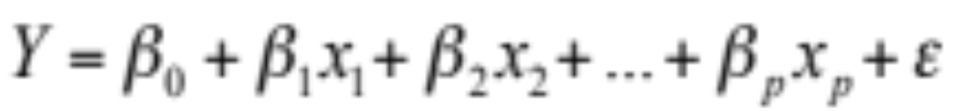
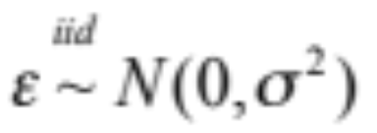
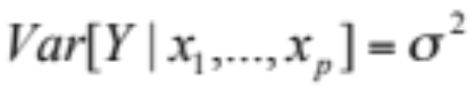
Model and Interpretation
Model:
  where we assume
Extension of simple linear regression!
  Systematic component:
  Random component:

Slide 8
Model and Interpretation
For example, let us assume that there are two predictors in the model and so
  E[Y|x₁, x₂] = β₀+ β₁ x₁ + β₂ x₂
Consider two observations with the same value for x₂, but one observation has x₁ one unit higher, that is,
  Obs 1: E[Y|x₁=k+1, x₂=c] = β₀+ β₁ (k+1) + β₂ c
  Obs 2: E[Y|x₁=k, x₂=c] = β₀+ β₁ (k) + β₂ c
  Thus, E[Y|x₁=k+1, x₂=c] - E[Y|x₁=k, x₂=c] = β₁
That is, β₁ is the expected mean change in y per unit change in x₁ if x₂ is held constant (adjusted/controlling for x₂)
  Similar interpretation applies to β₂

Slide 9

Model and Interpretation
To facilitate our discussion let’s assume we have two predictors with binary values
Model:
Mean of Y | X₂=0 | X₂=1
X₁=0 | β₀ | β₀+β₂
X₁=1 | β₀+β₁ | β₀+β₁ +β₂
E[Y|x₁=1, x₂=0] - E[Y|x₁=0,x₂=0] = β₁
E[Y|x₁=1, x₂=1] - E[Y|x₁=0,x₂=1] = β₁
E[Y|x₁=0, x₂=1] - E[Y|x₁=0,x₂=0] = β₂
E[Y|x₁=1, x₂=1] - E[Y|x₁=1,x₂=0] = β₂

Slide 10
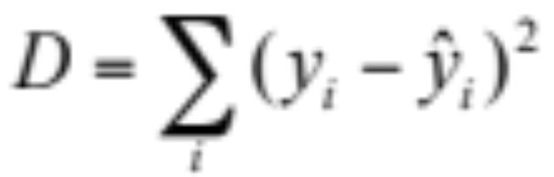
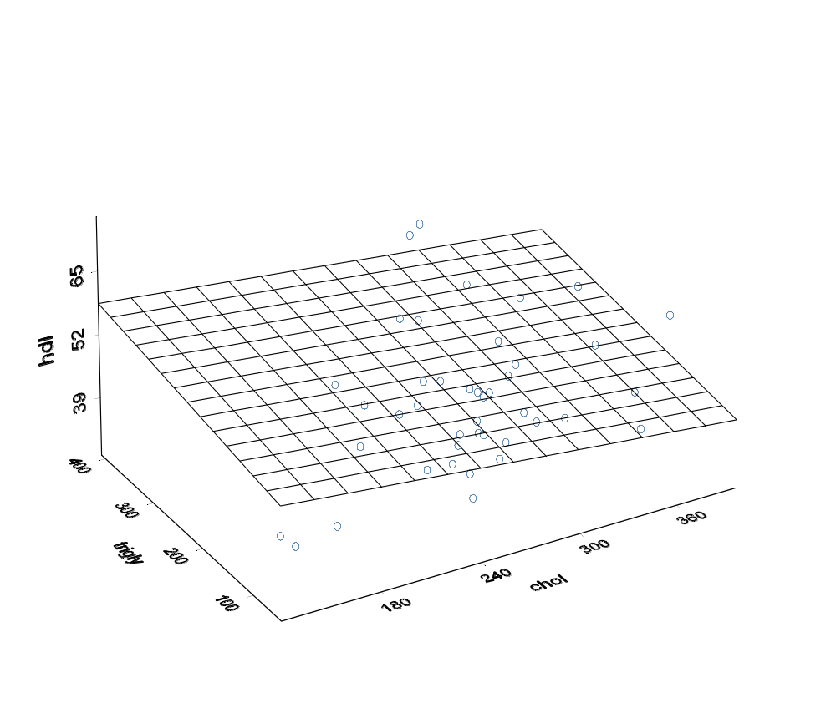
Estimation
Least Squares Estimation:
  As in linear regression, chooses the coefficient estimates that minimize the residual sum of squares
  Computation more difficult, but statistical software (R) will do that for you!

Slide 11
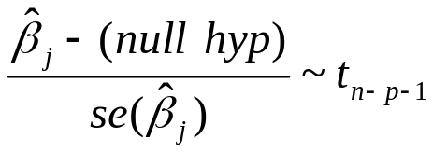

Estimation and Inference
Inference
  About regression model parameters
    Hypothesis Testing H₀: β_{j}=0 (j=0,1,2,…,p)
    Interpretation: Is there a statistically significant relationship between the response y and x_{j} after adjusting for all other factors (predictors) in the model?
    Test Statistic:
    Note: The square of the t-statistic gives the F-statistic and the test is known as the partial F-Test
    Confidence Intervals

Slide 12



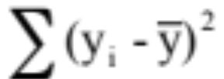
Estimation and Inference
  About the full model
    Hypotheses
    H₀: vs. H₁: At least one β_{j} is not null
    Analysis of variance table
Source | df | SS | MS | F
Regression | p | SSR= | MSR= SSR/p | MSR/MSE
Residual | n-p-1 | SSE= | MSE= SSE/(n-p-1)
Total | n-1 | SST=
-
-

Slide 13
Estimation and Inference
  The F-value is tested against a F-distribution with p, n-p-1 degrees of freedom
    If we reject the null hypothesis, then the predictors do aid in predicting Y [in this analysis we do not know which ones are important!]
    Failing to reject the null hypothesis does not mean that none of the covariates are important, since the effect of one or more covariates may be "masked" by others. The hard part is choosing which covariates to include or exclude.
  This is known as the global (multiple) F-test

Slide 14
Scientific example: Modeling cholesterol using age and BMI
We have seen that there is a significant relationship between age and cholesterol
Can we better understand variability in cholesterol by incorporating additional covariates?

Slide 15
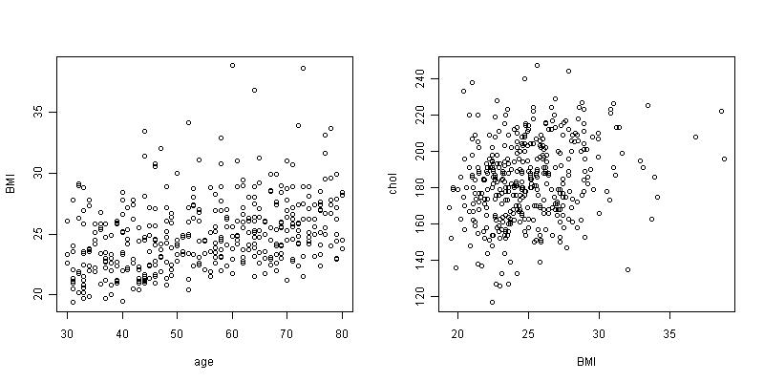
Scientific example: Modeling cholesterol using age and BMI

Slide 16
Scientific example: Modeling cholesterol using age and BMI
It appears that BMI increases with increasing age
And cholesterol increases with increasing BMI
What if we want to estimate the association between age and cholesterol while holding BMI constant?
Multiple regression!

Slide 17
Scientific example: Modeling cholesterol using age and BMI
> fit2=lm(chol~age+BMI)
> summary(fit2)
Call:
lm(formula = chol ~ age + BMI)
Residuals:
Min 1Q Median 3Q Max
-58.994 -15.793 0.571 14.159 62.992
Coefficients:
Estimate Std. Error t value Pr(>|t|)
(Intercept) 137.1612 9.0061 15.230 < 2e-16 ***
age 0.2023 0.0795 2.544 0.011327 *
BMI 1.4266 0.3822 3.732 0.000217 ***
---
Signif. codes: 0 ‘***’ 0.001 ‘**’ 0.01 ‘*’ 0.05 ‘.’ 0.1 ‘ ’ 1
Residual standard error: 21.34 on 397 degrees of freedom
Multiple R-squared: 0.07351, Adjusted R-squared: 0.06884
F-statistic: 15.75 on 2 and 397 DF, p-value: 2.62e-07

Slide 18
Scientific example: Modeling cholesterol using age and BMI
Our estimated regression equation is
Question: How do we interpret the age coefficient?

Slide 19
Scientific example: Modeling cholesterol using age and BMI
Our estimated regression equation is
Question: How do we interpret the age coefficient?
Answer: This is the estimated average difference in cholesterol associated with a one year difference in age for two subjects with the same BMI.

Slide 20
Scientific example: Modeling cholesterol using age and BMI
Our estimated regression equation is
The age coefficient from our simple linear regression model was 0.31.
Question: Why do the estimates from the two models differ?

Slide 21
Scientific example: Modeling cholesterol using age and BMI
Our estimated regression equation is
The age coefficient from our simple linear regression model was 0.31.
Question: Why do the estimates from the two models differ?
Answer: We are now conditioning on or controlling for BMI so our estimate of the age association is among subjects with the same BMI.

Slide 22
Scientific example: Modeling cholesterol using age and BMI
Call:
lm(formula = chol ~ age + BMI)
Residuals:
Min 1Q Median 3Q Max
-58.994 -15.793 0.571 14.159 62.992
Coefficients:
Estimate Std. Error t value Pr(>|t|)
(Intercept) 137.1612 9.0061 15.230 < 2e-16 ***
age 0.2023 0.0795 2.544 0.011327 *
BMI 1.4266 0.3822 3.732 0.000217 ***
---
Signif. codes: 0 ‘***’ 0.001 ‘**’ 0.01 ‘*’ 0.05 ‘.’ 0.1 ‘ ’ 1
Residual standard error: 21.34 on 397 degrees of freedom
Multiple R-squared: 0.07351, Adjusted R-squared: 0.06884
F-statistic: 15.75 on 2 and 397 DF, p-value: 2.62e-07

Slide 23
Cholesterol Example:
Did adding BMI improve our model?
How does the model with age and BMI compare to a model that contains only the mean?
> anova(fit,fit2)
Analysis of Variance Table
Model 1: chol ~ age
Model 2: chol ~ age + BMI
Res.Df RSS Df Sum of Sq F Pr(>F)
1 398 187187
2 397 1 80842 1 6345.8 13.931 0.0002174 ***
--- Signif. codes: 0 ‘***’ 0.001 ‘**’ 0.01 ‘*’ 0.05 ‘.’ 0.1 ‘ ’ 1
> fit0=lm(chol~1)
> anova(fit0,fit2)
Analysis of Variance Table
Model 1: chol ~ 1
Model 2: chol ~ age + BMI
Res.Df RSS Df Sum of Sq F Pr(>F)
1 399 195189
2 397 180842 2 14347 15.748 2.62e-07 ***
---
Signif. codes: 0 ‘***’ 0.001 ‘**’ 0.01 ‘*’ 0.05 ‘.’ 0.1 ‘ ’ 1

Slide 24
Interaction and Linear Regression
Statistical interaction (aka effect modification) occurs when the relationship between an outcome variable and one predictor is different depending on the levels of a second predictor
Interactions are usually investigated because of a priori assumptions/hypotheses on the part of the researchers
Linear regression models allow for the inclusion of interactions with cross-product terms

Slide 25
Confounding vs. Interaction/Effect Modification
Data and scientific understanding help distinguish between confounding and effect modifying variables:
  Confounder: Associated with predictor and response; Association between response and predictor constant across strata of the new variable
  Effect modifier/interaction: Association between response and the predictor varies across strata of the new variable

Slide 26
Confounding vs. Interaction/Effect Modification
Confounding: Estimates of association from unadjusted analysis are markedly different from estimates of association from adjusted analysis
  Association within each stratum is similar, but different from the “crude” association in the combined data (ignoring the strata)
  In linear regression, these symptoms are diagnostic of confounding
Effect modification would show differences between adjusted analysis and unadjusted analysis, but would also show different associations in the different strata

Slide 27
Effect Modification /Interaction
Even if present, effect modification may not always be of interest in summarizing the effect of a predictor.
For example, pleconaril, an antiviral drug, reduced the mean duration of symptoms in subjects with a common cold due to rhinoviruses but had no effect in subjects whose cold was due to some other agent.
In the case of the pleconaril, effect modification was important in checking that the drug did actually work by inhibiting rhinovirus. However, in clinical use of the drug, it would typically not be possible to determine the infectious agent (the tests are expensive and take longer than just recovering from the cold), and so the average effectiveness of the drug across all colds would be a more important quantity.

Slide 28
Graphical Representation
Y
W=1
Parallel lines
No Interaction
W=0
X

Slide 29
Graphical Representation
Y
W=1
No parallel lines
Interaction
W=0
X

Slide 30
Graphical Representation
Y
W=1
No parallel lines
Interaction
W=0
X

Slide 31
Graphical Representation
Y
W=1
Parallel lines
No Interaction
W=0
X

Slide 32
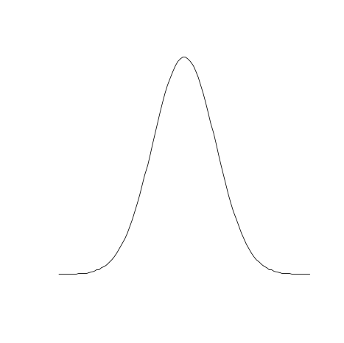

Graphical Representation
Y
W=1
[Y|W=1]
Parallel lines
No Interaction
W=0
W is possibly a
Confounder
[Y|W=0]
X
[X|W=0]
[X|W=1]

Slide 33
Model and Interpretation: interaction
Assume that there are two predictors in the model E[Y|x₁, x₂] = β₀+ β₁ x₁ + β₂ x₂ + β₃ x₁x₂
  Consider two observations with the same value, c, for x₂, but one observation has x₁ one unit higher
  Obs 1: E[Y|x₁=k+1, x₂=c] = β₀+ β₁ (k+1) + β₂ c + β₃ (k+1)c
  Obs 2: E[Y|x₁=k, x₂=c] = β₀+ β₁ (k) + β₂ c + β₃ kc
  Thus, E[Y|x₁=k+1, x₂=c] - E[Y|x₁=k, x₂=c] = β₁ + β₃ c
  That is, the difference in means depends now on the value of x₂!

Slide 34
Model and Interpretation: interaction
Model: E[Y|x₁, x₂] = β₀+ β₁ x₁ + β₂ x₂ + β₃ x₁x₂
Difference in Means:
  E[Y|x₁=k+1, x₂=c] - E[Y|x₁=k, x₂=c] = β₁ + β₃ c
  The difference in means depends on the value of x₂
    The difference in means is β₁ if c=0.
    The difference in means is β₁+ β₃ if c=1
    The difference in means changes by β₃ for each unit difference in c (that is, in x₂) [that is, β₃ is the difference of differences!]
H₀: β₃=0 tests for interaction

Slide 35
Model and Interpretation: interaction
Model: E[Y|x₁, x₂] = β₀+ β₁ x₁ + β₂ x₂ + β₃ x₁x₂
Another way to look at this
Factor terms involving x₁:
E[Y|x₁, x₂] = β₀+ (β₁ + β₃ x₂)x₁ + β₂ x₂
  Slope of x₁ changes with x₂ , i.e.
  Difference in means for each unit difference in x₁ changes with x₂ (for each one unit difference in x₂, the difference in means changes by β₃)

Slide 36
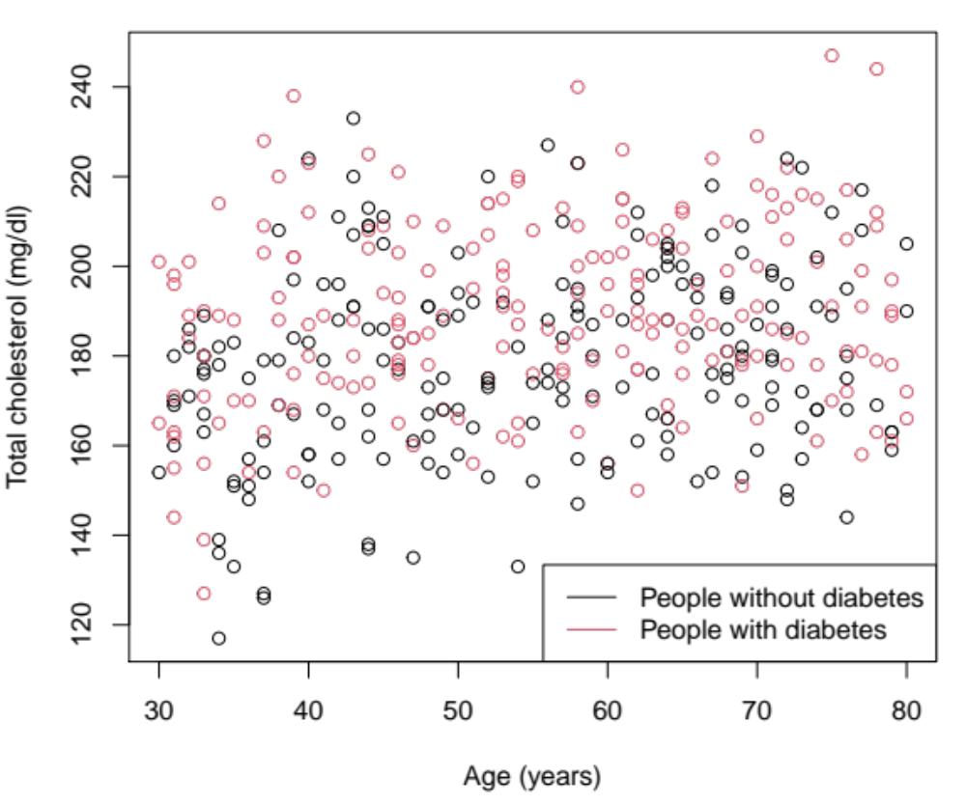
Cholesterol Example: Does diabetes affect the age – cholesterol relationship?

Slide 37
Cholesterol Example: Does diabetes affect the age – cholesterol relationship?
We first fit the model with age and DM terms only
(No diabetes: DM=0, With diabetes: DM=1)
> fit3 = lm(chol ~ age+DM)
> summary(fit3)
Call:
lm(formula = chol ~ age + DM)
Residuals:
Min 1Q Median 3Q Max
-55.662 -14.482 -1.411 14.682 57.876
Coefficients:
Estimate Std. Error t value Pr(>|t|)
(Intercept) 162.35445 4.24184 38.275 < 2e-16 ***
age 0.29697 0.07313 4.061 5.89e-05 ***
DM 10.50728 2.10794 4.985 9.29e-07 ***
---
Signif. codes: 0 ‘***’ 0.001 ‘**’ 0.01 ‘*’ 0.05 ‘.’ 0.1 ‘ ’ 1
Residual standard error: 21.06 on 397 degrees of freedom
Multiple R-squared: 0.09748, Adjusted R-squared: 0.09293
F-statistic: 21.44 on 2 and 397 DF, p-value: 1.440e-09

Slide 38
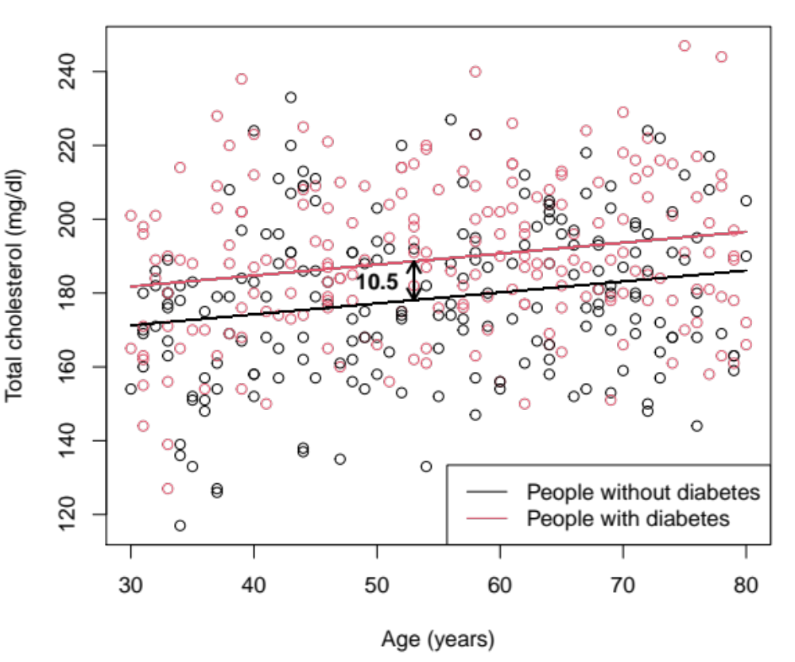
Cholesterol Example: Does diabetes affect the age – cholesterol relationship?

Slide 39
Cholesterol Example: Does diabetes affect the age – cholesterol relationship?
This model indicates that, after controlling for the effect of diabetes, the average cholesterol differs by 0.30 for each additional year of age
The age effect in this model is very similar to the effect from our simple linear regression (0.31)
However, this does not mean that the age/cholesterol relationship is the same in people with and without diabetes
To answer this question we must add the interaction term

Slide 40
Cholesterol Example: Does diabetes affect the age – cholesterol relationship?
Model with age and DM main effects, plus interaction effect
> fit4=lm(chol~age*DM)
> summary(fit4)
Call:
lm(formula = chol ~ age * DM)
Residuals:
Min 1Q Median 3Q Max
-56.474 -14.377 -1.215 14.764 58.301
Coefficients:
Estimate Std. Error t value Pr(>|t|)
(Intercept) 160.31151 5.86268 27.344 < 2e-16 ***
age 0.33460 0.10442 3.204 0.00146 **
DM 14.56271 8.29802 1.755 0.08004 .
age:DM -0.07399 0.14642 -0.505 0.61361
---
Signif. codes: 0 ‘***’ 0.001 ‘**’ 0.01 ‘*’ 0.05 ‘.’ 0.1 ‘ ’ 1
Residual standard error: 21.08 on 396 degrees of freedom
Multiple R-squared: 0.09806, Adjusted R-squared: 0.09123
F-statistic: 14.35 on 3 and 396 DF, p-value: 6.795e-09

Slide 41
Cholesterol Example: Does diabetes affect the age – cholesterol relationship?
Call:
lm(formula = chol ~ age * DM)
Residuals:
Min 1Q Median 3Q Max
-56.474 -14.377 -1.215 14.764 58.301
Coefficients:
Estimate Std. Error t value Pr(>|t|)
(Intercept) 160.31151 5.86268 27.344 < 2e-16 ***
age 0.33460 0.10442 3.204 0.00146 **
DM 14.56271 8.29802 1.755 0.08004 .
age:DM -0.07399 0.14642 -0.505 0.61361
---
Signif. codes: 0 ‘***’ 0.001 ‘**’ 0.01 ‘*’ 0.05 ‘.’ 0.1 ‘ ’ 1
Residual standard error: 21.08 on 396 degrees of freedom
Multiple R-squared: 0.09806, Adjusted R-squared: 0.09123
F-statistic: 14.35 on 3 and 396 DF, p-value: 6.795e-09
Mean cholesterol for people without diabetes (DM = 0) at age 0

Slide 42
Cholesterol Example: Does diabetes affect the age – cholesterol relationship?
Call:
lm(formula = chol ~ age * DM)
Residuals:
Min 1Q Median 3Q Max
-56.474 -14.377 -1.215 14.764 58.301
Coefficients:
Estimate Std. Error t value Pr(>|t|)
(Intercept) 160.31151 5.86268 27.344 < 2e-16 ***
age 0.33460 0.10442 3.204 0.00146 **
DM 14.56271 8.29802 1.755 0.08004 .
age:DM -0.07399 0.14642 -0.505 0.61361
---
Signif. codes: 0 ‘***’ 0.001 ‘**’ 0.01 ‘*’ 0.05 ‘.’ 0.1 ‘ ’ 1
Residual standard error: 21.08 on 396 degrees of freedom
Multiple R-squared: 0.09806, Adjusted R-squared: 0.09123
F-statistic: 14.35 on 3 and 396 DF, p-value: 6.795e-09
Difference in mean cholesterol between people with and without diabetes
at age 0

Slide 43
Cholesterol Example: Does diabetes affect the age – cholesterol relationship?
Call:
lm(formula = chol ~ age * DM)
Residuals:
Min 1Q Median 3Q Max
-56.474 -14.377 -1.215 14.764 58.301
Coefficients:
Estimate Std. Error t value Pr(>|t|)
(Intercept) 160.31151 5.86268 27.344 < 2e-16 ***
age 0.33460 0.10442 3.204 0.00146 **
DM 14.56271 8.29802 1.755 0.08004 .
age:DM -0.07399 0.14642 -0.505 0.61361
---
Signif. codes: 0 ‘***’ 0.001 ‘**’ 0.01 ‘*’ 0.05 ‘.’ 0.1 ‘ ’ 1
Residual standard error: 21.08 on 396 degrees of freedom
Multiple R-squared: 0.09806, Adjusted R-squared: 0.09123
F-statistic: 14.35 on 3 and 396 DF, p-value: 6.795e-09
Difference in mean cholesterol associated with each one year change in age
for people without diabetes

Slide 44
Cholesterol Example: Does diabetes affect the age – cholesterol relationship?
Call:
lm(formula = chol ~ age * DM)
Residuals:
Min 1Q Median 3Q Max
-56.474 -14.377 -1.215 14.764 58.301
Coefficients:
Estimate Std. Error t value Pr(>|t|)
(Intercept) 160.31151 5.86268 27.344 < 2e-16 ***
age 0.33460 0.10442 3.204 0.00146 **
DM 14.56271 8.29802 1.755 0.08004 .
age:DM -0.07399 0.14642 -0.505 0.61361
---
Signif. codes: 0 ‘***’ 0.001 ‘**’ 0.01 ‘*’ 0.05 ‘.’ 0.1 ‘ ’ 1
Residual standard error: 21.08 on 396 degrees of freedom
Multiple R-squared: 0.09806, Adjusted R-squared: 0.09123
F-statistic: 14.35 on 3 and 396 DF, p-value: 6.795e-09
Difference in change in mean cholesterol associated with each one year change in age comparing people with and without diabetes

Slide 45
Cholesterol Example: Does diabetes affect the age – cholesterol relationship?
Interpretation?
  Estimated model:
  160.3 + 0.33 Age + 14.56 Diabetes - 0.07 Age x Diabetes
    Subject 1: Age = a+1, diabetes = b
    Subject 2: Age = a, diabetes = b
    Difference in the estimated cholesterol:
    [160.3 + 0.33(a+1) + 14.56(b) – 0.07 (a+1)(b)] –
    [160.3 + 0.33(a) + 14.56 (b) – 0.07 (a)(b)] = 0.33-0.07b
  Diabetes exerts a small (not statistically significant) effect on the age/cholesterol relationship
    In people without diabetes: 160.3+0.33 Age
    In people with diabetes : 174.9+0.26 Age

Slide 46
Cholesterol Example: Does diabetes affect the age – cholesterol relationship?
We can also test the significance of interaction terms using an F-test
Adding the interaction term did not significantly improve model fit
> anova(fit3,fit4)
Analysis of Variance Table
Model 1: chol ~ age + DM
Model 2: chol ~ age * DM
Res.Df RSS Df Sum of Sq F Pr(>F)
1 397 176162
2 396 176049 1 113.52 0.2554 0.6136

Slide 47
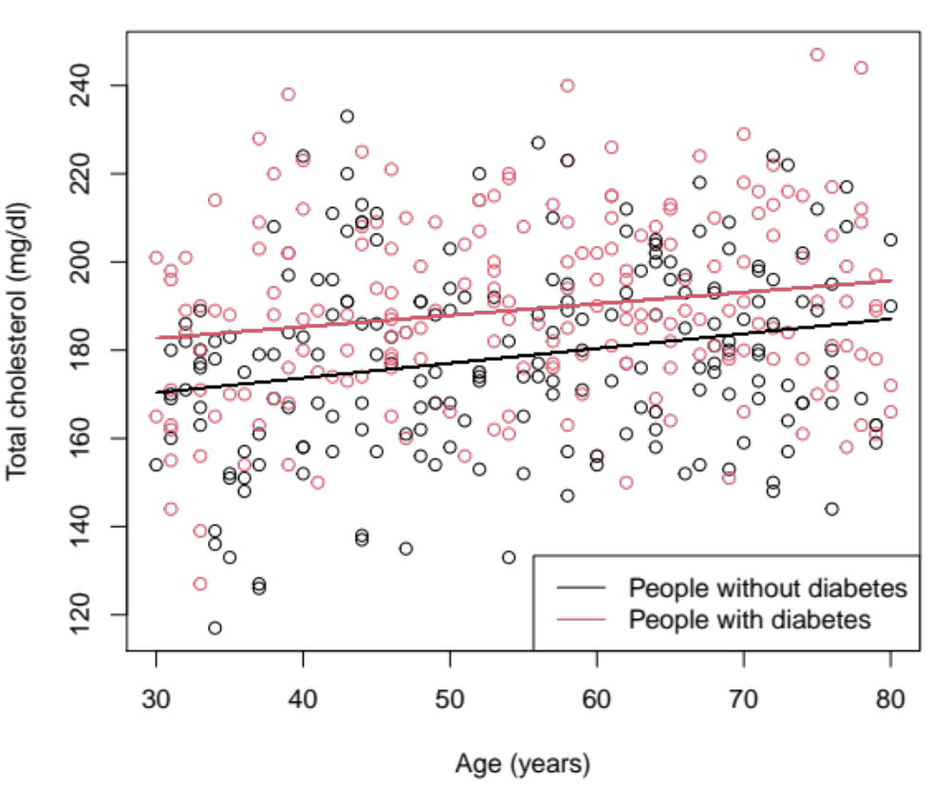
Cholesterol Example: Does diabetes affect the age – cholesterol relationship?

Slide 48
Summary
We have considered:
Simple linear regression
  Interpretation
  Estimation
  Model checking
Multiple linear regression
  Confounding
  Interpretation
  Estimation
  Interaction

Slide 49
Exercise
Work on Exercise 7-8
  Try each exercise on your own
  Make note of any questions or difficulties you have
  At 1:30PT we will meet as a group to go over the solutions and discuss your questions

