Slide 1
🛒
Shopping Zone
Project Documentation
PHP Programming · BCA Semester 4 · Academic Year 2025–26
Shiya Antala EN NO. 92400527243
Shopping Zone Project
Bachelor of Computer Applications (BCA)
Marwadi University · Rajkot, Gujarat
PHP · MySQL · HTML · CSS · XAMPP

Slide 2
CONTENTS
Table of Contents
01
Synopsis
08
Screen: Categories & Cart
Project overview and purpose
Shopping UI screenshots
02
Preamble
09
Core Features
Background, problem & objectives
Auth, cart, UI, session
03
Module Architecture
10
Technology Stack
File-level responsibilities
PHP, MySQL, HTML, CSS, XAMPP
04
System Design — DFD
11
Conclusion
Level 0, 1 & 2 data flow
Outcomes & extensibility
05
Database Design
12
Learning Outcomes
users table & session cart
Skills reinforced
06
Menu & Navigation
13
Bibliography
Header, category grid, cart nav
References
07
Screen: Login & Register
Authentication UI screenshots

Slide 3
SYNOPSIS
Project Synopsis
A Shopping Zone web application built with PHP, MySQL, HTML, and CSS. It provides user authentication (registration and login), a categorized product browsing interface with 6 categories, and a session-based shopping cart that persists across page navigations.
🔐
🛍️
🛒
💾
User Auth
6 Categories
Session Cart
MySQL DB
Register & Login with PHP sessions
Jewelry, Clothes, Shoes, Baby, Toys, Cosmetics
Add items, view total, clear cart
User data persisted in shopping_db

Slide 4
PREAMBLE 2.1 & 2.2
Introduction & Problem Statement
E-commerce and online shopping have become integral parts of modern daily life. Consumers expect seamless, user-friendly shopping experiences from any browser. This project provides a practical, local desktop demonstration of a complete PHP e-commerce flow.
Statement of Problem
🔑
How to implement secure user authentication with PHP sessions and MySQL database
📂
How to organize products into categories and present them in a responsive card-based UI
🛒
How to maintain a shopping cart across multiple page navigations using PHP sessions

Slide 5
PREAMBLE 2.3
Objectives & Scope
Objectives
Scope
✔ Design registration & login system with PHP & MySQL
IN SCOPE
✔ Local XAMPP/WAMP deployment
✔ Create 6 category-based product listing pages
✔ MySQL for user data storage
✔ PHP sessions for cart management
✔ Build session cart: add items, calculate total, clear
✔ HTML/CSS responsive frontend
✔ Allow seamless Continue Shopping navigation
OUT OF SCOPE
✗ Payment gateway
✔ Clean responsive UI with consistent green branding
✗ Admin panel
✗ Mobile app

Slide 6
MODULE DESCRIPTION 2.4
Module Architecture
login.php
Authentication entry point. Validates email/password against MySQL users table, creates PHP session on success.
register.php
New user registration. Hashes password with password_hash(), inserts record into users table via PDO/mysqli.
index.php
Main shopping page (post-login). Renders 6 category cards in a 3×2 grid. Green header with Cart & Logout buttons.
cart.php
Session cart view. Lists all added items with prices in INR, calculates total, offers Continue Shopping & Clear Cart.
category pages
Per-category product listing pages. Each shows product cards with Add to Cart buttons that append to $_SESSION cart.

Slide 7
SYSTEM DESIGN 3.1
Data Flow Diagram (DFD)
Level 0 — Context Diagram
users
(MySQL DB)
User
credentials / actions
Shopping
Zone App
pages / feedback
$_SESSION
(Cart)
Level 1 — Major Processes
1.0
User Auth
2.0
Categories
3.0
Cart Mgmt
Receives credentials → validates against Users DB → creates session
Reads category list → serves 6 product tile pages to user
Receives add/clear actions → updates session cart → returns cart view with total

Slide 8
SYSTEM DESIGN 3.2
Database Design
users table (MySQL — shopping_db)
$_SESSION
Cart Structure
Column | Type | Description
id | INT AI PK | Auto-increment primary key
email | VARCHAR(255) | Unique user email address
password | VARCHAR(255) | Bcrypt hashed password string
created_at | TIMESTAMP | Auto-set on registration
$_SESSION['user'] Logged-in user email
$_SESSION['cart'] Assoc. array of items
['name'] Product display name
['price'] Item price in INR (int)

Slide 9
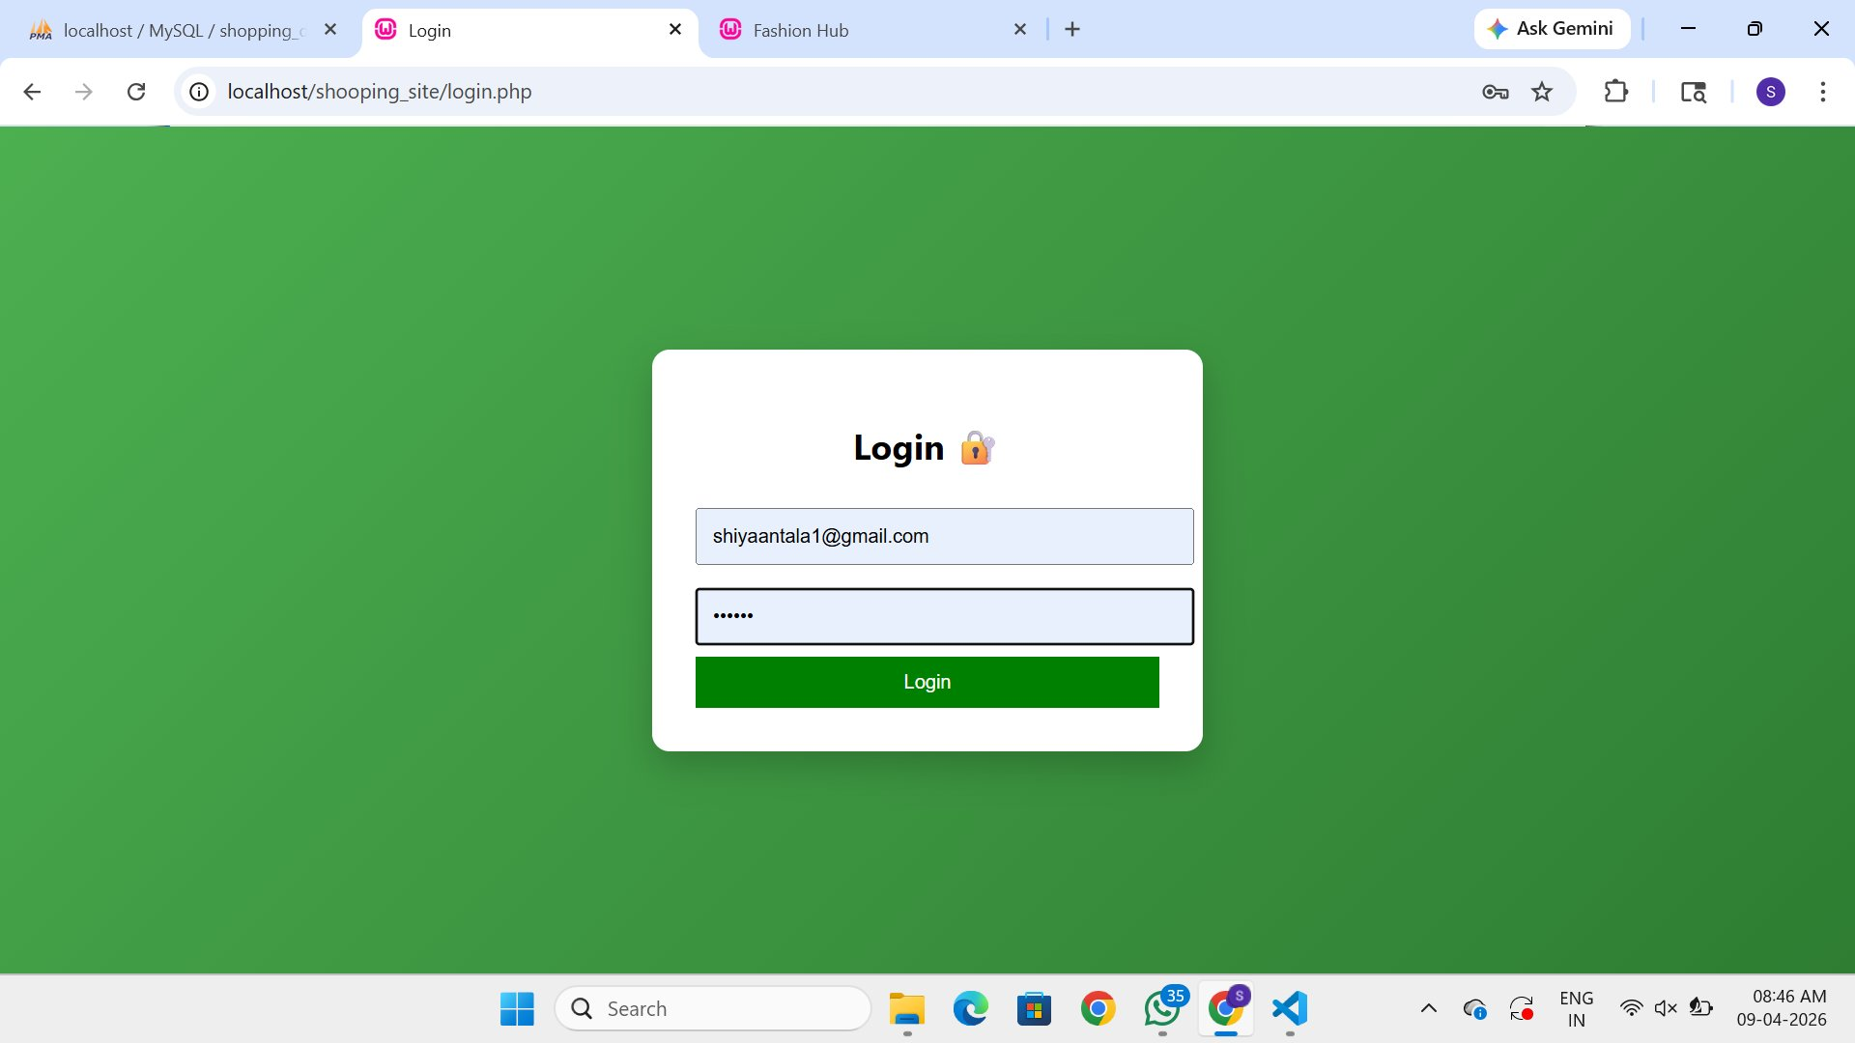
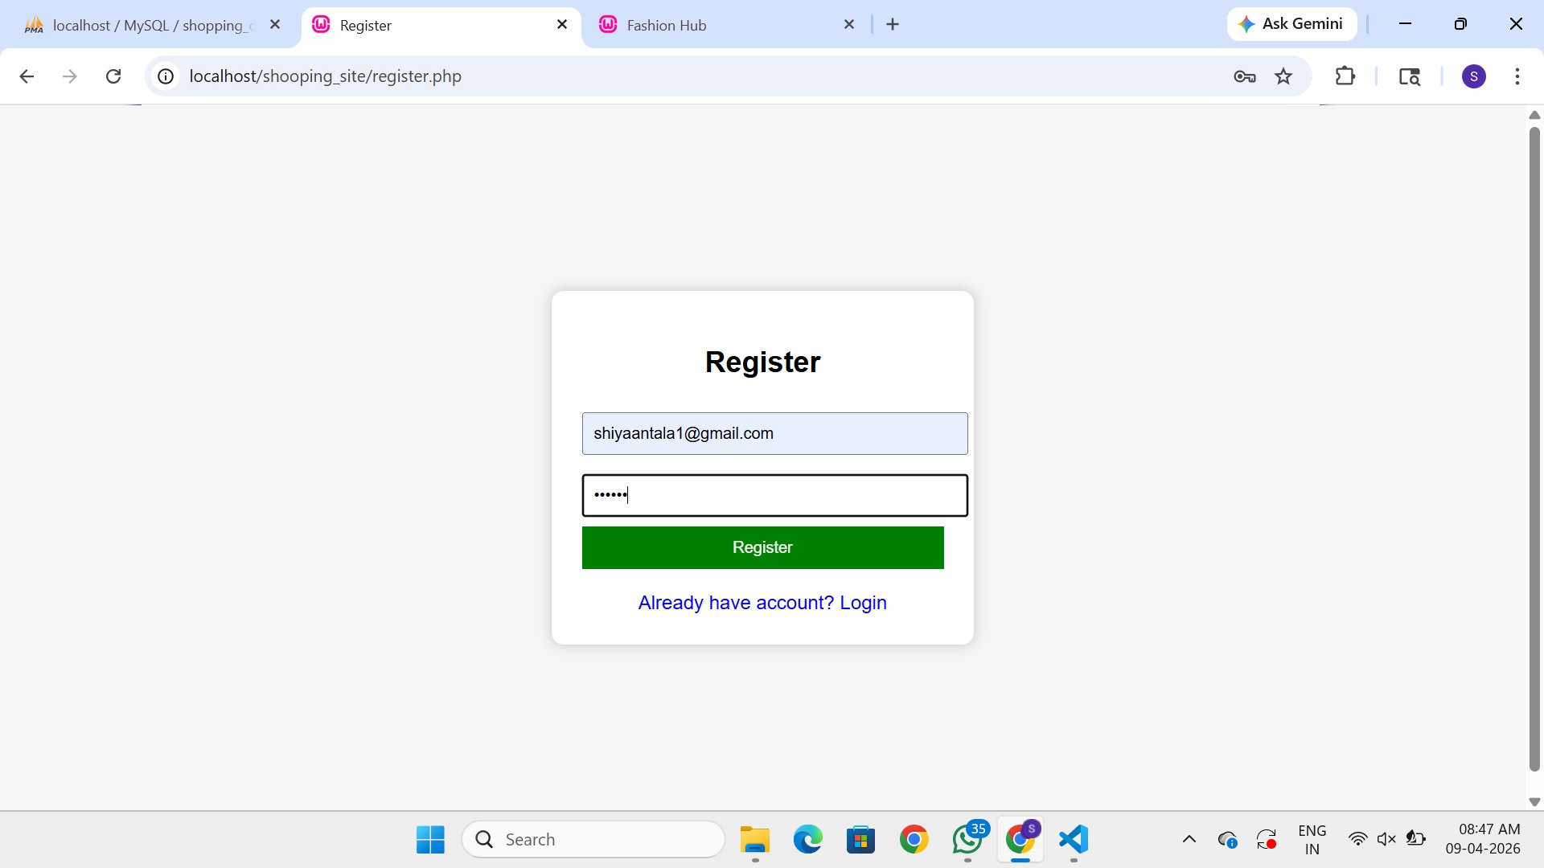
SCREEN DESIGN 3.4
Login & Registration Screens
Login Screen (login.php)
Registration Screen (register.php)
Green background · Email & Password fields · Session created on success
New user signup · password_hash() · Redirects to login on success

Slide 10
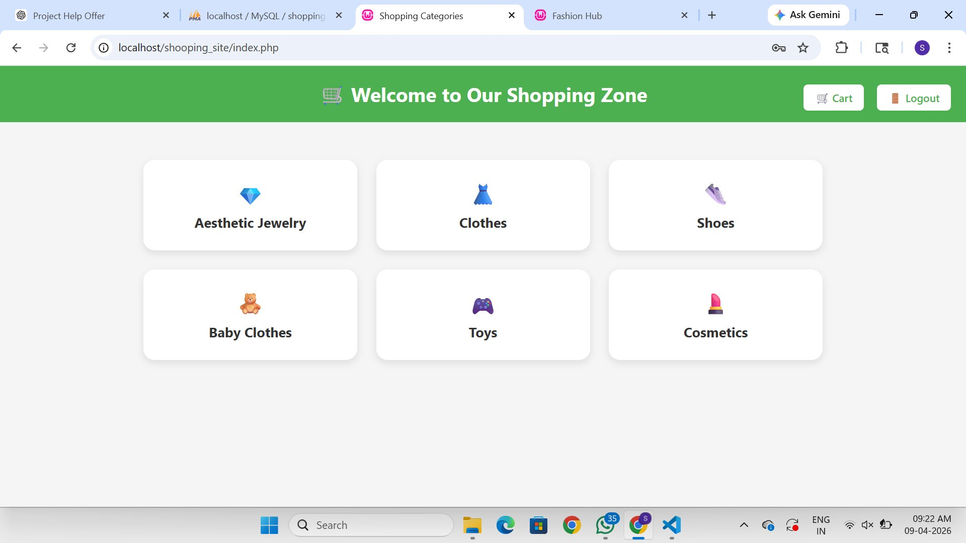
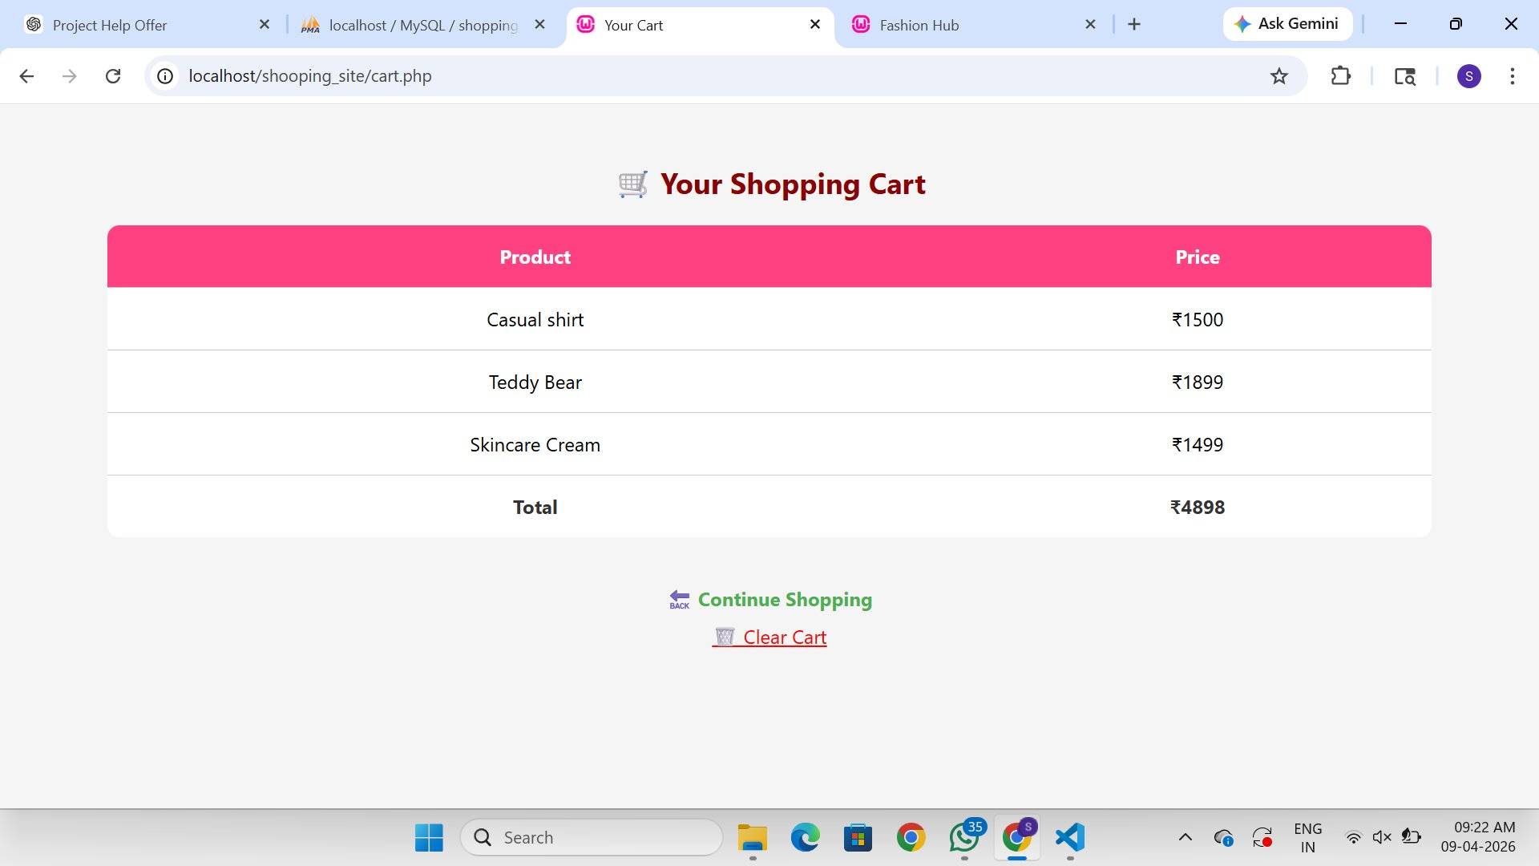
SCREEN DESIGN 3.4
Shopping Categories & Cart
Categories Page (index.php)
Shopping Cart (cart.php)
6 category cards · 3×2 grid · Cart & Logout in green header
Hot-pink header · Items + prices in INR · Total row · Clear Cart

Slide 11
CORE FEATURES
Key Application Features
🔐
📂
🛒
User Authentication
Category Navigation
Session-based Cart
PHP sessions for login state. password_hash() & password_verify() for secure credential storage and validation.
6 categories (Jewelry, Clothes, Shoes, Baby, Toys, Cosmetics) in a responsive 3×2 CSS Grid card layout.
$_SESSION stores cart items across page navigations. Add to Cart appends product+price to the session array.
💰
🎨
🚪
Price Calculation
Green Brand Theme
Logout & Session End
Cart page sums all prices in session array and displays total in INR with a bold Total row at the bottom.
Consistent #3a7d44 green across navigation, buttons, backgrounds. Hot-pink accent on cart table header.
Logout button destroys the PHP session entirely. Clear Cart destroys only the cart array in $_SESSION.

Slide 12
TECHNOLOGY STACK
Tools & Technologies Used
PHP 7/8
Sessions, password hashing, PDO/mysqli queries, form handling, page routing, and cart logic.
Server-side Language
MySQL
Stores user records in shopping_db.users. DDL: CREATE TABLE with id, email, password, created_at.
Database
HTML & CSS
Semantic HTML forms and structure. CSS Flexbox/Grid for 3×2 category cards and responsive layout.
Frontend
XAMPP / WAMP
Apache web server + MySQL bundled. Runs the PHP app locally at localhost/shooping_site/ with zero config.
Local Server Stack
In Scope: Local XAMPP/WAMP, PHP sessions, MySQL, HTML/CSS | Out of Scope: Payment gateway, Admin panel, Mobile app

Slide 13
CONCLUSION
Conclusion
The Shopping Zone web application successfully demonstrates a complete, self-contained PHP and MySQL e-commerce flow. User authentication via hashed passwords and PHP sessions provides a secure and stateful experience, while the session-based cart closely mirrors real-world e-commerce behavior.
✔ Self-contained
✔ Secure Auth
Runs on any local XAMPP/WAMP machine. No cloud infrastructure, payment gateway, or external API required.
password_hash() and PHP sessions ensure no plain-text passwords and proper login state management.
✔ Extensible
✔ Educational
Can be extended with an admin panel, product database, or payment gateway without rewriting core logic.
Demonstrates PHP + MySQL + HTML + CSS working together as a complete, structured academic web project.

Slide 14
LEARNING OUTCOMES
What Was Learned
01
PHP Sessions
02
Password Security
Implementing $_SESSION to maintain login state and cart data across multiple pages without a database write for every action.
Using password_hash() and password_verify() to store and validate credentials securely, avoiding plain-text password storage.
03
MySQL Integration
04
Responsive Card Layout
Writing PDO or mysqli queries to insert users during registration and retrieve/validate during login with parameterized queries to prevent SQL injection.
Using CSS Flexbox/Grid to create a uniform, aesthetically pleasing 3×2 category card grid that adapts to different screen widths.
05
UI/UX Consistency
06
Session-based Cart
Applying a consistent green brand color across navigation, buttons, and backgrounds, with hot-pink accent to guide user attention to the cart.
Learning to store, retrieve, and clear associative arrays in $_SESSION to replicate a shopping cart without a separate cart database table.

Slide 15
🛒
Thank You
Shopping Zone — BCA Semester 4 PHP Project
Shiya Antala · Shopping Zone Project
Marwadi University · Rajkot, Gujarat
PHP · MySQL · HTML · CSS · XAMPP

