Slide 1
Lsrw-skills
Shiyam saran S [122012012830]
Kubandra guptha J [122012012806]
Arun ignasiyas M [122012012784]

Slide 2
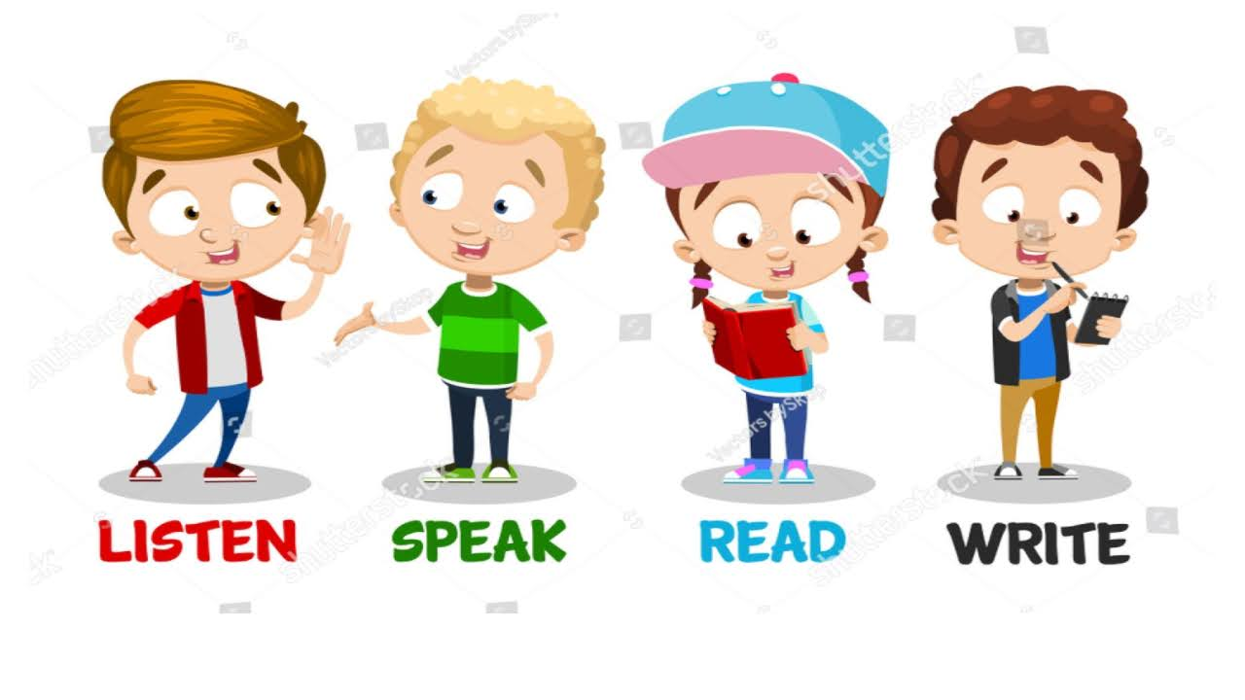
INTRODUCTION
LSRW skills stand for Listening, Speaking, Reading, and Writing skills. These are fundamental language skills that are essential for effective communication in any language

Slide 3

Listening Skills
Importance: Helps in understanding spoken language, following instructions, and comprehending information accurately.
Activities to improve: Listening to podcasts, watching movies or TV shows in the target language, participating in conversations, and practicing active listening techniques.

Slide 4
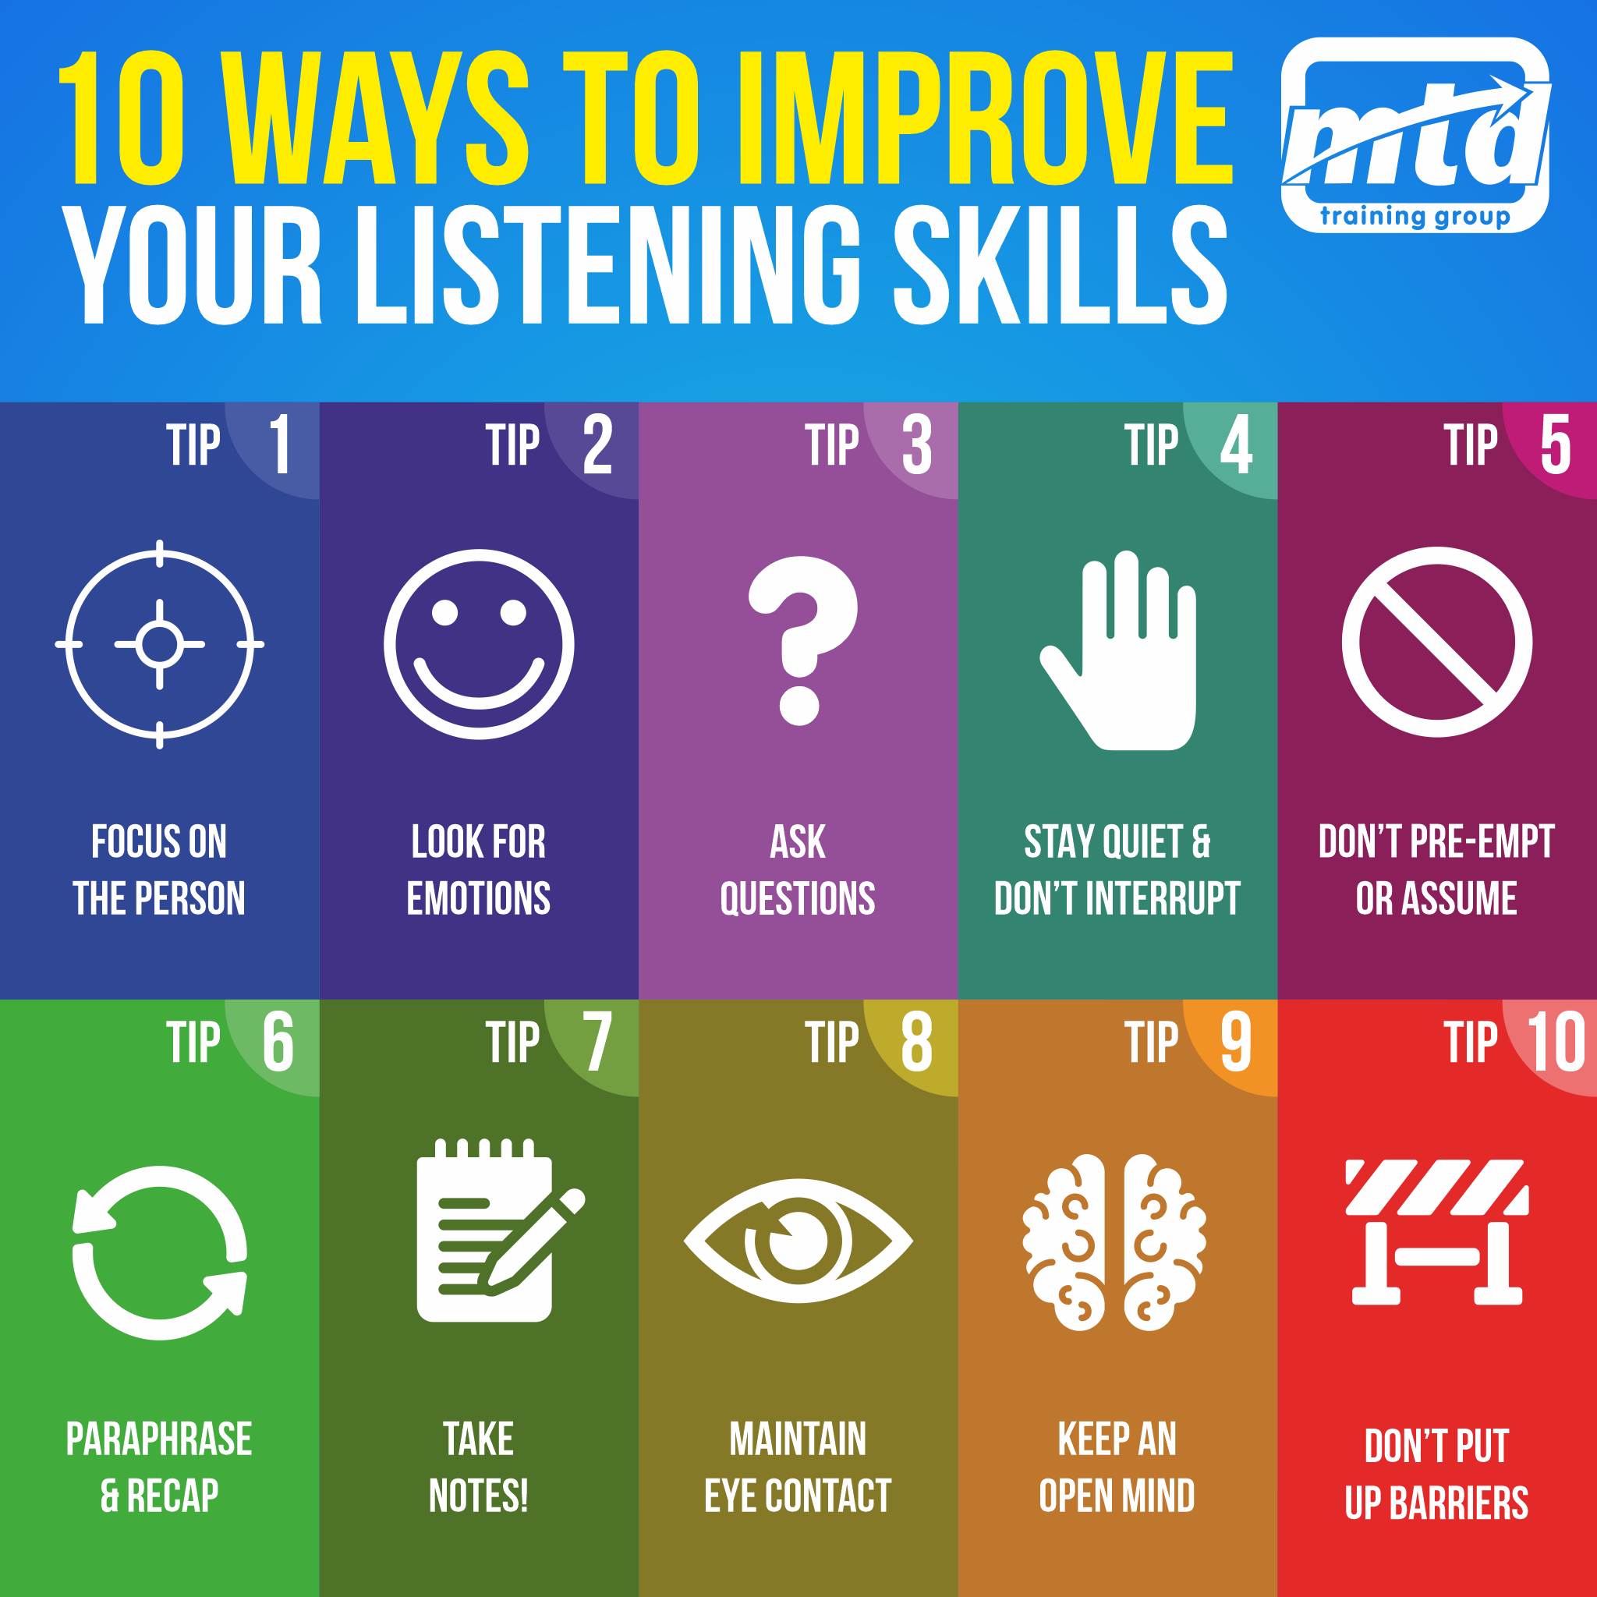
Listening Skills: Importance and Techniques
Importance: Understanding and retaining information, building relationships, reducing misunderstandings.
Techniques: Active listening, paraphrasing, note-taking, minimizing distractions

Slide 5

Improving Listening Skills
Tips: Engage in listening exercises, listen to diverse audio materials, join group discussions, seek feedback.

Slide 6

Speaking Skills
Importance: Enables verbal expression of thoughts, ideas, and information clearly and effectively
Activities to improve: Engaging in conversations, practicing pronunciation, participating in public speaking or debates, and using language learning apps for speaking practice.

Slide 7

Speaking Skills: Importance and Techniques
Importance: Expressing ideas clearly, effective communication, building confidence.
Techniques: Practice speaking regularly, work on pronunciation, use body language, engage in conversations

Slide 8

Improving Speaking Skills
Tips: Join speaking clubs, record and review your speeches, participate in public speaking events, use language learning apps.

Slide 9

Reading Skills
Importance: Facilitates understanding written texts, gathering information, and improving vocabulary and comprehension.
Activities to improve: Reading books, articles, and newspapers in the target language, practicing reading comprehension exercises, and using flashcards for vocabulary building.

Slide 10

Reading Skills: Importance and Techniques
Importance: Enhances comprehension, expands vocabulary, improves focus and concentration.
Techniques: Skimming and scanning, critical reading, annotating texts, summarizing.

Slide 11

Improving Reading Skills
Tips: Read regularly, explore diverse genres, join reading groups or book clubs, use reading comprehension exercises.

Slide 12

Writing Skills
Importance: Allows for clear and effective written communication, expressing ideas, and conveying information accurately.
Activities to improve: Writing essays, journal entries, and letters in the target language, practicing grammar and punctuation exercises, and using writing prompts to inspire creativity

Slide 13

Writing Skills: Importance and Techniques
Importance: Essential for clear communication, aids in organizing thoughts, enhances creativity.
Techniques: Prewriting (brainstorming, outlining), drafting, revising, editing and proofreading.

Slide 14

Improving Writing Skills
Tips: Practice writing daily, seek feedback from peers or mentors, participate in writing workshops, use writing prompts and exercises.

Slide 15
LSRW-SKILLS
Assessment and Improvement of LSRW Skills
Combining LSRW Skills for Effective Communication
Self-assessment techniques: reflective journals, self-recording.
Seeking feedback from peers, mentors, and language teachers.
Setting personal goals and tracking progress.
Importance: Integrated approach for comprehensive language proficiency.
Strategies: Practice regularly, expose yourself to the language in different contexts, seek opportunities to use all four skills.

Slide 16


