Slide 1
AcapellaFella
Brandon, Eric, Mark, Shiyan

Slide 2
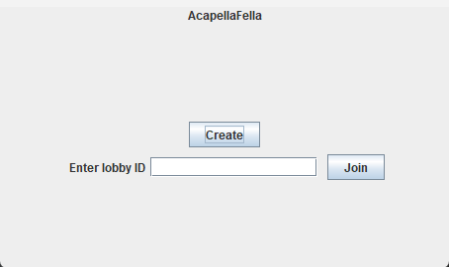
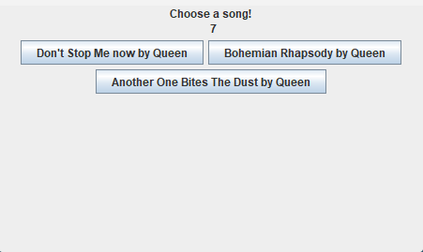
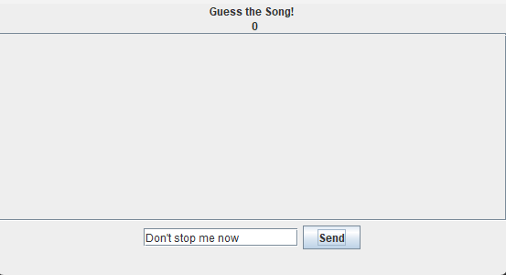
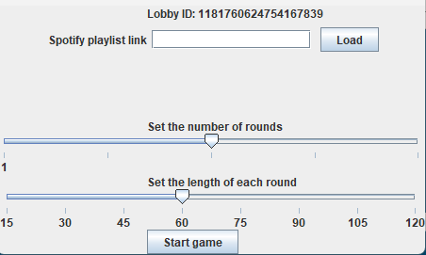
Specification
Take turns singing and guessing
Faster guess = More points
Create/Join Lobby

Slide 3

Functionality

Slide 4

API Usage
Spotify API

Slide 5
API Usage
Spotify API
Retrieving an access token
https://accounts.spotify.com/api/token
Retrieve songs from a playlist
https://api.spotify.com/v1/playlists/{id}/tracks

Slide 6
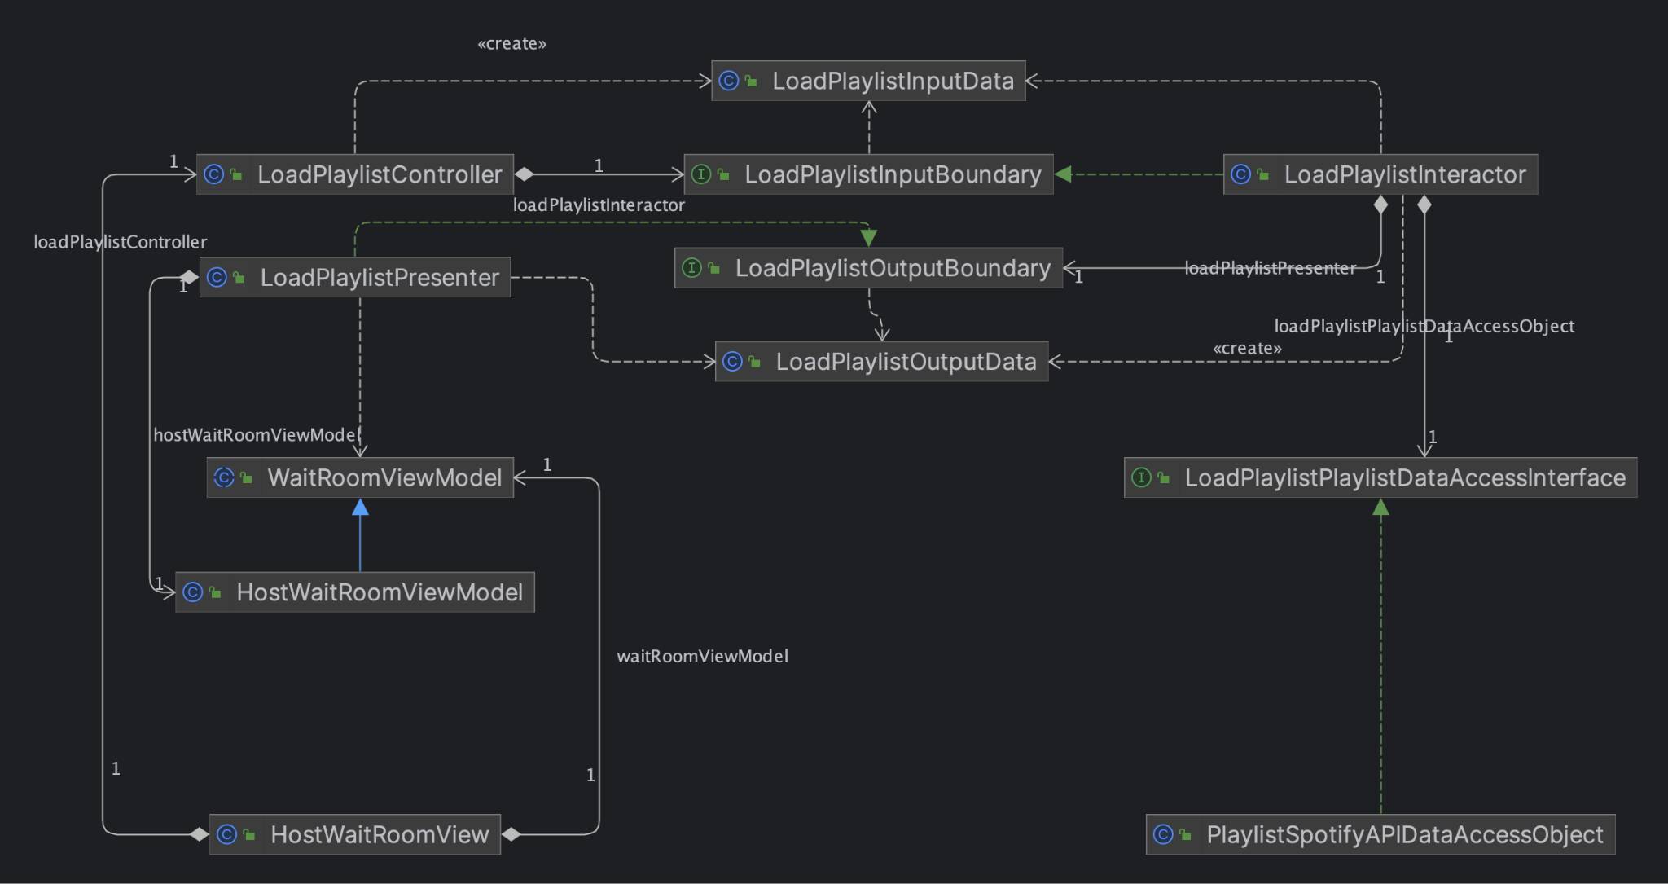
Adherence to Clean Architecture

Slide 7
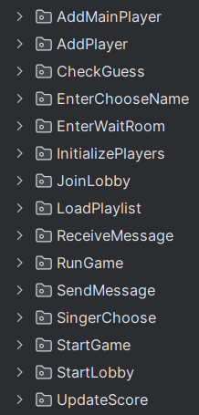
Adherence to SOLID
Single responsibility principle
Many use cases
No overlap in functionality

Slide 8
Adherence to SOLID
Open/Closed Principle
Easy to add on features due to how separated use cases and functionality is

Slide 9
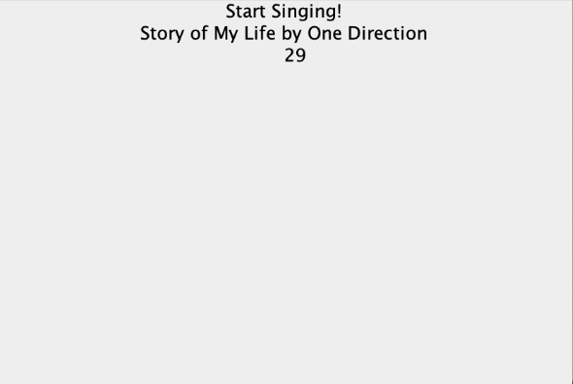
Adherence to SOLID
Open/Closed Principle
Can extend project by adding lyrics to SingerSingView (view shown after singer chooses a song)
I.e., Create a new DisplayLyrics use case, with the necessary controllers and presenters
Lyrics go here

Slide 10
Adherence to SOLID
Dependency Inversion principle
High-level modules does not depend on low-level modules

Slide 11
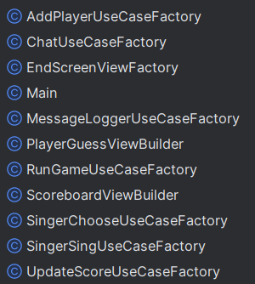
Design Patterns
Factory
Create different Views, Interactors, etc.

Slide 12
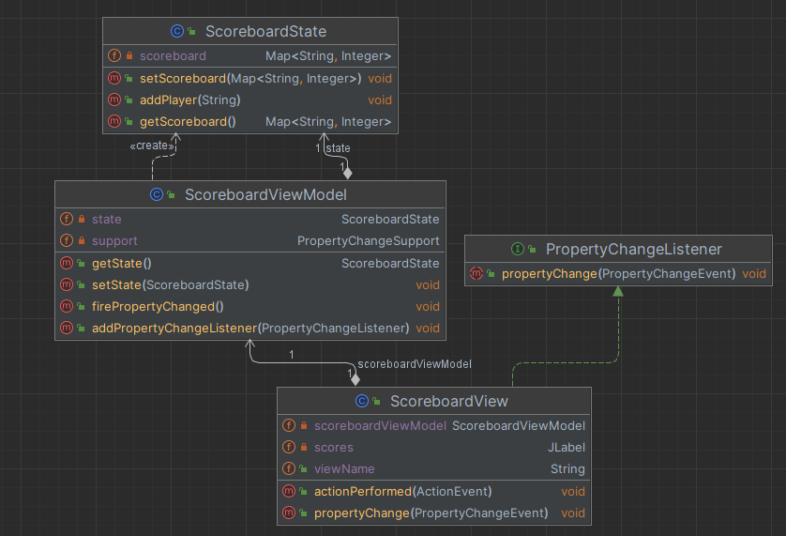
Design Patterns
Observer design pattern
For Views, ViewModels, and States

Slide 13
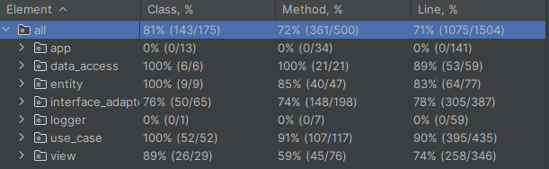
Testing
Approach
High level to low level (e.g. testing entities before interactors)
Not Tested
Main
Factories
Logger

Slide 14
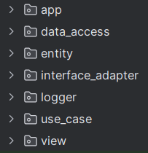
Code organization
Organization of code is by Layer
By layer of Clean Architecture

