Slide 1
Lending Club Project
By: Mehmet Bilgin Esen, Shiyang Ni

Slide 2
Background

Slide 3
Digitized Lending
McKinsey:
Faster credit decisions, vastly improved, customer experience, 40 percent lower costs, and a more secure risk prole.

Slide 4
Machine Learning Model based PD
Compared to traditional scoring models:
Incorporation of macro-economic variables
Cardinal output – the magnitude of output admits probability interpretation
Compared to structured models:
Readily available input
Flexible format

Slide 5
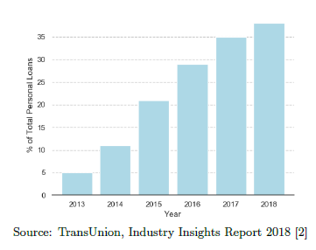
P2P Lending
Major Strength
Customized Interest Rate
Light operating structure

Slide 6
Project Overview
Data source
Training: 2007-2011, 35000+ loans. Test: 2011, about 4000 loans.
All loans have CONCLUDED(either defaulted on or fully paid).
Results Preview
Extensive EDA and data scope expansion
Unsatisfactory results in modeling; potential improvements will be discussed.

Slide 7
Data Cleaning

Slide 8
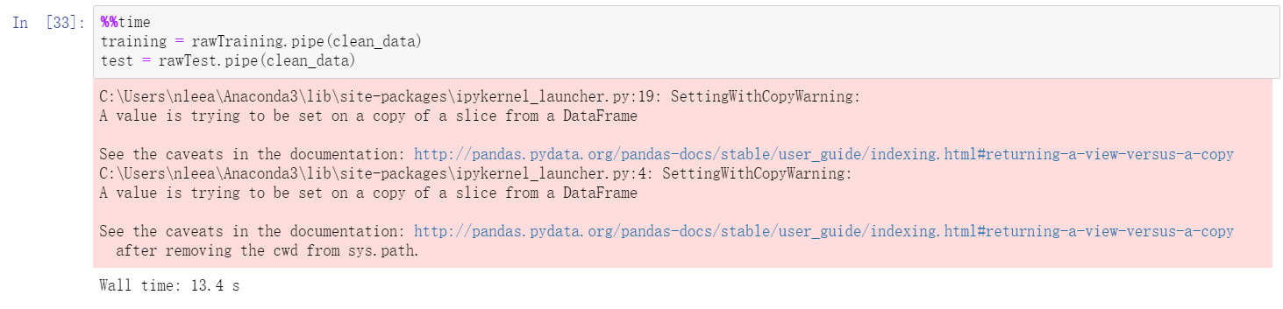
A Pipeline for Data Cleaning

Slide 9
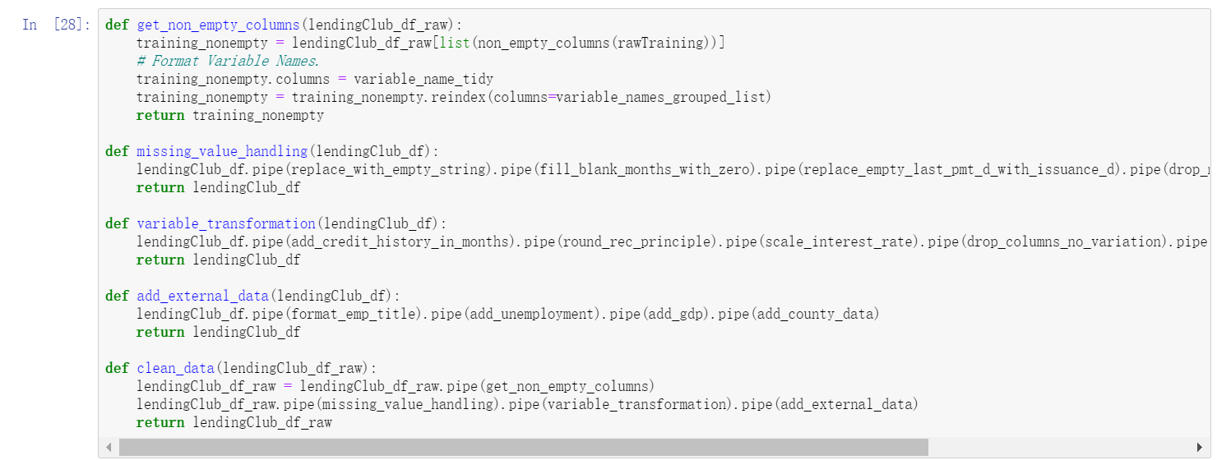
A Pipeline for Data Cleaning

Slide 10
A Pipeline for Data Cleaning
Advantage:
Easier Replication
Better control over what to include

Slide 11
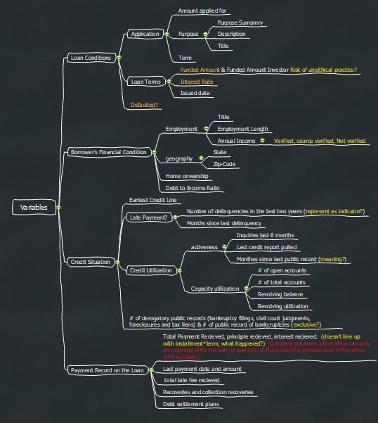
Data Processing: Inside the Dataset
Summarized Variables into 4 Baskets
Removed the empty columns and columns with no variation
Formatted the variables

Slide 12
Data Processing: Add Macroeconomic Variables
Monthly GDP growth: national
Monthly Unemployment Rate: state and zip-code level
House Price & Rent: zip-code level
Industry from employer title: extraction quality too poor

Slide 13
EDA

Slide 14
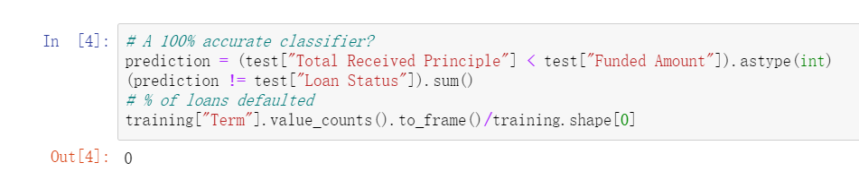
EDA: A 100% one-line predictor?

Slide 15
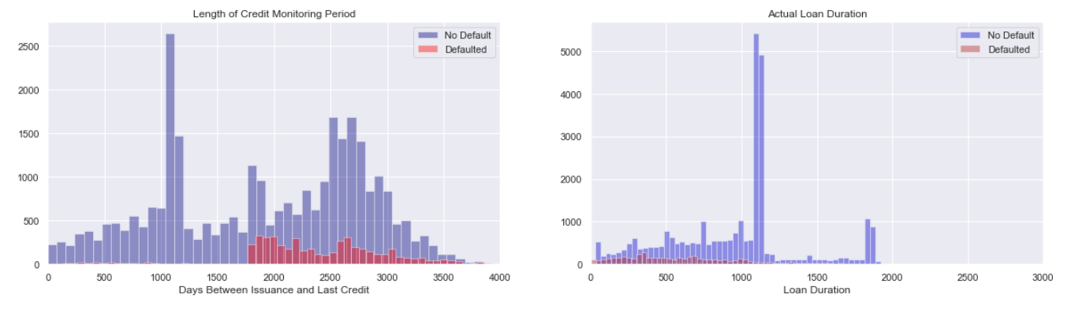
EDA: Variables with extraneous correlation
Payment Data
Last Credit Pulled Date: lending club likely does regular credit check on on-going loans.

Slide 16
EDA: Variables based on PD
Loan Grades, interest rate, installment

Slide 17
EDA: Ratio Funded by Investor is exogenous

Slide 18
EDA: Framework for the remaining variable
Recall we divided the variables into 4 baskets: loan condition, borrower financial strength, credit situation, payment information(now removed), and added external macro-economic variables

Slide 19
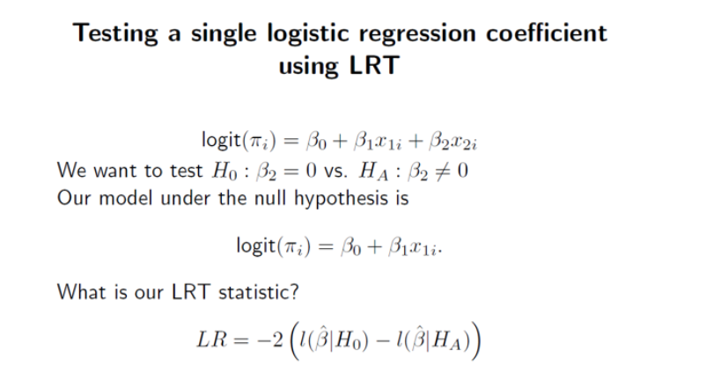
EDA: Framework for the remaining variable
For each of the basket:
Start with 1-2 variables
Incrementally test the inclusion of a new one through
Graphing against existing variable
Hypothesis Testing using LRT in logistics model

Slide 20
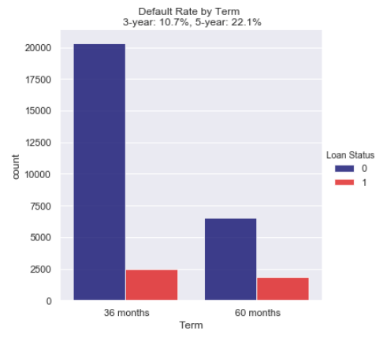
EDA: Loan Condition -- Term

Slide 21
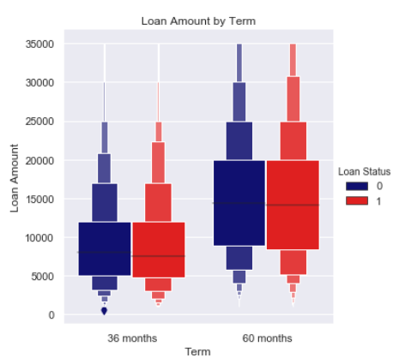
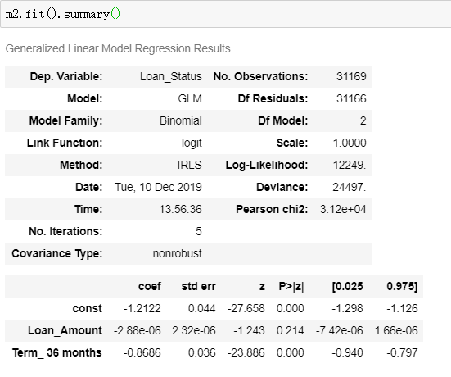
EDA: Loan Condition -- Term

Slide 22
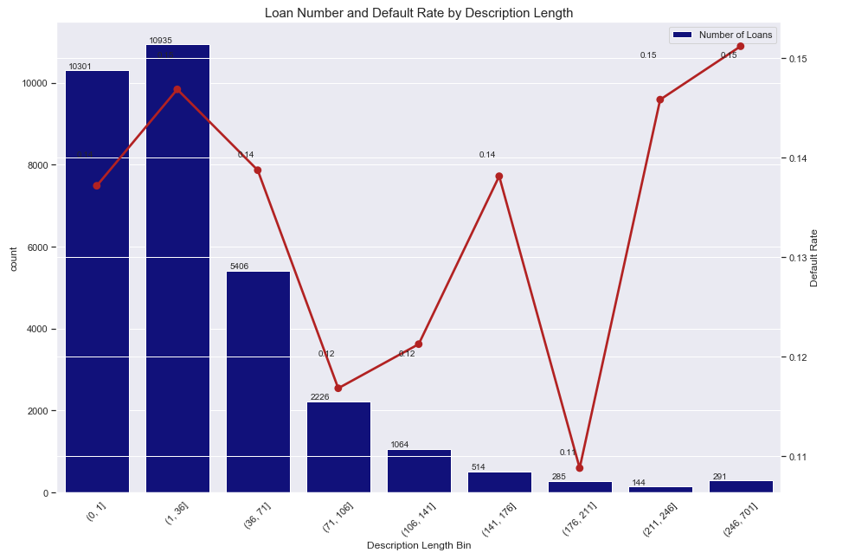
EDA: Loan Condition – Description Length

Slide 23
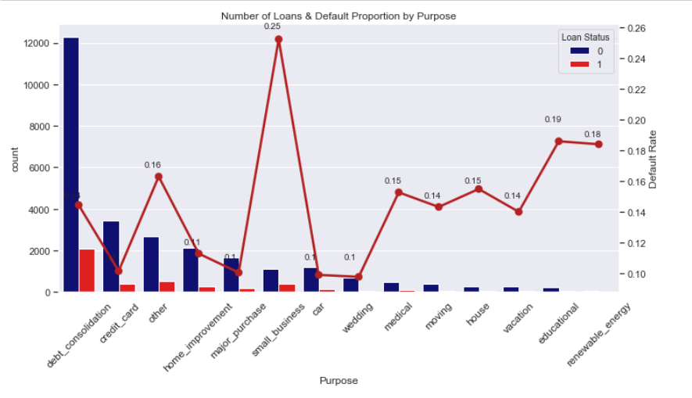
EDA: Loan Condition -- Purpose

Slide 24
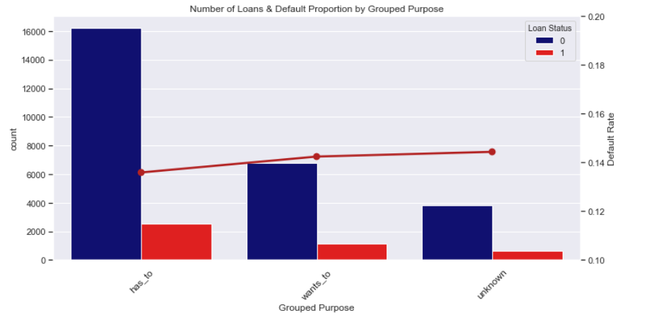
EDA: Loan Condition -- Purpose

Slide 25
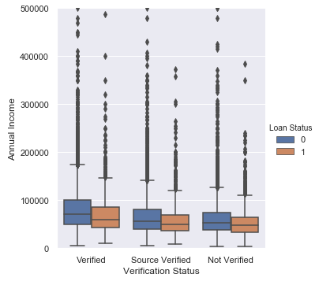
EDA: Borrower Financial Condition -- Income
Outliers

Slide 26
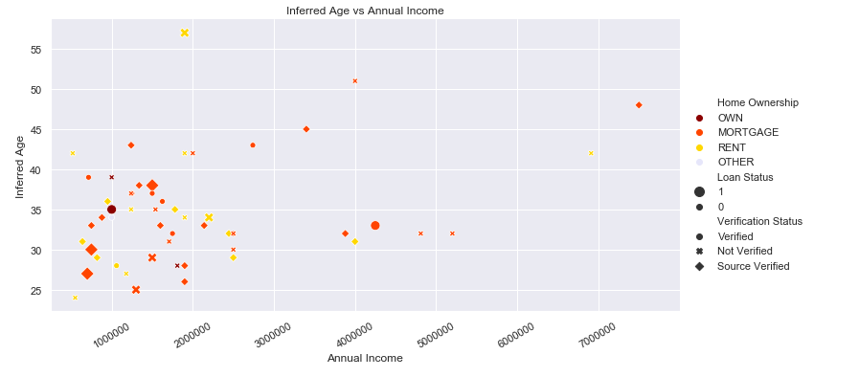
EDA: Borrower Financial Condition -- Income
Outliers: people under 35 claiming to own more than 1 million, and still renting a house?

Slide 27
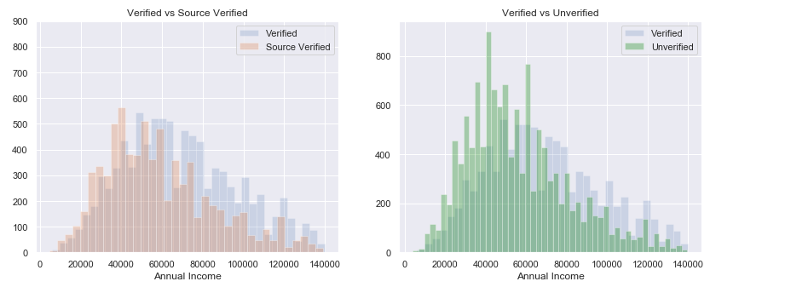
EDA: Borrower Financial Condition -- Income

Slide 28
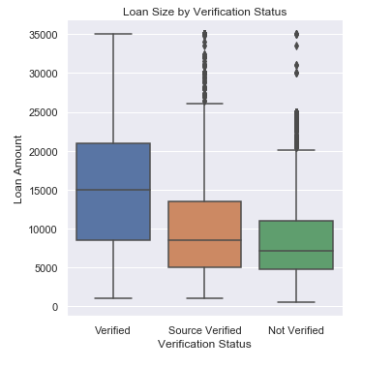
EDA: Borrower Financial Condition -- Income

Slide 29
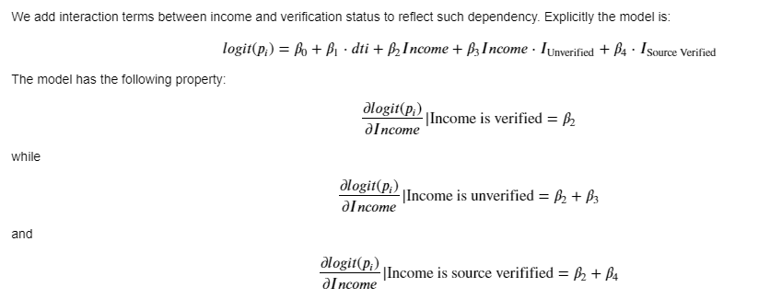
EDA: Borrower Financial Condition -- Income

Slide 30
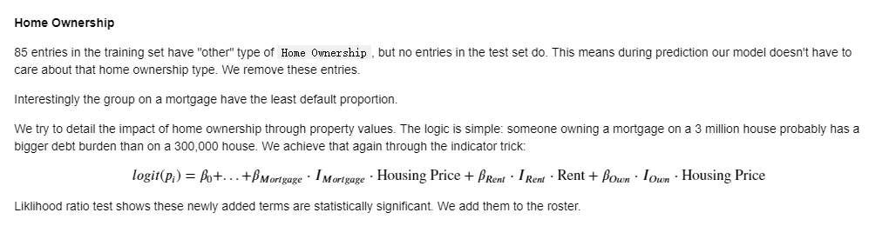
EDA: Borrower Financial Condition – Home Ownership

Slide 31
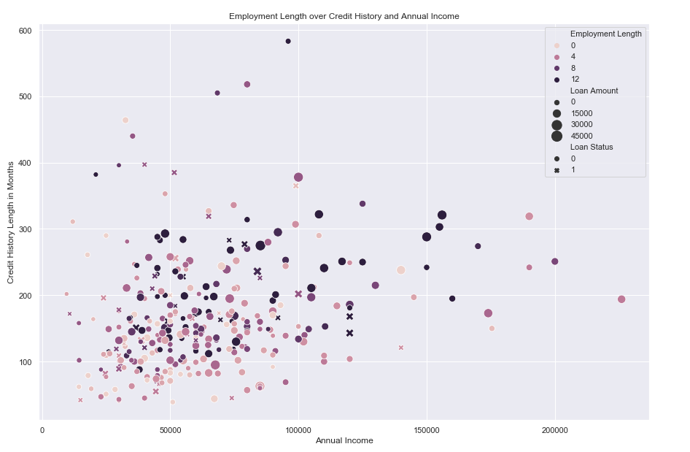
EDA: Borrower Financial Condition – Employment Length

Slide 32
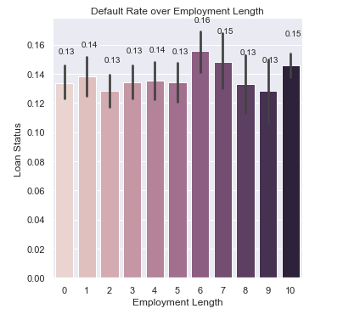
EDA: Borrower Financial Condition – Employment Length

Slide 33
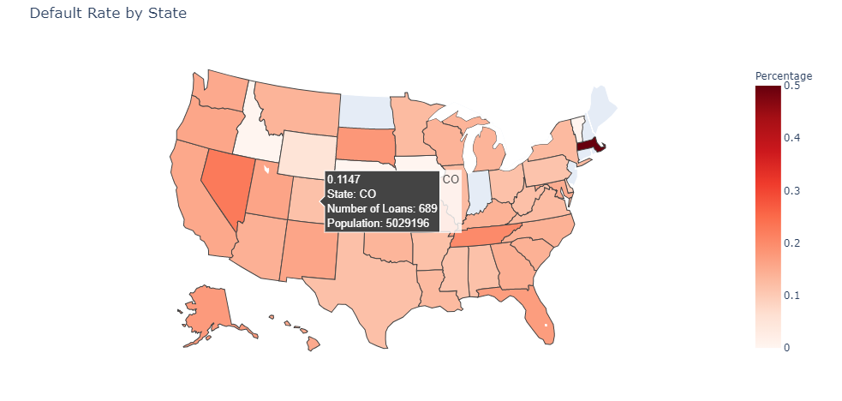
EDA: State

Slide 34
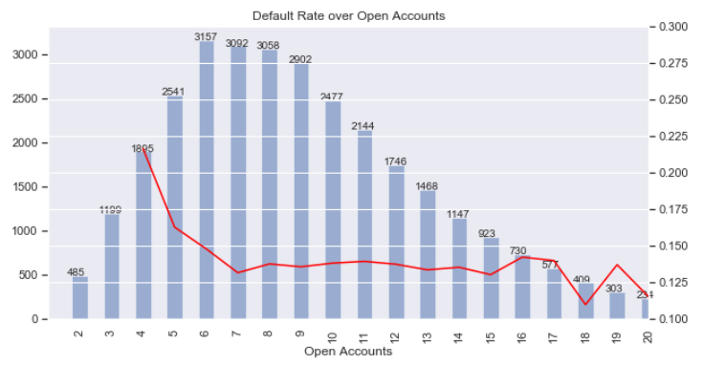
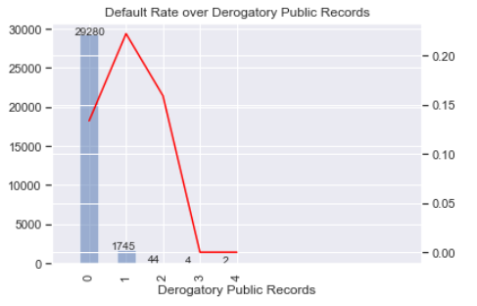
EDA: Credit Situation

Slide 35
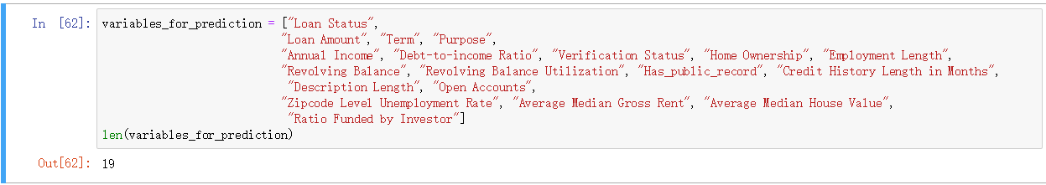
EDA: Dataset-wise recapture

Slide 36
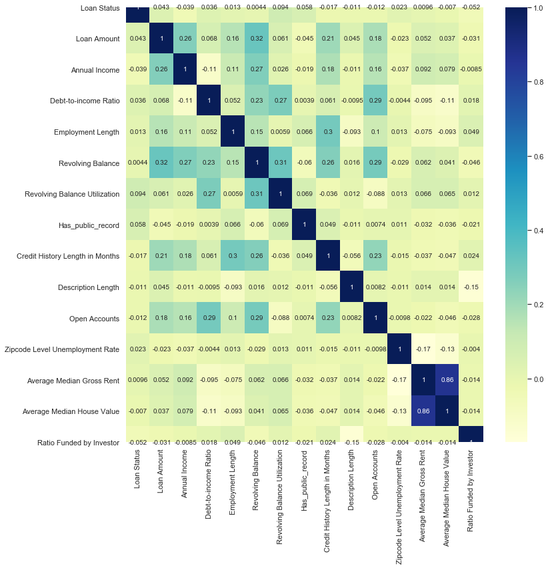
EDA: Dataset-wise recapture

Slide 37
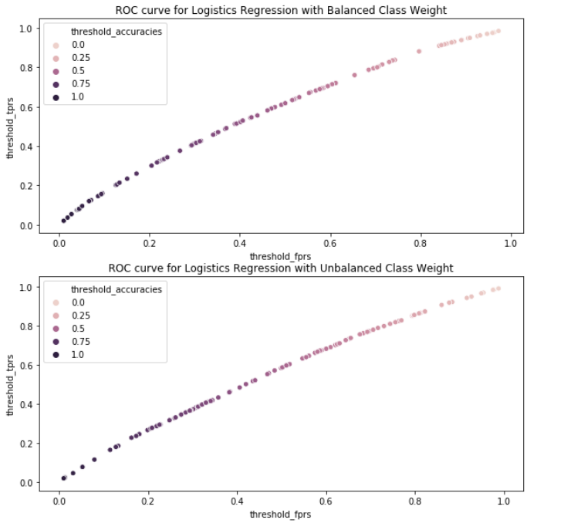
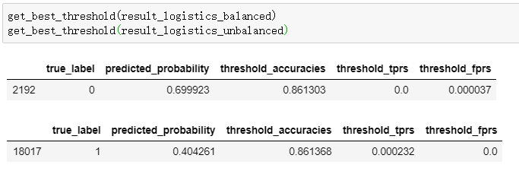
Modeling: does changing threshold work?

Slide 38
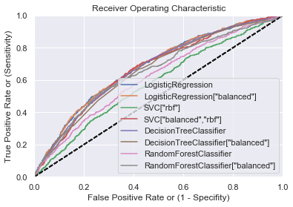
Modeling

Slide 39
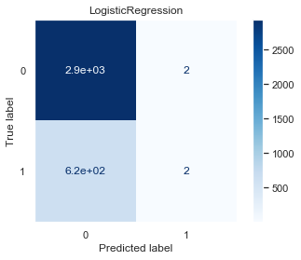
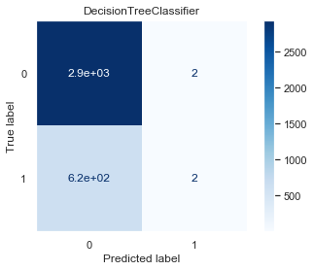


Modeling

Slide 40
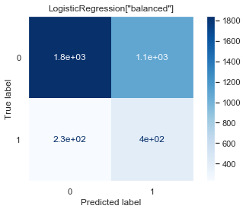
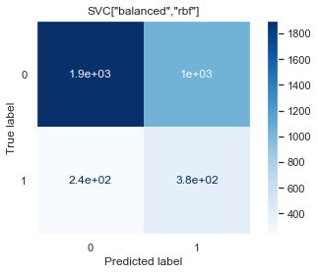
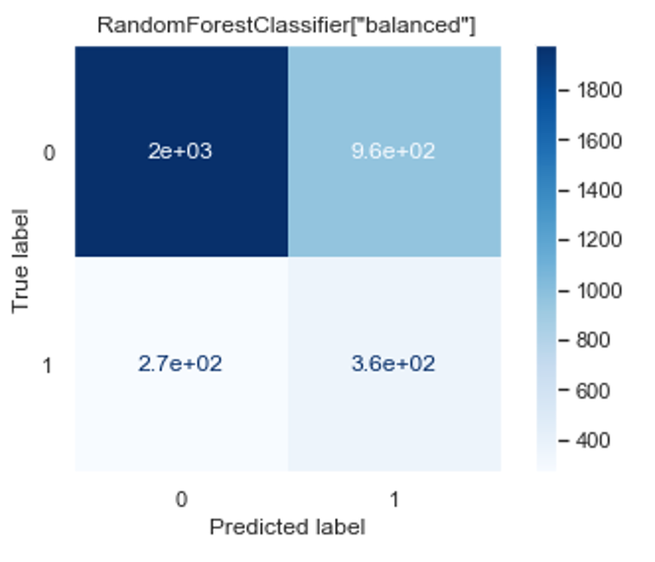
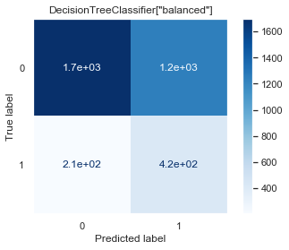
Modeling

Slide 41
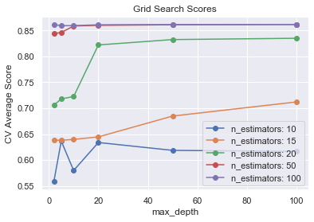
Modeling

Slide 42
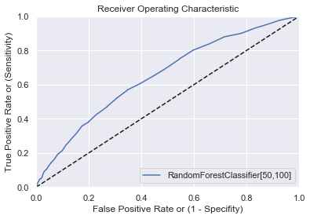
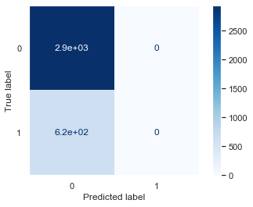
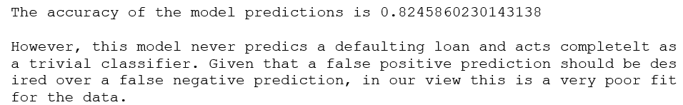
Modeling

Slide 43
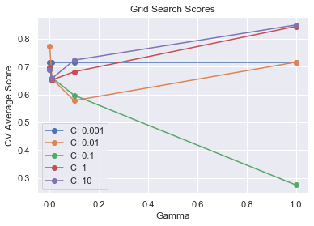
Modeling

Slide 44
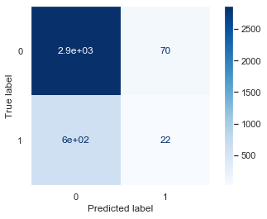
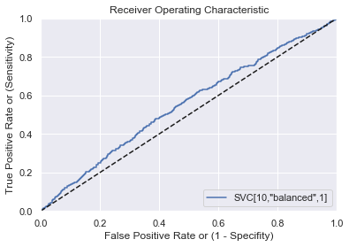
Modeling
Accuracy = 0.8111142295818131

Slide 45
Modeling
Different CV scoring: true positive rate + false negative rate(FN/(FN + TN))

