Slide 1





Bot Building Basics with 3DC

Slide 2
Telegram Bots
Visit telegram.me/botfather, click “open in web”, “start”
/newbot
Name your bot
Get your Bot Token
Add a description for your bot through botfather (optional)
For this tutorial, pip3 install requests if you haven’t done so.

Slide 3
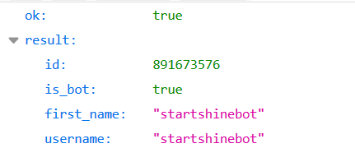
Interacting with our Bot through our web browser
https://api.telegram.org/bot<your-bot-token>/getme

Slide 4
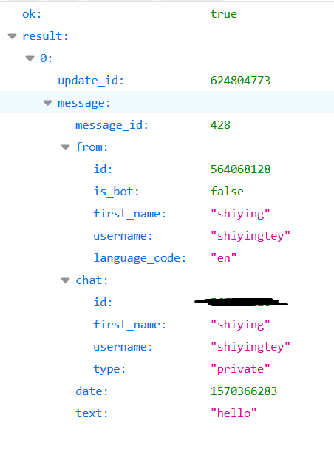
Interacting with our Bot through our web browser
https://api.telegram.org/bot<your-bot-token>/getUpdates

Slide 5
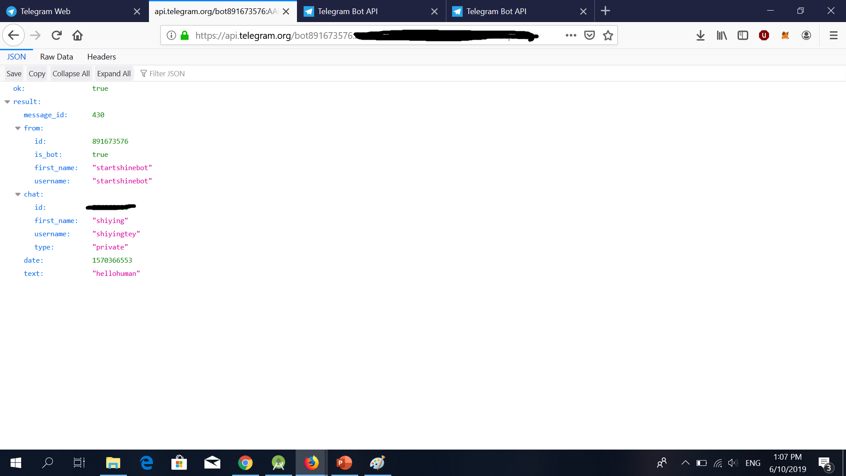
Interacting with our Bot through our web browser
https://api.telegram.org/bot<your-bot-token>/sendMessage?chat_id=<chat-id>&text=TestReply

Slide 6
Project Brief
Create a to-do-list bot
Basic commands to add item, remove item and display items

Slide 7
Setup Code
Download code from:
https://github.com/shiyingt/to-do-list-bot
Dbhelper.py has helper functions for sqllite3 database
Telebot.py is the main file which connects telegram with the database.
Notes:
Open up telebot.py to explain how the getupdates work in visual studio. Before we go over the handler functions, we will learn how to access the database to store, retrieve and delete information.

Slide 8
SQLite Database
A query SELECT, INSERT, or DELETE.
Internal data storage
Used for prototyping

Slide 9
Do laundry
Finish homework
Codewars
Gym

Slide 10
SQLite Database
CREATE TABLE tablename (args TEXT)
INSERT INTO tablename VALUES (args)
SELECT args FROM tablename WHERE arg1=somevalue
DELETE FROM tablename WHERE arg1=somevalue
Notes:
Open up sqllite.py to explain stmts in visual studio.
Specify the names that we want for the column followed by the datatype such as text for todolist
To store information in the database we have “insert int” .. In the parenthesis we put down the values for a row in the table; meaning that id there are 4 columns indicated in the parenthesis when you create table, we should also have a corresponding 4 values here.
To retrieve information for the database, we use the SELECT function where we can specify the row in which we would like to retrieve the value, corresponding to the value of another column (which we specify using the condition using WHERE)
To remove information for the database, we use the DELETE function.

Slide 11
Handler Functions
Select actions to take based on input from telegram
Notes:
Open up telebot.py to explain handler functions in visual studio.

Slide 12
Create a Table with Two columns containing (itemName, itemDescr) Write a function to update itemDescr after it has been instantiated.
HINT: SELECT tablename SET columnToBeChanged WHERE identifiedColumn = itemValue

Slide 13
Projects!
Next two Tuesdays 7-9pm with mentorship! AWS integration instead of local server
Additional Features for the bot
Other ideas for Telegram bot!

