Slide 1
机制可解释性课程项目
基于 Truth Direction 的
GPT-2-small 事实判断机制定位
Locate / Steer & Improve / Mechanistic Interpretability Reproduction
核心结论：可读的 truth direction 存在，但可读性不等于直接可控性。
528
0.953
3
true/false factual statements
best capital probe AUC
intervention families
Mechanistic Interpretability Project
01

Slide 2
QUESTION
研究问题聚焦在一个可复现实验闭环
哪些层能线性读出 true/false 信息？
实验闭环：定位表示 → 可视化结构 → 干预方向 → 分析负结果
这种信息是否跨事实领域稳定？
学到的 direction 能否被 steering 或 ablation 控制？
Activation patching 能否提供更强因果证据？
Mechanistic Interpretability Project
02

Slide 3
DATASET
数据集设计控制泄漏，并保留跨领域比较
264 / 264
7
group split
true / false balanced
fact domains
same pair_id stays in one split
Domain
Rows
模型：GPT-2-small
capital
152
框架：TransformerLens
continent
86
element_symbol
80
Hook：resid_post / attn_out / mlp_out
book_author
60
landmark_country
60
science + math
90
Mechanistic Interpretability Project
03

Slide 4
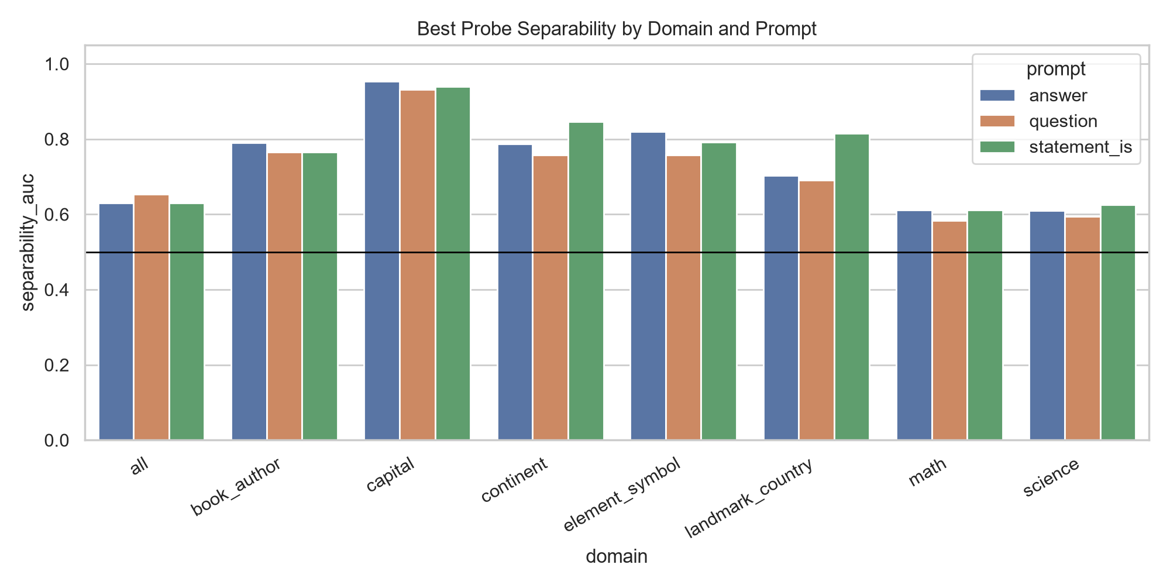
LOCATE
Truth signal is strongest in structured capital facts
Capital + answer prompt reaches AUC 0.953 at layer 8.
混合领域信号被任务差异稀释。
truth direction 更像领域相关结构。
后续主实验聚焦 capital。
Mechanistic Interpretability Project
04

Slide 5
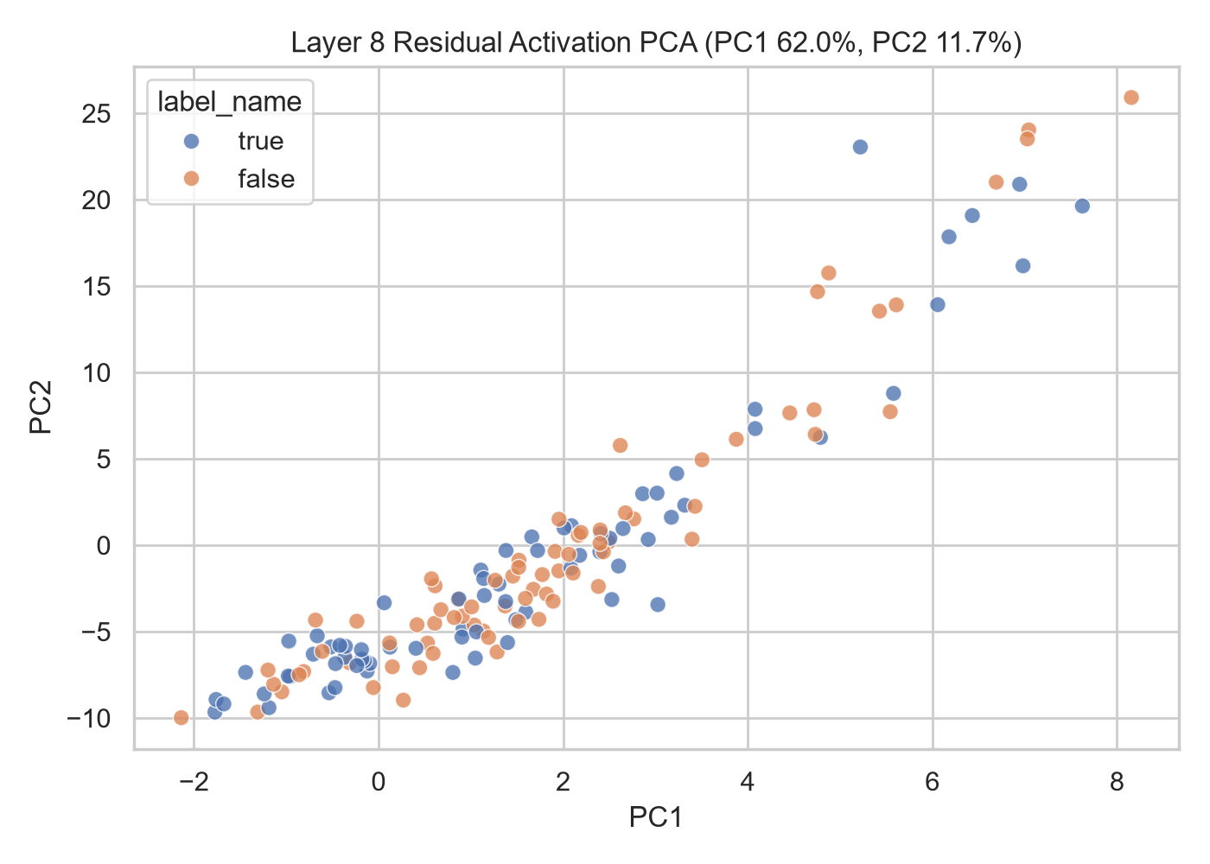
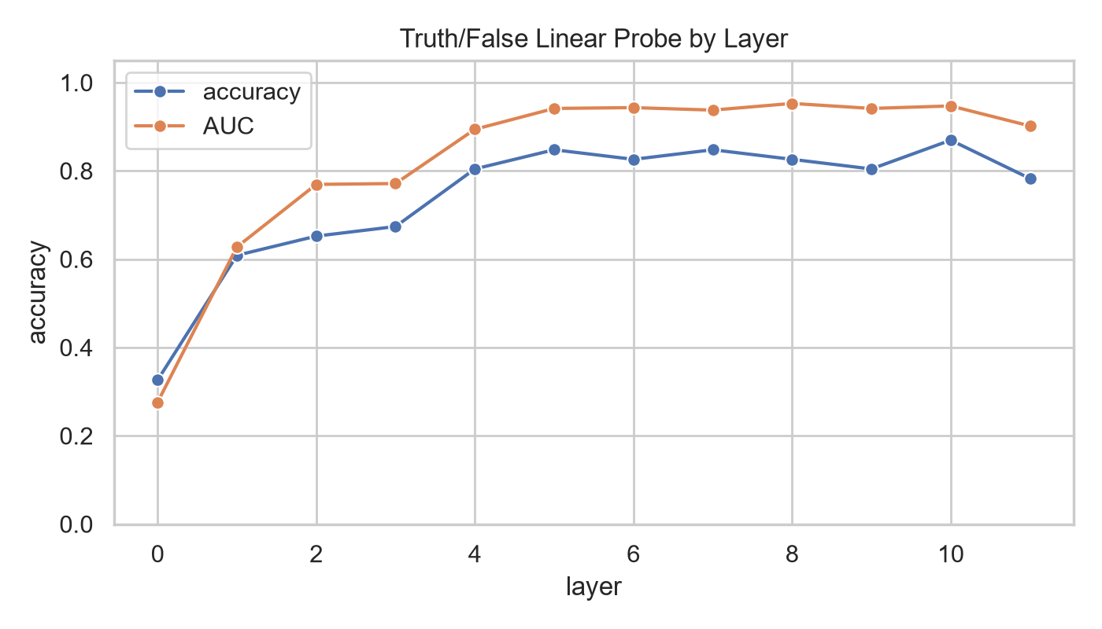
FOCUSED PROBE
High-dimensional probe succeeds where PCA does not fully separate
Best AUC: layer 8 = 0.953. Best accuracy: layer 10 = 0.870.
Mechanistic Interpretability Project
05

Slide 6
ERROR ANALYSIS
Errors show probe readability is not a perfect fact checker
46
38
8
test samples
correct
errors
Statement
Label
Pred.
AUC 高说明排序能力强；固定 0.5 阈值仍会产生偏置。
Laos is Vientiane
true
false
Canada is Amman
false
true
Chile is Santiago
true
false
India is New Delhi
true
false
Nigeria is Mexico City
false
true
Mechanistic Interpretability Project
06

Slide 7
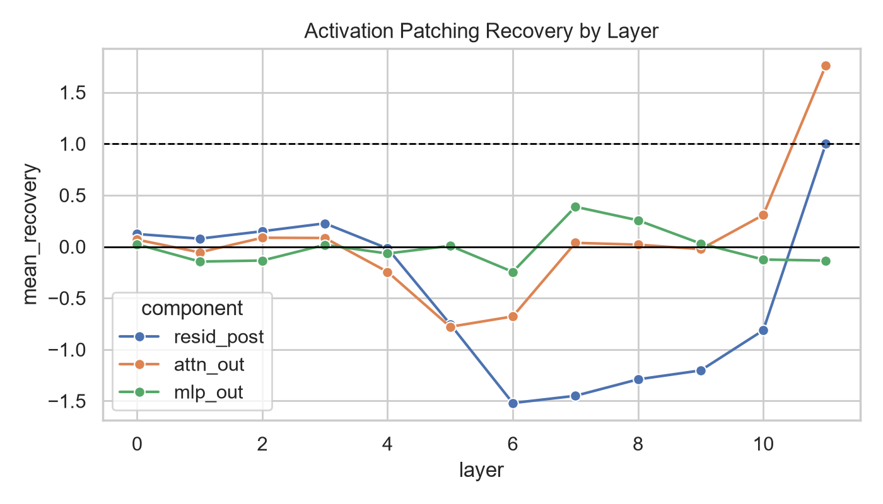
CAUSAL LOCATE
Activation patching gives causal evidence in capital recall
resid_post layer 11 recovery = 1.000
attn_out contributes strongly but is not sufficient alone
mlp_out patching is weaker
Mechanistic Interpretability Project
07

Slide 8
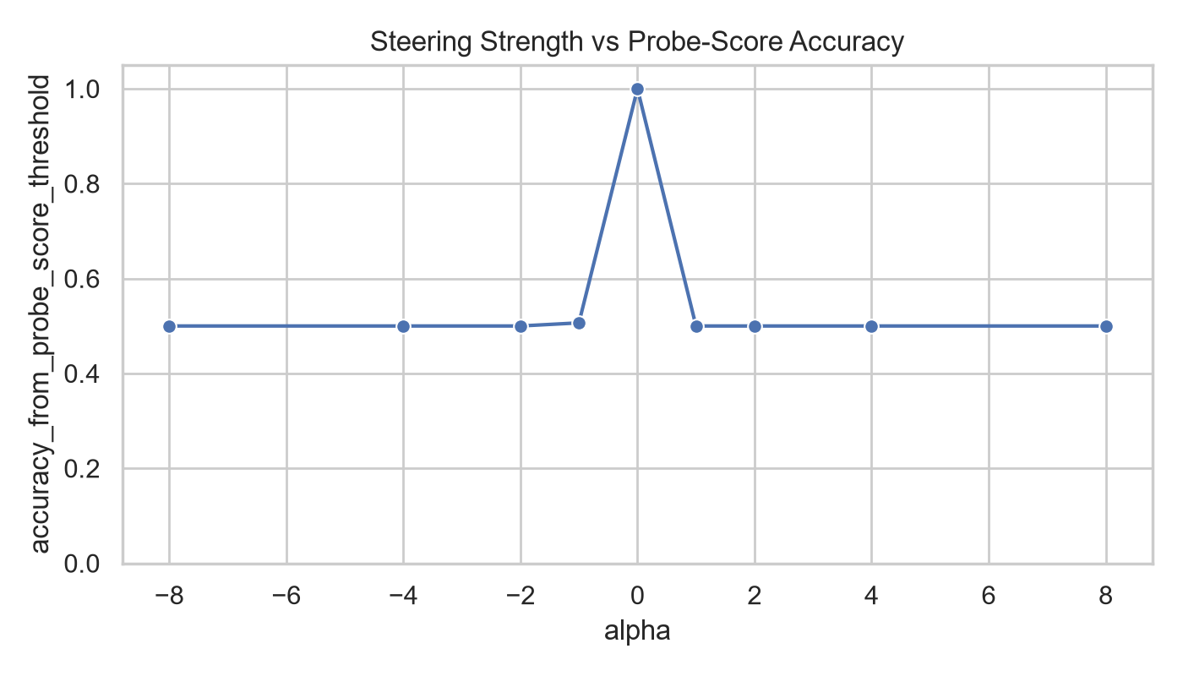
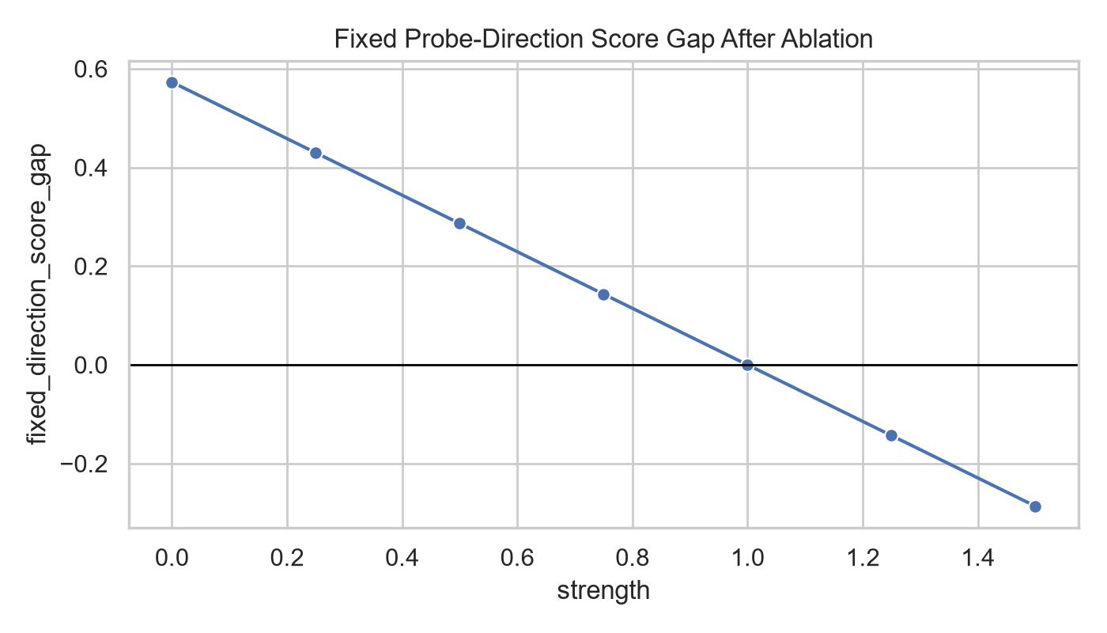
STEER & IMPROVE
Steering moves the internal score, ablation reveals redundancy
负结果也重要：global steering 未提升输出判断；单方向 ablation 后重新训练 probe 仍有高 AUC。
Mechanistic Interpretability Project
08

Slide 9
REPRODUCTION
This is a small-scale reproduction plus domain-stability analysis
Paper idea
Project evidence
True/false datasets
528 balanced factual statements
Linear truth representation
Layer-wise residual stream probe
Visualization
PCA activation scatter
Causal intervention
Patching, steering, ablation
Generalization question
Domain and prompt sweep
拓展点：报告不只展示成功，也明确保留跨领域弱泛化与 steering 负结果。
Mechanistic Interpretability Project
09

Slide 10
CONCLUSION
Takeaway: truth direction is useful, but not a universal button
Capital fact verification 中存在强线性 truth/false 表征。
后层 residual stream 对 capital recall 有清晰因果作用。
可读性不等于直接可控性；naive steering 不足以 improve 输出。
单一 direction 之外仍有冗余子空间，后续可做 head-level patching 与多方向 ablation。
最终观点：机制可解释性需要同时报告定位成功、因果证据、失败样本和负结果。
Mechanistic Interpretability Project
10

