Slide 1
Chapter 5
Relational Algebra and SQL

Slide 2
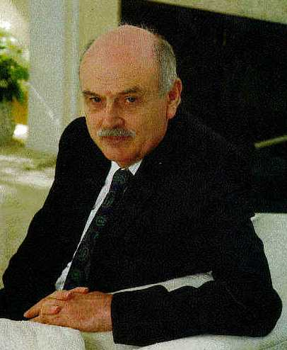
Father of Relational Model Edgar F. Codd (1923-2003)
PhD from U. of Michigan, Ann Arbor, Michigan
Received Turing Award in 1981.
More see http://en.wikipedia.org/wiki/Edgar_Codd

Slide 3
Relational Query Languages
Languages for describing queries on a relational database
Structured Query Language (SQL)
Predominant application-level query language
Declarative
Relational Algebra
Intermediate language used within DBMS
Procedural

Slide 4
What is an Algebra?
Operators: functions, whose functionalities are pre-defined.
Operands: a fixed set.
Domain: the set of values that operators take as inputs and outputs.
Example:
Operators: Add, Subtract, Multiply, and Divide
Domain: integer

Slide 5
Relational Algebra
Domain: set of relations
Basic operators: select, project, union, set difference, Cartesian product
Derived operators: set intersection, division, join
Procedural: Relational expression specifies query by describing an algorithm (the sequence in which operators are applied) for determining the result of an expression

Slide 6
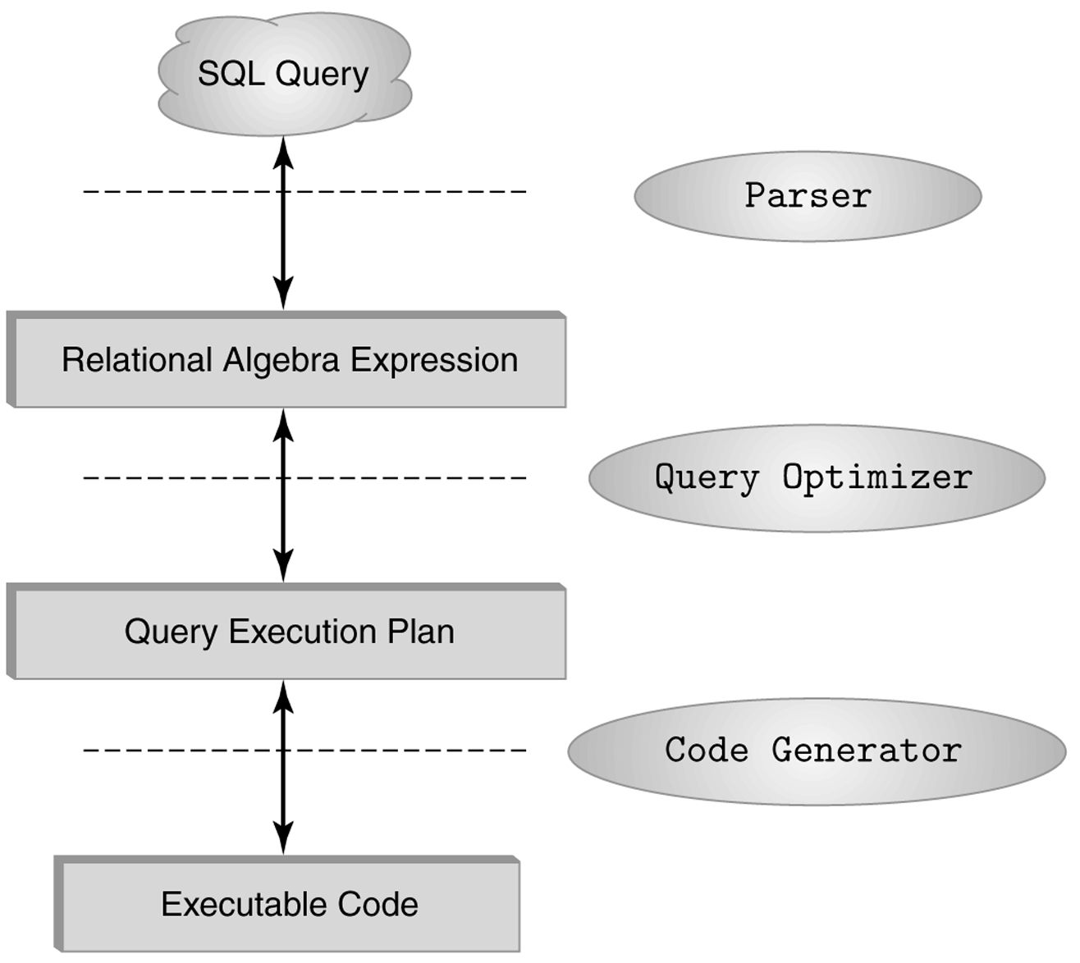
The Role of Relational Algebra in a DBMS

Slide 7
Select Operator
Produce table containing subset of rows of argument table satisfying condition
σ_{condition} (relation)
Example:
Person σ_{Hobby=‘stamps’}(Person)
Id Name Address Hobby
Id Name Address Hobby
1123 John 123 Main stamps
1123 John 123 Main coins
5556 Mary 7 Lake Dr hiking
9876 Bart 5 Pine St stamps
1123 John 123 Main stamps
9876 Bart 5 Pine St stamps

Slide 8
Selection Condition
Operators: <, ≤, ≥, >, =, ≠
Simple selection condition:
<attribute> operator <constant>
<attribute> operator <attribute>
<condition> AND <condition>
<condition> OR <condition>
NOT <condition>

Slide 9
Selection Condition - Examples
σ _{Id>3000 OR Hobby=‘hiking’} (Person)
σ _{Id>3000 AND Id <3999} (Person)
σ _{NOT(Hobby=‘hiking’)} (Person)
σ _{Hobby≠‘hiking’} (Person)

Slide 10
Project Operator
Produces table containing subset of columns of argument table
π_{attribute list}(relation)
Example:
Person π_{Name,Hobby}(Person)
Id Name Address Hobby Name Hobby
1123 John 123 Main stamps
1123 John 123 Main coins
5556 Mary 7 Lake Dr hiking
9876 Bart 5 Pine St stamps
John stamps
John coins
Mary hiking
Bart stamps

Slide 11
Project Operator
Example:
Person π_{Name,Address}(Person)
Id Name Address Hobby
Name Address
1123 John 123 Main stamps
1123 John 123 Main coins
5556 Mary 7 Lake Dr hiking
9876 Bart 5 Pine St stamps
John 123 Main
Mary 7 Lake Dr
Bart 5 Pine St
Result is a table (no duplicates); can have fewer tuples
than the original

Slide 12
Expressions
π _{Id, Name} (σ Hobby=’stamps’ OR Hobby=’coins’ (Person) )
Id Name Address Hobby Id Name
1123 John 123 Main stamps
1123 John 123 Main coins
5556 Mary 7 Lake Dr hiking
9876 Bart 5 Pine St stamps
1123 John
9876 Bart
Result
Person

Slide 13
Set Operators
Relation is a set of tuples, so set operations should apply: ∩, ∪, − (set difference)
Result of combining two relations with a set operator is a relation => all its elements must be tuples having same structure
Hence, scope of set operations limited to union compatible relations

Slide 14
Intersection ∩
R
S
π _{Name} (Administrator) ∩ π _{Name} (Professor)

Slide 15
Union ∪
R
S
π _{Name} (Administrator) ∪ π _{Name} (Professor)

Slide 16
Set Difference -
R
S
R
S
S - R
R - S
π _{Name} (Administrator) - π _{Name} (Professor)

Slide 17
Set Difference -
S
R
S
R – S = negation(S)
π _{Name} (Administrator) - π _{Name} (Professor)

Slide 18
Union Compatible Relations
Two relations are union compatible if
Both have same number of columns
Names of attributes are the same in both
Attributes with the same name in both relations have the same domain
Union compatible relations can be combined using union, intersection, and set difference

Slide 19
Example
Tables:
Person (SSN, Name, Address, Hobby)
Professor (Id, Name, Office, Phone)
are not union compatible.
But
π _{Name} (Person) and π _{Name} (Professor)
are union compatible so
π _{Name} (Person) - π _{Name} (Professor)
makes sense.

Slide 20
Cartesian Product
If R and S are two relations, R × S is the set of all concatenated tuples <x,y>, where x is a tuple in R and y is a tuple in S
R and S need not be union compatible.
But R and S must have distinct attribute names. Why?
R × S is expensive to compute. But why?
A B C D A B C D
x1 x2 y1 y2 x1 x2 y1 y2
x3 x4 y3 y4 x1 x2 y3 y4
x3 x4 y1 y2
R S x3 x4 y3 y4
R× S

Slide 21
Renaming
Result of expression evaluation is a relation
Attributes of relation must have distinct names. This is not guaranteed with Cartesian product
e.g., suppose in previous example A and C have the same name
Renaming operator tidies this up. To assign the names A₁, A₂,… A_{n} to the attributes of the n column relation produced by expression expr use expr [A₁, A₂, … A_{n}]

Slide 22
Example
Transcript (StudId, CrsCode, Semester, Grade)
Teaching (ProfId, CrsCode, Semester)
π _{StudId, CrsCode} (Transcript)[StudId, CrsCode1]
× π _{ProfId, CrsCode}(Teaching) [ProfId, CrsCode2]
This cross product results in a relation with 4 attributes:
StudId, CrsCode1, ProfId, CrsCode2

Slide 23
Derived Operation: Join
A (general or theta) join of R and S is the expression
R _{c} S
where join-condition c is a conjunction of terms:
A_{i} oper B_{i}
in which A_{i} is an attribute of R; B_{i} is an attribute of S; and oper is one of =, <, >, ≥ ≠, ≤.
Q: Any difference between join condition and selection condition?
The meaning is:
σ _{c} (R × S)
Where join-condition c becomes a select condition c
except for possible renamings of attributes (next)

Slide 24
Join and Renaming
Problem: R and S might have attributes with the same name – in which case the Cartesian product is not defined
Solutions:
Rename attributes prior to forming the product and use new names in join-condition´.
Qualify common attribute names with relation names (thereby disambiguating the names). For instance: Transcript.CrsCode or Teaching.CrsCode
This solution is nice, but doesn’t always work: consider
R _{join_condition} R
In R.A, how do we know which R is meant?

Slide 25
Theta Join – Example
Employee(Name,Id,MngrId,Salary)
Manager(Name,Id,Salary)
Output the names of all employees that earn
more than their managers.
π_{Employee.Name} (Employee MngrId=Id AND Employee.Salary> Manager.Salary Manager)
The join yields a table with attributes:
Employee.Name, Employee.Id, Employee.Salary, MngrId
Manager.Name, Manager.Id, Manager.Salary

Slide 26
Equijoin - Example
Equijoin: Join condition is a conjunction of equalities.
π_{Name,CrsCode}(Student
_{Id=StudId} σ_{Grade=‘A’} (Transcript))
Student
Transcript
Id Name Addr Status
111 John ….. …..
222 Mary ….. …..
333 Bill ….. …..
444 Joe ….. …..
StudId CrsCode Sem Grade
111 CSE305 S00 B
222 CSE306 S99 A
333 CSE304 F99 A
The equijoin is used very
frequently since it combines
related data in different relations.
Mary CSE306
Bill CSE304

Slide 27
Difference between Theta Join and Equijoin
A theta join allows for arbitrary comparison relationships (such as ≥).
An equijoin is a theta join that allows ONLY the equality operator.

Slide 28
Natural Join
Special case of equijoin:
join condition equates all and only those attributes with the same name (condition doesn’t have to be explicitly stated)
duplicate columns eliminated from the result
Transcript (StudId, CrsCode, Sem, Grade)
Teaching (ProfId, CrsCode, Sem)
Transcript
Teaching =
πStudId, Transcript.CrsCode, Transcript.Sem, Grade, ProfId
( Transcript
Transcipt.CrsCode=Teaching.CrsCode
AND Transcirpt.Sem=Teaching.Sem Teaching )
[StudId, CrsCode, Sem, Grade, ProfId ]
Q: but why natural join is a derived operator? Because…

Slide 29
Natural Join (cont’d)
More generally:
R
S = π_{attr-list} (σ_{join-cond} (R × S) )
where
attr-list = attributes (R) ∪ attributes (S)
(duplicates are eliminated) and join-cond has
the form:
R.A₁ = S.A₁ AND … AND R.A_{n} = S.A_{n}
where
{A₁ … A_{n}} = attributes(R) ∩ attributes(S)

Slide 30
Natural Join Example
List all Ids of students who took at least two different courses:
π_{StudId} ( σ_{CrsCode ≠ CrsCode2} (
Transcript
Transcript [StudId, CrsCode2, Sem2, Grade2] ))
We don’t want to join on CrsCode, Sem, and Grade attributes,
hence renaming!

Slide 31
StudId | CrsCode | Sem | Grade
0001 | csc4710 | f2001 | A
0002 | csc6710 | w2002 | B
0001 | csc4110 | w2002 | B
StudId | CrsCode | Sem | Grade
0001 | csc4710 | f2001 | A
0002 | csc6710 | w2002 | B
0001 | csc4110 | w2002 | B

Slide 32
Division
If A × B = C, then C/A = B and C/B = A
Goal: Produce the tuples in one relation, A, that match each tuple in another relation, B
C(A₁, …A_{n}, B₁, …B_{m})
B(B₁ …B_{m})
C/B, with attributes A₁, …A_{n}, is the set of all tuples <a> such that for every tuple <b> in B, <a,b> is in C (<a> has a match with each tuple in B>

Slide 33
Recap of arithmetic division
3 * 4 = 12
12/3 = 4
12/4 = 3
13/3 = 4 R 1
13/4 = 3 R 1

Slide 34
Recap of Cartesian Product
A
B
A1 | A2
X1 | X2
X3 | X4
B1 | B2
Y1 | Y2
Y3 | Y4
C
A1 | A2 | B1 | B2
X1 | X2 | Y1 | Y2
X1 | X2 | Y3 | Y4
X3 | X4 | Y1 | Y2
X3 | X4 | Y3 | Y4

Slide 35
Division (con’t)
If A × B = C, then C/A = B and C/B = A
Challenge: C’ = C ∪ R, R is some remainder tuples, then C’/A = B, C’/B = A
How can I tell what tuples in C’ are cross product result (red) or remainder tuples?

Slide 36
A
B
A1 | A2
X1 | X2
X3 | X4
B1 | B2
Y1 | Y2
Y3 | Y4
C’
A1 | A2 | B1 | B2
X1 | X2 | Y1 | Y2
X1 | X2 | Y3 | Y4
X1 | X2 | Y5 | Y6
X3 | X4 | Y7 | Y8
X3 | X4 | Y1 | Y2
X3 | X4 | Y3 | Y4

Slide 37
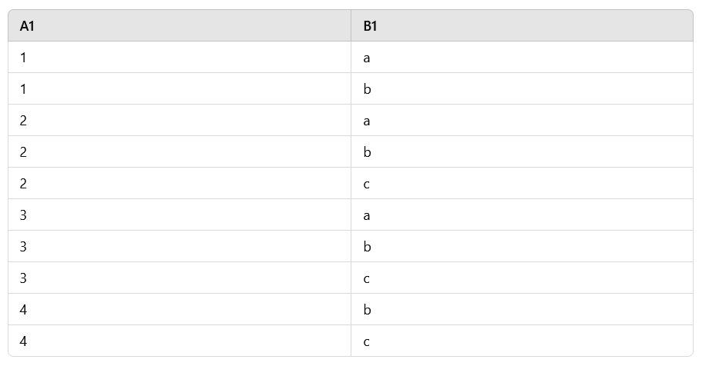

Slide 38
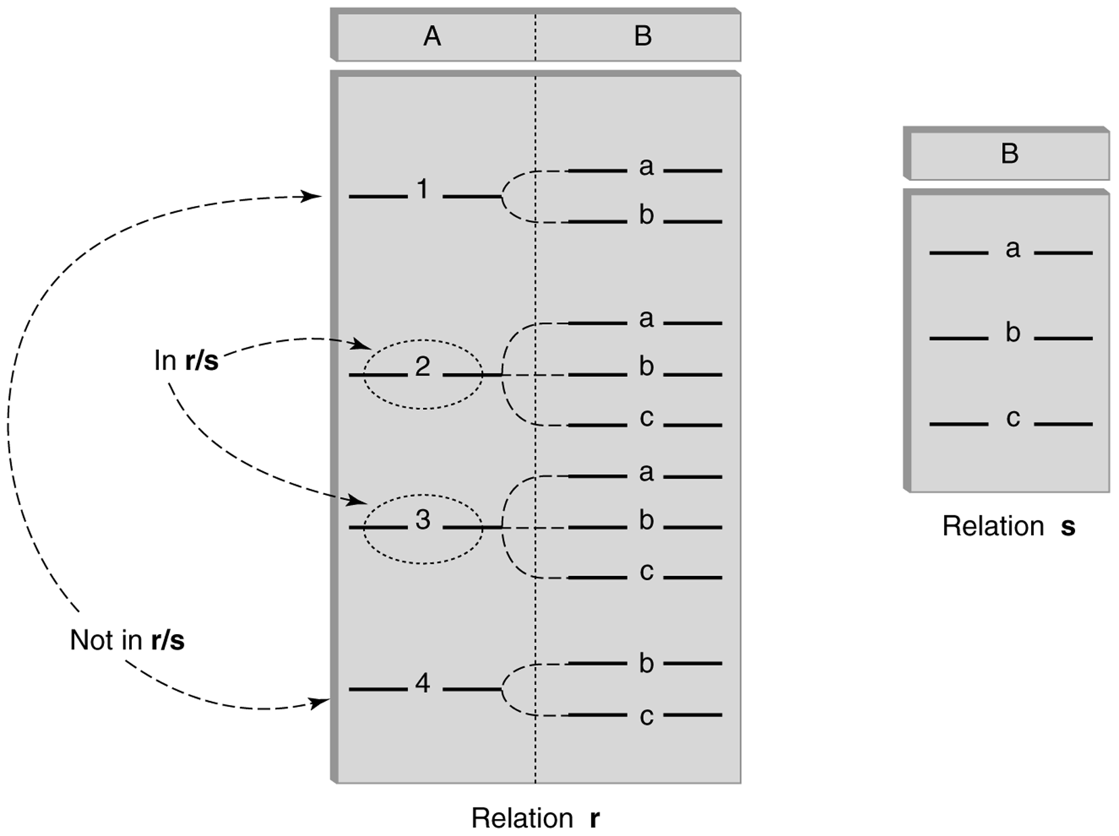
Division (cont’d)
A1
B1
B1
C/B
B
C/B
A1
2
3
C’

Slide 39
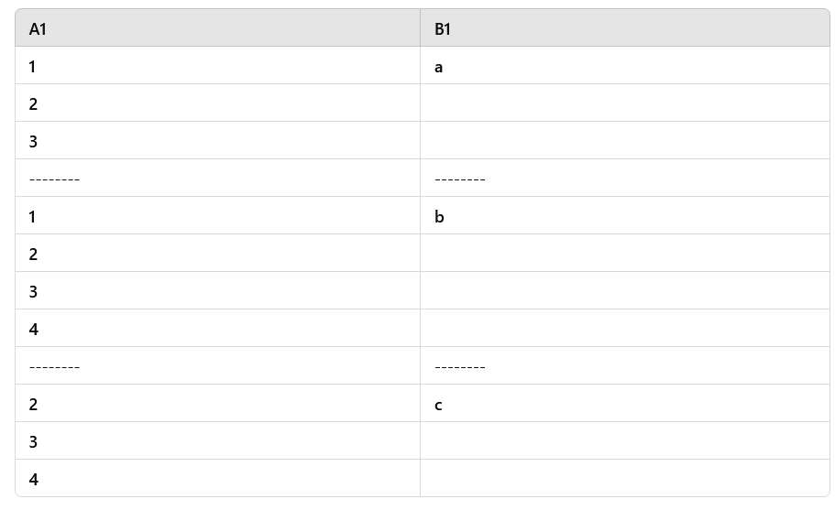

Slide 40
Division – Example 1
List the Ids of students who have passed all courses that were taught in spring 2000
Numerator:
StudId and CrsCode for every course passed by every student:
π_{StudId, CrsCode} (σ_{Grade≠ ‘F’} (Transcript) )
Denominator:
CrsCode of all courses taught in spring 2000
π_{CrsCode} (σ_{Semester=‘S2000’} (Teaching) )
Result is numerator/denominator
Give me something that is linked to each denominator
Id
Professor

Slide 41
facid | deptid
111 | aaa
111 | bbb
222 | bbb
333 | aaa
333 | bbb
facid | name | age
111 | john | 23
222 | kathy | 20
333 | frank | 22
deptid | name
aaa | CS
bbb | CHE
Professor
Department
WorksIn
For each department
1) WorksIn/π_{deptid}(Department)
Facid
111
333

Slide 42
facid | deptid
111 | aaa
111 | bbb
222 | bbb
333 | aaa
333 | bbb
facid | name | age
111 | john | 23
222 | kathy | 20
333 | frank | 22
deptid | name
aaa | CS
bbb | CHE
Professor
Department
WorksIn
For every professor
2) WorksIn/π_{facid}(Professor)
deptid
bbb

Slide 43
Schema for Student Registration System
Learning SQL by Patterns
Student (Id, Name, Addr, Status)
Professor (Id, Name, DeptId)
Course (DeptId, CrsCode, CrsName, Descr)
Transcript (StudId, CrsCode, Semester, Grade)
Teaching (ProfId, CrsCode, Semester)
Department (DeptId, Name)

Slide 44
Query Sublanguage of SQL
SELECT C.CrsName
FROM Course C
WHERE C.DeptId = ‘CS’
Tuple variable C ranges over rows of Course.
Evaluation strategy:
FROM clause produces Cartesian product of listed tables
WHERE clause assigns rows to C in sequence and produces table containing only rows satisfying condition
SELECT clause retains listed columns
Equivalent to: π_{CrsName}σ_{DeptId=‘CS’}(Course)

Slide 45
Join Queries
SELECT C.CrsName
FROM Course C, Teaching T
WHERE C.CrsCode=T.CrsCode AND T.Semester=‘S2000’
List CS courses taught in S2000
Tuple variables clarify meaning.
Join condition “C.CrsCode=T.CrsCode”
relates facts to each other
Selection condition “ T.Semester=‘S2000’ ”
eliminates irrelevant rows
Equivalent (using natural join) to:
π_{CrsName}(Course
σ_{Semester=‘S2000’} (Teaching) )
π_{CrsName} (σ_{Sem=‘S2000’} (Course Teaching) )

Slide 46
Correspondence Between SQL and Relational Algebra
SELECT C.CrsName
FROM Course C, Teaching T
WHERE C.CrsCode = T.CrsCode AND T.Semester = ‘S2000’
Also equivalent to:
π_{CrsName} σC_CrsCode=T_CrsCode AND Semester=‘S2000’
(Course [C_CrsCode, DeptId, CrsName, Desc]
× Teaching [ProfId, T_CrsCode, Semester])
This is the simplest evaluation algorithm for SELECT.
Relational algebra expressions are procedural.
Which of the two equivalent expressions is more easily evaluated?

Slide 47
Self-join Queries
Find Ids of all professors who taught at least two courses in the same semester:
SELECT T1.ProfId
FROM Teaching T1, Teaching T2
WHERE T1.ProfId = T2.ProfId
AND T1.Semester = T2.Semester
AND T1.CrsCode <> T2.CrsCode
Tuple variables are essential in this query!
Equivalent to:
π_{ProfId} (σ_{T1.CrsCode≠T2.CrsCode}(Teaching[ProfId, T1.CrsCode, Semester]
Teaching[ProfId, T2.CrsCode, Semester]))

Slide 48
Duplicates
Duplicate rows not allowed in a relation
However, duplicate elimination from query result is costly and not done by default; must be explicitly requested:
SELECT DISTINCT …..
FROM …..

Slide 49
Use of Expressions
Equality and comparison operators apply to strings (based on lexical ordering)
WHERE S.Name < ‘P’
Concatenate operator applies to strings
WHERE S.Name || ‘--’ || S.Address = ….
Expressions can also be used in SELECT clause:
SELECT S.Name || ‘--’ || S.Address AS NmAdd
FROM Student S

Slide 50
Set Operators
SQL provides UNION, EXCEPT (set difference), and INTERSECT for union compatible tables
Example: Find all professors in the CS Department and all professors that have taught CS courses
(SELECT P.Name
FROM Professor P, Teaching T
WHERE P.Id=T.ProfId AND T.CrsCode LIKE ‘CS%’)
UNION
(SELECT P.Name
FROM Professor P
WHERE P.DeptId = ‘CS’)

Slide 51
Nested Queries
List all courses that were not taught in S2000
SELECT C.CrsName
FROM Course C
WHERE C.CrsCode NOT IN
(SELECT T.CrsCode --subquery
FROM Teaching T
WHERE T.Sem = ‘S2000’)
Evaluation strategy: subquery evaluated once to
produces set of courses taught in S2000. Each row
(as C) tested against this set.

Slide 52
Correlated Nested Queries
Output a row <prof, dept> if prof has taught a course
in dept.
SELECT P.Name, D.Name --outer query
FROM Professor P, Department D
WHERE P.Id IN
-- set of all ProfId’s who have taught a course in D.DeptId
(SELECT T.ProfId --subquery
FROM Teaching T, Course C
WHERE T.CrsCode=C.CrsCode AND
C.DeptId=D.DeptId --correlation
)

Slide 53
Correlated Nested Queries
Output a row <prof, dept> if prof has taught a course
in dept.
SELECT P.Name, D.Name --outer query
FROM each <P, D> pair
WHERE P.Id IN
(the list of professor Ids that taught a course in
D.deptId)
Tip: Consider P and D as two fixed tuples in the subquery.

Slide 54
Correlated Nested Queries (con’t)
Tuple variables T and C are local to subquery
Tuple variables P and D are global to subquery
Correlation: subquery uses a global variable, D
The value of D.DeptId parameterizes an evaluation of the subquery
Subquery must (at least) be re-evaluated for each distinct value of D.DeptId
Correlated queries can be expensive to evaluate

Slide 55
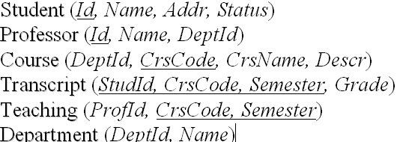
Division in SQL
Query type: Find the subset of items in one set that are related to all items in another set
Example: Find professors who taught courses in all departments
Why does this involve division?
ProfId DeptId
DeptId
Contains row
<p,d> if professor
p taught a
course in
department d
All department Ids
π_{ProfId,DeptId}(Teaching Course) / π_{DeptId}(Department)

Slide 56
Division in SQL
Strategy for implementing division in SQL:
Find set, A, of all departments in which a particular professor, p, has taught a course
Find set, B, of all departments
Output p if A ⊇ B, or, equivalently, if B–A is empty
But how to do this exactly in SQL?

Slide 57
Division Solution Sketch (1)
SELECT P.Id
FROM Professor P
WHERE P taught courses in every department
SELECT P.Id
FROM Professor P
WHERE there does not exist any department that P has never taught a course
SELECT P.Id
FROM Professor P
WHERE NOT EXISTS(a department that P has never taught a course)

Slide 58
Division Solution Sketch (1)
SELECT P.Id
FROM Professor P
WHERE NOT EXISTS(the departments that P has never taught a course)
SELECT P.Id
FROM Professor P
WHERE NOT EXISTS(
B: All departments
EXCEPT
A: the departments that P has ever taught a course)
But how do we formulate A and B?

Slide 59
facid | name | age
111 | john | 23
222 | kathy | 20
333 | frank | 22
facid | deptid
111 | aaa
111 | bbb
222 | bbb
333 | aaa
333 | bbb
P
B: All dept IDs
A: Those dept IDs that P works
deptid | name
aaa | CS
bbb | CHE
If B-A= Empty

Slide 60
Division – SQL Solution in details
SELECT P.Id
FROM Professor P
WHERE NOT EXISTS
(SELECT D.DeptId // all dept Ids
FROM Department D
EXCEPT
SELECT C.DeptId // dept Ids that P teaches a course
FROM Teaching T, Course C
WHERE T.ProfId = P.Id
AND T.CrsCode=C.CrsCode)
Tip: consider P as a fixed tuple in the subquery.

Slide 61
Division – SQL Solution in details
1. For each Professor P, calculate B - A
(SELECT D.DeptId // all dept Ids
FROM Department D
EXCEPT
SELECT C.DeptId // dept Ids that P teaches a course
FROM Teaching T, Course C
WHERE T.ProfId = P.Id
AND T.CrsCode=C.CrsCode)
2. If the result is empty, then P will be in the answer.

Slide 62
Aggregates
Functions that operate on sets:
COUNT, SUM, AVG, MAX, MIN
Produce numbers (not tables)
Aggregates over multiple rows into one row
Not part of relational algebra (but not hard to add)
SELECT COUNT(*)
FROM Professor P
SELECT MAX (Salary)
FROM Employee E

Slide 63
Aggregates (cont’d)
Count the number of courses taught in S2000
SELECT COUNT (T.CrsCode)
FROM Teaching T
WHERE T.Semester = ‘S2000’
But if multiple sections of same course
are taught, use:
SELECT COUNT (DISTINCT T.CrsCode)
FROM Teaching T
WHERE T.Semester = ‘S2000’

Slide 64
Grouping
But how do we compute the number of courses taught in S2000 per professor?
Strategy 1: Fire off a separate query for each professor:
SELECT COUNT(T.CrsCode)
FROM Teaching T
WHERE T.Semester = ‘S2000’ AND T.ProfId = 123456789
Cumbersome
What if the number of professors changes? Add another query?
Strategy 2: define a special grouping operator:
SELECT T.ProfId, COUNT(T.CrsCode)
FROM Teaching T
WHERE T.Semester = ‘S2000’
GROUP BY T.ProfId
Grou ID is unique in a group!

Slide 65
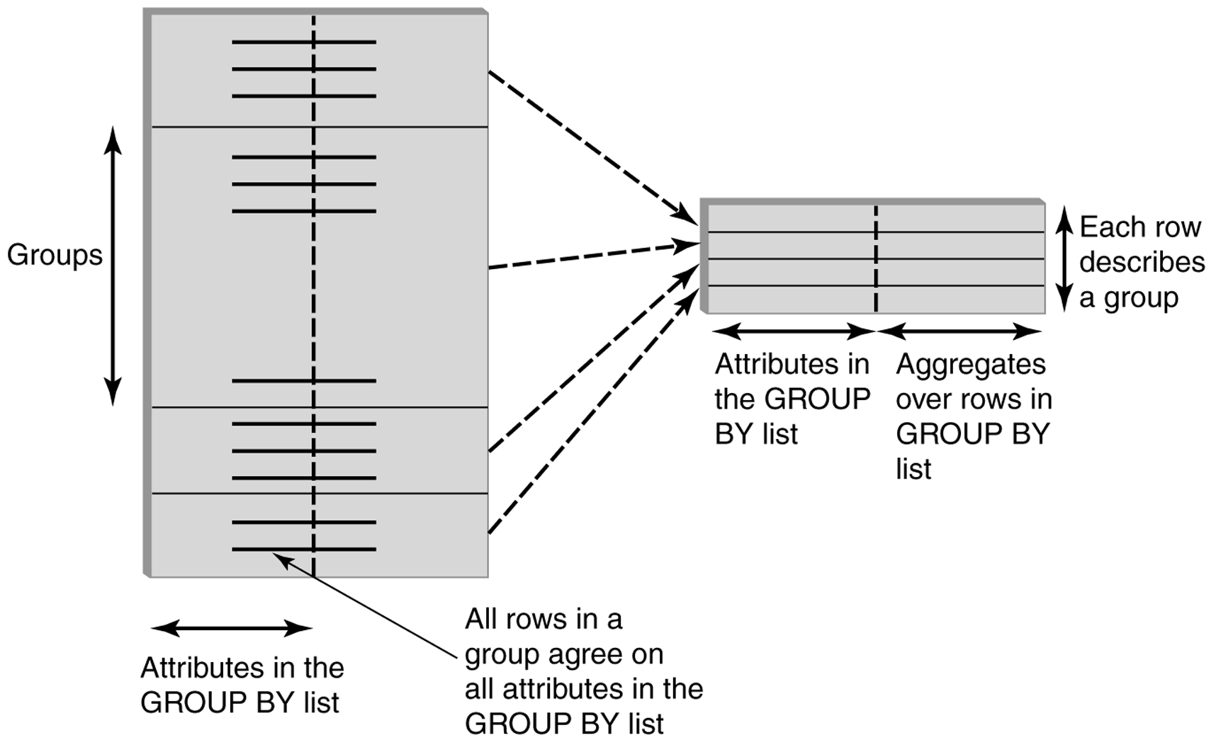
GROUP BY
Groupid attributes
Other attributes
Values are the same for all rows in same group
Values might be different for rows in the same group, need aggregation!

Slide 66
GROUP BY - Example
Transcript
1234
1234
1234
1234
3.0
3.6
3.1
3.5
1234 3.3 4
SELECT T.StudId, AVG(T.Grade), COUNT (*)
FROM Transcript T
GROUP BY T.StudId
Each group is aggregated into one row.

Slide 67
Each group is aggregated into one row
Transcript
1234
1234
1234
1234
3.0
3.6
3.1
3.5
1234 3.3 4
1. 1234 is selected as column 1.
2. AVG(grade) as column 2.
3. count(*) as column 3.

Slide 68
The Groupby rule
SELECT groupid attributes, or aggregations on other attributes
Group BY
Groupid attributes have the same value in on group.
Other attributes might not have the same value in one group, therefore, they need aggregation.

Slide 69
HAVING Clause
Eliminates unwanted groups (analogous to WHERE clause, but works on groups instead of individual tuples)
HAVING condition is constructed from attributes of GROUP BY list and aggregates on attributes not in that list
SELECT T.StudId,
AVG(T.Grade) AS CumGpa,
COUNT (*) AS NumCrs
FROM Transcript T
WHERE T.CrsCode LIKE ‘CS%’
GROUP BY T.StudId
HAVING AVG (T.Grade) > 3.5
Apply to each group not to the whole table

Slide 70
Where condition and Having conditions
WHERE condition: filter rows, compares individual row attributes to constants or to other attributes
HAVING condition: filter groups, compares groupid attributes or aggregations to constants.

Slide 71
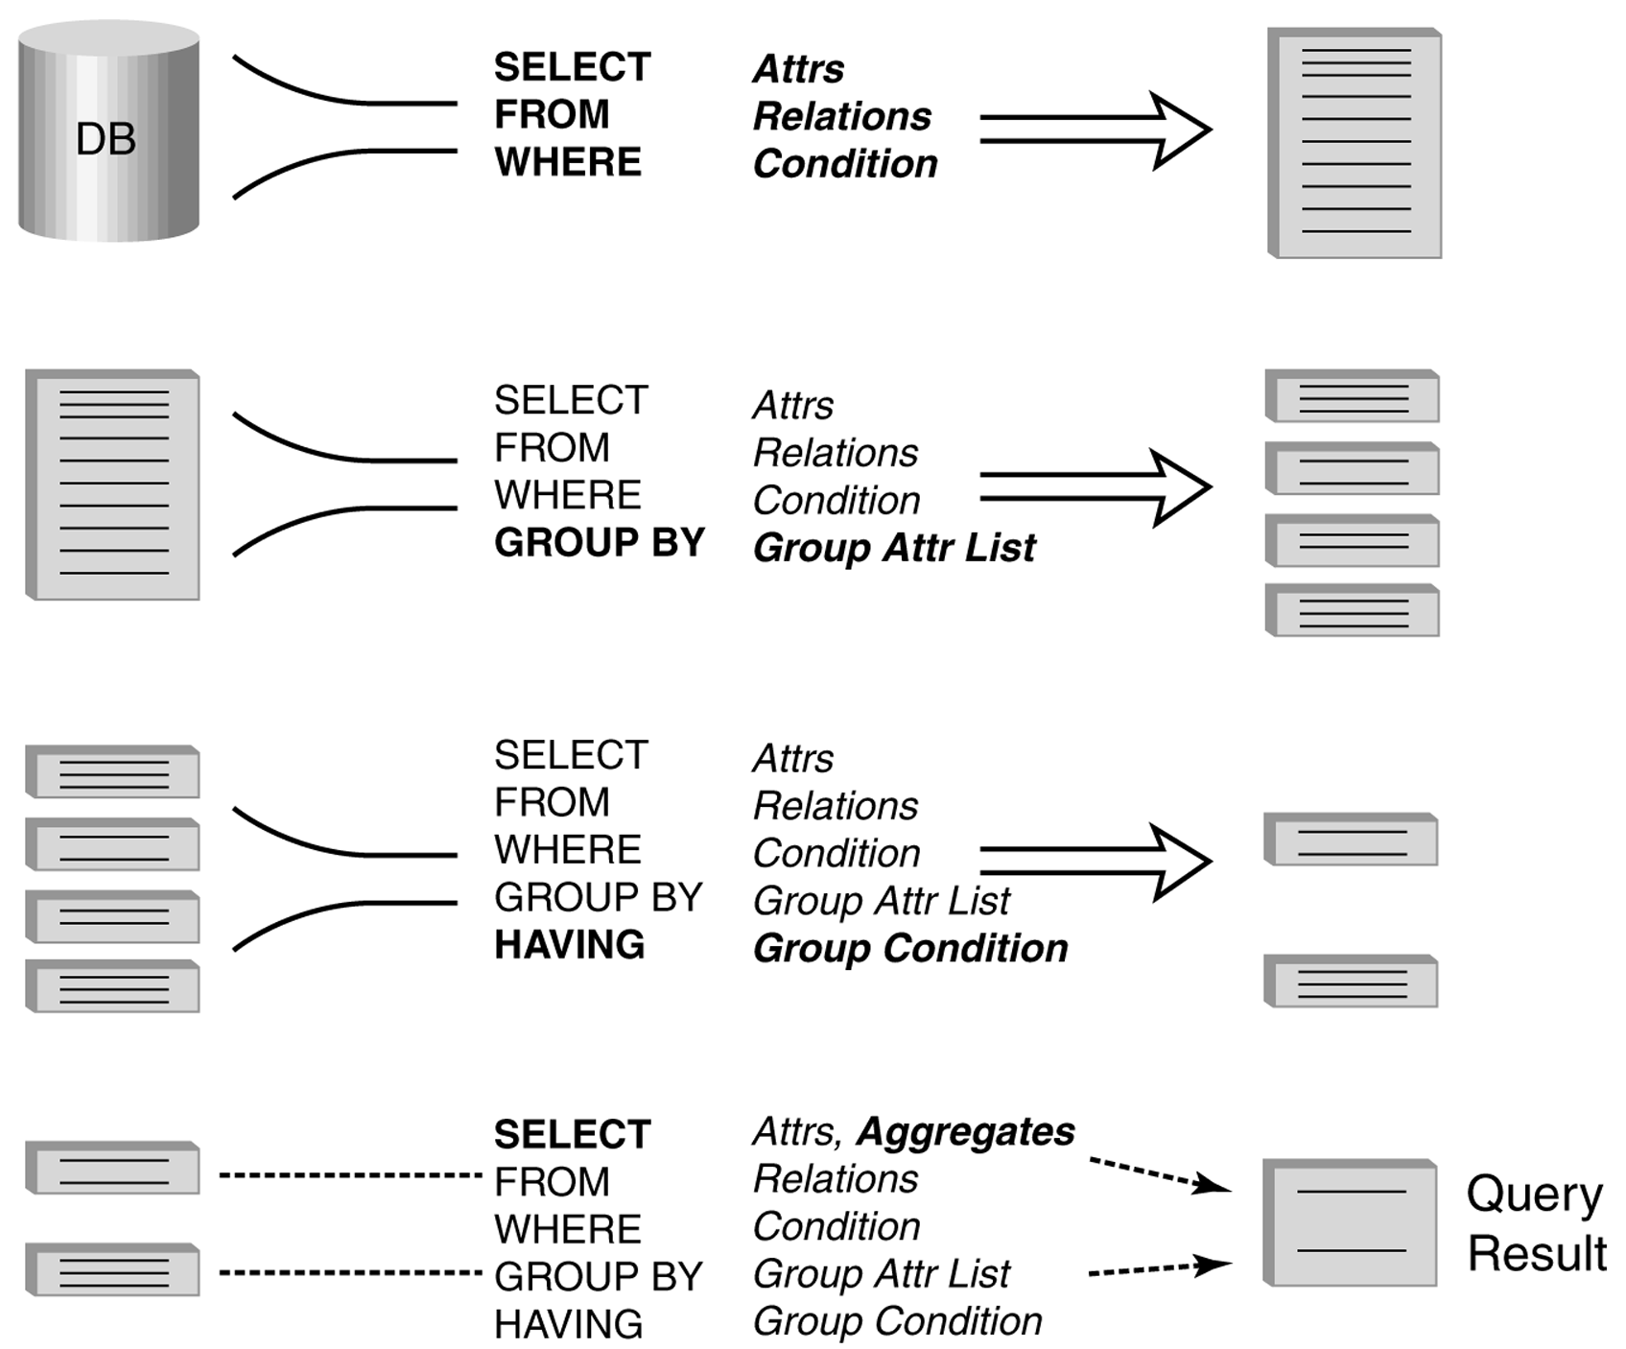
Evaluation of GroupBy with Having

Slide 72
Example
Output the name and address of all seniors on the Dean’s List
SELECT S.Id, S.Name
FROM Student S, Transcript T
WHERE S.Id = T.StudId AND S.Status = ‘senior’
GROUP BY
HAVING AVG (T.Grade) > 3.5 AND SUM (T.Credit) > 90
S.Id -- wrong
S.Id, S.Name -- right
Every attribute that occurs in SELECT clause must also occur in GROUP BY or it must be an aggregate. S.Name does not.
S.Name needs to be part of a groupid attribute to be selected!

Slide 73
Aggregates: Proper and Improper Usage
SELECT COUNT (T.CrsCode), T. ProfId
– makes no sense (in the absence of
GROUP BY clause)
SELECT COUNT (*), AVG (T.Grade)
– but this is OK
WHERE T.Grade > COUNT (SELECT ….)
– aggregate cannot be applied to result
of SELECT statement

Slide 74
Common Mistake
SELECT …
FROM Course
WHERE COUNT (crscode) > 5
No aggregation allowed in the WHERE clause unless the aggregation is inside another nested SELECT statement.
WHERE for selecting rows, nothing to aggregate in one row

Slide 75
ORDER BY Clause
Causes rows to be output in a specified order
SELECT T.StudId, COUNT (*) AS NumCrs,
AVG(T.Grade) AS CumGpa
FROM Transcript T
WHERE T.CrsCode LIKE ‘CS%’
GROUP BY T.StudId
HAVING AVG (T.Grade) > 3.5
ORDER BY DESC CumGpa, ASC StudId
Descending
Ascending

Slide 76
Query Evaluation with GROUP BY, HAVING, ORDER BY
Evaluate FROM: produces Cartesian product, A, of tables in FROM list
Evaluate WHERE: produces table, B, consisting of rows of A that satisfy WHERE condition
Evaluate GROUP BY: partitions B into groups that agree on attribute values in GROUP BY list
Evaluate HAVING: eliminates groups in B that do not satisfy HAVING condition
Evaluate SELECT: produces table C containing a row for each group. Attributes in SELECT list limited to those in GROUP BY list and aggregates over group
Evaluate ORDER BY: orders rows of C
A s b e f o r e

Slide 77
Views
Used as a relation, but rows are not physically stored.
The contents of a view is computed when it is used within an SQL statement
Each time it is used (thus computed), the content might different as underlying base tables might have changed
View is the result of a SELECT statement over other views and base relations
When used in an SQL statement, the view definition is substituted for the view name in the statement
As SELECT statement nested in FROM clause

Slide 78
View – Example 1
CREATE VIEW CumGpa (StudId, Cum) AS
SELECT T.StudId, AVG (T.Grade)
FROM Transcript T
GROUP BY T.StudId
SELECT S.Name, C.Cum
FROM CumGpa C, Student S
WHERE C.StudId = S.StudId AND C.Cum > 3.5

Slide 79
Floor 3
GoodCumGpa
NameCumGpa
Floor 2
CumGpa
CsReg
ProfDept
Floor 1
Transcript
Student
Professor
Department

Slide 80
View - Example 2
Create a view GreatCumGpa for those students whose GPA is better than average.
CREATE VIEW GoodCumGpa (StudId, Cum) AS
SELECT *
FROM CumGpa C
WHERE c.cum > ( SELECT AVG(Cum)
CumGpa
)
ORDER BY Cum

Slide 81
View – Example 3
CREATE VIEW NameCumGpa (Name, Cum) AS
SELECT S.Name, C.Cum
FROM CumGpa C, Student S
WHERE C.StudId = S.StudId AND C.Cum > 3.5
SELECT * FROM NameCumGpa;

Slide 82
View – Example 4
CREATE VIEW CsReg (StudId, CrsCode, Semester) AS
SELECT T.StudId, T. CrsCode, T.Semester
FROM Transcript T
WHERE T.CrsCode LIKE ‘CS%’ AND T.Semester=‘S2000’
SELECT * FROM CsReg;

Slide 83
View – Example 5
CREATE VIEW ProfDept (PrName, DeName) AS
SELECT P.Name, D.Name
FROM Professor P, Department D
WHERE P.DeptId = D.DeptId
SELECT * FROM ProfDept

Slide 84
View - Substitution
When used in an SQL statement, the view definition is substituted for the view name in the statement. As SELECT statement nested in FROM clause
SELECT S.Name, C.Cum
FROM (SELECT T.StudId, AVG (T.Grade)
FROM Transcript T
GROUP BY T.StudId) C, Student S
WHERE C.StudId = S.StudId AND C.Cum > 3.5
84
Notes:
84

Slide 85
View Benefits
Access Control: Users not granted access to base tables. Instead they are granted access to the view of the database appropriate to their needs.
External schema is composed of views.
View allows owner to provide SELECT access to a subset of columns (analogous to providing UPDATE and INSERT access to a subset of columns)

Slide 86
Views – Limiting Visibility
Grade projected out
CREATE VIEW PartOfTranscript (StudId, CrsCode, Semester) AS
SELECT T. StudId, T.CrsCode, T.Semester -- limit columns
FROM Transcript T
WHERE T.Semester = ‘S2000’ -- limit rows
Give permissions to access data through view:
GRANT SELECT ON PartOfTranscript TO joe
This would have been analogous to:
GRANT SELECT (StudId,CrsCode,Semester)
ON Transcript TO joe
on regular tables, if SQL allowed attribute lists in GRANT SELECT

Slide 87
View Benefits (cont’d)
Customization: Users need not see full complexity of database. View creates the illusion of a simpler database customized to the needs of a particular category of users
A view is similar in many ways to a subroutine in standard programming
Can be reused in multiple queries

Slide 88
Nulls
Conditions: x op y (where op is <, >, <>, =, etc.) has value unknown (U) when either x or y is null
WHERE T.cost > T.price
Arithmetic expression: x op y (where op is +, –, *, etc.) has value NULL if x or y is NULL
WHERE (T. price/T.cost) > 2
Aggregates: COUNT counts NULLs like any other value; other aggregates ignore NULLs
SELECT COUNT (T.CrsCode), AVG (T.Grade)
FROM Transcript T
WHERE T.StudId = ‘1234’

Slide 89
Nulls (cont’d)
WHERE clause uses a three-valued logic – T, F, U(ndefined) – to filter rows. Portion of truth table:
Rows are discarded if WHERE condition is F(alse) or U(nknown)
WHERE NOT(T.CrsCode = ‘CS305’) AND T.Grade > 2.5
Student: 1111, NULL, 3.3
C1 C2 C1 AND C2 C1 OR C2
T U U T
F U F U
U U U U

Slide 90
The complete truth table
C1 | C2 | C1 AND C2 | C1 OR C2 | NOT C1
F | F | F | F | T
F | T | F | T | T
T | F | F | T | F
T | T | T | T | F
T | U | U | T | F
U | T | U | T | U
F | U | F | U | T
U | F | F | U | U
U | U | U | U | U

Slide 91
Modifying Tables – Insert
Inserting a single row into a table
Attribute list can be omitted if it is the same as in CREATE TABLE (but do not omit it)
NULL and DEFAULT values can be specified
INSERT INTO Transcript(StudId, CrsCode, Semester, Grade)
VALUES (12345, ‘CSE305’, ‘S2000’, NULL)

Slide 92
Bulk Insertion
Insert the rows output by a SELECT
CREATE TABLE DeansList (
StudId INTEGER,
Credits INTEGER,
CumGpa FLOAT,
PRIMARY KEY StudId )
INSERT INTO DeansList (StudId, Credits, CumGpa)
SELECT T.StudId, 3 * COUNT (*), AVG(T.Grade)
FROM Transcript T
GROUP BY T.StudId
HAVING AVG (T.Grade) > 3.5 AND COUNT(*) > 30

Slide 93
Modifying Tables – Delete
Similar to SELECT except:
No project list in DELETE clause
No Cartesian product in FROM clause (only 1 table name)
Rows satisfying WHERE clause (general form, including subqueries, allowed) are deleted instead of output
DELETE FROM Transcript T
WHERE T.Grade IS NULL AND T.Semester <> ‘S2000’

Slide 94
Modifying Data - Update
UPDATE Employee E
SET E.Salary = E.Salary * 1.05
WHERE E.Department = ‘R&D’
Updates rows in a single table
All rows satisfying WHERE clause (general form, including subqueries, allowed) are updated

Slide 95
Updating Views
Question: Since views look like tables to users, can they be updated?
Answer: Yes – a view update changes the underlying base table to produce the requested change to the view
CREATE VIEW CsReg (StudId, CrsCode, Semester) AS
SELECT T.StudId, T. CrsCode, T.Semester
FROM Transcript T
WHERE T.CrsCode LIKE ‘CS%’ AND T.Semester=‘S2000’

Slide 96
Updating Views - Problem 1
INSERT INTO CsReg (StudId, CrsCode, Semester)
VALUES (1111, ‘CSE305’, ‘S2000’)
Tuple is in the VIEW
Question: What value should be placed in attributes of underlying table that have been projected out (e.g., Grade)?
Answer: NULL (assuming null allowed in the missing attribute) or DEFAULT

Slide 97
Updating Views - Problem 2
INSERT INTO CsReg (StudId, CrsCode, Semester)
VALUES (1111, ‘ECO105’, ‘S2000’)
Problem: New tuple not in view
Solution: Allow insertion (assuming the WITH CHECK OPTION clause has not been appended to the CREATE VIEW statement)

Slide 98
Updating Views - Problem 3
Update to a view might not uniquely specify the change to the base table(s) that results in the desired modification of the view (ambiguity)
CREATE VIEW ProfDept (PrName, DeName) AS
SELECT P.Name, D.Name
FROM Professor P, Department D
WHERE P.DeptId = D.DeptId

Slide 99
Updating Views - Problem 3 (cont’d)
Tuple <Smith, CS> can be deleted from ProfDept by:
Deleting row for Smith from Professor (but this is inappropriate if he is still at the University)
Deleting row for CS from Department (not what is intended)
Updating row for Smith in Professor by setting DeptId to null (seems like a good idea, but how would the computer know?)

Slide 100
Updating Views – Restrictions
Updatable views are restricted to those in which
No Cartesian product in FROM clause, single table
no aggregates, GROUP BY, HAVING
…
For example, if we allowed:
CREATE VIEW AvgSalary (DeptId, Avg_Sal ) AS
SELECT E.DeptId, AVG(E.Salary)
FROM Employee E
GROUP BY E.DeptId
then how do we handle:
UPDATE AvgSalary
SET Avg_Sal = 1.1 * Avg_Sal

Slide 101
Relational Algebra and SQL Exercises
Professor(ssn, profname, status)
Course(crscode, crsname, credits)
Taught(crscode, semester, ssn)
https://www.programiz.com/sql/online-compiler/

Slide 102
Relational Algebra and SQL Exercises
CREATE TABLE professor(
ssn INTEGER,
profname VARCHAR(50),
status VARCHAR(10),
PRIMARY KEY(ssn)
);

Slide 103
Relational Algebra and SQL Exercises
CREATE TABLE course(
crscode CHAR(7),
crsname VARCHAR(100),
credit TINYINT,
PRIMARY KEY(crscode)
);

Slide 104
Relational Algebra and SQL Exercises
CREATE TABLE taught(
crscode CHAR(7),
semester MEDIUMINT,
ssn INTEGER,
PRIMARY KEY(crscode, semester),
FOREIGN KEY(crscode) REFERENCES course(crscode), FOREIGN KEY(ssn) REFERENCES professor(ssn)
);

Slide 105
Relational Algebra and SQL Exercises
INSERT INTO professor
VALUES (1111, 'Smith', 'Full'),
(2222, 'John', 'Associate'),
(3333, 'Thomas', 'Associate'),
(4444, 'Kathy', 'Assistant'),
(5555, 'Peter', 'Full');

Slide 106
Relational Algebra and SQL Exercises
INSERT INTO course
VALUES('CSC6710', 'Database course I', 3),
('CSC7710', 'Database II', 3),
('CSC4710', 'Introduction to Database', 3),
('CSC3020', 'Java Programming', 3),
('CSC4110', 'Software engineering', 3),
('CSC8710', 'Big Data Management', 3);

Slide 107
Relational Algebra and SQL Exercises
INSERT INTO taught
VALUES('CSC6710', 20172, 1111),
('CSC7710', 20172, 1111),
('CSC4710', 20172, 1111),
('CSC3020', 20172, 1111),
('CSC4710', 20150, 2222),
('CSC3020', 20151, 2222),
('CSC6710', 20190, 2222),
('CSC7710', 20190, 2222),
('CSC7710', 20180, 3333),
('CSC8710', 20162, 1111),
('CSC6710', 20152, 5555),
('CSC4110', 20172, 1111);

Slide 108
Query Patterns
Pattern 1: Double circle
Pattern 2: Negation
Pattern 3: Left-hand-right-hand
Pattern 4: IN AND NOT IN
Pattern 5: GroupBy

Slide 109
Query Patterns
6. Pattern 6: JOIN
Pattern 7: No-witness
Pattern 8: Division
Pattern 9: the VIEW pattern

Slide 110
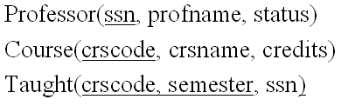
Query 1
Return those professors who have taught ‘csc6710’ but never ‘csc7710’.

Slide 111
Double Circle Pattern
A: Professors
who taught CSC 6710
B: Professors
who taught CSC7710
Solution: A - B

Slide 112
Relational Algebra Solution
π_{ssn}(σ_{crscode=‘csc6710’}(Taught))-π_{ssn}(σ_{crscode=‘csc7710’}(Taught))

Slide 113
SQL Solution
SELECT ssn
From Taught
Where crscode = 'CSC6710'
EXCEPT
SELECT ssn
From Taught
Where crscode = 'CSC7710’;

Slide 114
Simulate Except
SELECT ssn From Taught
Where crscode = 'CSC6710' AND ssn NOT IN (SELECT ssn From Taught
Where crscode = 'CSC7710'
);

Slide 115
What does it mean by NOT IN
WHERE ssn NOT IN [1111, 2222, 3333]
Means
ssn <> 1111 AND ssn <> 2222 AND ssn <> 3333
WHERE ssn IN [1111,2222,3333]
Means
ssn = 1111 OR 2222 OR 3333

Slide 116
Query 2
Return those professors who have taught both ‘csc6710’ and ‘csc7710’.

Slide 117
Double Circle Pattern
A: Professors
who taught CSC 6710
B: Professors
who taught CSC7710
Solution: A - B

Slide 118
Relational Algebra Solution
π_{ssn}(σ_{crscode=‘csc6710’}(Taught)) ∩ π_{ssn}(σ_{crscode=‘csc7710’}(Taught))

Slide 119
SQL Solution
SELECT T1.ssn
From Taught T1
Where T1.crscode = 'CSC6710'
INTERSECT
SELECT T2.ssn
From Taught T2
Where T2.crscode = 'CSC7710’;

Slide 120
Similate INTERSECT
SELECT T1.ssn
From Taught T1
Where T1.crscode = 'CSC6710' AND T1.ssn IN
(SELECT T2.ssn
From Taught T2
Where T2.crscode = 'CSC7710’);

Slide 121


LHRH Pattern
Crscode | semester | ssn
csc6710 | Fall 2017 | 111
csc7710 | Fall 2016 | 111
csc4710 | Winter 2015 | 222
Crscode | semester | ssn
csc6710 | Fall 2017 | 111
csc7710 | Fall 2016 | 111
csc4710 | Winter 2015 | 222

Slide 122
SQL Solution
SELECT T1.ssn
From Taught T1, Taught T2
Where T1.crscode = 'CSC6710' AND
T2.crscode='CSC7710' AND
T1.ssn=T2.ssn;

Slide 123
Common mistake
π_{ssn}(σcrscode=‘csc6710’ ∧ crscode=‘csc7710’ (Taught), wrong!

Slide 124
Query 3
Return those professors who have never taught ‘csc7710’.

Slide 125
Negation Pattern
A: All professors
B: Professors who taught CSC7710
Solution: A – B

Slide 126
Relational Algebra Solution
π_{ssn}(σ_{crscode<>‘csc7710’}(Taught)), wrong answer!
π_{ssn}(Professor)-π_{ssn}(σ_{crscode=‘csc7710’}(Taught)), correct answer!

Slide 127
SQL Solution
SELECT ssn
From Professor
EXCEPT
SELECT ssn
From Taught T
Where T.crscode = 'CSC7710’;

Slide 128
Simulate Except
SELECT ssn
From Professor
WHERE ssn NOT IN
(SELECT T.ssn
From Taught T
Where T.crscode = 'CSC7710'
);

Slide 129
Query 4
Return those professors who taught ‘CSC6710’ and ‘CSC7710” in the same semester

Slide 130
LHRH Pattern
Crscode | semester | ssn
csc6710 | Fall 2017 | 111
csc7710 | Fall 2017 | 111
csc4710 | Winter 2015 | 222
Crscode | semester | ssn
csc6710 | Fall 2017 | 111
csc7710 | Fall 2017 | 111
csc4710 | Winter 2015 | 222

Slide 131
Relational Algebra Solution
Relational Algebra Solution
π_{ssn}(σ_{crscode1=‘csc6710’}(Taught[crscode1, ssn, semester]) σ_{crscode2=‘csc7710’}(Taught[crscode2, ssn, semester]))

Slide 132
SQL Solution
SELECT T1.ssn
From Taught T1, Taught T2
Where T1.crscode = 'CSC6710' AND T2.crscode='CSC7710' AND T1.ssn=T2.ssn AND T1.semester=T2.semester;

Slide 133
Query 5
Return those professors who taught ‘CSC6710’ or ‘CSC7710” but not both.

Slide 134
Double Circle Pattern
A: Professors
who taught CSC 6710
B: Professors
who taught CSC7710
Solution 1: (A – B) ∪ (B – A)
Solution 2: (A ∪ B) – (A ∩ B)

Slide 135
Relational Algebra Solution 2
(π_{ssn}(σ_{crscode=‘csc6710’}(Taught)) ∪ π_{ssn}(σ_{crscode=‘csc7710’}(Taught)))-
(π_{ssn}(σ_{crscode=‘csc6710’}(Taught)) ∩ π_{ssn}(σ_{crscode=‘csc7710’}(Taught)))

Slide 136
Relational Algebra Solution 3
Use v to implement UNION
π_{ssn}(σcrscode=‘csc6710’ ∨ crscode=‘csc7710’(Taught))-(π_{ssn}(σ_{crscode=‘csc6710’}(Taught)) ∩ π_{ssn}(σ_{crscode=‘csc7710’}(Taught)))

Slide 137
Relational Algebra Solution 4
Use LFRH to implement INTERSECTION
π_{ssn}(σcrscode=‘csc6710’ ∨ crscode=‘csc7710’(Taught))-(π_{ssn}(σ_{crscode1=‘csc6710’}(Taught[crscode1, ssn, semester1]) σ_{crscode2=‘csc7710’}(Taught[crscode2, ssn, semester2])))

Slide 138
SQL Solution
Use v to implement UNION
Use LFRH to implement INTERSECTION
SELECT ssn
FROM Taught T
WHERE T.crscode='CSC6710' OR T.crscode='CSC7710’ Except
SELECT T1.ssn
From Taught T1, Taught T2,
Where T1.crscode = ‘CSC6710’ AND T2.crscode=‘CSC7710’ AND T1.ssn=T2.ssn;

Slide 139
SQL Solution
SELECT T.ssn
FROM Taught T
WHERE (T.crscode='CSC6710' OR T.crscode='CSC7710') AND ssn NOT IN
(SELECT T1.ssn
From Taught T1, Taught T2
Where T1.crscode = 'CSC6710' AND T2.crscode='CSC7710'
AND T1.ssn=T2.ssn);

Slide 140
Query 6
Return those courses that have never been taught.

Slide 141
Negation Pattern
A: All courses
B: Courses ever taught
Solution: A – B

Slide 142
Relational Algebra Solution
π_{crscode}(Course)-π_{crscode}(Taught)

Slide 143
SQL Solution
SELECT crscode
FROM Course
EXCEPT
SELECT crscode
FROM Taught;

Slide 144
SQL Solution
SELECT crscode
FROM Course
where crscode NOT IN
(SELECT crscode
FROM TAUGHT
)
INSERT INTO course
VALUE ('CSC7777', 'Database course 7', 3);

Slide 145
Query 7
Return those courses that have been taught at least in two semesters.

Slide 146
LHRH Pattern
Crscode | semester | ssn
csc6710 | Fall 2017 | 111
csc6710 | Winter 2017 | 222
csc4710 | Winter 2015 | 333
Crscode | semester | ssn
csc6710 | Fall 2017 | 111
csc6710 | Winter 2017 | 222
csc4710 | Winter 2015 | 333
Condition 1: T1.crscode = T2.crscode
Condition 2: T1.semester <> T2.semester
No need to compare between T1.ssn and T2.ssn

Slide 147
Relational Algebra Solution
π_{crscode}(σ _{semester1 <> semester2}(
Taught[crscode, ssn1, semester1] Taught[crscode, ssn2, semester2]))

Slide 148
SQL Solution
SELECT DISTINCT(T1.crscode)
FROM Taught T1, Taught T2
WHERE T1.crscode=T2.crscode AND T1.semester <> T2.semester;
SELECT T1.crscode
FROM Taught T1, Taught T2, Taught T3
WHERE T1.crscode=T2.crscode AND T1.semester <> T2.semester
AND T1.crscode = T3.crscode AND T1.semester <> T3.semester AND T2.semester <> T3.semester;

Slide 149
Query 8
Return those courses that have been taught at least in 3 semesters.

Slide 150
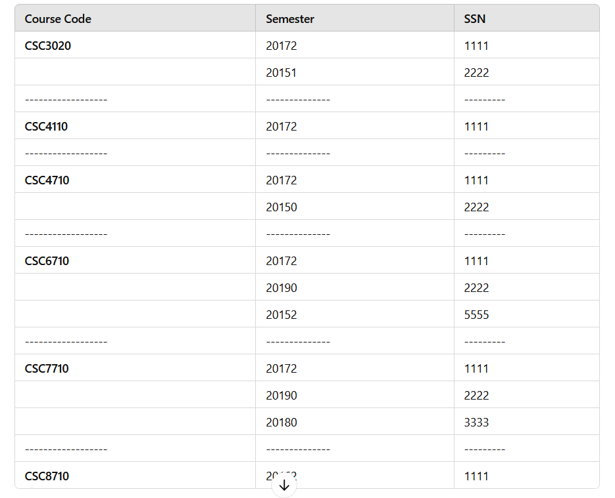

Slide 151
SQL Solution
SELECT crscode
FROM Taught
GROUP BY crscode
HAVING COUNT(semester) >= 3;

Slide 152
Query 9
Return those courses that have been taught by at least 3 different professors.

Slide 153
SQL Solution
SELECT crscode
FROM Taught
GROUP BY crscode
HAVING COUNT(ssn) >= 3;

Slide 154
Query 10
Return the names of professors who ever taught ‘CSC6710’.

Slide 155
Relational Algebra Solution
π_{profname}(σ_{crscode=‘csc6710’}(Taught) Professor)

Slide 156
SQL Solution
SELECT P.ssn, P.profname
FROM Professor P, Taught T
WHERE P.ssn = T.ssn AND T.crscode = 'CSC6710';

Slide 157
Query 11
Return the names of full professors who ever taught ‘CSC6710’.

Slide 158
Relational Algebra Solution
π_{profname}(σ_{crscode=‘csc6710’}(Taught) σ_{status=‘full’}(Professor))

Slide 159
SQL Solution
SELECT P.profname
FROM Professor P, Taught T
WHERE P.ssn = T.ssn AND
P.status = 'Full' AND
T.crscode = 'CSC6710';

Slide 160
Query 12
Return the names of full professors who ever taught more than two courses in one semester.

Slide 161
SQL Solution
SELECT P.profname
FROM Professor P
WHERE p.status = 'Full' AND P.ssn IN
(SELECT ssn
FROM Taught
GROUP BY ssn, semester
HAVING COUNT(*) > 2
);
What are counting? For each professor in each semester,

Slide 162
SQL Solution
Select P.profname
from professor P, taught T
where P.status='Full' AND P.ssn=T.ssn
Group by T.ssn, T.semester // for each prof and each semester
Having Count(T.crscode)>2;
Courtesy of Shahrzad Amoozegar

Slide 163
Query 13
Delete those professors who never taught a course.

Slide 164
Let’s insert some professors first
INSERT INTO Professor
VALUES (6666, 'Luke', 'Full'),
(7777, 'James', 'Associate'),
(8888, 'Grace', 'Assistant');

Slide 165
SQL Solution
DELETE FROM Professor
WHERE ssn NOT IN
(SELECT ssn
FROM Taught
)

Slide 166
Query 14
Change all the credits to 4 for those courses that are taught in Spring 2015 semester.

Slide 167
SQL Solution
UPDATE Course
SET credit = 4
WHERE crscode IN
(SELECT crscode
FROM Taught
WHERE semester = 20151
);

Slide 168
Query 15
Return the names of the professors who have taught more than 12 credits of courses.

Slide 169
SQL Solution
SELECT profname
FROM Professor
WHERE ssn IN
(
SELECT T.ssn
FROM Taught T, Course C
WHERE T.crscode = C.crscode
GROUP BY T.ssn
HAVING SUM(C.credit) > 12
)

Slide 170
Query 16
Return the name(s) of the professor(s) who taught the most number of courses in F2017.

Slide 171
SQL Solution
CREATE VIEW TeachNumS2006(ssn, Num)
AS
SELECT ssn, COUNT(*) as Num
FROM Taught
WHERE semester = 20172
GROUP BY ssn;

Slide 172
SQL Solution
SELECT profname
FROM Professor
WHERE ssn IN (
SELECT ssn FROM TeachNumS2006
where num =
(SELECT MAX(Num)
FROM TeachNumS2006)
);

Slide 173
Query 17
List all the course names that professor ‘Smith” taught in Fall of 2017.

Slide 174
Relational Algebra Solution
π_{crsname}(σ_{profname=‘Smith’}(Professor) σ_{semester=‘f2007’}(Taught)
Course)

Slide 175
SQL Solution
SELECT crsname FROM
Professor P, Taught T, Course C
WHERE P.profname = 'Smith' AND
P.ssn = T.ssn AND
T.semester = 20172 AND
T.crscode = C.crscode

Slide 176
Query 18
In chronological order, list the number of courses that the professor with ssn ssn = 1111 taught in each semester.

Slide 177
SQL Solution
SELECT semester, COUNT(*)
FROM Taught
WHERE ssn = 1111
GROUP BY semester
ORDER BY semester ASC;

Slide 178
Query 19
In alphabetical order of the names of professors, list the name of each professor and the total number of courses she/he has taught.

Slide 179
SQL Solution
1111 | 1111 | Smith | Full | Csc6710 | Fall 2011
1111 | 1111 | Smith | Full | CSC4710 | Winter 2011
2222 | 2222 | John | Associate | CSC7710 | Fall 2012
3333 | 3333 | Thomas | Associate | CSC 8710 | Winter 2012
3333 | 3333 | Thomas | Assistant | CSC 5710 | Fall 2012
For each professor
SELECT P.profname, COUNT(distinct crscode)
FROM Professor P, Taught T
WHERE P.ssn = T.ssn
GROUP BY P.ssn, P.profname
ORDER BY P.profname ASC
Note: we can only select groupby attributes

Slide 180
Query 20
Delete those professors who taught less than 3 courses.

Slide 181

SQL Solution
1111 | CSC 6710 | Fall 2011
1111 | CSC 4710 | Winter 2011
2222 | CSC 7710 | Fall 2012
2222 | CSC 2110 | Fall 2013
2222 | CSC 8710 | Winter 2012
DELETE FROM Professor
WHERE ssn IN(
SELECT ssn
FROM Taught
GROUP BY ssn
HAVING COUNT(DISTINCT crscode) < 3
)
For each professor
Is it a correct solution?

Slide 182
SQL Solution
1111 | CSC 6710 | Fall 2011
1111 | CSC 4710 | Winter 2011
2222 | CSC 7710 | Fall 2012
2222 | CSC 2110 | Fall 2013
2222 | CSC 8710 | Winter 2012
DELETE FROM Professor
WHERE ssn NOT IN(
SELECT ssn
FROM Taught
GROUP BY ssn
HAVING COUNT(crscode) >= 3
)
For each professor
Is it a correct solution?

Slide 183
Query 21
Delete those professors who taught less than 5 credits.

Slide 184
SQL Solution
DELETE FROM Professor
WHERE ssn IN(
SELECT T.ssn
FROM Taught T, Course C
WHERE T.crscode = C.crscode
GROUP BY T.ssn
HAVING SUM(C.credit) < 5
)
Is it a correct solution?

Slide 185
SQL Solution
DELETE FROM Professor
WHERE ssn NOT IN(
SELECT T.ssn
FROM Taught T, Course C
WHERE T.crscode = C.crscode
GROUP BY ssn
HAVING SUM(C.credit) >= 5
)

Slide 186
Query 22
List those professors who have not taught any course in the past three semesters (F2006, W2007, F2007).

Slide 187
Query 22
INSERT INTO taught
VALUES('CSC6710', 20062, 1111),
('CSC4710', 20070, 2222),
('CSC6710', 20072, 5555);

Slide 188
Meaning of IN
T.semester IN (20062, 20070, 20072) means
T.semester = 20062 OR T.semester = 20070 OR T.semester=20072

Slide 189
SQL Solution 1
SELECT *
FROM Professor P
WHERE P.ssn NOT IN(
SELECT ssn
FROM Taught T
WHERE T.semester = 20062 OR
T.semester = 20070 OR T.semester=20072
);
The IN Pattern

Slide 190
SQL Solution 2
SELECT *
FROM Professor P
WHERE P.ssn IN(
SELECT ssn FROM Professor
EXCEPT
SELECT ssn
FROM Taught T
WHERE T.semester = 20062 OR
T.semester = 20070 OR T.semester=20072
)
The Negation Pattern

Slide 191
SQL Solution 3
SELECT *
FROM Professor P
WHERE no witness will say P teaches a course in one of the three semesters
The no-witness pattern

Slide 192
SQL Solution 3
SELECT *
FROM Professor P
WHERE NOT EXISTS(
SELECT *
FROM Taught T
WHERE T.ssn = P.ssn AND
(T.semester = 20062 OR
T.semester = 20070 OR T.semester=20072) );
The no-witness pattern

Slide 193
Meaning of NOT EXISTS
NOT EXISTS([]) TRUE
NOT EXISTS([1111, 2222] FALSE
EXISTS([]) FALSE
EXISTS ([1111, 2222] TRUE

Slide 194
SQL Solution 4
SELECT *
FROM Professor P
WHERE NOT EXISTS(
SELECT *
FROM Taught T
WHERE T.ssn = P.ssn AND
T.semester IN (20062, 20070, 20072)
)
The no-witness pattern

Slide 195
Query 23
List the names of those courses that professor Smith have never taught.

Slide 196
SQL Solution 1
SELECT crsname
FROM Course C
WHERE C.crscode NOT IN
(SELECT T.crscode
FROM Professor P, Taught T
WHERE P.profname='Smith' AND P.ssn = T.ssn);
The NOT IN Pattern

Slide 197
SQL Solution 2
SELECT crsname
FROM Course C
WHERE C.crscode IN (
SELECT crscode FROM Course
EXCEPT
SELECT T.crscode
FROM Professor P, Taught T
WHERE P.profname='Smith' AND P.ssn = T.ssn
)
The Negation Pattern

Slide 198
SQL Solution 2
SELECT C.crsname
FROM Course C
WHERE C.crscode IN
(SELECT crscode
FROM Course
WHERE crscode NOT IN
(SELECT T.crscode
FROM Professor P, Taught T
WHERE P.profname='Smith' AND P.ssn = T.ssn));
The Negation Pattern

Slide 199
SQL Solution 3
SELECT crsname
FROM Course C
WHERE NOT EXISTS(
SELECT *
FROM Professor P, Taught T
WHERE P.profname='Smith' AND P.ssn = T.ssn AND T.crscode = C.crscode
);
The No-witness pattern

Slide 200
Query 24
Return those professors that have taught all the courses (each course).

Slide 201
Relational Algebra Solution
π_{crscode, ssn}(Taught)/ π_{crscode}(Course)

Slide 202
SQL Solution
SELECT *
FROM Professor P
WHERE NOT EXISTS(
SELECT crscode
FROM Course
EXCEPT
SELECT T.crscode
FROM Taught T
WHERE T.ssn = P.ssn
)
The division pattern = no-witness+negation

Slide 203
NO witness | all witness
No witness: nobody say yes
All witness: everybody say yes, DIVISION pattern

Slide 204
Query 25
Return those courses that have been taught ONLY by Full professors.

Slide 205
Double Circle Pattern
A: Courses taught by
Full professors
B: Courses taught by
non-Full professors
Solution: A - B

Slide 206
SQL Solution 1
SELECT crscode
FROM Taught T, Professor P
WHERE T.ssn = P.ssn AND P.status = 'Full'
EXCEPT
SELECT crscode
FROM Taught T, Professor P
WHERE T.ssn = P.ssn AND P.status <> 'Full'

Slide 207
Negation Pattern
U: Courses taught by
some professors
B: Courses taught by
non-full professors
Solution: U – B = A – B
Because U = A ∪ B

Slide 208
SQL Solution 2
SELECT crscode
FROM Taught T
EXCEPT
SELECT crscode
FROM Taught T, Professor P
WHERE T.ssn = P.ssn AND P.status <> 'Full'

Slide 209
Relational Algebra Solution
π_{crscode}(Taught) - π_{crscode} (σ_{status≠‘Junior’}(Professor) Taught)

Slide 210
SQL Solution 3
SELECT T1.crscode
FROM Taught T1
WHERE T1.crscode NOT IN
(SELECT crscode
FROM Taught T2, Professor P
WHERE T2.ssn = P.ssn AND P.status <> 'Full'
)
The NOT-IN pattern

Slide 211
Common Mistake
Matching ?
SELECT crscode
FROM Course C
WHERE c.crscode NOT IN(
(SELECT T.crscode // a list of tuples rather than a list of elements
FROM Taught T, Professor P
WHERE T.ssn = P.ssn AND P.status <> ‘Junior’
)

Slide 212
Query 25
Return those courses that have been taught in all semesters (each).

Slide 213
Change the Taught table
INSERT INTO taught
VALUES('CSC6710', 20170, 1111),
('CSC7710', 20170, 1111),
('CSC4710', 20171, 1111),
('CSC3020', 20172, 1111),
('CSC6710', 20171, 2222),
('CSC6710', 20172, 2222),
('CSC4110', 20171, 3333);

Slide 214
Relational Algebra Solution
π_{crscode, semester}(Taught)/ π_{semester}(Taught)

Slide 215
SQL Solution 1
SELECT crscode
FROM Taught T1
WHERE NOT EXISTS(
SELECT semester
FROM Taught
EXCEPT
SELECT semester
FROM Taught T2
WHERE T2.crscode = T1.crscode
);
The division pattern

Slide 216
SQL Solution 2
SELECT distinct crscode
FROM Taught T1
WHERE NOT EXISTS(
SELECT semester
FROM Taught WHERE semester NOT IN
(SELECT semester
FROM Taught T2
WHERE T2.crscode = T1.crscode)
)
The division pattern

Slide 217


Slide 218
Query 27
Graphs(graphid, graphname)
Nodes(nodeid, nodename, nodeweight, graphid)
Edges(parentid, childid, edgeweight, graphid)
Entry nodes: no incoming edges
Exit nodes: no outgoing edges
Fork nodes: at least two outgoing edges
Join nodes: at least two incoming edges
Linear nodes: one incoming edge and one outgoing edge, or one parent AND one child

Slide 219
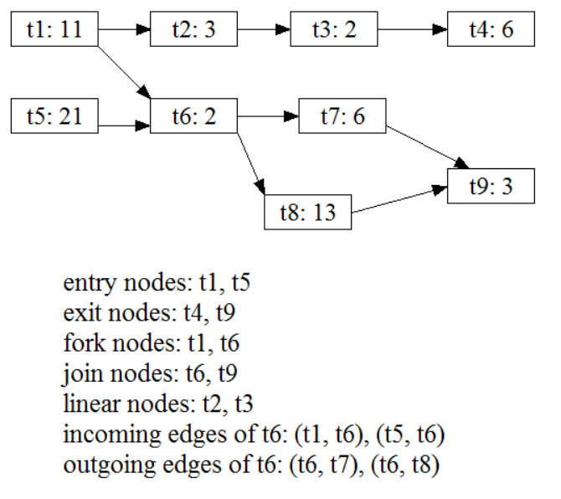
A graph example
3
7
13
5
2
11
9
9
5

Slide 220
create table Graphs (
graphid int,
graphname VARCHAR(50));
create table Nodes(
nodeid int,
nodename VARCHAR(50),
weight float,
graphid int,
primary key(nodeid),
foreign key(graphid) references Graphs(graphid));
create table Edges (
parentid int,
childid int,
weight float,
graphid int,
primary key(parentid, childid),
foreign key(graphid) references Graphs(graphid));

Slide 221
insert into Graphs VALUES(1, 'SampleGraph’);
insert into Nodes VALUES(1, 't1', 11, 1);
insert into Nodes VALUES(2, 't2', 3, 1);
insert into Nodes VALUES(3, 't3', 2, 1);
insert into Nodes VALUES(4, 't4', 6, 1);
insert into Nodes VALUES(5, 't5', 21, 1);
insert into Nodes VALUES(6, 't6', 2, 1);
insert into Nodes VALUES(7, 't7', 6, 1);
insert into Nodes VALUES(8, 't8', 13, 1);
insert into Nodes VALUES(9, 't9', 3, 1);
insert into Edges Values(1, 2, 3, 1);
insert into Edges Values(2, 3, 7, 1);
insert into Edges Values(3, 4, 13, 1);
insert into Edges Values(1, 6, 5, 1);
insert into Edges Values(5, 6, 9, 1);
insert into Edges Values(6, 7, 2, 1);
insert into Edges Values(6, 8, 9, 1);
insert into Edges Values(7, 9, 11, 1);
insert into Edges Values(8, 9, 5, 1);

Slide 222
Query 27
Graphs(graphid, graphname)
Nodes(nodeid, nodename, nodeweight, graphid)
Edges(parentid, childid, edgeweight, graphid)
Return all the entry nodes for graph with graphid = 1.

Slide 223
SQL Solution
Graphs(graphid, graphname)
Nodes(nodeid, nodename, nodeweight, graphid)
Edges(parentid, childid, edgeweight, graphid)
SELECT N.nodeid
FROM Nodes N
WHERE and N.graphid = 1 AND N has no parents

Slide 224
SQL Solution
Graphs(graphid, graphname)
Nodes(nodeid, nodename, nodeweight, graphid)
Edges(parentid, childid, edgeweight, graphid)
SELECT N.nodeid
FROM Nodes N
WHERE graphid = 1 AND NOT EXISTS(
select parentid
FROM Edges E
where E.childid = N.nodeid
)

Slide 225
Query 28
Graphs(graphid, graphname)
Nodes(nodeid, nodename, nodeweight, graphid)
Edges(parentid, childid, edgeweight, graphid)
Return all the entry nodes for graph named “1”.

Slide 226
SQL Solution
Graphs(graphid, graphname)
Nodes(nodeid, nodename, nodeweight, graphid)
Edges(parentid, childid, edgeweight, graphid)
SELECT N.nodeid
FROM Nodes N, Graphs G
WHERE N.graphid = G.graphid AND G.graphname =
‘SampleGraph' AND NOT EXISTS(
select parentid
FROM Edges E
where E.childid= N.nodeid AND E.graphid = N.graphid
)

Slide 227
Query 29
Graphs(graphid, graphname)
Nodes(nodeid, nodename, nodeweight, graphid)
Edges(parentid, childid, edgeweight, graphid)
Return all the fork nodes for graph with graphid = 1.

Slide 228
SQL Solution
Graphs(graphid, graphname)
Nodes(nodeid, nodename, nodeweight, graphid)
Edges(parentid, childid, edgeweight, graphid)
SELECT N.nodeid
FROM Nodes N
WHERE N.graphid = 1 AND 2 <= the number of children of N);

Slide 229
SQL Solution
Graphs(graphid, graphname)
Nodes(nodeid, nodename, nodeweight, graphid)
Edges(parentid, childid, edgeweight, graphid)
SELECT N.nodeid
FROM Nodes N
WHERE N.graphid = 1 AND 2 <= (
select COUNT(childid)
FROM Edges E
where E.parentid = N.nodeid AND E.graphid = 1
);

Slide 230
SQL Solution
Graphs(graphid, graphname)
Nodes(nodeid, nodename, nodeweight, graphid)
Edges(parentid, childid, edgeweight, graphid)
SELECT E.parentid
From Edges E
WHERE E.graphid = 1
GROUP BY E.parentid
HAVING COUNT(childid) >= 2

Slide 231
Query 30
Graphs(graphid, graphname)
Nodes(nodeid, nodename, nodeweight, graphid)
Edges(parentid, childid, edgeweight, graphid)
Return all the join nodes for graph with graphid = 1.

Slide 232
SQL Solution
Graphs(graphid, graphname)
Nodes(nodeid, nodename, nodeweight, graphid)
Edges(parentid, childid, edgeweight, graphid)
SELECT N.nodeid
FROM Nodes N
WHERE N.graphid = 1 AND 2 <= (
select COUNT(parentid)
FROM Edges E
where E.childid = N.nodeid AND E.graphid = 1
)

Slide 233
Query 31
Graphs(graphid, graphname)
Nodes(nodeid, nodename, nodeweight, graphid)
Edges(parentid, childid, edgeweight, graphid)
Return all the linear nodes for graph with graphid = 1.

Slide 234
SQL Solution
Graphs(graphid, graphname)
Nodes(nodeid, nodename, nodeweight, graphid)
Edges(parentid, childid, edgeweight, graphid)
SELECT E1.parentid
FROM Edges E1
WHERE E1.parentid IN
(
SELECT E2.childid
FROM Edges E2
GROUP BY E2.childid
HAVING COUNT(E2.parentid) = 1
)
GROUP BY E1.parentid
HAVING COUNT(E1.childid) = 1;

Slide 235
SQL Solution
Graphs(graphid, graphname)
Nodes(nodeid, nodename, nodeweight, graphid)
Edges(parentid, childid, edgeweight, graphid)
SELECT N.nodeid
FROM Nodes N
WHERE N.graphid = 1 AND 1 == number of parents
) AND1 == number of children
)

Slide 236
SQL Solution
Graphs(graphid, graphname)
Nodes(nodeid, nodename, nodeweight, graphid)
Edges(parentid, childid, edgeweight, graphid)
SELECT N.nodeid
FROM Nodes N
WHERE N.graphid = 1 AND 1 = (
select COUNT(parentid)
FROM Edges E
where E.childid = N.nodeid
) AND 1 = (
select COUNT(childid)
FROM Edges E
where E.parentid= N.nodeid
);

Slide 237
Query 32
Graphs(graphid, graphname)
Nodes(nodeid, nodename, nodeweight, graphid)
Edges(parentid, childid, edgeweight, graphid)
Return all the graphs whose total node weight is over 40.

Slide 238
SQL Solution
Graphs(graphid, graphname)
Nodes(nodeid, nodename, nodeweight, graphid)
Edges(parentid, childid, edgeweight, graphid)
SELECT N.graphid
FROM Nodes N
GROUP BY graphid
HAVING SUM(nodeweight) > 40

Slide 239
Query 33
Graphs(graphid, graphname)
Nodes(nodeid, nodename, nodeweight, graphid)
Edges(parentid, childid, edgeweight, graphid)
Return all the graphs whose total edge weight is over 40.

Slide 240
SQL Solution
Graphs(graphid, graphname)
Nodes(nodeid, nodename, nodeweight, graphid)
Edges(parentid, childid, edgeweight, graphid)
SELECT E.graphid
FROM Edges E
GROUP BY graphid
HAVING SUM(edgeweight) > 40

Slide 241
Query 34
Graphs(graphid, graphname)
Nodes(nodeid, nodename, nodeweight, graphid)
Edges(parentid, childid, edgeweight, graphid)
Return all the graphs whose total node weight is over 40 and total edge weight is over 50.

Slide 242
SQL Solution
Graphs(graphid, graphname)
Nodes(nodeid, nodename, nodeweight, graphid)
Edges(parentid, childid, edgeweight, graphid)
(SELECT N.graphid
FROM Nodes N
GROUP BY graphid
HAVING SUM(nodeweight) > 40 )
INTERSECT
(SELECT E.graphid
FROM Edges E
GRROUP BY graphid
HAVING SUM(edgeweight) > 50)

Slide 243
SQL Solution
Graphs(graphid, graphname)
Nodes(nodeid, nodename, nodeweight, graphid)
Edges(parentid, childid, edgeweight, graphid)
(SELECT N.graphid
FROM Nodes N
GROUP BY graphid
HAVING SUM(nodeweight) > 40 ) and N.graphid IN
(SELECT E.graphid
FROM Edges E
GRROUP BY graphid
HAVING SUM(edgeweight) > 50)

Slide 244
Query 35
Graphs(graphid, graphname)
Nodes(nodeid, nodename, nodeweight, graphid)
Edges(parentid, childid, edgeweight, graphid)
Return all the graphs that have 5 entry nodes.

Slide 245
SQL Solution
Graphs(graphid, graphname)
Nodes(nodeid, nodename, nodeweight, graphid)
Edges(parentid, childid, edgeweight, graphid)
CREATE VIEW entrynodes(nodeid, nodename, nodeweight, graphid) AS
SELECT *
FROM Nodes N
WHERE NOT EXISTS( // witness of no parents
SELECT E.parentid
FROM Edges E
WHERE E.childid = N.nodeid)
SELECT graphid
FROM entrynodes
GROUP BY graphid
HAVGING COUNT(nodeid) = 5; // groups of size 5

Slide 246
Query 36
Graphs(graphid, graphname)
Nodes(nodeid, nodename, nodeweight, graphid)
Edges(parentid, childid, edgeweight, graphid)
Return all the grandchildren nodes of node named “T34” in graph with graphid of 1234.

Slide 247
Query 36
Graphs(graphid, graphname)
Nodes(nodeid, nodename, nodeweight, graphid)
Edges(parentid, childid, edgeweight, graphid)
Select nodeid
From Nodes
Where N.graphid = ‘1234 and nodename = ‘T34”

Slide 248
SQL Solution
Graphs(graphid, graphname)
Nodes(nodeid, nodename, nodeweight, graphid)
Edges(parentid, childid, edgeweight, graphid)
SELECT E2.childid
FROM Nodes N, Edges E1, Edge E2
WHERE N.graphid = 1234 AND N.nodename = ‘T34’ AND E1.parentid = N.nodeid AND E1.childid = E2.parentid

Slide 249
Query 37
Graphs(graphid, graphname)
Nodes(nodeid, nodename, nodeweight, graphid)
Edges(parentid, childid, edgeweight, graphid)
For each graph, return the total number of nodes and total number of edges

Slide 250
SQL Solution
Graphs(graphid, graphname)
Nodes(nodeid, nodename, nodeweight, graphid)
Edges(parentid, childid, edgeweight, graphid)
CREATE VIEW V1(graphid, totalnodes)
AS
SELECT graphid, COUNT(nodeid) as totalnodes
FROM Nodes N
GROUP BY graphid
CREATE VIEW V2(graphid, totaledges)
AS
SELECT graphid, COUNT(*) as totaledges
FROM Edges E
GROUP BY graphid
CREATE VIEW V3(graphid, totalnodes, totaledges) AS
SELECT V1.graphid, V1.totalnodes, V2.totaledges
FROM V1, V2
WHERE V1.graphid = V2.graphid

Slide 251
SQL Exercise 3
Users(userid, name, gender, age, banned)
myFriends(myid, friendid)
Jokes(jokeid, title, desc, authorid)
JokeTag(jokeid, tag)
myFavoriteJokes(myid, jokeid)
Reviews(jokeid, reviewerid, score, comment, submitTime)

Slide 252
Query 38
Users(userid, name, gender, age, banned)
myFriends(myid, friendid)
Jokes(jokeid, title, desc, authorid)
JokeTag(jokeid, tag)
myFavoriteJokes(myid, jokeid)
Reviews(jokeid, reviewerid, score, comment, submitTime)
Return the userids of those users who have posted “excellent” reviews but never “poor” reviews

Slide 253
Query 38
Users(userid, name, gender, age, banned)
myFriends(myid, friendid)
Jokes(jokeid, title, desc, authorid)
JokeTag(jokeid, tag)
myFavoriteJokes(myid, jokeid)
Reviews(jokeid, reviewerid, score, comment, submitTime)
(SELECT reviewerid
FROM Reviews
WHERE score = “Excellent”)
EXCEPT
(SELECT reviewerid
FROM Reviews
WHERE score = “Poor”)

Slide 254
Query 39
Users(userid, name, gender, age, banned)
myFriends(myid, friendid)
Jokes(jokeid, title, desc, authorid)
JokeTag(jokeid, tag)
myFavoriteJokes(myid, jokeid)
Reviews(jokeid, reviewerid, score, comment, submitTime)
Return the jokeids of those jokes that have been reviewed by all users.

Slide 255
Query 39
Users(userid, name, gender, age, banned)
myFriends(myid, friendid)
Jokes(jokeid, title, desc, authorid)
JokeTag(jokeid, tag)
myFavoriteJokes(myid, jokeid)
Reviews(jokeid, reviewerid, score, comment, submitTime)
(SELECT jokeid
FROM Jokes J1 // for each J1
WHERE NOT EXISTS(
(SELECT userid FROM Users) // all users
EXCEPT
(SELECT reviewerid // reviewers for J1
FROM Reviews R
WHERE R.jokeid = J1.jokeid)
)

Slide 256
Query 39
Users(userid, name, gender, age, banned)
myFriends(myid, friendid)
Jokes(jokeid, title, desc, authorid)
JokeTag(jokeid, tag)
myFavoriteJokes(myid, jokeid)
Reviews(jokeid, reviewerid, score, comment, submitTime)
SELECT jokeid
FROM Reviews
GROUP BY jokeid
HAVING COUNT(*) = (SELECT COUNT(*) FROM Users)

Slide 257
Query 40
Users(userid, name, gender, age, banned)
myFriends(myid, friendid)
Jokes(jokeid, title, desc, authorid)
JokeTag(jokeid, tag)
myFavoriteJokes(myid, jokeid)
Reviews(jokeid, reviewerid, score, comment, submitTime)
Return the jokeids of those jokes that ‘John Smith’ gives “excellent” reviews while ‘David Liu’ gives ‘poor’ reviews.

Slide 258
Query 40
Users(userid, name, gender, age, banned)
myFriends(myid, friendid)
Jokes(jokeid, title, desc, authorid)
JokeTag(jokeid, tag)
myFavoriteJokes(myid, jokeid)
Reviews(jokeid, reviewerid, score, comment, submitTime)
(SELECT jokeid
FROM Reviews R1, Users U1
WHERE R1.reviewerid = U1.userid AND score = “Excellent” AND U1.name = “John Smith”)
INTERSECT
(SELECT jokeid
FROM Reviews R2, Users U2
WHERE R2.reviewerid = U2.userid AND score = “Poor” AND U2.name = “David Liu”)

Slide 259
Query 41
Users(userid, name, gender, age, banned)
myFriends(myid, friendid)
Jokes(jokeid, title, desc, authorid)
JokeTag(jokeid, tag)
myFavoriteJokes(myid, jokeid)
Reviews(jokeid, reviewerid, score, comment, submitTime)
Return the jokeids of those jokes that have been reviewed by both male and female users.

Slide 260
Query 41
Users(userid, name, gender, age, banned)
myFriends(myid, friendid)
Jokes(jokeid, title, desc, authorid)
JokeTag(jokeid, tag)
myFavoriteJokes(myid, jokeid)
Reviews(jokeid, reviewerid, score, comment, submitTime)
(SELECT jokeid
FROM Reviews R1, Users U1
WHERE R1.reviewerid = U1.authorid AND U1.gender = “M”)
INTERSECT
(SELECT jokeid
FROM Reviews R2, Users U2
WHERE R2.reviewerid = U2.authorid AND U2.gender=“F”)

Slide 261
Query 42
Users(userid, name, gender, age, banned)
myFriends(myid, friendid)
Jokes(jokeid, title, desc, authorid)
JokeTag(jokeid, tag)
myFavoriteJokes(myid, jokeid)
Reviews(jokeid, reviewerid, score, comment, submitTime)
Return the jokeids of those jokes that have been reviewed by all users of age 20.

Slide 262
Query 42
Users(userid, name, gender, age, banned)
myFriends(myid, friendid)
Jokes(jokeid, title, desc, authorid)
JokeTag(jokeid, tag)
myFavoriteJokes(myid, jokeid)
Reviews(jokeid, reviewerid, score, comment, submitTime)
(SELECT jokeid
FROM Jokes J1 // for each J1
WHERE NOT EXISTS(
(SELECT userid FROM Users WHERE age=20) // all users of age 20
EXCEPT
(SELECT reviewerid // reviewers for J1
FROM Reviews R
WHERE R.jokeid = J1.jokeid)
)

Slide 263
Query 42
Users(userid, name, gender, age, banned)
myFriends(myid, friendid)
Jokes(jokeid, title, desc, authorid)
JokeTag(jokeid, tag)
myFavoriteJokes(myid, jokeid)
Reviews(jokeid, reviewerid, score, comment, submitTime)
(SELECT DISTINCT U.jokeid
FROM Reviews R, Users U
WHERE R.reviewerid = U.userid AND U.age = 20
GROUP BY R.jokeid
HAVING COUNT(*) = (SELECT COUNT(*) FROM Users where age = 20)
Witness-counting pattern

Slide 264
Query 43
Users(userid, name, gender, age, banned)
myFriends(myid, friendid)
Jokes(jokeid, title, desc, authorid)
JokeTag(jokeid, tag)
myFavoriteJokes(myid, jokeid)
Reviews(jokeid, reviewerid, score, comment, submitTime)
Return the jokeids of those jokes that have been reviewed ONLY by users younger than 20 (not including 20).

Slide 265
Query 43
Users(userid, name, gender, age, banned)
myFriends(myid, friendid)
Jokes(jokeid, title, desc, authorid)
JokeTag(jokeid, tag)
myFavoriteJokes(myid, jokeid)
Reviews(jokeid, reviewerid, score, comment, submitTime)
(SELECT jokeid
FROM Reviews R1, User U1
WHERE R1.reviewerid = U1.userid AND U1.age < 20)
EXCEPT
(SELECT jokeid
FROM Reviews R2, User U2
WHERE R2.reviewerid = U2.userid AND U2.age >= 20)

Slide 266
Query 44
Users(userid, name, gender, age, banned)
myFriends(myid, friendid)
Jokes(jokeid, title, desc, authorid)
JokeTag(jokeid, tag)
myFavoriteJokes(myid, jokeid)
Reviews(jokeid, reviewerid, score, comment, submitTime)
Return the userids of the users who posted the most number of jokes on 1/1/2019

Slide 267
Query 44
Users(userid, name, gender, age, banned)
myFriends(myid, friendid)
Jokes(jokeid, title, desc, authorid, postDay)
JokeTag(jokeid, tag)
myFavoriteJokes(myid, jokeid)
Reviews(jokeid, reviewerid, score, comment, submitTime)
CREATE VIEW JokeNum(authorid, num) AS
SELECT authorid, COUNT(*) AS num
FROM Jokes
WHERE postDay = ‘1/1/2019’
GROUP BY authorid
SELECT authorid
FROM JokeNum
WHERE num = SELECT MAX(num) FROM JokeNum

Slide 268
Query 45
Users(userid, name, gender, age, banned)
myFriends(myid, friendid)
Jokes(jokeid, title, desc, authorid)
JokeTag(jokeid, tag)
myFavoriteJokes(myid, jokeid)
Reviews(jokeid, reviewerid, score, comment, submitTime)
Return an SQL view JokesNum that gives the number of jokes each user posts on each day

Slide 269
Query 45
Users(userid, name, gender, age, banned)
myFriends(myid, friendid)
Jokes(jokeid, title, desc, authorid)
JokeTag(jokeid, tag)
myFavoriteJokes(myid, jokeid)
Reviews(jokeid, reviewerid, score, comment, submitTime)
CREATE VIEW JokeNum(authorid, postDay, num) AS
SELECT authorid, postDay, COUNT(*) AS num
FROM Jokes
GROUP BY authorid, postDay

Slide 270
Query 46
Users(userid, name, gender, age, banned)
myFriends(myid, friendid)
Jokes(jokeid, title, desc, authorid)
JokeTag(jokeid, tag)
myFavoriteJokes(myid, jokeid)
Reviews(jokeid, reviewerid, score, comment, submitTime)
Write an SQL CREATE ASSERTION statement to force the constraint “one user cannot post more than five jokes per day”.

Slide 271
Query 46
Users(userid, name, gender, age, banned)
myFriends(myid, friendid)
Jokes(jokeid, title, desc, authorid)
JokeTag(jokeid, tag)
myFavoriteJokes(myid, jokeid)
Reviews(jokeid, reviewerid, score, comment, submitTime)
CREATE ASSERTION NoMoreThenFive
CHECK NOT EXISTS(
SELECT authorid, postDay, COUNT(*) AS num
FROM Jokes
GROUP BY authorid, postDay
HAVING COUNT(*) > 5
)

Slide 272
Query 47
Users(userid, name, gender, age, banned)
myFriends(myid, friendid)
Jokes(jokeid, title, desc, authorid)
JokeTag(jokeid, tag)
myFavoriteJokes(myid, jokeid)
Reviews(jokeid, reviewerid, score, comment, submitTime)
Write an SQL CREATE TRIGGER statement to force the constraint “a user cannot provide more than five reviews per day”.

Slide 273
Query 47
Users(userid, name, gender, age, banned)
myFriends(myid, friendid)
Jokes(jokeid, title, desc, authorid)
JokeTag(jokeid, tag)
myFavoriteJokes(myid, jokeid)
Reviews(jokeid, reviewerid, score, comment, submitTime)
CREATE TRIGGER NoMoreThanFive
BEFORE INSERT
ON Reviews
FOR EACH ROW
BEGIN
IF ( 5 = (SELECT count(*) from Reviews R
where R.reviewerid = NEW.reviewerid AND DATE(submitTime) = NEW.submitTime) )) THEN SIGNAL SQLSTATE '45000’;
END IF; // count how many jokes I already posted on the day I // wanted to insert
END;

Slide 274
Query 48
Users(userid, name, gender, age, banned)
myFriends(myid, friendid)
Jokes(jokeid, title, desc, authorid)
JokeTag(jokeid, tag)
myFavoriteJokes(myid, jokeid)
Reviews(jokeid, reviewerid, score, comment, submitTime)
List the userids of the users who posted at least two jokes on the same day, one has a tag of “db” and the other has a tag of “sql”

Slide 275
Query 48
Users(userid, name, gender, age, banned)
myFriends(myid, friendid)
Jokes(jokeid, title, desc, authored, postDay)
JokeTag(jokeid, tag)
myFavoriteJokes(myid, jokeid)
Reviews(jokeid, reviewerid, score, comment, submitTime)
SELECT J1.authorid
FROM Jokes J1, JokeTag T1, Jokes J2, JokeTag T2
WHERE J1.jokeid = T1.jokeid AND J2.jokeid = T2.jokeid
AND J1.authorid = J2.authorid
AND J1.postDay = J2.postDay
AND J1.jokeid <> J2.jokeid
AND T1.tag = “db” AND T2.tag = “sql”

Slide 276
Query 49
Users(userid, name, gender, age, banned)
myFriends(myid, friendid)
Jokes(jokeid, title, desc, authorid)
JokeTag(jokeid, tag)
myFavoriteJokes(myid, jokeid)
Reviews(jokeid, reviewerid, score, comment, submitTime)
List the jokeids of the jokes posted by “john” such that these jokes have some comments, but all these comments are either “excellent” or “good”.

Slide 277
Query 49
Users(userid, name, gender, age, banned)
myFriends(myid, friendid)
Jokes(jokeid, title, desc, authorid, postDay)
JokeTag(jokeid, tag)
myFavoriteJokes(myid, jokeid)
Reviews(jokeid, reviewerid, score, comment, submitTime)
SELECT J.jokeid
FROM Jokes J1, Users U1
WHERE J1.authorid = U1.userid and U1.name = “John” AND J1.jokeid IN
( // jokes that have ONLY excellent or good reviews.
(SELECT jokeid
FROM Reviews
where score = “Excellent” OR score = “Good”)
EXCEPT
(SELECT jokeid
FROM Reviews
where score <> “Excellent” AND score <> “Good”)
)

Slide 278
Query 49
Users(userid, name, gender, age, banned)
myFriends(myid, friendid)
Jokes(jokeid, title, desc, authorid)
JokeTag(jokeid, tag)
myFavoriteJokes(myid, jokeid)
Reviews(jokeid, reviewerid, score, comment, submitTime)
List the userids of the authors who posted the most number of jokes since 3/1/2018 (inclusive).

Slide 279
Query 49
Users(userid, name, gender, age, banned)
myFriends(myid, friendid)
Jokes(jokeid, title, desc, authorid, postDay)
JokeTag(jokeid, tag)
myFavoriteJokes(myid, jokeid)
Reviews(jokeid, reviewerid, score, comment, submitTime)
CREATE VIEW jokeNum(authorid, num) AS
SELECT authorid, COUNT(*)
FROM Jokes
WHERE postDay >= ‘3/1/2018’
GROUP BY authorid
SELECT authorid
FROM jokeNum
WHERE num =
(SELECT MAX(num) FROM jokeNum)

Slide 280
Query 50
Users(userid, name, gender, age, banned)
myFriends(myid, friendid)
Jokes(jokeid, title, desc, authorid)
JokeTag(jokeid, tag)
myFavoriteJokes(myid, jokeid)
Reviews(jokeid, reviewerid, score, comment, submitTime)
List the userids of the users who are befriended by both “John” and “Kathy”.

Slide 281
Query 50 (Solution 1)
Users(userid, name, gender, age, banned)
myFriends(myid, friendid)
Jokes(jokeid, title, desc, authorid, postDay)
JokeTag(jokeid, tag)
myFavoriteJokes(myid, jokeid)
Reviews(jokeid, reviewerid, score, comment, submitTime)
SELECT F1.friendid
FROM Users U1, myFriends F1, Users U2, myFriends F2
WHERE U1.userid = F1.myid AND U2.userid = F2.myid AND
U1.name = “John” AND U2.name = “Kathy”
AND F1.friendid = F2.friendid

Slide 282
Query 50 (Solution 2)
Users(userid, name, gender, age, banned)
myFriends(myid, friendid)
Jokes(jokeid, title, desc, authorid, postDay)
JokeTag(jokeid, tag)
myFavoriteJokes(myid, jokeid)
Reviews(jokeid, reviewerid, score, comment, submitTime)
(SELECT F1.friendid
FROM Users U1, myFriends F1
WHERE U1.userid = F1.myid AND U1.name = “John”)
INTERSECT
(SELECT F2.friendid
FROM Users U2, myFriends F2
WHERE U2.userid = F2.myid AND U2.name = “Kathy”)

Slide 283
Query 51
Users(userid, name, gender, age, banned)
myFriends(myid, friendid)
Jokes(jokeid, title, desc, authorid)
JokeTag(jokeid, tag)
myFavoriteJokes(myid, jokeid)
Reviews(jokeid, reviewerid, score, comment, submitTime)
List the userids of the authors who never posted any joke that has at least three “excellent” reviews.

Slide 284
Query 51
Users(userid, name, gender, age, banned)
myFriends(myid, friendid)
Jokes(jokeid, title, desc, authorid, postDay)
JokeTag(jokeid, tag)
myFavoriteJokes(myid, jokeid)
Reviews(jokeid, reviewerid, score, comment, submitTime)
SELECT userid FROM Users
WHERE userid NOT IN(
SELECT authorid // authors that have posted a joke that has
FROM Jokes // at least 3 excellent reviews
WHERE jokeid IN (
SELECT jokeid // jokes that have at least 3 excellent reviews
FROM Reviews
WHERE score=“EXCELLENT”
GROUP BY jokeid
HAVING COUNT(*) >=3
)
)

Slide 285
Query 52
Users(userid, name, gender, age, banned)
myFriends(myid, friendid)
Jokes(jokeid, title, desc, authorid)
JokeTag(jokeid, tag)
myFavoriteJokes(myid, jokeid)
Reviews(jokeid, reviewerid, score, comment, submitTime)
PositiveReviewers: List the userids of the reviewers who never posted a “poor” review.

Slide 286
Query 52
Users(userid, name, gender, age, banned)
myFriends(myid, friendid)
Jokes(jokeid, title, desc, authorid, postDay)
JokeTag(jokeid, tag)
myFavoriteJokes(myid, jokeid)
Reviews(jokeid, reviewerid, score, comment, submitTime)
SELECT userid
FROM Users
WHERE userid NOT IN (
SELECT reviewerid
FROM Reviews
WHERE score = “Poor”
)

Slide 287
Query 53
Users(userid, name, gender, age, banned)
myFriends(myid, friendid)
Jokes(jokeid, title, desc, authorid)
JokeTag(jokeid, tag)
myFavoriteJokes(myid, jokeid)
Reviews(jokeid, reviewerid, score, comment, submitTime)
NegativeReviewers: List the userids of the reviewers who posted some reviews and each of them is “poor”.

Slide 288
Query 53
Users(userid, name, gender, age, banned)
myFriends(myid, friendid)
Jokes(jokeid, title, desc, authorid, postDay)
JokeTag(jokeid, tag)
myFavoriteJokes(myid, jokeid)
Reviews(jokeid, reviewerid, score, comment, submitTime)
SELECT reviewerid
FROM Reviews
WHERE reviewerid NOT IN (
SELECT reviewerid // reviewers who ever posted any non-poor
FROM Reviews // reviews
WHERE score <> “Poor”
)

Slide 289
Query 54
Users(userid, name, gender, age, banned)
myFriends(myid, friendid)
Jokes(jokeid, title, desc, authorid)
JokeTag(jokeid, tag)
myFavoriteJokes(myid, jokeid)
Reviews(jokeid, reviewerid, score, comment, submitTime)
GoodAuthors: List the userids of the authors who posted some jokes, but none of them received a “poor” review.

Slide 290
Query 54
Users(userid, name, gender, age, banned)
myFriends(myid, friendid)
Jokes(jokeid, title, desc, authorid, postDay)
JokeTag(jokeid, tag)
myFavoriteJokes(myid, jokeid)
Reviews(jokeid, reviewerid, score, comment, submitTime)
SELECT authorid
FROM Jokes J
WHERE NOT EXISTS(
SELECT * // poor review for J
FROM Reviews R
WHERE R.jokeid = J.jokeid AND R.score = “Poor”
)

Slide 291
Query 55
Users(userid, name, gender, age, banned)
myFriends(myid, friendid)
Jokes(jokeid, title, desc, authorid)
JokeTag(jokeid, tag)
myFavoriteJokes(myid, jokeid)
Reviews(jokeid, reviewerid, score, comment, submitTime)
Collusion: List all user pairs <A, B> such that they always give each other “excellent” review for every single joke the other posted.

Slide 292
Query 55
SELECT U1.authorid, U2.authorid
FROM Jokes U1, Jokes U2
WHERE U1.authorid < U2.authorid AND // to avoid duplicate
(SELECT COUNT(*) // number of jokes by U1
FROM Jokes
WHERE authorid = U1.authorid) =
(SELECT COUNT(J.jokeid) // number of excellent to U1 by U2
FROM Jokes J, Reviews R
WHERE J.authorid = U1.authorid AND J.jokeid = R.jokeid AND R.reviewerid = U2.authorid AND R.score = “Excellent”)
AND
(SELECT COUNT(*) // number of jokes by U2
FROM Jokes
WHERE authorid = U2.authorid) =
(SELECT COUNT(J1.jokeid) // number of excellent to U2 by U1
FROM Jokes J1, Reviews R1
WHERE J1.authorid = U2.authorid AND J1.jokeid = R1.jokeid AND R1.reviewerid = U1.authorid AND R1.score = “Excellent”)
// assumption: each reviewer can only give at most only review to each joke

Slide 293
Query 55
SELECT U1.authorid, U2.authorid
FROM Jokes U1, Jokes U2
WHERE U1.authorid < U2.authorid AND NOT EXISTS(
SELECT J.jokeid // any joke by U1 that U2 does not give a E?
FROM Jokes J
WHERE J.authorid = U1.authorid AND J.jokeid NOT IN
(SELECT jokeid FROM Reviews R
WHERE R.reviewerid = U2.authorid and R.score = ‘Excellent’)
) AND NOT EXISTS(
SELECT J.jokeid // any joke by U2 that U1 does not give a E?
FROM Jokes J
WHERE J.authorid = U2.authorid AND J.jokeid NOT IN
(SELECT jokeid FROM Reviews R
WHERE R.reviewerid = U1.authorid and R.score = ‘Excellent’)
)
// assumption: each reviewer can only give at most only review to each joke

Slide 294
Query 56
Users(userid, name, gender, age, banned)
myFriends(myid, friendid)
Jokes(jokeid, title, desc, authorid)
JokeTag(jokeid, tag)
myFavoriteJokes(myid, jokeid)
Reviews(jokeid, reviewerid, score, comment, submitTime)
Return the jokeids of those jokes that are posted by users who are banned now.

Slide 295
Query 56
Users(userid, name, gender, age, banned)
myFriends(myid, friendid)
Jokes(jokeid, title, desc, authorid, postDay)
JokeTag(jokeid, tag)
myFavoriteJokes(myid, jokeid)
Reviews(jokeid, reviewerid, score, comment, submitTime)
SELECT jokeid
FROM Jokes
WHERE authorid IN (
SELECT userid
FROM Users
WHERE banned = True
)

Slide 296
Query 57
Users(userid, name, gender, age, banned)
myFriends(myid, friendid)
Jokes(jokeid, title, desc, authorid)
JokeTag(jokeid, tag)
myFavoriteJokes(myid, jokeid)
Reviews(jokeid, reviewerid, score, comment, submitTime)
Return the jokeids of those jokes that contain a comment that is given by a user who is banned now.

Slide 297
Query 57
Users(userid, name, gender, age, banned)
myFriends(myid, friendid)
Jokes(jokeid, title, desc, authorid, postDay)
JokeTag(jokeid, tag)
myFavoriteJokes(myid, jokeid)
Reviews(jokeid, reviewerid, score, comment, submitTime)
SELECT jokeid
FROM Reviews
WHERE reviewerid IN (
SELECT userid
FROM Users
WHERE banned = True
)

Slide 298
Query 58
Users(userid, name, gender, age, banned)
myFriends(myid, friendid)
Jokes(jokeid, title, desc, authorid)
JokeTag(jokeid, tag)
myFavoriteJokes(myid, jokeid)
Reviews(jokeid, reviewerid, score, comment, submitTime)
Return the jokeids of those jokes, each comment of which is given by a user who is banned now.

Slide 299
Query 58
Users(userid, name, gender, age, banned)
myFriends(myid, friendid)
Jokes(jokeid, title, desc, authorid, postDay)
JokeTag(jokeid, tag)
myFavoriteJokes(myid, jokeid)
Reviews(jokeid, reviewerid, score, comment, submitTime)
SELECT jokeid
FROM Reviews R1
WHERE NOT EXISTS (
SELECT *
FROM Reviews R2, Users U
WHERE R2.reviewerid = U.userid AND
U.banned = False AND
R2.jokeid = R1.jokeid
)

Slide 300
Query 59
Users(userid, name, gender, age, banned)
myFriends(myid, friendid)
Jokes(jokeid, title, desc, authorid)
JokeTag(jokeid, tag)
myFavoriteJokes(myid, jokeid)
Reviews(jokeid, reviewerid, score, comment, submitTime)
Return the jokeids of all the jokes that have no tags

Slide 301
Query 59
Users(userid, name, gender, age, banned)
myFriends(myid, friendid)
Jokes(jokeid, title, desc, authorid, postDay)
JokeTag(jokeid, tag)
myFavoriteJokes(myid, jokeid)
Reviews(jokeid, reviewerid, score, comment, submitTime)
SELECT jokeid
FROM Jokes J
WHERE NOT EXISTS (
SELECT *
FROM JokeTag T
WHERE T.jokeid = J.jokeid
)
OR
SELECT jokeid FROM Jokes
EXCEPT
SELECT jokeid FROM JokeTag

Slide 302
Query 60
Users(userid, name, gender, age, banned)
myFriends(myid, friendid)
Jokes(jokeid, title, desc, authorid)
JokeTag(jokeid, tag)
myFavoriteJokes(myid, jokeid)
Reviews(jokeid, reviewerid, score, comment, submitTime)
Return the jokeids of the jokes that have both tags of “database” and “sql”.

Slide 303
Query 60 (Solution 1)
Users(userid, name, gender, age, banned)
myFriends(myid, friendid)
Jokes(jokeid, title, desc, authorid, postDay)
JokeTag(jokeid, tag)
myFavoriteJokes(myid, jokeid)
Reviews(jokeid, reviewerid, score, comment, submitTime)
(SELECT jokeid
FROM JokeTags T
WHERE t.tag = ‘database’
INTERSECT
(SELECT jokeid
FROM JokeTag T
WHERE T.tag = ‘sql’
)

Slide 304
Query 60 (Solution 2)
Users(userid, name, gender, age, banned)
myFriends(myid, friendid)
Jokes(jokeid, title, desc, authorid, postDay)
JokeTag(jokeid, tag)
myFavoriteJokes(myid, jokeid)
Reviews(jokeid, reviewerid, score, comment, submitTime)
(SELECT jokeid
FROM JokeTags T
WHERE t.tag = ‘database’ AND jokeid IN
(SELECT jokeid
FROM JokeTag T
WHERE T.tag = ‘sql’
)

Slide 305
Query 61
Users(userid, name, gender, age, banned)
myFriends(myid, friendid)
Jokes(jokeid, title, desc, authorid)
JokeTag(jokeid, tag)
myFavoriteJokes(myid, jokeid)
Reviews(jokeid, reviewerid, score, comment, submitTime)
Return the userids of those female users who never posted any jokes but gave some comments to some jokes.

Slide 306
Query 61
Users(userid, name, gender, age, banned)
myFriends(myid, friendid)
Jokes(jokeid, title, desc, authorid, postDay)
JokeTag(jokeid, tag)
myFavoriteJokes(myid, jokeid)
Reviews(jokeid, reviewerid, score, comment, submitTime)
((SELECT userid
FROM Users U
WHERE U.gender = ‘F’)
EXCEPT
(SELECT authored
FROM Jokes)) INTERSECT
(SELECT reviewerid FROM Reviews)

Slide 307
Query 62
Users(userid, name, gender, age, banned)
myFriends(myid, friendid)
Jokes(jokeid, title, desc, authorid)
JokeTag(jokeid, tag)
myFavoriteJokes(myid, jokeid)
Reviews(jokeid, reviewerid, score, comment, submitTime)
Return the userids of those male users who only posted jokes but never gave any comments.

Slide 308
Query 62
Users(userid, name, gender, age, banned)
myFriends(myid, friendid)
Jokes(jokeid, title, desc, authorid, postDay)
JokeTag(jokeid, tag)
myFavoriteJokes(myid, jokeid)
Reviews(jokeid, reviewerid, score, comment, submitTime)
((SELECT userid
FROM Users U
WHERE U.gender = ‘M’)
INTERSECT
(SELECT authored
FROM Jokes)) EXCEPT
(SELECT reviewerid FROM Reviews)

Slide 309
Query 63
Users(userid, name, gender, age, banned)
myFriends(myid, friendid)
Jokes(jokeid, title, desc, authorid)
JokeTag(jokeid, tag)
myFavoriteJokes(myid, jokeid)
Reviews(jokeid, reviewerid, score, comment, submitTime)
Write an UPDATE stmt to ban the users who neither posted any jokes nor gave any comments.

Slide 310
Query 63
Users(userid, name, gender, age, banned)
myFriends(myid, friendid)
Jokes(jokeid, title, desc, authorid, postDay)
JokeTag(jokeid, tag)
myFavoriteJokes(myid, jokeid)
Reviews(jokeid, reviewerid, score, comment, submitTime)
UPDATE Users
SET banned = True
WHERE userid NOT IN (SELECT authored FROM Jokes) AND
userid NOT IN (SELECT reviewerid FROM Reviews)

Slide 311
Query 64
Users(userid, name, gender, age, banned)
myFriends(myid, friendid)
Jokes(jokeid, title, desc, authorid)
JokeTag(jokeid, tag)
myFavoriteJokes(myid, jokeid)
Reviews(jokeid, reviewerid, score, comment, submitTime)
Write a DELETE stmt to delete all the users who posted at least 10 empty jokes – those jokes that have no description.

Slide 312
Query 64
Users(userid, name, gender, age, banned)
myFriends(myid, friendid)
Jokes(jokeid, title, desc, authorid, postDay)
JokeTag(jokeid, tag)
myFavoriteJokes(myid, jokeid)
Reviews(jokeid, reviewerid, score, comment, submitTime)
DELETE FROM Users
WHERE userid IN (
// a white list of authors who posted at least 10 white jokes
SELECT authorid
FROM Jokes J
WHERE J.desc IS NULL
GROUP BY authorid
HAVING COUNT(*)>=10
)

Slide 313
Query 65
Users(userid, name, gender, age, banned)
myFriends(myid, friendid)
Jokes(jokeid, title, desc, authorid)
JokeTag(jokeid, tag)
myFavoriteJokes(myid, jokeid)
Reviews(jokeid, reviewerid, score, comment, submitTime)
Return the userids of the users who have posted some jokes as well as some comments to some jokes.

Slide 314
Query 65
Users(userid, name, gender, age, banned)
myFriends(myid, friendid)
Jokes(jokeid, title, desc, authorid, postDay)
JokeTag(jokeid, tag)
myFavoriteJokes(myid, jokeid)
Reviews(jokeid, reviewerid, score, comment, submitTime)
Solution 1:
(SELECT authorid
FROM Jokes)
INTERSECT
(SELECT reviewerid
FROM Reviews)
Solution 2:
SELECT authorid
FROM Jokes
WHERE authorid IN (
(SELECT reviewerid FROM Reviews)

Slide 315
Query 65
Employees(id, company, salary)
Id | Company | Salary
111 | A | 24,000
222 | A | 35,000
333 | A | 23,000
444 | A | 46,000
555 | B | 56,000
666 | B | 43,000
777 | B | 12,000
888 | B | 32,000
999 | C | 45,000
000 | C | 78,000

Slide 316
Query 65
Employees(id, company, salary)
Return the id of the employee whose salary ranks the third in all employees.

Slide 317
Query 65
Employees(id, company, salary)
SELECT E1.id, E1.company, E1.salary
FROM Employees E1, Employees E2
WHERE E1.salary <= E2.salary
GROUP BY E1.id
HAVING COUNT(*) = 3

Slide 318
Query 65
Employees(id, company, salary)
For each company, return the id of the employee whose salary ranks the third in his/her own company.

Slide 319
Query 65
Employees(id, company, salary)
SELECT E1.id, E1.company, E1.salary
FROM Employees E1, Employees E2
WHERE E1.salary <= E2.salary AND E1.company = E2.company
GROUP BY E1.id, E1.company
HAVING COUNT(*) = 3

Slide 320
Query 65
Employees(id, company, salary)
Return the ids of the employees whose salaries rank from 3rd to 7th in all employees.

Slide 321
Query 65
Employees(id, company, salary)
SELECT E1.id, E1.company, E1.salary
FROM Employees E1, Employees E2
WHERE E1.salary <= E2.salary
GROUP BY E1.id
HAVING COUNT(*) BETWEEN [3,7]

Slide 322
Query 65
Employees(id, company, salary)
For each company, return the ids of the employees whose salaries rank from 3rd to 7th in their own companies.

Slide 323
Query 65
Employees(id, company, salary)
SELECT E1.id, E1.company, E1.salary
FROM Employees E1, Employees E2
WHERE E1.salary <= E2.salary AND E1.company = E2.company
GROUP BY E1.id, E1.company
HAVING COUNT(*) BETWEEN [3,7]

Slide 324
Query 65
Employees(id, company, salary)
Choose the company which has at least 2 employees whose salary is in the top 10 in all employees and none of its employees have salary in the bottom 10 in all employees.

Slide 325
Query 65
Employees(id, company, salary)
Choose the company whose average salary is higher than its median salary.

Slide 326
Query 65
Employees(id, company, salary)
Return the median salary of all the employees.

Slide 327
Query 65
Employees(id, company, salary)
SELECT AVG(salary）
FROM
（SELECT E1.salary
FROM Employees E1
WHERE (SELECT COUNT(*) FROM Employee E2 WHERE E2.salary >= E1.salary) >= 0.5*（SELECT COUNT(*) FROM Employee)+1）
INTERSECT
SELECT E1.salary
FROM Employees E1
WHERE
(SELECT COUNT(*) FROM Employee E2 WHERE E2.salary <= E1.salary) >= 0.5*SELECT COUNT(*) FROM Employee+1）Sal

Slide 328
Query 66
CREATE TABLE eat(
ssn INTEGER,
food VARCHAR(20),
day DATE,
PRIMARY KEY(ssn, food, day)
);

Slide 329
Query 66
Delete from eat;
INSERT INTO eat
VALUES (111, 'apple', '2023-10-10'),
(222, 'pineapple', '2023-10-12'),
(333, 'cherry', '2023-10-11'),
(333, 'apple', '2023-10-11'),
(111, 'cherry', '2023-10-11'),
(222, 'cherry', '2023-10-11'),
(222, 'apple', '2023-10-11'),
(111, 'pineapple', '2013-10-11'),
(111, 'pears', '2023-10-10'),
(111, 'apple', '2023-10-12'),
(222, 'cheery', '2023-10-12');

Slide 330
Query 66
Return those dates when 111 eat at least two foods. select distinct e1.day
FROM eat e1, eat e2
WHERE e1.ssn = 111 and e2.ssn = 111 AND e1.day = e2.day AND e1.food <> e2.food

Slide 331
Query 66
Return those foods that are eaten by at least two different people on the same day. select distinct e1.food
FROM eat e1, eat e2
WHERE e1.food = e2.food AND e1.day = e2.day AND e1.ssn <> e2.ssn

Slide 332
Query 66
Return those people who have eaten the same food on at least two different days. select distinct e1.ssn
FROM eat e1, eat e2
WHERE e1.food = e2.food AND e1.day <> e2.day AND e1.ssn = e2.ssn

Slide 333
Query 66
On which days, apple are eaten by at least two people. select distinct e1.day
FROM eat e1, eat e2
WHERE e1.food = 'apple' AND e2.food = 'apple' AND e1.day = e2.day AND e1.ssn <> e2.ssn

