Slide 1
Chapter 1
Overview of Databases and Transaction Processing

Slide 2
What is a Database?
Collection of data central to some enterprise
Essential to operation of enterprise
Contains the only record of enterprise activity
An asset in its own right
Historical data can guide enterprise strategy
Of interest to other enterprises
State of database mirrors state of enterprise
Database is persistent

Slide 3
What is a Database Management System?
A Database Management System (DBMS) is a program that manages a database:
Supports a high-level access language (e.g. SQL).
Application describes database accesses using that language.
DBMS interprets statements of language to perform requested database access.

Slide 4
Database products
Oracle (https://www.oracle.com/database/index.html)
MySQL https://www.mysql.com/
Microsoft SQL server (http://www.microsoft.com/en-us/server-cloud/products/sql-server/)
SAP HANA (www.sap.com)
Question: What are the requirements of the system?

Slide 5
System Requirements
High Availability: on-line => must be operational while enterprise is functioning
High Reliability: correctly tracks state, does not lose data, controlled concurrency
High Throughput: many users => many transactions/sec
Low Response Time: on-line => users are waiting

Slide 6
System Requirements (con’t)
Long Lifetime: complex systems are not easily replaced
Must be designed so they can be easily extended as the needs of the enterprise change
Security: sensitive information must be carefully protected since system is accessible to many users
Authentication, authorization, encryption

Slide 7
Roles in Design, Implementation, and Maintenance of a TPS
System Analyst - specifies system using input from customer; provides complete description of functionality from customer’s and user’s point of view
Data Scientists: use all available data sources (internal and external) to analyze and gain insights to help decision makers.
Database Designer - specifies structure of data that will be stored in database.

Slide 8
Roles in Design, Implementation and Maintenance of a TPS (con’t)
Application Programmer - implements application programs (transactions) that access data and support enterprise rules
Database Administrator - maintains database once system is operational: space allocation, performance optimization, database security
System Administrator - maintains transaction processing system: monitors interconnection of HW and SW modules, deals with failures and congestion

Slide 9
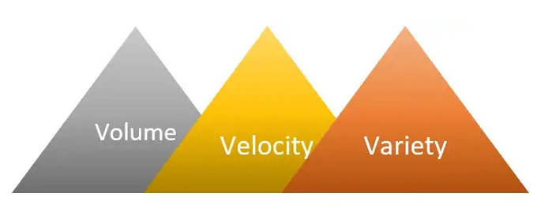
Big Data Era
Science: Astronomy, Physics, Bioinformatics, Neuroinfomatics, earth science, etc.
Business: Automobile, Healthcare, Financial, infotaiment

Slide 10
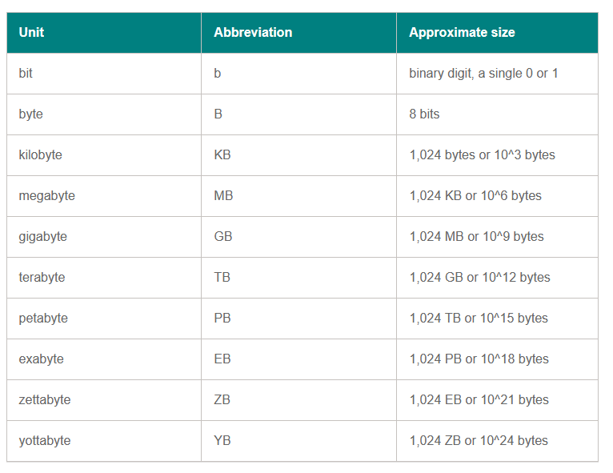
How big is your data?

Slide 11
Big Data Opportunities to Auto
Google self-driving car (generates 1GB/s).
Recommendation/alert to customers.
Manufactures can better understand customers and market trends.
Better driving behaviors, better cars, less accidents, and the bottom line is happier customers.

Slide 12
Big Data Opportunities to Auto
Google self-driving car (generates 1GB/s).
Recommendation/alert to customers.
Manufactures can better understand customers and market trends.
Better driving behaviors, better cars, less accidents, and the bottom line is happier customers.

Slide 13




Turing Awardees in DB
Charles Bachman (1973)
Edgar F. Codd (1981)
Jim Gray (1998)
Michael Stonebraker (2014)

Slide 14
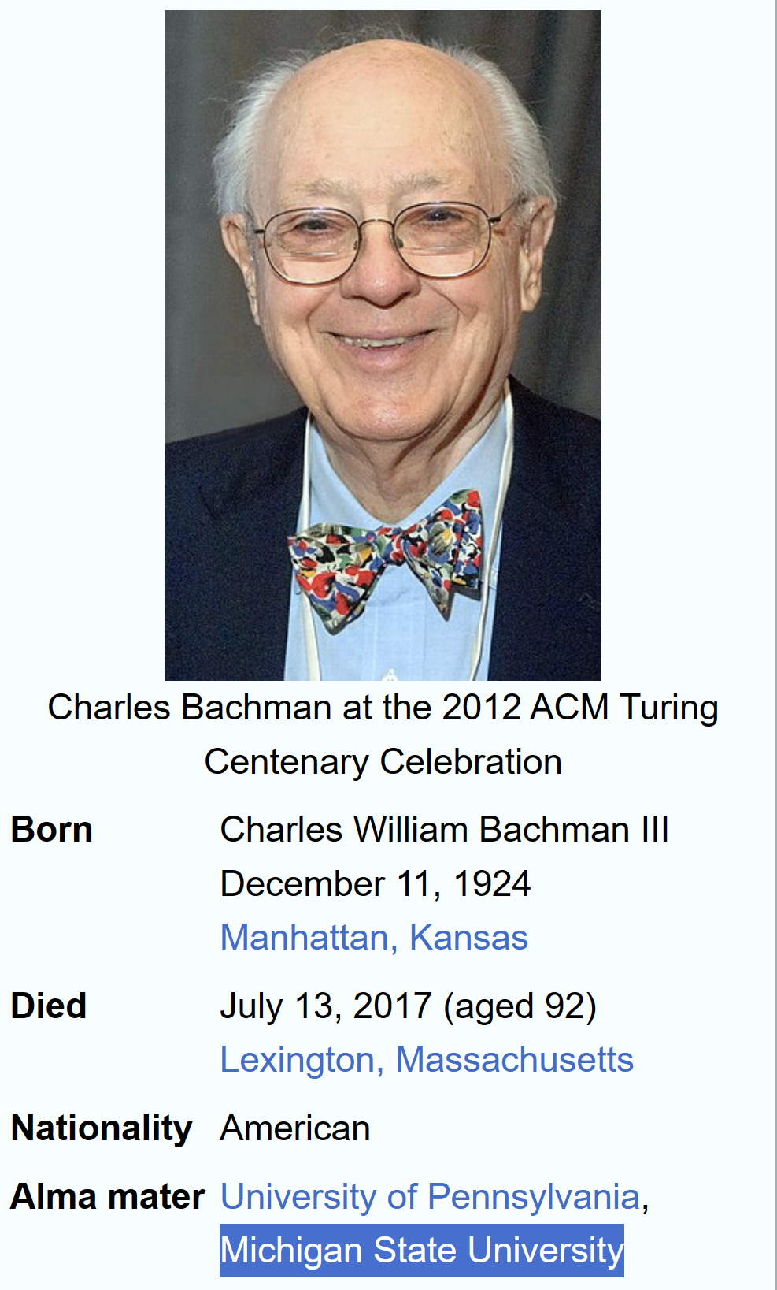
Developer of IDS: the first database system

Slide 15

Inventor of the Relational Model

Slide 16

Jim Gray
Founder of Transaction Processing

Slide 17
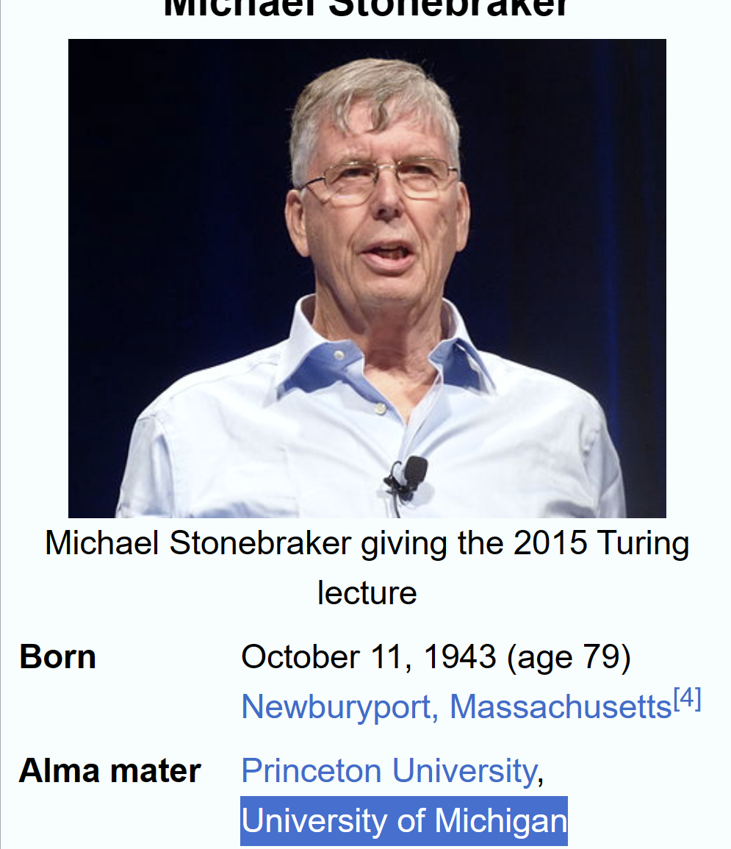
Inventor of Ingres and Postgres
Talk: https://eecs.berkeley.edu/turing-colloquium/schedule/stonebraker

Slide 18
Let’s try some SQL: https://www.programiz.com/sql/online-compiler/#google_vignette

