Slide 1
Chapter 11
An Overview of Query Optimization

Slide 2
Query Evaluation
Problem: An SQL query is declarative – does not specify a query execution plan.
A relational algebra expression is procedural – there is an associated query execution plan.
Solution: Convert SQL query to an equivalent relational algebra and evaluate it using the associated query execution plan.
But which equivalent expression is best?

Slide 3
Naive Conversion
SELECT DISTINCT TargetList
FROM R1, R2, …, RN
WHERE Condition
is equivalent to
π_{TargetList} (σ_{Condition} (R1 × R2 × ... × RN))
but this may imply a very inefficient query execution plan.
Example: π_{Name} (σ_{Id=ProfId ∧CrsCode=‘CS532’} (Professor × Teaching))
Result can be < 100 bytes
But if each relation is 50K then we end up computing an
intermediate result Professor × Teaching of size 500M
before shrinking it down to just a few bytes.
Problem: Find an equivalent relational algebra expression that can be evaluated “efficiently”.

Slide 4
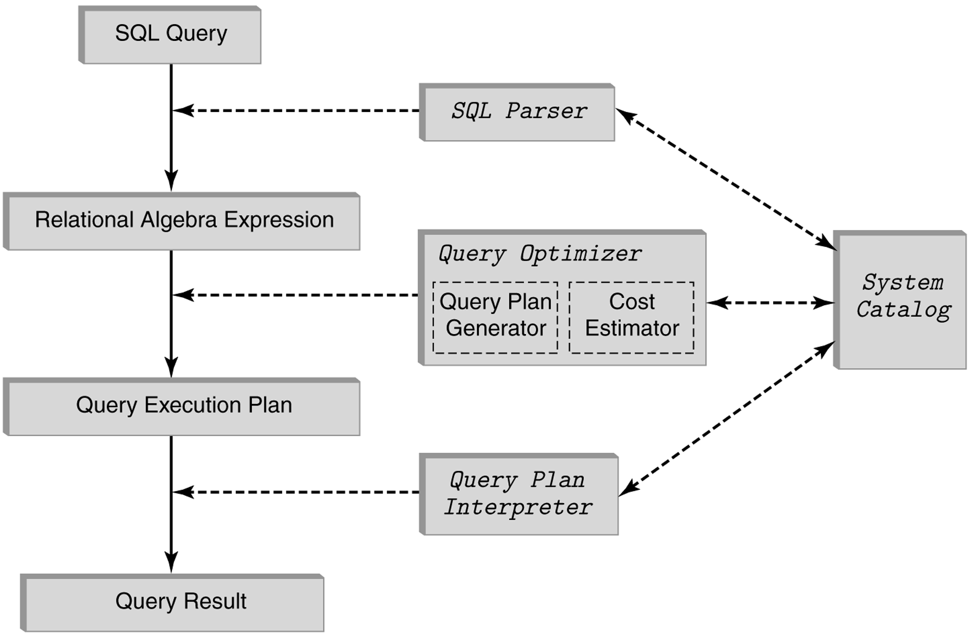
Query Processing Architecture

Slide 5
Query Optimizer
Uses heuristic algorithms to evaluate relational algebra expressions. This involves:
estimating the cost of a relational algebra expression
transforming one relational algebra expression to an equivalent one
choosing access paths for evaluating the subexpressions
Query optimizers do not “optimize” – just try to find “reasonably good” evaluation strategies

Slide 6
Equivalence Preserving Transformations
To transform a relational expression into another equivalent expression we need transformation rules that preserve equivalence
Each transformation rule
Is provably correct (ie, does preserve equivalence)
Has a heuristic associated with it

Slide 7
Selection and Projection Rules
Break complex selection into simpler ones:
σ_{Cond1∧Cond2} (R) ≡ σ_{Cond1} (σ_{Cond2} (R) )
Break projection into stages:
π_{attr} (R) ≡ π _{attr} (π _{attr′} (R)), if attr ⊆ attr′
Commute projection and selection:
π _{attr} (σ_{Cond}(R)) ≡ σ_{Cond} (π _{attr} (R)),
if attr ⊇ all attributes in Cond

Slide 8
Commutativity and Associativity of Join (and Cartesian Product as Special Case)
Join commutativity: R S ≡ S R
used to reduce cost of nested loop evaluation strategies (smaller relation should be in outer loop)
Join associativity: R (S T) ≡ (R S) T
used to reduce the size of intermediate relations in computation of multi-relational join – first compute the join that yields smaller intermediate result
N-way join has T(N)× N! different evaluation plans
T(N) is the number of parenthesized expressions
N! is the number of permutations
Query optimizer cannot look at all plans (might take longer to find an optimal plan than to compute query brute-force). Hence it does not necessarily produce optimal plan

Slide 9
Pushing Selections and Projections
σ_{Cond} (R × S) ≡ R _{Cond} S
Cond relates attributes of both R and S
Reduces size of intermediate relation since rows can be discarded sooner
σ_{Cond} (R × S) ≡ σ_{Cond} (R) × S
Cond involves only the attributes of R
Reduces size of intermediate relation since rows of R are discarded sooner
π_{attr}(R × S) ≡ π_{attr}(π_{attr′} (R) × S),
if attributes(R) ⊇ attr′ ⊇ attr ∩ attributes(R)
reduces the size of an operand of product

Slide 10
Equivalence Example
σ_{C1 ∧C2 ∧C3} (R × S) ≡ σ_{C1} (σ_{C2} (σ_{C3} (R × S) ) ) ≡ σ_{C1} (σ_{C2} (R) × σ_{C3} (S) ) ≡ σ_{C2} (R) _{C1} σ_{C3} (S)
assuming C2 involves only attributes of R,
C3 involves only attributes of S,
and C1 relates attributes of R and S

Slide 11
Cost - Example 1
SELECT P.Name
FROM Professor P, Teaching T
WHERE P.Id = T.ProfId -- join condition
AND P. DeptId = ‘CS’ AND T.Semester = ‘F1994’
π _{Name}(σ_{DeptId=‘CS’ ∧ Semester=‘F1994’}(Professor _{Id=ProfId} Teaching))
π _{Name}
σ_{DeptId=‘CS’∧ Semester=‘F1994’}
_{Id=ProfId}
Master query execution plan (nothing pushed)
Professor Teaching

Slide 12
Metadata on Tables (in system catalogue)
Professor (Id, Name, DeptId)
size: 200 pages, 1000 rows, 50 departments
indexes: clustered, 2-level B⁺tree on DeptId, hash on Id
Teaching (ProfId, CrsCode, Semester)
size: 1000 pages, 10,000 rows, 4 semesters
indexes: clustered, 2-level B⁺tree on Semester;
hash on ProfId
Definition: Weight of an attribute – average number of rows that have a particular value
weight of Id = 1 (it is a key)
weight of ProfId = 10 (10,000 classes/1000 professors)

Slide 13
Estimating Cost - Example 1
Join - block-nested loops with 52 page buffer (50 pages – input for Professor, 1 page – input for Teaching, 1 – output page
Scanning Professor (outer loop): 200 page transfers, (4 iterations, 50 transfers each)
Finding matching rows in Teaching (inner loop): 1000 page transfers for each iteration of outer loop
Total cost = 200+4*1000 = 4200 page transfers

Slide 14
Estimating Cost - Example 1 (cont’d)
Selection and projection – scan rows of intermediate file, discard those that don’t satisfy selection, project on those that do, write result when output buffer is full.
Complete algorithm:
do join, write result to intermediate file on disk
read intermediate file, do select/project, write final result
Problem: unnecessary I/O

Slide 15
Pipelining
Solution: use pipelining:
join and select/project act as coroutines, operate as producer/consumer sharing a buffer in main memory.
When join fills buffer; select/project filters it and outputs result
Process is repeated until select/project has processed last output from join
Performing select/project adds no additional cost
join
Intermediate
result
select/project
output
final result
buffer

Slide 16
Estimating Cost - Example 1 (cont’d)
Total cost:
4200 + (cost of outputting final result)
We will disregard the cost of outputting final result in comparing with other query evaluation strategies, since this will be same for all

Slide 17
Cost Example 2
SELECT P.Name
FROM Professor P, Teaching T
WHERE P.Id = T.ProfId AND
P. DeptId = ‘CS’ AND T.Semester = ‘F1994’
π_{Name}(σ_{Semester=‘F1994’} (σ_{DeptId=‘CS’} (Professor) _{Id=ProfId} Teaching))
π _{Name}
σ_{Semester=‘F1994’}
σ_{DeptId=‘CS’}
Professor Teaching
Partially pushed plan: selection pushed to Professor
_{Id=ProfId}

Slide 18
Cost Example 2 -- selection
Compute σ_{DeptId=‘CS’} (Professor) (to reduce size of one join table) using clustered, 2-level B⁺ tree on DeptId.
50 departments and 1000 professors; hence weight of DeptId is 20 (roughly 20 CS professors). These rows are in ~4 consecutive pages in Professor.
Cost = 4 (to get rows) + 2 (to search index) = 6
keep resulting 4 pages in memory and pipe to next step
clustered index
on DeptId
rows of
Professor

Slide 19
Cost Example 2 -- join
Index-nested loops join using hash index on ProfId of Teaching and looping on the selected professors (computed on previous slide)
Since selection on Semester was not pushed, hash index on ProfId of Teaching can be used
Note: if selection on Semester were pushed, the index on ProfId would have been lost – an advantage of not using a fully pushed query execution plan

Slide 20
Cost Example 2 – join (cont’d)
Each professor matches ~10 Teaching rows. Since 20 CS professors, hence 200 teaching records.
All index entries for a particular ProfId are in same bucket. Assume ~1.2 I/Os to get a bucket.
Cost = 1.2 × 20 (to fetch index entries for 20 CS professors) + 200 (to fetch Teaching rows, since hash index is unclustered) = 224
Teaching
1.2
20 × 10
hash
ProfId

Slide 21
Cost Example 2 – select/project
Pipe result of join to select (on Semester) and project (on Name) at no I/O cost
Cost of output same as for Example 1
Total cost:
6 (select on Professor) + 224 (join) = 230
Comparison:
4200 (example 1) vs. 230 (example 2) !!!

Slide 22
Estimating Output Size
It is important to estimate the size of the output of a relational expression – size serves as input to the next stage and affects the choice of how the next stage will be evaluated.
Size estimation uses the following measures on a particular instance of R:
Tuples(R): number of tuples
Blocks(R): number of blocks
Values(R.A): number of distinct values of A
MaxVal(R.A): maximum value of A
MinVal(R.A): minimum value of A

Slide 23
Estimating Output Size
For the query:
Reduction factor is
Estimates by how much query result is smaller than input
SELECT TargetList
FROM R₁, R₂, …, R_{n}
WHERE Condition
Blocks (result set)
Blocks(R₁) × ... × Blocks(R_{n})

Slide 24
Estimation of Reduction Factor
Assume that reduction factors due to target list and query condition are independent
Thus:
reduction(Query) =
reduction(TargetList) × reduction(Condition)

Slide 25
Reduction Due to Simple Condition
1
Values(R.A)
reduction (R_{i}.A=val) =
reduction (R_{i}.A=R_{j}.B) =
Assume that values are uniformly distributed, Tuples(R_{i}) < Tuples(R_{j}), and every row of R_{i} matches a row of R_{j} . Then the number of tuples that satisfy Condition is:
reduction (R_{i}.A > val) =
1
max(Values(R_{i}.A), Values(R_{j}.B))
Values(R_{i}.A) × (Tuples(R_{i})/Values(R_{i}.A))
× (Tuples(R_{j})/Values(R_{j}.B))
MaxVal(R_{i}.A) – val
MaxVal(R_{i}.A) – MinVal(R_{i}.A)

Slide 26
Reduction Due to Complex Condition
reduction(Cond₁ AND Cond₂) = reduction(Cond₁) × reduction(Cond₂)
reduction(Cond₁ OR Cond₂) =
min(1, reduction(Cond₁) + reduction(Cond₂))

Slide 27
Reduction Due to TargetList
reduction(TargetList) =
number-of-attributes (TargetList)
Σ_{i} number-of-attributes (R_{i})

Slide 28
Estimating Weight of Attribute
weight(R.A) =
Tuples(R) × reduction(R.A=value)

Slide 29
Choosing Query Execution Plan
Step 1: Choose a logical plan
Step 2: Reduce search space
Step 3: Use a heuristic search to further reduce complexity

Slide 30
Step 1: Choosing a Logical Plan
Involves choosing a query tree, which indicates the order in which algebraic operations are applied
Heuristic: Pushed trees are good, but sometimes “nearly fully pushed” trees are better due to indexing (as we saw in the example)
So: Take the initial “master plan” tree and produce a fully pushed tree plus several nearly fully pushed trees.

Slide 31
Step 2: Reduce Search Space
Deal with associativity of binary operators (join, union, …)
D
A B C D
A B C D
C
Logical query
execution plan
A B
Equivalent
query tree
Equivalent left
deep query tree

Slide 32
Step 2 (cont’d)
Two issues:
Choose a particular shape of a tree (like in the previous slide)
Equals the number of ways to parenthesize N-way join – grows very rapidly
Choose a particular permutation of the leaves
E.g., 4! permutations of the leaves A, B, C, D

Slide 33
Step 2: Dealing With Associativity
Too many trees to evaluate: settle on a particular shape: left-deep tree.
Used because it allows pipelining:
Property: once a row of X has been output by P₁, it need not be output again (but C may have to be processed several times in P₂ for successive portions of X)
Advantage: none of the intermediate relations (X, Y) have to be completely materialized and saved on disk.
Important if one such relation is very large, but the final result is small
P₁ P₂ P₃
A B
X C
Y D
X
Y

Slide 34
Step 2: Dealing with Associativity
consider the alternative: if we use the association ((A B) (C D))
A B
P₁
P₂
X
Each row of X must
be processed against
all of Y. Hence all of
Y (can be very large)
must be stored
in P₃, or P₂ has to
recompute it several
times.
X Y
C D
Y
P₃

Slide 35
Step 3: Heuristic Search
The choice of left-deep trees still leaves open too many options (N! permutations):
(((A B) C) D),
(((C A) D) B), …..
A heuristic (often dynamic programming based) algorithm is used to get a ‘good’ plan

Slide 36
Step 3: Dynamic Programming Algorithm
Just an idea – see book for details
To compute a join of E₁, E₂, …, E_{N} in a left-deep manner:
Start with 1-relation expressions (can involve σ, π)
Choose the best and “nearly best” plans for each (a plan is considered nearly best if its out put has some “interesting” form, e.g., is sorted)
Combine these 1-relation plans into 2-relation expressions. Retain only the best and nearly best 2-relation plans
Do same for 3-relation expressions, etc.

Slide 37
Index-Only Queries
A B⁺ tree index with search key attributes A₁, A₂, …, A_{n} has stored in it the values of these attributes for each row in the table.
Queries involving a prefix of the attribute list A₁, A₂, .., A_{n} can be satisfied using only the index – no access to the actual table is required.
Example: Transcript has a clustered B⁺ tree index on StudId. A frequently asked query is one that requests all grades for a given CrsCode.
Problem: Already have a clustered index on StudId – cannot create another one (on CrsCode)
Solution: Create an unclustered index on (CrsCode, Grade)
Keep in mind, however, the overhead in maintaining extra indices

