Slide 1
XML and Web Data
Dr. Shiyong Lu
Big Data Research Laboratory
Department of Computer Science
Wayne State University
shiyong@wayne.edu

Slide 2
What is XML
XML stands for eXtensible Markup Language
XML is a markup language much like HTML
XML was designed to store and transport data
XML was designed to be self-descriptive
XML is a W3C Recommendation

Slide 3
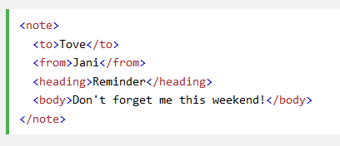
An example of XML document
Tags: note, to, from, heading, body
Nested elements
Self-descriptive
XML has no predefined tags, but for a particular application, tags can be predefined and fixed.

Slide 4
Difference between XML and HTML
XML was designed to carry data - with focus on what data is.
HTML was designed to display data - with focus on how data looks
HTML tags are predefined.
XML tags are not predefined, but are introduced by each application.

Slide 5
Advantages of XML
It simplifies data sharing
It simplifies data transport
It simplifies platform changes
It simplifies data availability

Slide 6
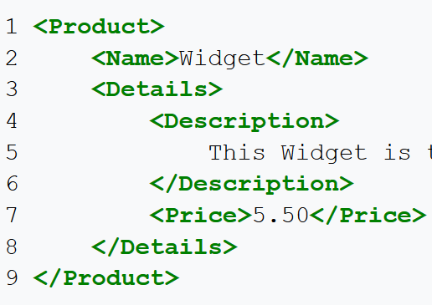
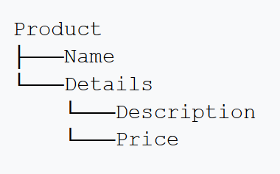
XML tree

Slide 7
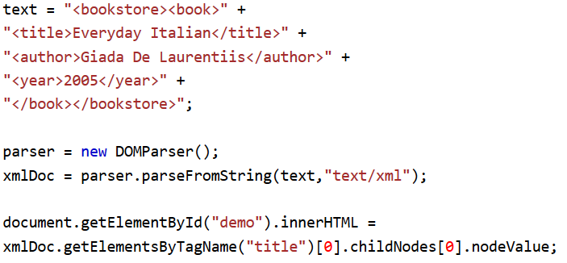
XML Parser

Slide 8
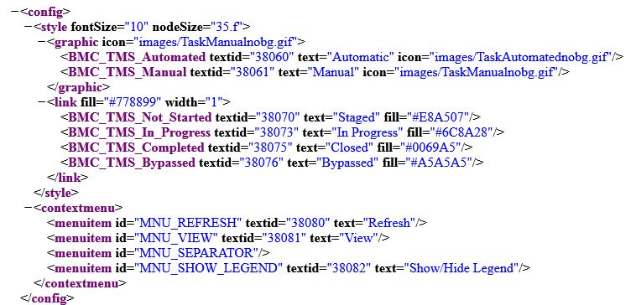
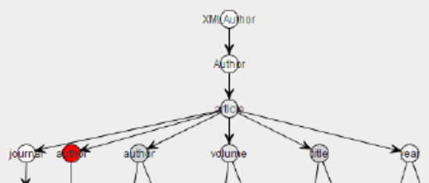
XML visualization

Slide 9
DTD
DTD stands for Document Type Definition.
A DTD defines the structure and the legal elements and attributes of an XML document.
A simple XML schema language, simpler than XSD.

Slide 10
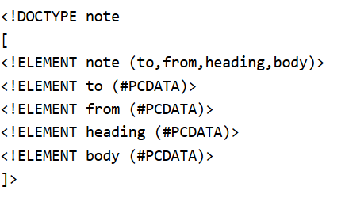
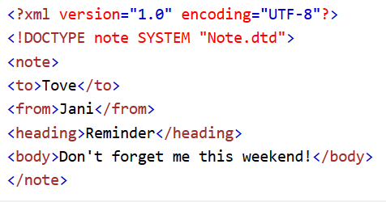
A DTD example
A "Valid" XML document is "Well Formed", as well as it conforms to the rules of a DTD.

Slide 11
ID and IDREF attributes
<!ELEMENT book (title,author,publisher)>
<!ATTLIST book destination ID #REQUIRED>
<!ELEMENT bestbooks (bookref)* >
<!ELEMENT bookref (#PCDATA)>
<!ATTLIST bookref target IDREF #IMPLIED>
<book destination="BookId28752">
<title>Introduction to GKS</title>
<author>Bob Hopgood</author>
<publisher>Academic</publisher>
</book>
<bestbooks>
<bookref target="BookId28752">
Introduction to GKS
</bookref>
<bookref>GKS for Dummies</bookref>
</bestbooks>

Slide 12
XSD
XSD stands for XML Schema Definition.
An XSD defines the structure and the legal elements and attributes of an XML document.
An XML schema language, more sophisticated than DTD.

Slide 13
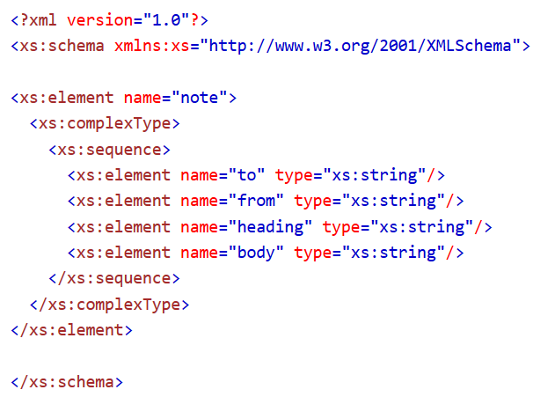
An XSD example
It is an XML document with predefined tags (vocabulary of XSD).

Slide 14
XPath
XPath can be used to navigate through elements and attributes in an XML document.
It is a simple XML query language.
Simpler than XQuery

Slide 15
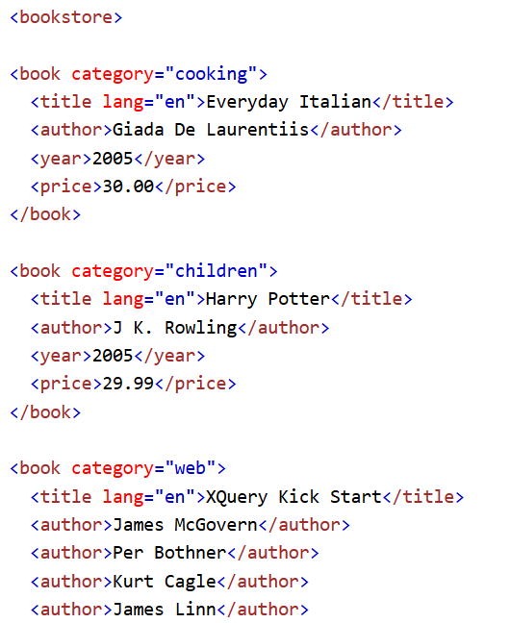
Another example of XML doc

Slide 16
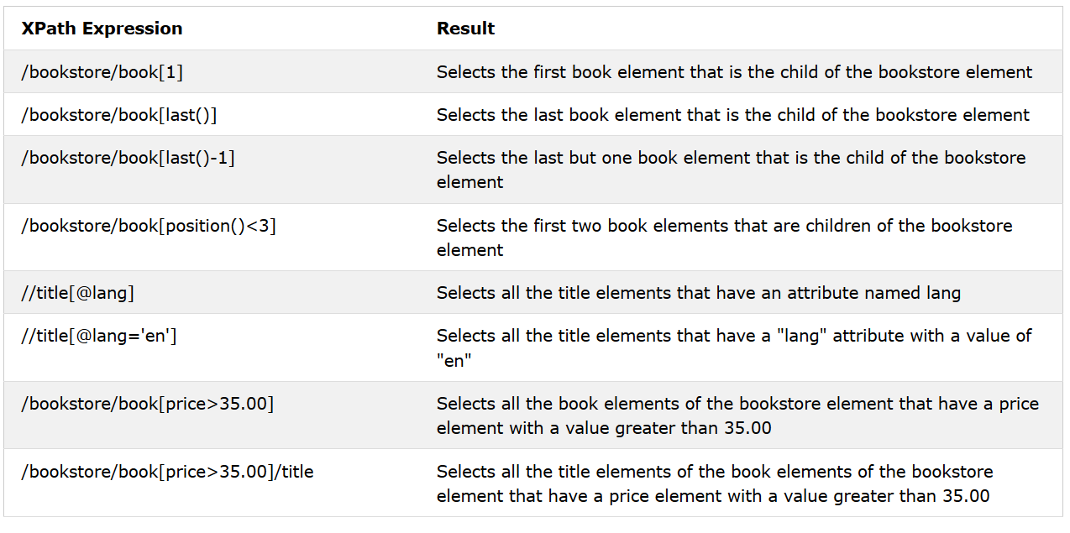
XPath expression examples

Slide 17
XQuery
XQuery is the language for querying XML data
XQuery for XML is like SQL for databases
XQuery is built on XPath expressions
XQuery is supported by all major databases
XQuery is a W3C Recommendation

Slide 18
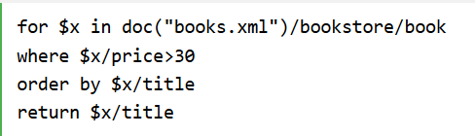
An XQuery query

Slide 19



A comparison between SQL, XPath and XQuery

Slide 20
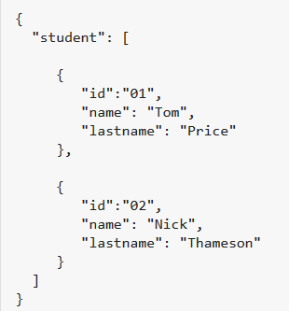
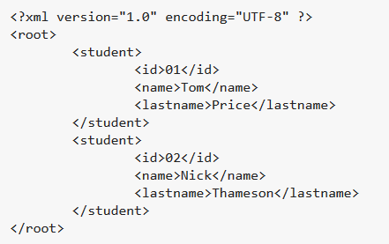
JSON or XML

Slide 21
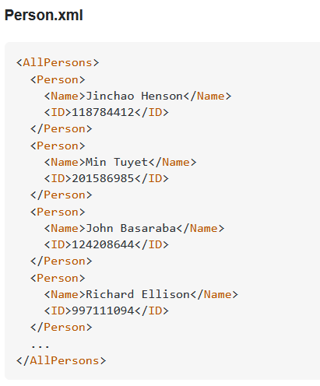
Join in XQuery

Slide 22
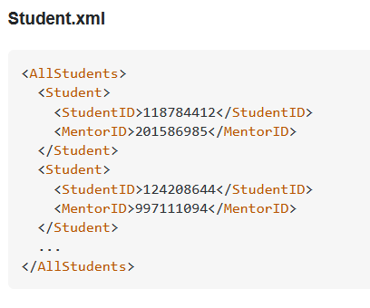
Join in XQuery

Slide 23
Join in XQuery
Faculty.xml
<AllFaculty>
<Faculty>
<FacultyID>201586985</FacultyID>
<Rank>Professor</Rank>
</Faculty>
<Faculty>
<FacultyID>997111094</FacultyID>
<Rank>Reader</Rank>
</Faculty>
...
</AllFaculty>

Slide 24
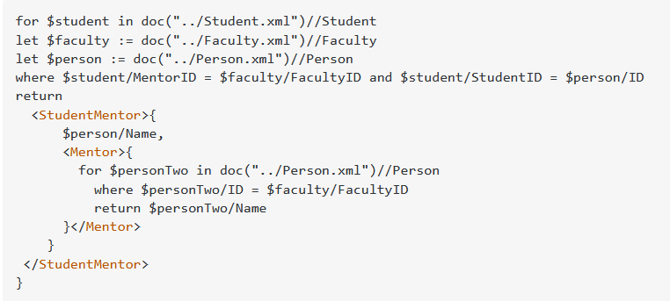
Join in XQuery

Slide 25
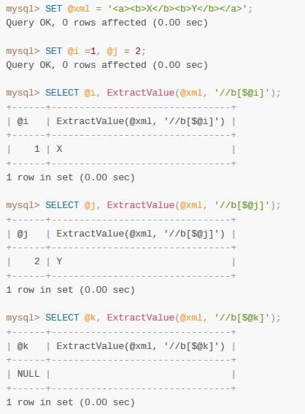
XML in mysql

Slide 26
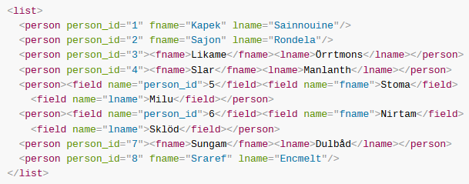

XML in mysql

Slide 27
Summary
XML is one Markup language
Tags are not predefined
Self-descriptive and semi-structured
Schemas and query languages
For some applications, JSON might be a simpler alternative.

