Slide 1
Chapter 4
Database Design I: The Entity-Relationship
Model

Slide 2
Database Design
Goal: specification of database schema
Methodology:
Use E-R model to get a high-level graphical view of essential components of enterprise and how they are related
Convert E-R diagram to DDL
E-R Model: enterprise is viewed as a set of
Entities
Relationships among entities
Constraints among entities or realtionships

Slide 3
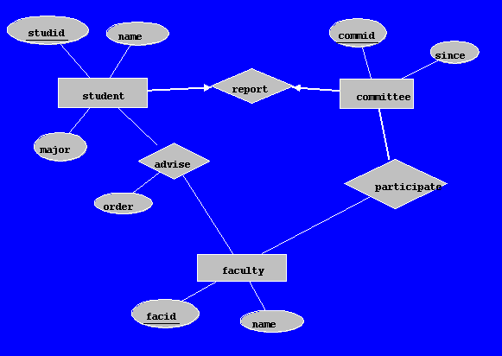
A Sample ER Diagram

Slide 4
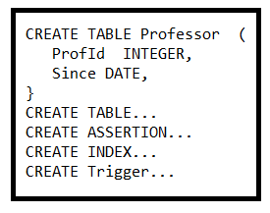
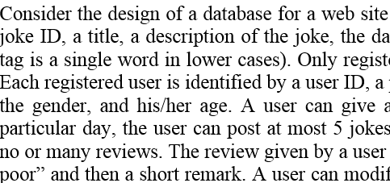
A Two-Phase Design Process
1
2
A project description
An ER model
A relational model

Slide 5
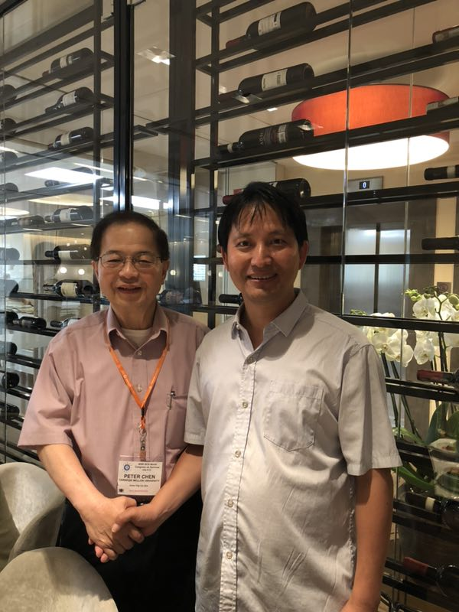
ER Diagram Inventor Prof. Peter Chen
2019 in Milan, Italy

Slide 6
Entities
Entity: an object that is involved in the enterprise
Ex: John, CSE305
Entity Type: set of similar objects
Ex: students, courses
Attribute: describes one aspect of an entity type
Ex: name, maximum enrollment

Slide 7
Entity Type
Entity type described by set of attributes
Person: Id, Name, Address, Hobbies
Domain: possible values of an attribute
Value can be a set (in contrast to relational model)
(111111, John, 123 Main St, {stamps, coins})
Key: minimum set of attributes that uniquely identifies an entity (candidate key)
Entity Schema: entity type name, attributes (and associated domain), key constraints

Slide 8

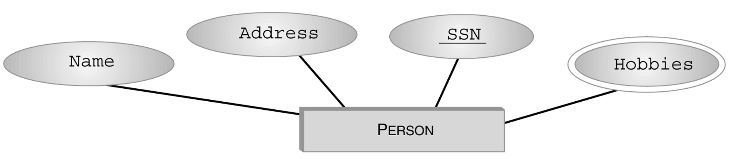
An Example of Entity Type
Set valued

Slide 9
Relationships
Relationship: relates two or more entities
John majors in Computer Science
Relationship Type: set of similar relationships
Student (entity type) related to Department (entity type) by MajorsIn (relationship type).
Distinction:
relation (relational model) - set of tuples
relationship (E-R Model) – describes relationship between entities of an enterprise
Both entity types and relationship types (E-R model) may be represented as relations (in the relational model)

Slide 10
Attributes and Roles
Attribute of a relationship type describes the relationship
e.g., John majors in CS since 2000
John and CS are related
2000 describes relationship - value of SINCE attribute of MajorsIn relationship type
Role of a relationship type names one of the related entities
e.g., John is value of Student role, CS value of Department role of MajorsIn relationship type
(John, CS; 2000) describes a relationship

Slide 11
Relationship Type
Described by set of attributes and roles
e.g., MajorsIn: Student, Department, Since
Here we have used as the role name (Student) the name of the entity type (Student) of the participant in the relationship, but ...

Slide 12






An Example of Relationship Type

Slide 13
Roles
Problem: relationship can relate elements of same entity type
e.g., ReportsTo relationship type relates two elements of Employee entity type:
Bob reports to Mary since 2000
We do not have distinct names for the roles
It is not clear who reports to whom

Slide 14
Roles (con’t)
Solution: role name of relationship type need not be same as name of entity type from which participants are drawn
ReportsTo has roles Subordinate and Supervisor and attribute Since
Values of Subordinate and Supervisor both drawn from entity type Employee

Slide 15

Another Example of Relationship Type

Slide 16
Schema of a Relationship Type
Role names, R_{i}, and their corresponding entity sets. Roles must be single valued (number of roles = degree of relationship)
Attribute names, A_{j}, and their corresponding domains. Attributes may be set valued
Key: Minimum set of roles and attributes that uniquely identify a relationship
Relationship: <e₁, …e_{n}; a₁, …a_{k}>
e_{i} is an entity, a value from R_{i}’s entity set
a_{j} is a set of attribute values with elements from domain of A_{j}

Slide 17
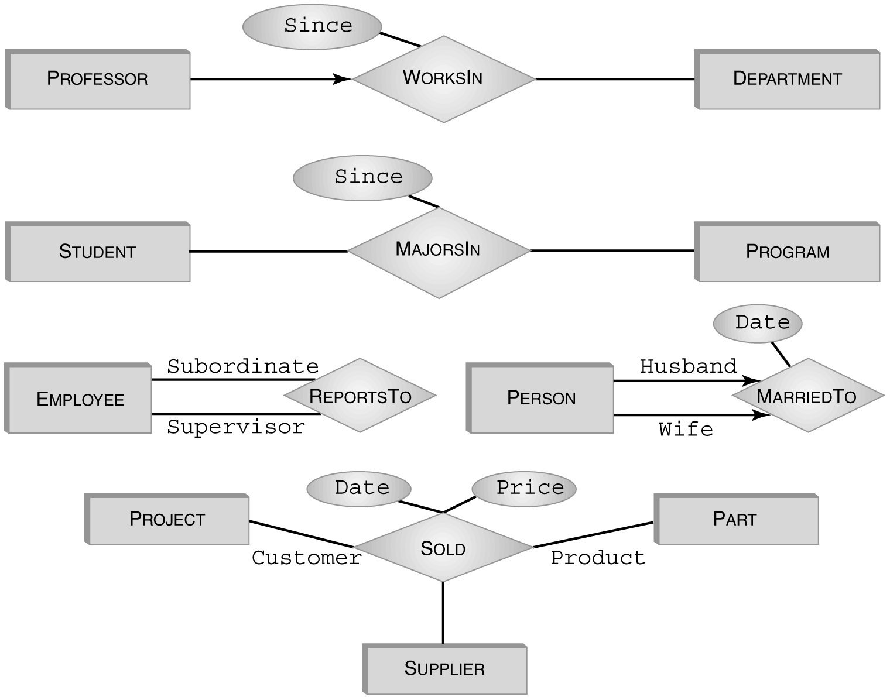
Graphical Representation
Roles are edges labeled with role names (omitted if role name = name of entity set). Most attributes have been omitted.

Slide 18
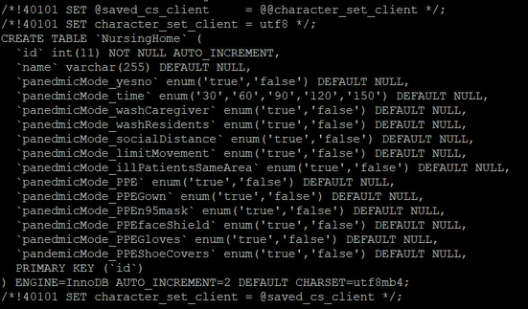






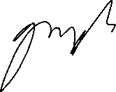


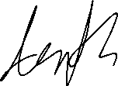




Slide 19
Entity Type Hierarchies
One entity type might be subtype of another
Freshman is a subtype of Student
A relationship exists between a Freshman entity and the corresponding Student entity
e.g., Freshman John is related to Student John
This relationship is called IsA
Freshman IsA Student
The two entities related by IsA are always descriptions of the same real-world object

Slide 20
IsA
Student
Represents 4
relationship types
IsA
Freshman
Sophmore
Junior
Senior

Slide 21
IsA
Student
Represents 4
relationship types
IsA
Freshman
Sophmore
Junior
Senior

Slide 22
Properties of IsA
Inheritance - Attributes of supertype apply to subtype.
E.g., GPA attribute of Student applies to Freshman
Subtype inherits all attributes of supertype.
Key of supertype is key of subtype
Transitivity - Hierarchy of IsA
Student is subtype of Person, Freshman is subtype of Student, so Freshman is also a subtype of Person

Slide 23
Advantages of IsA
Can create a more concise and readable E-R diagram
Attributes common to different entity sets need not be repeated
They can be grouped in one place as attributes of supertype
Attributes of (sibling) subtypes can be different

Slide 24
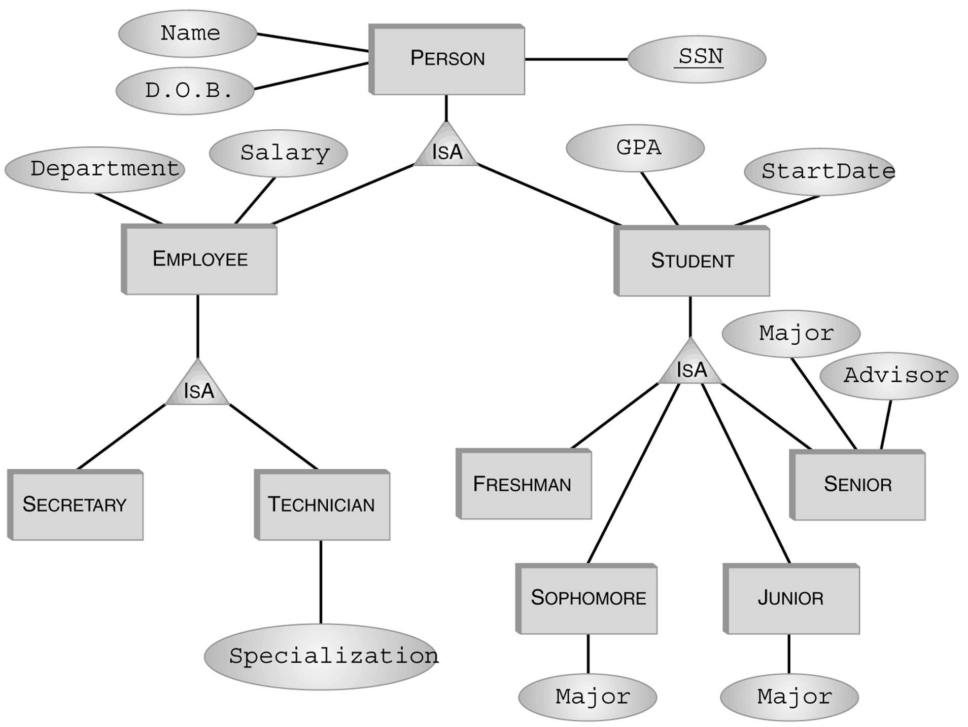
IsA Hierarchy - Example

Slide 25
Constraints on Type Hierarchies
Might have associated constraints:
Covering constraint: Union of subtype entities is equal to set of supertype entities
Employee is either a secretary or a technician (or both)
Disjointness constraint: Sets of subtype entities are disjoint from one another
Freshman, Sophomore, Junior, Senior are disjoint set

Slide 26
An Example
Student
CD
Freshman
Sophomore
Junior
Senior
A student is either a freshman, a sophomore, a junior or a senior but not both.

Slide 27
Another Example
Person
C
Student
Employee
A person is either a student, or an employee, or both.

Slide 28
Single-role Key Constraint
If, for a particular participant entity type, each entity participates in at most one relationship, corresponding role is a key of relationship type
E.g., Professor role is unique in WorksIn
Representation in E-R diagram: arrow
Professor
WorksIn
Department

Slide 29
Participation Constraint
If every entity participates in at least one relationship, a participation constraint holds:
A participation constraint of entity type E having role ρ in relationship type R states that for e in E there is an r in R such that ρ(r) = e.
e.g., every professor works in at least one department
Reprsentation in E-R
Professor
WorksIn
Department

Slide 30
Participation and Key Constraint
If every entity participates in exactly one relationship, both a participation and a key constraint hold:
e.g., every professor works in exactly one department
E-R representation: thick line
Professor
WorksIn
Department

Slide 31
Phase 2: ER to Relational
1
2
A project description
An ER model
A relational model

Slide 32
How to translate this into relational model?
Set valued

Slide 33
Representation of Entity Types in the Relational Model
An entity type corresponds to a relation
Relation’s attributes = entity type’s attributes
Problem: entity type can have set valued attributes, e.g.,
Person: Id, Name, Address, Hobbies
Solution: Use several rows to represent a single entity
(111111, John, 123 Main St, stamps)
(111111, John, 123 Main St, coins)
Problems with this solution:
Redundancy
Key of entity type (Id) not key of relation
Hence, the resulting relation must be further transformed (Chapter 6)

Slide 34
Representation of Relationship Types in the Relational Model
Typically, a relationship becomes a relation in the relational model
Attributes of the corresponding relation are
Attributes of relationship type
For each role, the primary key of the entity type associated with that role
Example:
S2000Courses (CrsCode, SectNo, Enroll)
Professor (Id, DeptId, Name)
Teaching (CrsCode, SecNo, Id, RoomNo, TAs)
SectNo
CrsCode
Enroll
RoomNo
DeptId
Name
Teaching
S2000Courses
Professor
TAs
Id

Slide 35
Representation of Relationship Types in the Relational Model
Candidate key of corresponding table = candidate key of relation
Except when there are set valued attributes
Example: Teaching (CrsCode, SectNo, Id, RoomNo, TAs)
Key of relationship type = (CrsCode, SectNo)
Key of relation = (CrsCode, SectNo, TAs)
Set valued
CrsCode SectNo Id RoomNo TAs
CSE305 1 1234 Hum 22 Joe
CSE305 1 1234 Hum 22 Mary

Slide 36
Representation in SQL
Each role of relationship type produces a foreign key in corresponding relation
Foreign key references table corresponding to entity type from which role values are drawn

Slide 37

proj1
part2
supp4
Date
Price
Sold
Project
Part
Supplier
CREATE TABLE Sold (
Price INTEGER, -- attribute
Date DATE, -- attribute
ProjId INTEGER, -- role
SupplierId INTEGER, -- role
PartNumber INTEGER, -- role
PRIMARY KEY (ProjId, SupplierId, PartNumber, Date),
FOREIGN KEY (ProjId) REFERENCES Project,
FOREIGN KEY (SupplierId) REFERENCES Supplier (Id),
FOREIGN KEY (PartNumber) REFERENCES Part (Number) )
What if in the same day, a part is ordered from the same supplier for the same project?

Slide 38
Key Constraints
Each professor works in AT MOST ONE department
Professor
WorksIn
Department
Id
ProfId
Key
1123
4100
3216
1123 CSE
3216 AMS
WorksIn
Professor

Slide 39
Key Constraints
Since
Status
WorksIn
Professor
Department
CREATE TABLE Professor (
ProfId INTEGER, -- role (key of Professor)
Since DATE, -- attribute
Status CHAR (10), -- attribute
DeptId CHAR (4), -- role (key of Department)
PRIMARY KEY (ProfId), -- since a professor works in at most one department
FOREIGN KEY (ProfId) REFERENCES Professor (Id),
FOREIGN KEY (DeptId) REFERENCES Department )
What if there is also a thick line between Professor and WorksIn?

Slide 40
Key and Total Participation Constraints
Each professor works in EXACTLY ONE department
Professor
WorksIn
Department
Id
ProfId
xxxxxx 1123
yyyyyy 4100
zzzzzzz 3216
1123 CSE
4100 ECO
3216 AMS
Professor
WorksIn

Slide 41
Key + Total Participation Constraints
Since
Status
WorksIn
Professor
Department
CREATE TABLE Professor (
ProfId INTEGER, -- role (key of Professor)
Since DATE, -- attribute
Status CHAR (10), -- attribute
DeptId CHAR (4) NOT NULL, -- role (key of Department)
PRIMARY KEY (ProfId), -- since a professor works in at most one department
FOREIGN KEY (DeptId) REFERENCES Department )
What if there is ONLY a thick line between Professor and WorksIn?

Slide 42
Total Participation Constraints
Each professor works in AT LEST ONE department
Professor
WorksIn
Department
ProfId
Id
1123 CSE
1123 AMS
4100 ECO
3216 AMS
1123
4100
3216
Professor
WorksIn

Slide 43
Solution 1
CREATE ASSERTION ProfsInDepts
CHECK ( NOT EXISTS (
SELECT * FROM Professor P
WHERE NOT EXISTS (
SELECT * FROM WorksIn W
WHERE W.ProfId = P.id ) ) )
The “No witness” Pattern
Abnormal professors: those professors who do not work in any department.
Two questions: 1) What are abnormal? Professor
2) When are they abnormal? When they don’t work in any department.

Slide 44
Solution 2
CREATE ASSERTION ProfsInDepts
CHECK ( NOT EXISTS (
SELECT * FROM Professor P
WHERE 0 = (
SELECT COUNT(*) FROM
WorksIn W
WHERE P.Id = W.ProfId ) ) )
The “No witness” pattern:
Abnormal professors: those professors who do not work in any department.
Two questions: 1) What are abnormal? Professor
2) When are they abnormal? When they don’t work in any department.

Slide 45
Solution 3
CREATE ASSERTION ProfsInDepts
CHECK (0 = (
SELECT COUNT(*) FROM Professor P
WHERE 0 = (
SELECT COUNT(*) FROM WorksIn W
WHERE P.Id = W.ProfId ) ) )
The “No witness” pattern:
Abnormal professors: those professors who do not work in any department.
Two questions: 1) What are abnormal? Professor
2) When are they abnormal? When they don’t work in any department.

Slide 46
Constraints Example
Advise
Faculty
Student
B
A
C
 | b
a
0 or many a
0 or many b
At most 1 a
At most 1 b
At least 1 b
At least 1 a
Exactly 1 b
Exactly 1 a

Slide 47
Constraints Example
Ask
Questions
Student
B
A
C
 | b
a
0 or many a
0 or many b
At most 1 a
At most 1 b
At least 1 b
At least 1 a
Exactly 1 b
Exactly 1 a

Slide 48
Representing Type Hierarchies in the Relational Model
Supertypes and subtypes can be realized as separate relations
Need a way of identifying subtype entity with its (unique) related supertype entity
Choose a candidate key and make it an attribute of all entity types in hierarchy

Slide 49
Type Hierarchies and the Relational Model
Translated by adding the primary key of supertype to all
subtypes. Plus foreign key from subtypes to the supertype.
Id attribs0
Student
Id attribs1 Id attribs2 Id attribs3 Id attribs4
Freshman Sophmore Junior Senior
FOREIGN KEY Id REFERENCES Student
in Freshman, Sophomore, Sunior, Senior

Slide 50
Type Hierarchies and the Relational Model
Redundancy eliminated if IsA is not disjoint
For individuals who are both employees and students, Name and DOB are stored only once
Person
Employee Student
SSN Name DOB SSN Department Salary SSN GPA StartDate
1234 Mary 1950 1234 Accounting 35000 1234 3.5 1997

Slide 51
Type Hierarchies and the Relational Model
Other representations are possible in special cases, such as when all subtypes are disjoint
See in the book

Slide 52
Entity or Attribute?
Sometimes information can be represented as either an entity or an attribute.
Transcript
Student
Semester
Grade
Course
Semester
Appropriate if Semester has attributes
(next slide)
Transcript
Student
Grade
Course

Slide 53
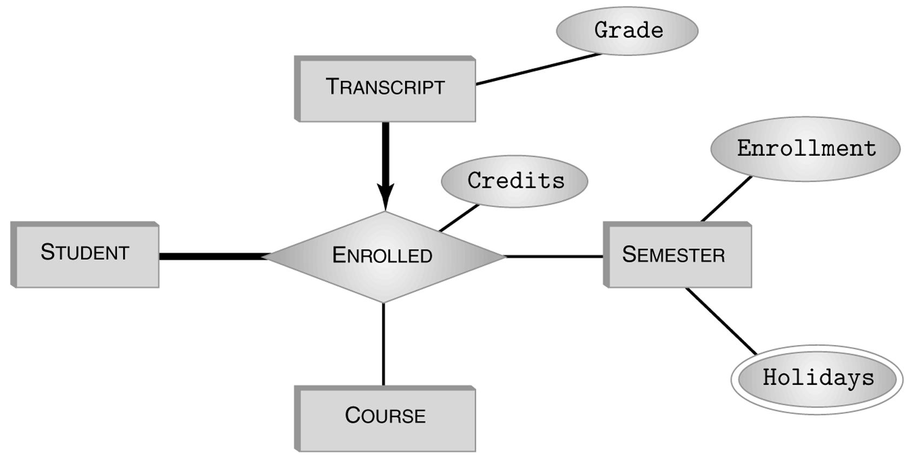
Entity or Relationship?

Slide 54
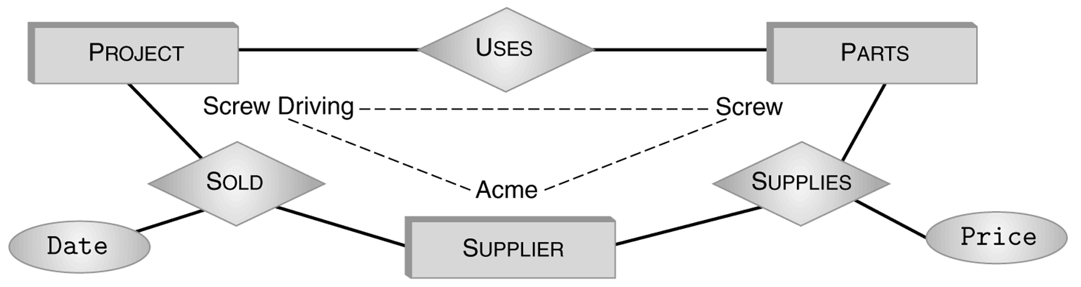
(Non-) Equivalence of Diagrams
Transformations between binary and ternary relationships.
Part
Date
Project
Sold
Price
Supplier
supp3
part2
proj1

Slide 55
Create a new entity type
Part
Supplier
Project
Orders
OrID
Date
Price
Each order is for EXACTLY one project, one supplier, and multiple parts.

Slide 56
Create a new entity type
CREATE TABLE Orders (
OrId INTEER,
Price INTEGER, -- attribute
Date DATE, -- attribute
ProjId INTEGER, -- role
SupplierId INTEGER, -- role
PRIMARY KEY (OrId),
FOREIGN KEY (ProjId) REFERENCES Project,
FOREIGN KEY (SupplierId) REFERENCES Supplier (Id),
)
CREATE TABLE OrderParts(
OrID INTEGER,
partNO INTEGER,
PRIMARY KEY(OrID, partNO),
FOREIGN KEY(partNO) REFERENCES Parts(partNO)
)

Slide 57
Self-relationship
catid
catname
catid
catname
Category
Category
ChildOf
keywords
keywords

Slide 58
Self-relationship
catid
catname
child
Category
ChildOf
parent
keywords

Slide 59
Self-relationship
CREATE TABLE Category
(
catid INTEGER,
parentid INTEGER, // parentid can take NULL value
catname VARCHAR(50),
PRIMARY KEY(catid),
FOREIGN KEY parentid REFERENCES Category(catid)
)
CREATE TABLE catHasKeywords(
catid INTEGER,
keyword VARCHAR(50),
PRIMARY KEY(catid, keyword),
FOREIGN KEY catid REFERENCES Category
)

Slide 60
Self-relationship
Catid | Catname | parentid
111 | a | Not applicable
222 | b | 111
333 | c | 111
444 | d | 222
a
b
c
d
Catid | Keyword
111 | "funny"
222 | "fantastic"
111 | "hilarious"
111 | "agnostic"
333 NULL (wrong)

Slide 61
An Example of Entity Type
Set valued

Slide 62
How to deal with Anomalies
ER Model
SSN Name Address Hobby
1111 Joe 123 Main {biking, hiking}
Relational Model
SSN Name Address Hobby
1111 Joe 123 Main biking
1111 Joe 123 Main hiking
…………….
Redundancy

Slide 63
Anomalies
Redundancy leads to anomalies:
Update anomaly: A change in Address must be made in several places
Deletion anomaly: Suppose a person gives up all hobbies. Do we:
Set Hobby attribute to null? No, since Hobby is part of key
Delete the entire row? No, since we lose other information in the row
Insertion anomaly: Hobby value must be supplied for any inserted row since Hobby is part of key

Slide 64
Decomposition
Solution: use two relations to store Person information
Person1 (SSN, Name, Address)
Hobbies (SSN, Hobby)
The decomposition is more general: people with hobbies can now be described
No update anomalies:
Name and address stored once
A hobby can be separately supplied or deleted

Slide 65
Decomposition
R={ssn, town, zip, crscode, semester, grade}
R1 = {ssn, town}
R2 = {town, zip}
R3 = {ssn, crscode, semester, grade}.
Assumption: assume each town has exactly one ZIP.

Slide 66
ER case study 1
Consider the design of the following database system for managing a conference X: a collection of papers are submitted to X, each of which has a unique paper IDs, a list of authors (names, affiliations, emails) in the order of contribution significance, title, abstract, and a PDF file for its content. The conference has a list of program committee (PC) members to review the papers. To ensure review quality, each paper is assigned to 3 PC members for review. To avoid overloading, each PC member is assigned with at most 5 papers, assuming that there are enough PC members. Each review report consists of a report ID, a description of review comment, a final recommendation (accept, reject), and the date the review report is submitted. A PC member can submit at most one review report for the paper that is assigned to him/her.

Slide 67
ER case study 1 (con’t)
Draw an E-R diagram for the above system. Use underlines, thick lines, and arrows to represent constraints. State your assumptions if necessary.
Translate the previous E-R diagram for exercise1 into a relational model, i.e., a set of CREAT TABLE statements enforcing all stated constraints. In addition, write a CREATE ASSERTION statement to enforce that no PC member will be assigned to a paper of which she/he is a coauthor.

Slide 68
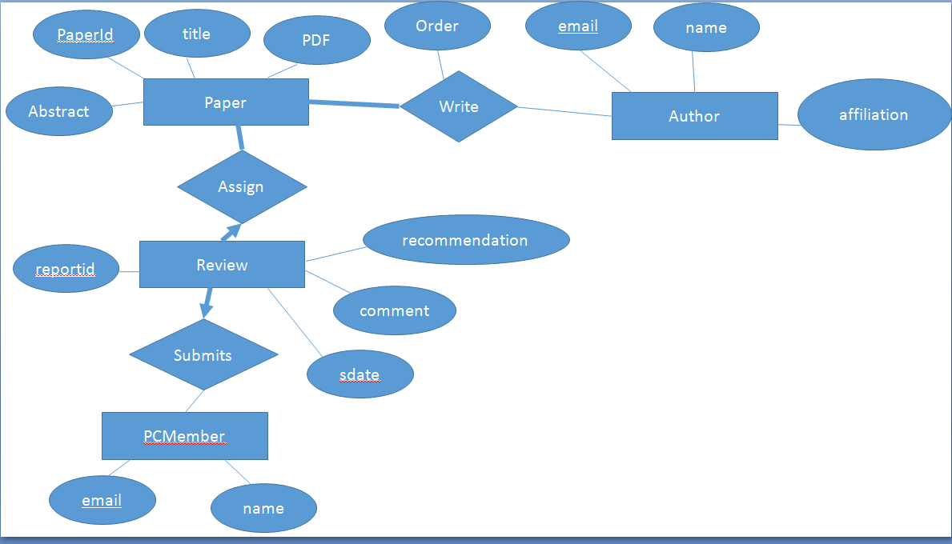
How about modeling ‘Review’ as an entity type?
Credit of Renuka Gangireddy

Slide 69
SQL statements
Create table paper (
paperid integer,
title VARCHAR(50),
abstract VARCHAR(250),
pdf VARCHAR(100),
primary key (paperid)
)

Slide 70
SQL statements
Create table author(
email VARCHAR(100),
name VARCHAR(50),
affiliation VARCHAR(100),
primary key(email)
)

Slide 71
CREATE table write(
paperid integer,
email varchar(50),
order integer,
primary key(paperid, email),
foreign key paperid references paper,
foreign key email references author,
Unique(paperid, order),
)

Slide 72
create table pcmember(
email VARCHAR(50),
name VARCHAR(20),
primary key (email)
)

Slide 73
create table review(
reportid integer,
sdate DATE,
comment VARCHAR(250),
recommendation CHAR(1),
paperid integer NOT NULL,
email VARCHAR(100) NOT NULL,
primary key(reportid),
foreign key(paperid) references paper,
foreign key(email) references pcmember
)

Slide 74
CREATE Assertion 3pc
CHECK NOT EXISTS (
SELECT * FROM Papers P
WHERE 3 <> (
SELECT COUNT(*)
FROM Review R
WHERE R.paperid = P.paperid
)
)
The “No witness” pattern:
Witnesses: those whose number of reviewers is not equal to 3.

Slide 75
CREATE ASSERTION atmostfivepapers
CHECK NOT EXISTS
(
SELECT * FROM pcmember P
WHERE 5 < (
SELECT COUNT(*)
FROM review R
WHERE R.email = P.email
)
)
The “No witness” pattern:
Witnesses: those who review more than five papers.

Slide 76
ER case study 2
Suppose you are asked to design a club database system based on the following information. Each student has a unique student id, a name, and an email; each club has a unique club id, a name, a contact telephone number, and has exactly one student as its president. Each student can serve as a president in at most one of the clubs, although he/she can be the members of several clubs. Clubs organize activities and students can participate in any of them. Each activity is described by a unique activity id, a place, a date, a time and those clubs that organize it. If an activity is organized by more than one club, different clubs might contribute different activity fees.

Slide 77
ER case study 2 (con’t)
Draw an E-R diagram for the system, in particular, use arrows or thick lines to represent constraints appropriately. Write down your assumptions if necessary.
Translate the above E-R diagram to a relational model, in particular, specify your primary key and foreign key constraints clearly.

Slide 78
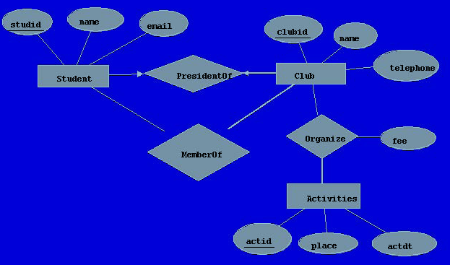
Reference solution
Participate

Slide 79
CREATE TABLE Student (
studid CHAR(9),
email VARCHAR(50),
name VARCHAR(50) NOT NULL,
PRIMARY KEY ( studid ),
)

Slide 80
CREATE TABLE Club (
clubid INTEGER,
telephone VARCHAR(15),
name VARCHAR(50),
studentid CHAR(9) NOT NULL,
unique(studtid),
PRIMARY KEY (clubid),
FOREIGN KEY (studtid) REFERENCES Student(studid )
)

Slide 81
CREATE TABLE MemberOf (
clubid INTEGER,
studid VARCHAR(50),
PRIMARY KEY (clubid, studid ),
FOREIGN KEY (clubid ) REFERENCES Club( clubid ),
FOREIGN KEY (studid ) REFERENCES Student( studid )
)

Slide 82
CREATE TABLE Activities (
actid INTEGER,
actdt DATETIME,
place VARCHAR(50),
PRIMARY KEY (actid )
)

Slide 83
CREATE TABLE Organize (
actid INTEGER,
clubid INTEGER,
fee DOUBLE,
PRIMARY KEY (actid, clubid ),
FOREIGN KEY (actid ) REFERENCES Activities(actid ),
FOREIGN KEY (clubid ) REFERENCES Club( clubid )
)

Slide 84
CREATE ASSERTION AtLeastOneOrganizer
CHECK NOT EXISTS(
SELECT *
FROM Activities A
WHERE NOT EXISTS(
SELECT *
FROM Organize O
WHERE O.actid=A.actid
)
)
The “NO witness” pattern:
Witnesses: those that have no organizers

Slide 85
ER case study 3
Consider the design of a database for the management of grants. Each grant is identified by a unique grant ID, a title, the funding source of the grant, the period (starting date and ending date), and the amount of grant. Each grant might be participated by several professors and each professor might also participate in several grants. Each professor is identified by a unique SSN, name, and email address. In addition, several graduate students might be supported by a grant as GRAs, although each student can be supported by at most one grant. Each graduate student has exactly one professor as his/her advisor.

Slide 86
ER case study 3 (con’t)
Draw an E-R diagram for the system, in particular, use arrows or thick lines to represent constraints appropriately. Write down your assumptions and justifications briefly and clearly.
Translate the above E-R diagram into a relational model, i.e., write a set of CREATE TABLE statements. In particular, specify primary key, foreign key and other constraints whenever possible.

Slide 87
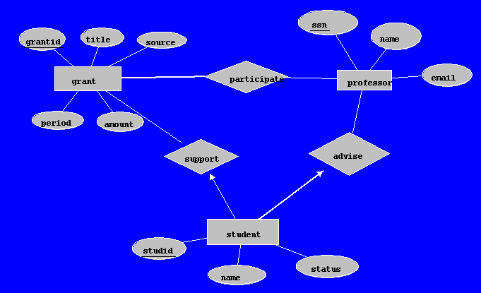
Reference solution

Slide 88
create table grant(
grantid integer,
title varchar(50),
source varchar(50),
periodstart DATE,
periodend DATE,
amount integer,
primary key(grantid)
)

Slide 89
Create table professor(
ssn char(9),
name VARCHAR(20),
email varchar(20),
primary key(ssn),
unique(email)
)

Slide 90
Create table participate
(grantid integer,
professorid char(9),
primary key(grantid, professorid),
foreign key grantid references grant,
foreign key professorid references professor(ssn))

Slide 91
Create student
(studid integer,
name varchar(50),
status varchar(20),
advisor char(9) NOT NULL,
supportgrantid integer,
primary key(studid),
foreign key advisor references professor,
Foreign key supportgrantid references grant(grantid)
)

Slide 92
ER case study 4
Consider the design of the following database system: each PhD student has exactly one a dissertation committee which consists of 4-5 faculty, and each committee is for exactly one student. Each student has an ordered list of advisors including the primary advisor followed by 0 or more secondary advisors. Each student has a unique studid, a name, and a major. Each committee has a unique committee id, and the date the committee is formed. Each faculty has a unique facid and a name. Each faculty can participate in multiple committees and be the advisors (either primary or secondary) of several students.

Slide 93
ER case study 4 (con’t)
Draw an E-R diagram for the above system. Use underlines, thick lines, and arrows to represent constraints. State your assumptions if necessary.
Translate your E-R diagram for problem 1 into a relational model, i.e., a set of CREAT TABLE/ASSERTION statements enforcing all stated constraints. In addition, write a CREATE ASSERTION statement to enforce that each committee consists of the primary advisor of the student and all other members of the committee cannot be the secondary advisors of the student.

Slide 94
Reference solution

Slide 95
Reference solution
CREATE TABLE Advise (
studid CHAR(9),
facid VARCHAR(50),
order INTEGER,
PRIMARY KEY ( studid, facid),
UNIQUE(studid, order),
FOREIGN KEY ( studid ) REFERENCES Students ( studid ),
FOREIGN KEY (facid ) REFERENCES Faculty ( facid )
)

Slide 96
CREATE TABLE Student (
studid CHAR(9) NOT NULL,
name VARCHAR(50),
major VARCHAR(50),
since DATE,
PRIMARY KEY ( studid )
)

Slide 97
CREATE TABLE Participate (
studid CHAR(9),
facid CHAR(9),
PRIMARY KEY (studid, facid ),
FOREIGN KEY ( studid ) REFERENCES Student
FOREIGN KEY (facid ) REFERENCES Faculty ( facid )
)

Slide 98
The primary advisor must be in the committee
CREATE ASSERTION
CHECK NOT EXISTS(
SELECT * from Student S
WHERE (
SELECT facid // one primary advisor
FROM Advise A
WHERE A.stuid = S.stuid and A.order = 1
) NOT IN
( // all my committee members
select facid
FROM Participate P
WHERE P.stuid = S.studid
)
)

Slide 99
Other co-advisors must be NOT in the committee
CREATE ASSERTION
CHECK NOT EXISTS(
SELECT * from Student S
WHERE EXISTS( // some committee members are co-advisors
SELECT A.facid
FROM Advise A, Pariticpate P
WHERE A.stuid = S.stuid AND A.stuid = P.stuid AND A.order <> 1 AND A.facid = P.facid
)

