Slide 1
Chapter 9
Physical Data Organization and Indexing

Slide 2
Disks
Capable of storing large quantities of data cheaply
Non-volatile
Extremely slow compared with cpu speed
Performance of DBMS largely a function of the number of disk I/O operations that must be performed

Slide 3
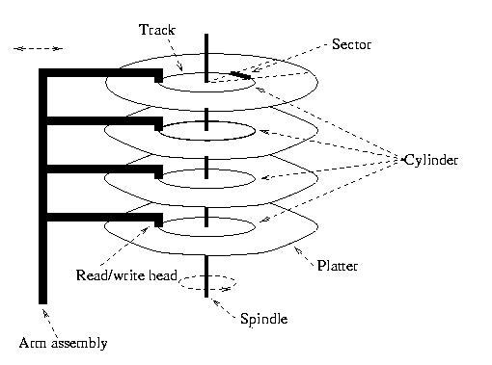
Physical Disk Structure

Slide 4
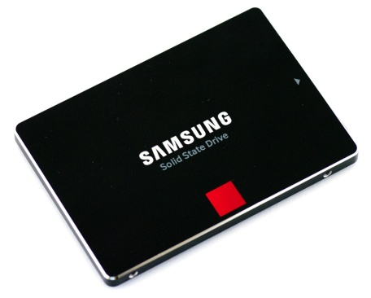
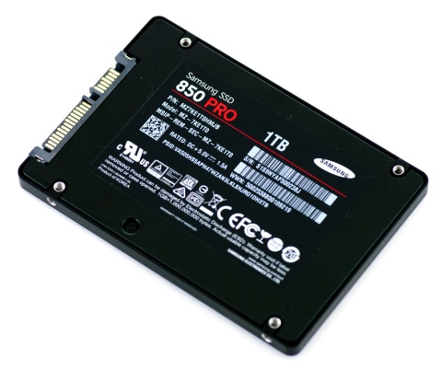
Solid State Drive
There are no moving parts as HDD.
Information is stored in microchips.
SSD is much faster than HDD.
A typical SSD uses a non-volatile type of memory that called NAND-based flash memory.

Slide 5
Pages and Blocks
Data files decomposed into pages
  Fixed size piece of contiguous information in the file
  Unit of exchange between disk and main memory
Disk divided into page size blocks of storage
  Page can be stored in any block
Application’s request for read item satisfied by:
  Read page containing item to buffer in DBMS
  Transfer item from buffer to application
Application’s request to change item satisfied by
  Read page containing item to buffer in DBMS (if it is not already there)
  Update item in DBMS (main memory) buffer
  (Eventually) copy buffer page to page on disk

Slide 6
I/O Time to Access a Page
Seek latency – time to position heads over cylinder containing page (avg = ~10 - 20 ms)
Rotational latency – additional time for platters to rotate so that start of block containing page is under head (avg = ~5 - 10 ms)
Transfer time – time for platter to rotate over block containing page (depends on size of block)
Latency = seek latency + rotational latency
Our goal – minimize average latency, reduce number of page transfers

Slide 7
Reducing Latency
Store pages containing related information close together on disk
  Justification: If application accesses x, it will next access data related to x with high probability
Page size tradeoff:
  Large page size – data related to x stored in same page; hence additional page transfer can be avoided
  Small page size – reduce transfer time, reduce buffer size in main memory
  Typical page size – 4096 bytes

Slide 8
Reducing Number of Page Transfers
Keep cache of recently accessed pages in main memory
  Rationale: request for page can be satisfied from cache instead of disk
  Purge pages when cache is full
    For example, use LRU algorithm
    Record clean/dirty state of page (clean pages don’t have to be written)

Slide 9
Accessing Data Through Cache
DBMS
Page transfer
Application
cache
block
Item
transfer
Page frames

Slide 10
RAID Systems
RAID (Redundant Array of Independent Disks) is an array of disks configured to behave like a single disk with
  Higher throughput
    Multiple requests to different disks can be handled independently
    If a single request accesses data that is stored separately on different disks, that data can be transferred in parallel
  Increased reliability
    Data is stored redundantly
    If one disk should fail, the system can still operate

Slide 11
Striping
Data that is to be stored on multiple disks is said to be striped
  Data is divided into chunks
    Chunks might be bytes, disk blocks etc.
  If a file is to be stored on three disks
    First chunk is stored on first disk
    Second chunk is stored on second disk
    Third chunk is stored on third disk
    Fourth chunk is stored on first disk
    And so on

Slide 12
F1
F2
F3
F4
The striping of a file across three disks

Slide 13
Levels of RAID System
Level 1: Striping but no redundancy
  A striped array of n disks
  The failure of a single disk ruins everything

Slide 14
RAID Levels (con’t)
  Level 2: Mirrored Disks (no striping)
    An array of n mirrored disks
      All data stored on two disks
    Increases reliability
      If one disk fails, the system can continue
    Increases speed of reads
      Both of the mirrored disks can be read concurrently
    Decreases speed of writes
      Each write must be made to two disks
    Requires twice the number of disks

Slide 15
RAID Levels (con’t)
Level 3: Data is striped over n disks and an (n+1)^{th} disk is used to stores the exclusive or (XOR) of the corresponding bytes on the other n disks
  The (n+1)^{th} disk is called the parity disk
  Chunks are bytes

Slide 16
Level 3 (con’t)
Redundancy increases reliability
  Setting a bit on the parity disk to be the XOR of the bits on the other disks makes the corresponding bit on each disk the XOR of the bits on all the other disks, including the parity disk
  1 0 1 0 1 1 (parity disk)
  If any disk fails, its information can be reconstructed as the XOR of the information on all the other disks

Slide 17
Level 3 (con’t)
Whenever a write is made to any disk, a write must by made to the parity disk
  New_Parity_Bit = Old_Parity_Bit XOR
    (Old_Data_Bit XOR New_Data_Bit)
Thus each write requires 4 disk accesses
The parity disk can be a bottleneck since all writes involve a read and a write to the parity disk

Slide 18
RAID Levels (con’t)
Level 5: Data is striped and parity information is stored as in level 3, but
  The chunks are disk blocks
  The parity information is itself striped and is stored in turn on each disk
    Eliminates the bottleneck of the parity disk
  Level most often recommended for transaction processing applications

Slide 19
RAID Levels (con’t)
Level 10: A combination of levels 0 and 1 (not an official level)
  A striped array of n disks (as in level 0)
  Each of these disks is mirrored (as in level 1)
    Achieves best performance of all levels
    Requires twice as many disks

Slide 20
Controller Cache
To further increase the efficiency of RAID systems, a controller cache can be used in memory
  When reading from the disk, a larger number of disk blocks than have been requested can be read into memory
  In write back cache, the RAID system reports that the write is complete as soon as the data is in the cache (before it is on the disk)
    Requires some redundancy of information in cache
  If all the blocks in a stripe are to be updated, the new value of the parity block can be computed in the cache and all the writes done in parallel

Slide 21
Access Path
Refers to the algorithm + data structure (e.g., an index) used for retrieving and storing data in a table
The choice of an access path to use in the execution of an SQL statement has no effect on the semantics of the statement
This choice can have a major effect on the execution time of the statement

Slide 22
Heap Files
Rows appended to end of file as they are inserted
  Hence the file is unordered
Deleted rows create gaps in file
  File must be periodically compacted to recover space

Slide 23
Transcript Stored as a Heap File
666666 MGT123 F1994 4.0
123456 CS305 S1996 4.0 page 0
987654 CS305 F1995 2.0
717171 CS315 S1997 4.0
666666 EE101 S1998 3.0 page 1
765432 MAT123 S1996 2.0
515151 EE101 F1995 3.0
234567 CS305 S1999 4.0
page 2
878787 MGT123 S1996 3.0

Slide 24
Heap File - Performance
Assume file contains F pages
Inserting a row:
  Access path is scan
  Avg. F/2 page transfers if row already exists
  F+1 page transfers if row does not already exist
Deleting a row:
  Access path is scan
  Avg. F/2+1 page transfers if row exists
  F page transfers if row does not exist

Slide 25
Heap File - Performance
Query
  Access path is scan
  Organization efficient if query returns all rows and order of access is not important
    SELECT * FROM Transcript
  Organization inefficient if a few rows are requested
    Average F/2 pages read to get get a single row
SELECT T.Grade
FROM Transcript T
WHERE T.StudId=12345 AND T.CrsCode =‘CS305’
AND T.Semester = ‘S2000’

Slide 26
Heap File - Performance
  Organization inefficient when a subset of rows is requested: F pages must be read
SELECT T.Course, T.Grade
FROM Transcript T -- equality search
WHERE T.StudId = 123456
SELECT T.StudId, T.CrsCode
FROM Transcript T -- range search
WHERE T.Grade BETWEEN 2.0 AND 4.0

Slide 27
Sorted File
Rows are sorted based on some attribute(s)
  Access path is binary search
  Equality or range query based on that attribute has cost log₂F to retrieve page containing first row
  Successive rows are in same (or successive) page(s) and cache hits are likely
  By storing all pages on the same track, seek time can be minimized
Example – Transcript sorted on StudId :
SELECT T.Course, T.Grade
FROM Transcript T
WHERE T.StudId = 123456
SELECT T.Course, T.Grade
FROM Transcript T
WHERE T.StudId BETWEEN
111111 AND 199999

Slide 28
Transcript Stored as a Sorted File
111111 MGT123 F1994 4.0
111111 CS305 S1996 4.0 page 0
123456 CS305 F1995 2.0
123456 CS315 S1997 4.0
123456 EE101 S1998 3.0 page 1
232323 MAT123 S1996 2.0
234567 EE101 F1995 3.0
234567 CS305 S1999 4.0
page 2
313131 MGT123 S1996 3.0

Slide 29
Maintaining Sorted Order
Problem: After the correct position for an insert has been determined, inserting the row requires (on average) F/2 reads and F/2 writes (because shifting is necessary to make space)
Partial Solution 1: Leave empty space in each page: fillfactor
Partial Solution 2: Use overflow pages (chains).
  Disadvantages:
    Successive pages no longer stored contiguously
    Overflow chain not sorted, hence cost no longer log₂ F

Slide 30
Overflow
3
111111 MGT123 F1994 4.0
111111 CS305 S1996 4.0 page 0
111111 ECO101 F2000 3.0
122222 REL211 F2000 2.0
-
123456 CS315 S1997 4.0
123456 EE101 S1998 3.0 page 1
232323 MAT123 S1996 2.0
234567 EE101 F1995 3.0
-
234567 CS305 S1999 4.0
page 2
313131 MGT123 S1996 3.0
7
111654 CS305 F1995 2.0
111233 PSY 220 S2001 3.0 page 3
Pointer to
overflow chain
These pages are
Not overflown
Pointer to
next block
in chain

Slide 31
Index
Mechanism for efficiently locating row(s) without having to scan entire table
Based on a search key: rows having a particular value for the search key attributes can be quickly located
Don’t confuse candidate key with search key:
  Candidate key: set of attributes; guarantees uniqueness
  Search key: sequence of attributes; does not guarantee uniqueness –just used for search

Slide 32

Example: Table of Contents
index entry

Slide 33
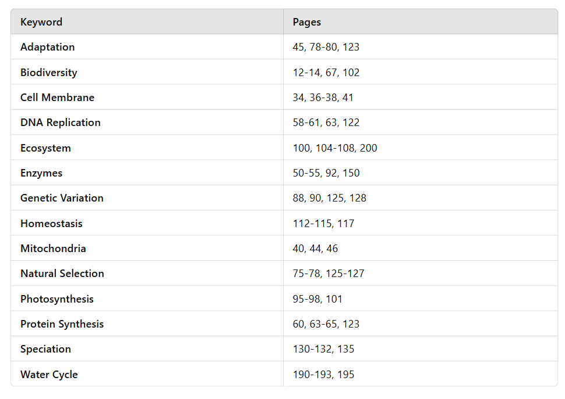
Keyword Index

Slide 34
Index Structure
Contains:
  Index entries
    Can contain the data tuple itself (index and table are integrated in this case); or
    Search key value and a pointer to a row having that value; table stored separately in this case – unintegrated index
  Location mechanism
    Algorithm + data structure for locating an index entry with a given search key value
  Index entries are stored in accordance with the search key value
    Entries with the same search key value are stored together (hash, B- tree)
    Entries may be sorted on search key value (B-tree)

Slide 35
Index Structure
S
Search key
value
Location Mechanism
Location mechanism
facilitates finding
index entry for S
S
Index entries
Once index entry is found, the row can be directly accessed
S, …….

Slide 36
Storage Structure
Structure of file containing a table
  Heap file (no index, not integrated)
  Sorted file (no index, not integrated)
  Integrated file containing index and rows (index entries contain rows in this case)
    ISAM
    B⁺ tree
    Hash

Slide 37
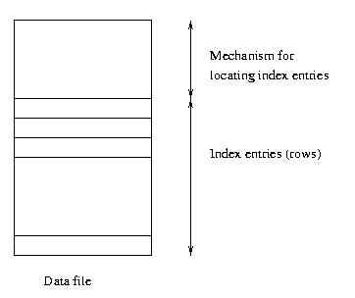
Integrated Storage Structure
Contains table
and (main) index

Slide 38
Index File With Separate Storage Structure
Location mechanism
Storage
structure
for table
Index file
Index entries
In this case, the storage structure might be a heap or sorted file, but often is an integrated file with another index (on a different search key – typically the primary key)

Slide 39
Indices: The Down Side
Additional I/O to access index pages (except if index is small enough to fit in main memory)
Index must be updated when table is modified.
SQL-92 does not provide for creation or deletion of indices
  Index on primary key generally created automatically
  Vendor specific statements:
    CREATE INDEX ind ON Transcript (CrsCode)
    DROP INDEX ind

Slide 40
Clustered Index
Clustered index: index entries and rows are ordered in the same way
  An integrated storage structure is always clustered (since rows and index entries are the same)
  The particular index structure (eg, hash, tree) dictates how the rows are organized in the storage structure
    There can be at most one clustered index on a table
  CREATE TABLE generally creates an integrated, clustered (main) index on primary key

Slide 41
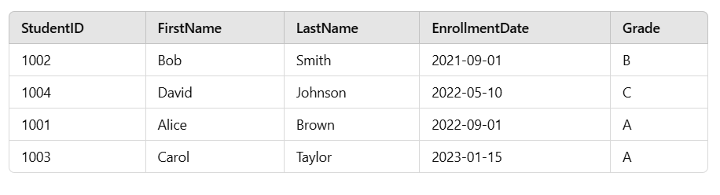
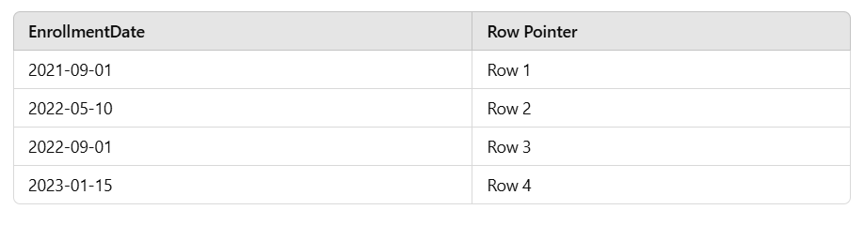
Clustered Index Example

Slide 42
Clustered Main Index
Storage structure
contains table
and (main) index;
rows are contained
in index entries

Slide 43
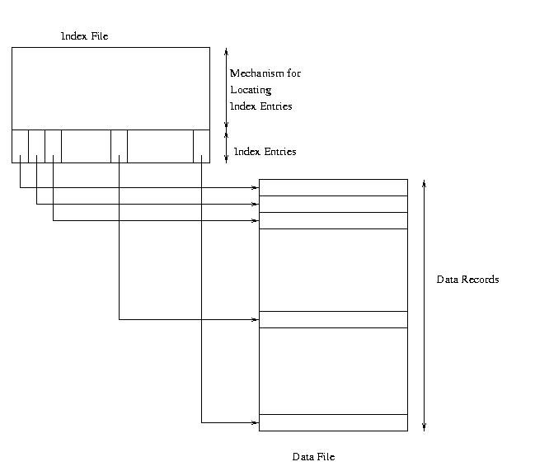
Clustered Secondary Index

Slide 44
Unclustered Index
Unclustered (secondary) index: index entries and rows are not ordered in the same way
An secondary index might be clustered or unclustered with respect to the storage structure it references
  It is generally unclustered (since the organization of rows in the storage structure depends on main index)
  There can be many secondary indices on a table
  Index created by CREATE INDEX is generally an unclustered, secondary index

Slide 45
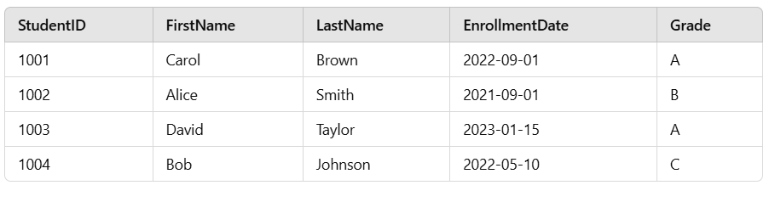
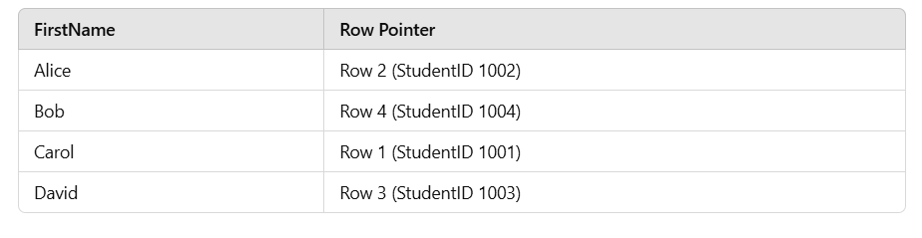
Unclustered Index Example

Slide 46
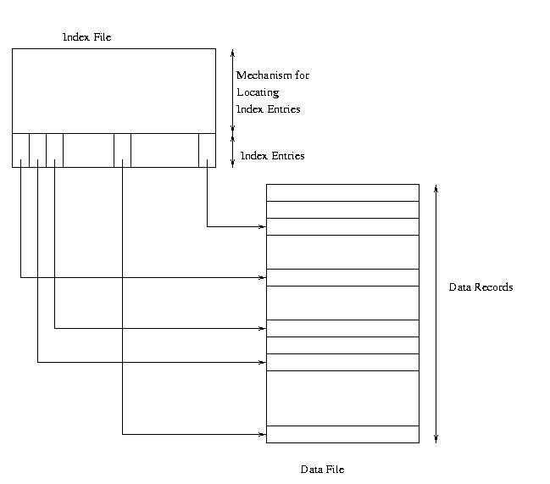
Unclustered Secondary Index

Slide 47
Clustered Index
Good for range searches when a range of search key values is requested
  Use location mechanism to locate index entry at start of range
    This locates first row.
  Subsequent rows are stored in successive locations if index is clustered (not so if unclustered)
  Minimizes page transfers and maximizes likelihood of cache hits

Slide 48
Example – Cost of Range Search
Data file has 10,000 pages, 100 rows in search range
Page transfers for table rows (assume 20 rows/page):
  Heap: 10,000 (entire file must be scanned)
  File sorted on search key: log₂ 10000 + (5 or 6) ≈ 19
  Unclustered index: ≤ 100
  Clustered index: 5 or 6
Page transfers for index entries (assume 200 entries/page)
  Heap and sorted: 0
  Unclustered secondary index: 1 or 2 (all index entries for the rows in the range must be read)
  Clustered secondary index: 1 (only first entry must be read)

Slide 49
Sparse vs. Dense Index
Dense index: has index entry for each data record
  Unclustered index must be dense
  Clustered index need not be dense
Sparse index: has index entry for each page of data file

Slide 50
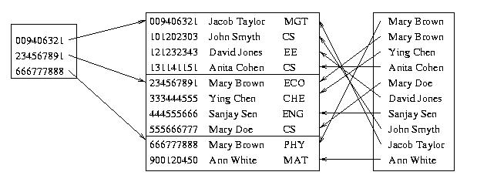
Sparse Vs. Dense Index
Id Name Dept
Sparse,
clustered
index sorted
on Id
Data file sorted on Id
Dense,
unclustered
index sorted
on Name

Slide 51
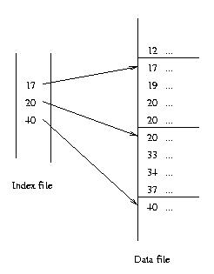
Sparse Index
Search key should
be candidate key of
data file (else additional
measures required)

Slide 52
Multiple Attribute Search Key
CREATE INDEX Inx ON Tbl (Att1, Att2)
Search key is a sequence of attributes; index entries are lexically ordered
Supports finer granularity equality search:
  “Find row with value (A1, A2) ”
Supports range search (tree index only):
  “Find rows with values between (A1, A2) and (A1′, A2′) ”
Supports partial key searches (tree index only):
  Find rows with values of Att1 between A1 and A1′
  But not “Find rows with values of Att2 between A2 and A2′ ”

Slide 53
Locating an Index Entry
Use binary search (index entries sorted)
    If Q pages of index entries, then log₂Q page transfers (which is a big improvement over binary search of the data pages of a F page data file since F >>Q)
Use multilevel index: Sparse index on sorted list of index entries

Slide 54
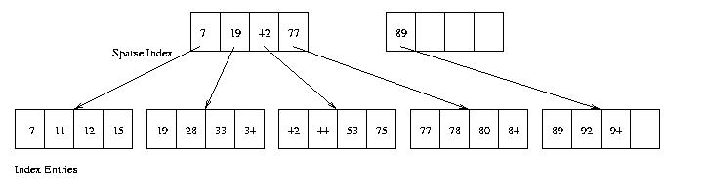
Two-Level Index
– Separator level is a sparse index over pages of index entries
– Leaf level contains index entries
– Cost of searching the separator level << cost of searching index level
since separator level is sparse
– Cost or retrieving row once index entry is found is 0 (if integrated) or 1 (if not)

Slide 55
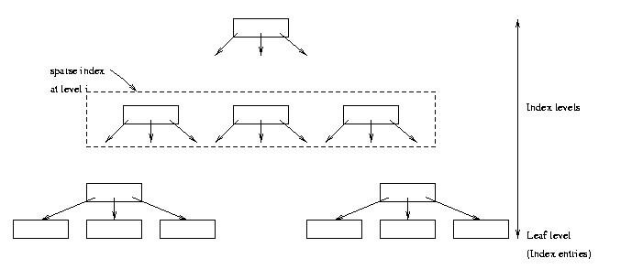
Multilevel Index
– Search cost = number of levels in tree
– If Φ is the fanout of a separator page, cost is log_{Φ} Q + 1
– Example: if Φ = 100 and Q = 10,000, cost = 3
(reduced to 2 if root is kept in main memory)

Slide 56
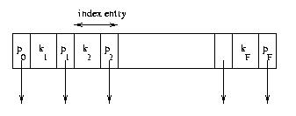
Index Sequential Access Method (ISAM)
Generally an integrated storage structure
  Clustered, index entries contain rows
Separator entry = (k_{i} , p_{i}); k_{i} is a search key value; p_{i} is a pointer to a lower level page
k_{i} separates set of search key values in the two subtrees pointed at by p_{i-1} and p_{i.}

Slide 57
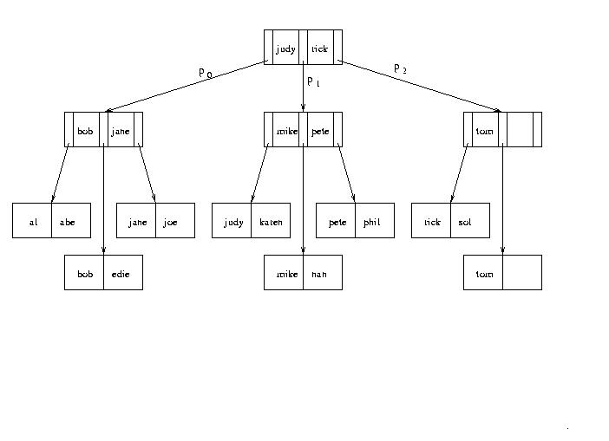
Index Sequential Access Method
Location
mechanism

Slide 58
Index Sequential Access Method
The index is static:
  Once the separator levels have been constructed, they never change
  Number and position of leaf pages in file stays fixed
Good for equality and range searches
  Leaf pages stored sequentially in file when storage structure is created to support range searches
    if, in addition, pages are positioned on disk to support a scan, a range search can be very fast (static nature of index makes this possible)
Supports multiple attribute search keys and partial key searches

Slide 59
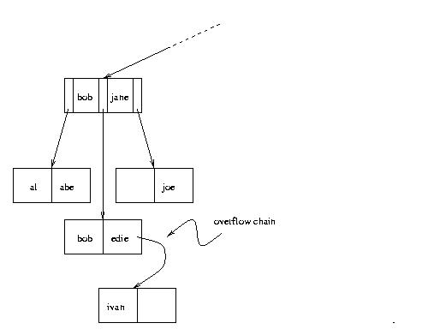
Overflow Chains
- Contents of leaf pages change
– Row deletion yields empty slot
in leaf page
– Row insertion can result in
overflow leaf page and
ultimately overflow chain
– Chains can be long, unsorted,
scattered on disk
– Thus ISAM can be inefficient
if table is dynamic

Slide 60
B⁺ Tree
Supports equality and range searches, multiple attribute keys and partial key searches
Either a secondary index (in a separate file) or the basis for an integrated storage structure
Responds to dynamic changes in the table
Homeostasis

Slide 61
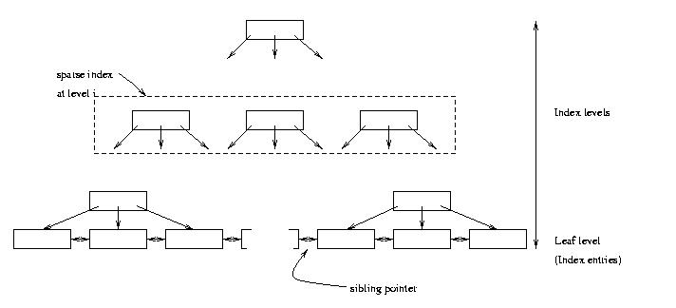
B⁺ Tree Structure
– Leaf level is a (sorted) linked list of index entries
– Sibling pointers support range searches in spite of
allocation and deallocation of leaf pages (but leaf
pages might not be physically contiguous on disk)

Slide 62
Insertion and Deletion in B⁺ Tree
Structure of tree changes to handle row insertion and deletion – no overflow chains
Tree remains balanced: all paths from root to index entries have same length
Algorithm guarantees that the number of separator entries in an index page is between Φ/2 and Φ
  Hence the maximum search cost is log_{Φ/2}Q + 1 (with ISAM search cost depends on length of overflow chain)

Slide 63
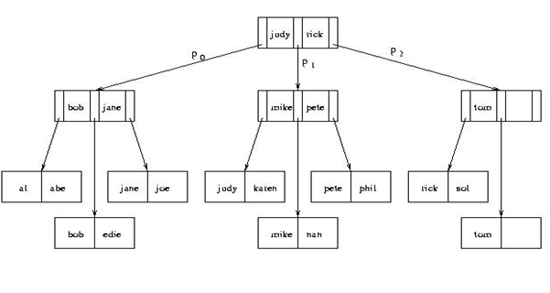
Handling Insertions - Example
Insert vince

Slide 64
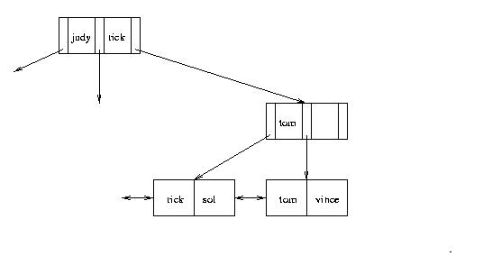
Handling Insertions - Example
- After inserting “vince”
Next, insert “vera”

Slide 65
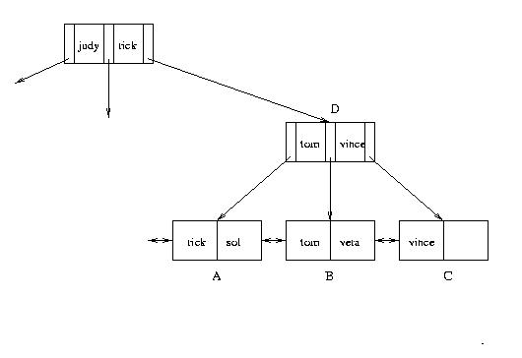
Handling Insertions (cont’d)
– Insert “vera”: Since there is no room in leaf page:
1. Create new leaf page, C
2. Split index entries between B and C (but maintain
sorted order)
3. Add separator entry at parent level (copy up)
Next, insert “rob”

Slide 66
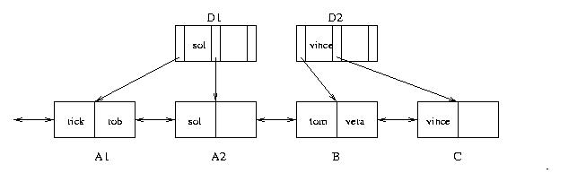
Handling Insertions (con’t)
– Insert “rob”. Since there is no room in leaf page A:
1. Split A into A1 and A2 and divide index entries
between the two (but maintain sorted order)
2. Split D into D1 and D2 to make room for additional
pointer
3. Three separators are needed: “sol”, “tom” and “vince”
tom

Slide 67
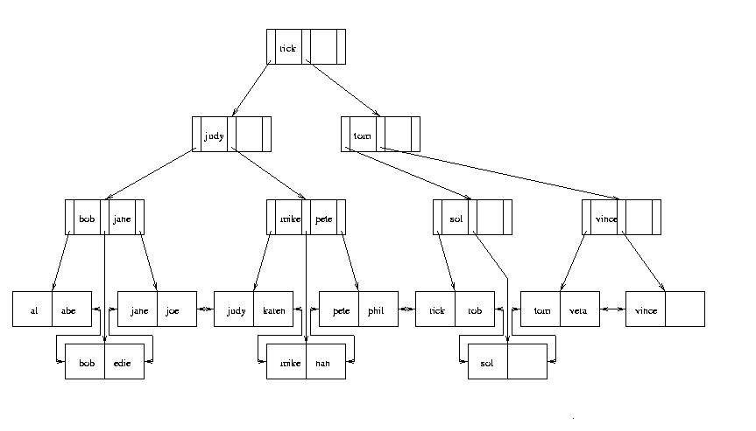
Handling Insertions (cont’d)
– When splitting a separator page, push a separator up (push up)
– Repeat process at next level
– Height of tree increases by one

Slide 68
Handling Deletions
Deletion can cause page to have fewer than Φ/2 entries
  Entries can be redistributed over adjacent pages to maintain minimum occupancy requirement
  Ultimately, adjacent pages must be merged, and if merge propagates up the tree, height might be reduced
  see an example: http://www.cs.princeton.edu/courses/archive/fall08/cos597A/Notes/BplusInsertDelete.pdf
In practice, tables generally grow, and merge algorithm is often not implemented
  Reconstruct tree to compact it

Slide 69
Delete Exercise
Delete bob, edie, joe, jane, abe

Slide 70
ISAM vs B⁺
For read-only databases, ISAM outperforms B+ because:
  ISAM ensures that data is stored in contiguous blocks in the disk, B+ does not ensure that.
  For a range query, ISAM can read contiguous blocks more efficiently than B+, which will read one block, and then jump to read the next block to retrieve all solutions.
  The maintence of ISAM is less costing than that of a B+.

Slide 71
Hash Index
Index entries partitioned into buckets in accordance with a hash function, h(v), where v ranges over search key values
  Each bucket is identified by an address, a
  Bucket at address a contains all index entries with search key v such that h(v) = a
Each bucket is stored in a page (with possible overflow chain)
If index entries contain rows, set of buckets forms an integrated storage structure; else set of buckets forms an (unclustered) secondary index

Slide 72
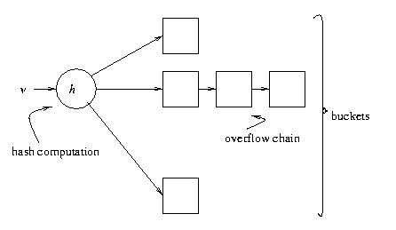
Equality Search with Hash Index
Location
mechanism
Given v:
1. Compute h(v)
2. Fetch bucket at h(v)
3. Search bucket
Cost = number of pages
in bucket (cheaper than
B⁺ tree, if no overflow
chains)
1
2
n

Slide 73
Choosing a Hash Function
Goal of h: map search key values randomly
  Occupancy of each bucket roughly same for an average instance of indexed table
Example: h(v) = (c₁∗ v + c₂) mod M
  M must be large enough to minimize the occurrence of overflow chains
  M must not be so large that bucket occupancy is small and too much space is wasted

Slide 74
Hash Indices – Problems
Does not support range search
  Since adjacent elements in range might hash to different buckets, there is no efficient way to scan buckets to locate all search key values v between v₁ and v₂
Although it supports multi-attribute keys, it does not support partial key search
  Entire value of v must be provided to h
Dynamically growing files produce overflow chains, which negate the efficiency of the algorithm

Slide 75
Extendable Hashing
Eliminates overflow chains by splitting a bucket when it overflows
Range of hash function has to be extended to accommodate additional buckets
Example: family of hash functions based on h:
  h_{k}(v) = h(v) mod 2^{k} (use the last k bits of h(v))
  At any given time a unique hash, h_{k} , is used depending on the number of times buckets have been split

Slide 76
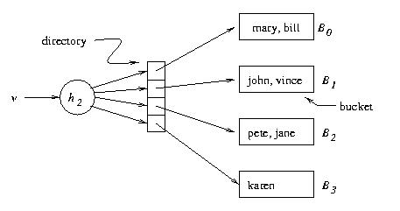
Extendable Hashing – Example
v h(v)
pete 11010
mary 00000
jane 11110
bill 00000
john 01001
vince 10101
karen 10111
Location
mechanism
Extendable hashing uses a directory (level of indirection) to
accommodate family of hash functions
Suppose next action is to insert sol, where h(sol) = 10001.
Problem: This causes overflow in B₁

Slide 77
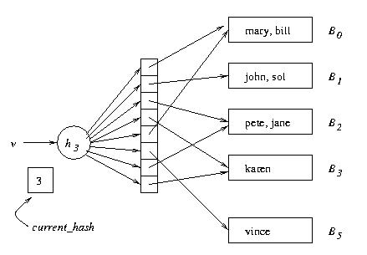
Example (cont’d)
physical
logical
Solution:
1. Switch to h₃
2. Concatenate copy of old
directory to new directory
3. Split overflowed bucket, B,
into B and B′, dividing
entries in B between the
two using h₃
4. Pointer to B in directory
copy replaced by pointer
to B′
Note: Except for B′ , pointers in directory copy refer to original
buckets (share the same buckets)
current_hash identifies current hash function.

Slide 78
Example (cont’d)
physical
logical
2
Next action: Insert judy,
where h(judy) = 00110
B₂ overflows, but directory
need not be extended
3
2
2
3
Problem: When B_{i} overflows, we need a mechanism for deciding
whether the directory has to be doubled
Solution: bucket_level[i] records the number of times B_{i} has been
split. If current_hash > bucket_level[i], do not enlarge directory

Slide 79
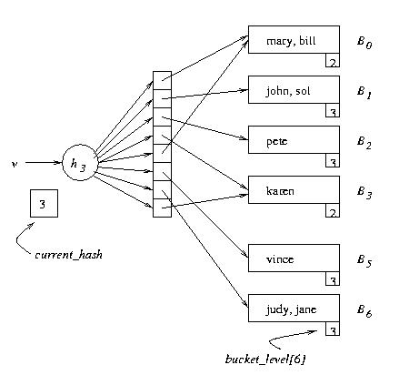
Example (cont’d)

Slide 80
Extendable Hashing
Deficiencies:
  Extra space for directory
  Cost of added level of indirection:
    If directory cannot be accommodated in main memory, an additional page transfer is necessary.

Slide 81
Choosing An Index
An index should support a query of the application that has a significant impact on performance
  Choice based on frequency of invocation, execution time, acquired locks, table size
Example 1: SELECT E.Id
FROM Employee E
WHERE E.Salary < :upper AND E.Salary > :lower
– This is a range search on Salary.
– Since the primary key is Id, it is likely that there is a clustered,
main index on that attribute that is of no use for this query.
– Choose a secondary, B⁺ tree index with search key Salary

Slide 82
Choosing An Index (cont’d)
Example 2: SELECT T.StudId
FROM Transcript T
WHERE T.Grade = :grade
- This is an equality search on Grade.
- Since the primary key is (StudId, Semester, CrsCode) it is
likely that there is a main, clustered index on these attributes
that is of no use for this query.
- Choose a secondary, B+ tree or hash index with search key
Grade

Slide 83
Choosing an Index (cont’d)
Example 3:
SELECT T.CrsCode, T.Grade
FROM Transcript T
WHERE T.StudId = :id AND T.Semester = ‘F2000’
– Equality search on StudId and Semester.
– If the primary key is (StudId, Semester, CrsCode) it is
likely that there is a main, clustered index on this
sequence of attributes.
– If the main index is a B⁺ tree it can be used for this search.
– If the main index is a hash it cannot be used for this
search. Choose B⁺ tree or hash with search key StudId
(since Semester is not as selective as StudId) or
(StudId, Semester)

