Slide 1
Big Data Research Laboratory
Dr. Shiyong Lu
Department of Computer Science
Wayne State University
shiyong@wayne.edu

Slide 2
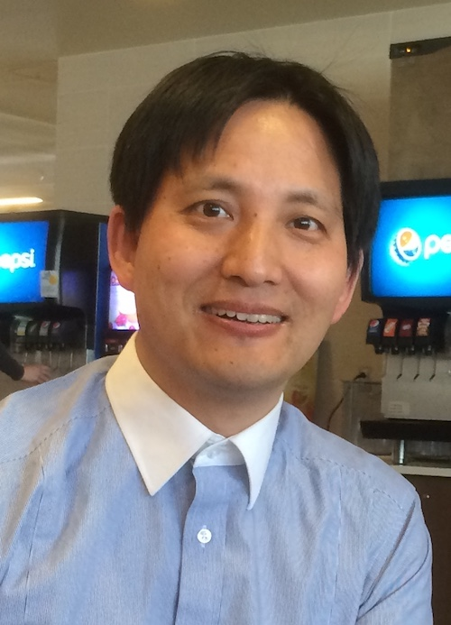
About Me
Professor, IEEE Senior Member
Department of Computer Science
Wayne State University
Detroit, MI, U.S.A.
http://shiyong.eng.wayne.edu
Research interests:
Blockchain security
Big data workflows

Slide 3
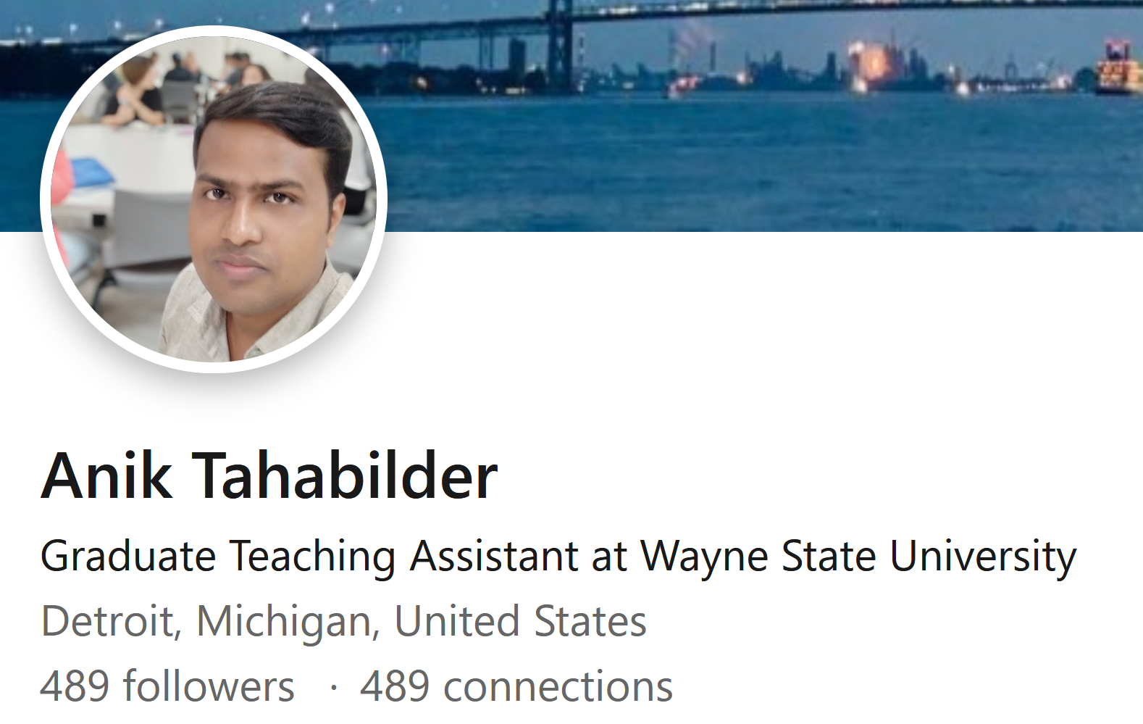
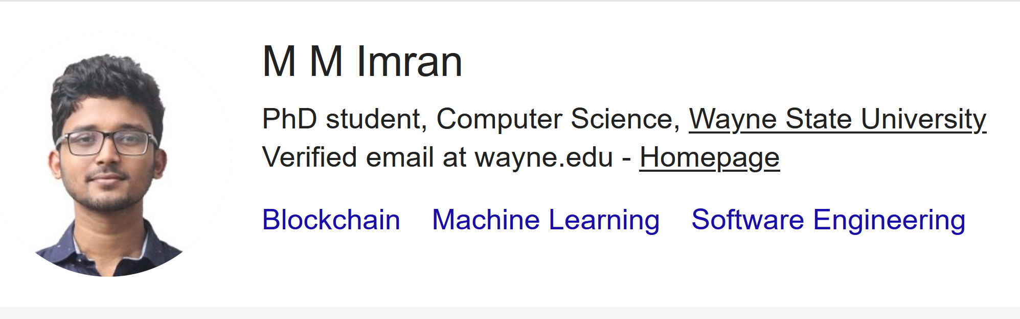
Current PhD students

Slide 4
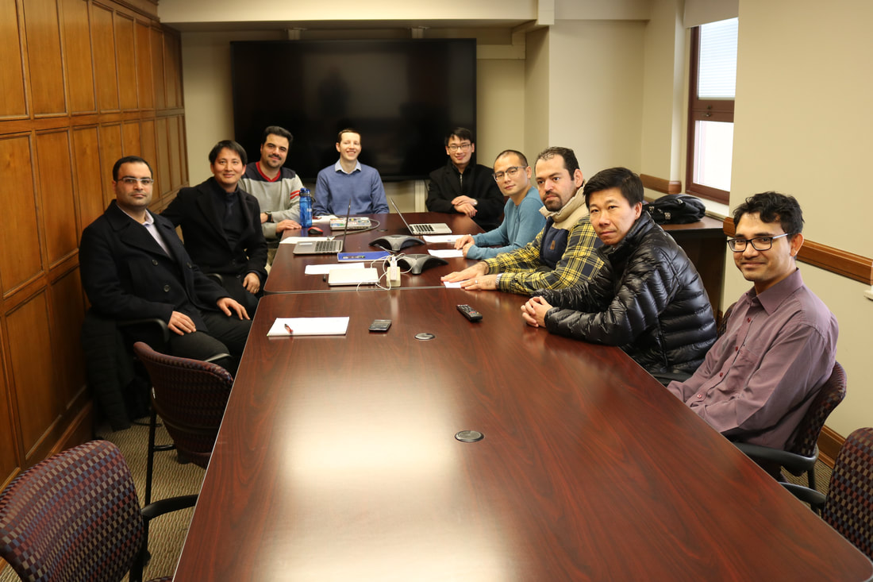

The Group

Slide 5
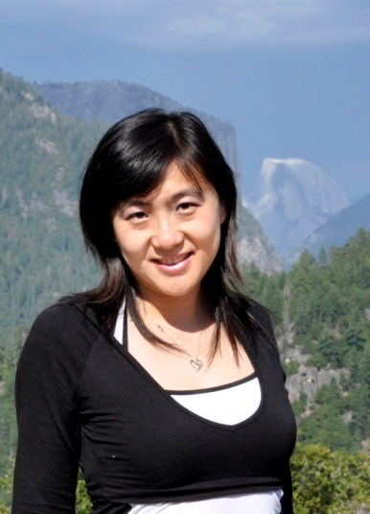
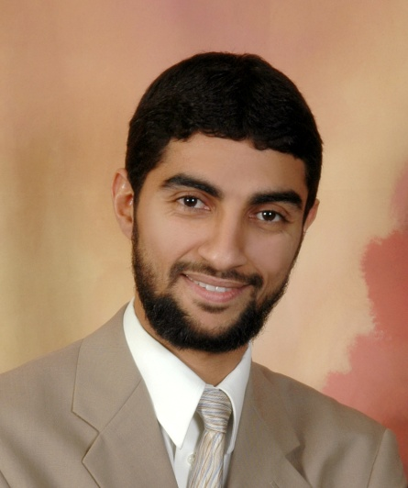
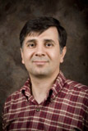

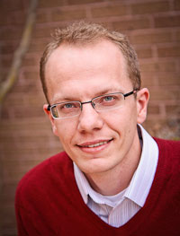
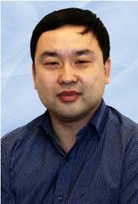
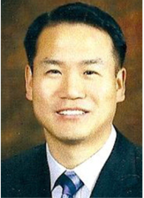
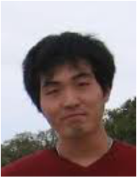
Ph.D. Alumni

Slide 6
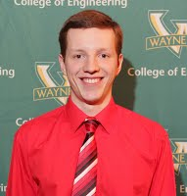
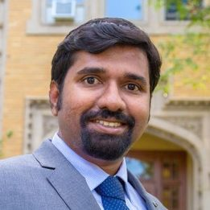
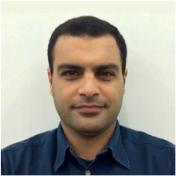
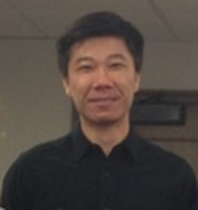
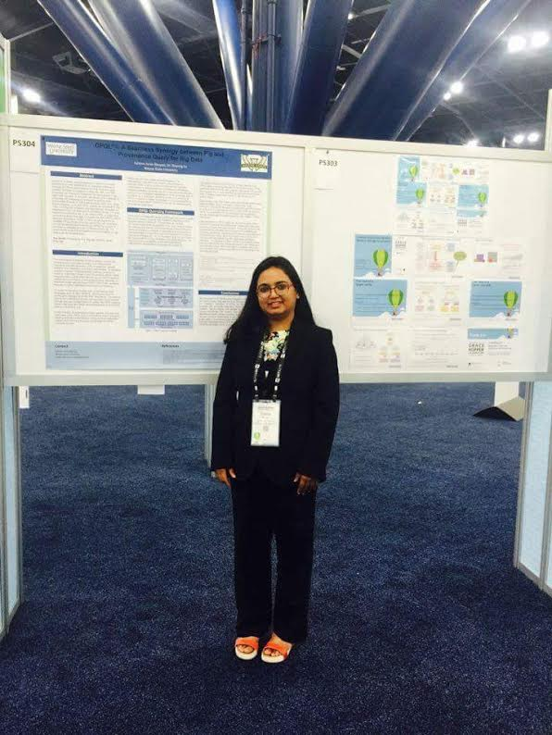
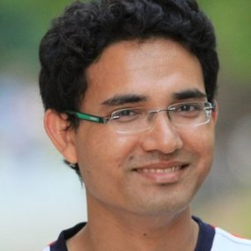
Ph.D. Alumni
https://bigdataworkflow.weebly.com/

Slide 7
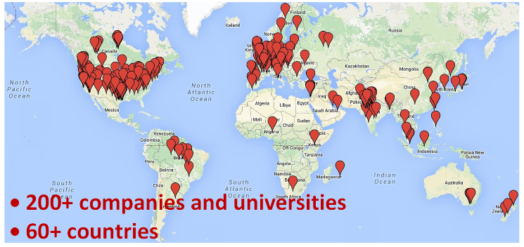
KDM
Chebotko, Artem, Andrey Kashlev, and Shiyong Lu. "A big data modeling methodology for Apache Cassandra." In 2015 IEEE International Congress on Big Data, pp. 238-245. IEEE, 2015.

Slide 8
Teaching
CSC 4710: Introduction to DBMSs
CSC 6710: Database Management I (DSE 6100)
CSC 8710: Advanced Seminar on Blockchain Security

Slide 9
Contact Information
Office: 14102.1 Maccabeeds Bldg.
Lab: 3105 Maccabeeds Bldg.
Phone: 313-577-1667(O), 577-6711(L)
Homepage: http://shiyong.eng.wayne.edu
Email: shiyong@wayne.edu

