Slide 1
Project Hint Slides
Available at Canvas/Files/projecthelp.pptx

Slide 2
Outline of the talk
How does HTTP work?
How to debug your project?
How does JDBC work?
How does session work?
How does JSP/JSTL work?
How to design a good interface?
Summary: the architecture of your project

Slide 3

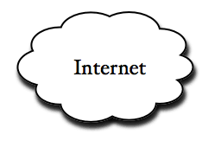
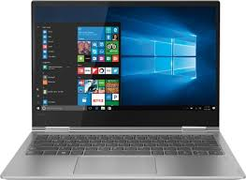
How does HTTP work?
Java, JSP, HTML,
Javascript programs
Layer 2
http
HTML, Javascript
Layer 1
Web browser
Check out: https://www.youtube.com/watch?v=eesqK59rhGA

Slide 4
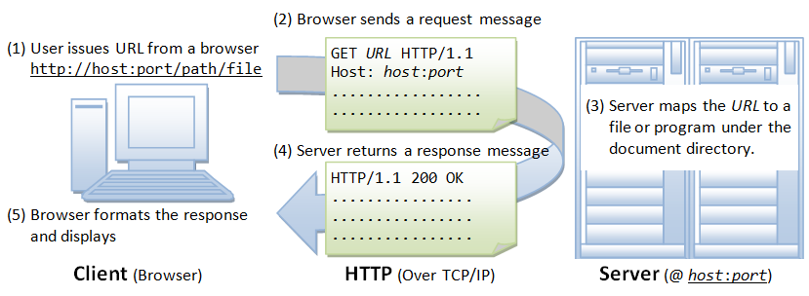
HTTP Messages
Check out: https://developer.mozilla.org/en-US/docs/Web/HTTP/Messages

Slide 5
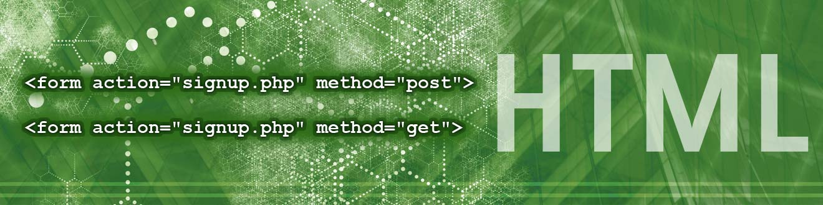
HTTP GET/POST Requests
Check out: https://www.diffen.com/difference/GET-vs-POST-HTTP-Requests

Slide 6
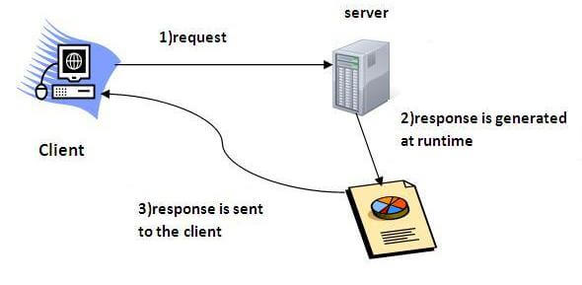
Java Servlet Tutorial
Check out: https://www.javatpoint.com/servlet-tutorial

Slide 7
Debugging One Layer at a Time
Web Interace Layer (login.jsp logout.jsp, signup.html)
JSP/HTML
Application Logic Layer (Query1.java Trans1.java...)
Java
Database Acces Layer (Table1.java Table2.java...)
Java
Database Access Layer: Only CRUD operations for each table

Slide 8

How does JDBC work?
Tables, indexes, triggers, stored procedures
Layer 3
MySQL Database Server
jdbc
Java, JSP, HTML,
Javascript programs
Layer 2
Check out: https://www.youtube.com/watch?v=y_YxwyYRJek&list=PLsyeobzWxl7rU7Jz3zDRpqB-EODzBbHOI

Slide 9
Include JDBC jar file
Add JDBC jar library manually to the project: Right click the project -> build path -> configure build path
In libraries Tab press Add Eternal Jar and Select your Jar.

Slide 10
Connect to Mysql Database Server
Run the MySQL service (in Windows, run services.msc)
Class.forName("com.mysql.jdbc.Driver");
connect = DriverManager .getConnection("jdbc:mysql://141.217.48.128:3306/dataview?” + "user=shiyong&password=view1234");

Slide 11
The use of Session
After each user signs in the system, all the requests and responses need to be processed within a context called "session", so that these requests and responses are connected to the same user and the same context.
Check out Youtube: https://www.youtube.com/watch?v=4GfAhuKNCdM

Slide 12
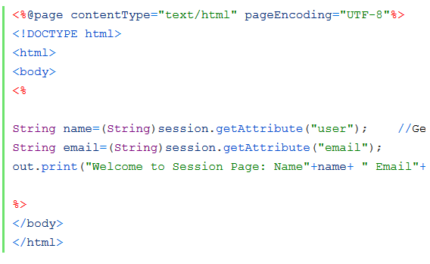
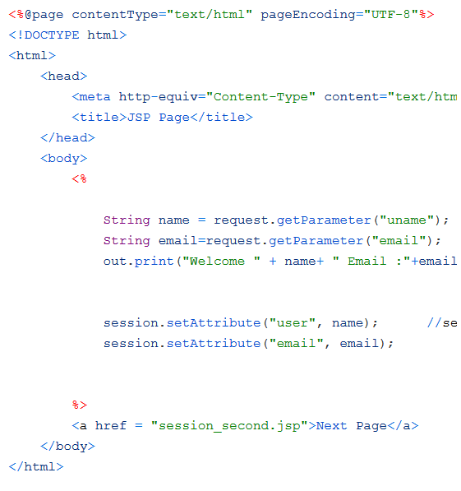

B.jsp
retrieve
store
A.jsp
Session

Slide 13
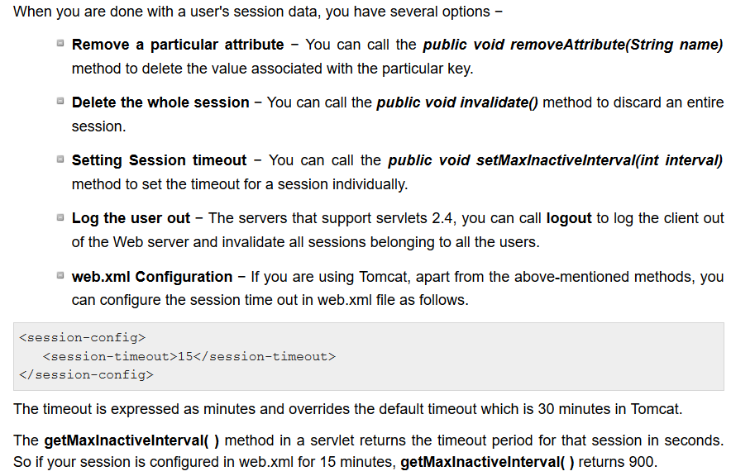
The use of Session (con’t)

Slide 14
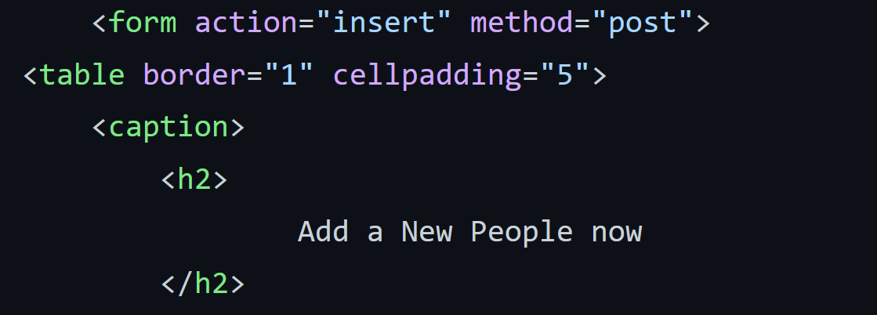
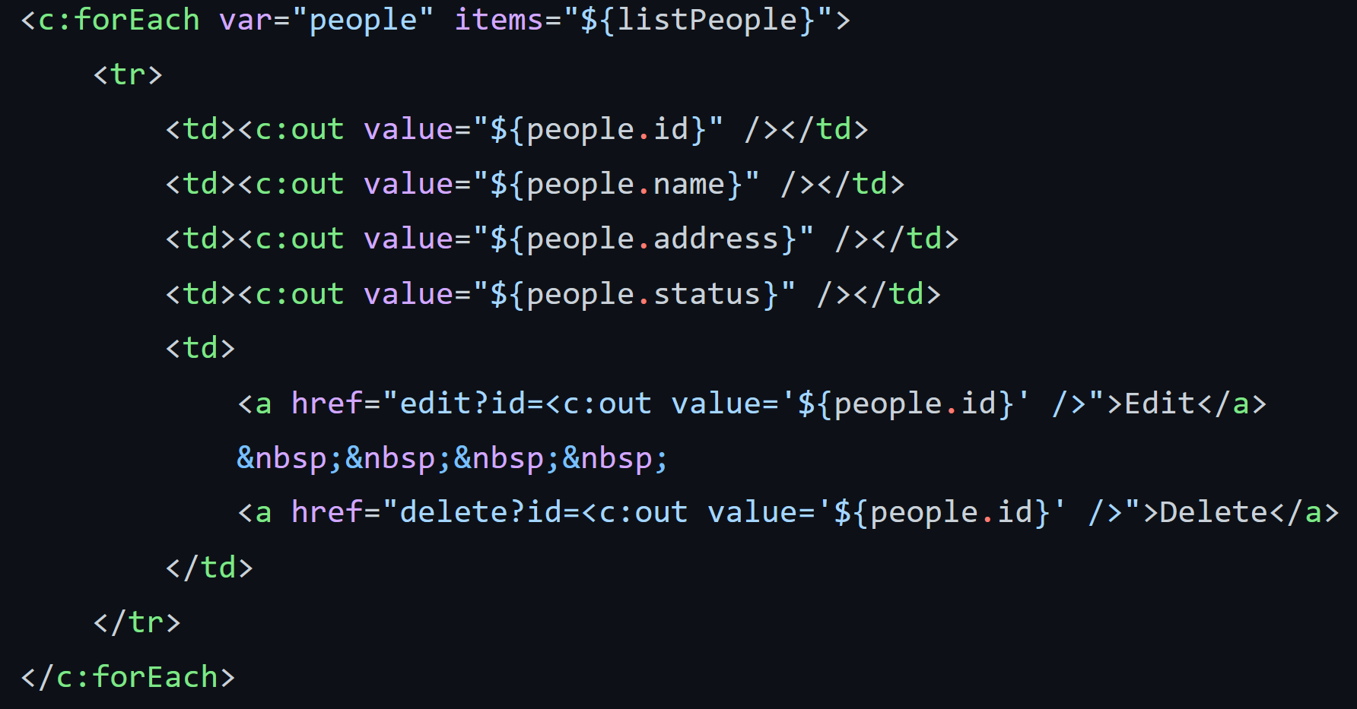
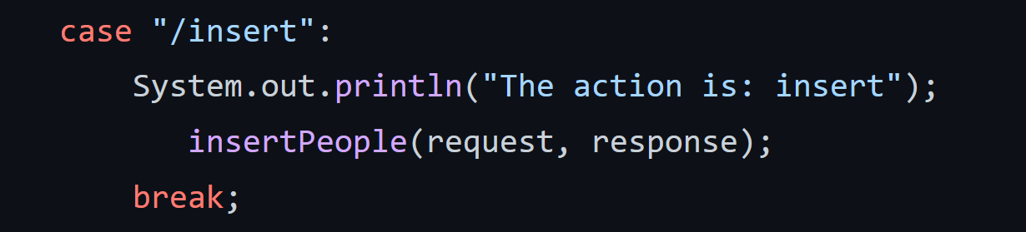
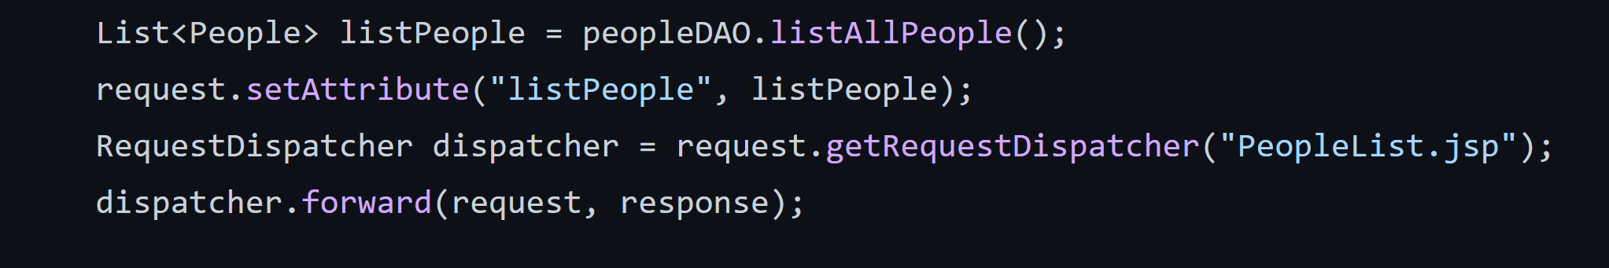
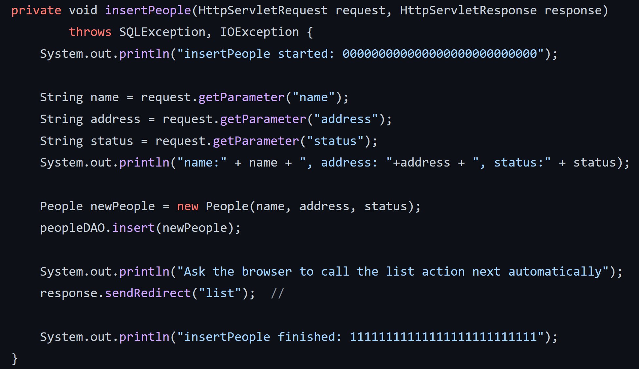
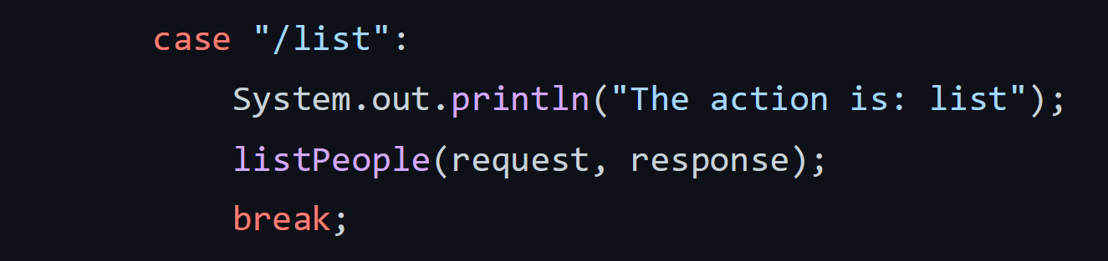
Insert sth and then show it!
InsertPeopleForm.jsp
1.
PeopleList.jsp
PeopleList.jsp
2.
ControlServlet.java
6
3.
5.
ControlServlet.java
ControlServlet.java
4.
ControlServlet.java

Slide 15
How to get the value from a request parameter in JSP
<% if (request.getParameter("name") == null) { out.println("Please enter your name."); } else { out.println("Hello <b>"+request. getParameter("name")+"</b>!"); } %>
https://stackoverflow.com/questions/1890438/how-to-get-parameters-from-the-url-with-jsp

Slide 16
Generating an HTML Page in JSP using out.println() method
PrintWriter out = response.getWriter( ); response.setContentType("text/html"); out.println(“Hello from a Servlet"); out.println(“This servlet ran at here");
http://www.onjava.com/pub/a/onjava/excerpt/java_cookbook_ch18/index.html?page=2

Slide 17
How to implement a Login interface
You need to know 1) Get method; 2) Post method; 3) Web form; 4) how to pass web form data to a JSP page.
Source: http://www.javawebtutor.com/articles/jsp/jspform.php

Slide 18
How to insert data into database in JSP
You need to learn: 1) How to create a web form so that a user can input data; 2) how to connect to a database; 3) how to receive the values input in the web form using request.getParameter("xxx"); 4) how to prepare an insert statement with question marks; 5) how to fill the question marks with real values using pstatement.setString(), etc.
Source: https://www.roseindia.net/jsp/prepared-statement-query.shtml

Slide 19
How to pass values from one JSP page to another
You need to learn: 1) Using Query parameter;
2) Using Hidden variable in a web form.
3) you can send Using Session object.
session.setAttribute("userId", userid);
These values will now be available from any jsp as long as your session is still active.
int userid = session.getAttribute("userId");
Source: https://stackoverflow.com/questions/22369717/how-to-pass-value-from-one-jsp-to-another-jsp-page

Slide 20
How to create an input of type date so that you can select from a popup calendear
Just use the type of "date" for the input element.
To create other types of input fields, check out:
<form> Birthday: <input type="date" name="bday"> </form>
https://www.w3schools.com/html/html_form_input_types.asp

Slide 21
How to retrieve data from database and then display as a webpage in JSP
You need to know 1) how to connect to the database; 2) how to execute a SQL query; 3) how to retrieve the query result suing resultSet.next() and resultSet.getString(), etc; and 4) How to format and display the result as a table.
Source: https://www.roseindia.net/jsp/how-to-retrieve-data-from-database-in-jsp.shtml

Slide 22
How to set initial value and auto increment in MySQL?
It is convenient to let the database to manage id, such as order IDs that can be generated automatically each time we insert a new order tuple into the order table. Moreover, we might want to set an initial value for the IDs so that it will not start from 0 as the first customer does not like to see a "000000" order.
ALTER TABLE users AUTO_INCREMENT=1001;
Source: https://stackoverflow.com/questions/1485668/how-to-set-initial-value-and-auto-increment-in-mysql

Slide 23
How to update database in JSP
You will learn: 1) How to create a web from to take values from a user: 2) How to pass those values from the user to a JSP page using action="updatingDatabase.jsp" and request.getParameter("name"); 3) How to prepare an INSERT SQL statement with question marks; 4) how to fill the questionsmarks with the values from the user using ps.setString(1, name) and ps.setInt(2, id) methods; 5) how to select the new table and display its content in a webpage.
Source: https://www.roseindia.net/jsp/update-database.shtml

Slide 24
How to create a static Drop-Down List
You will learn: 1) HTML form, and 2) the SELECT tag.
Source: https://www.youtube.com/watch?v=89rRD04QZE4

Slide 25
How to create a dynamic Drop-Down List from the database
You will learn: 1) HTML form, 2) querying the database; and 3) create a dynamic select element from the querying result.
Source: https://www.roseindia.net/jsp/get-data-into-dropdownlist-database.shtml

Slide 26
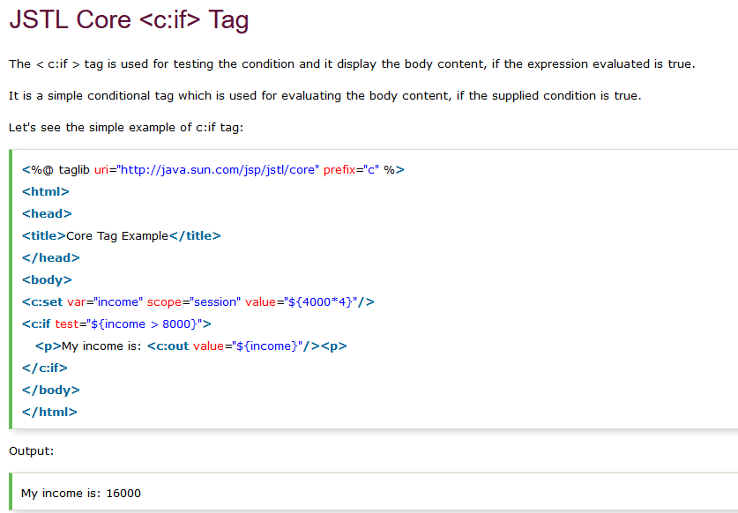

Slide 27
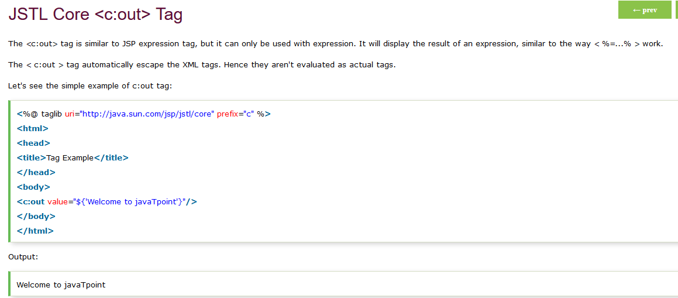

Slide 28
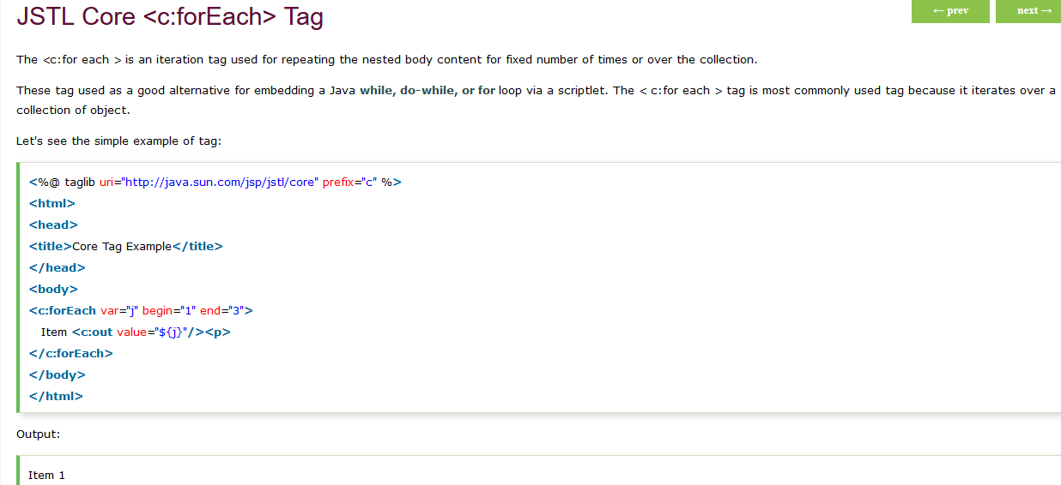

Slide 29
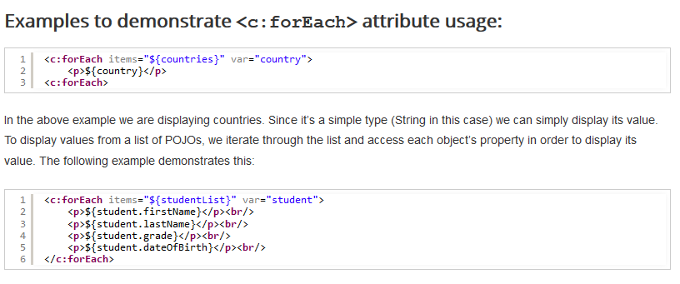

Slide 30
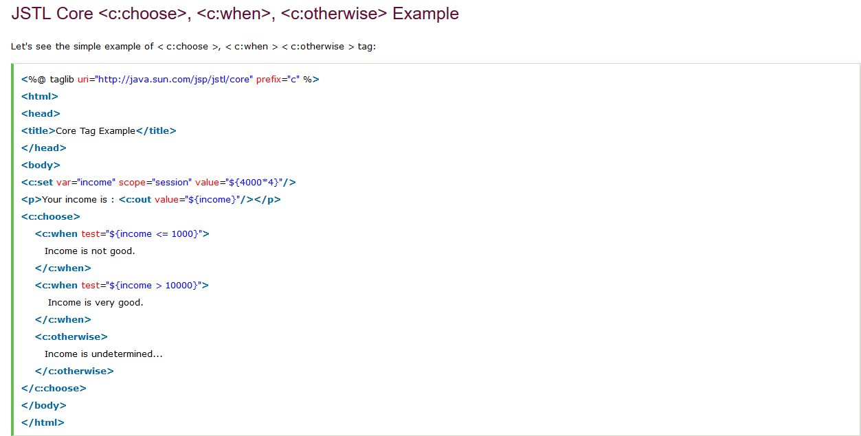

Slide 31
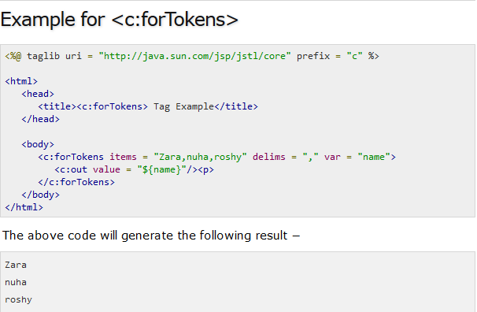

Slide 32
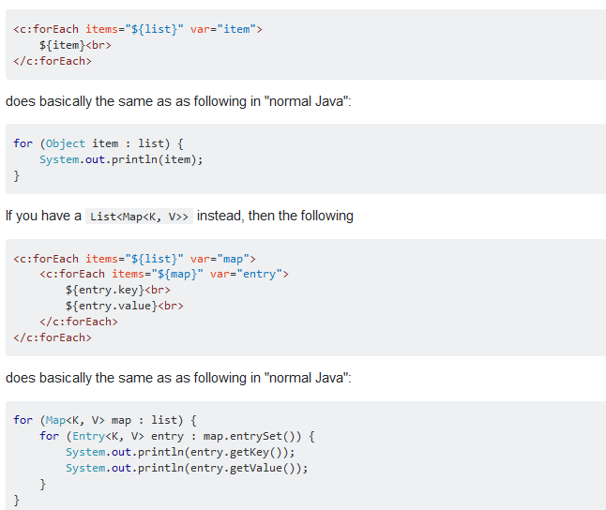

Slide 33
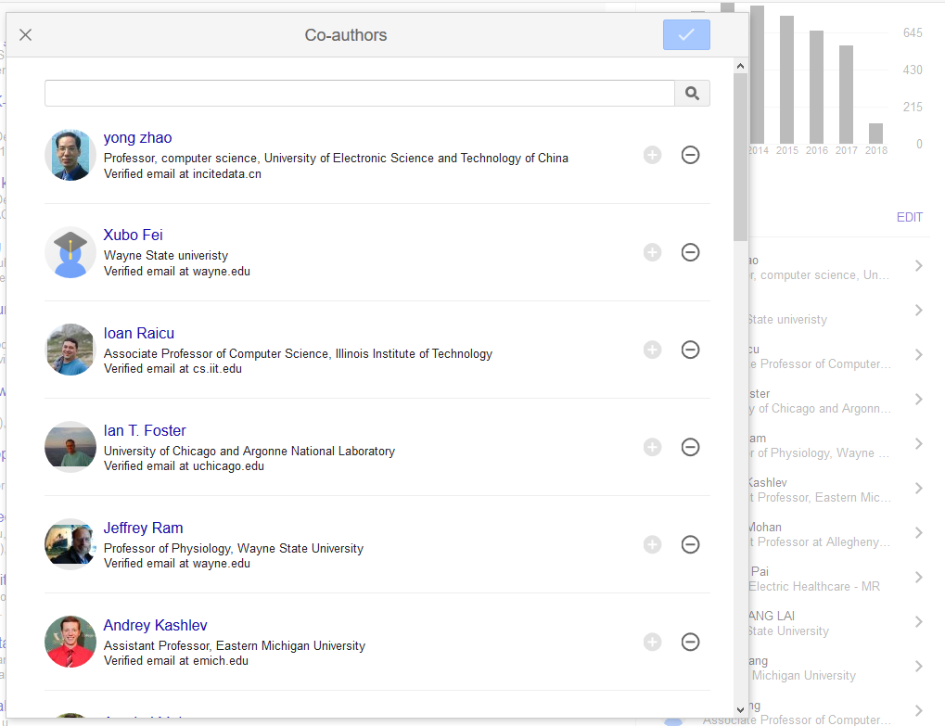
Modify a list using a Popup window

Slide 34
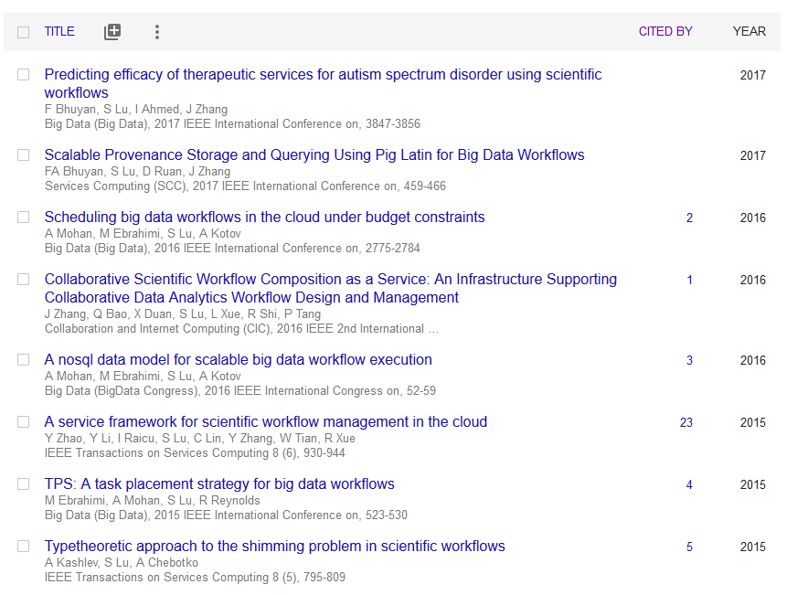
Click a column to sort
click

Slide 35
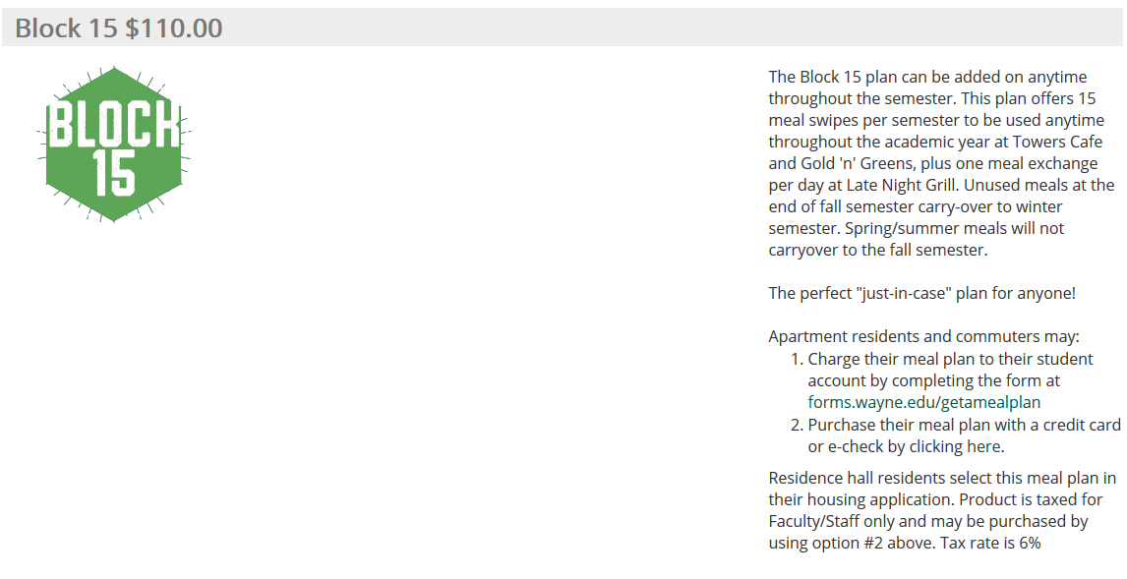
Interface Matters (Case study: https://wayne.campusdish.com/ )

Slide 36
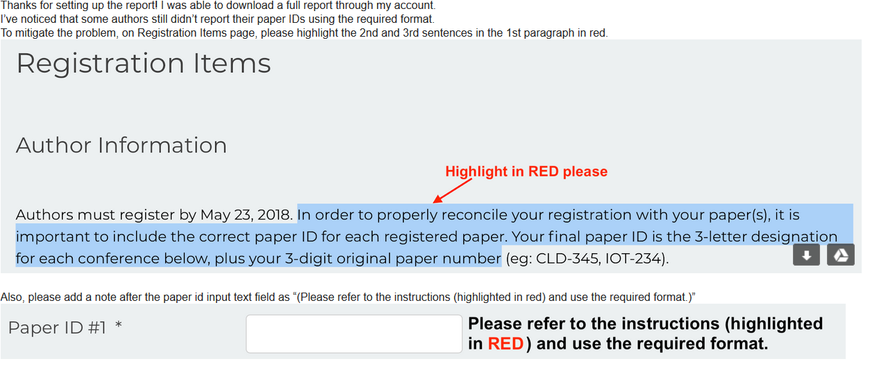
Interface Matters (Case study: IEEE conference registration

Slide 37
Summary
Web Interace Layer (login.jsp logout.jsp, signup.html)
JSP/HTML
Application Logic Layer (Query1.java Trans1.java...)
Java
Database Acces Layer (Table1.java Table2.java...)
Java
Database Access Layer: Only CRUD operations for each table
Simple: ONLY HTML+JSP+JAVA

Slide 38
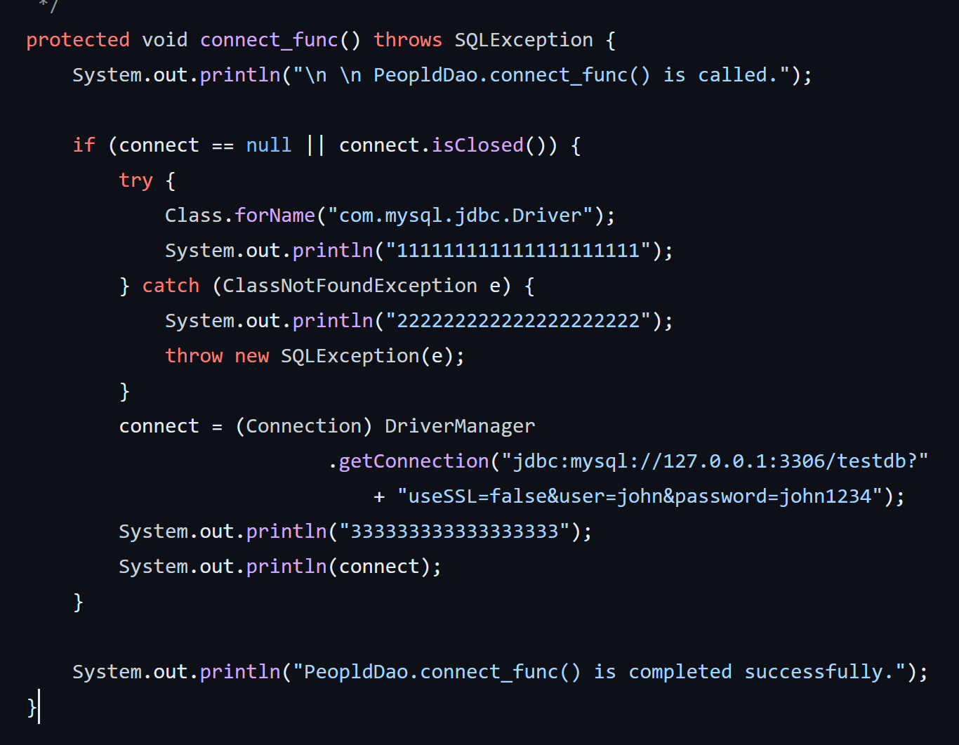
How to debug
Before you see the TA, you should tell which line gives you’re the trouble!!!

Slide 39
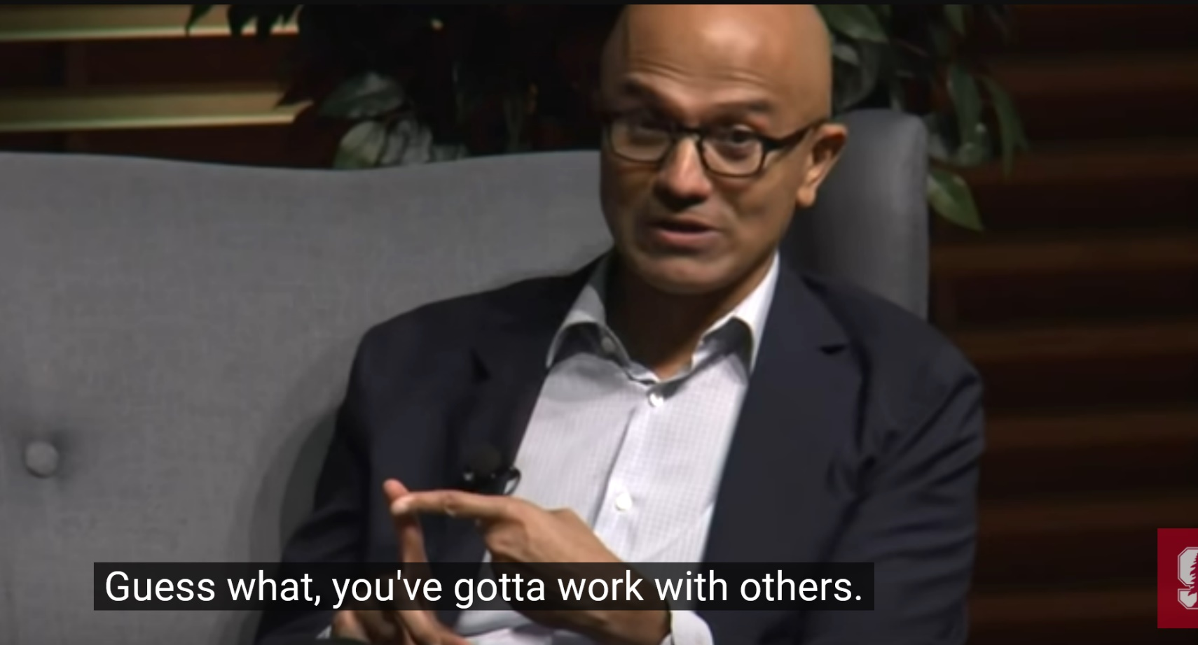
Collaboration skill is the key
Satya Nadella, CEO of Microsoft

