Slide 1
Tutorial for the projects

Slide 2

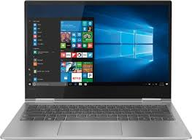
How does HTTP work?
request
response
Web browser
Check out: https://www.youtube.com/watch?v=eesqK59rhGA

Slide 3
GET or POST?
Request (Get/Post)
response
Web browser
Check out: https://www.diffen.com/difference/GET-vs-POST-HTTP-Requests

Slide 4
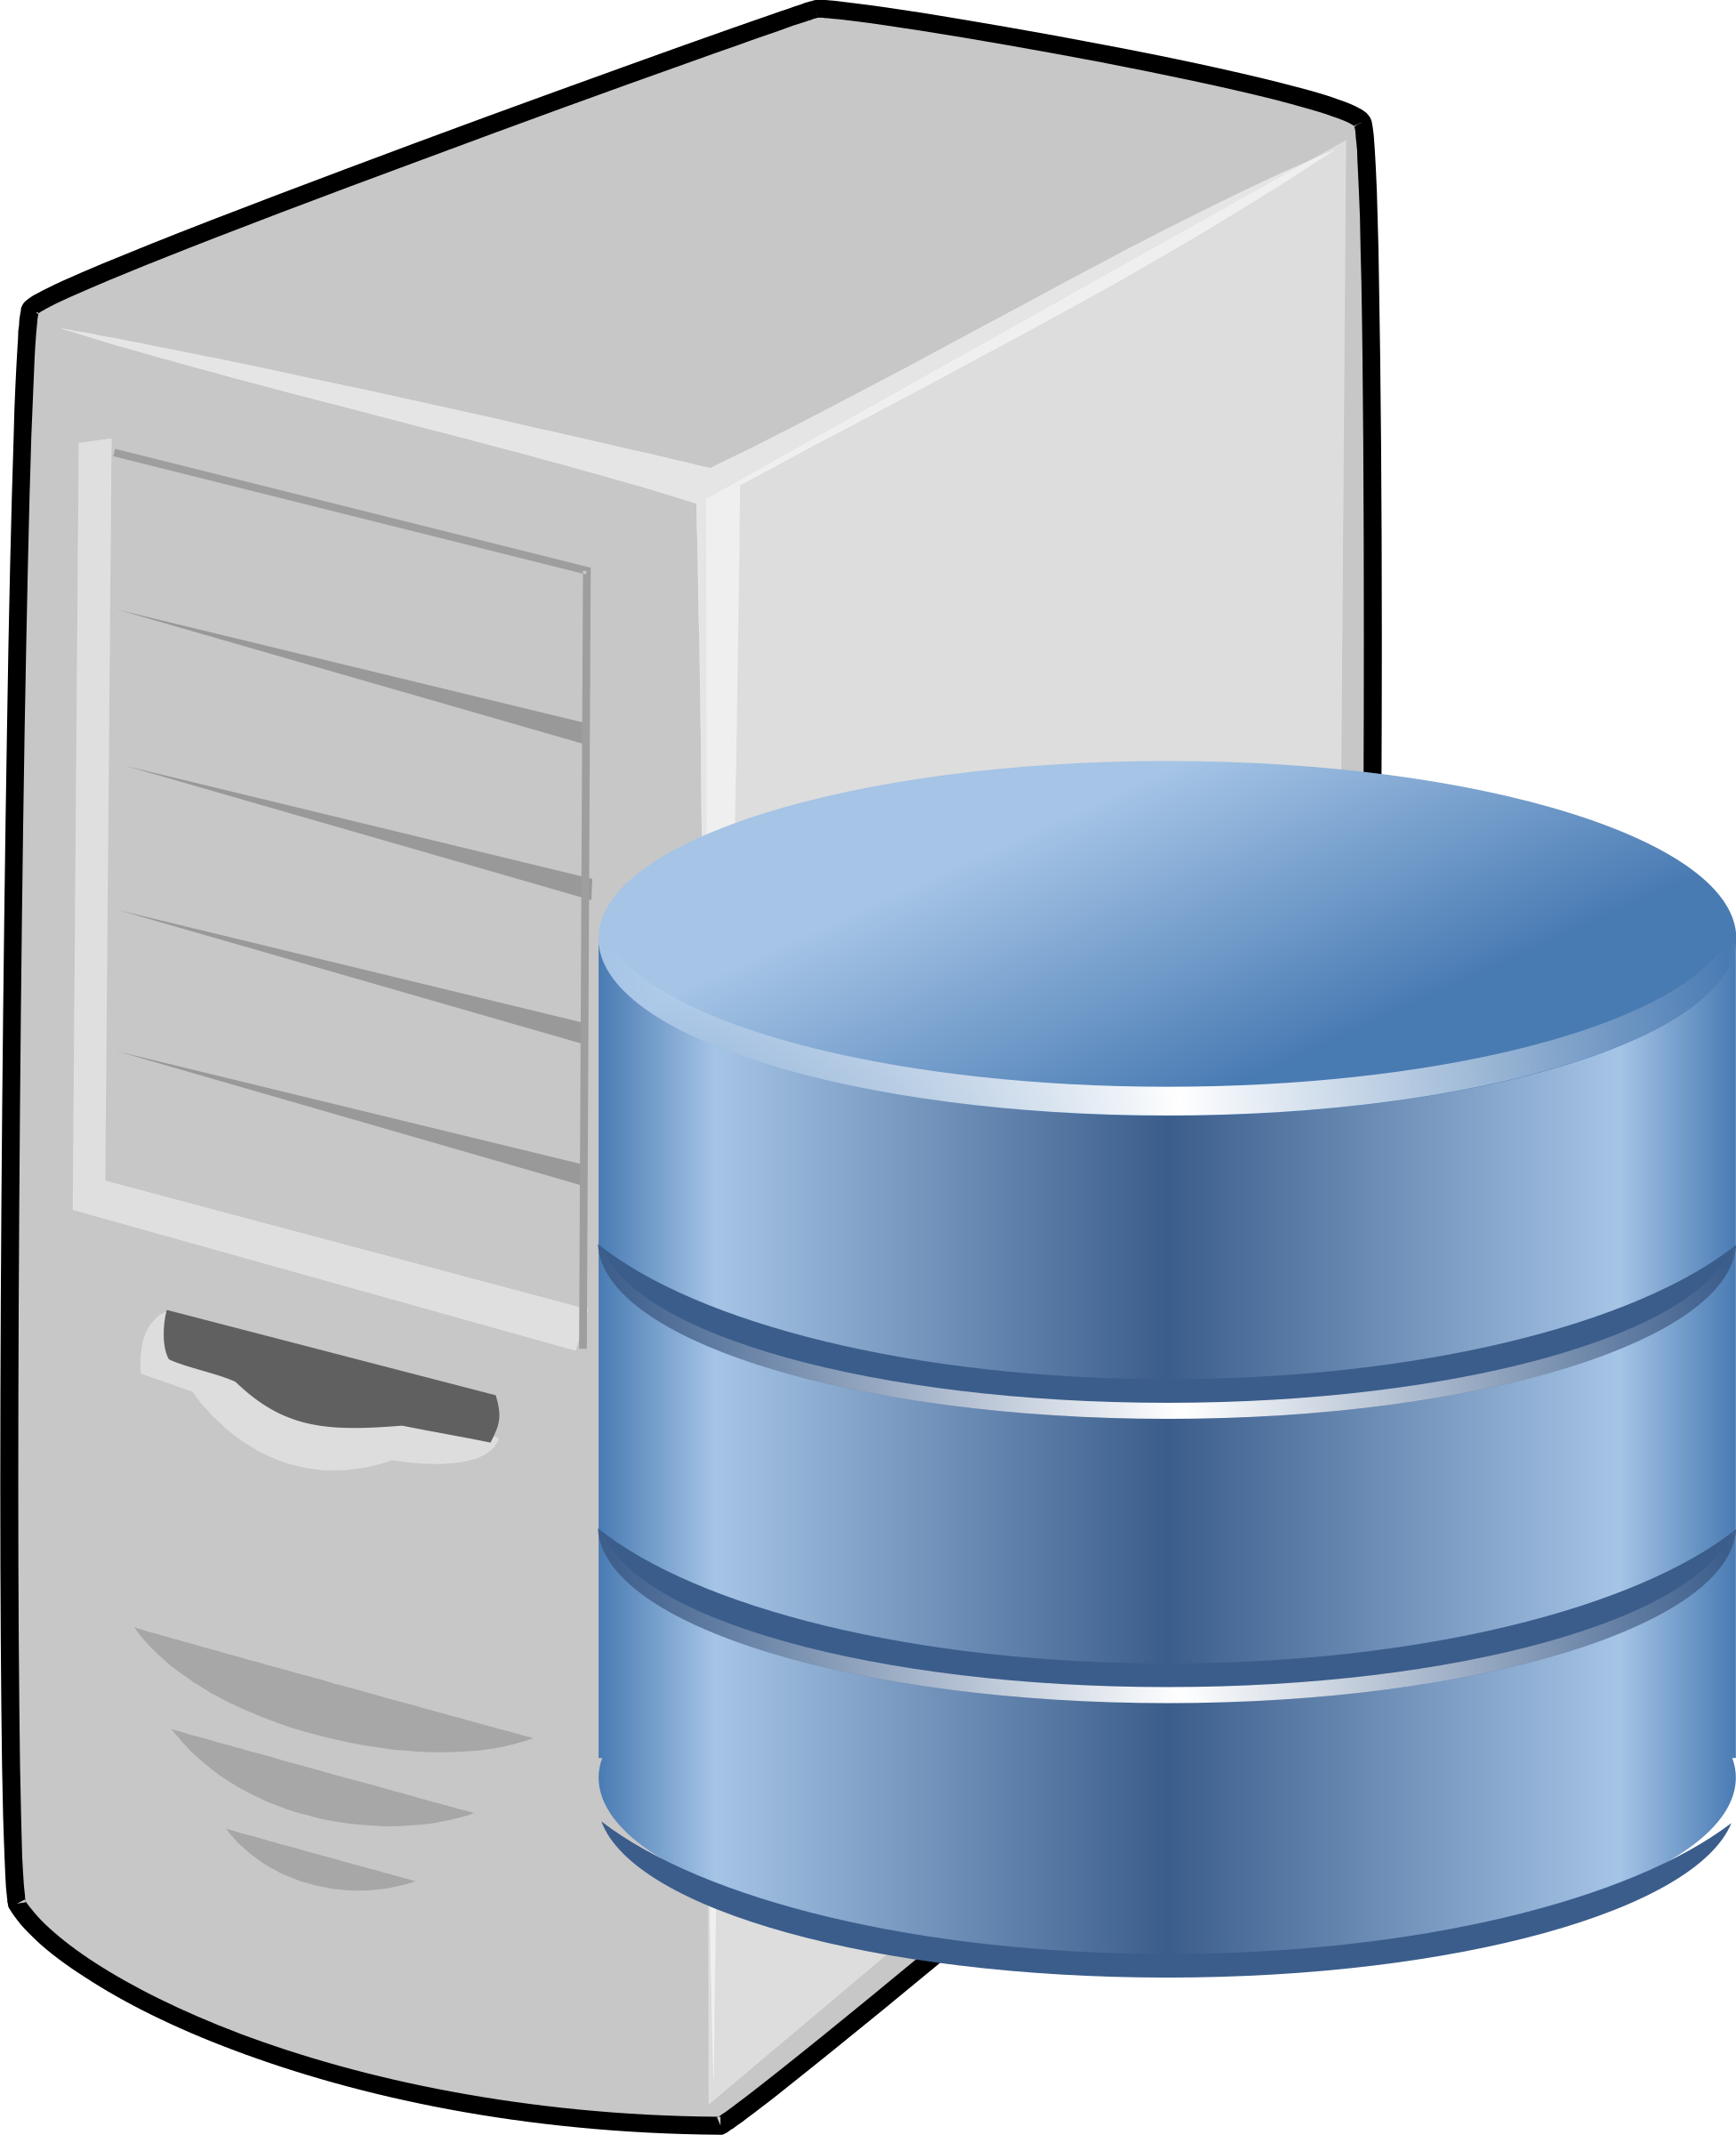
request
Db connection
response
Web browser
Layer 3
Layer 1
Layer 2

Slide 5
Frontend
Backend
request
response
Frontend
methods
Application
services
Database
methods
Web pages

Slide 6
Frontend
Backend
index.js
app.js
dbService.js
index.html
stylesheet.css

Slide 7
Connect to DB (DbService.js)
const dbconn = mysql.createConnection({
host: "localhost",
user: "root",
password: "",
database: "test"
})

Slide 8
Connect to DB (DbService.js)
const dbconn = mysql.createConnection({
host: "localhost",
user: "root",
password: "",
database: "test"
})

Slide 9
A more secure way
1. Put all parameters in .env file PORT=5000
USER=john
PASSWORD=1234
DATABASE=web_app
DB_PORT=3306
HOST=localhost
2. Load the parameters using dotenv package:
const dotenv = require('dotenv’);
dotenv.config(); // read from .env file

Slide 10
Connect to DB with environment variables
const connection = mysql.createConnection({
host: process.env.HOST,
user: process.env.USER,
password: process.env.PASSWORD,
database: process.env.DATABASE,
port: process.env.DB_PORT
});

Slide 11
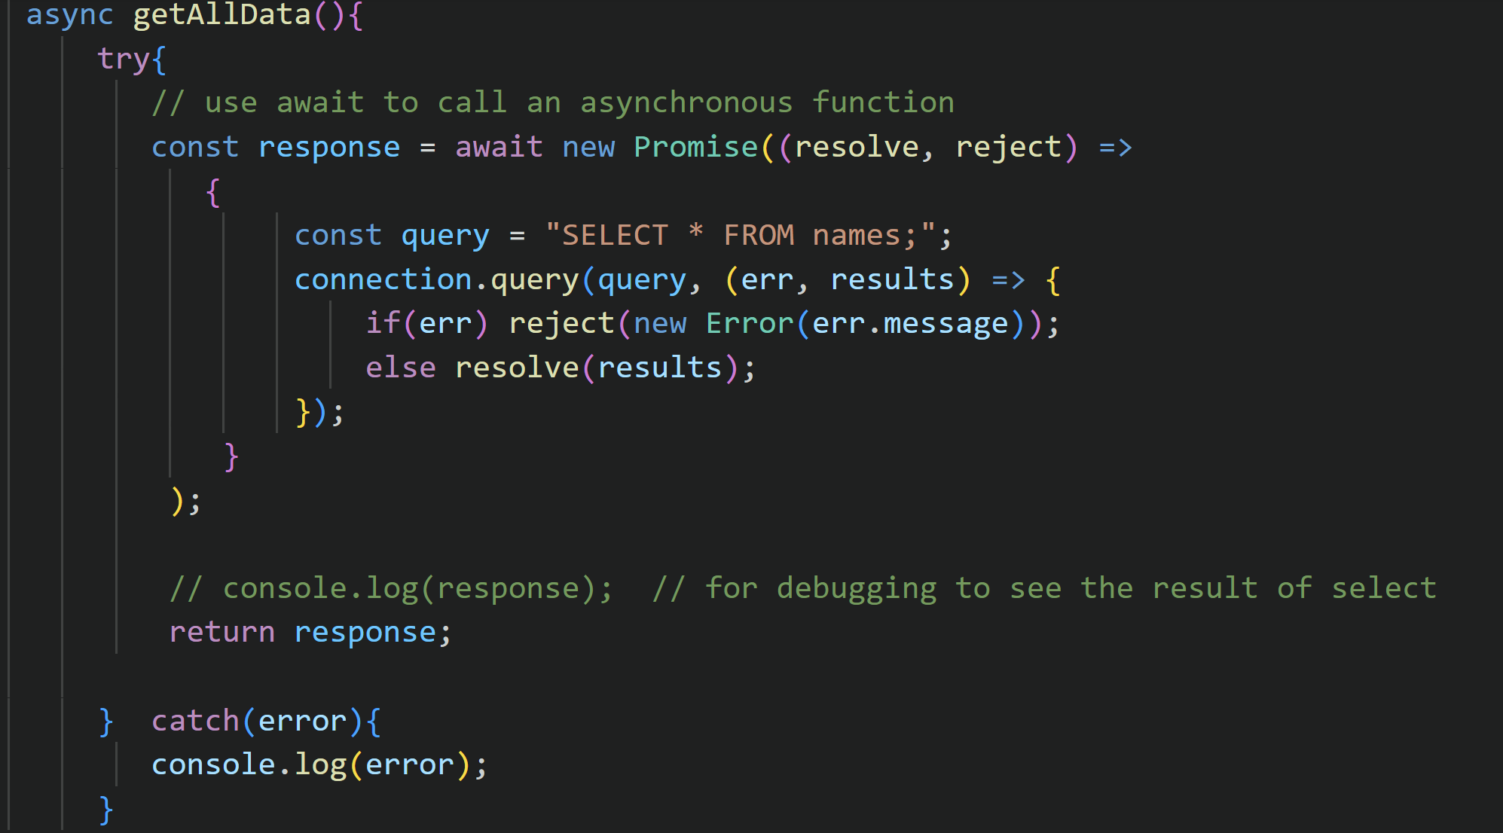
Database method (select)

Slide 12
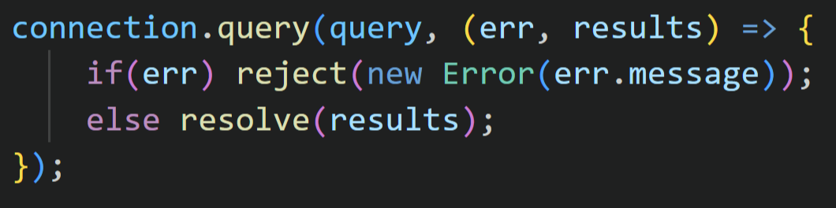
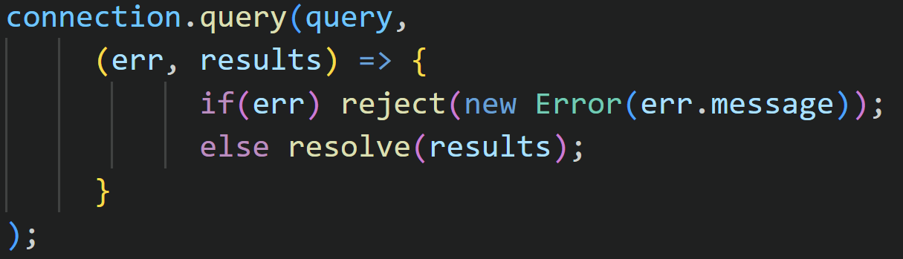
Callback function

Slide 13
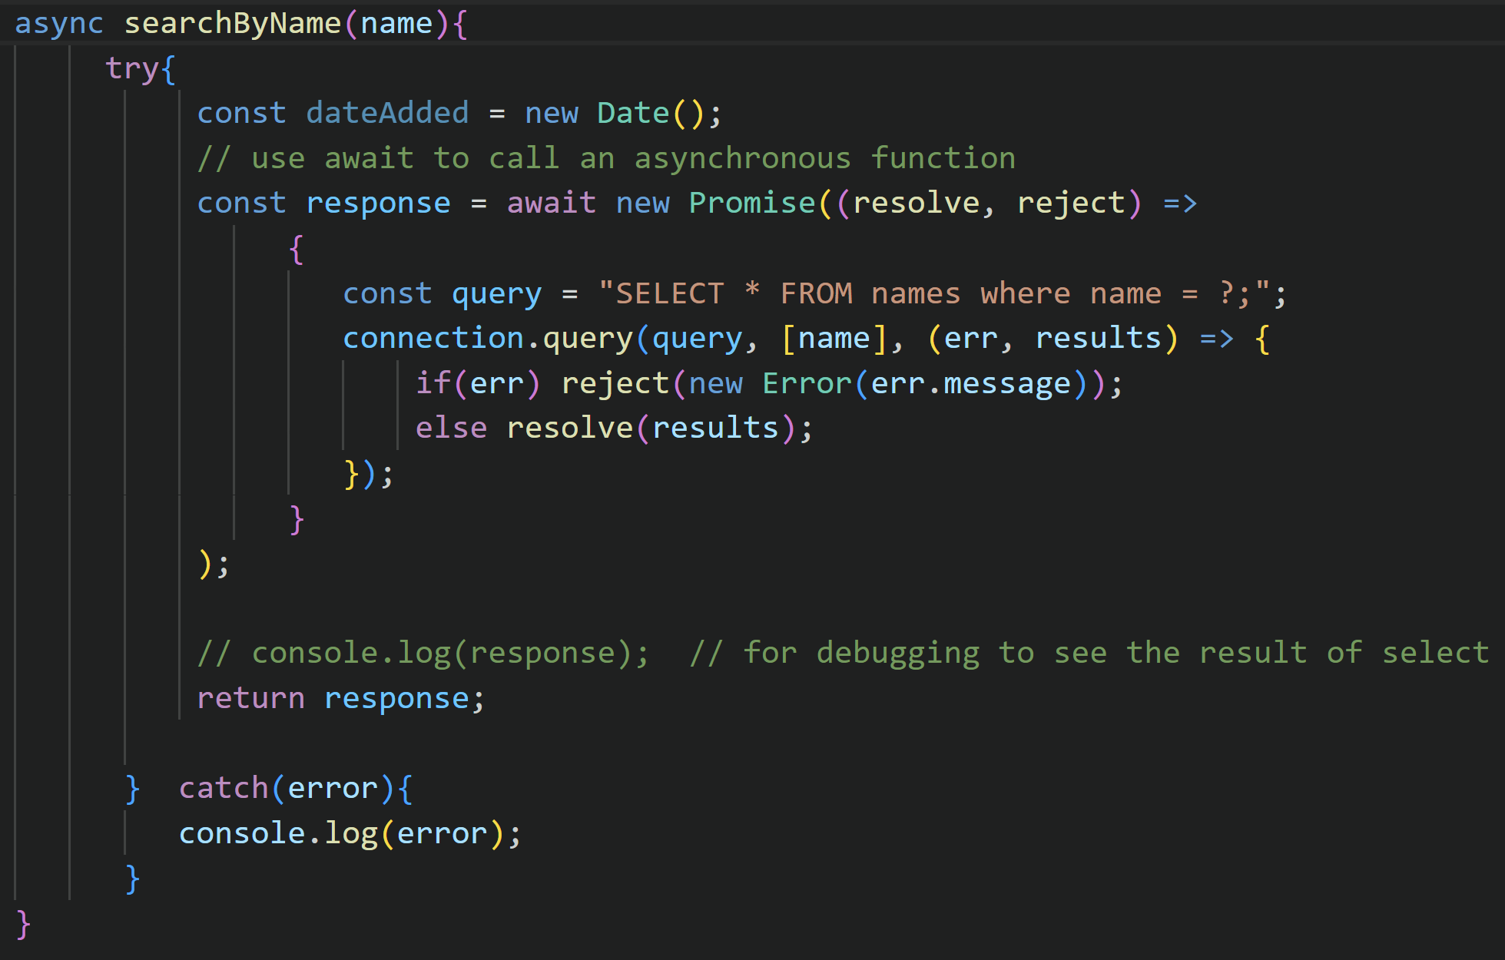
Database method (select with ?)

Slide 14
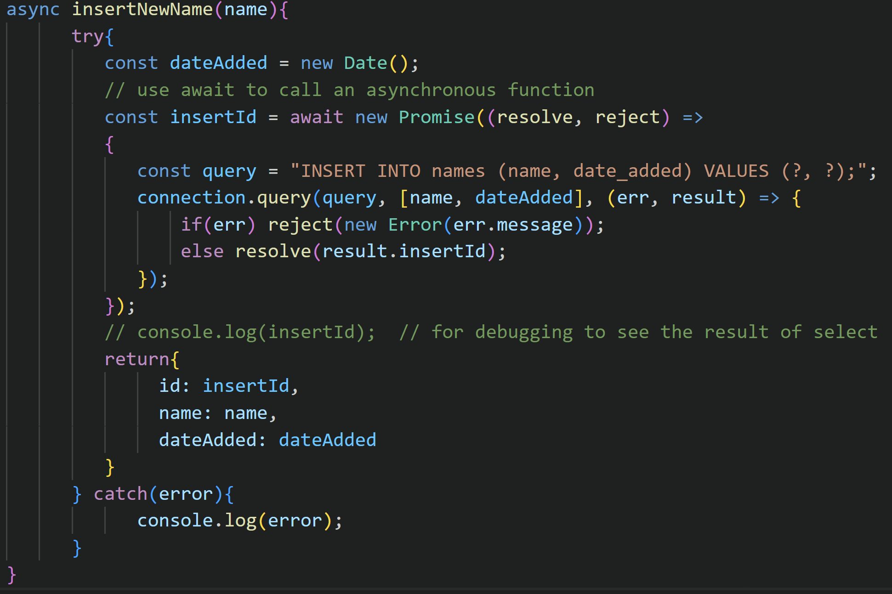
Database method (insert)

Slide 15
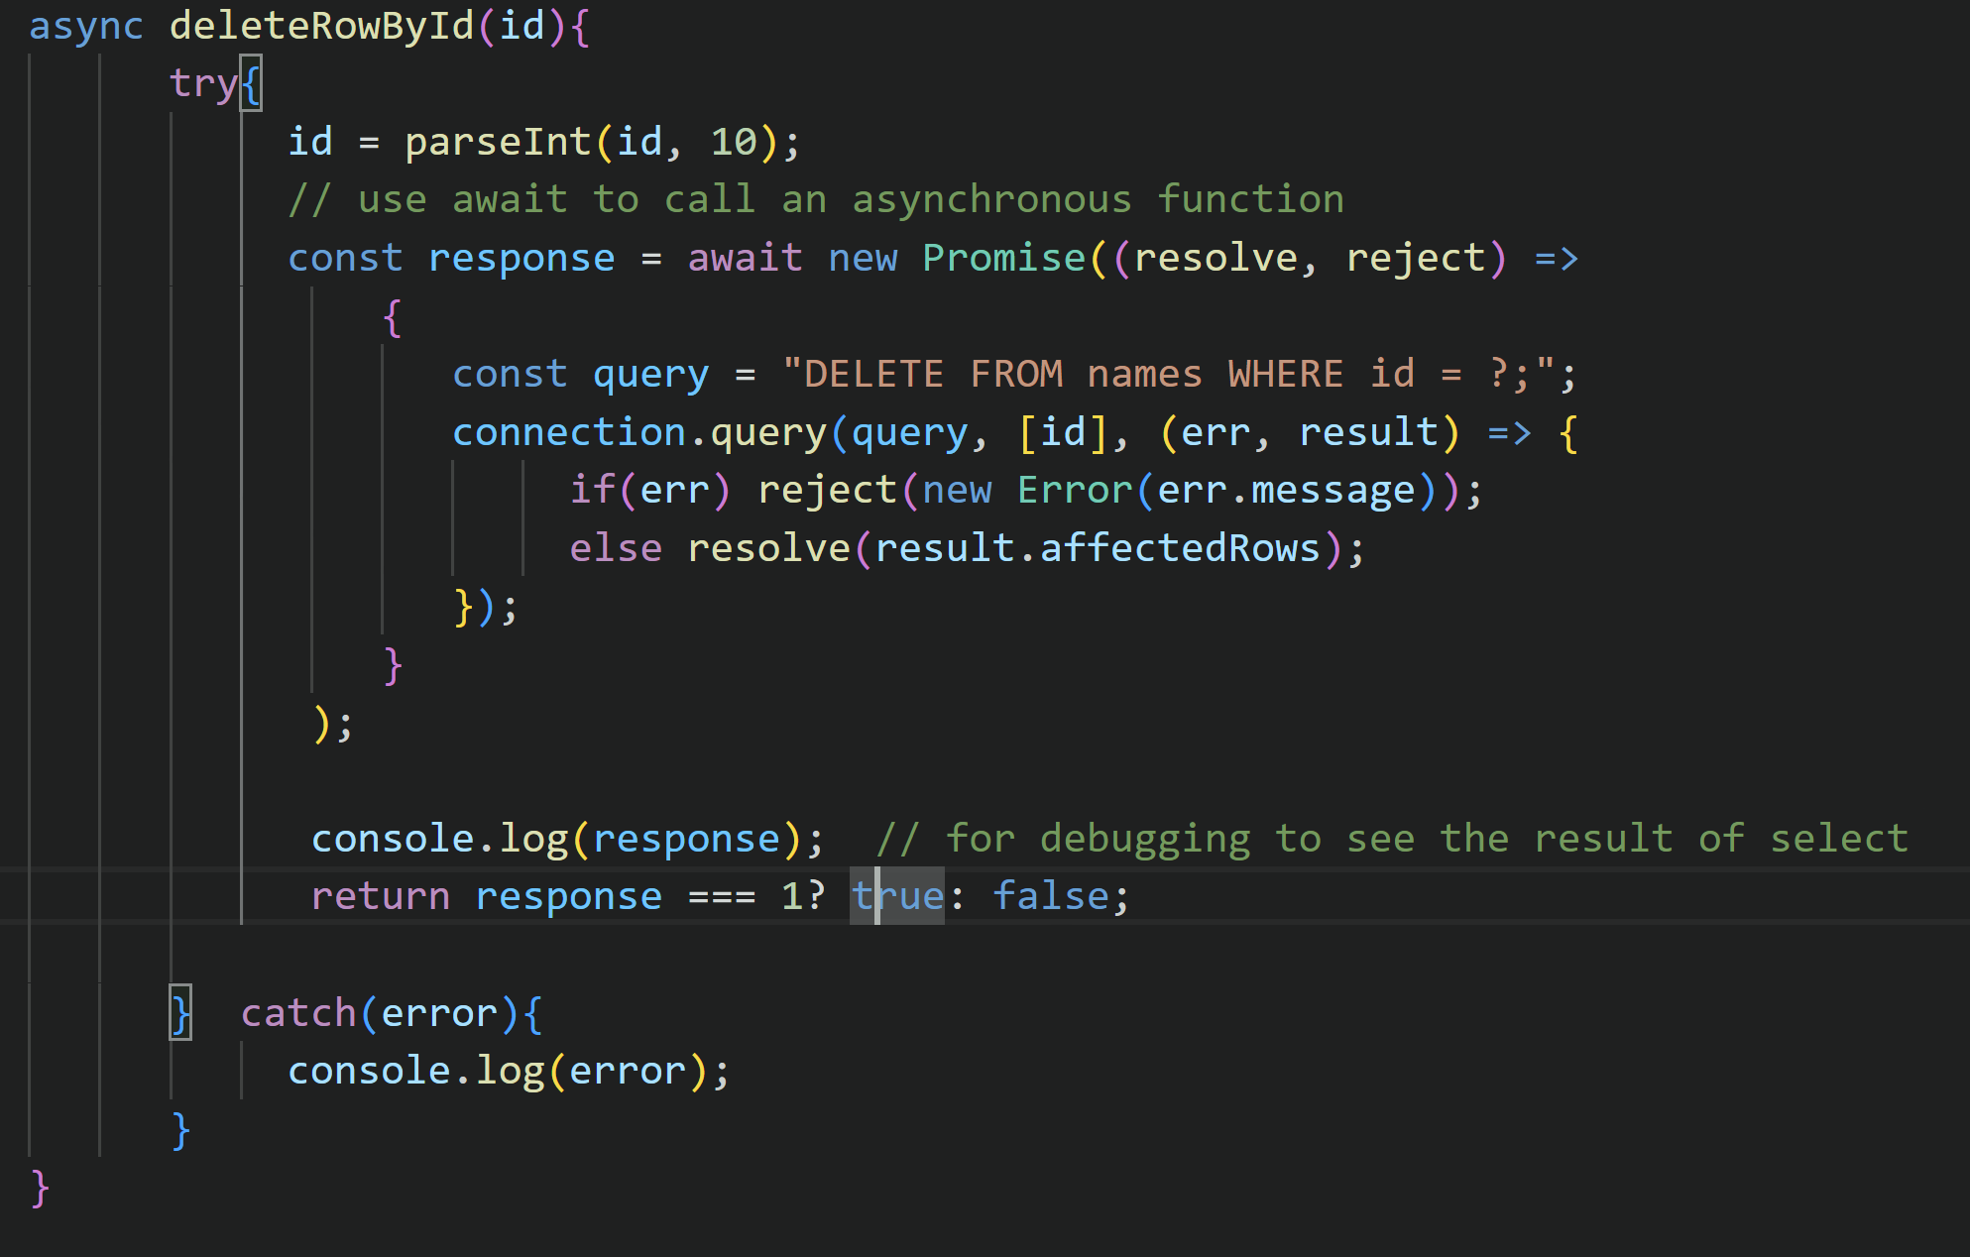
Database method (delete)

Slide 16
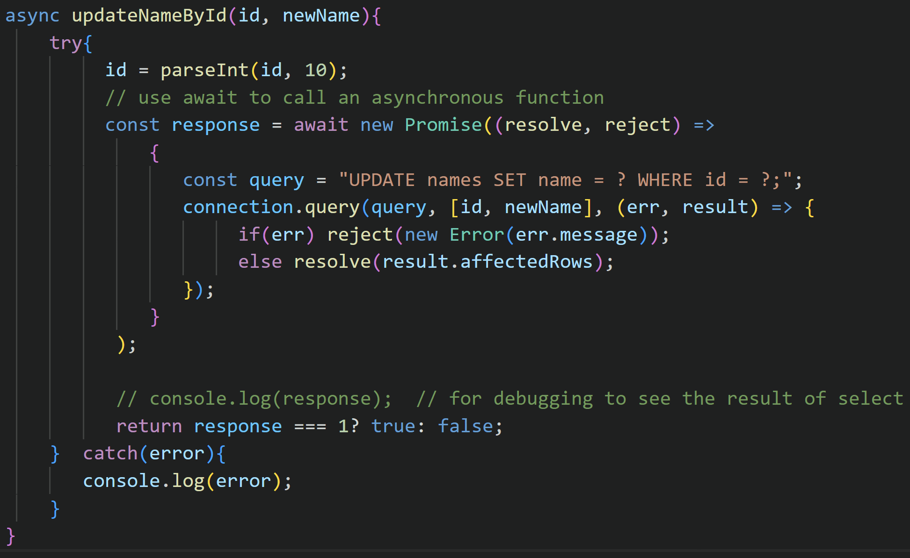
Database method (update)

Slide 17
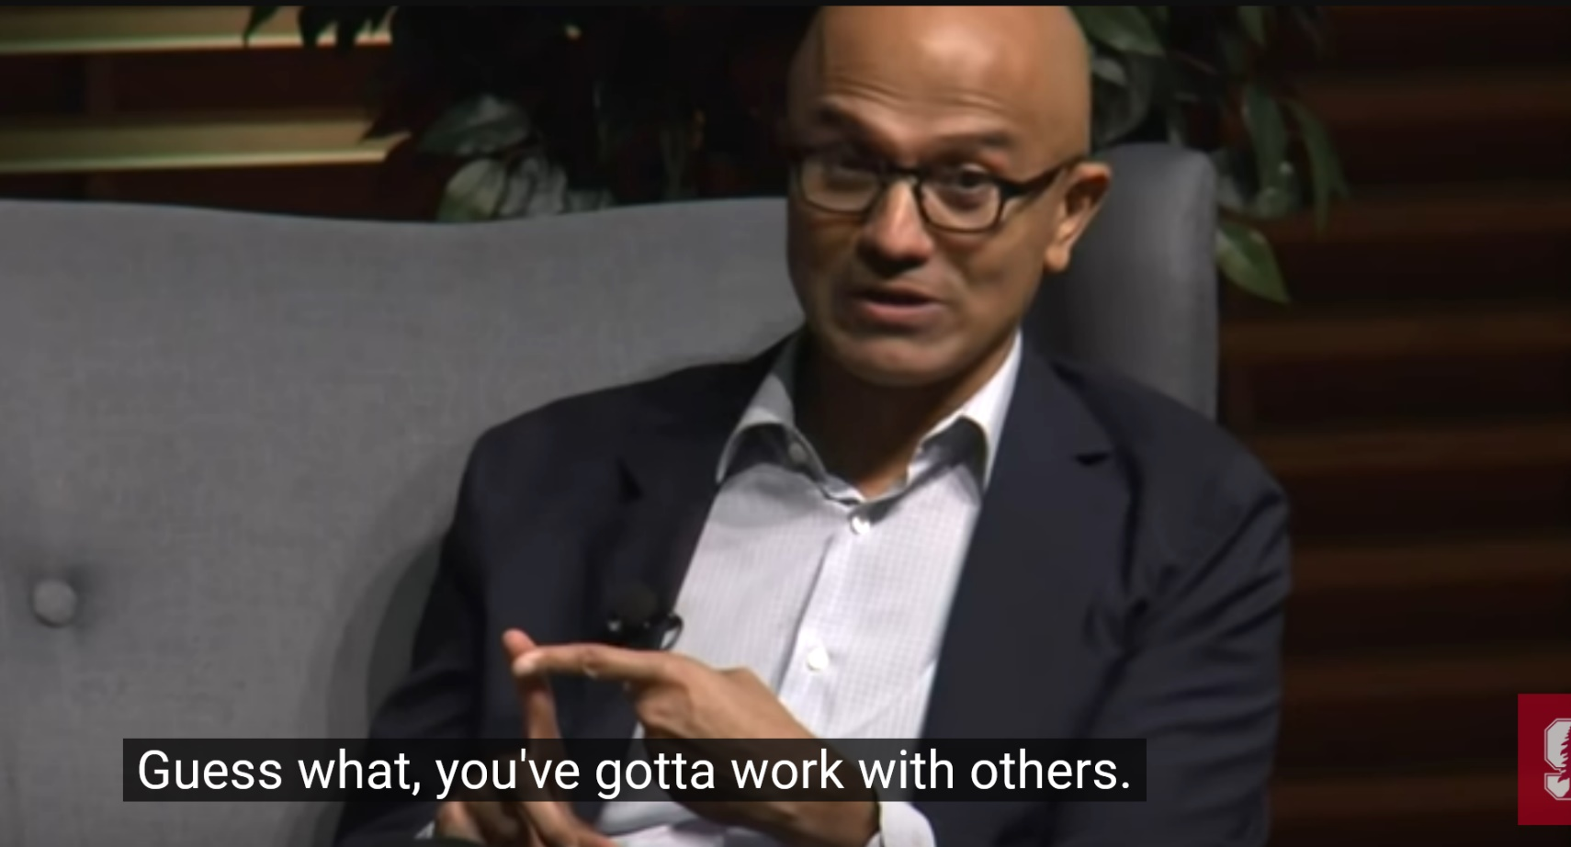
Collaboration skill is the key
Satya Nadella, CEO of Microsoft

