Slide 1
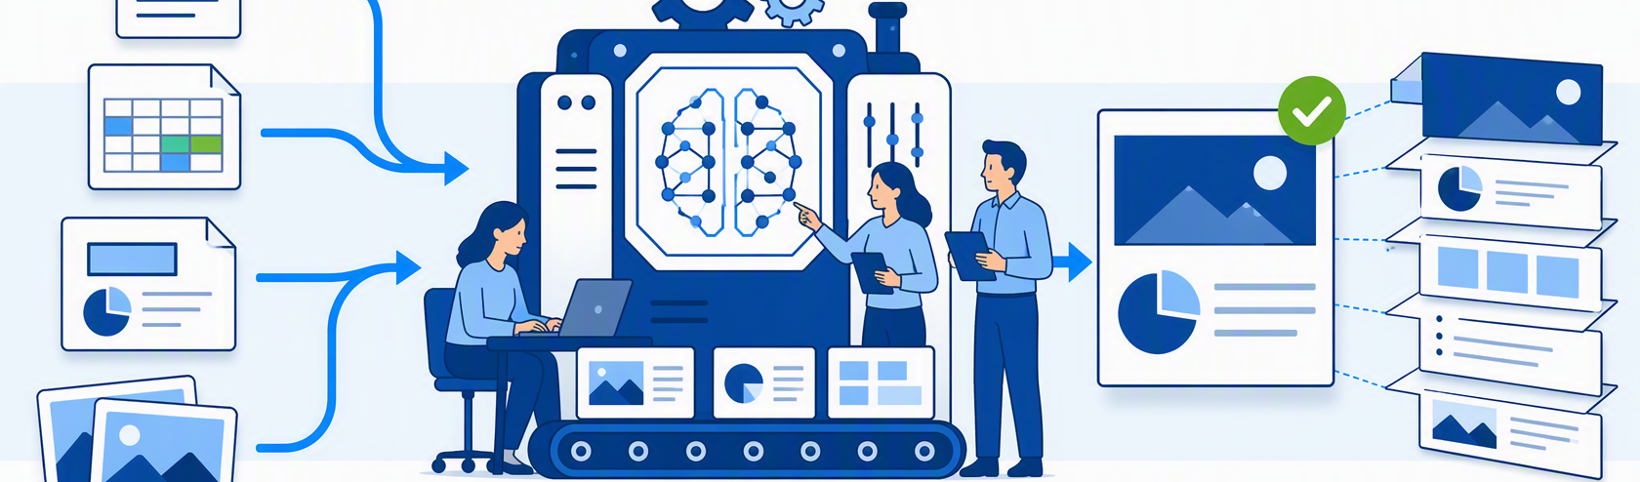
PPT Generator 介绍
面向集团AI负责人的企业演示文稿生产系统
2026年8月

Slide 2
目录
1 | 超越文案生成
2 | 材料成为任务上下文
3 | 先规划再设计
4 | 受控Agent执行
5 | SVG到原生PPTX
6 | 三部分协同系统
7 | 企业级控制机制
8 | 战略价值
9
To shift Highlight
Click the arrow, press shift key and move top or bottom

Slide 3

Beyond Text-to-Slides
3
A complete production lifecycle—not a one-shot content shortcut
NOT THIS
PPT GENERATOR
Chat copy
→ slide text dump
1
2
3
4
5
6
7
Fixed template
Materials
Understand
Plan
Confirm
Design
Brand
Export
→ automatic filling
Traceable
Repeatable
Editable
Fast output, weak control,
Evidence and decisions
Artifacts and workflow
Native PowerPoint objects
limited narrative judgment
For internal use - Confidential

Slide 4
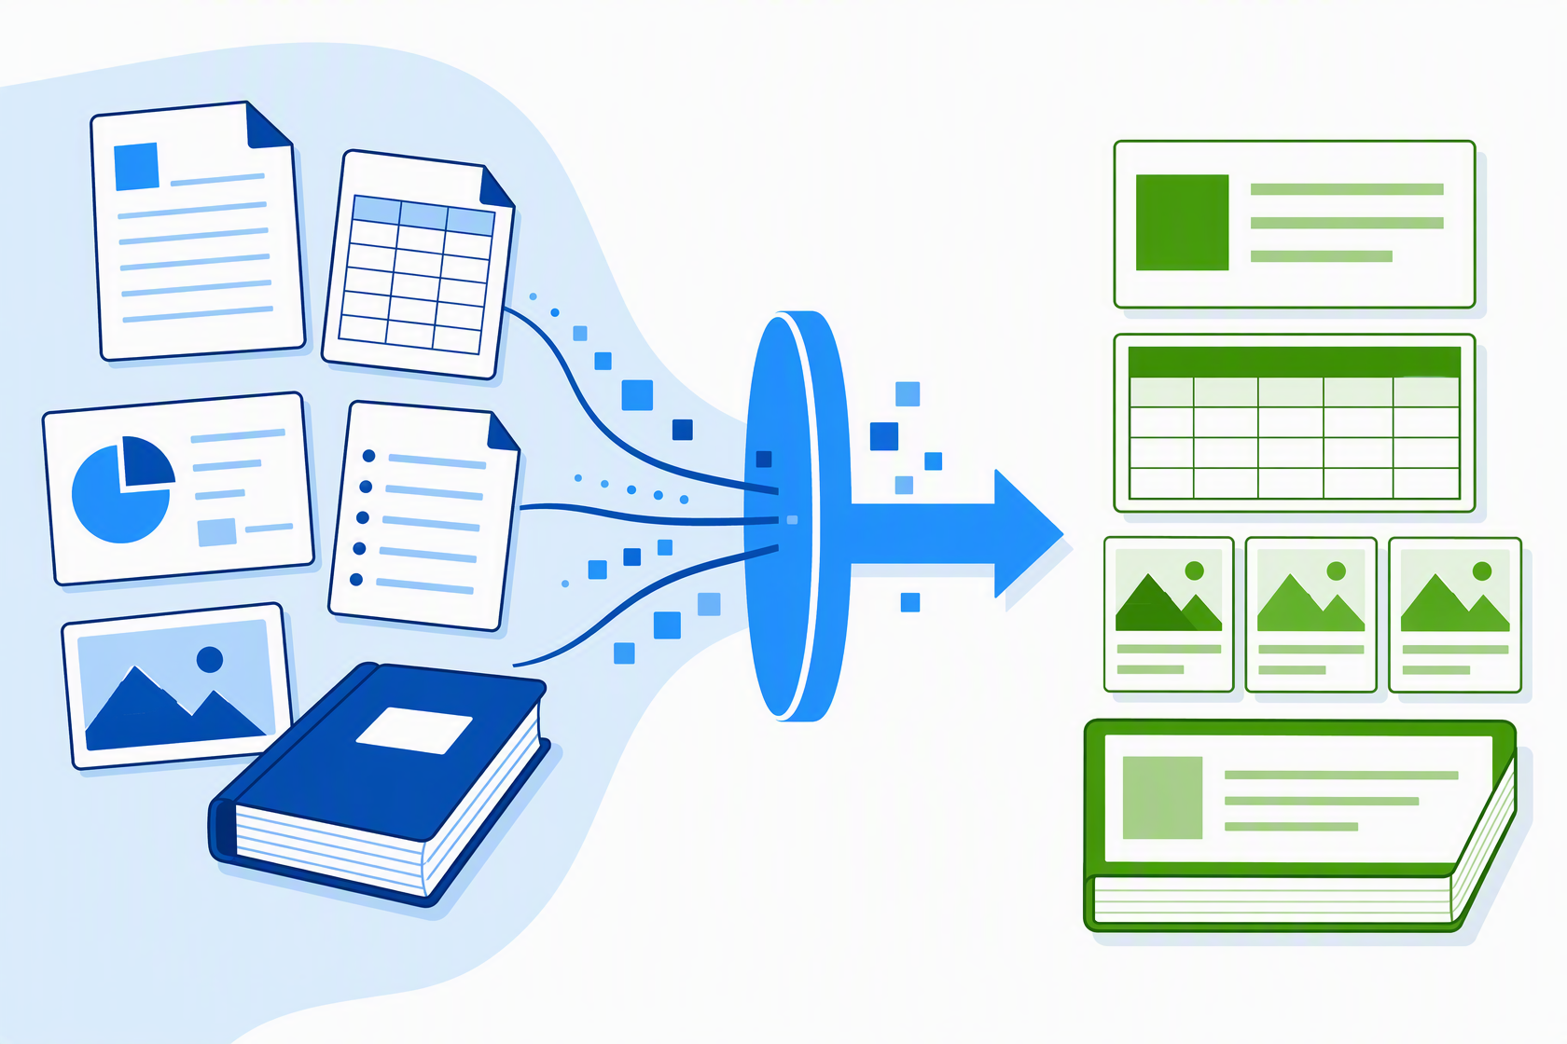
Materials Become Task Context
4
Normalize once. Reuse broadly. Freeze the evidence basis per task.
1 NORMALIZE
Text · Markdown · tables · image facts
2 REUSE
Persistent material library + material Q&A
3 SNAPSHOT
Each task receives an isolated evidence basis.
Later source edits or deletion cannot change it.
PDF · Word · PowerPoint · Excel · Markdown · Text · Images
Result: reproducible context
For internal use - Confidential

Slide 5
Plan Before Design
5
Solve “what the deck must say” before “how each page should look”
UNDERSTAND + PLAN
DESIGN + PRODUCE
Read audience, facts, purpose
Create isolated project workspace
1
Identify the communication job
EDITABLE
Retain, merge, compare, visualize
OUTLINE
Apply brand and design rules
2
human checkpoint
Turn material into narrative decisions
Author, inspect, validate, export
Author a page-by-page plan
3
Title · task · claim · support · visual
The confirmed plan becomes the production contract.
Human actions before production:
Edit title
Add / delete
Reorder
Regenerate structure
or skip when already clear
For internal use - Confidential

Slide 6

A Governed Agent Executes the Plan
6
AI makes judgment calls; the platform constrains scope, tools, artifacts, and completion
THE CONTROL ENVELOPE
Project isolation
Only the current task workspace
Approved tools
Explicit scripts and capabilities
Required artifacts
Plan · SVG · checks · PPTX
Protected boundaries
No system or cross-user mutation
MODEL OWNS
SYSTEM OWNS
Synthesis · narrative · hierarchy · visual judgment
Boundaries · tools · files · gates · export criteria
For internal use - Confidential

Slide 7
SVG Is the Page-Design Source
7
One inspectable visual source bridges generative design and editable PowerPoint engineering
SVG
PAGE-DESIGN BLUEPRINT
PPTX
DRAWINGML OBJECTS
Text
Shapes
Editable text boxes
PPT
Editable charts + shapes
Images
Coordinates
ENGINE
Replaceable images + crops
Size + z-order
Complete, previewable, checkable
Packaged native file
Not screenshots.
Not a bitmap collection.
A presentation people can continue to edit.
For internal use - Confidential

Slide 8
Three Systems, One Production Chain
8
Clear boundaries let probabilistic intelligence and deterministic tooling work together
AI AGENT
WEB APPLICATION
PPT MASTER
Judgment + creation
Experience + orchestration
Deterministic production
Multi-step understanding
Login and material library
File parsing + projects
Planning and decisions
Material Q&A and task setup
Images + template rules
Tool calls and file work
Model / style selection
SVG page design
Sequential page creation
Planning confirmation
Quality checks
Status · preview · download
Quality-driven recovery
Native PPTX export
Responses API execution loop
Shared task state and metadata persisted in SQLite
For internal use - Confidential

Slide 9
Enterprise Controls Are Built In
9
Trust comes from explicit boundaries and durable artifacts—not model behavior alone
Material snapshots
OPERATING EVIDENCE
Scoped tools +
User / task
Same confirmed plan
permissions
isolation
Run through multiple text models for controlled comparison
ISOLATED
Stepwise Responses API execution
PROJECT CORE
Auditable tool calls—not one oversized prompt
Brand + template
Planning +
Governance artifact chain
contracts
quality gates
Materials → plan → project files → SVG → checks → PPTX
Each stage leaves something inspectable behind.
Native editable output
For internal use - Confidential

Slide 10
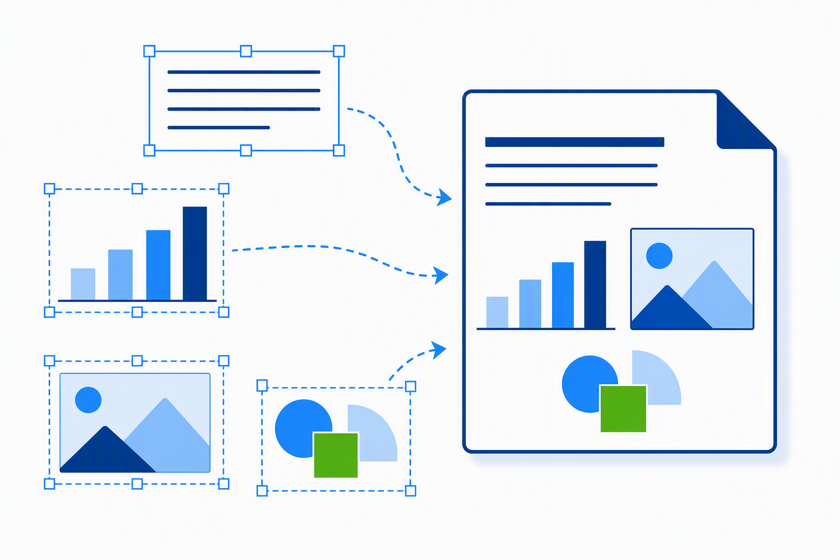
The Strategic Value
10
Scale expert presentation work without flattening judgment, governance, or editability
THE VALUE EQUATION
Enterprise evidence
+ human direction and key judgments
+ AI understanding and creation
+ deterministic file engineering
Continuously producible
brand-compliant, editable presentations
LESS MANUAL WORK
MORE CONSISTENCY
DURABLE OUTPUT
Synthesis and layout at scale
Narrative and visual quality
Reusable assets—not ephemeral chat
For internal use - Confidential

