Slide 1

PPT Generator：企业级 AI 演示文稿生产系统
从企业材料到可编辑、符合品牌规范的 PowerPoint
2026年8月

Slide 2
目录
1 | 企业演示文稿生产挑战
2 | 产品定位与核心价值
3 | 端到端用户旅程
4 | 先规划，后生产
5 | 受控 AI Agent 生产
6 | 平台架构
7 | 企业级输出与治理
8 | 战略影响与落地路径
9
To shift Highlight
Click the arrow, press shift key and move top or bottom

Slide 3


The Enterprise Presentation Challenge
3
The bottleneck is not formatting—it is the compound work of synthesis, judgment, story, and controlled production.
1 Fragmented evidence
PDF • Word • PowerPoint • Excel • Markdown • text • images
2 Repeated manual work
Read → synthesize → structure → design → format every page
3 Naïve AI shortcuts
Generic copy or rigid template filling loses enterprise context
Target state
Human judgment + AI creativity + deterministic file production
For internal use - Confidential

Slide 4
Product Positioning and Core Value
4
Plan what the deck must say and why each page exists—then decide how every page should look.
WHY THIS PAGE?
Process
Plan
role • message
Design
Apply
Editable
materials
narrative
evidence • visual
pages
brand
PPTX
FASTER
COHERENT
COMPLIANT
EDITABLE
Synthesis at material scale
Consistent story logic
Brand rules built in
Native PowerPoint objects
Less repeated reading and assembly
One narrative contract across pages
Template, type, header, footer
Not flattened slide screenshots
For internal use - Confidential

Slide 5
End-to-End User Journey
5
A reusable material snapshot anchors every step—from setup and plan confirmation to version comparison and editable download.
PERSISTENT TASK SNAPSHOT
Submitted evidence stays fixed even when the personal material library later changes.
1
2
3
4
BUILD A REUSABLE LIBRARY
CONFIGURE THE TASK
REVIEW THE PAGE PLAN
GENERATE & DOWNLOAD
Upload enterprise materials
Audience • objective • pages • model
Edit titles, points and sequence
Preview and compare versions
Query them before a task
Style • template • AI imagery
Change count before production
Download editable PPTX
One governed journey • Multiple model/style versions • One editable deliverable
For internal use - Confidential

Slide 6
Plan Before Production
6
Planning is the intelligence layer: it turns raw evidence into an explicit narrative contract before drawing begins.
READ THE MATERIALS
MAKE CONTENT DECISIONS
PAGE-PLAN BLUEPRINT
Topic & audience
RETAIN
Narrative order & page count
Facts & metrics
Titles & page roles
MERGE
Key messages & supporting evidence
Conclusions & cases
Recommended visual treatment
PRIORITIZE
Communication objective
Users can confirm, edit, reorder or reuse the plan.
EXPRESS
Fixed storyline? Skip confirmation and produce.
process • comparison • case • data
For internal use - Confidential

Slide 7
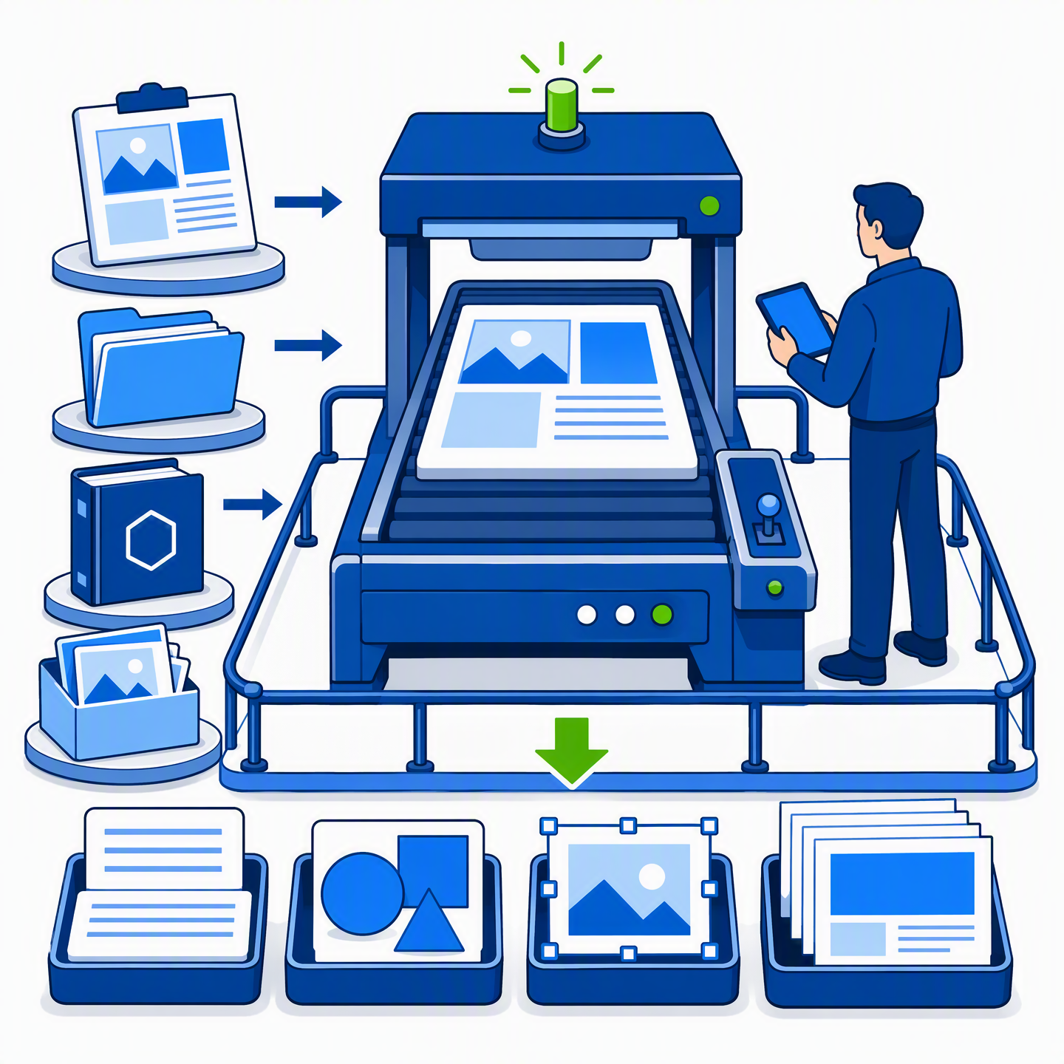
Controlled AI Agent Production
7
Creativity operates inside a task-scoped boundary; SVG gives the Agent precise, inspectable control over every page.
SCOPED INPUTS
UNIFIED SYSTEM BEFORE PAGES
Confirmed page plan
Color • typography • rhythm
Hierarchy • image strategy
Source snapshot
Brand & design rules
PAGE-BY-PAGE SVG
Text • shapes • images • coordinates
Cropping • visual layers
OPERATING BOUNDARY
Current task files + approved tools
No system code or shared templates
No access to other users’ work
Model judgment for content and design • deterministic tools for controlled file production
For internal use - Confidential

Slide 8
Platform Architecture
8
Four separated layers combine an intuitive user experience with agent reasoning, deterministic production, and isolated state.
WEB APPLICATION
Authentication • material library • document Q&A • task setup • plan confirmation • progress • previews • downloads
AI AGENT
PPT MASTER ENGINE
Multi-step understanding and planning
Parsing • project organization • images • templates
Tool use • visual decisions • page creation
SVG processing • quality checks • PPTX export
Responses API execution
SQLITE + ISOLATED TASK WORKSPACES
User scope • material metadata • task state • immutable snapshots • project files • output separation
Each task owns its own material basis, workspace, tool boundary, and export directory.
For internal use - Confidential

Slide 9
Enterprise-Grade Output and Governance
9
Governance is embedded across evidence, brand, visual resources, and native-object export—not added after generation.
1 MATERIAL SNAPSHOTS
3 VISUAL INSPECTION
Preserve the submitted evidence base
Check relevance, focal subject, crop
even when library files change later.
safety and placement before use.
EDITABLE
POWERPOINT
2 COMPANY TEMPLATES
governed end to end
4 NATIVE DRAWINGML
Constrain cover, agenda, colors, type,
Edit text, replace images, adjust
headers, footers and confidentiality.
positions and continue in PowerPoint.
Evidence snapshot → confirmed plan → branded SVG → quality gates → native PPTX objects
For internal use - Confidential

Slide 10

Strategic Impact and Adoption Path
10
Prove value in high-frequency pilots, then scale through reusable assets, isolation, and standardized quality gates.
PILOT → PROVE → SCALE
MEASURE WHAT MATTERS
PILOT
Production time
1
Executive updates • project reviews
Solution proposals • strategy decks
Revision cycles
PROVE
Brand-compliance rate
2
Time • revision cycles • compliance
Content reuse
Reuse • adoption
User adoption
SCALE
3
Templates • model comparison • libraries
SHARED AI INFRASTRUCTURE
Task isolation • quality gates
Governed knowledge in. Communication-ready, editable PowerPoint out.
For internal use - Confidential

