Slide 1
中医辨证 · 机器学习研究
Traditional Chinese Medicine Syndrome Classification
Using Machine Learning
辨
DS 340W Midterm · Penn State University
Q: How accurately can ML models classify TCM syndromes from symptoms and clinical data?
GitHub: github.com/shiyx1224-shi/tcm-project
Website: shiyx1224-shi.github.io/tcm-project
Slide 1 · ~0:30 · Section 1 — Background & parent papers
Notes:
SPEAKING TIME ~0:30. Introduce title, course, RQ, links.

Slide 2
What is TCM syndrome differentiation?
Background for data science classmates (not TCM specialists)
• Traditional Chinese Medicine (TCM) reads the whole person—not only a single disease name.
• Syndrome differentiation (辨证) groups symptoms into patterns such as qi deficiency or damp-heat.
• Clinicians use the four examinations: inspection, listening/smelling, inquiry, palpation (望闻问切).
• Hard for ML: free-text notes, similar syndromes, sparse tongue/pulse signs, many rare labels.
• Machine learning lets us measure how well clinical text maps to syndrome labels at scale.
Slide 2 · ~1:00
Notes:
SPEAKING TIME ~1:00. Keep TCM explanation simple and concrete.

Slide 3
Research question & motivation
What I am trying to discover—not just “train an AI”
How accurately can machine learning models classify Traditional Chinese Medicine (TCM) syndromes based on patients’ symptoms and clinical data?
• Motivation: complex clinical narratives, 148 syndrome classes, and long-tailed rare labels.
• I want to know whether simple TF-IDF + classical ML can compete with deeper paper-inspired models.
• I also need a public, citable dataset so another student can reproduce the study.
Slide 3 · ~0:45
Notes:
SPEAKING TIME ~0:45. Read the RQ slowly.

Slide 4
Parent paper 1 — Gong et al., 2023
Multi-label Deep Forest + biomedical text mining · Frontiers in Genetics
• Goal: predict TCM syndromes when multiple patterns can co-exist (multi-label).
• Method: symptom mining + Pearson-style feature ranking + multi-label deep forest.
• Why it matters: feature selection and set-valued syndrome outputs matter in TCM ML.
• Influence on me: I adapted Pearson-inspired / importance-based feature-selection experiments.
• Critical limit: my TCM-SD benchmark is single-label multiclass—not multi-label—so I do not claim a full MLDF reproduction.
Slide 4 · ~0:55 · doi:10.3389/fgene.2023.1272016
Notes:
SPEAKING TIME ~0:55. Stress adaptation vs reproduction.

Slide 5
Parent paper 2 — Huang et al., 2022
Cross-feature generation by CNN (Cross-FGCNN) · JMIR Medical Informatics
• Goal: classify dysmenorrhea syndromes from sparse four-examination EMR fields.
• Method: 60 structured fields → cross network + FGCNN for feature interactions.
• Insight: TCM signs interact—independent flat features miss field structure.
• Influence on me: AdaptedCrossFGCNN on free-text virtual fields (not their private EMR table).
• Honest stance: adaptation under data/compute constraints—not an exact replica.
Slide 5 · ~0:55 · doi:10.2196/29290
Notes:
SPEAKING TIME ~0:55.

Slide 6
Parent paper 3 — Chen et al., 2024 + how the three connect
Holistic deep learning · Integrative Medicine Research
Gong
Feature ranking &
multi-label framing
Huang
CNN + feature
crosses / fields
Chen
BERT + CNN over
clinical language
• Chen: deep learning for holistic syndrome prediction with BERT-style text + CNN heads.
• My synthesis: place adapted Gong/Huang/Chen ideas on one public multiclass benchmark (TCM-SD).
• Then compare them fairly against Random Forest, Logistic Regression, and Linear SVM.
Slide 6 · ~0:55 · Transition to my methods · doi:10.1016/j.imr.2023.101019
Notes:
SPEAKING TIME ~0:55. End of first 5 minutes.

Slide 7
My dataset & preprocessing — TCM-SD
Public link: https://github.com/Borororo/ZY-BERT · License: CC BY-NC-SA 4.0
• 54,152 clinical records → 148 norm_syndrome labels (Ren et al., CCL 2022).
• Inputs: chief_complaint + description + detection. Target: one syndrome (multiclass).
• Leakage-aware split: 70% / 10% / 20% by patient + clinical-text fingerprint (train 37,955 / val 5,420 / test 10,777).
• Train-only char TF-IDF + lengths; SelectKBest(χ², k=5000) fit on train only.
• Long-tailed labels → report micro-F1 and macro-F1, not accuracy alone.
Slide 7 · ~1:00 · Section 2 — My project
Notes:
SPEAKING TIME ~1:00. Point to the public dataset URL.

Slide 8
My machine learning methodology
Baselines first, then parent-paper–inspired adaptations
Dataset
Preprocess
Features
Train
Validate
Test once
• Classical baselines (same matrices): Random Forest, Logistic Regression, Linear SVM.
• Feature-selection ablation: variance truncate vs MI / RF-importance / Gong-inspired PCC filter.
• Deep adaptations: Huang-inspired Cross-FGCNN; Chen-inspired frozen Chinese BERT + TextCNN.
• Protocol: choose by validation micro-F1 only; score held-out test once.
Slide 8 · ~1:10
Notes:
SPEAKING TIME ~1:10. Emphasize shared split and no test peeking.

Slide 9
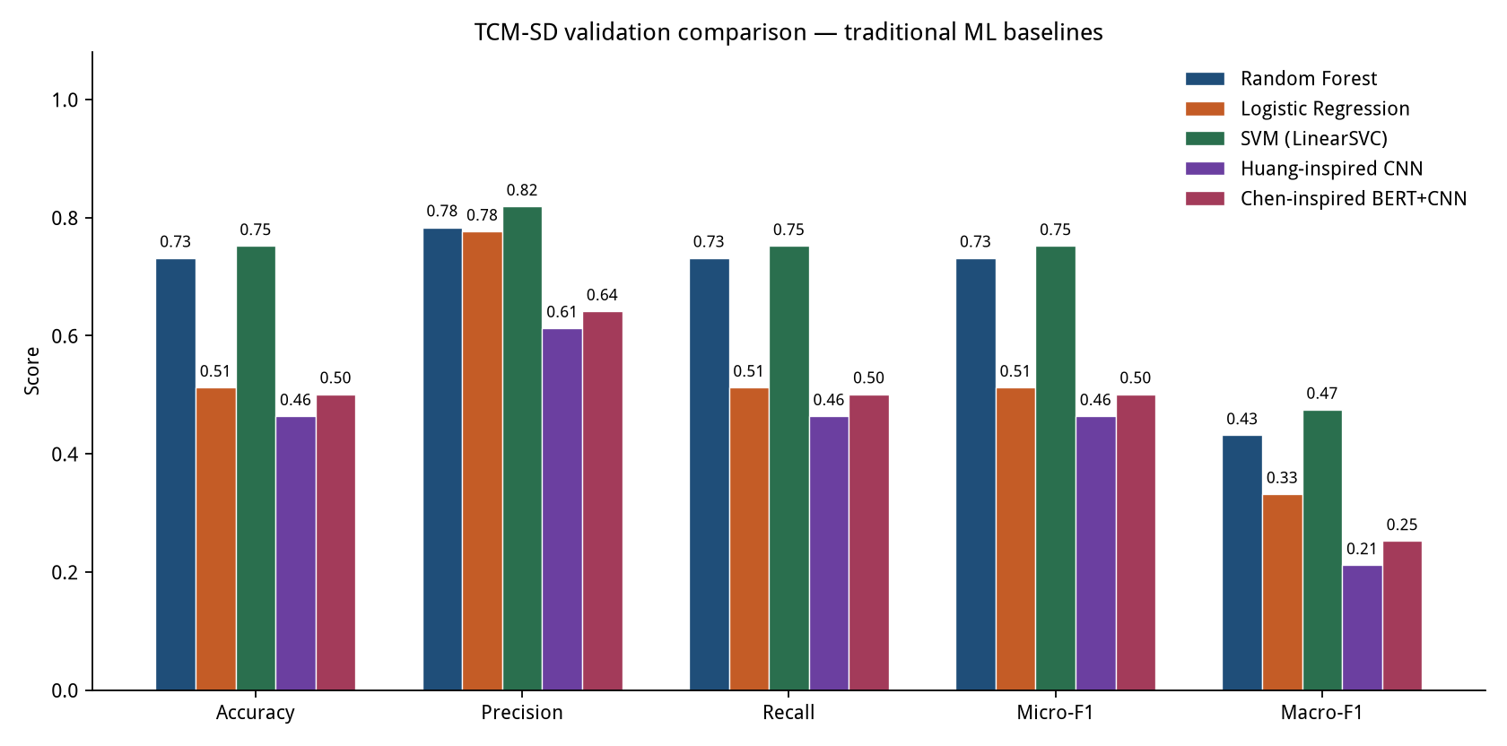
Verified results (from repository artifacts)
model_comparison.csv · final_test_metrics.json · independently re-scored
Model (validation)
Acc
Micro-F1
Macro-F1
SVM (LinearSVC) ★ selected
0.7517
0.7517
0.4745
Random Forest
0.7314
0.7314
0.4312
Logistic Regression
0.5120
0.5120
0.3316
Chen-inspired BERT+CNN
0.5007
0.5007
0.2521
Huang-inspired CNN
0.4635
0.4635
0.2112
Held-out TEST (n=10,777)
Accuracy / Micro-F1 = 0.7548
Macro-F1 = 0.4992
Deep adaptations did not beat TF-IDF SVM/RF.
Feature selection: mixed results.
Teaching website ≠ TCM-SD classifier.
Slide 9 · ~0:55
Notes:
SPEAKING TIME ~0:55. Distinguish validation selection from locked test.

Slide 10
My contribution vs the parent papers
What is novel here—and what is not
• Shared public TCM-SD benchmark for classical ML + Gong/Huang/Chen–inspired adaptations.
• Reproducible leakage-aware pipeline: split → train-only features → validation select → one test.
• Empirical finding: Linear SVM (~75.5% test micro-F1) beat adapted deep models on this setup.
• Honest scope: multiclass (not multi-label); adaptations disclosed; no SOTA claims.
• Website: Research Results/About for ML evidence; Syndrome Explorer is an educational demo only.
Slide 10 · ~0:55
Notes:
SPEAKING TIME ~0:55. Professor cares about novelty/deviation—speak slowly.

Slide 11
Future work & conclusion
Closing the loop on the research question
• Next: improve rare-class performance (macro-F1 ≈ 0.50); try hierarchical TCM label constraints.
• Richer Chinese clinical NLP; probability calibration; error-driven dictionary expansion.
• If a licensed multi-label corpus appears, revisit Gong-style multi-label methods properly.
• So far: on public TCM-SD text, classical margin models reach ~75% micro-F1 across 148 syndromes,
• while adapted deep models lag—and rare syndromes remain the hard frontier.
Thank you — questions welcome. github.com/shiyx1224-shi/tcm-project
Slide 11 · ~1:00 · End ≈ 10:00
Notes:
SPEAKING TIME ~1:00. End on RQ + next steps.

