Slide 1
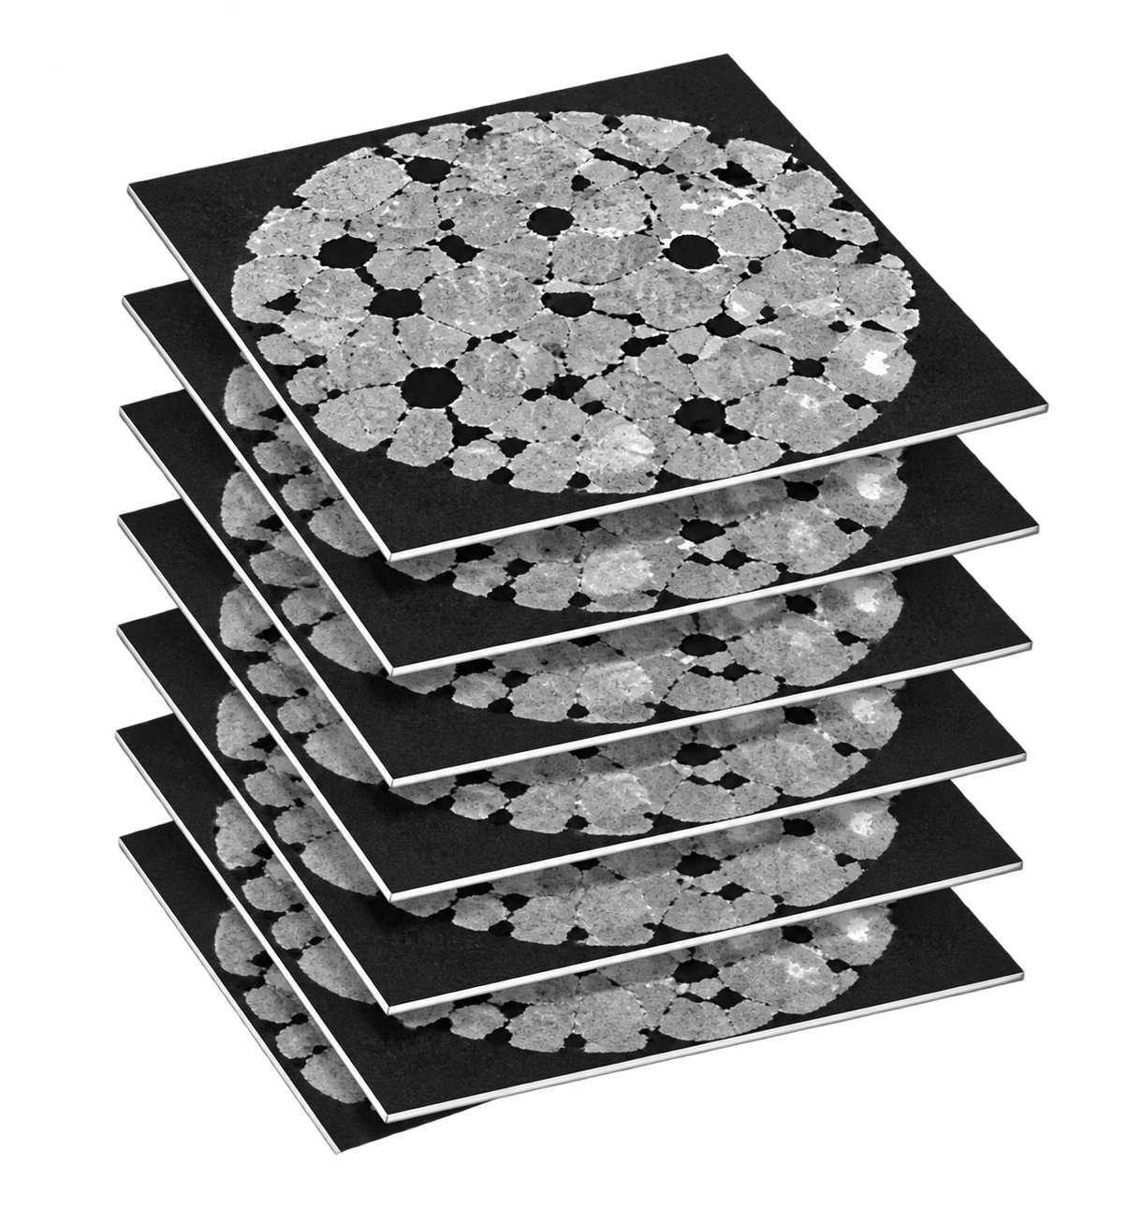
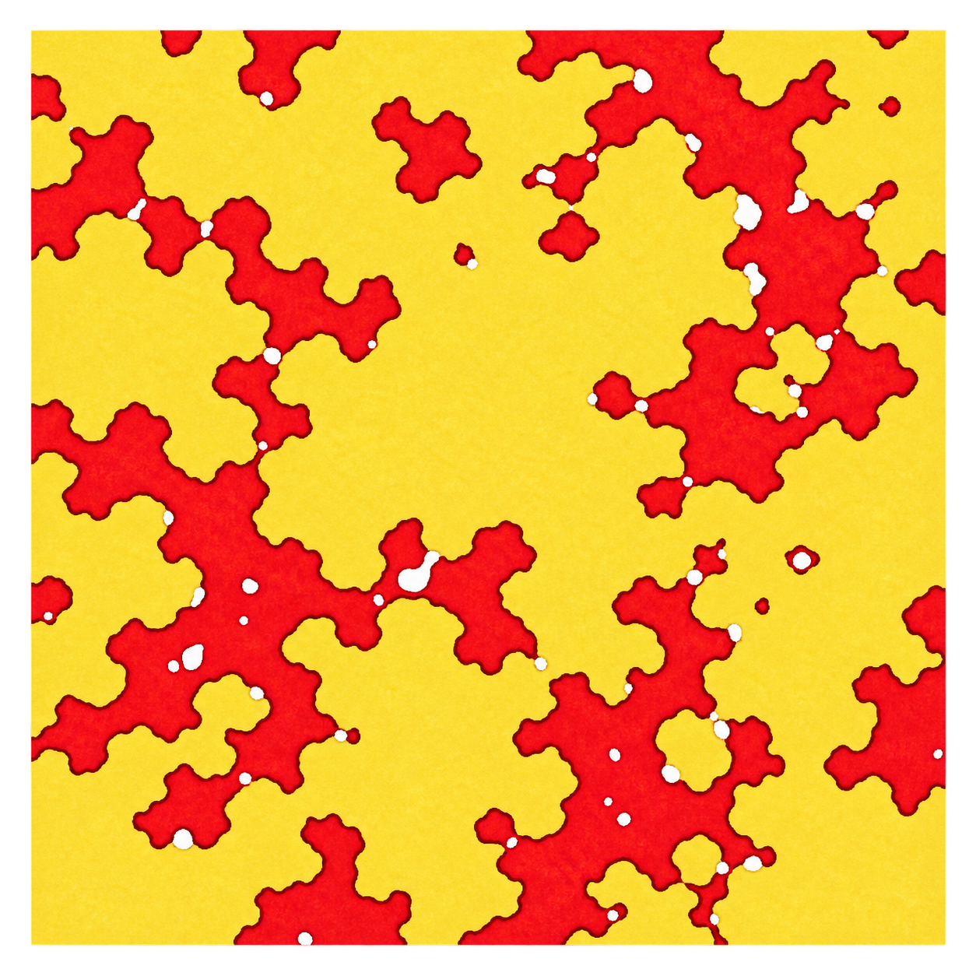
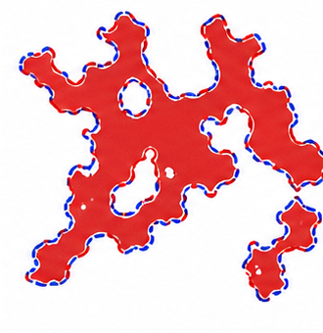
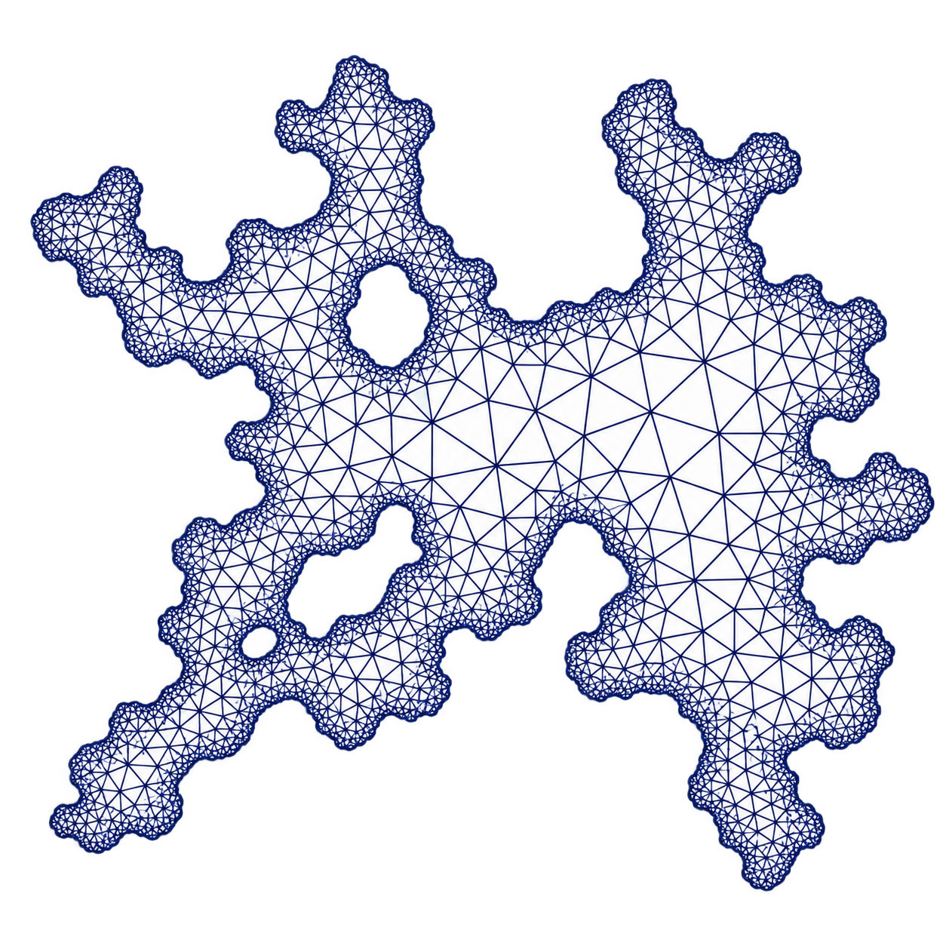
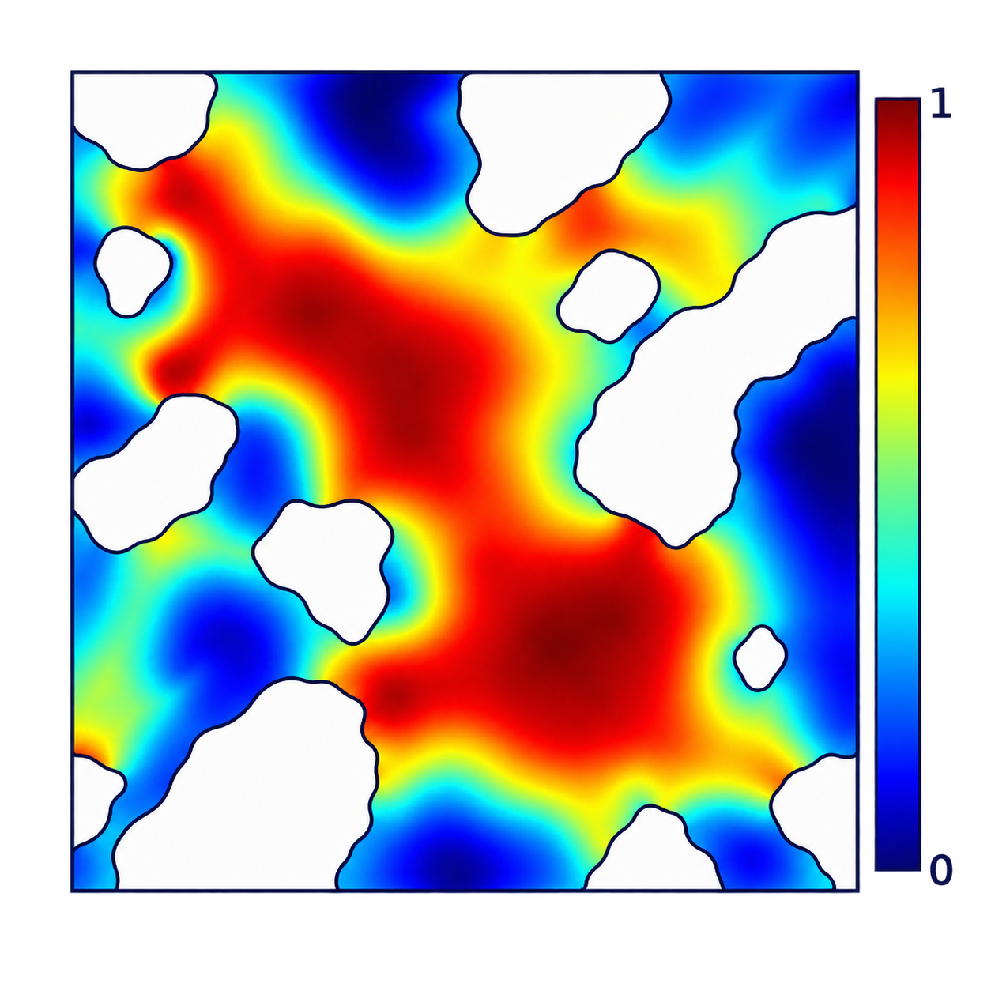
Pore-scale NMR T₂ Workflow
3D CT Stack
Representative
2D Slice
Water Domain
2D FEM
M(x,t)
Decay S(t)
T₂ Spectrum
Simulated
Experimental
Solid-fluid boundary
Water-air boundary
Geometry → M(x,t) → S(t) → f(T₂)
representative-slice approximation — not a full 3D solve

Slide 2
Full Physical Model
Current T₂ Solver
m = [mₓ, mᵧ, m_z]^{T}
homogeneous field
+
post-excitation
∂M/∂t = D∇²M − M/T₂B
solid–fluid
RF pulse
Robin relaxation
D∂ₙM + ρₛM = 0
solid
water
water–air
zero flux
air
D∂ₙM = 0
M(x,0) = 1

Slide 3
CT Geometry → FEM Domain
contiguous porosity groups: max(ϕ) − min(ϕ) ≤ 0.01
3D CT stack
Representative 2D slice
Interface classification
Boundary-refined mesh
solid–fluid edge
water–air edge
water
solid
air
Ωw = water-occupied domain

Slide 4
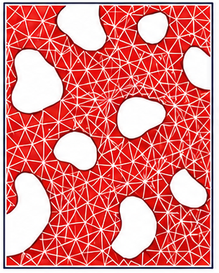
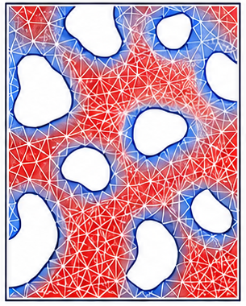
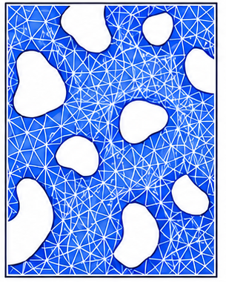
Magnetization Evolution → NMR Decay
↝
↑
↓↓↓
diffusion
bulk relaxation
surface relaxation
t₀
t₁
t₂
S(t) =
∫
M(x,t) dΩ
Ωw
(M + Δt DK + Δt M/T₂B + Δt ρₛRₛ) mⁿ⁺¹ = M mⁿ

Slide 5
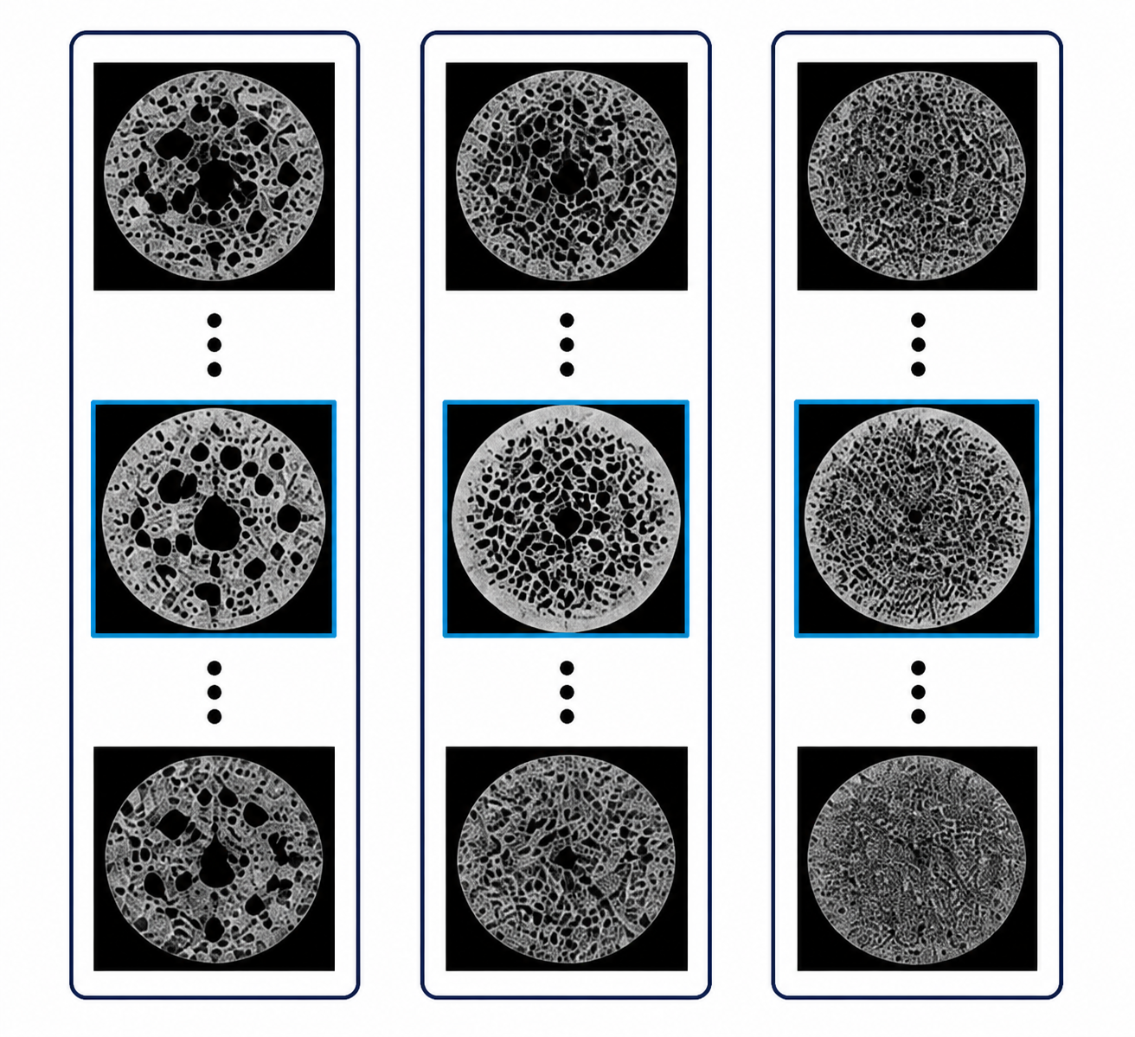
Representative Slices → T₂ Spectrum
Porosity groups
Representative decays
Weighted decay
NNLS / L-curve
Simulation
Experiment
weight w₁
(N₁ slices)
weight w₂
(N₂ slices)
weight w₃
(N₃ slices)
2D representative-slice approximation — not a full 3D solve
S̄(t) = Σ_{g} w_{g} S_{g}(t) / Σ_{g} w_{g}
min
‖Kf − s‖² + α²‖Lf‖²
f ≥ 0

