Slide 1
Simulating complex conductivity in carbonate rocks: using digital carbonate rocks and comparison to laboratory measurements
Master’s Thesis Defense for James Colgin
University of Kansas, Department of Geology
November 28, 2018
Committee:
Chair: Chi Zhang, Department of Geology
George Tsoflias, Department of Geology
Xianglin Li, Department of Mechanical Engineering

Slide 2
Outline
Introduction
  Digital Rock Physics and IP theory
Methods
  Sample Selection, Image Processing, and Simulation Steps
Results and Discussion
  Laboratory Comparison, Comments on Model Parameters and Processing Steps
Conclusions and Next Steps

Slide 3
Introduction – The Scientific Problem
Macroscopic geophysical measurements are governed by pore-scale rock properties
Carbonate rocks are intrinsically heterogeneous and complex
How do pore-scale geometry and electrical properties control bulk complex conductivity?

Slide 4
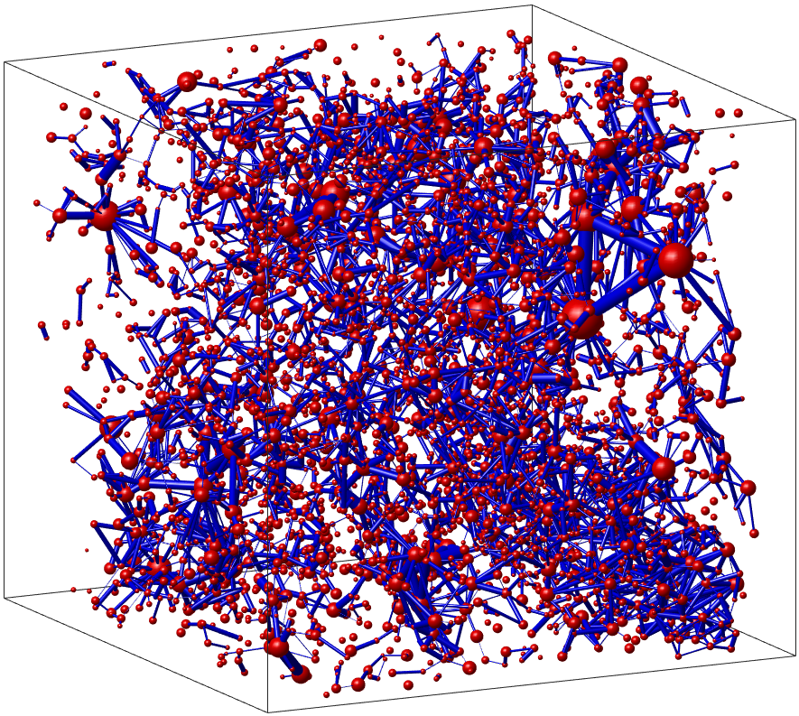
Introduction – Digital Rock Physics
Digital rock physics: high-resolution 3D imaging of a real samples, digitization of the microstructure, and computation of macroscopic properties (Andrä et al. 2013a, b)
Forward modeling approach
Very few studies incorporating the effects of the electrical double layer and surface conductance
Digital Rock Physics:
  “Do it because we can” … “Do it because it’s needed” (Dvorkin et al. 2011)

Slide 5
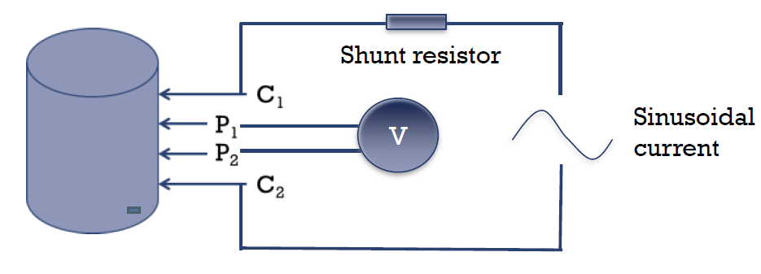
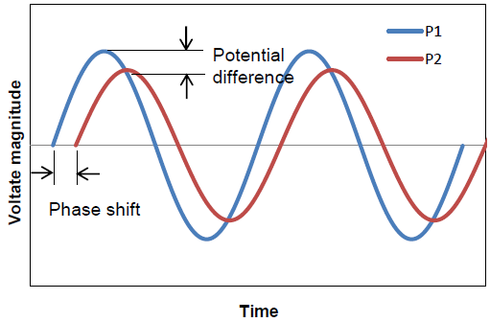
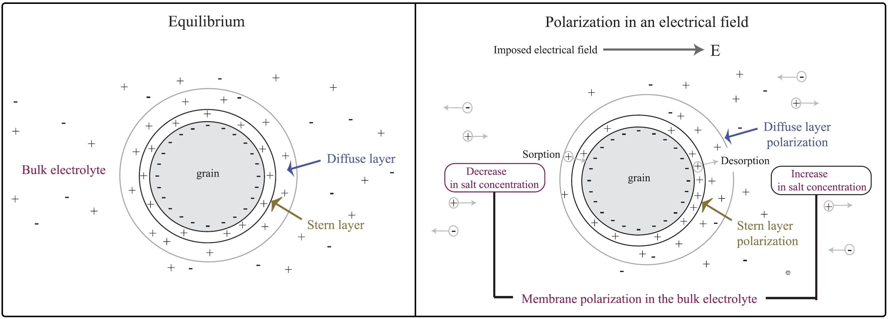
Introduction – Complex Conductivity
IP method is sensitive to electrical properties of the solid and fluid phases, the geometry of the microstructure (internal surface area, connectivity), and the electrical double layer that forms at the solid-fluid interface (Revil, Florsch, and Camerlynck 2014)
Laboratory or field data can lead to the estimation of pore size distributions (Florsch, Revil, and Camerlynck 2014), contaminant plume mapping (Sogade et al. 2006), and microbial activity monitoring (Davis et al. 2006).

Slide 6
Methods - Workflow
CT Scanning and Reconstruction
Phase Segmentation
Image Post-Processing (Re-gridding)
Connectivity Analysis
Pore Network Extraction
Application of EDL Model
Effective (Bulk) Conductivity Calculation

Slide 7
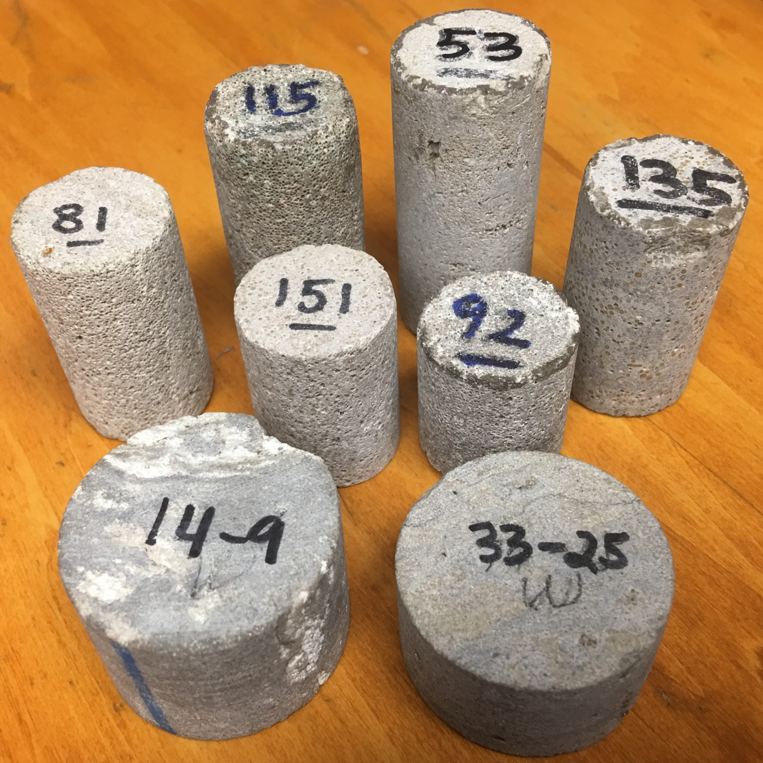
Methods – Sample Selection
12 carbonate core plugs selected for study:
  2 packstones and 2 mudstones from the Wellington field, Arbuckle Group (Cambro-Ordovician)
  7 oomoldic and 1 skeletal grainstone from other various fields in Kansas, Lansing-Kansas Group (Upper Pennsylvanian)
Sample | Helium Porosity (%) | Permeability, K_{air} (mD)
G1 | 32.6 | 16.1
G2 | 32.2 | 11.9
G3 | 26.4 | 1.1
G4 | 25.6 | 50.4
G5 | 20.5 | 3.5
G6 | 14.0 | 19.3
G7 | 8.3 | 0.03
G8 | 5.7 | 0.01
P1 | 7.7 | 27.9
P2 | 2.8 | 198.9
M1 | 3.2 | 0.07
M2 | 11.8 | 5.8

Slide 8
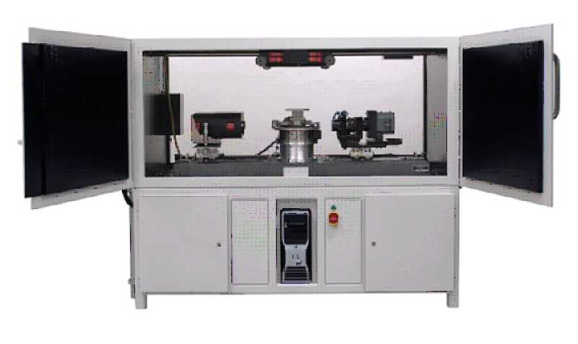
Methods – Imaging
Samples cut into thin sticks (1.5 – 3 mm thick)
Micro-CT scanning was performed at the KU IBER with the Xradia MicroXCT-400
4x and 10x lens magnifications used
Acquired 1000 image “slices” for all samples, roughly 1000x1000 pixels each
Sample | Lens Magnification | Resolution (µm)
G1 | 4x | 4.30
G2 | 4x | 4.30
G3 | 10x | 1.92
G4 | 4x | 4.30
G5 | 4x | 4.30
G6 | 4x | 4.30
G7 | 4x | 4.30
G8 | 10x | 1.95
P1 | 10x | 1.79
P2 | 4x | 4.30
M1 | 10x | 1.62
M2 | 4x | 4.30

Slide 9
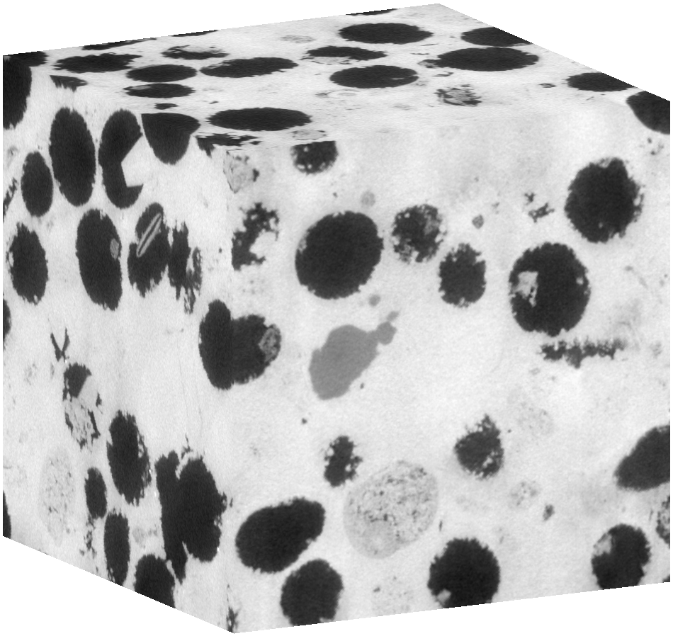
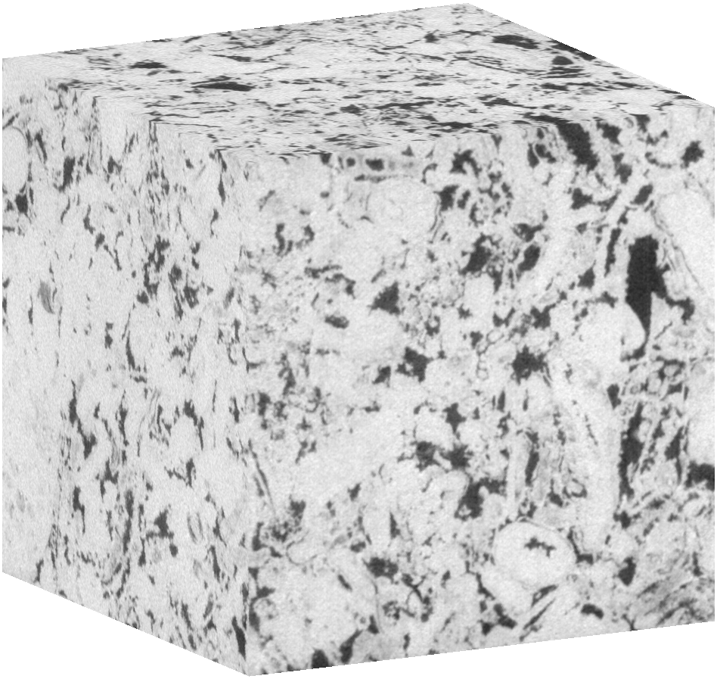
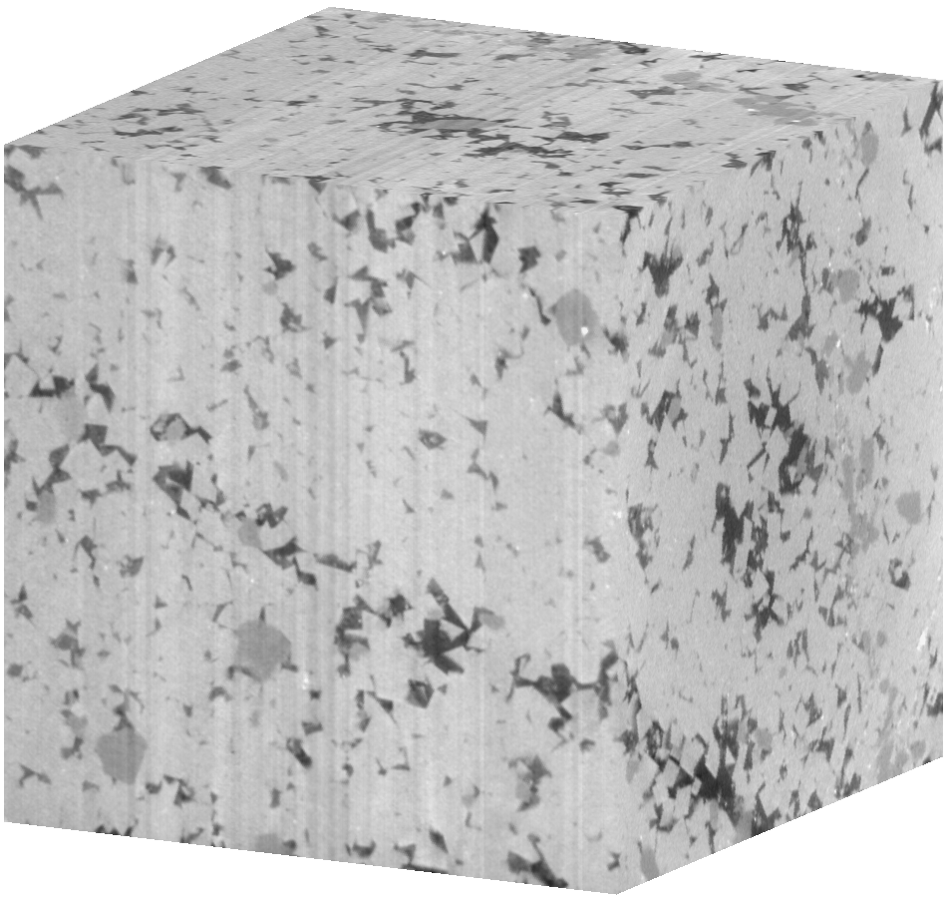
Methods – Imaging
600 center image slices were cropped to 600x600 squares and compiled together to construct image “cubes” (600³ voxel dimensions)
Dense, thick material (bright areas) absorbs x-rays more than open, porous material (dark areas)
G2
G6
M2
4.30 µm resolution, cube edge ~ 2.6 mm

Slide 10
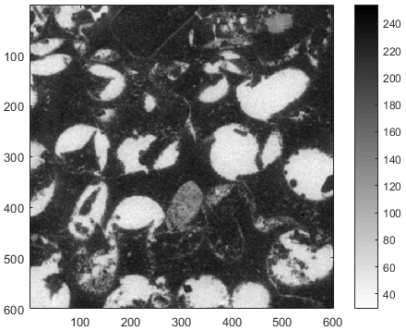
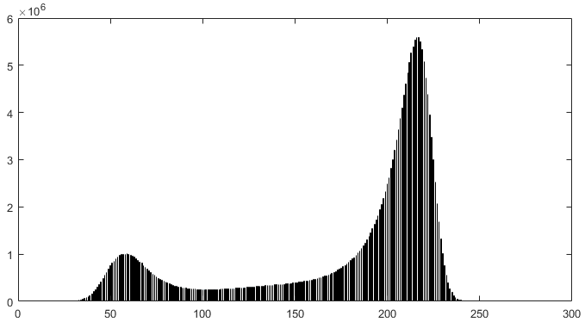
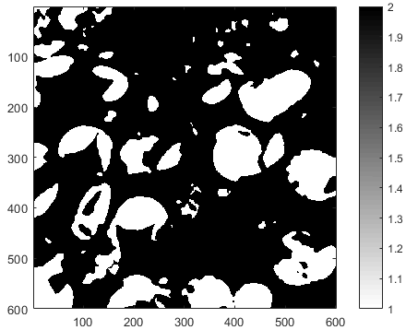
Methods – Phase Segmentation
Grayscale values range from 0 (black) to 255 (white)
Intensity histograms generated for each sample to help choose the ideal threshold value (105 to 145)
Note: black and white grayscale values are flipped for these cross sections

Slide 11
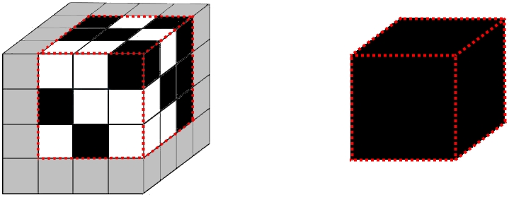
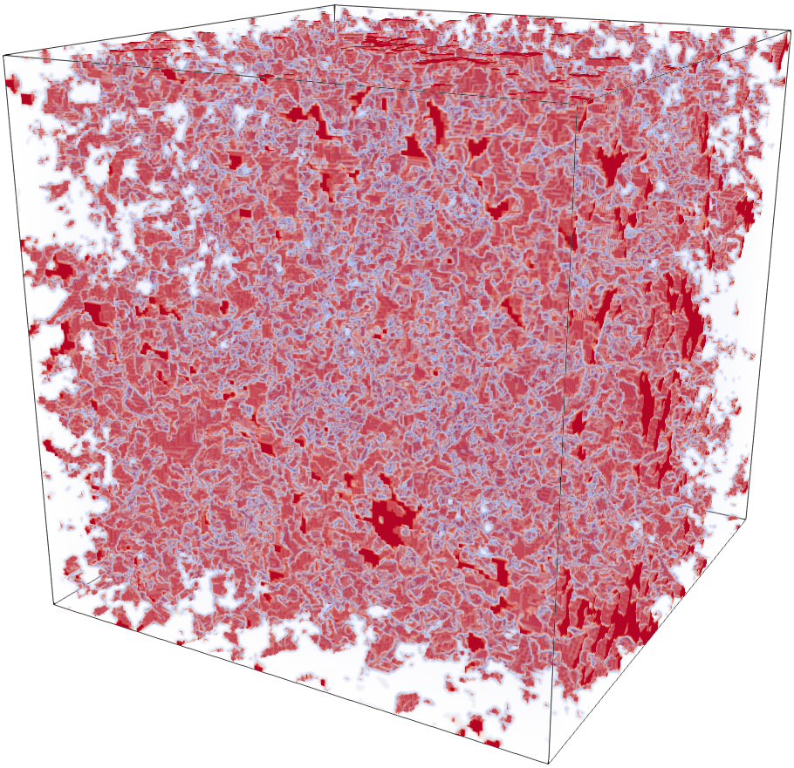
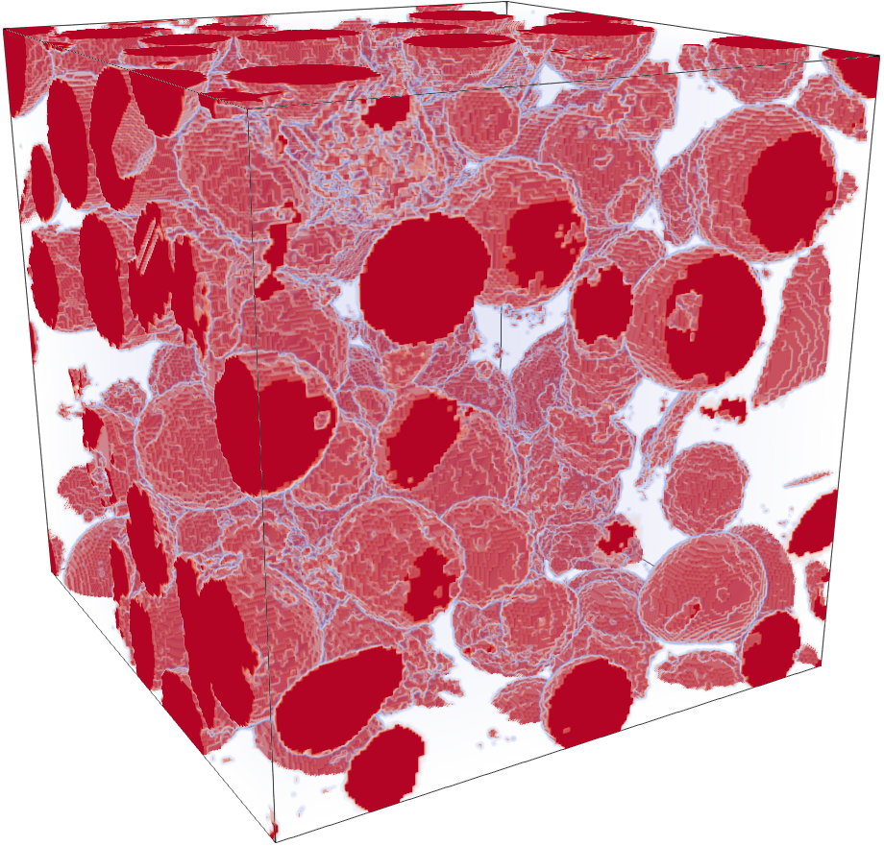
Methods – Post-Processing: Re-gridding
The 600³ image cubes were re-gridded to 200³ image cubes
  The original cubes were partitioned into smaller sections of 3³ regions
  Within each 3³ region, we counted the number of pore versus solid voxels
  If a high enough number of pore voxels out of 27 were present (at or greater than a user-chosen value), a single pore voxel was defined from the region. Otherwise, a single solid voxel was defined
This reduced the number of voxels to process from 216,000,000 to 8,000,000 and cut down on processing time, however, some detail is lost as edges are “smoothed out”
Different user-chosen “compression criterion” values (from 3 to 10) were used during simulation trials to investigate its effects
M2
G2
cube edge ~ 2.6 mm

Slide 12
Methods – Connectivity Analysis
A burning algorithm (Garboczi 1998) was used to check if the pore phase percolated from one face of an image cube to the opposite face
Only 5 of the original 12 samples had pore phase percolation on at least 2 faces
We defined these 5 image cubes as “well connected” and continued study of these cubes only: 1 mudstone (M2), 1 skeletal grainstone (G6), and 3 oomoldic grainstones (G4, G2, G1)

Slide 13
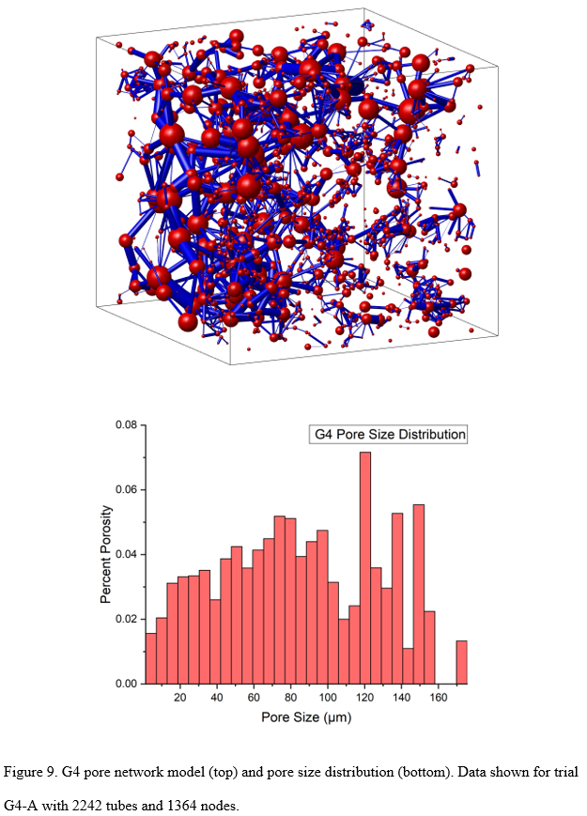
Methods – Pore Network Extraction
Pore network models were extracted from the image cubes using a maximal ball algorithm developed by the Imperial College London (Dong and Blunt 2009)
Algorithm works by filling the pore space with spheres inscribed within the solid-pore boundary. Large spheres near the center of pore regions become nodes. Chains of smaller spheres that connect larger nodes become cylindrical tubes
From this information, we extracted pore radii, pore throats and their volumes. Pore sizes were binned into 30 groups and pore size distributions were plotted

Slide 14
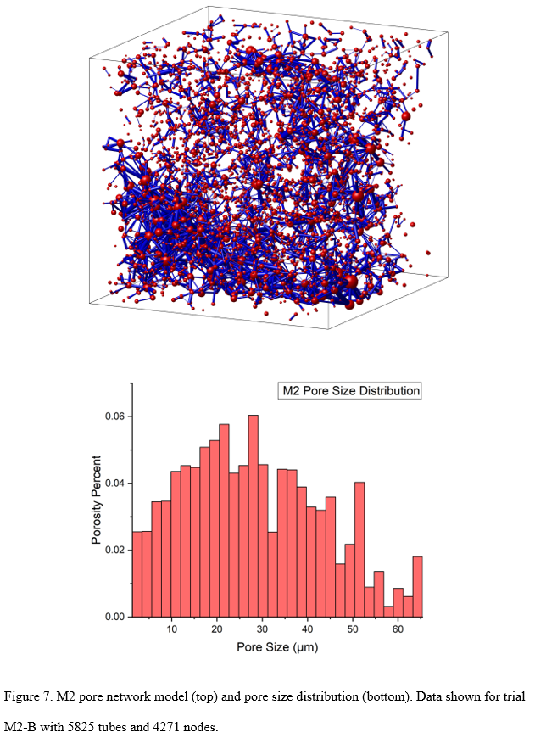
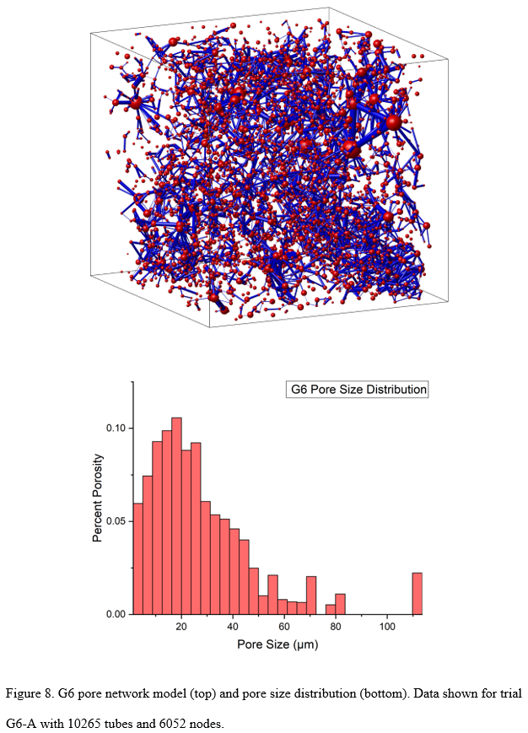

Slide 15






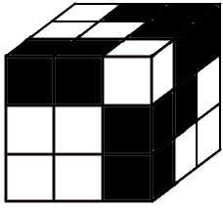
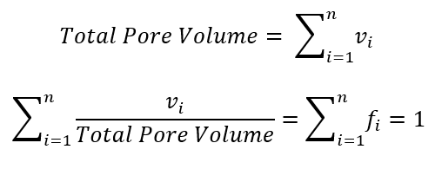
Methods – Application of EDL Model
Additional complex conductivity in the fluid phase due to EDL polarization effects
Complex conductivity of fluid phase
Relaxation time
Diffuse layer influence
Complex conductivity of solid phase
Stern layer influence
Pore size weighting
Only pore sizes (and weights), dynamic pore radius, and surface charge density were varied between simulation trials

Slide 16
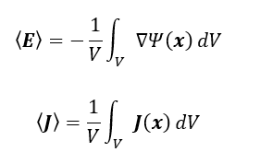



Methods – Bulk Conductivity Calculation
Current I is simulated across the digital sample, resulting in potential difference across it
or
Laplace Equation: Local current density and potential
Average electric field and current density
Effective complex conductivity

Slide 17
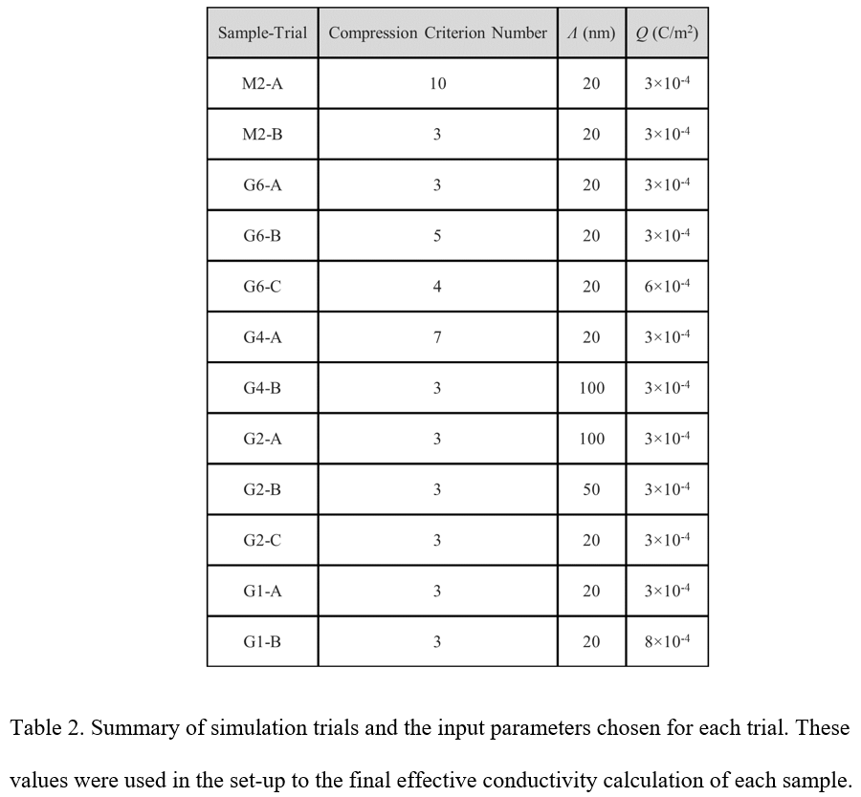
Methods – Simulation Trial Variables

Slide 18
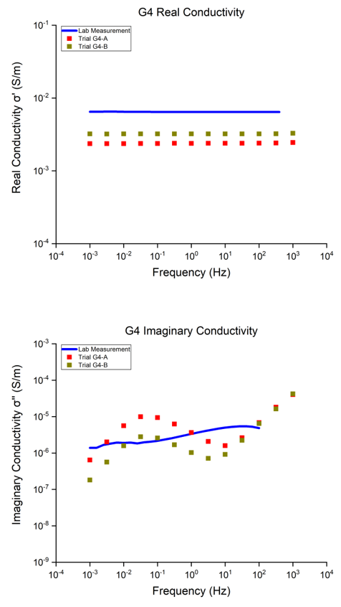
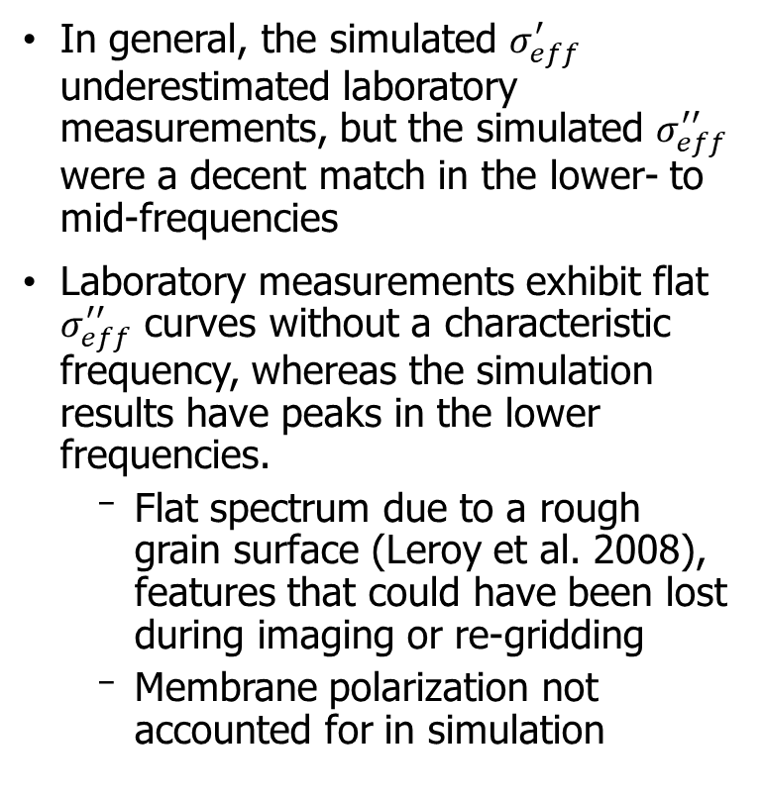
Results and Discussion
In general, the simulated $σ_{eff}^{′}$ underestimated laboratory measurements, but the simulated $σ_{eff}^{′′}$ were a decent match in the lower- to mid-frequencies
Laboratory measurements exhibit flat $σ_{eff}^{′′}$ curves without a characteristic frequency, whereas the simulation results have peaks in the lower frequencies.
  Flat spectrum due to a rough grain surface (Leroy et al. 2008), features that could have been lost during imaging or re-gridding
  Membrane polarization not accounted for in simulation

Slide 19
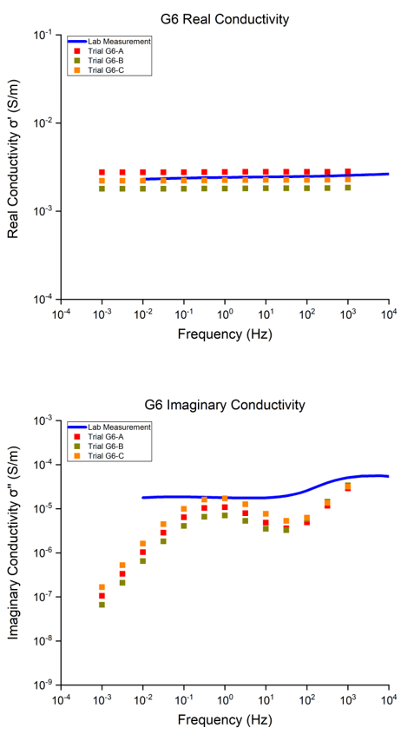
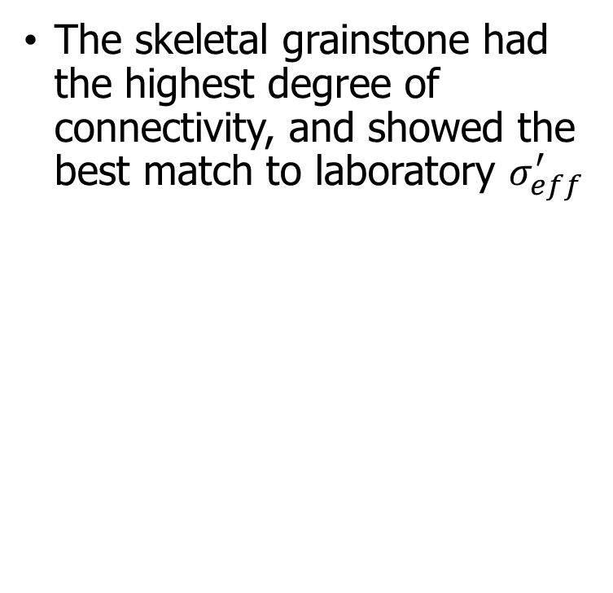
Results and Discussion
The skeletal grainstone had the highest degree of connectivity, and showed the best match to laboratory $σ_{eff}^{′}$

Slide 20
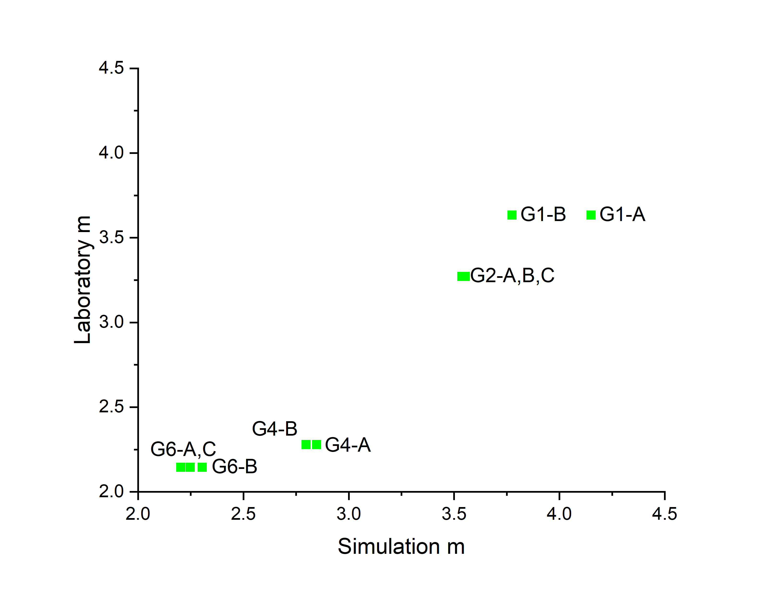
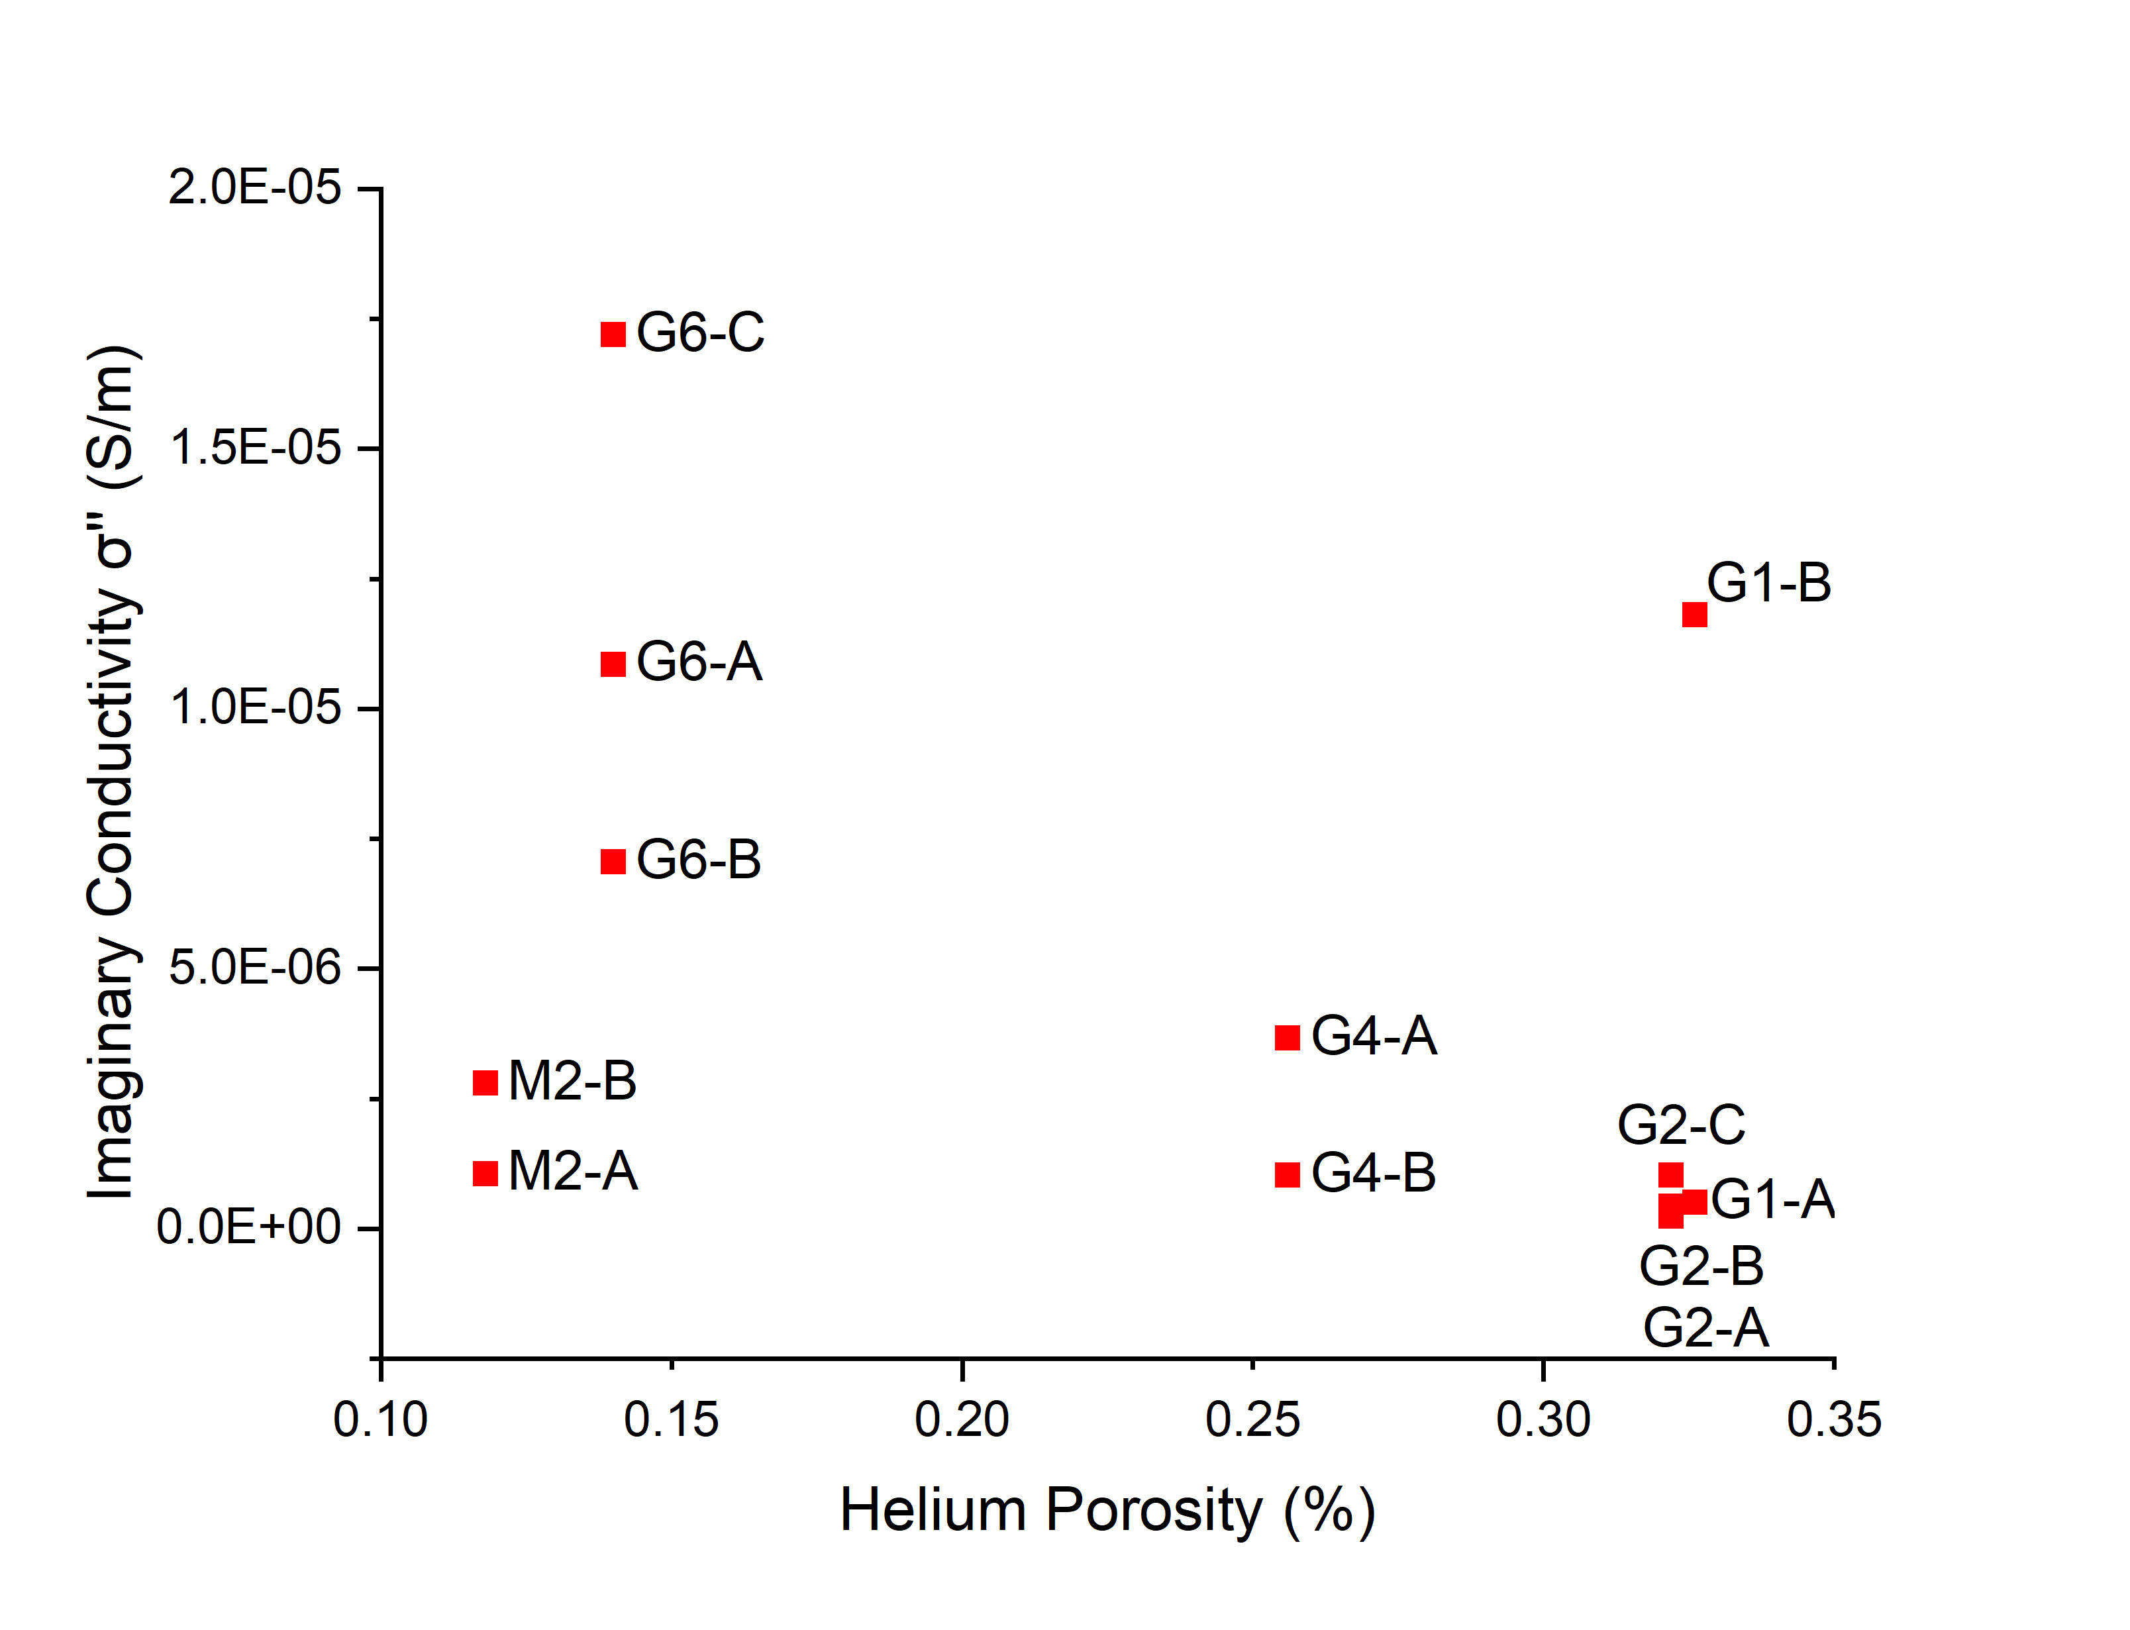
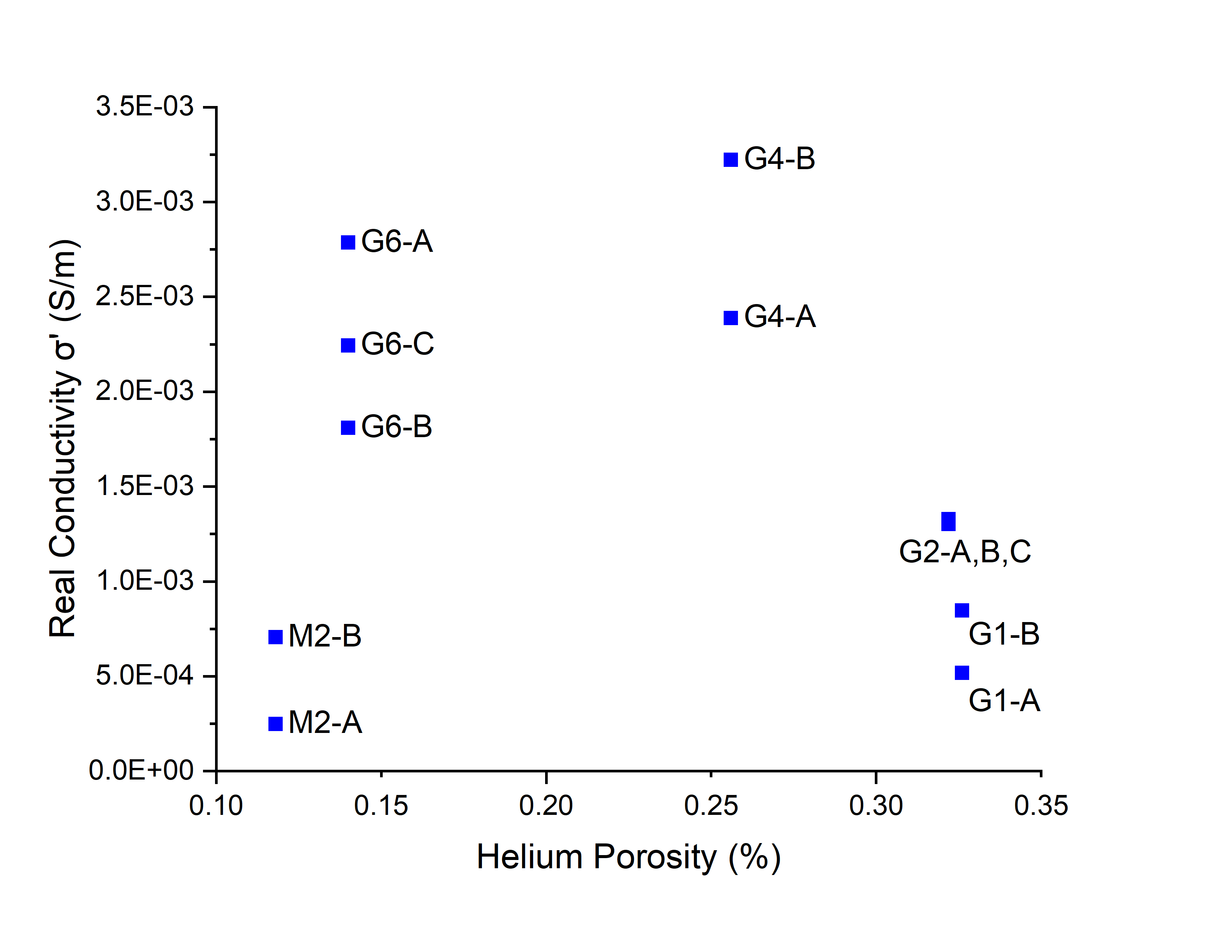
Results and Discussion
No obvious trends between Helium porosity and conductivity
Simulation m and F values overestimated calculations from laboratory measurements

Slide 21
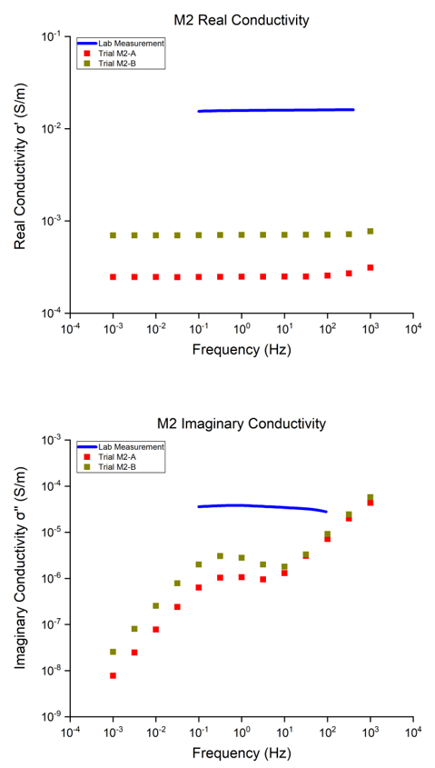
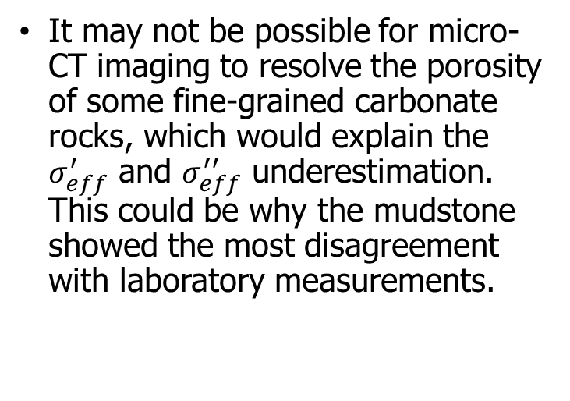
Results and Discussion
It may not be possible for micro-CT imaging to resolve the porosity of some fine-grained carbonate rocks, which would explain the $σ_{eff}^{′}$ and $σ_{eff}^{′′}$ underestimation. This could be why the mudstone showed the most disagreement with laboratory measurements.

Slide 22
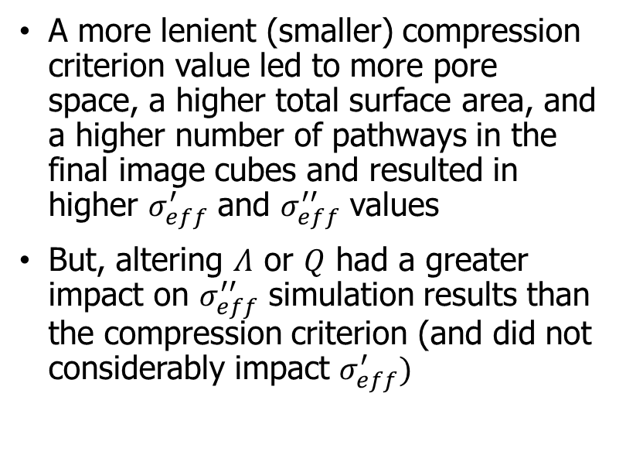
Results and Discussion
A more lenient (smaller) compression criterion value led to more pore space, a higher total surface area, and a higher number of pathways in the final image cubes and resulted in higher $σ_{eff}^{′}$ and $σ_{eff}^{′′}$ values
But, altering $Λ$ or $Q$ had a greater impact on $σ_{eff}^{′′}$ simulation results than the compression criterion (and did not considerably impact $σ_{eff}^{′})$
Trial A to B: decrease in compression criterion, increase in $Λ$

Slide 23
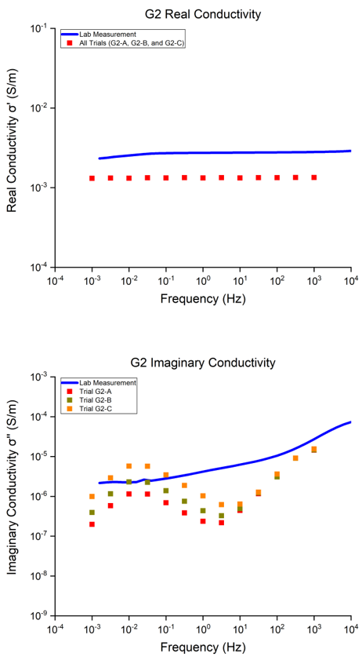
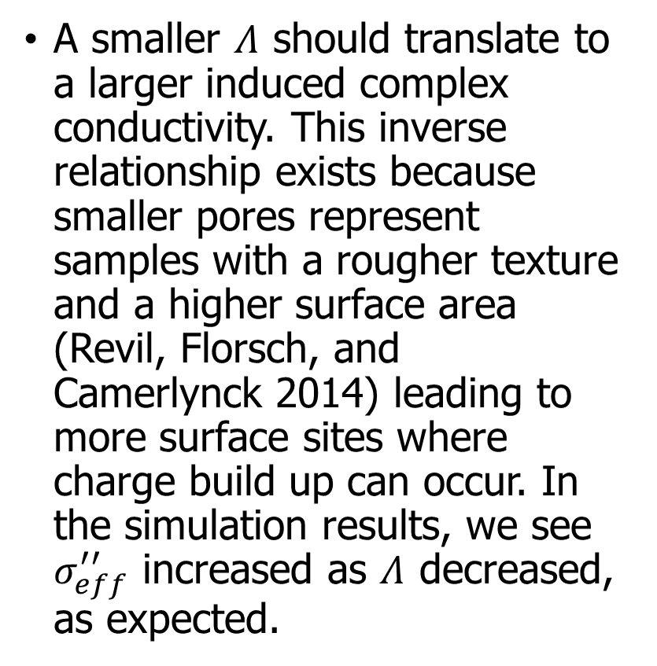

Results and Discussion
A smaller $Λ$ should translate to a larger induced complex conductivity. This inverse relationship exists because smaller pores represent samples with a rougher texture and a higher surface area (Revil, Florsch, and Camerlynck 2014) leading to more surface sites where charge build up can occur. In the simulation results, we see $σ_{eff}^{′′}$ increased as $Λ$ decreased, as expected.
Trial A to B to C: decrease in $Λ$

Slide 24
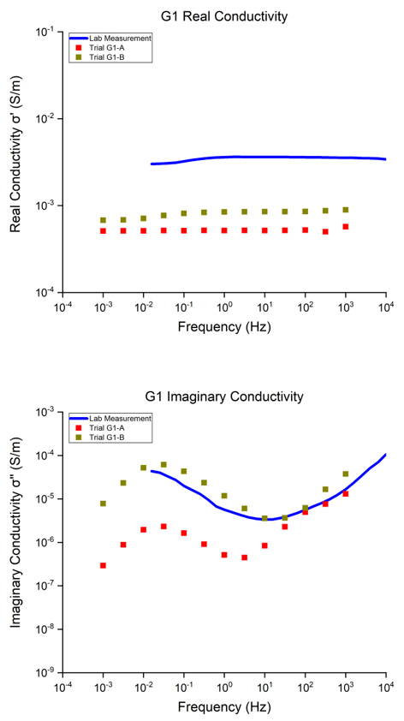

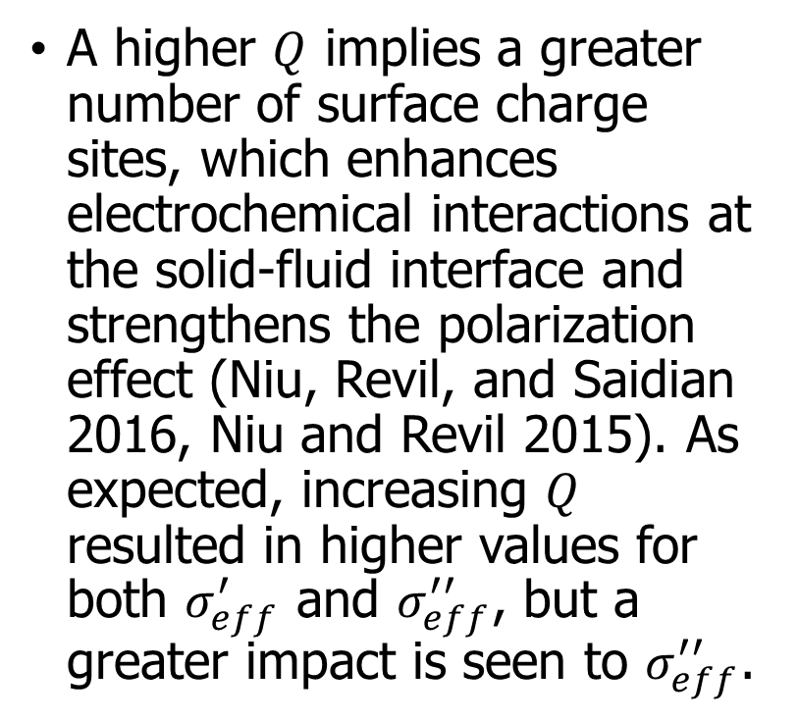
Results and Discussion
A higher $Q$ implies a greater number of surface charge sites, which enhances electrochemical interactions at the solid-fluid interface and strengthens the polarization effect (Niu, Revil, and Saidian 2016, Niu and Revil 2015). As expected, increasing $Q$ resulted in higher values for both $σ_{eff}^{′}$ and $σ_{eff}^{′′}$, but a greater impact is seen to $σ_{eff}^{′′}$.
Trial A to B: increase in $Q$

Slide 25
Conclusions
The imaging and digital segmentation technique is important to consider, as it remains a challenge to capture interconnected microporosity due to the limits in micro-CT scanning resolutions and to build a digital microstructure that is representative of the real rock volume
Fundamental rock characteristics such as carbonate petrology, porosity, and most importantly connectivity play a large role in the complex conductivity predictions
Despite their heterogeneity, complex conductivity predictions through numerical simulations are feasible using previously established pore-scale electrical polarization models on digitally reconstructed carbonate rocks
Forward modeling investigations into pore scale parameters helped us understand how well our theoretical models can explain laboratory measurements
The use us imaging methods combined with laboratory MICP, SIP, and NMR gives us a more comprehensive understanding of complex carbonate rocks. Ultimately, this leads to improved petrophysical characterization of carbonate rocks for any reservoir or aquifer characterization or remediation project.

Slide 26
Next Steps
Incorporate membrane polarization into simulation model
Replace image-derived pore size information with MICP or NMR laboratory measurements
Incorporate data from other imaging methods such as FIB-SEM
Use more powerful computers to process more detailed image cubes
More data: more trials, more samples, deeper investigation of model parameters

Slide 27
References
Andrä, H., N. Combaret, J. Dvorkin, E. Glatt, J. Han, M. Kabel, Y. Keehm, F. Krzikalla, M. Lee, C. Madonna, M. Marsh, T. Mukerji, E. H. Saenger, R. Sain, N. Saxena, S. Ricker, A. Wiegmann, and X. Zhan. 2013a, Digital rock physics benchmarks—Part I: Imaging and segmentation. Computers & Geosciences, 50,25-32. doi: https://doi.org/10.1016/j.cageo.2012.09.005.
Andrä, H., N. Combaret, J. Dvorkin, E. Glatt, J. Han, M. Kabel, Y. Keehm, F. Krzikalla, M. Lee, C. Madonna, M. Marsh, T. Mukerji, E. H. Saenger, R. Sain, N. Saxena, S. Ricker, A. Wiegmann, and X. Zhan. 2013b, Digital rock physics benchmarks—part II: Computing effective properties. Computers & Geosciences, 50,33-43. doi: https://doi.org/10.1016/j.cageo.2012.09.008.
Dvorkin, J., N. Derzhi, E. Diaz, and Q. Fang. 2011, Relevance of computational rock physics. GEOPHYSICS, 76, no. 5,E141–E153. doi: 10.1190/GEO2010-0352.1.
Revil, A., N. Florsch, and C. Camerlynck. 2014, Spectral induced polarization porosimetry. Geophysical Journal International, 198, no. 2,1016-1033. doi: 10.1093/gji/ggu180.
Florsch, N., A. Revil, and C. Camerlynck. 2014, Inversion of generalized relaxation time distributions with optimized damping parameter. Journal of Applied Geophysics, 109,119-132. doi: https://doi.org/10.1016/j.jappgeo.2014.07.013.
Sogade, J., F. Scira-Scappuzzo, Y. Vichabian, W. Shi, W. Rodi, D. Lesmes, and F. Morgan. 2006, Induced-polarization detection and mapping of contaminant plumes. GEOPHYSICS, 71, no. 3,B75-B84. doi: 10.1190/1.2196873.
Davis, C. A., E. Atekwana, E. Atekwana, L. D. Slater, S. Rossbach, and M. R. Mormile. 2006, Microbial growth and biofilm formation in geologic media is detected with complex conductivity measurements. Geophysical Research Letters, 33, no. 18. doi: 10.1029/2006GL027312.
Garboczi, E. J. 1998, Finite Element and Finite Difference Programs for Computing the Linear Electric and Elastic Properties of Digital Images of Random Materials.
Leroy, P., A. Revil, A. Kemna, P. Cosenza, and A. Ghorbani. 2008, Complex conductivity of water-saturated packs of glass beads. Journal of Colloid and Interface Science, 321, no. 1,103-117. doi: https://doi.org/10.1016/j.jcis.2007.12.031.
Revil, A., N. Florsch, and C. Camerlynck. 2014, Spectral induced polarization porosimetry. Geophysical Journal International, 198, no. 2,1016-1033. doi: 10.1093/gji/ggu180.
Niu, Q., A. Revil, and M. Saidian. 2016, Salinity dependence of the complex surface conductivity of the Portland sandstone. GEOPHYSICS, 81, no. 2,D125-D140. doi: 10.1190/geo2015-0426.1.
Niu, Q., and A. Revil. 2015, Connecting complex conductivity spectra to mercury porosimetry of sedimentary rocks. GEOPHYSICS, 81, no. 1,E17-E32. doi: 10.1190/geo2015-0072.1.

Slide 28
Questions/Comments

Slide 29
Supplemental Figures

Slide 30
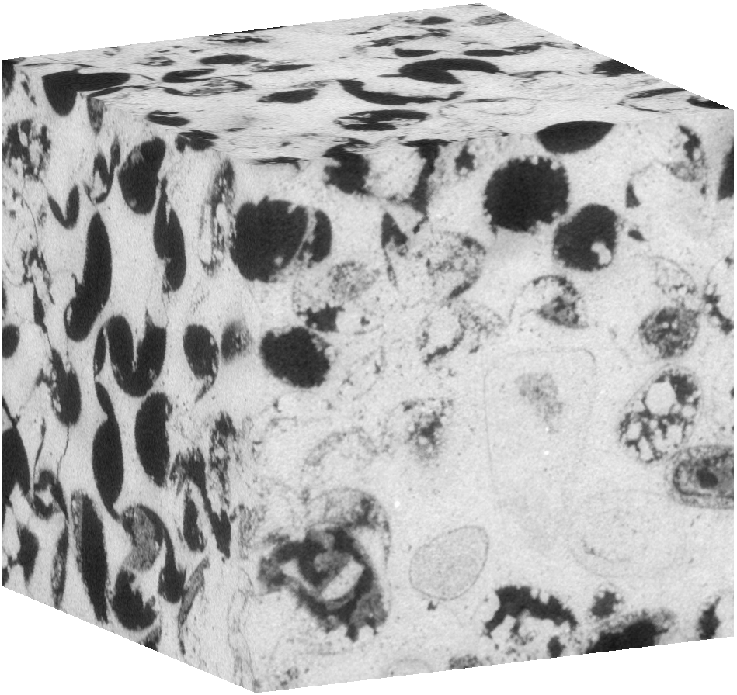
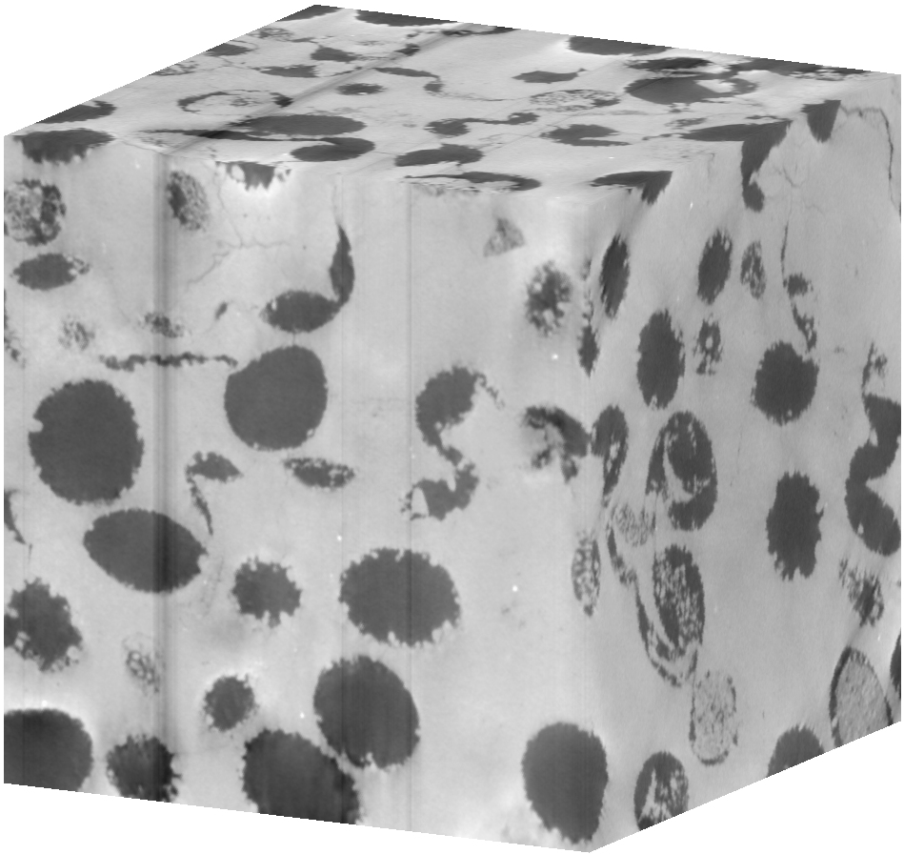
Methods – Imaging
M2
G6
G4
G2
G1
4.30 µm resolution, cube edge ~ 2.6 mm

Slide 31
Methods – Phase Segmentation
Grayscale values range from 0 (black) to 255 (white)
Intensity histograms generated for each sample to help choose the ideal threshold value (105 to 145)
Note: black and white grayscale values are flipped for these cross sections

Slide 32
Methods – Post-Processing: Re-gridding
The 600³ image cubes were re-gridded to 200³ image cubes
  The original cubes were partitioned into smaller sections of 3³ regions
  Within each 3³ region, we counted the number of pore versus solid voxels
  If a high enough number of pore voxels out of 27 were present (at or greater than a user-chosen value), a single pore voxel was defined from the region. Otherwise, a single solid voxel was defined
This reduced the number of voxels to process from 216,000,000 to 8,000,000 and cut down on processing time, however, some detail is lost as edges are “smoothed out”
Different user-chosen “compression criterion” values (from 3 to 10) were used during simulation trials to investigate its effects

Slide 33
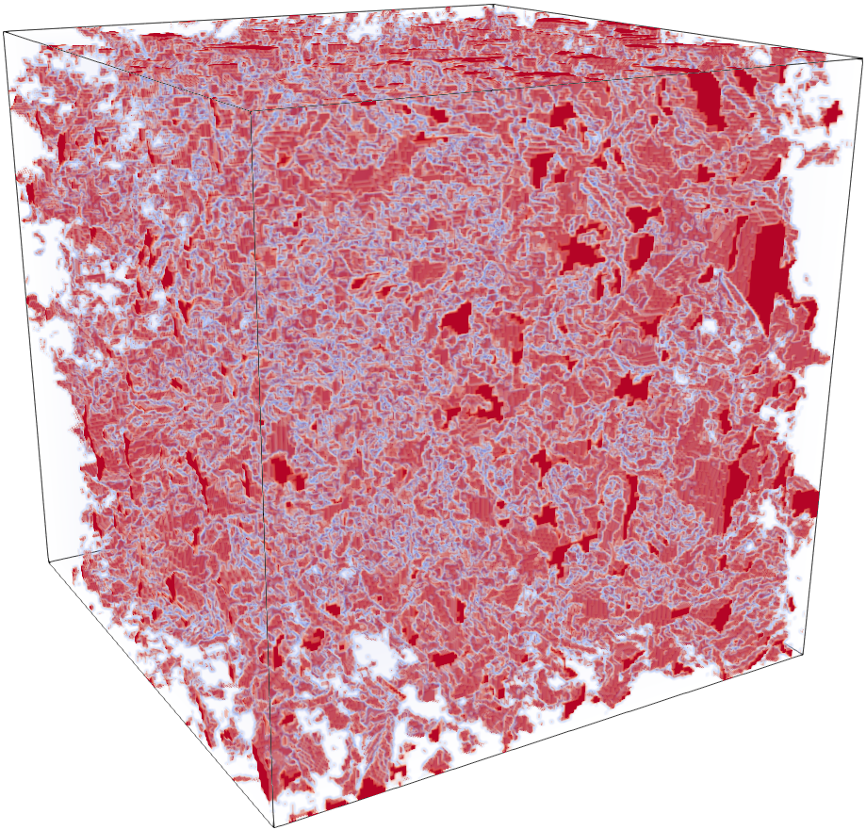
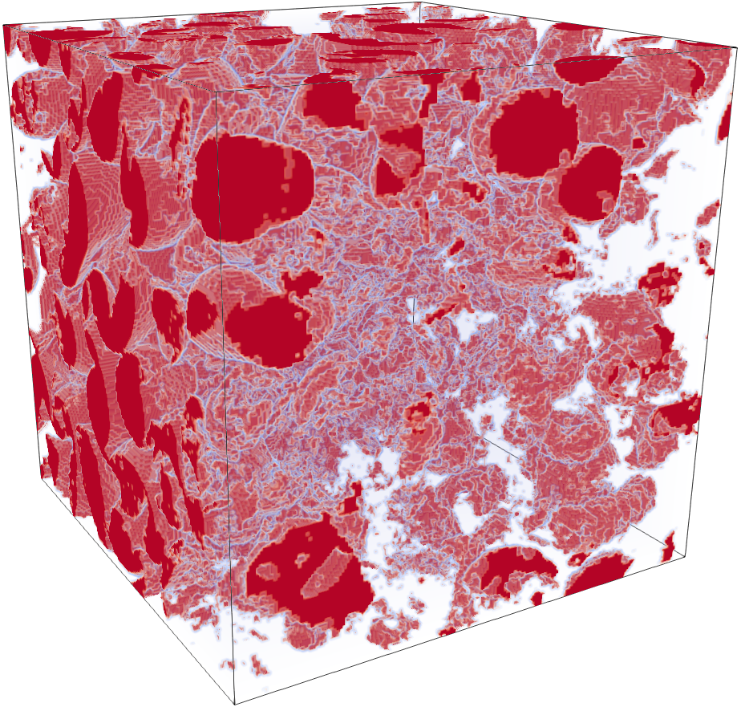
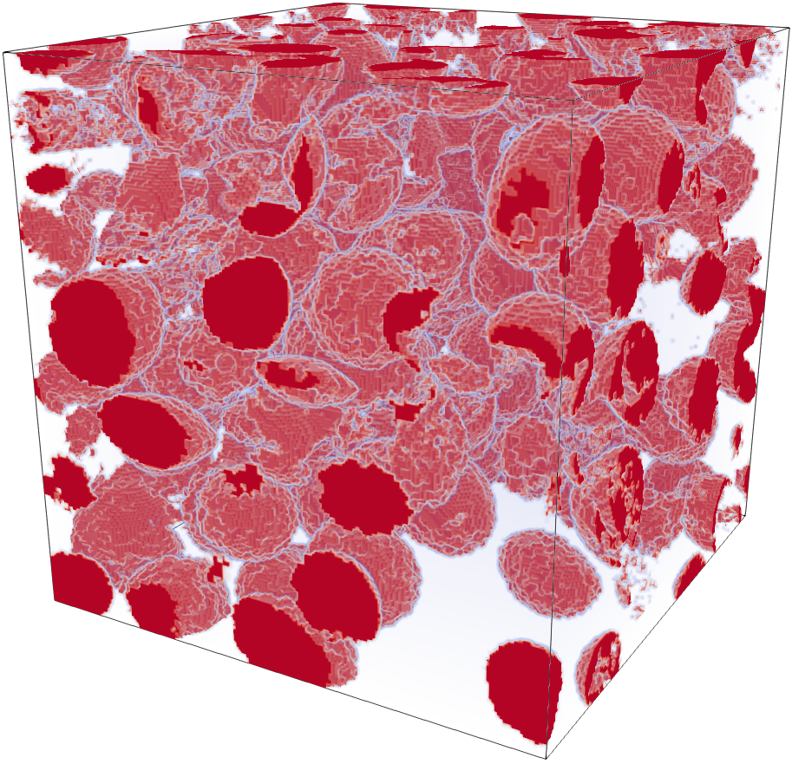
Methods – Segmentation
M2
G6
G4
G2
G1

Slide 35
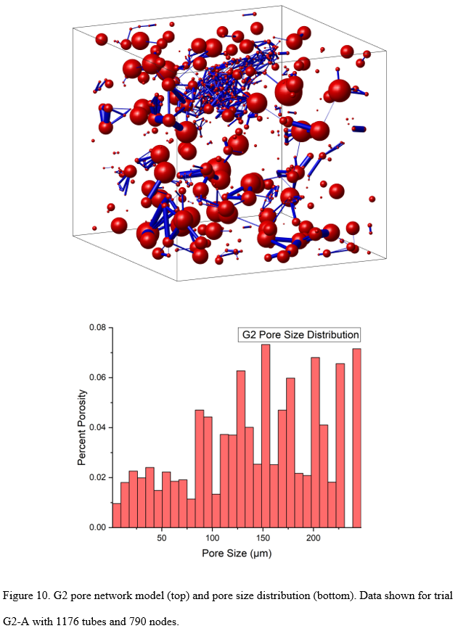

Slide 36
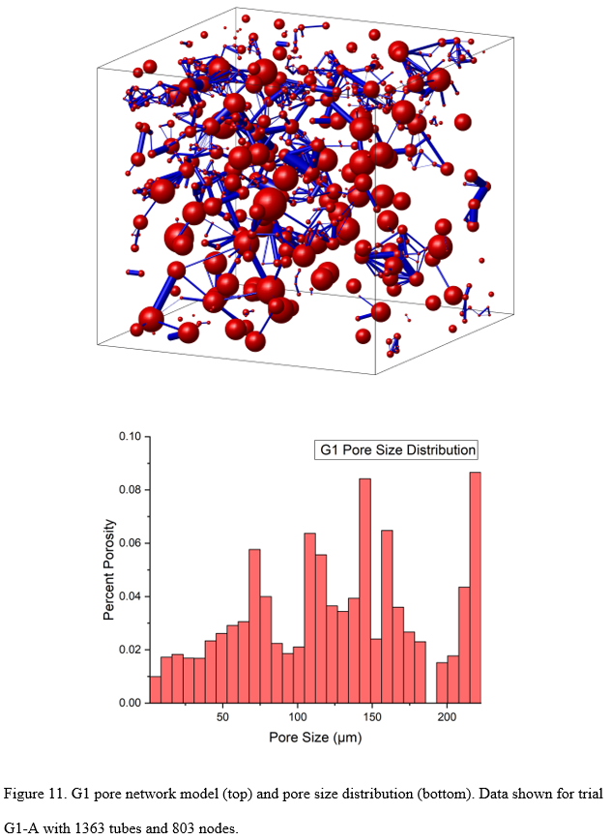

Slide 37
Simulation Results

Slide 38
Simulation Results

