Slide 1



Estimating pore size distribution in carbonate reservoir rocks using joint inversion of NMR and complex conductivity data
Fan Zhang¹, Qifei Niu^{1,2}, Chi Zhang¹
Dept. of Geology, University of Kansas, United States
Dept. of Applied Geophysics, Central South University, China

Slide 2
Outlines
Introduction
Methodology and Inversion Algorithm
Joint Inversion Results
Conclusion and Discussion
Alternative Models
Membrane Polarization Modeling

Slide 3

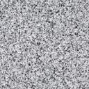
Introduction
Complexity of Carbonate pore system
Abiotic grain
Intercrystalline pore
Biotic grain
Moldic pore
Interparticle pore
Semi-connected vuggy
Cements
Touching vuggy
Intraparticle pore
(Effective pathway)
Oolitic Carbonate
Dissolved matrix pore
Primary porosity
Deposition
Secondary porosity
Diagenesis

Slide 4
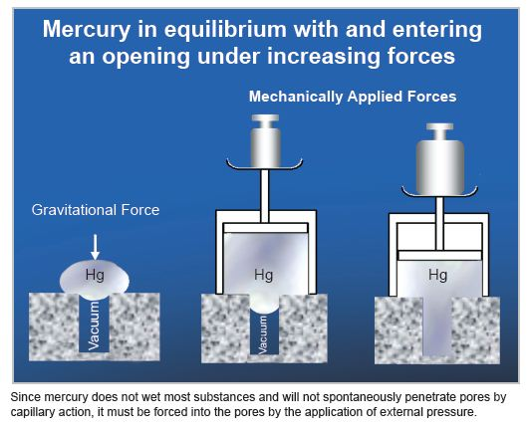
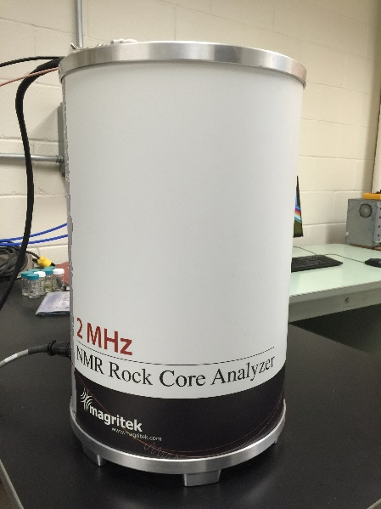
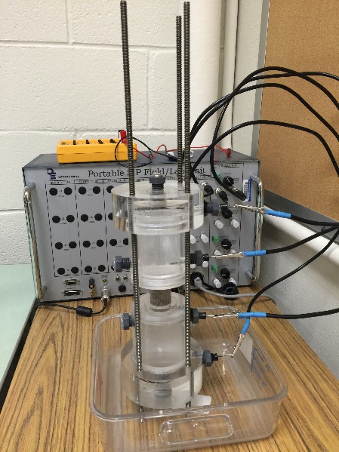
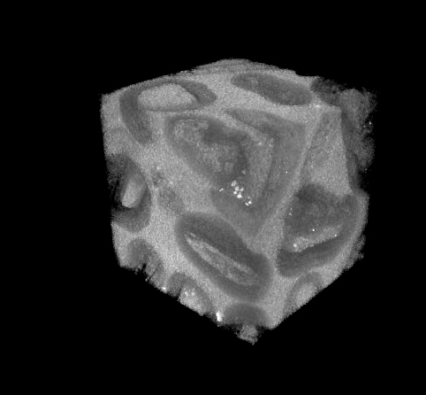
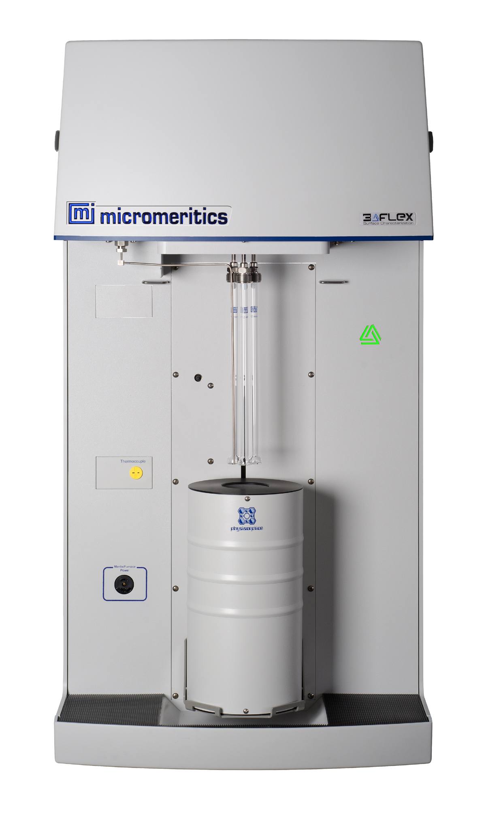
Current methods for determining pore size distribution
Conventional Methods
Geophysical Methods
Mercury injection
http://porotechnology.com/gallery
Micro-CT and
Digital image analysis
Nuclear magnetic resonance (NMR)
Spectral induced polarization (SIP)
Gas adsorption (micromeritics, inc)

Slide 5


Characterizing carbonate
SIP&NMR
Special Core Analysis
Well-log Analysis
SIP
NMR
Gas adsorption
Micro-CT
k_{air}
T₁/T₂
$$σ^{′}$$
$$σ^{"}$$
F
τ
φ
PSD
T_{2ml}
3-D Texture
(>μm)
Sonic calibrated perm model
PCA
m
Clustering
S_{por}
Permeability
Permeability
Permeability
Classification
SIP&NMR Joint Inversion
Electrofacies
Inverted PSD
Modified Forward Model

Slide 6


Characterizing carbonate
SIP&NMR
Special Core Analysis
Well-log Analysis
SIP
NMR
Gas adsorption
Micro-CT
k_{air}
T1/T2
$$σ^{′}$$
$$σ^{"}$$
F
τ
φ
PSD
T_{2ml}
3-D Texture
(>μm)
Sonic calibrated perm model
PCA
m
Clustering
S_{por}
Permeability
Permeability
Permeability
Classification
SIP&NMR Joint Inversion
Electrofacies
Inverted PSD
Modified Forward Model

Slide 7


Characterizing carbonate
SIP&NMR
Special Core Analysis
Well-log Analysis
SIP
NMR
Gas adsorption
Micro-CT
k_{air}
T1/T2
$$σ^{′}$$
$$σ^{"}$$
F
τ
φ
PSD
T_{2ml}
3-D Texture
(>μm)
Sonic calibrated perm model
PCA
m
Clustering
S_{por}
Permeability
Permeability
Permeability
Classification
SIP&NMR Joint Inversion
Electrofacies
Inverted PSD
Modified Forward Model

Slide 8
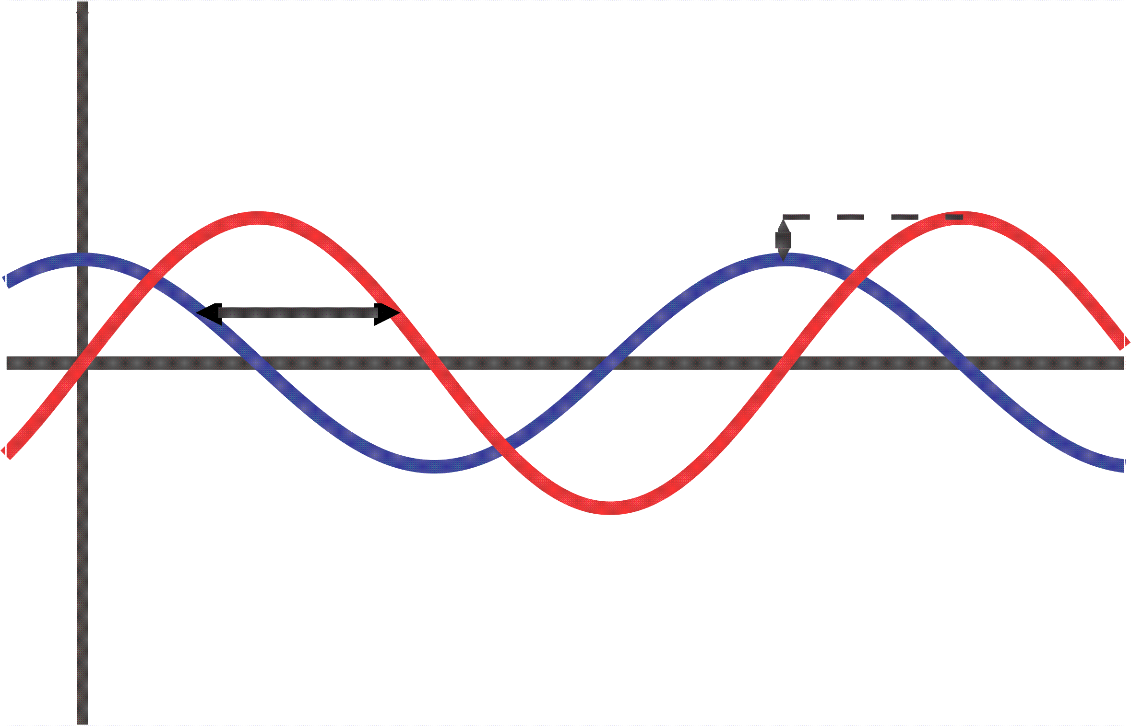





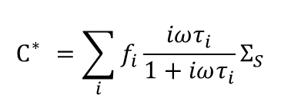

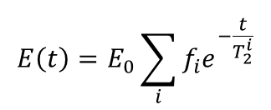



Methodology
NMR
SIP
Magnitude change
Relaxation time distribution
Free induction decay
Phase change
$$σ^{′}=\frac{1}{F}σ_{f}+σ_{s}^{′}$$
$$\frac{1}{T_{2}}≈\frac{1}{T_{2S}}=ρ_{2}S_{por}$$
$$σ"∝S_{por}Σ_{s}"$$
$T_{2S}$ is surface relaxation time; $ρ_{2}$ is surface relaxivity; $S_{por}$ is surface to volume ratio;
$F$ is formation factor; $Σ_{s}“$ imaginary part of specific surface conductance
NMR transverse relaxation
Electrical double layer(EDL) polarization
$$E_{i}\left(t\right)=E_{0}e^{−\frac{t}{T_{2}^{i}}}$$
Responses – Single pore
$$C_{}^{∗}=\frac{iωτ}{1+iωτ}Σ_{S}$$
$$E\left(t\right)=E_{0}\sum_{i}{f_{i}e^{−\frac{t}{T_{2}^{i}}}}$$
$$C_{}^{∗}=\sum_{i}{f_{i}\frac{iωτ_{i}}{1+iωτ_{i}}}Σ_{S}$$
Responses – Multiple pore sizes
$r_{i}=$ 3$ρ_{2}T_{2i}^{}$
Pore size distribution
$$r_{i}=\sqrt{2D^{+}τi}$$

Slide 9

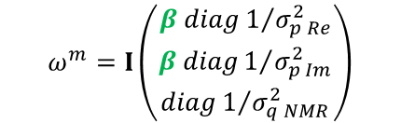


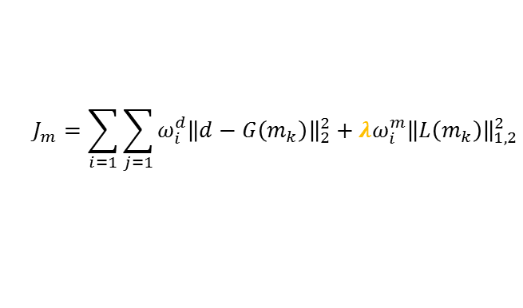

Inversion Algorithm
System information and inputs
Observations:${ σ}^{′}, σ“, f,\text{M}\text{x}\text{,}\text{y}$, $T_{2}^{}$
Parameters: ${f_{i}, σ}_{∞}, σ_{0},{\text{ε}}_{inf⁡},ρ_{2},M_{0}$
Update
parameters
Initial model: m
Initial guess of pore size distribution r
Model adjustment
NMR forward model
T₂ distribution
SIP forward model
$τ$ distribution
Tikhonov regularization scheme:
$$J_{m}=\sum_{i=1}{\sum_{j=1}{ω_{i}^{d}{\left\|d−G\left(m_{k}\right)\right\|}_{2}^{2}}}+λω_{i}^{m}{\left\|L\left(m_{k}\right)\right\|}_{1,2}^{2}$$
Levenberg–Marquardt algorithm
Weighting:
Parameter estimation
$$ω^{m}=I\left(\begin{matrix}β diag1/{σ_{p Re}^{2}} \\ β diag1/{σ_{p Im}^{2}} \\ diag1/{σ_{q NMR}^{2}}\end{matrix}\right)$$
$$ω^{d}=\frac{1}{σ_{i}^{2}}$$
Fix regularization $λ$/weighting parameters $β$
Evaluate model fit
Output inverted pore size distribution

Slide 10
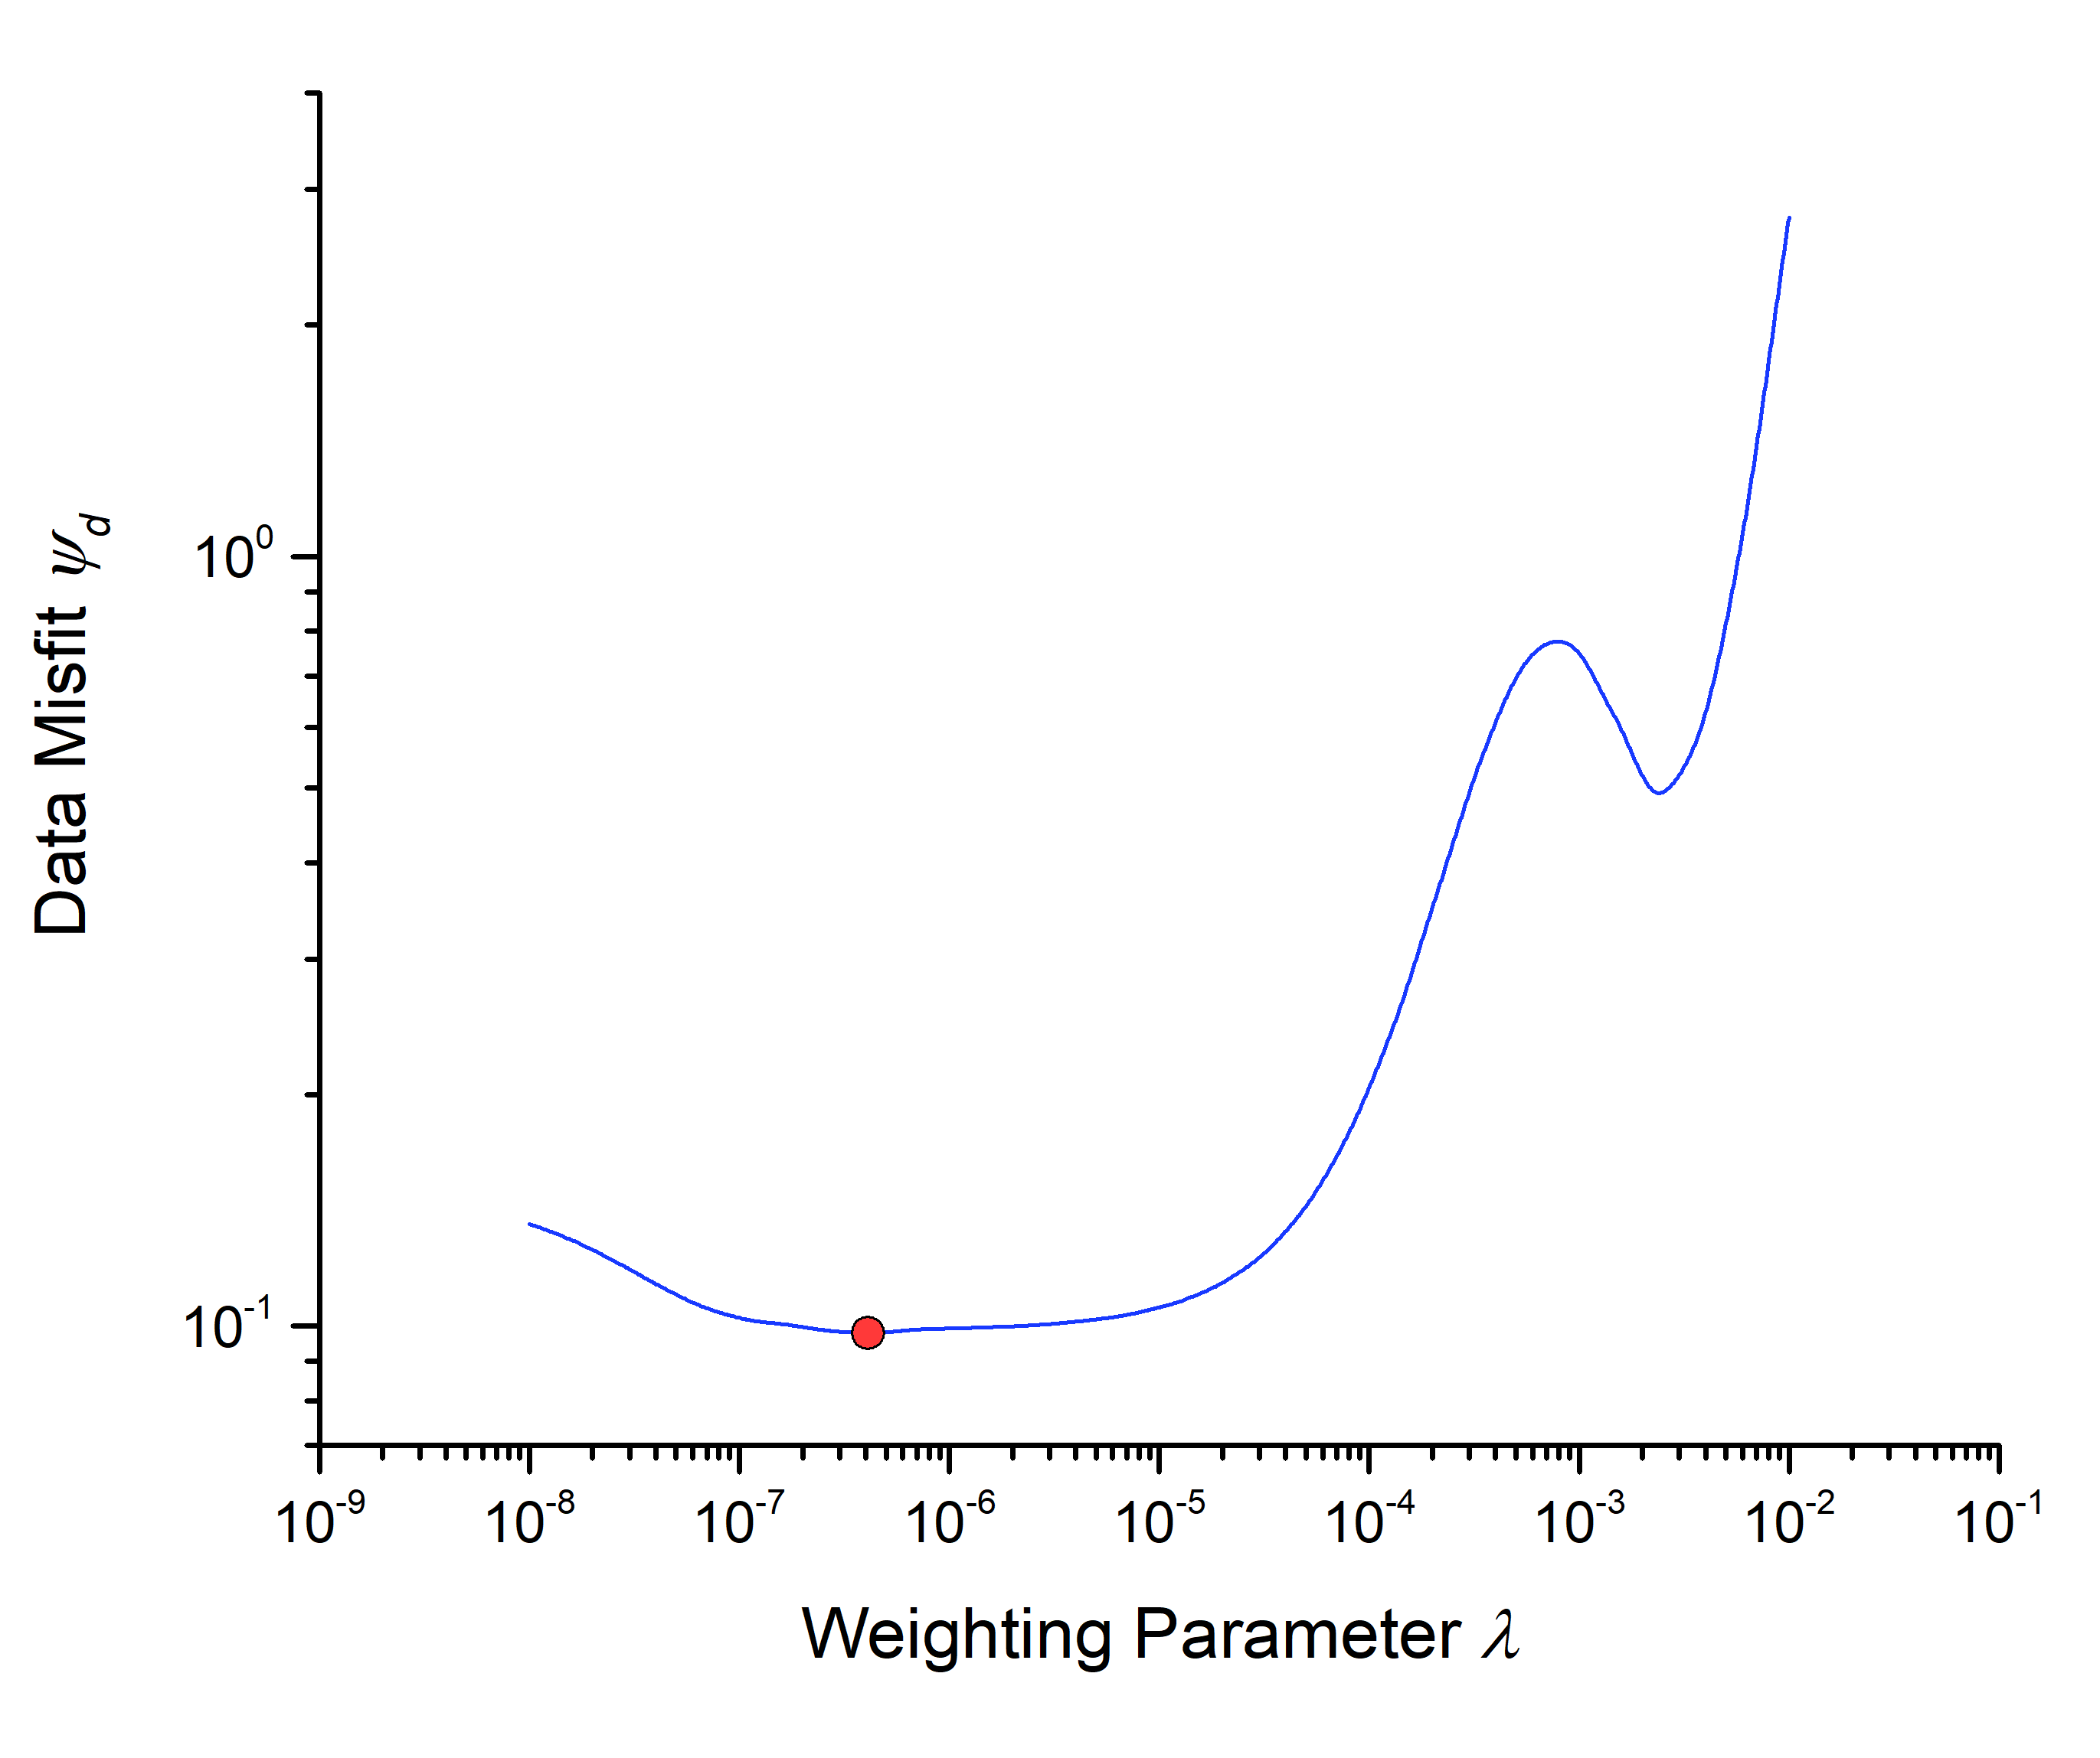
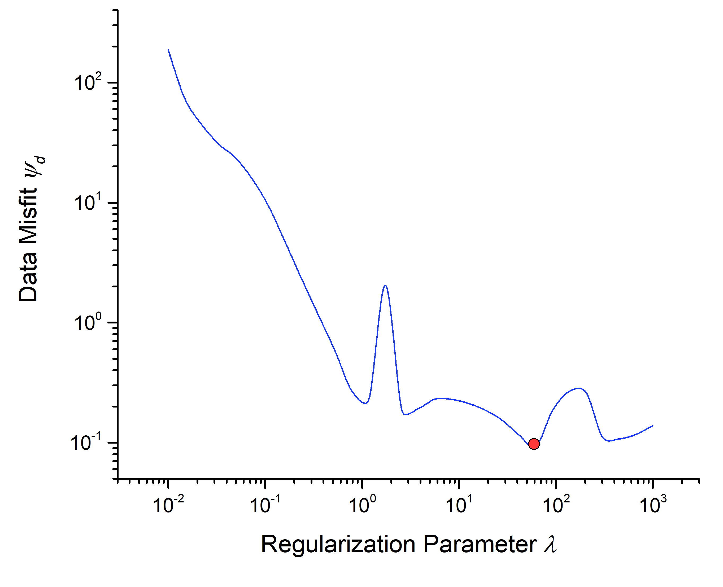

Joint inversion results
$λ$ and $β$ searching
$$β$$

Slide 11
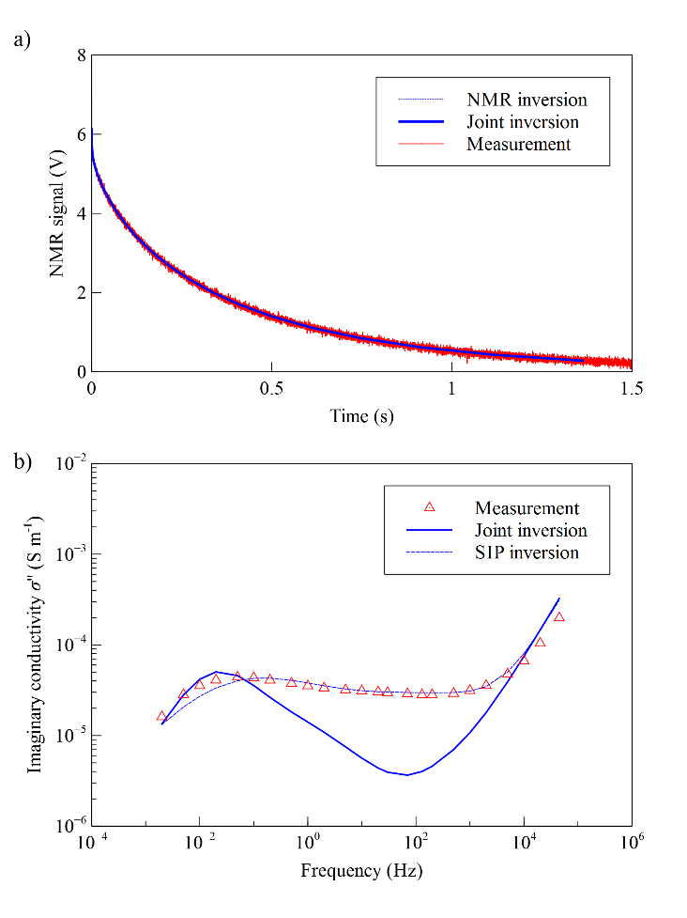
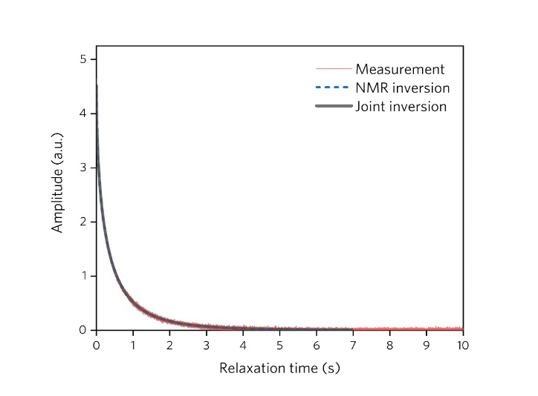
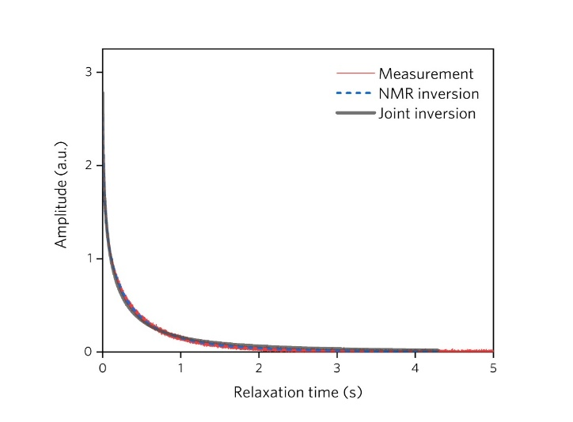
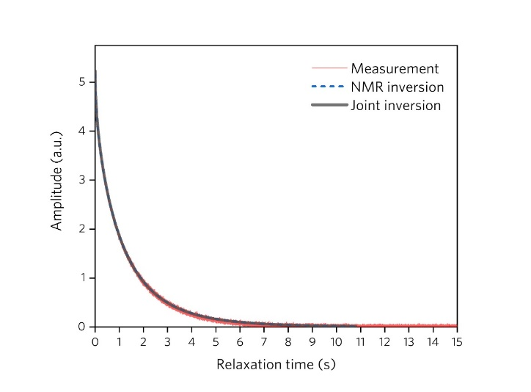
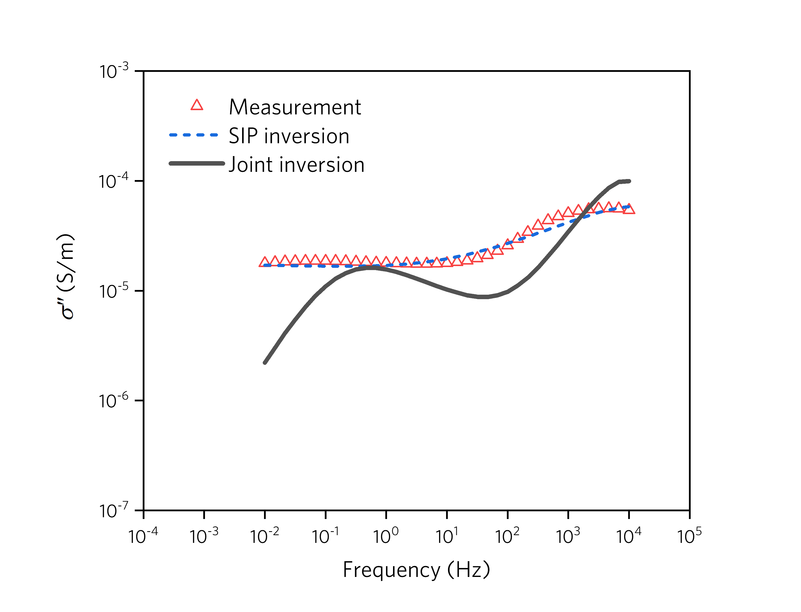
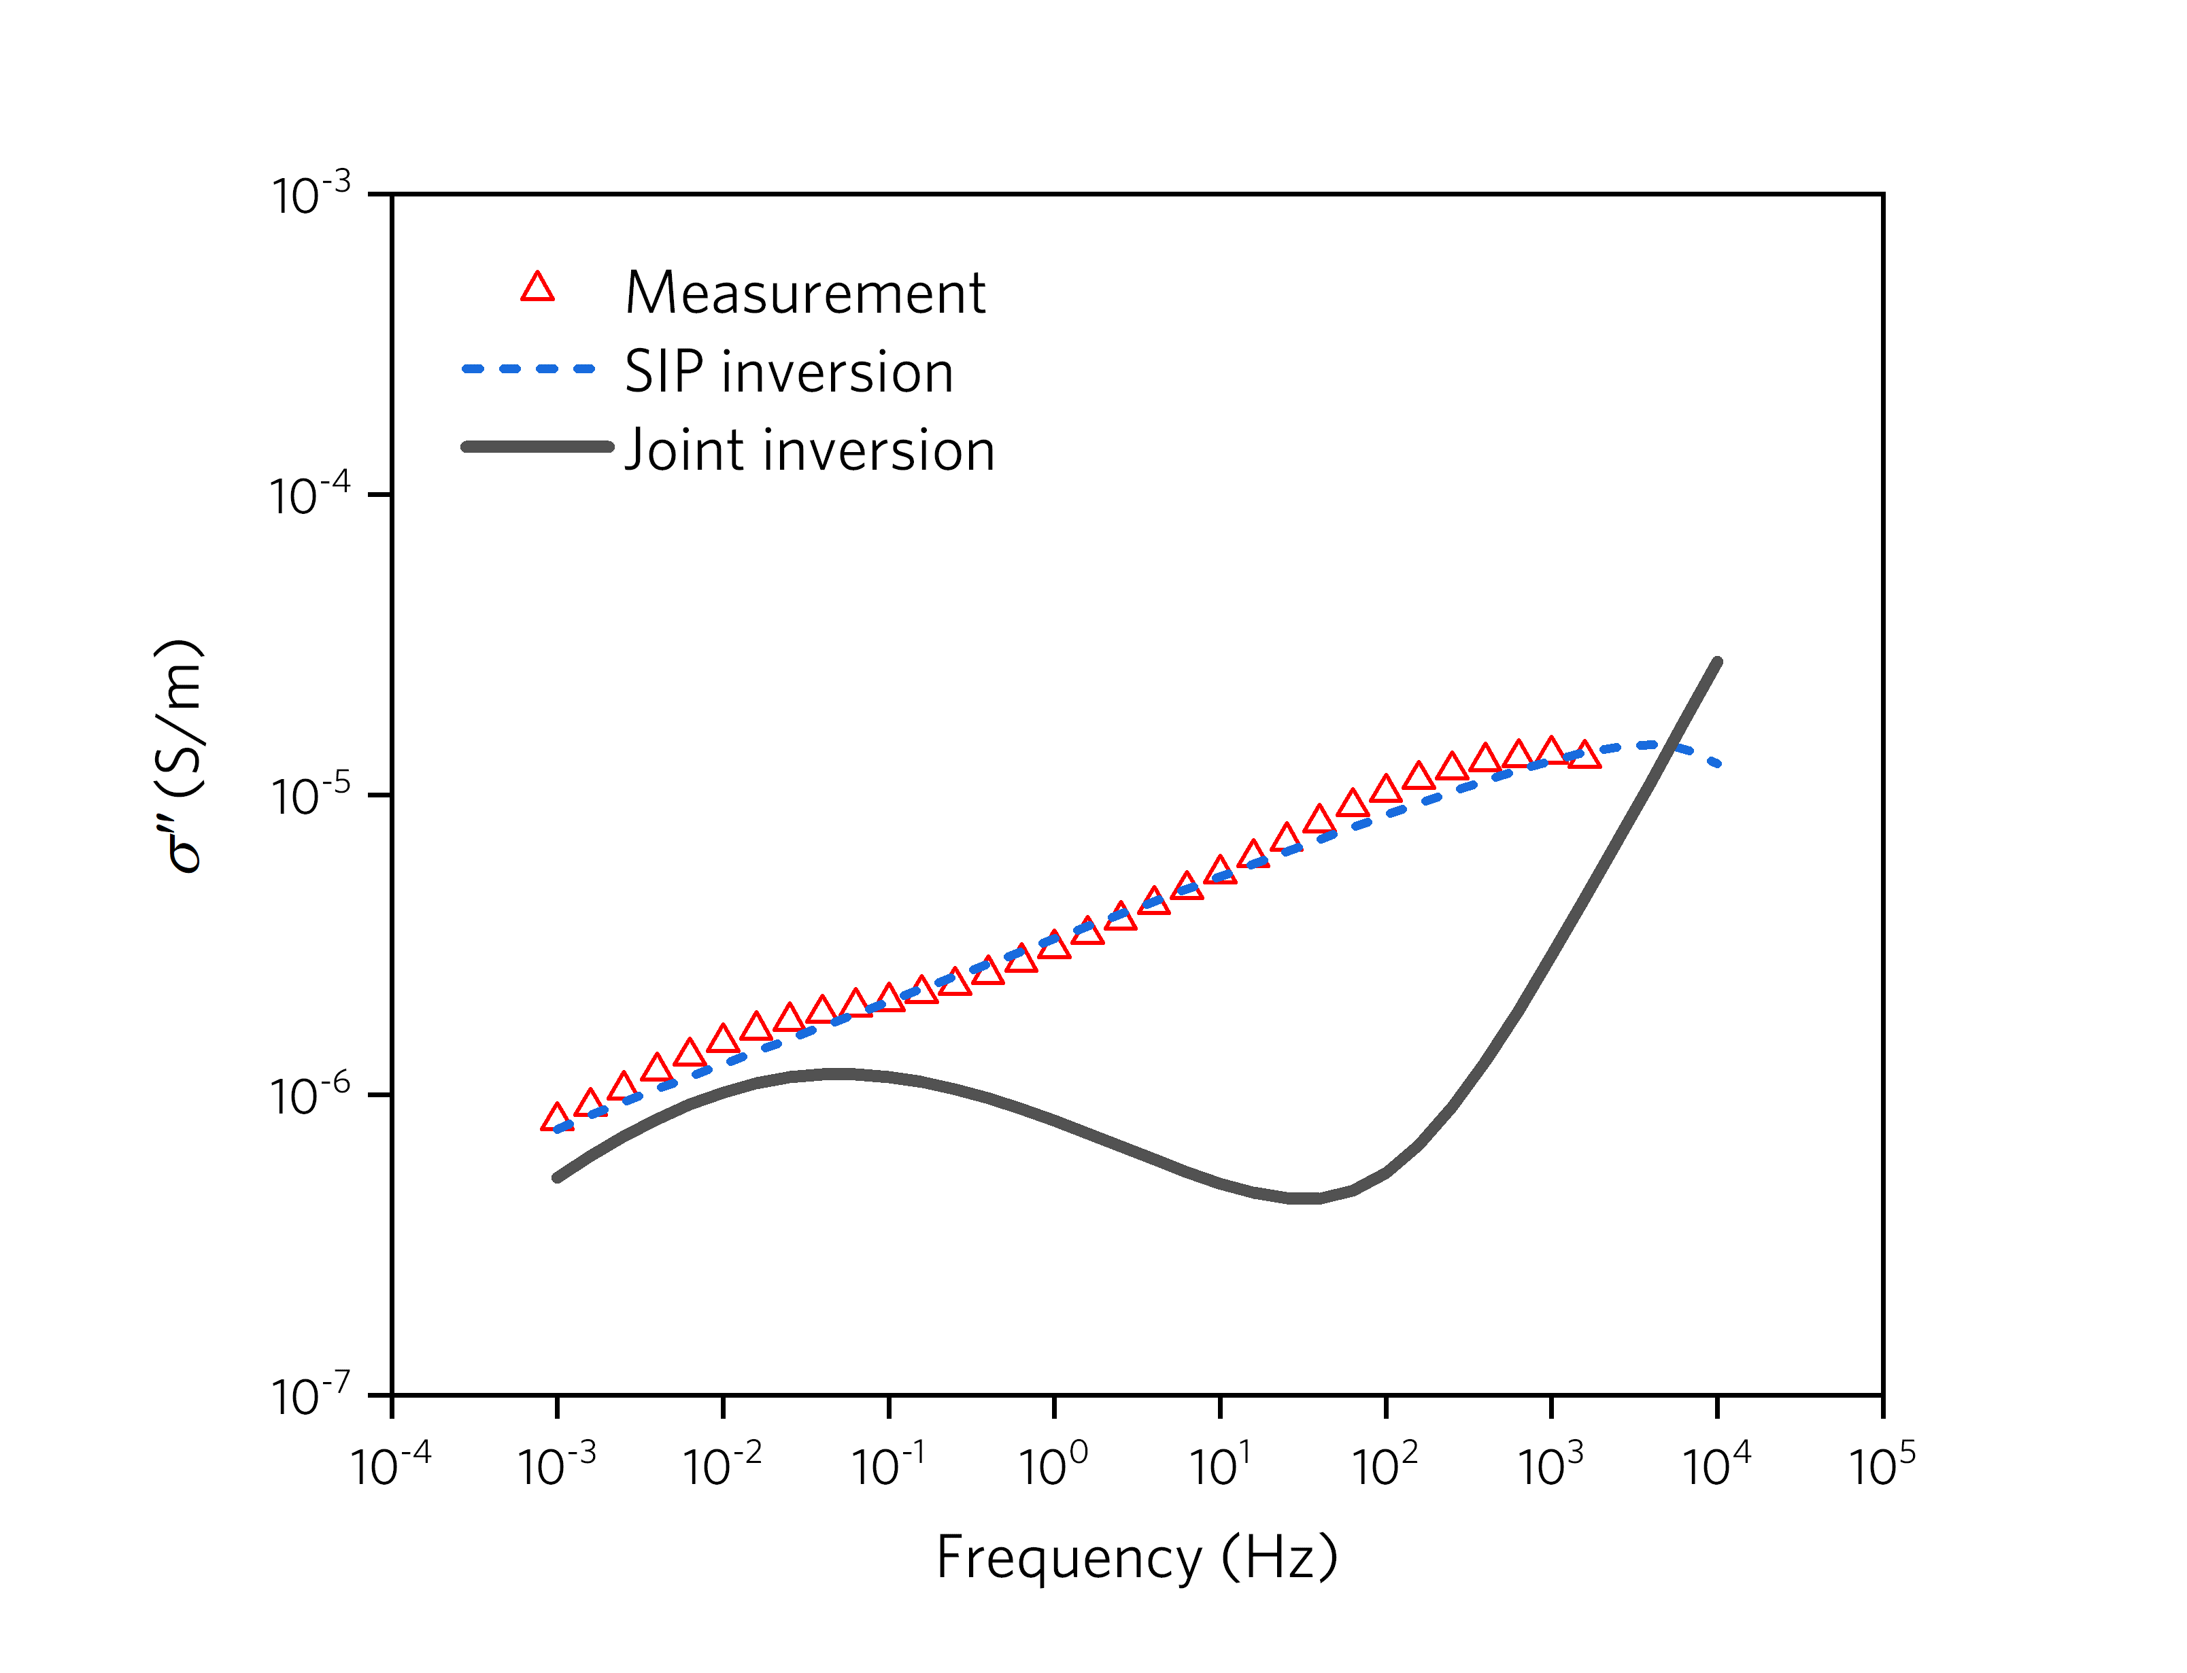
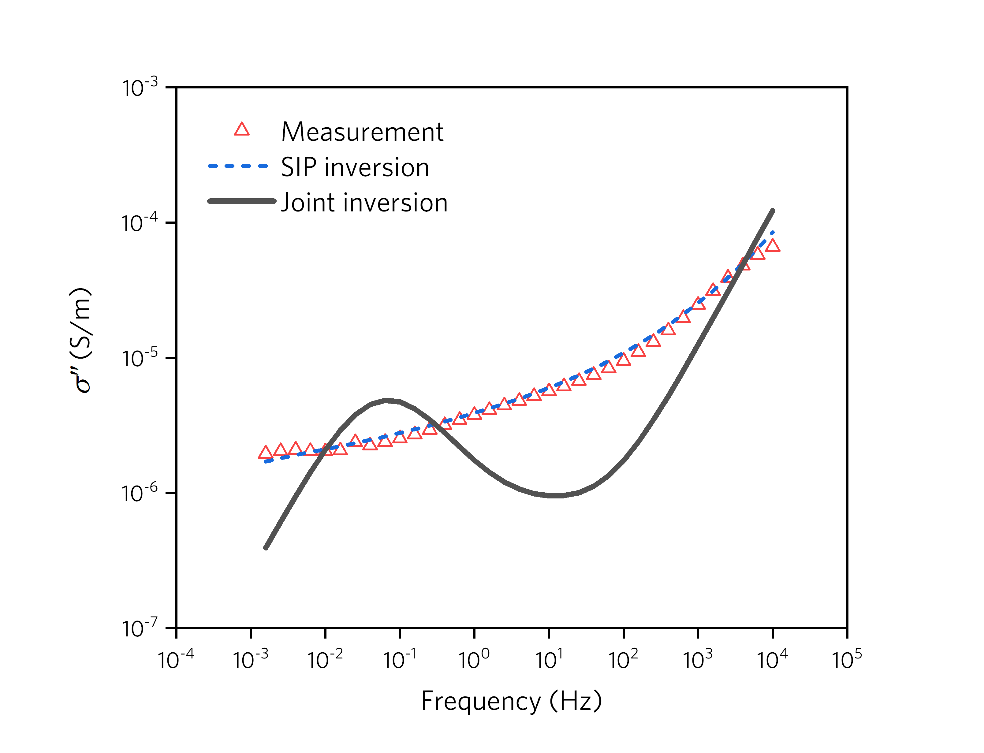
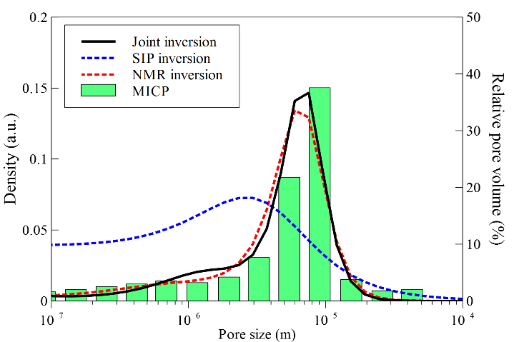
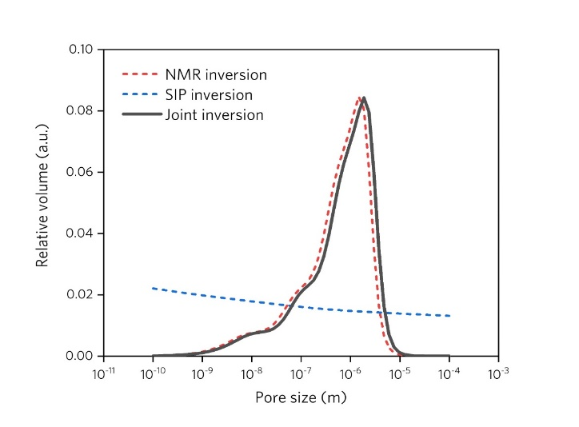
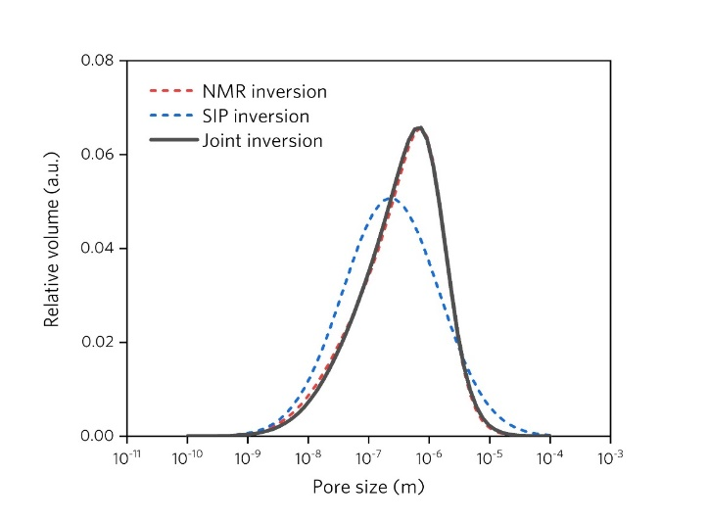
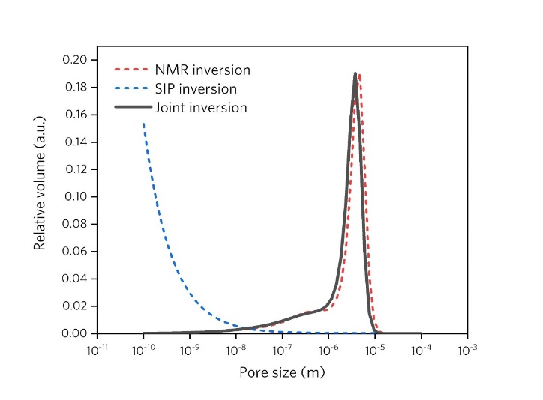
Berea Sandstone
Carbonate (Oomoldic grainstone)
LKC-53
LKC-59
LKC-92
(Niu, 2018)

Slide 12
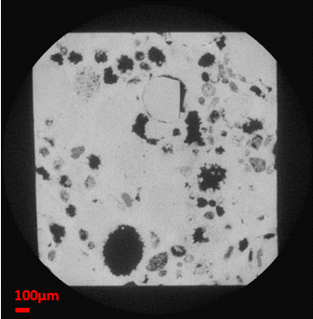
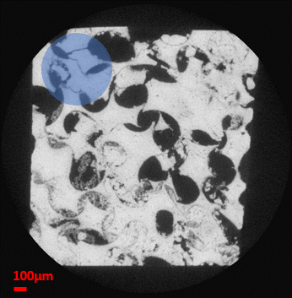
Alternative model
EDL (Electrochemical) Polarization

Slide 13
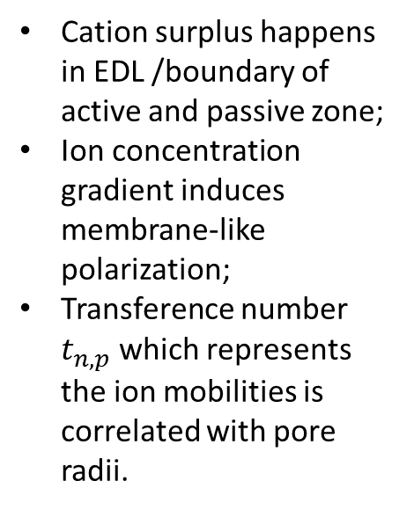
Membrane polarization
Initial flow
Steady-state flow
Cation surplus happens in EDL /boundary of active and passive zone;
Ion concentration gradient induces membrane-like polarization;
Transference number $t_{n,p}$ which represents the ion mobilities is correlated with pore radii.
Solid Phase
Solid Phase
r₁
r₁
External electric field
r₂
r₂
L₁
L₂
L₁
L₂
Active Zone
Passive Zone
Active Zone
Passive Zone

Slide 14
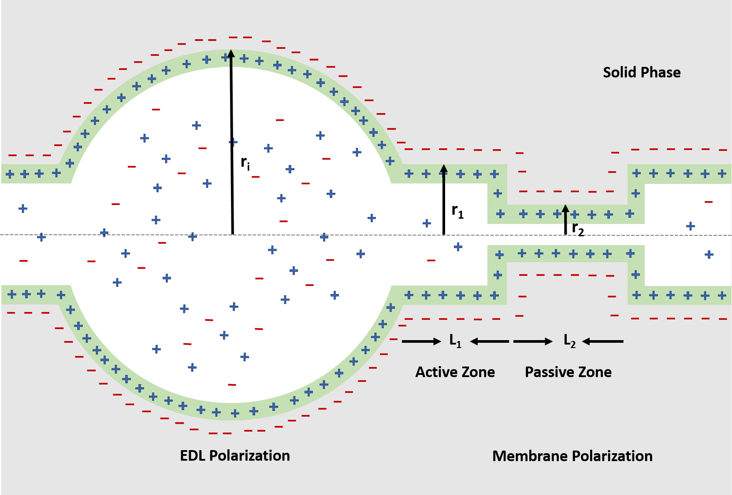
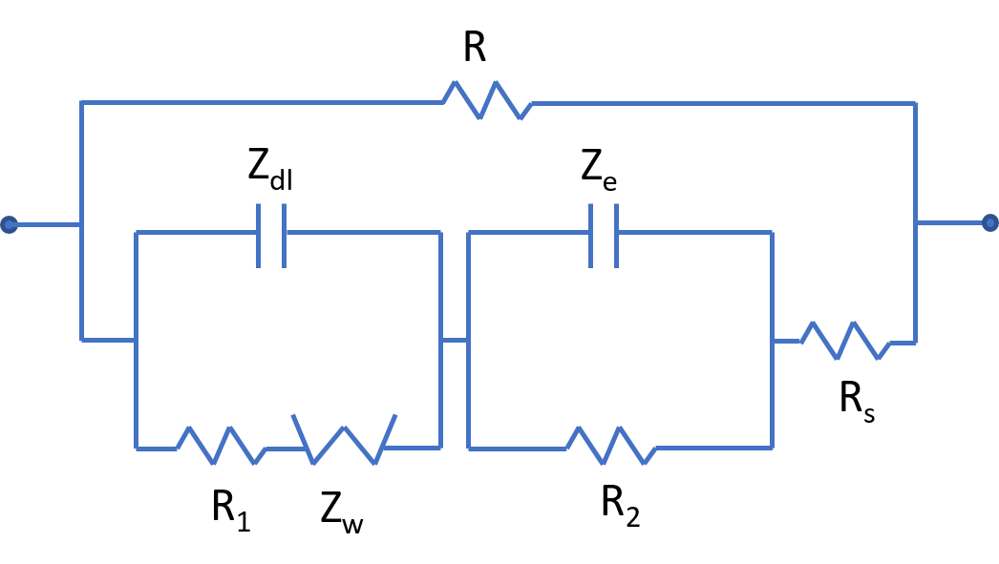
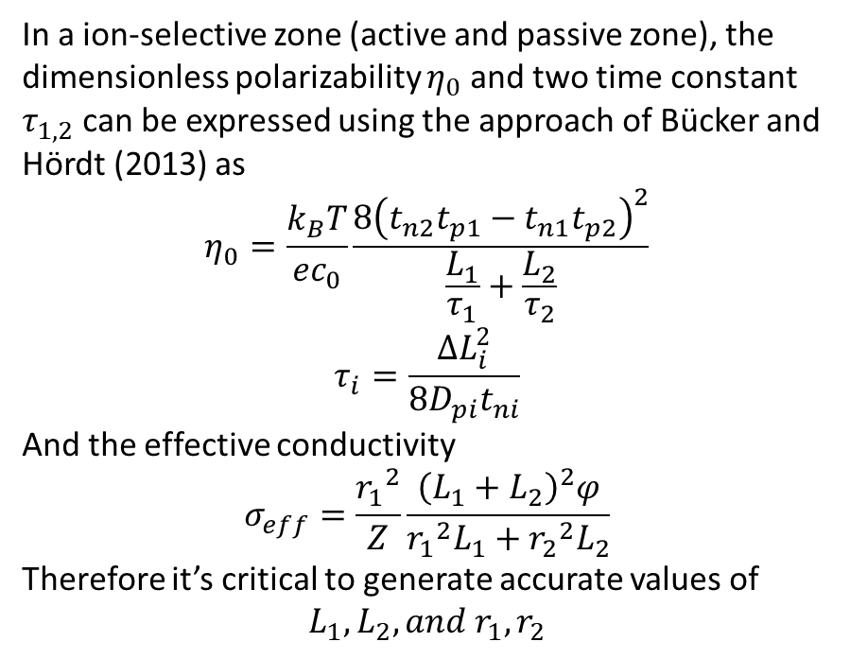
In a ion-selective zone (active and passive zone), the dimensionless polarizability $η_{0}$ and two time constant $τ_{1,2}$ can be expressed using the approach of Bücker and Hördt (2013) as
$$η_{0}=\frac{k_{B}T}{ec_{0}}\frac{8{\left(t_{n2}t_{p1}−t_{n1}t_{p2}\right)}^{2}}{\frac{L_{1}}{τ_{1}}+\frac{L_{2}}{τ_{2}}}$$
$$τ_{i}=\frac{∆L_{i}^{2}}{8D_{pi}t_{ni}}$$
And the effective conductivity
$$σ_{eff}=\frac{{r_{1}}^{2}}{Z}\frac{{\left(L_{1}+L_{2}\right)}^{2}φ}{{{r_{1}}^{2}L}_{1}+{{r_{2}}^{2}L}_{2}}$$
Therefore it’s critical to generate accurate values of
$$L_{1},L_{2},and r_{1},r_{2}$$
R: unblocked path resistance
R1,2: metallic resistance
Rs: solution resistance
Z_{dl}: EDL impedance
Z_{w}: Warburg impedance
Z_{e}: electrolyte diffusive impedance

Slide 15
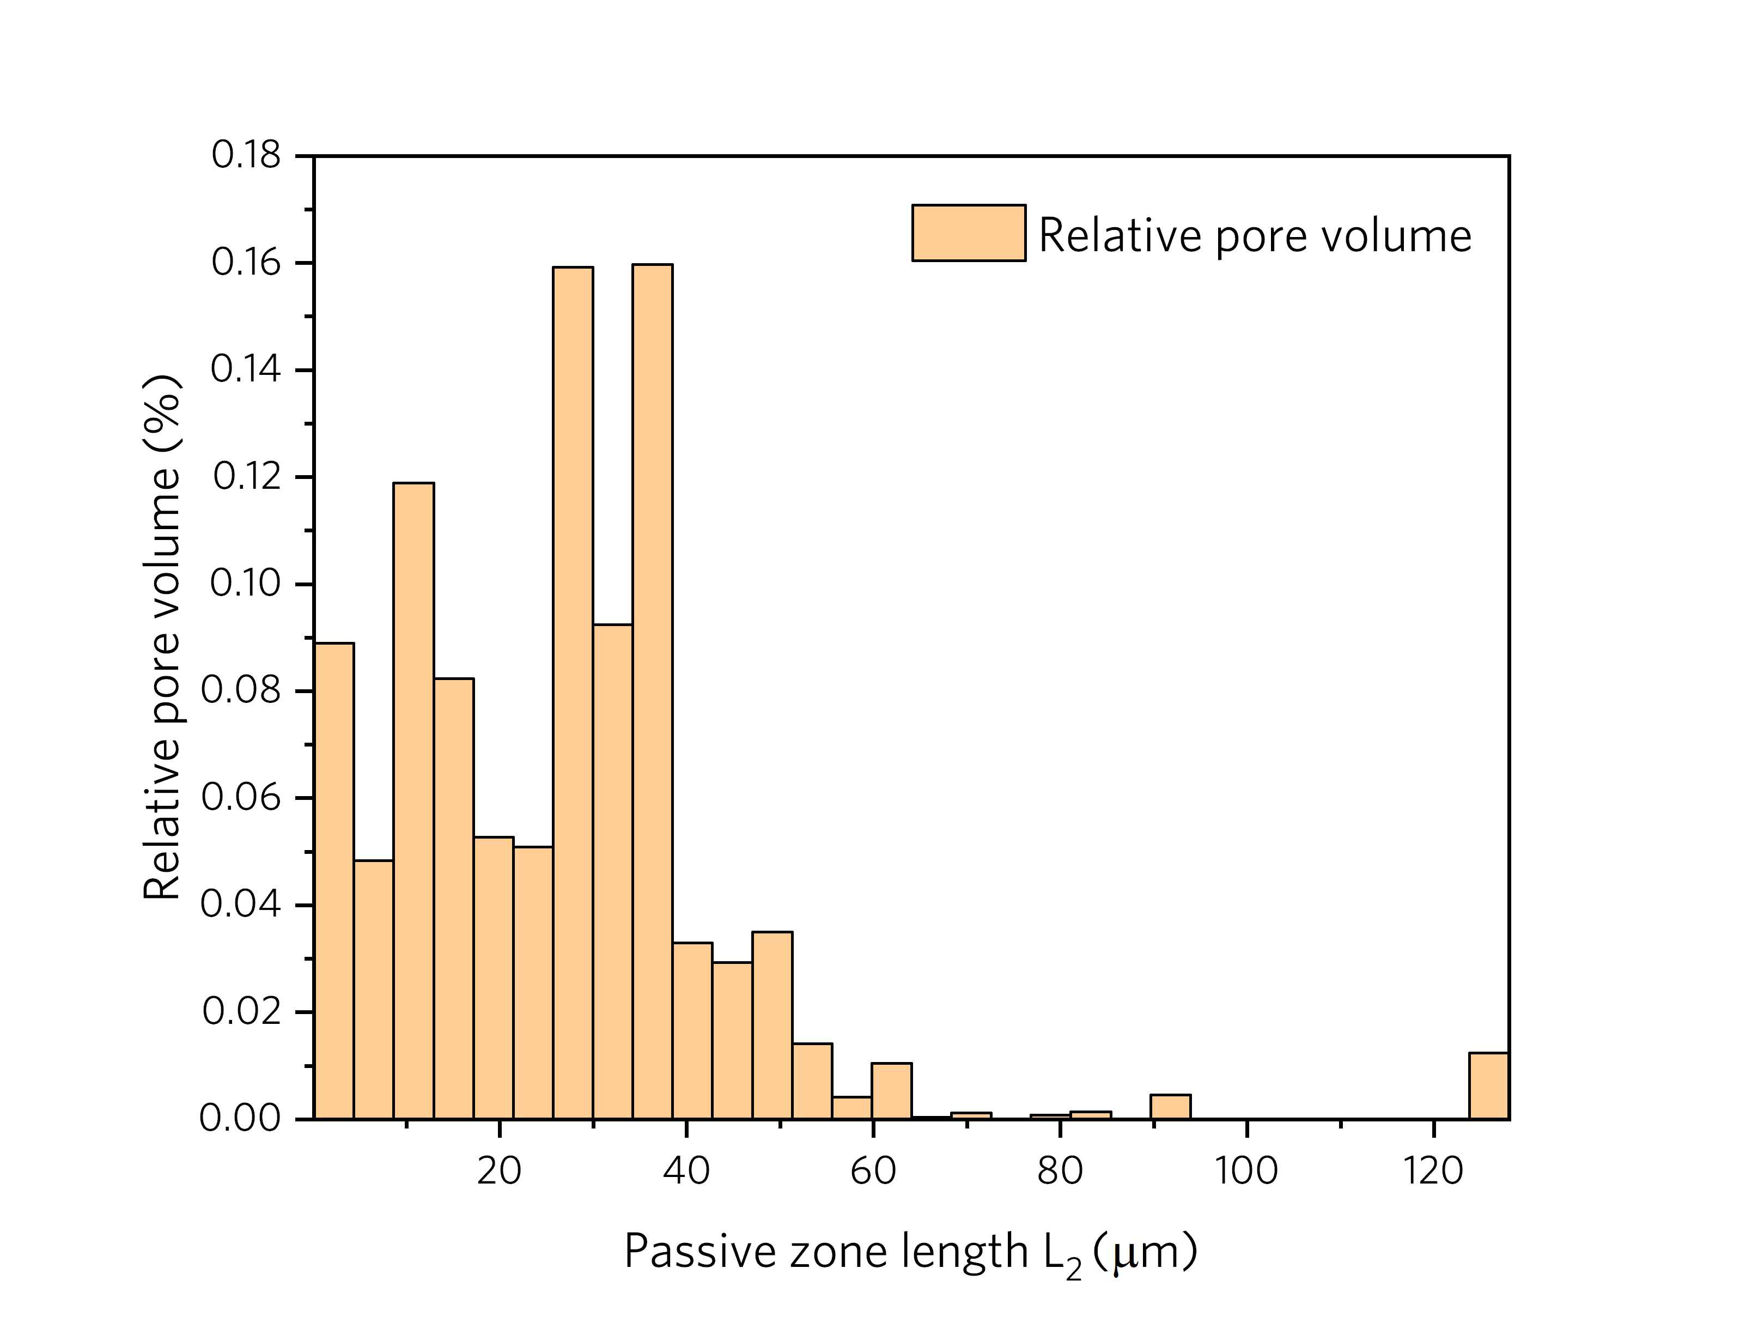
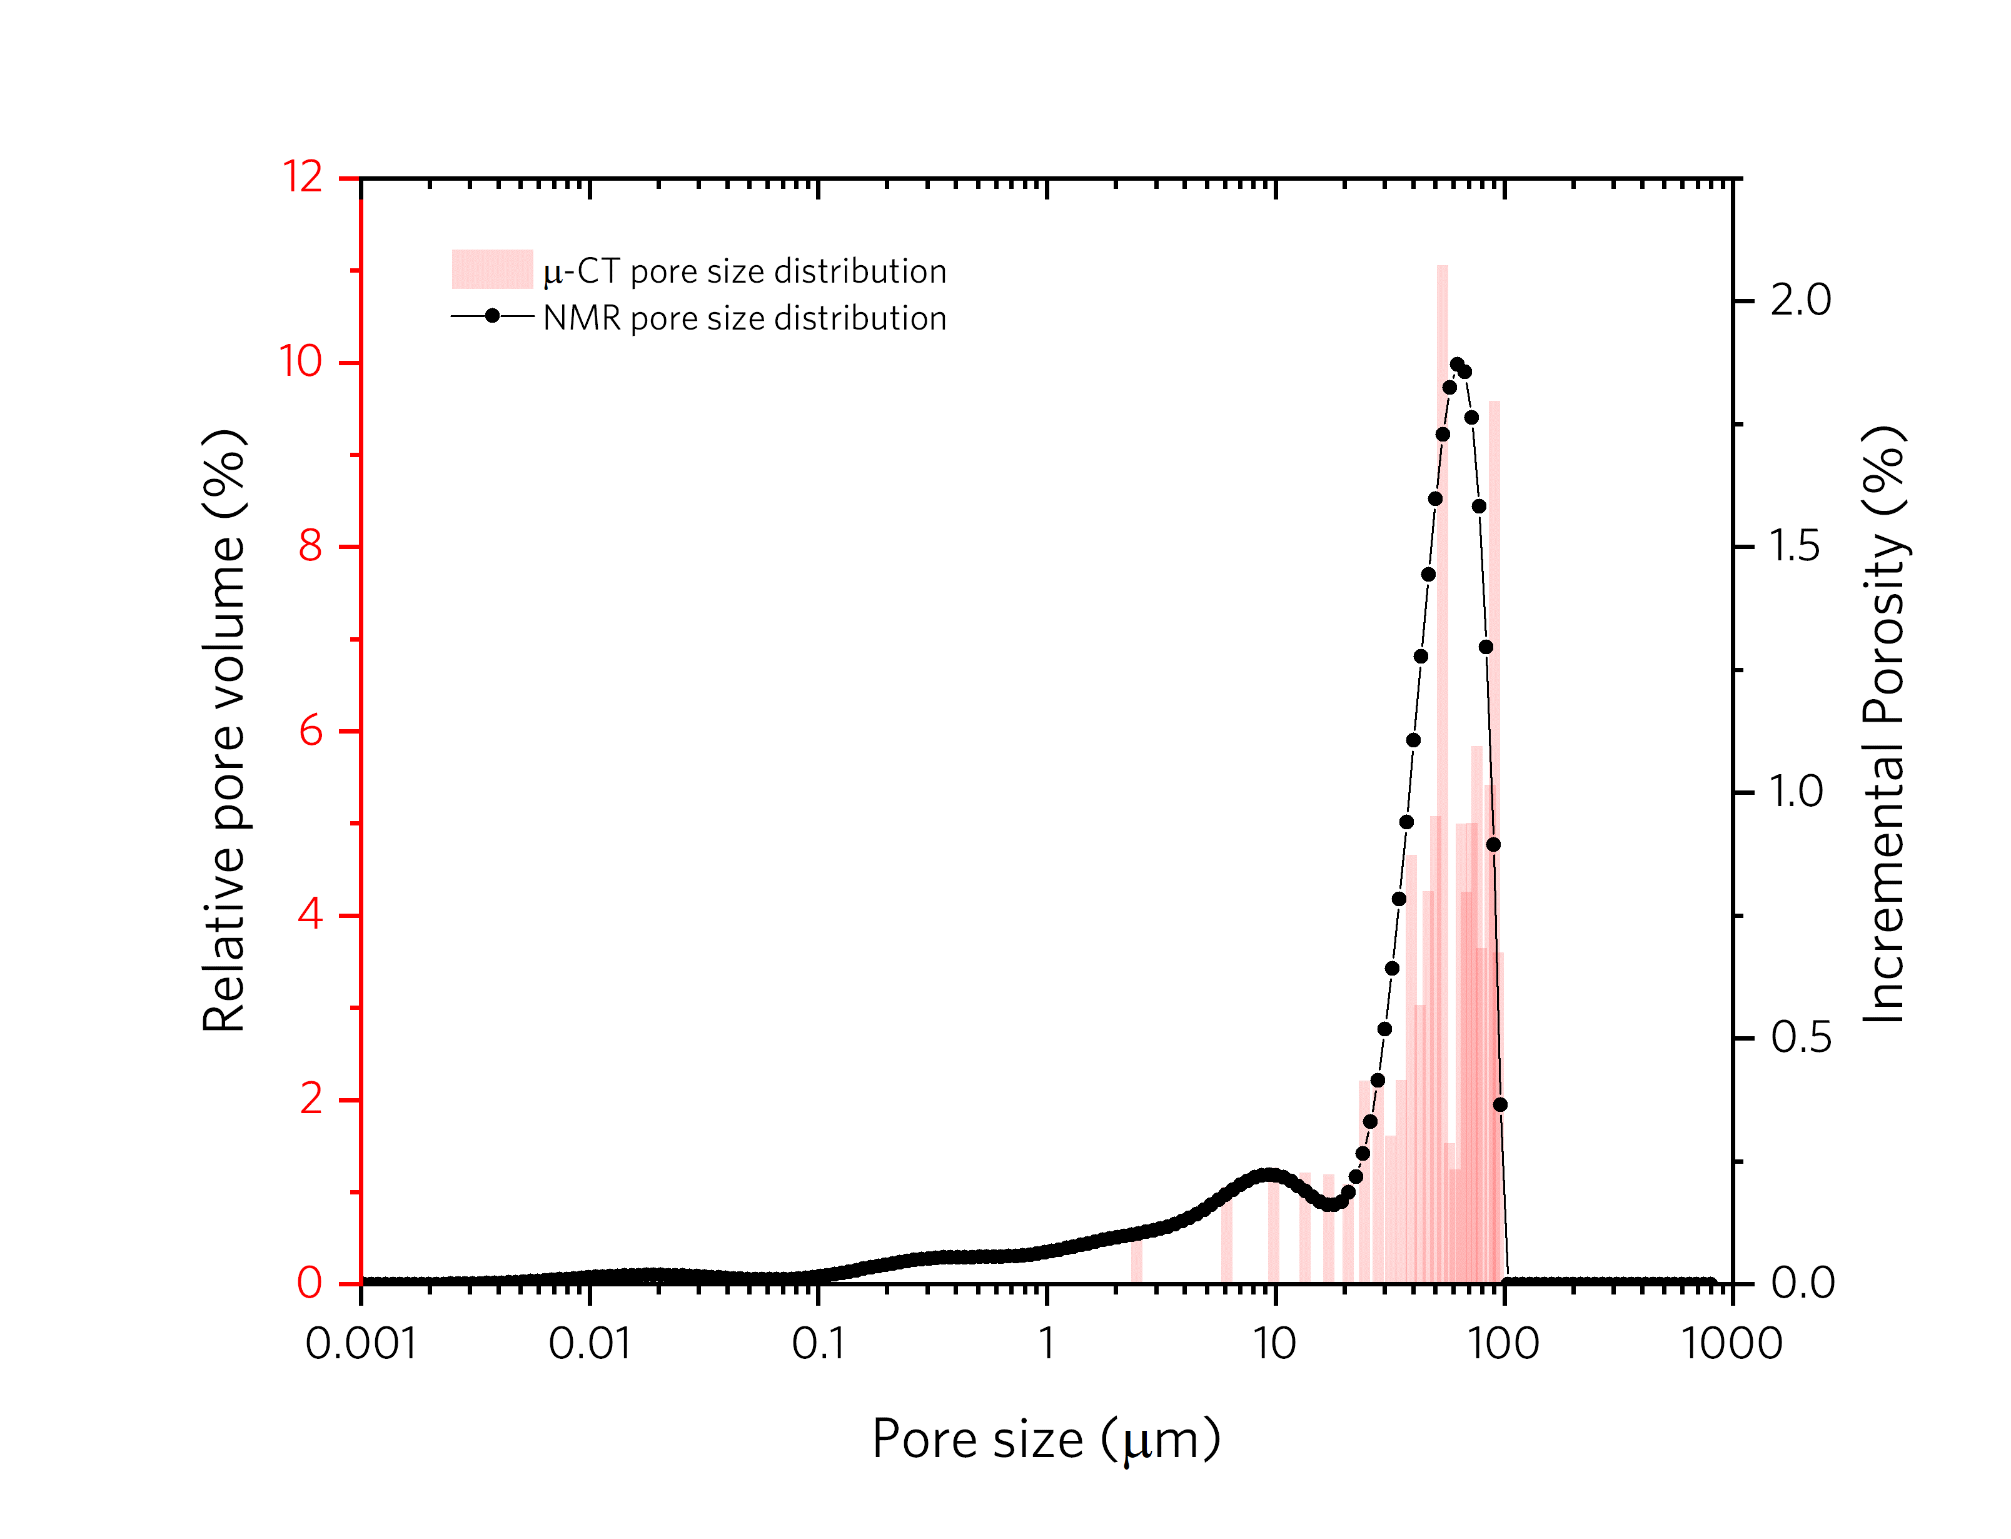
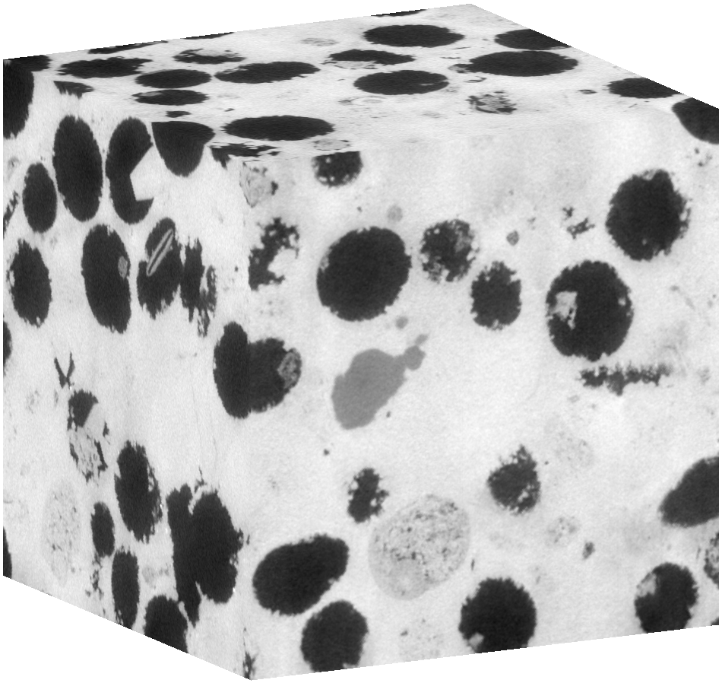
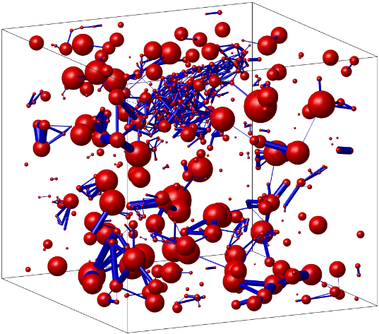
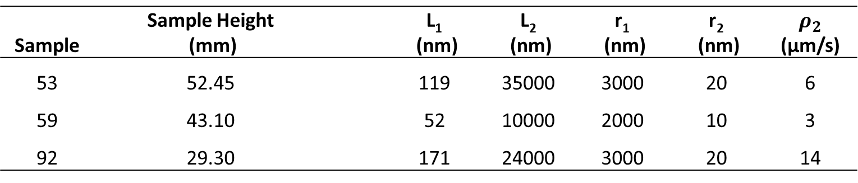
CT image
Digital rock network
Pore attributes calculation
Pore size distribution and comparison with NMR data
CT image and digital rock network credit to James Colgin
Characteristic r₁ L₂ can be derived but not r₂ L₁
Sample | Sample Height (mm) |  | L₁ (nm) | L₂ (nm) | r₁ (nm) | r₂ (nm) | $$ρ_{2}$$ (µm/s)
53 | 52.45 |  | 119 | 35000 | 3000 | 20 | 6
59 | 43.10 |  | 52 | 10000 | 2000 | 10 | 3
92 | 29.30 |  | 171 | 24000 | 3000 | 20 | 14

Slide 16
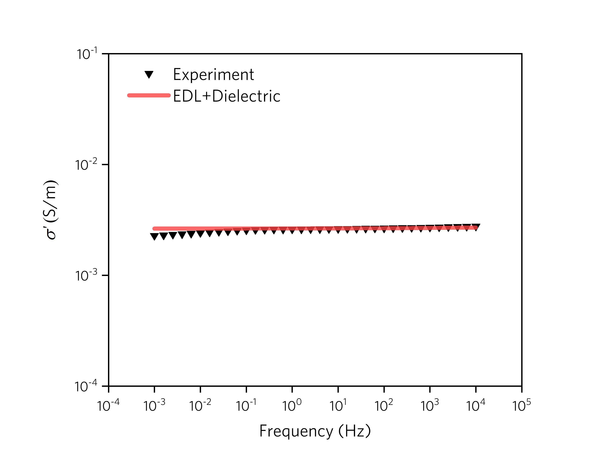
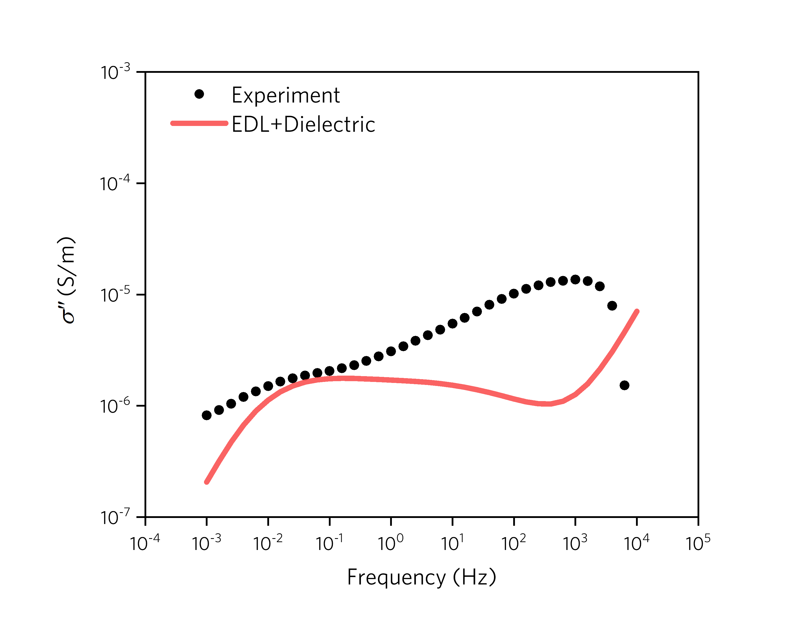
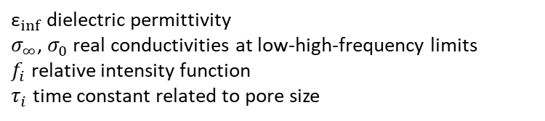
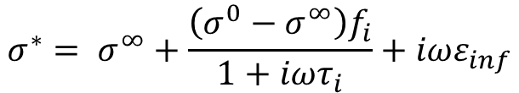
New forward model
$$σ^{∗}= σ^{∞}+\frac{\left({σ^{0}−σ}^{∞}\right)f_{i}}{1+iωτ_{i}}+iωε_{inf}$$
${\text{ε}}_{inf⁡}$ dielectric permittivity
$σ_{∞}$, $σ_{0}$ real conductivities at low-high-frequency limits
$f_{i}$ relative intensity function
$τ_{i}$ time constant related to pore size
EDL Polarization
Dielectric Polarization

Slide 17
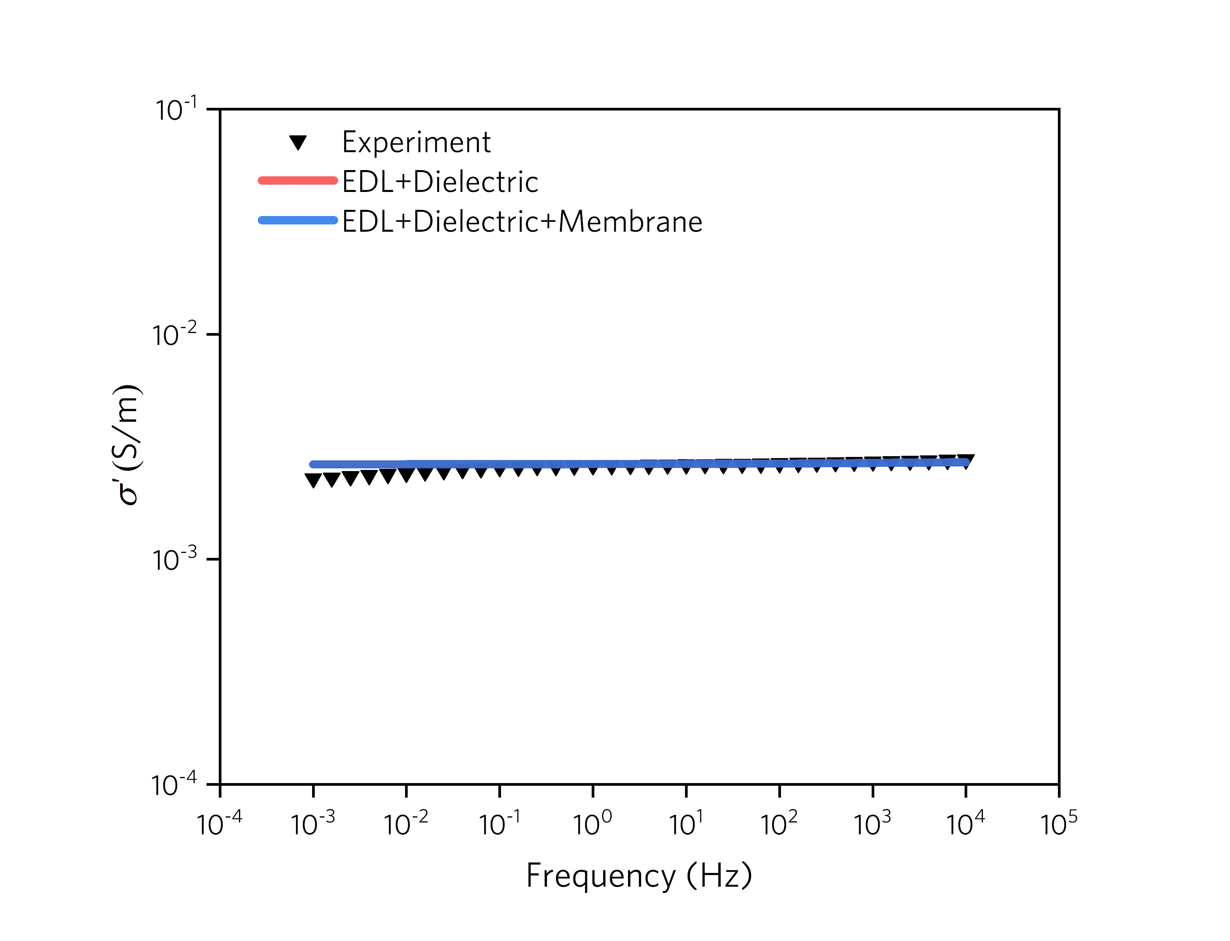
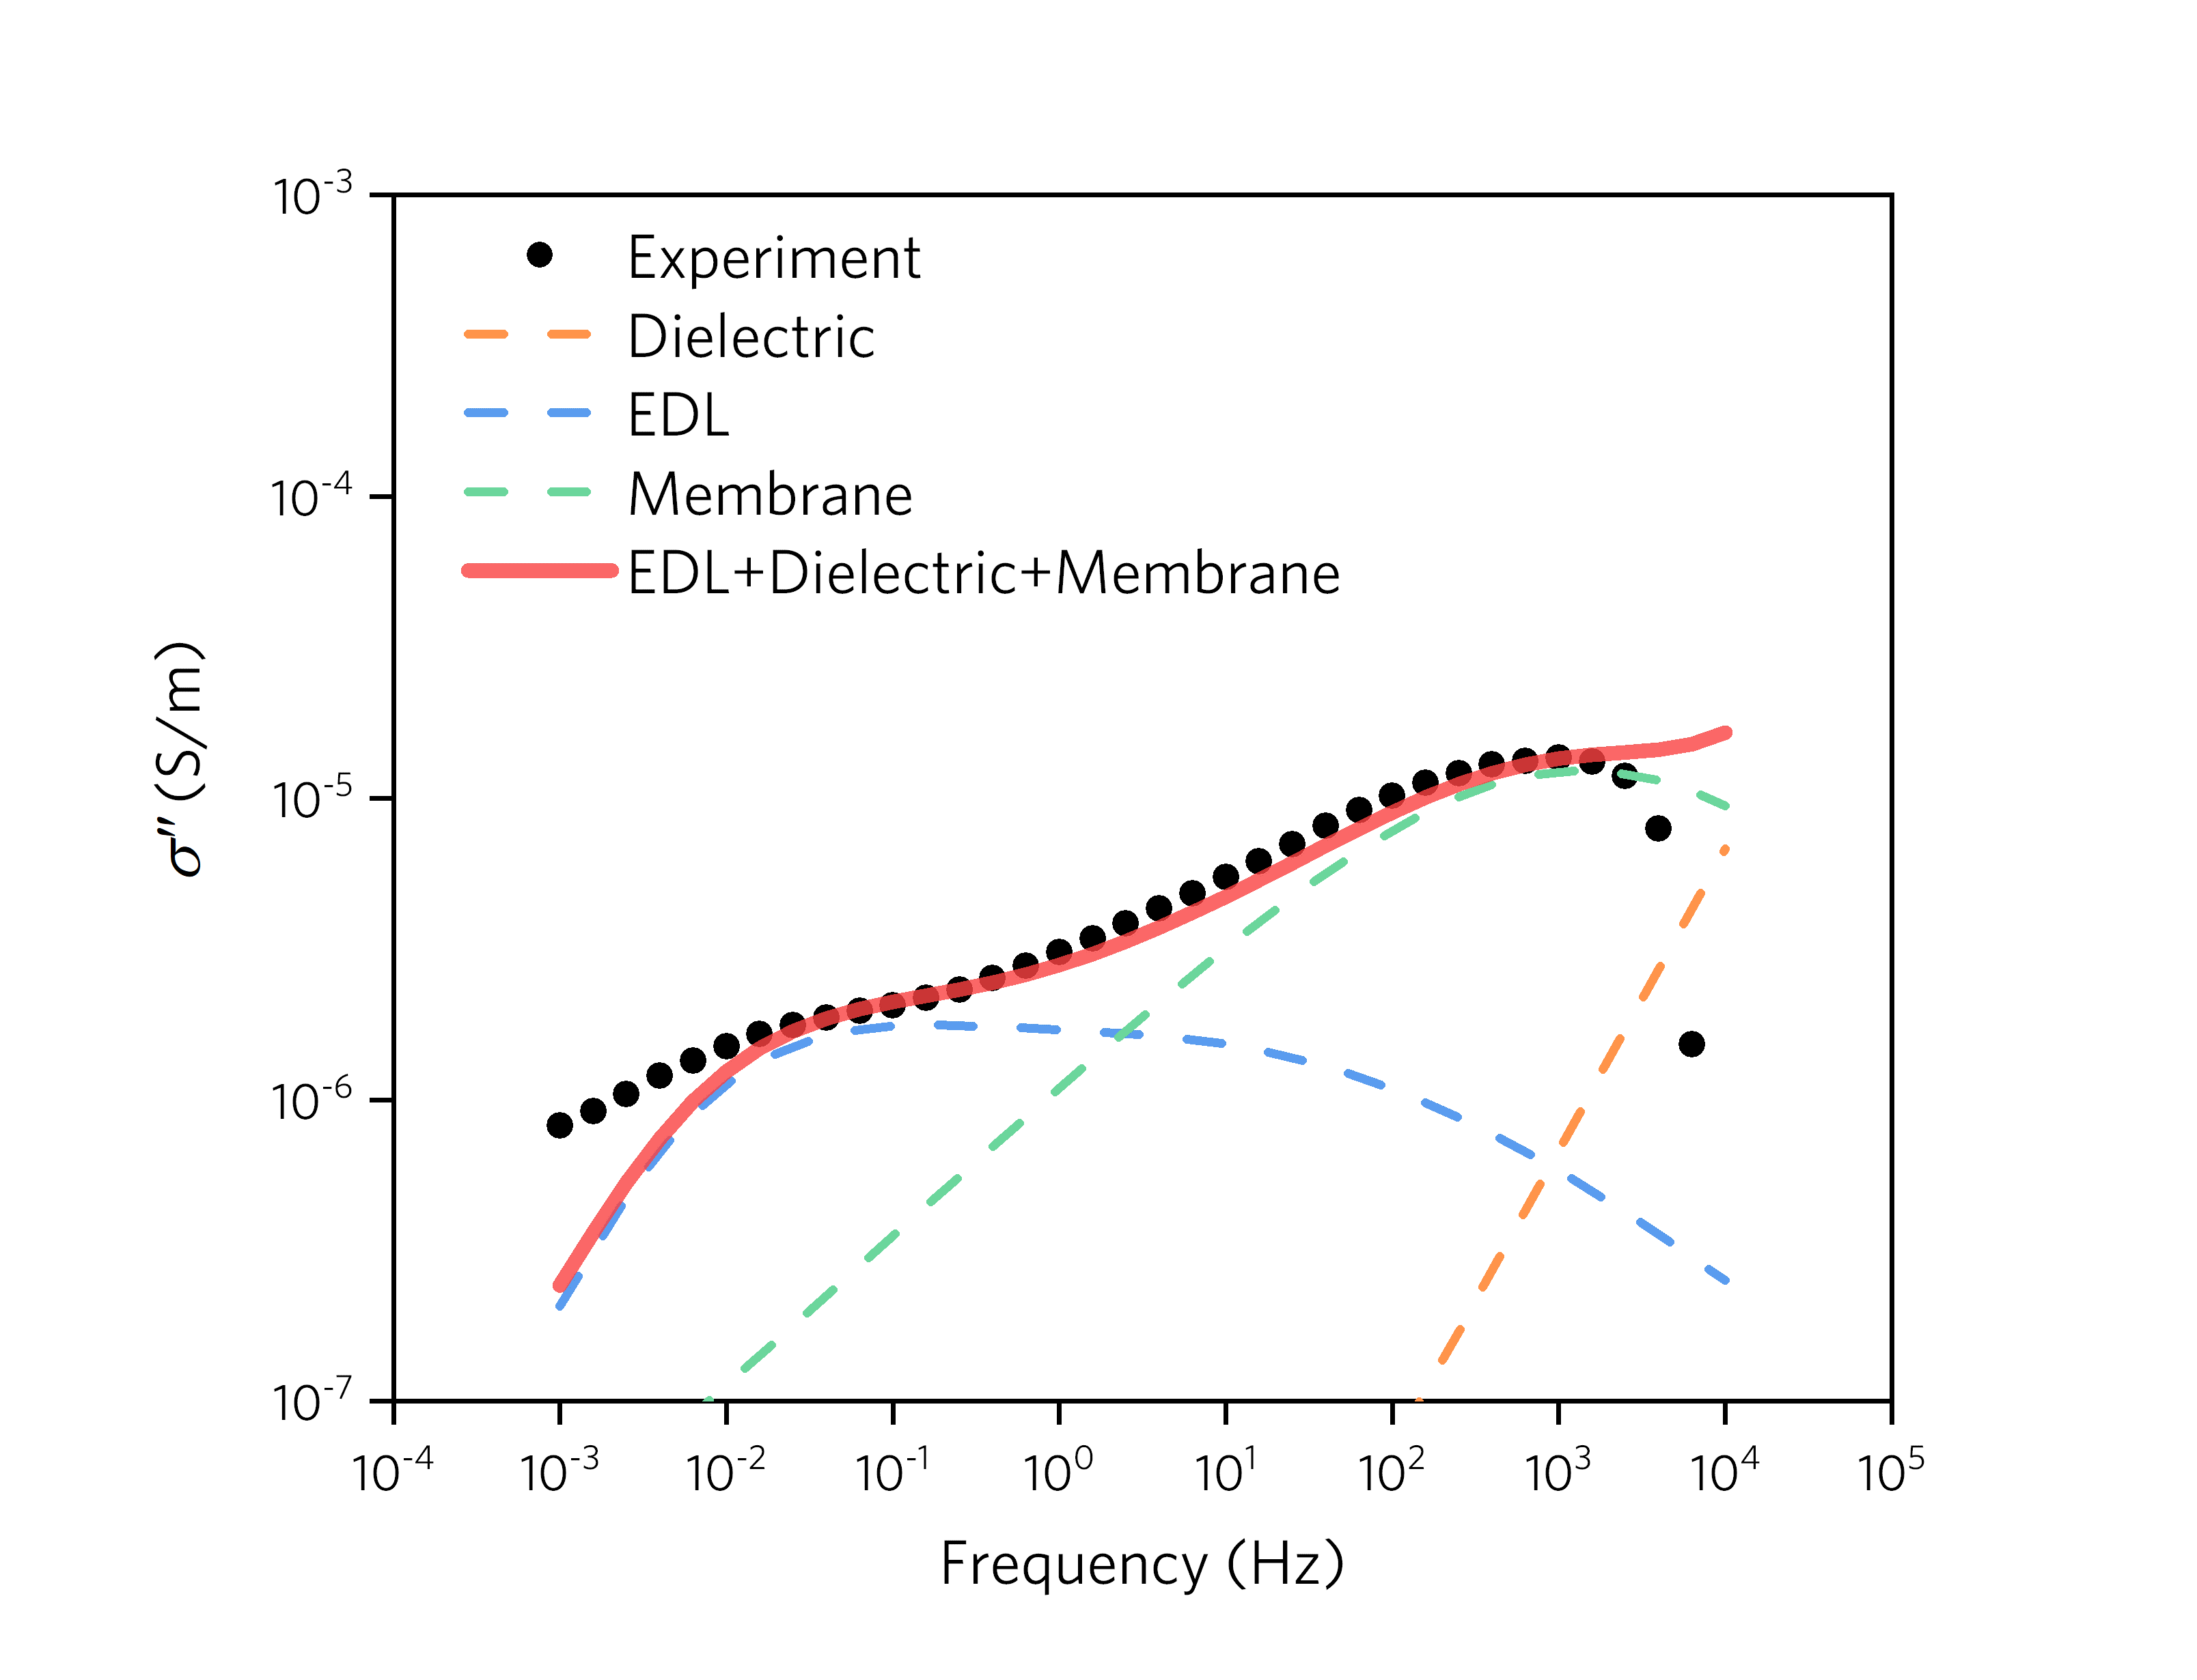
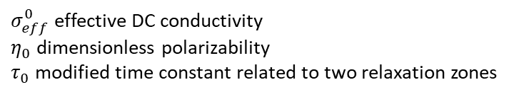
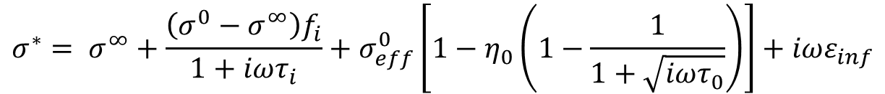
$σ_{eff}^{0}$ effective DC conductivity
$η_{0}$ dimensionless polarizability
$τ_{0}$ modified time constant related to two relaxation zones
$$σ^{∗}= σ^{∞}+\frac{\left({σ^{0}−σ}^{∞}\right)f_{i}}{1+iωτ_{i}}+σ_{eff}^{0}\left[1−η_{0}\left(1−\frac{1}{1+\sqrt{iωτ_{0}}}\right)\right]+iωε_{inf}$$
EDL Polarization
Membrane Polarization
Dielectric Polarization

Slide 18
LKC-53
LKC-59
LKC-92

Slide 19
Conclusion
Compared with individual inversions, the shape of modal and peak position from jointly estimated pore size distribution are mostly dictated by NMR data and only lightly constrained by SIP data. This is consistent with inversion result for Berea sandstone.
The limited information from SIP data can be explained by the missing of information from small pores. To better represent SIP data, we introduced membrane polarization to explain underestimated imaginary conductivity at intermediate frequencies.
Improved new model has great agreement with SIP responses especially for intermediate frequency around 100 Hz.
Comparison between membrane and EDL polarization has validated the theory that membrane polarization contributes more to small-narrow pores and EDL contributes more to large-wide pores.

Slide 20
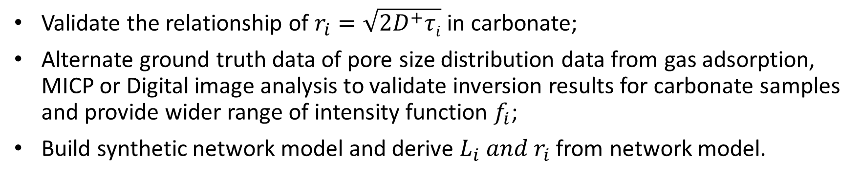
Future work
Validate the relationship of $r_{i}=\sqrt{2D^{+}τi}$ in carbonate;
Alternate ground truth data of pore size distribution data from gas adsorption, MICP or Digital image analysis to validate inversion results for carbonate samples and provide wider range of intensity function $f_{i}$;
Build synthetic network model and derive $L_{i} and r_{i}$ from network model.
Acknowledgements
Deepest appreciation goes to Dr. Lynn Watney for providing plug core samples and geological description of cores. We thank my colleague James Colgin for processing the CT images and generate the digital rock network. Thanks AAPG and GSA grant for funding this project.

Slide 21
Thanks for listening!
Questions?

