Slide 1


(RHSA 124)
Chapter 8:
CONTROLLING SERVICES AND DAEMONS
Prepared by: Ahmed Hamza
SPRING 2020

Slide 2
Outline:
Goal:
To control and monitor network services and system daemons using systemd
Objectives:
List system daemons and networks services started by the systemd service and socket units
Control system daemons and network services using systemctl
Sections:
Identifying automatically started system processes
Controlling system services
Lab:
Controlling services and daemons

Slide 3
CONTROLLING SERVICES AND DAEMONS
Identifying automatically started system processes

Slide 4
Identifying Automatically Started System Processes
Objectives:
After completing this section, you should be able to list system daemons and network services started by the systemd service and socket units.
Introduction to systemd:
System startup and server processes are managed by the systemd System and Service Manger
Systemd provides a method for activating system resources, server daemons, and other processes, both at boot time and on a running system

Slide 5
Identifying Automatically Started System Processes
Daemons
They are processes that wait or run in the background performing various tasks
Generally, daemons start automatically at boot time and continue to run until shutdown or until they are manually stopped
Daemon refers to services that run
By convention, the names of many daemon programs end with letter “d”
To listen for connections, a daemon uses a socket, this is the primary communication channel with local or remote clients
Sockets may be created by daemons or may be separated from the daemon and be created by another process, such as systemd
The socket is passed to daemon when a connection is established by the client

Slide 6
Identifying Automatically Started System Processes
A service often refers to one or more daemons, but starting or stopping a service may instead make a one-time change to the state of the system, which does not involve leaving a daemon process running afterward ( this is called oneshot)
A bit of history:
For many years, process ID 1 of Linux and Unix systems has been the init process
This process was responsible for activating other services on the system and is the origin of the term “init system”
Starting from Red Hat Enterprise Linux 7, process ID 1 is systemd, which is the new init system

Slide 7
Identifying Automatically Started System Processes (Cont’d)
A few of the new features provided by systemd include:
Parallelization capabilities, which increase the boot speed of a system
On-demand starting of daemons without requiring a separate service (daemons here can run automatically)
Automatic service dependency management, which can prevent timeouts (such as by not starting a network service when the network is not available)
A method of tracking related processes together by using Linux control groups

Slide 8
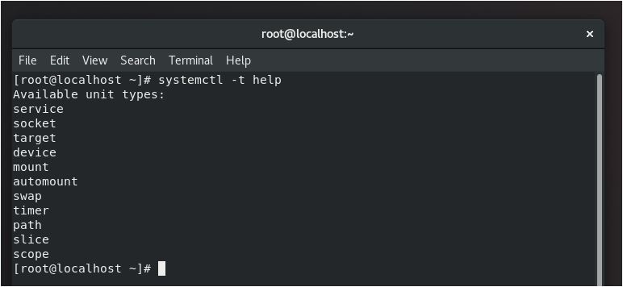
Identifying Automatically Started System Processes (Cont’d)
systemctl and systemd units:
The systemctl command is used to manage different types of systemd objects called units
A list of available unit types can be displayed with systemctl –t help

Slide 9
Identifying Automatically Started System Processes (Cont’d)
Some common unit types are listed below:
Service units have a.service extension and represent system services. This type of unit is used to start frequently accessed daemons, such as a web server.
Socket units have a.socket extension and represent inter-process communication (IPC) sockets.
Control of the socket will be passed to a daemon or newly started service when a client connection is made
Socket units are used to delay the start of a service at boot time.
Path units have a.path extension and are used to delay the activation of a service until a specific file system change occurs (for example: in printing systems)

Slide 10
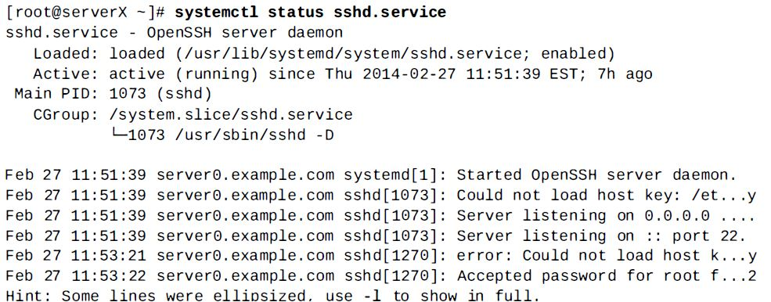
Identifying Automatically Started System Processes (Cont’d)
Service states:
The status of a service can be viewed with systemctl status name.type
If the unit type is not provided, systemctl will show the status of a service unit, if one exists

Slide 11
Identifying Automatically Started System Processes (Cont’d)
These are several keywords indicating the state of the service that can be found in the status output
Keyword | Description
Loaded | Unit configuration file has been processed
Active(running) | Running with one or more continuing processes
Active(exited) | Successfully completed a one-time configuration
Active(waiting) | Running but waiting for an event
Inactive | Not running
Enabled | Will be started at boot time
Disabled | Will not be started at boot time
Static | Can not be enabled, but may be started by an enabled unit automatically

Slide 12
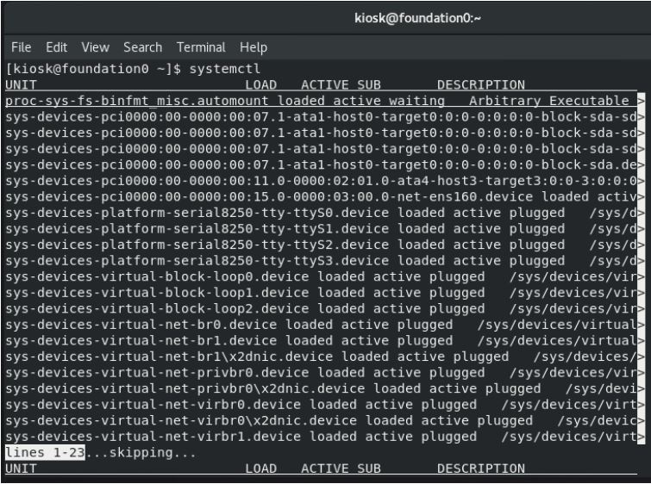
Identifying Automatically Started System Processes (Cont’d)
Listing unit files with systemctl:
To query the state of all units to verify a system startup
[root@ServerX ~]# systemctl

Slide 13
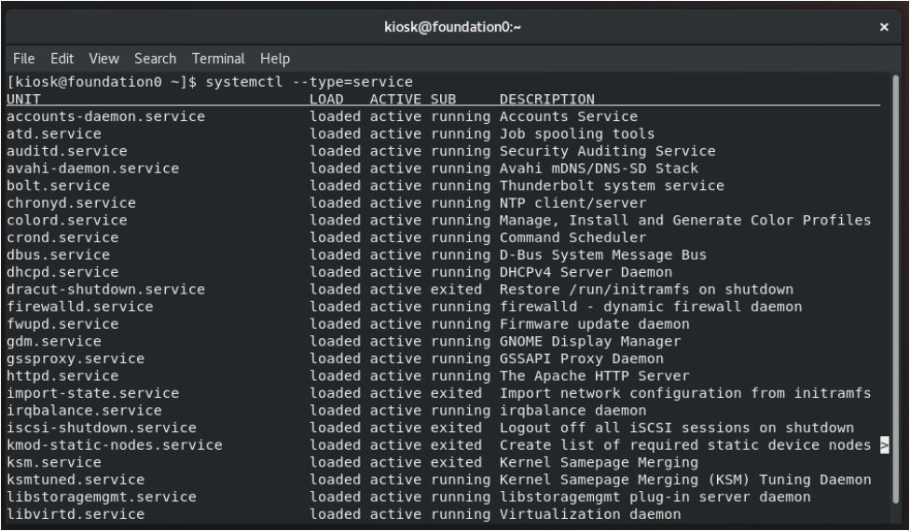
Identifying Automatically Started System Processes (Cont’d)
Listing unit files with systemctl:
To query the state of only the service units
[root@ServerX ~]# systemctl --type=service

Slide 14
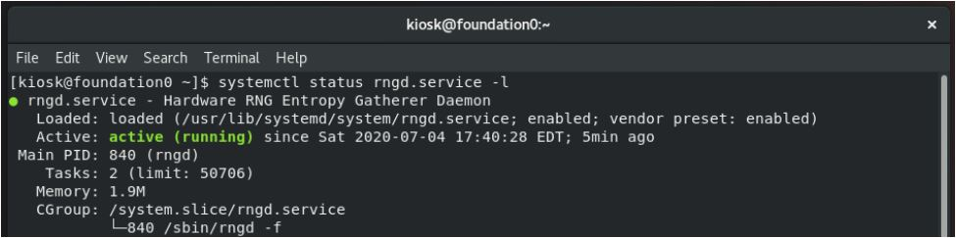
Identifying Automatically Started System Processes (Cont’d)
Listing unit files with systemctl:
To investigate any units which are in a failed or maintenance state. Optionally, add the –l option to show the full output
[root@ServerX ~]# systemctl status rngd.service –l

Slide 15
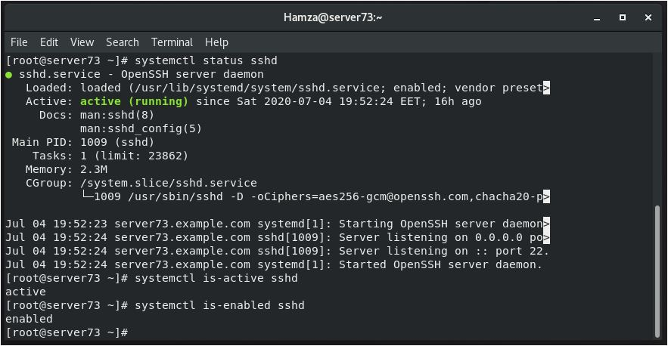
Identifying Automatically Started System Processes (Cont’d)
Listing unit files with systemctl:
The status argument may also be used to determine if a particular unit is active and show if the unit is enabled to start at boot time. Alternate commands can also easily show the active and enabled states:
[root@ServerX ~]# systemctl status sshd
OR
[root@ServerX ~]# systemctl is-active
sshd
[root@ServerX ~]# systemctl is enabled
sshd

Slide 16
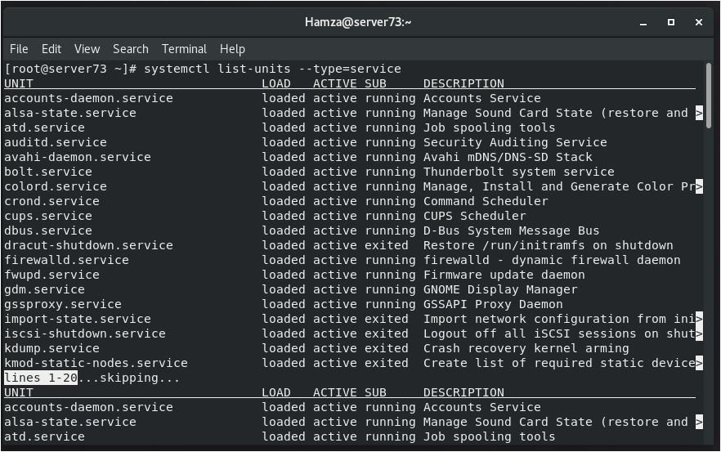
Identifying Automatically Started System Processes (Cont’d)
(a) List the active state of all loaded units. Optionally, limit the type of unit.
[root@ServerX ~]# systemctl list-units --type=service

Slide 17
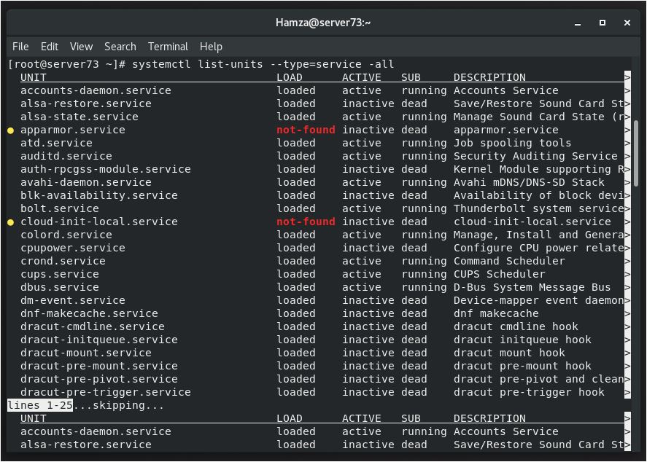
Identifying Automatically Started System Processes (Cont’d)
(b) List the active state of all loaded units. Optionally, limit the type of unit. (The --all option will add inactive units)
[root@ServerX ~]# systemctl list-units --type=service --all

Slide 18
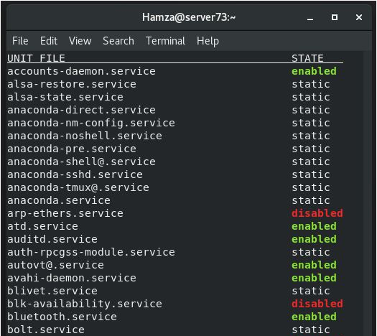
Identifying Automatically Started System Processes (Cont’d)
View the enabled and disabled settings for all units. Optionally, limit the type of unit
[root@ServerX ~]# systemctl list-unit-files --type=service

Slide 19
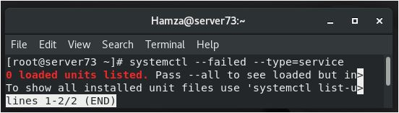
Identifying Automatically Started System Processes (Cont’d)
View only failed services
[root@ServerX ~]# systemctl --failed --type=service

Slide 20
CONTROLLING SERVICES AND DAEMONS
Controlling System Services

Slide 21
Controlling System Services
Objectives:
After completing this section, you should be able to control system daemons and network services using systemctl.
Starting and stopping system daemons on a running system:
Changes to a configuration file or other updates to a service may require that the service be restarted
A service that is no longer used may be stopped before removing the software
A service that is not frequently used may be manually started by an administrator only when it is needed

Slide 22
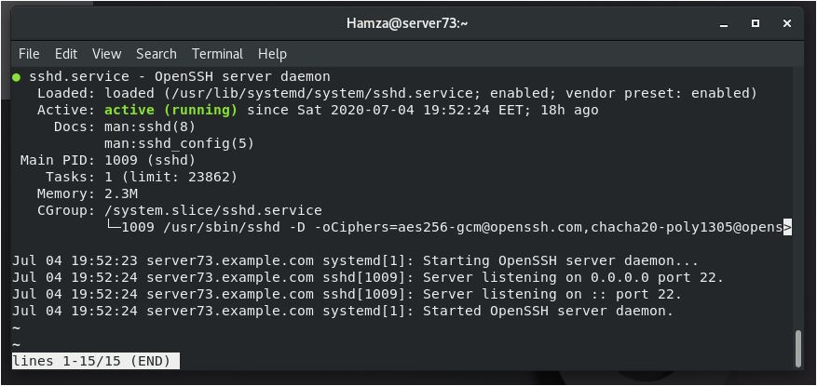
Controlling System Services (Cont’d)
In this example, please follow along with the next steps on managing services on a running system
View the status of a service
[root@ServerX ~]# systemctl status sshd.service
Service is active as shown
Process ID (PID)

Slide 23
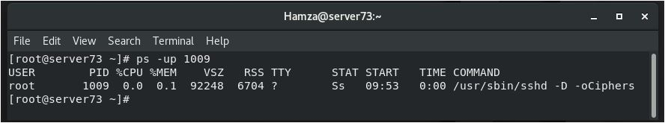
Controlling System Services (Cont’d)
In this example, please follow along with the next steps on managing services on a running system
Verify that the process is running (you will find PID from the previous output)From the previous slide, it is shown obviously that the PID is 1009
[root@ServerX ~]# ps –up PID
Options: -p PID → show details about a specific process using its PID
-u → show all processes to a specific user (if there is no user exists so by default it is a root user)

Slide 24
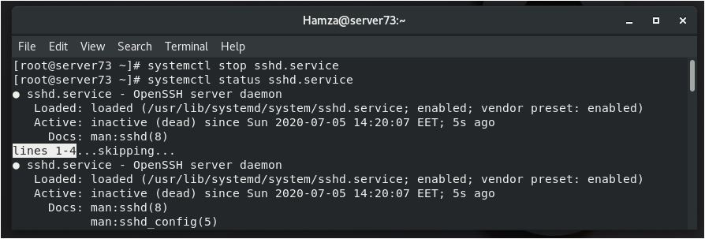
Controlling System Services (Cont’d)
In this example, please follow along with the next steps on managing services on a running system
Stop the service and verify the status
[root@ServerX ~]# systemctl stop sshd.service
[root@ServerX ~]# systemctl status sshd.service
Service is inactive as shown

Slide 25
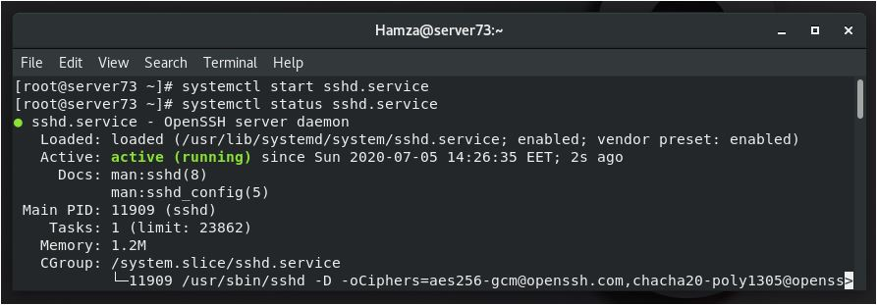
Controlling System Services (Cont’d)
Start the service and view the status. The process ID has changed
[root@ServerX ~]# systemctl start sshd.service
[root@ServerX ~]# systemctl status sshd.service
Service is active as shown
Old PID: 1009
New PID: 11909
Process ID is changed after Stopping and Starting again the service

Slide 26
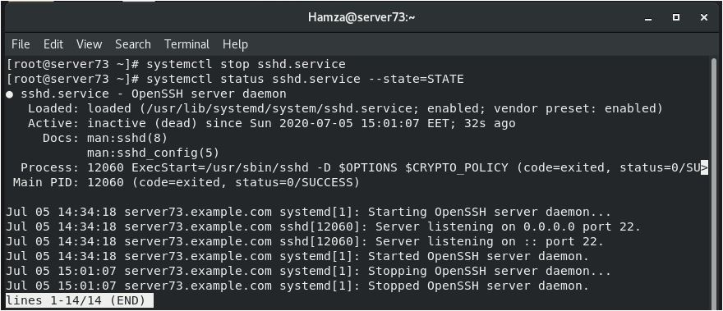
Controlling System Services (Cont’d)
(a)Stop, then start, the service in a single command
[root@ServerX ~]# systemctl stop sshd.service
[root@ServerX ~]# systemctl status sshd.service --state=STATE
Stopping the service by the administrator (root)
Service is inactive as shown
Current PID: 12060

Slide 27
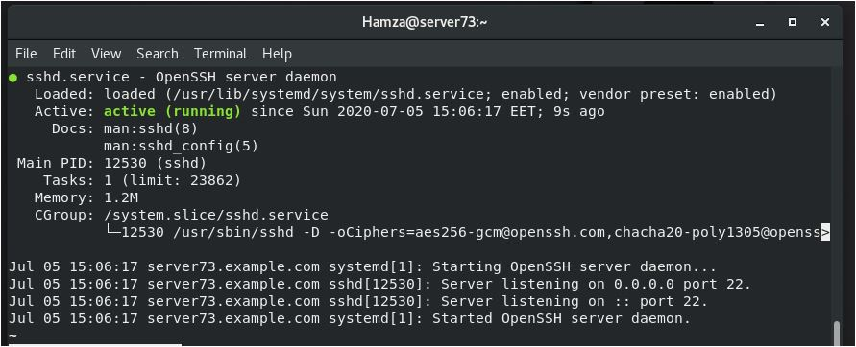
Controlling System Services (Cont’d)
(b)Stop, then start, the service in a single command
[root@ServerX ~]# systemctl restart sshd.service
[root@ServerX ~]# systemctl status sshd.service --state=STATE
Restarting the service by the administrator (root)
Process ID is changed after Stopping and Restarting again the service
Service is active as shown
Old PID: 12060
New PID: 12530

Slide 28
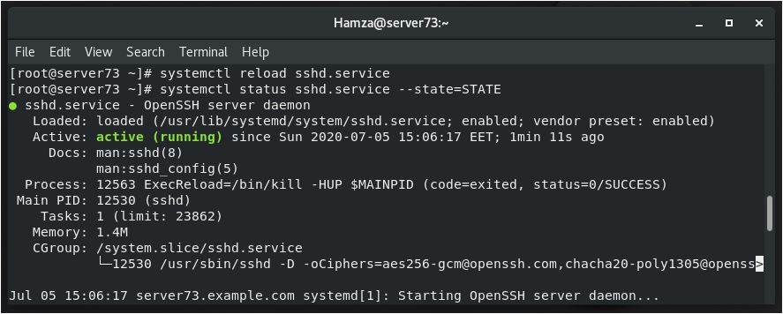
Controlling System Services (Cont’d)
Issue instructions for a service to read and reload its configuration file without a complete top and start. The process ID will not change.
[root@ServerX ~]# systemctl reload sshd.service
[root@ServerX ~]# systemctl status sshd.service
Reloading the service by the administrator (root)
Service is active as shown
Old PID: 12530
New PID: 12530
Process ID is changed after reloading the service

Slide 29
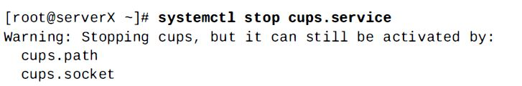
Controlling System Services (Cont’d)
Unit dependencies:
Services may be started as dependencies of other services
Services may also be triggered by path units when a file system condition is met
CUPS is an abbreviation for Common UNIX Printing System
So placing a file into the print queue directory will cause the cups print service with its dependencies to be started if it is not running
cups.path and cups.socket are two dependencies which depend on cups service

Slide 30
Controlling System Services (Cont’d)
To completely stop printing services on a system, stop all three units
Disabling the service will disable the dependencies

Slide 31
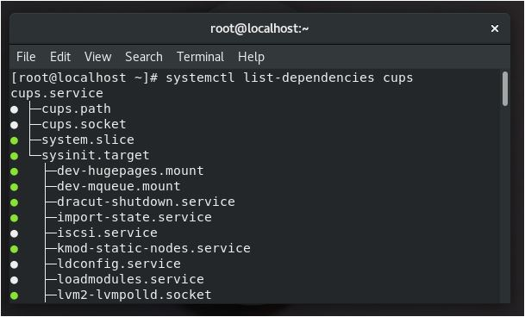
Controlling System Services (Cont’d)
There is a command that is used to print out a tree of what other units must be started if the specified unit is started.
[root@localhost ~]# systemctl list-dependencies UNIT
Example for UNITs ➔ sshd.service, cups.service
cups.path, cups.socket, system slice and sysinit.target depends on cups.service

Slide 32
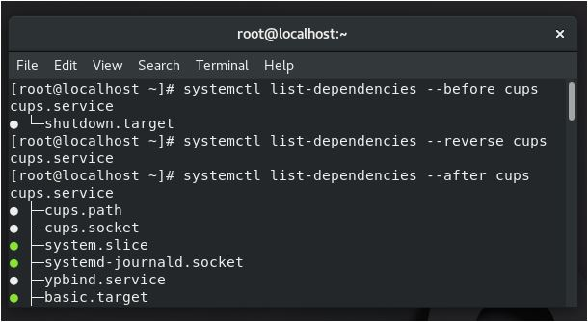
Controlling System Services (Cont’d)
To show reverse dependencies (units that depend on the specified unit), you can add the --reverse flag to the command
Other flags that are useful are the --before and --after flags, which can be used to show units that depend on the specified unit starting before and after themselves, respectively
Commands:
systemctl list-dependencies --reverse cups
systemctl list-dependencies --before cups
systemctl list-dependencies --after cups

Slide 33
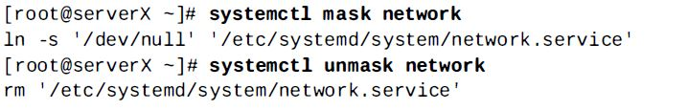
Controlling System Services (Cont’d)
Masking Services:
A system may have conflicting services installed
For example, there are multiple methods to manage
networks (network and NetworkManager)
firewalls (iptables and firewalld)
To prevent an administrator from accidentally starting a service, that service may be masked.
Masking will create a link in the configuration directories so that if the service is started, nothing will happen

Slide 34
Controlling System Services (Cont’d)
Note:
A disabled service will not be started automatically at boot or by other unit files but can be started manually
A masked service can not be started manually or automatically
This table summarizes (disable and masked services at boot time)
Started at boot time | Manually | Automatically
Disabled Service | Will | Will not
Masked Service | Will not | Will not

Slide 35
Controlling System Services (Cont’d)
Enabling system daemons to start or stop at boot:
Starting a service on a running system does not guarantee that the service will be started when the system reboots
Similarly, stopping a service on a running system will not keep it from starting again when the system reboots
Services are started at boot time when links are created in the appropriate systemd configuration directories
These links are created and removed with systemctl commands

Slide 36
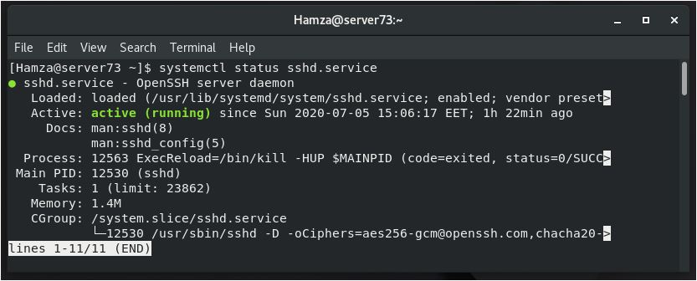
Controlling System Services (Cont’d)
In this example, please follow along with these steps to be able to enable and disable services
View the status if a service
[root@ServerX ~]# systemctl status sshd.service
Service is enabled
Service is active as shown
PID: 12530

Slide 37
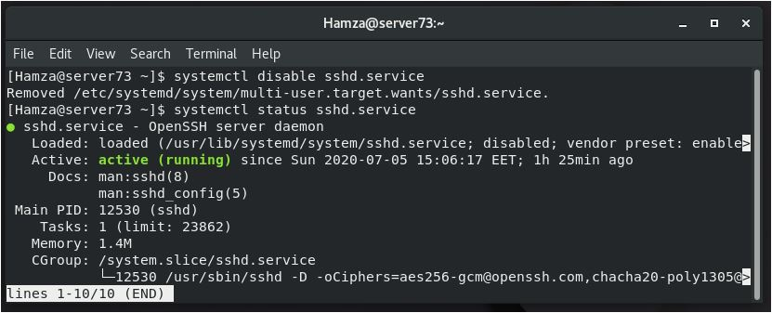
Controlling System Services (Cont’d)
Disable the service and verify the status. Note that disabling a service does not stop the service
[root@ServerX ~]# systemctl disable sshd.service
[root@ServerX ~]# systemctl status sshd.service
Service is disabled
Service is active as shown
PID: 12530

Slide 38
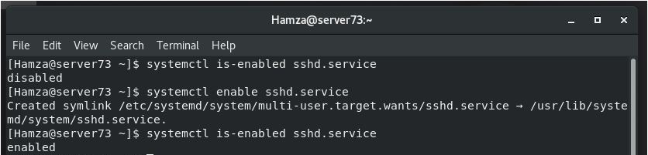
Controlling System Services (Cont’d)
Enable the service and verify the status [root@ServerX ~]# systemctl is-enabled sshd.service
[root@ServerX ~]# systemctl enable sshd.service
[root@ServerX ~]# systemctl is-enabled sshd.service
Service is disabled
Enable the service by the administrator (root)
Service is enabled

Slide 39
Controlling System Services (Cont’d)
Summary of the systemctl commands:
Services can be started and stopped on a running system and enabled or disabled for automatic start at boot time
Command | Task
systemctl status unit | View detailed information about a unit state
systemctl stop unit | Stop a service on a running system
systemctl start unit | Start a service on a running system
systemctl restart unit | Restart a service on a running system
systemctl reload unit | Reload configuration file of a running service
systemctl mask unit | Completely disable a service from being started, both manually and at boot
systemctl unmask unit | Make a masked service available

Slide 40
Controlling System Services (Cont’d)
Summary of the systemctl commands (cont’d):
Services can be started and stopped on a running system and enabled or disabled for automatic start at boot time
Command | Task
systemctl enable unit | Configure a service to start at boot time
systemctl disable unit | Disable a service from starting at boot time
systemctl list-dependencies unit | List units which are required and wanted by the specified unit

Slide 41
Thank you
Good luck ☺

