Slide 1
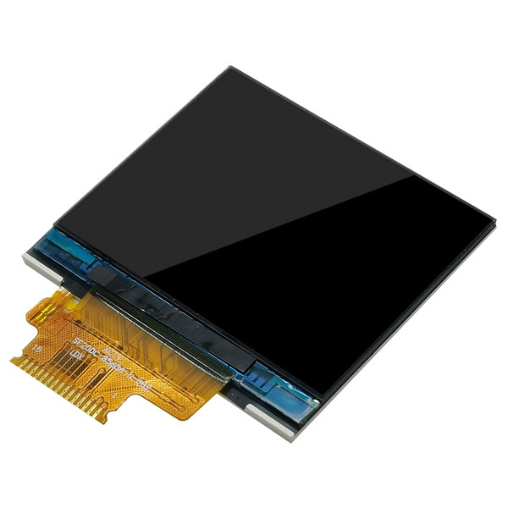
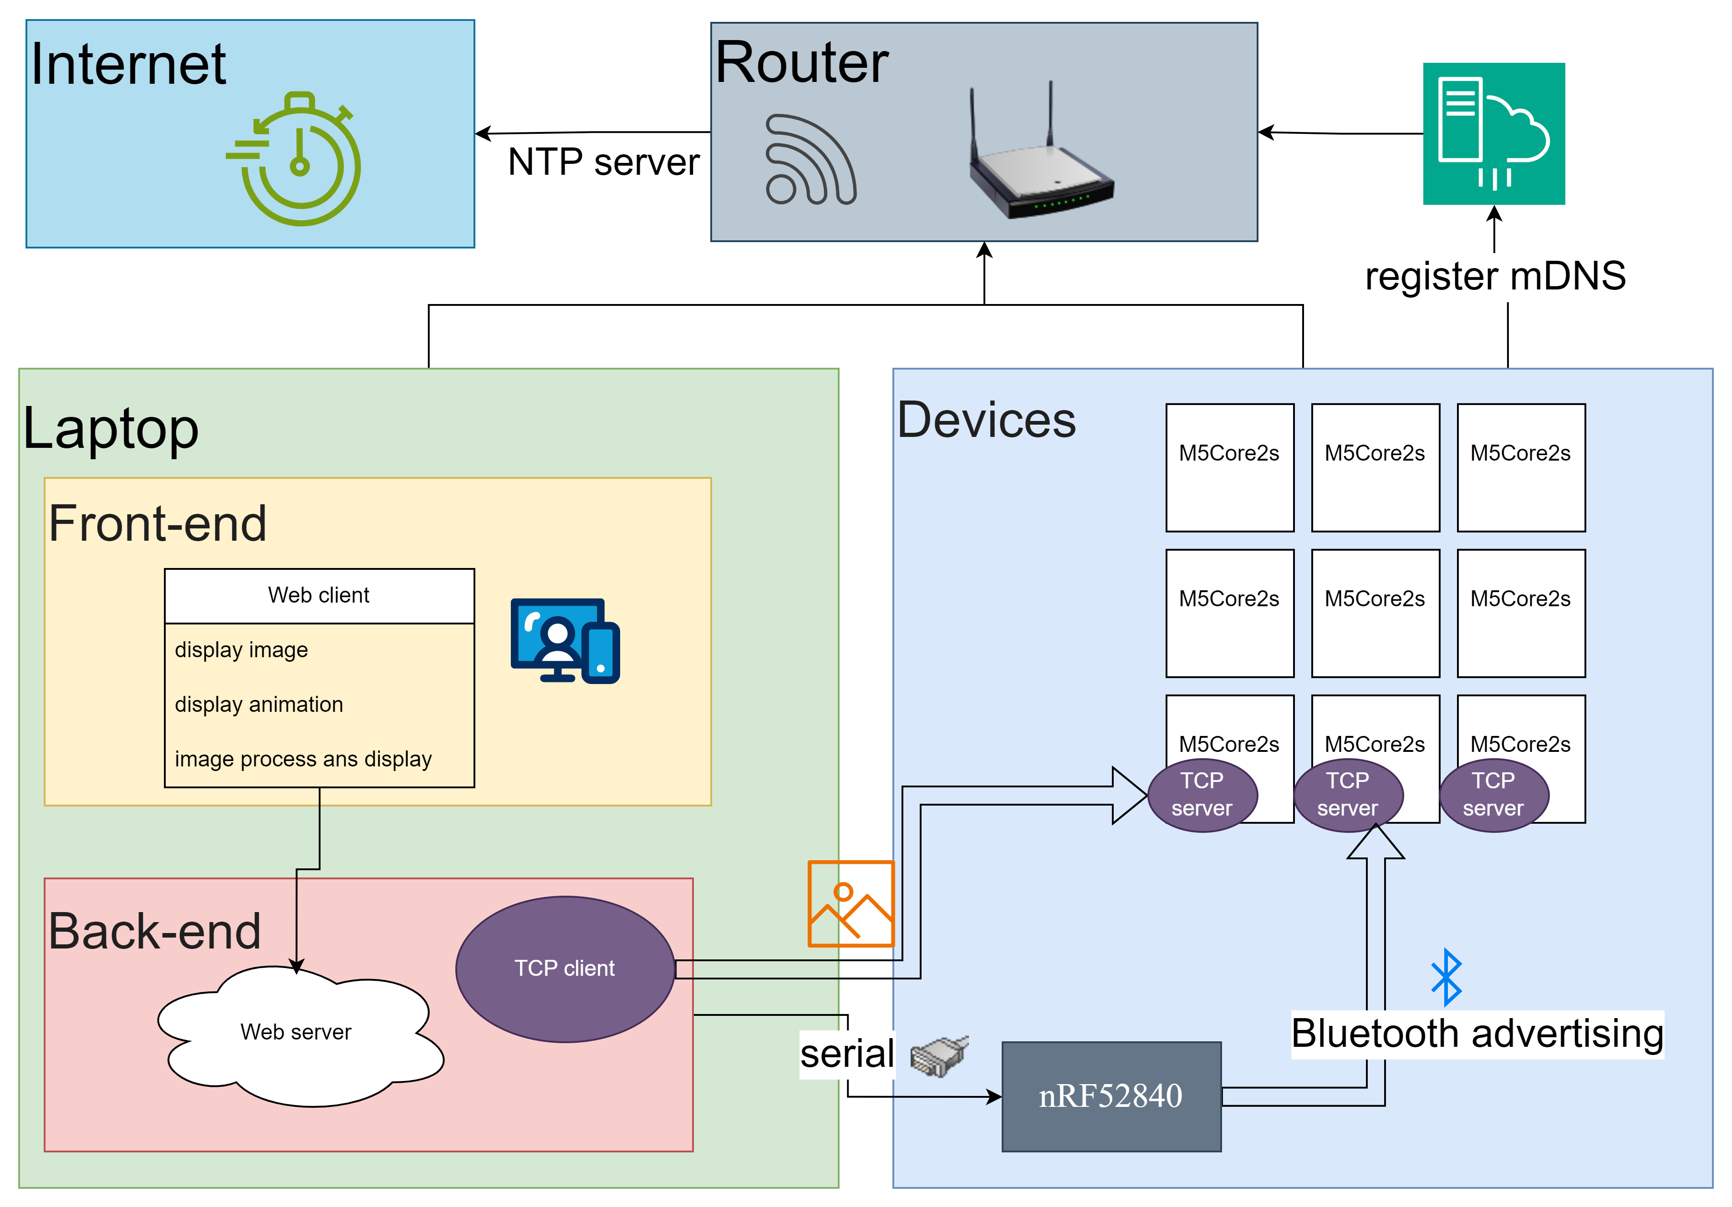
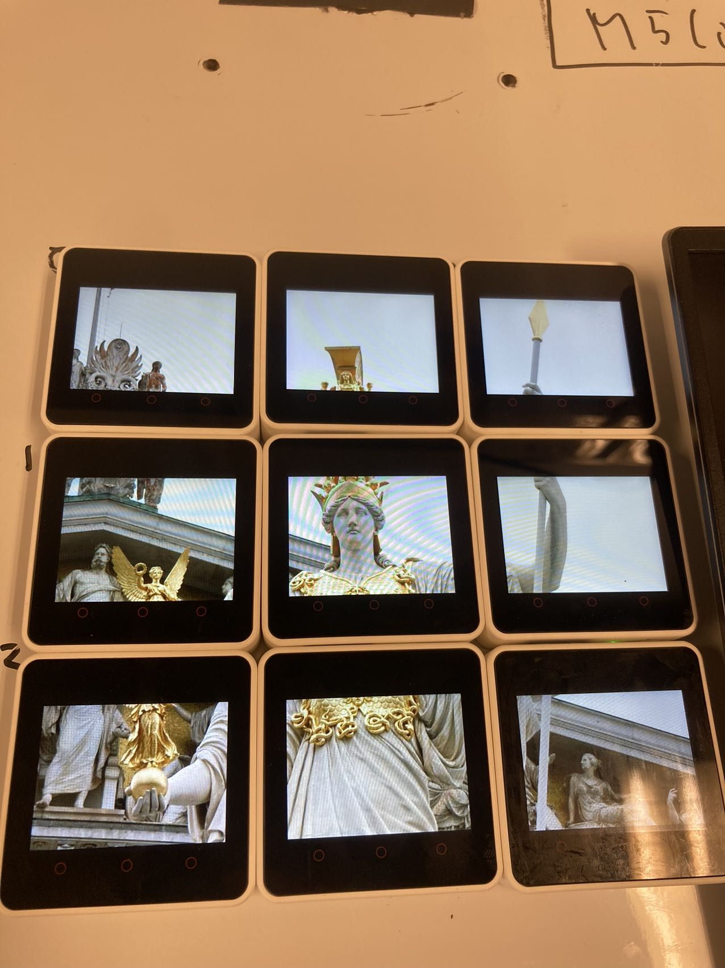

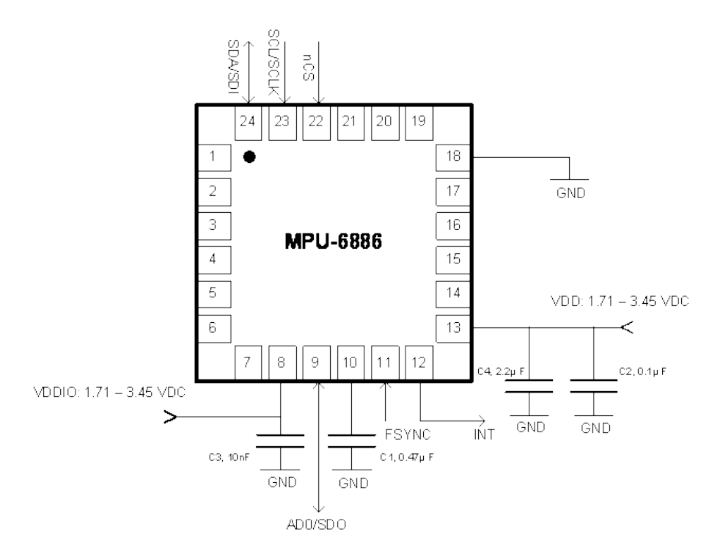
Cu.1 Synchronised Mult-display
Zhan Shi, Huantao Li (Team Athena‐yellow)
MAIN HEADINGS – BODONI MT 18PT ALL CAPS
Devices – Hardware/Software
9 M5Core2s as displays – FreeRTOS
1 nRF52840 DK(blue board) - zephyr
1 nRF52840 USB Dongle - zephyr
Server on the laptop – windows
Github repository link: https://github.com/shizhan1109/Athena-yellow
Github wiki link: https://github.com/shizhan1109/Athena-yellow/wiki/Index
Key Performance Indicator(KPI)
More than image: Screen casting.
Motion Tracking sensor. Shaking on, shaking off. Quick activation/deactivation based on motion detection.
Performance. FPS > 7
Auto Wi-Fi connecting. Bluetooth advertising Wi-Fi information. No need input or fix configuration.
GUI. Synchronized display 9 screens.
System Overview
Techniques Lecture-related
Time Synchronization: Network Time Protocol (NTP) server
Sensor: Motion track
Result
Sensor
Attitude sensor with gravity accelerometer X, Y and Z axis.
Any axis changes will turn on/off screen.

