Slide 1
GMG Fit Comparison Overview
CHT vs. Hankel vs. 1/√x — all three fits overlaid on data, per wavenumber
860–1000 cm⁻¹ · 3 samples · 15 wavenumbers each · combined overlay + a/b/c/d panel breakdown per wn

Slide 2
graphene_3x1_manual
Gr/SiO₂/Si

Slide 3
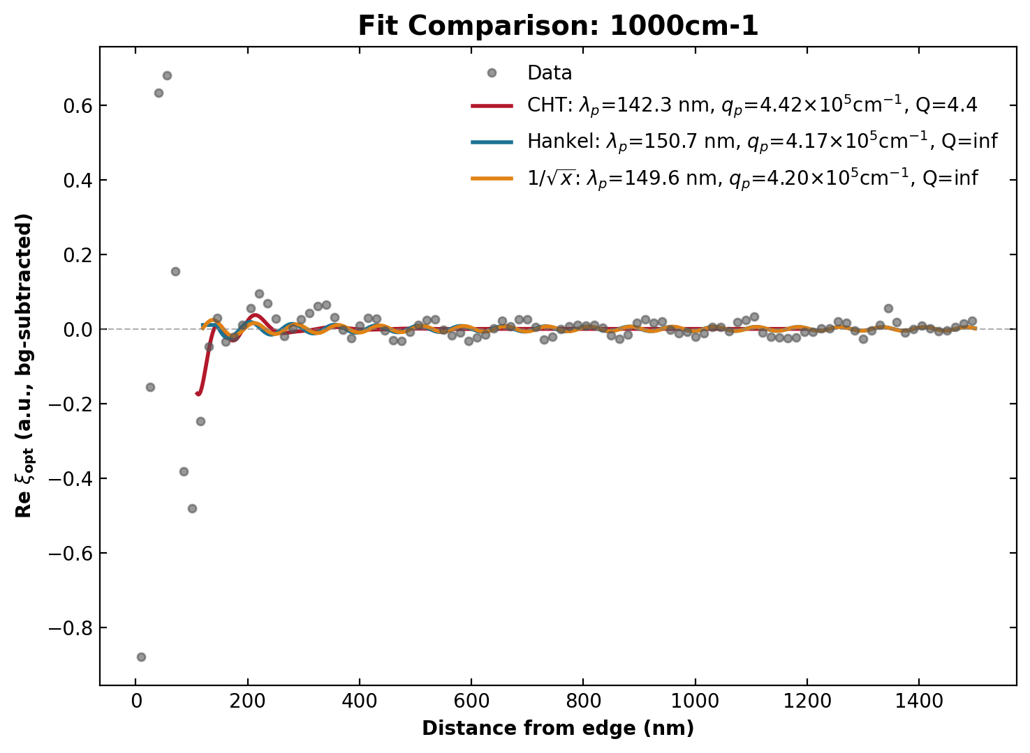
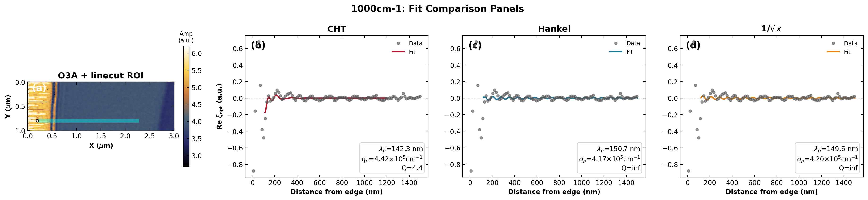
1000 cm⁻¹
Gr/SiO₂/Si

Slide 4
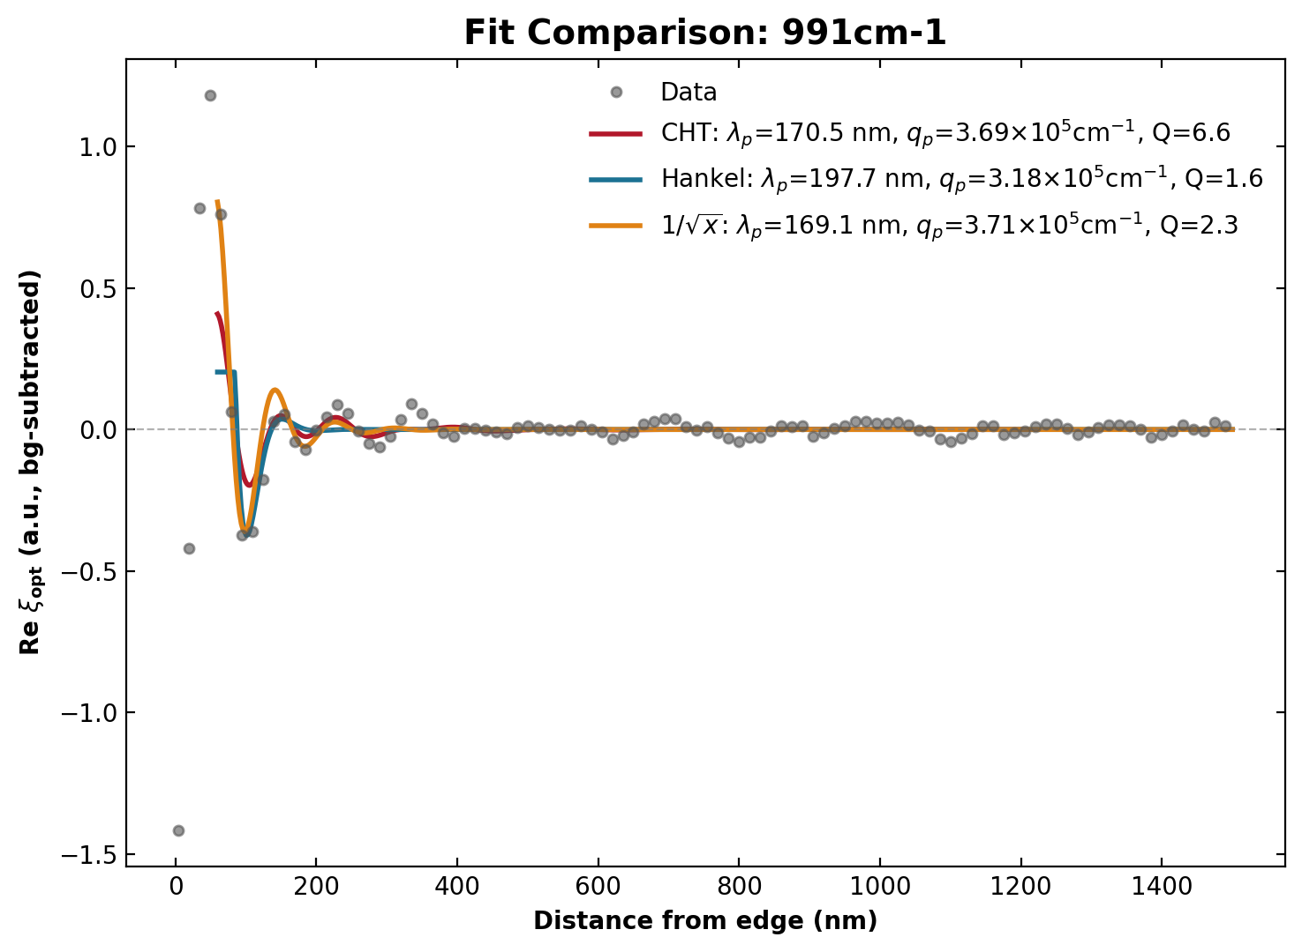
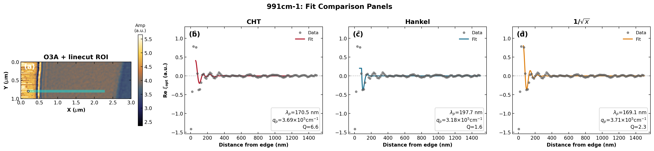
991 cm⁻¹
Gr/SiO₂/Si

Slide 5
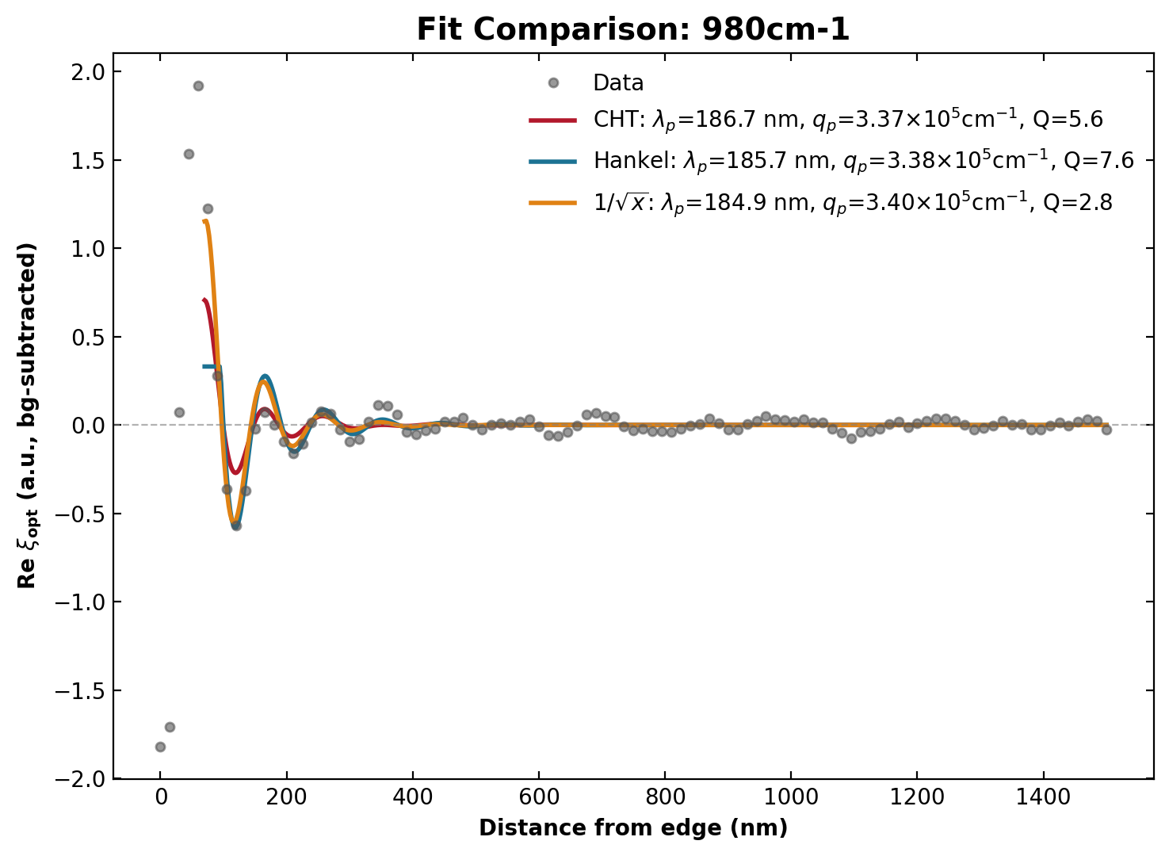
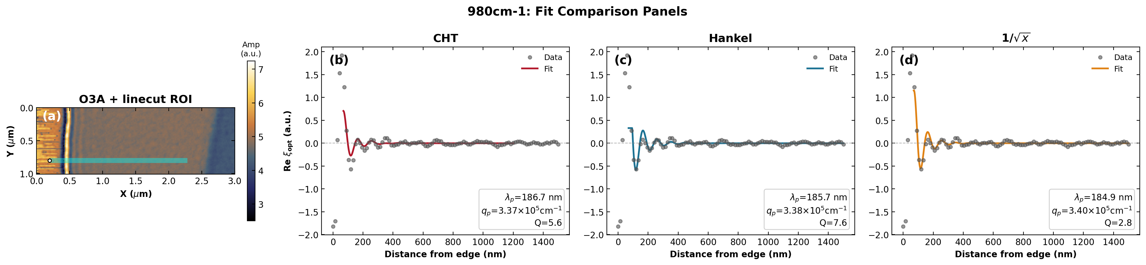
980 cm⁻¹
Gr/SiO₂/Si

Slide 6
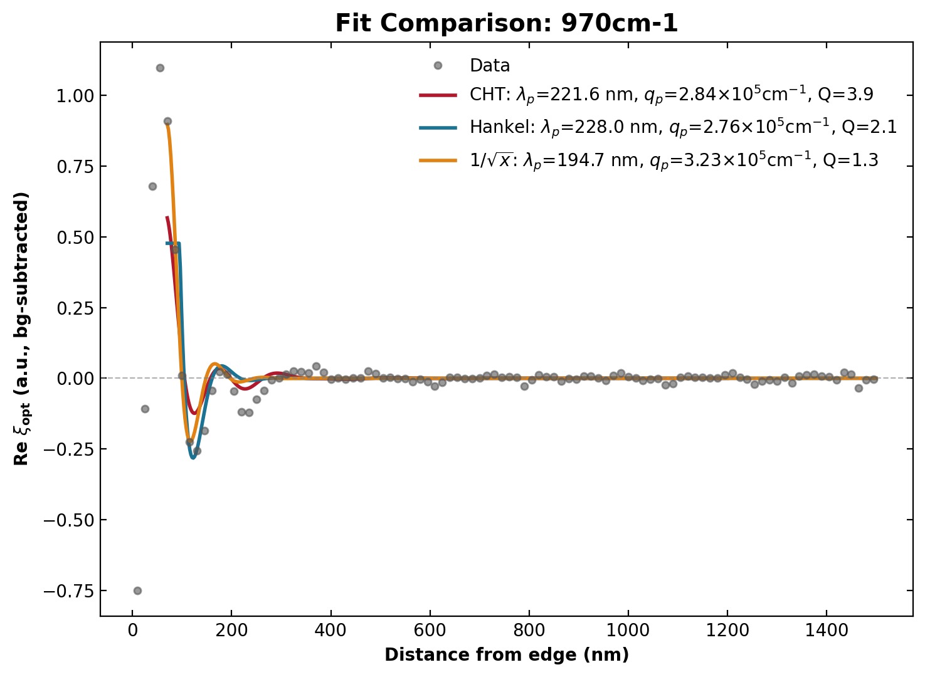
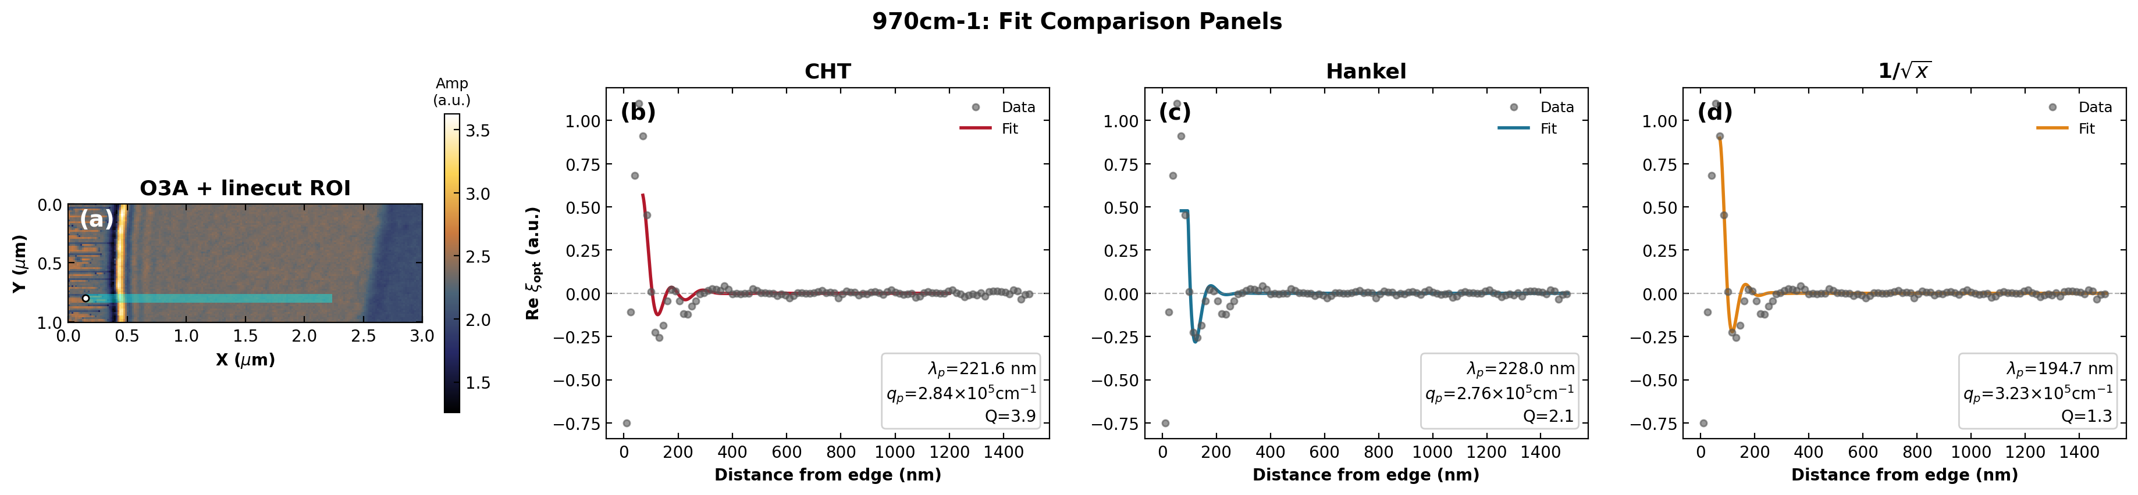
970 cm⁻¹
Gr/SiO₂/Si

Slide 7
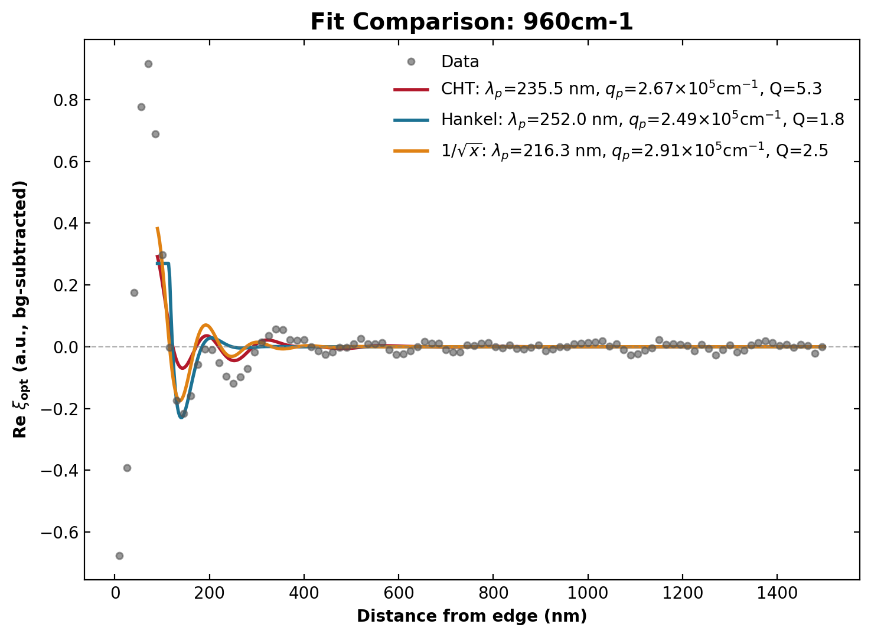
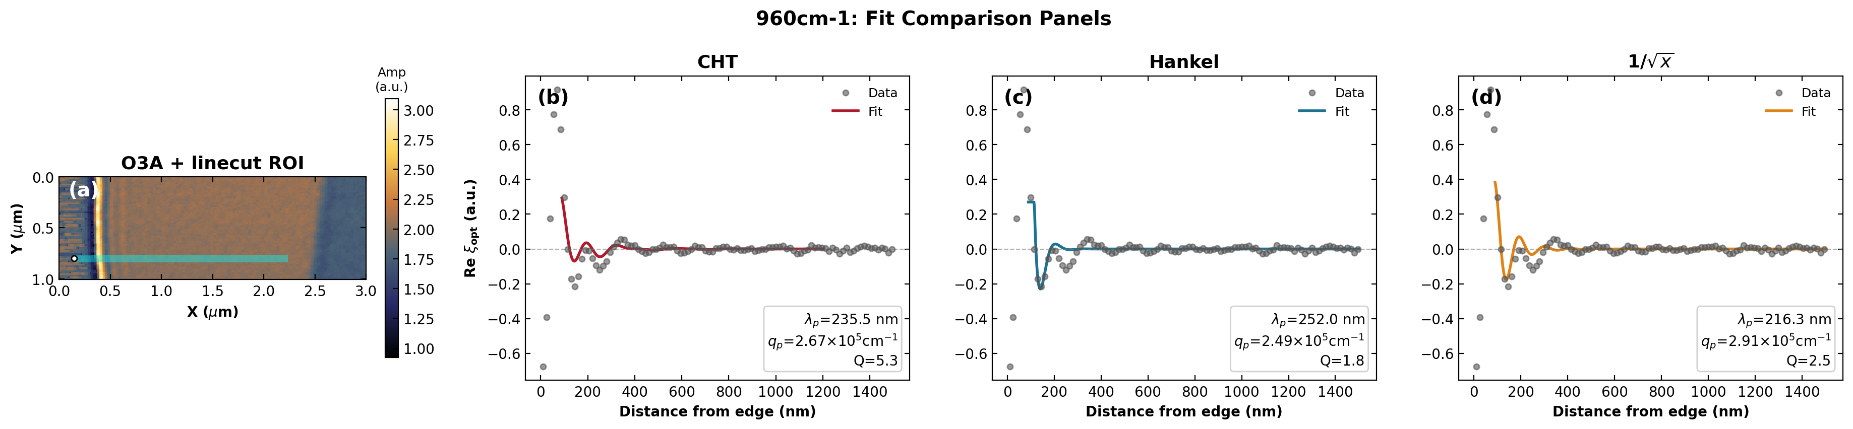
960 cm⁻¹
Gr/SiO₂/Si

Slide 8
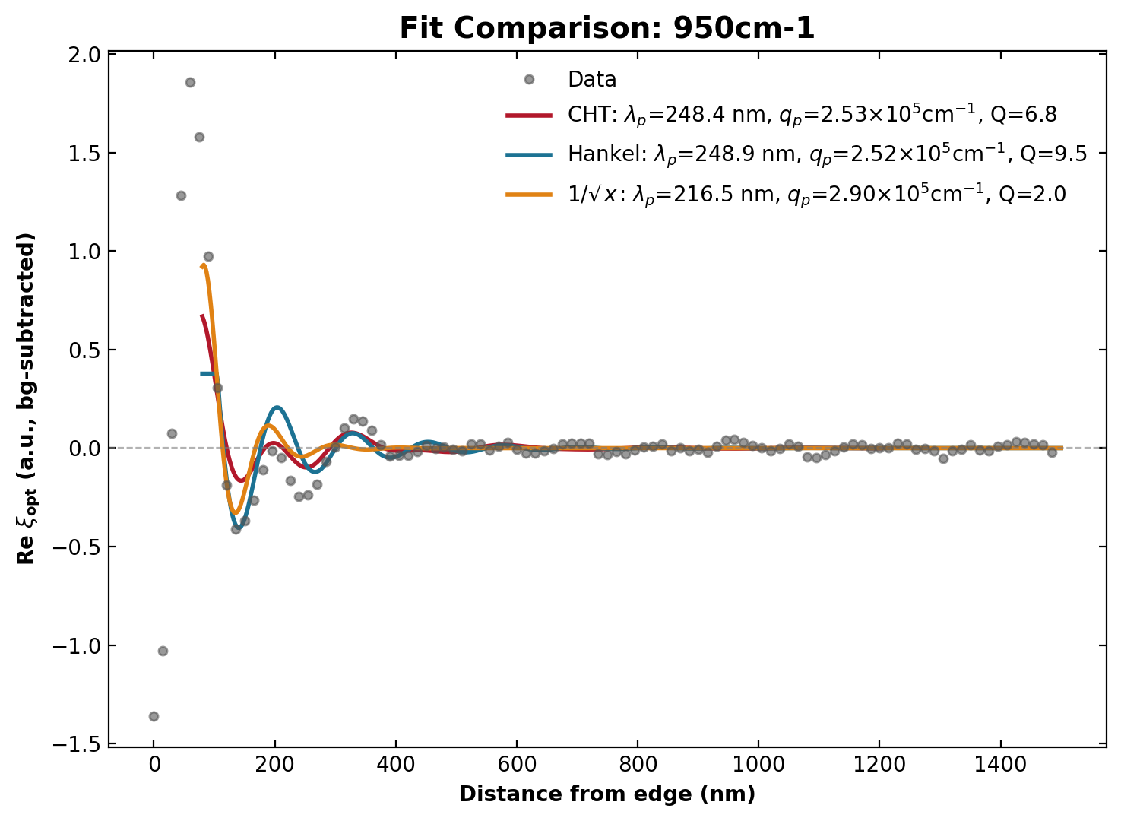

950 cm⁻¹
Gr/SiO₂/Si

Slide 9
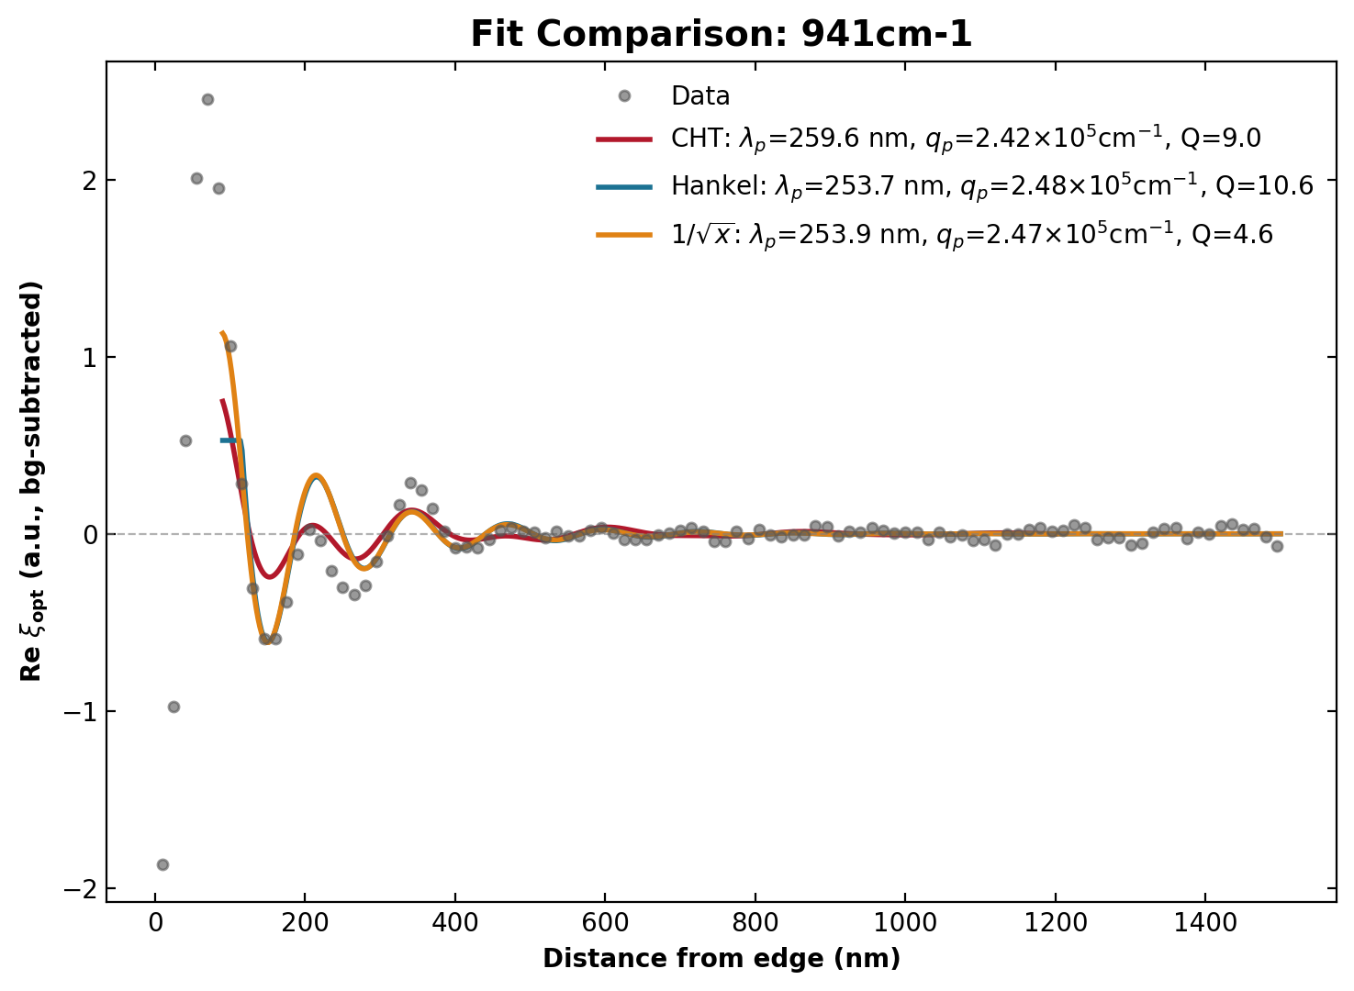
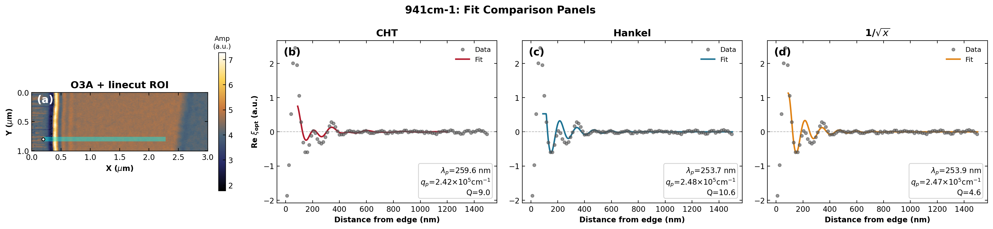
941 cm⁻¹
Gr/SiO₂/Si

Slide 10
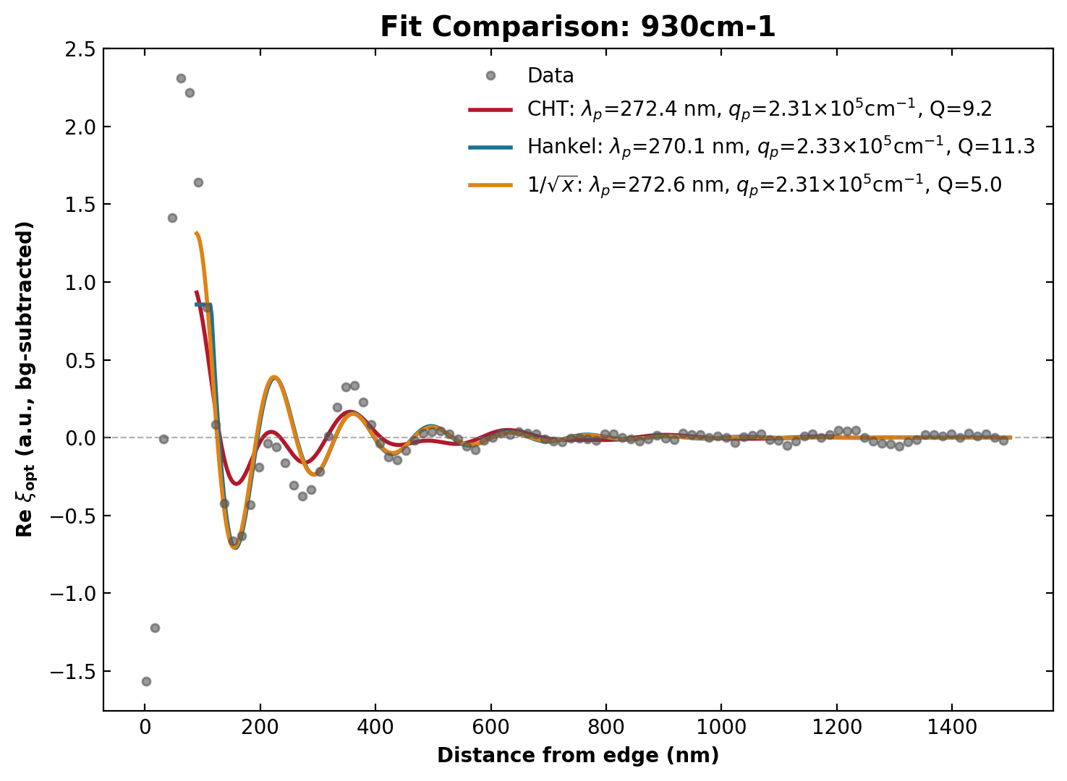
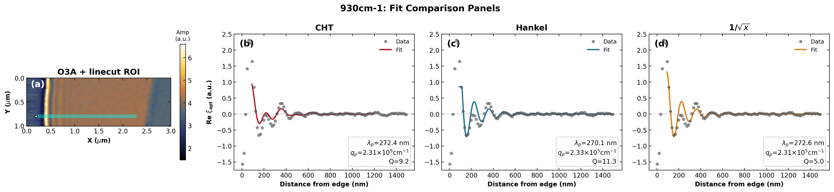
930 cm⁻¹
Gr/SiO₂/Si

Slide 11
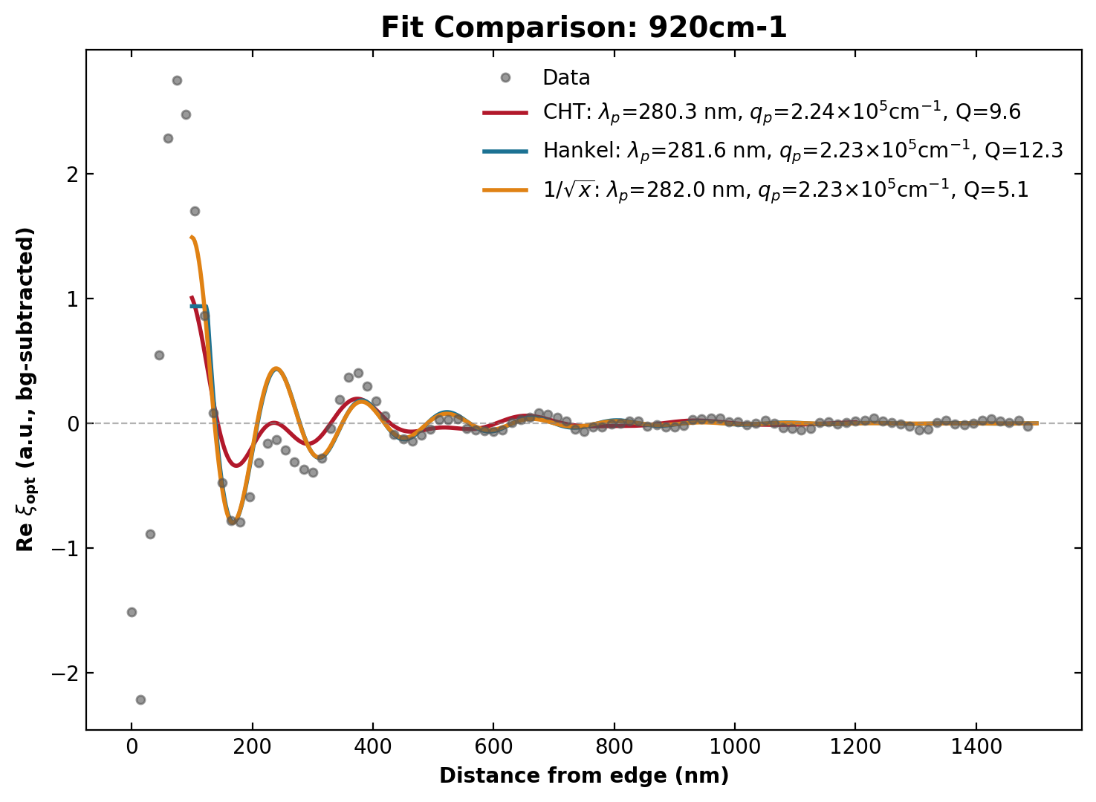
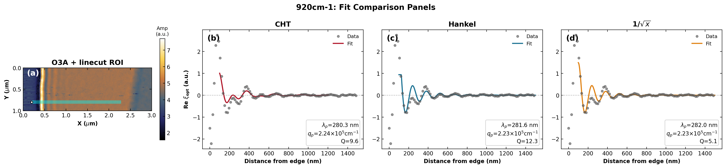
920 cm⁻¹
Gr/SiO₂/Si

Slide 12
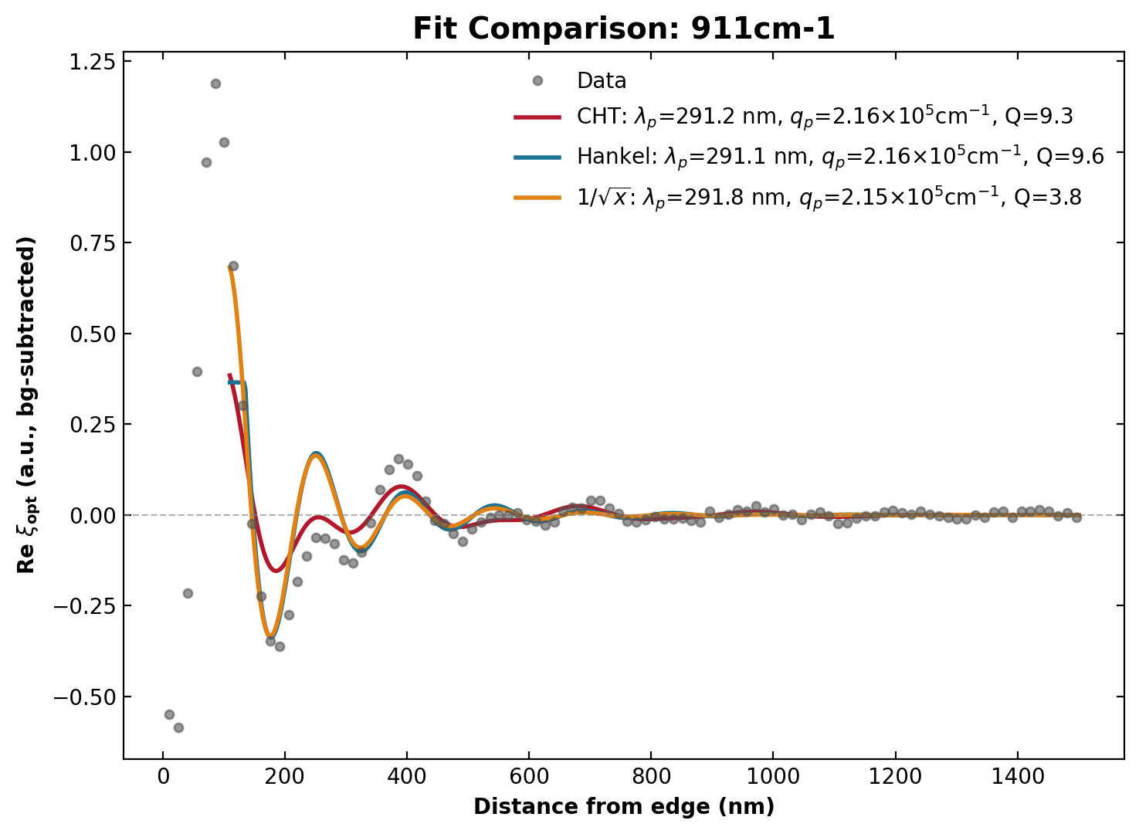
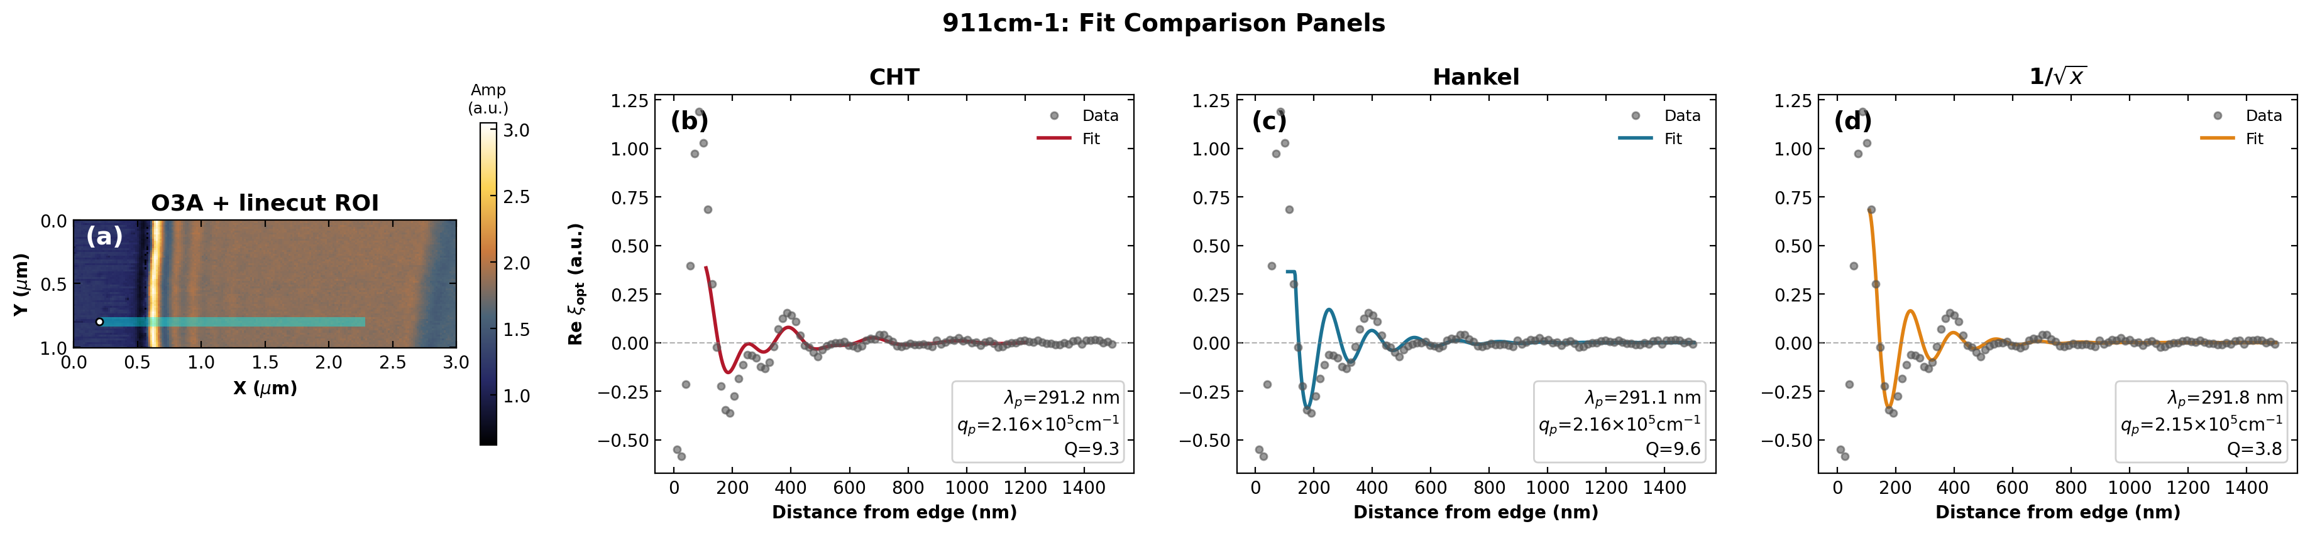
911 cm⁻¹
Gr/SiO₂/Si

Slide 13
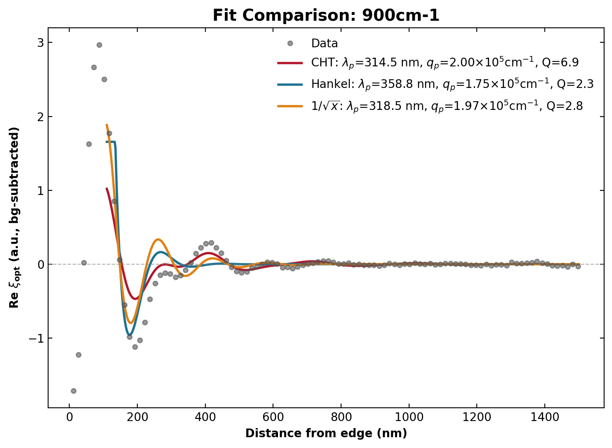
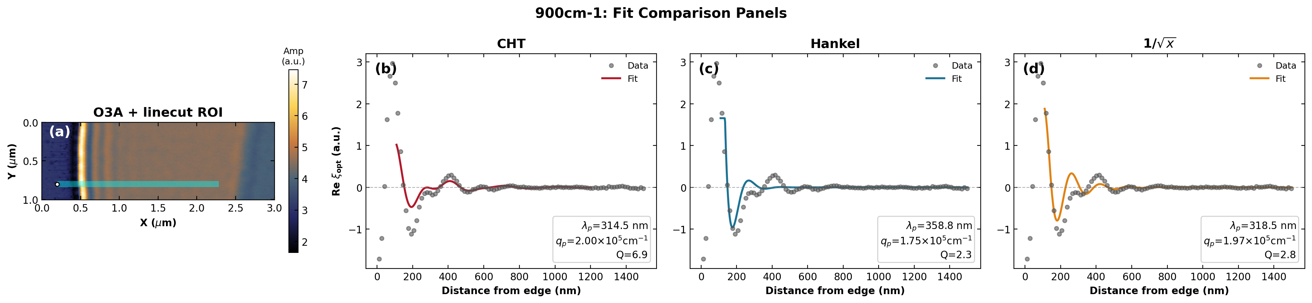
900 cm⁻¹
Gr/SiO₂/Si

Slide 14
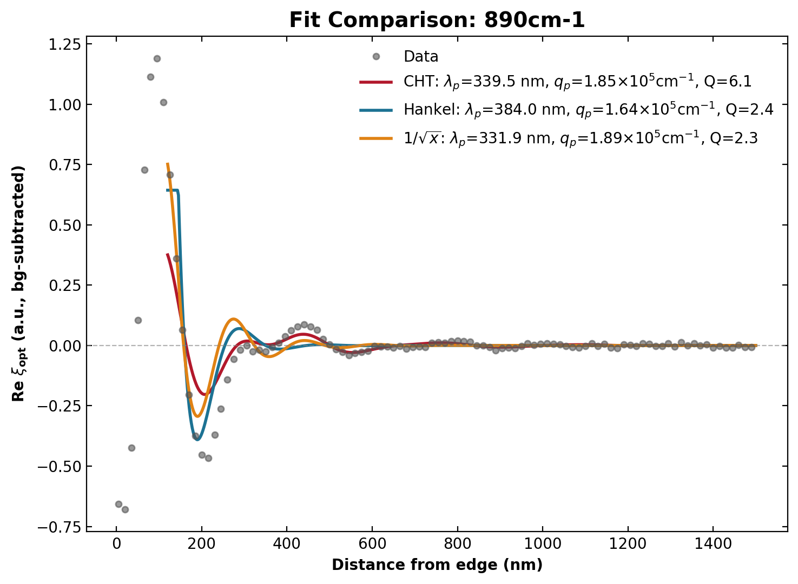
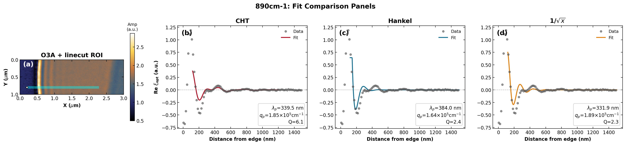
890 cm⁻¹
Gr/SiO₂/Si

Slide 15
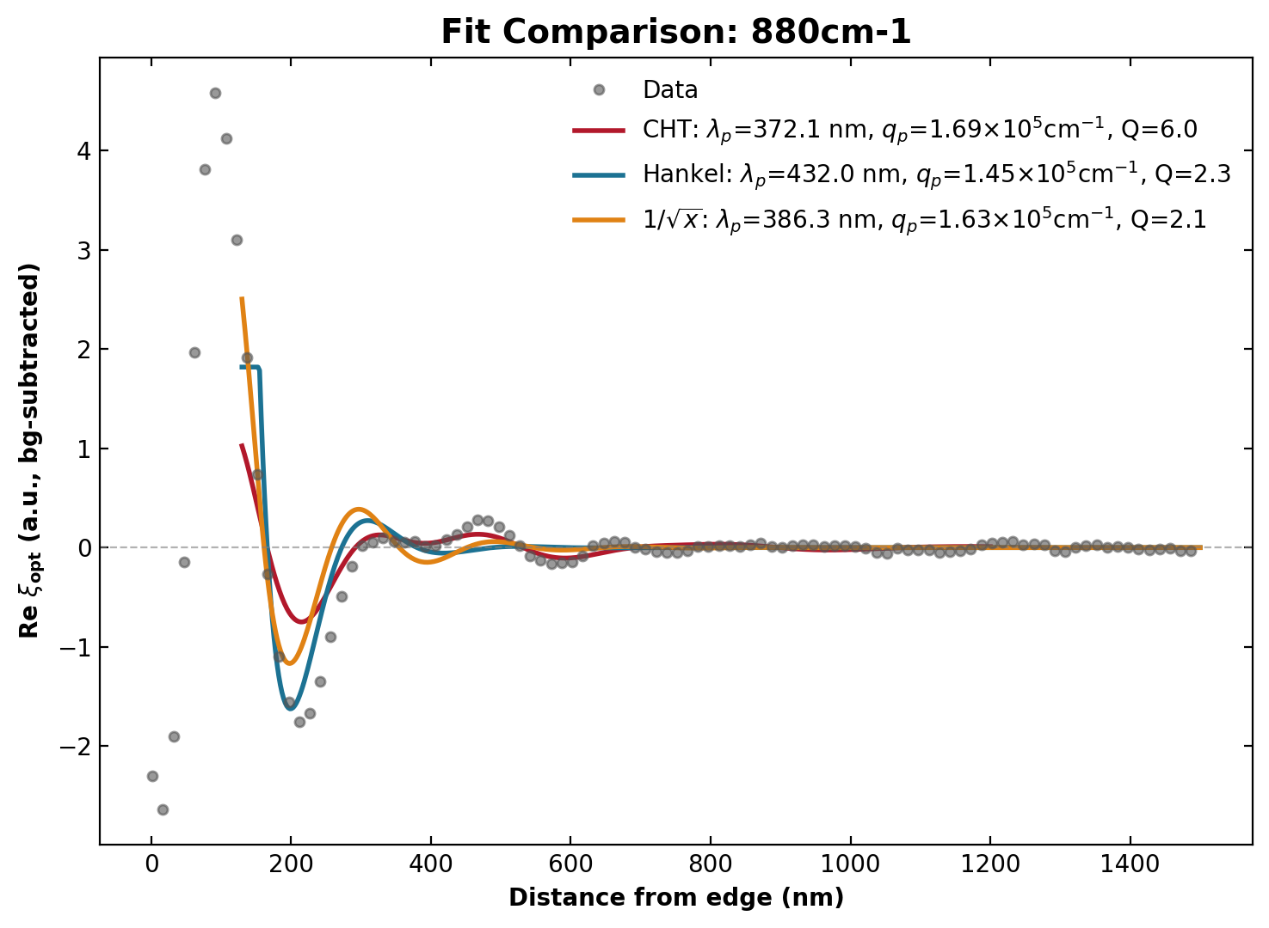

880 cm⁻¹
Gr/SiO₂/Si

Slide 16
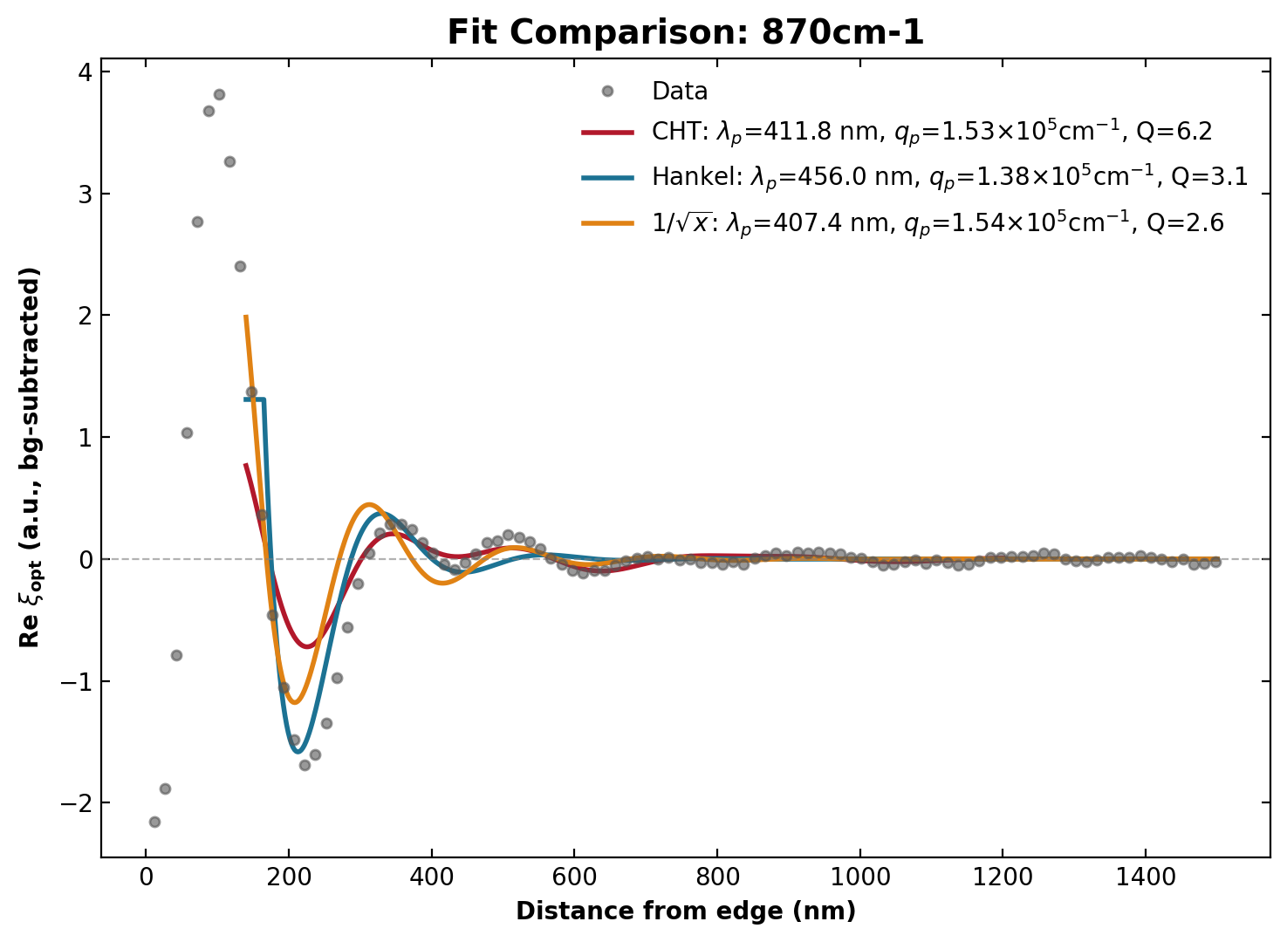
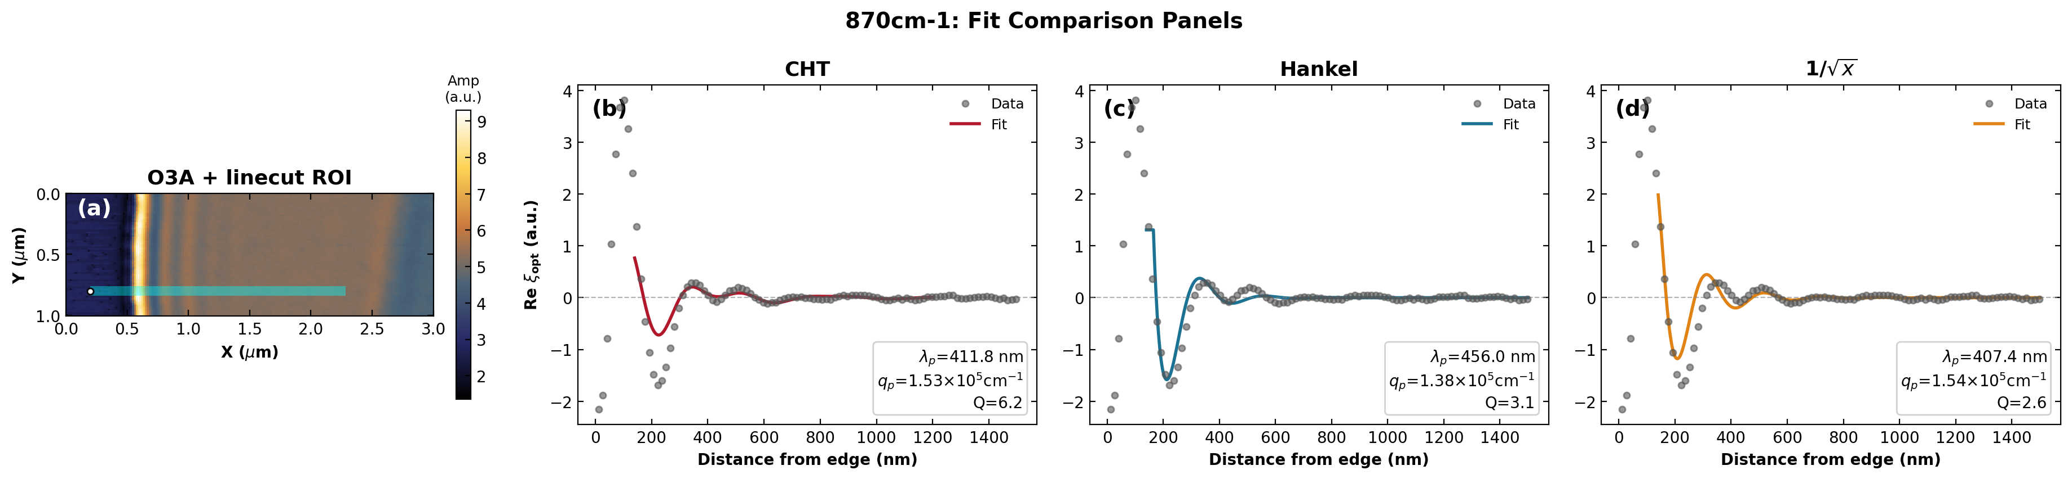
870 cm⁻¹
Gr/SiO₂/Si

Slide 17
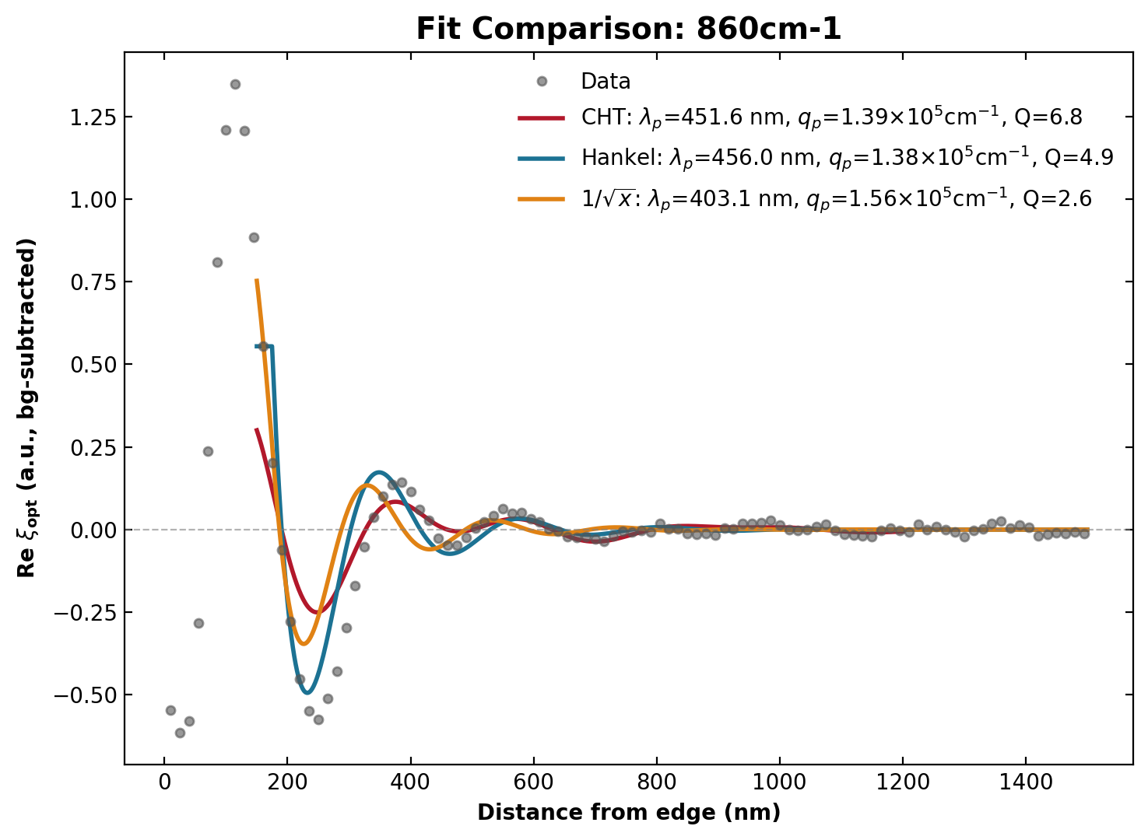
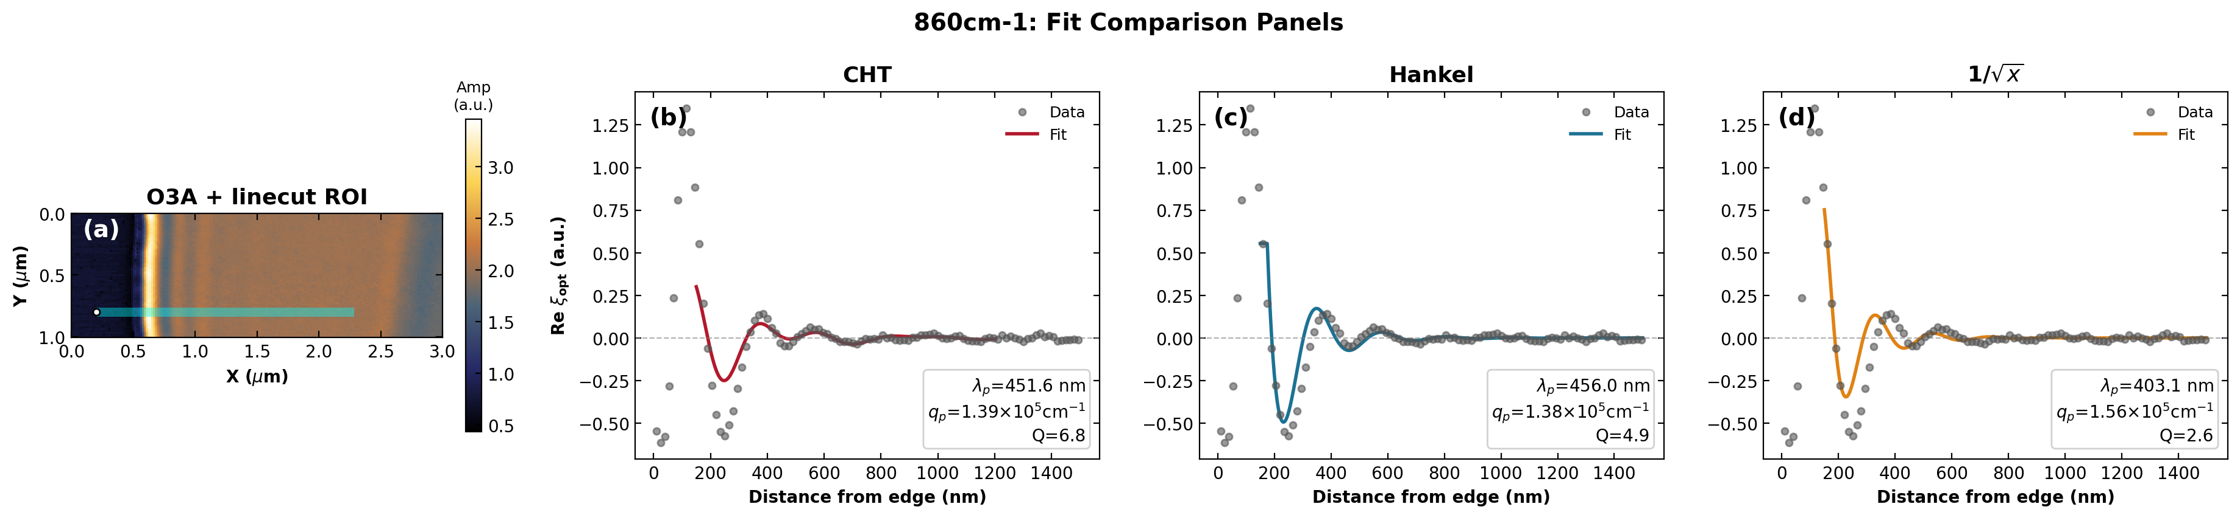
860 cm⁻¹
Gr/SiO₂/Si

Slide 18
graphene_4x1_lp1 (edge)
MoO₃(4.2nm)/Gr/SiO₂/Si — edge (lp1)

Slide 19
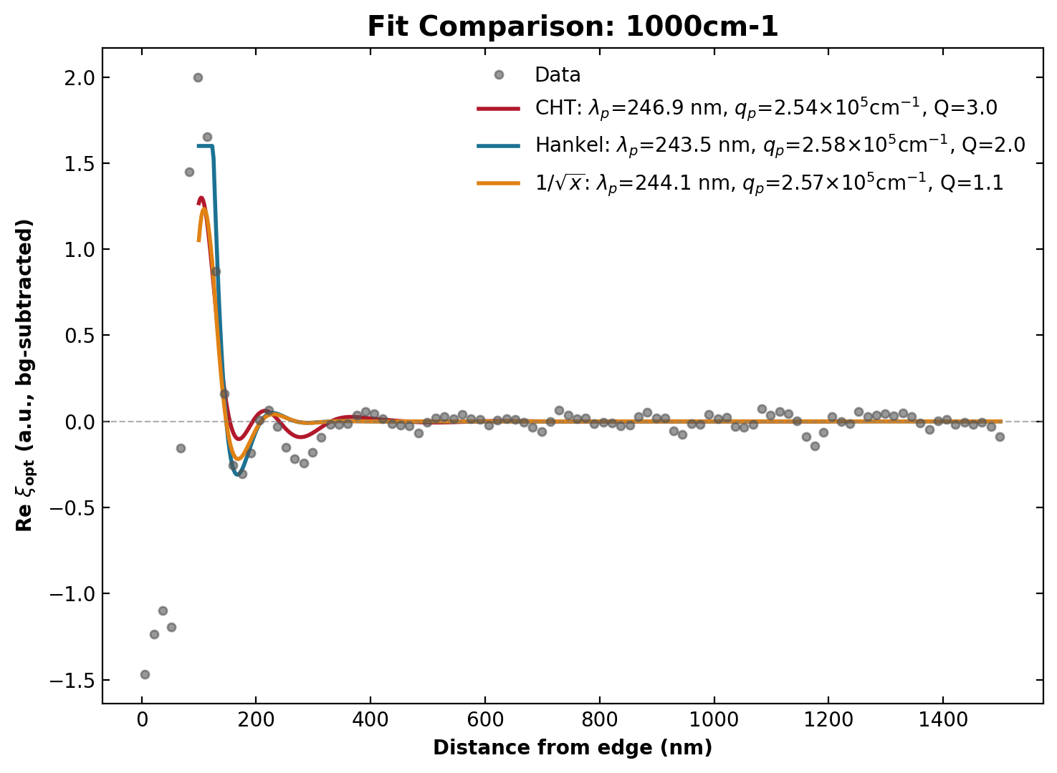
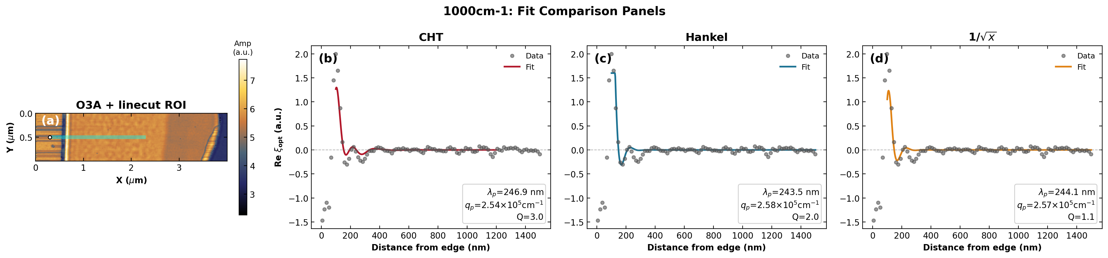
1000 cm⁻¹
MoO₃(4.2nm)/Gr/SiO₂/Si — edge (lp1)

Slide 20
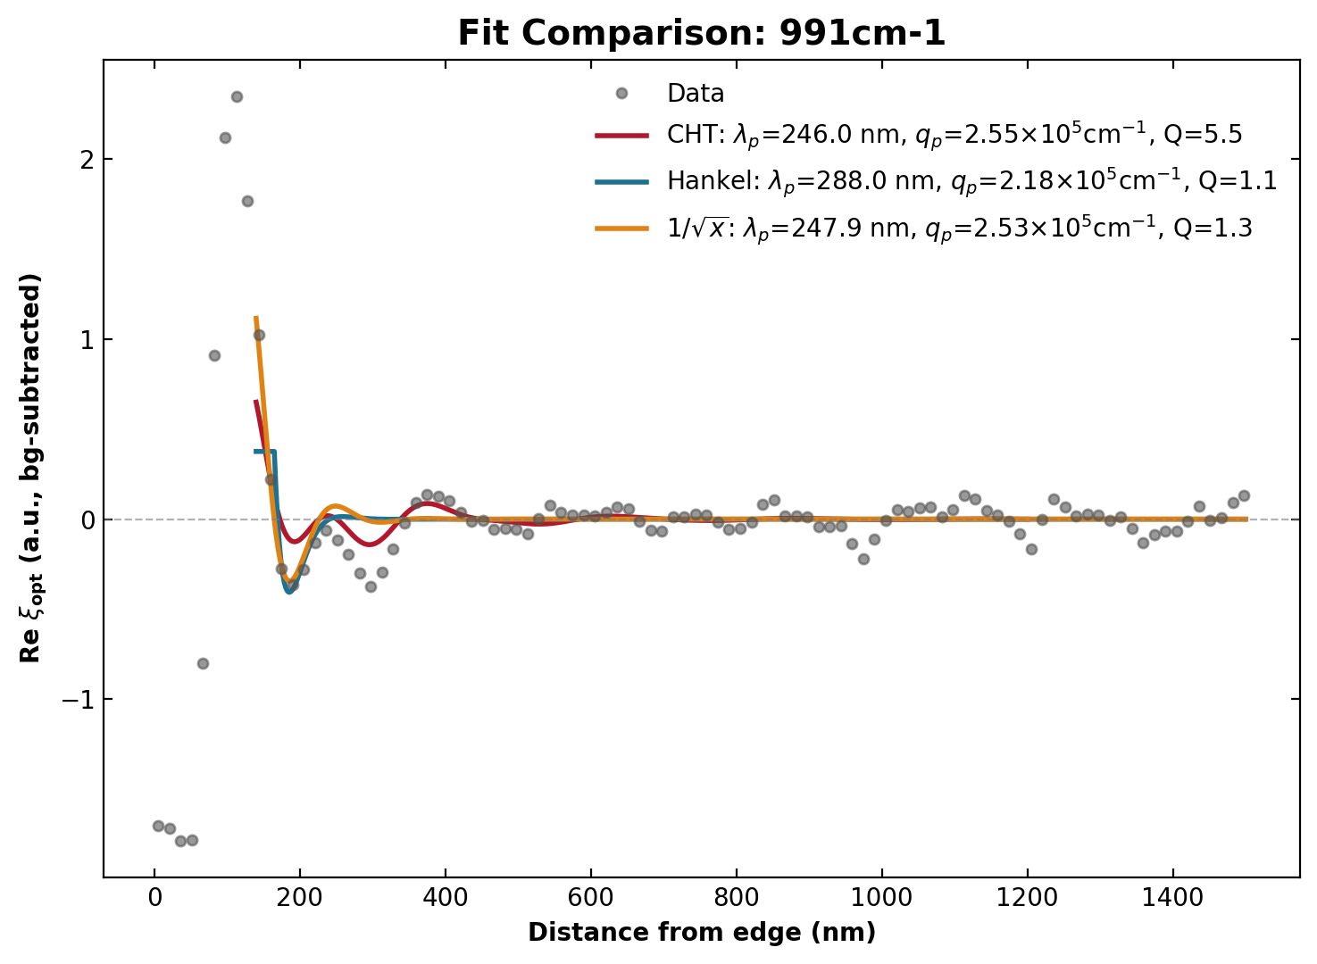
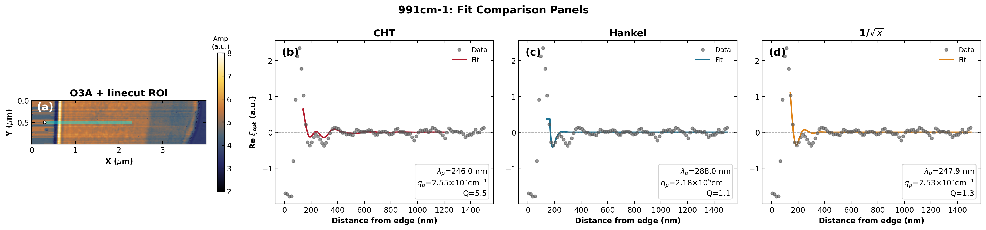
991 cm⁻¹
MoO₃(4.2nm)/Gr/SiO₂/Si — edge (lp1)

Slide 21
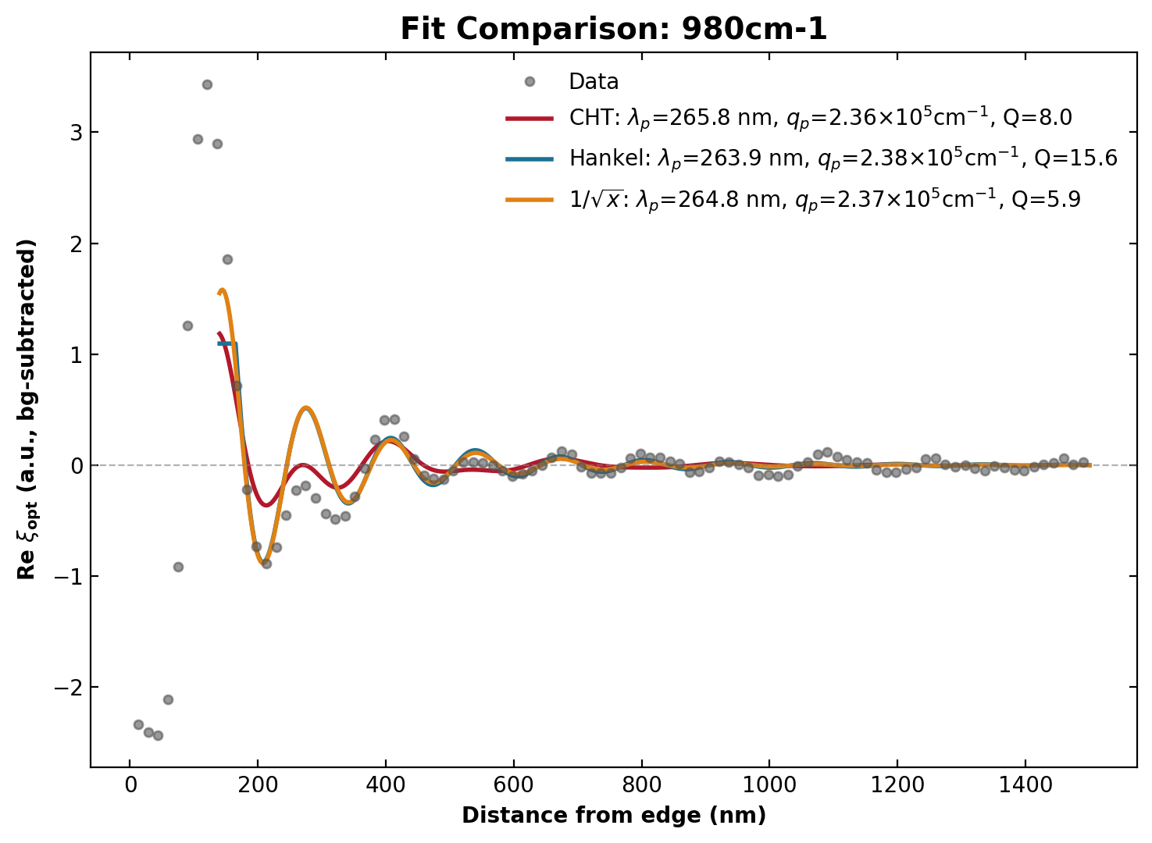
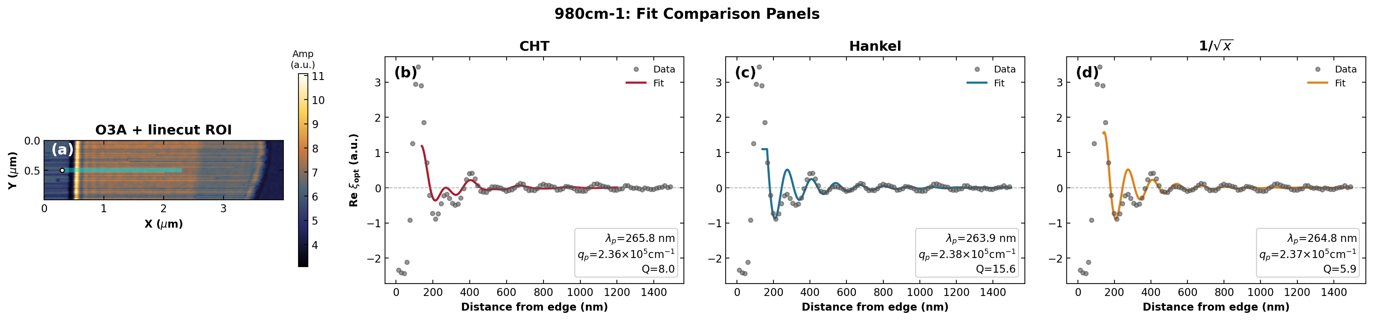
980 cm⁻¹
MoO₃(4.2nm)/Gr/SiO₂/Si — edge (lp1)

Slide 22
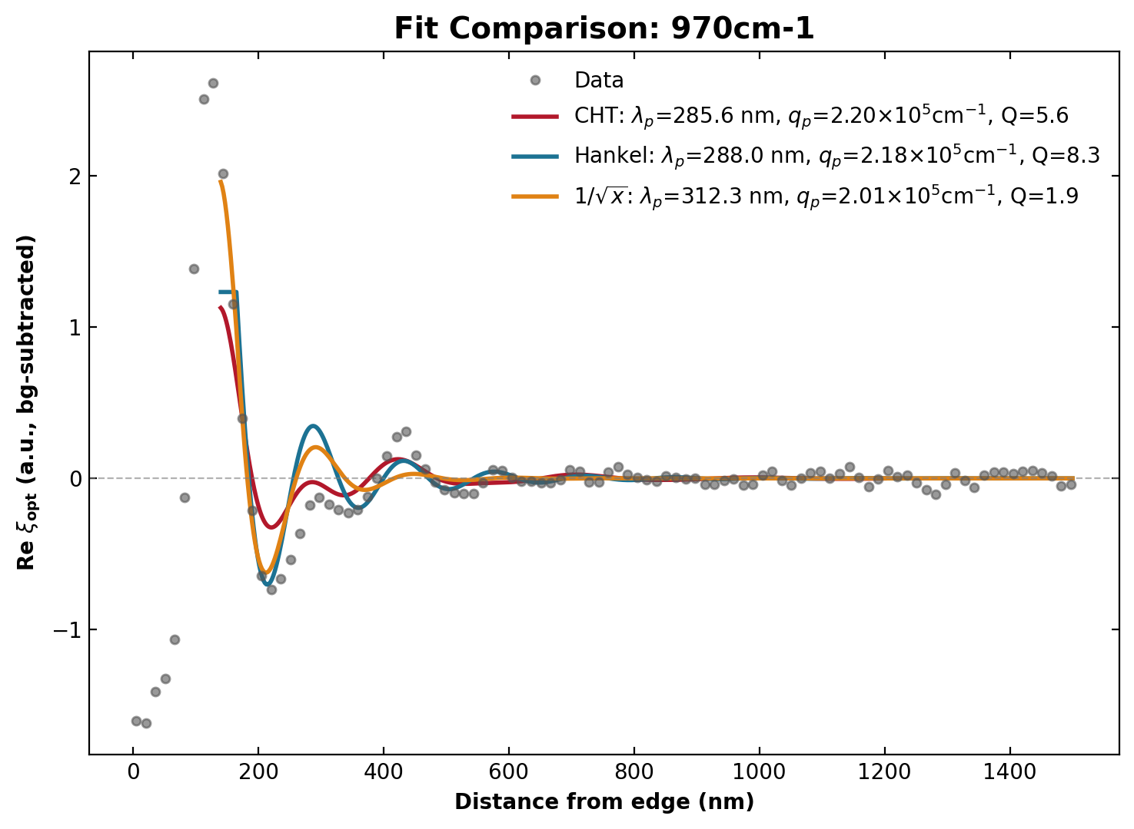
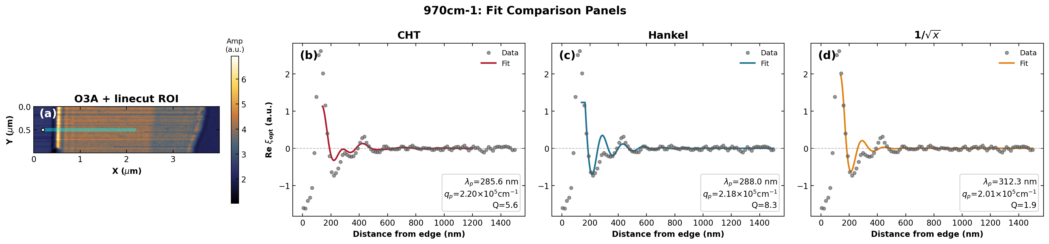
970 cm⁻¹
MoO₃(4.2nm)/Gr/SiO₂/Si — edge (lp1)

Slide 23
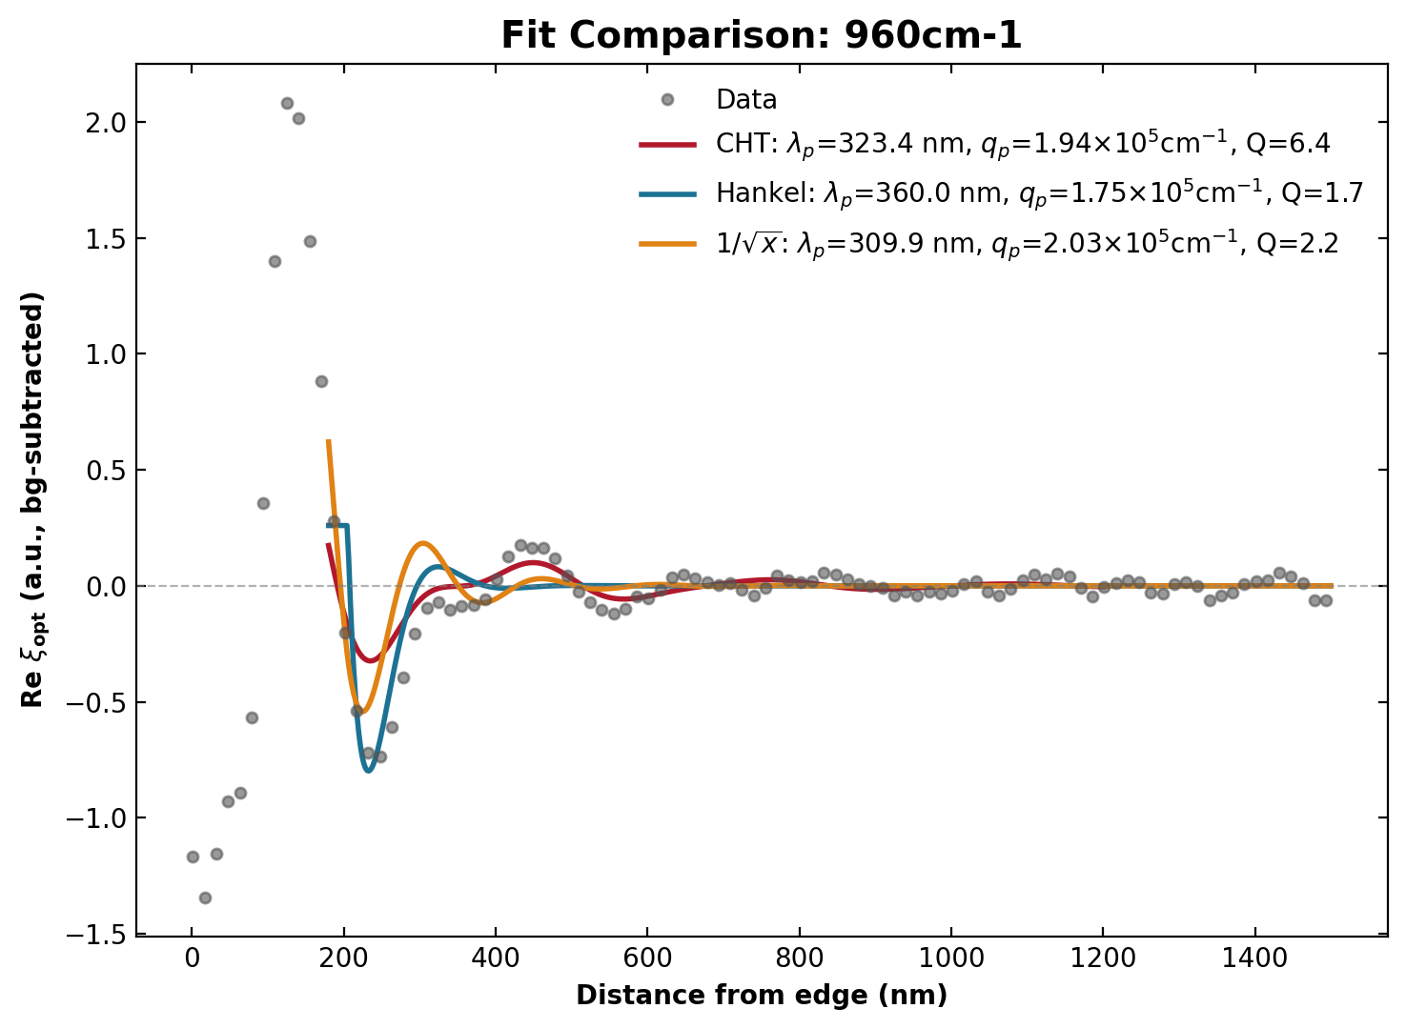
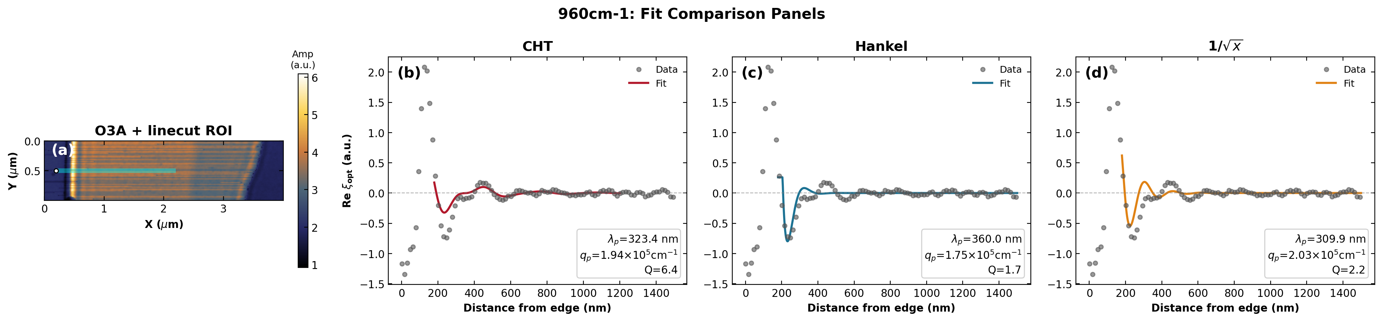
960 cm⁻¹
MoO₃(4.2nm)/Gr/SiO₂/Si — edge (lp1)

Slide 24
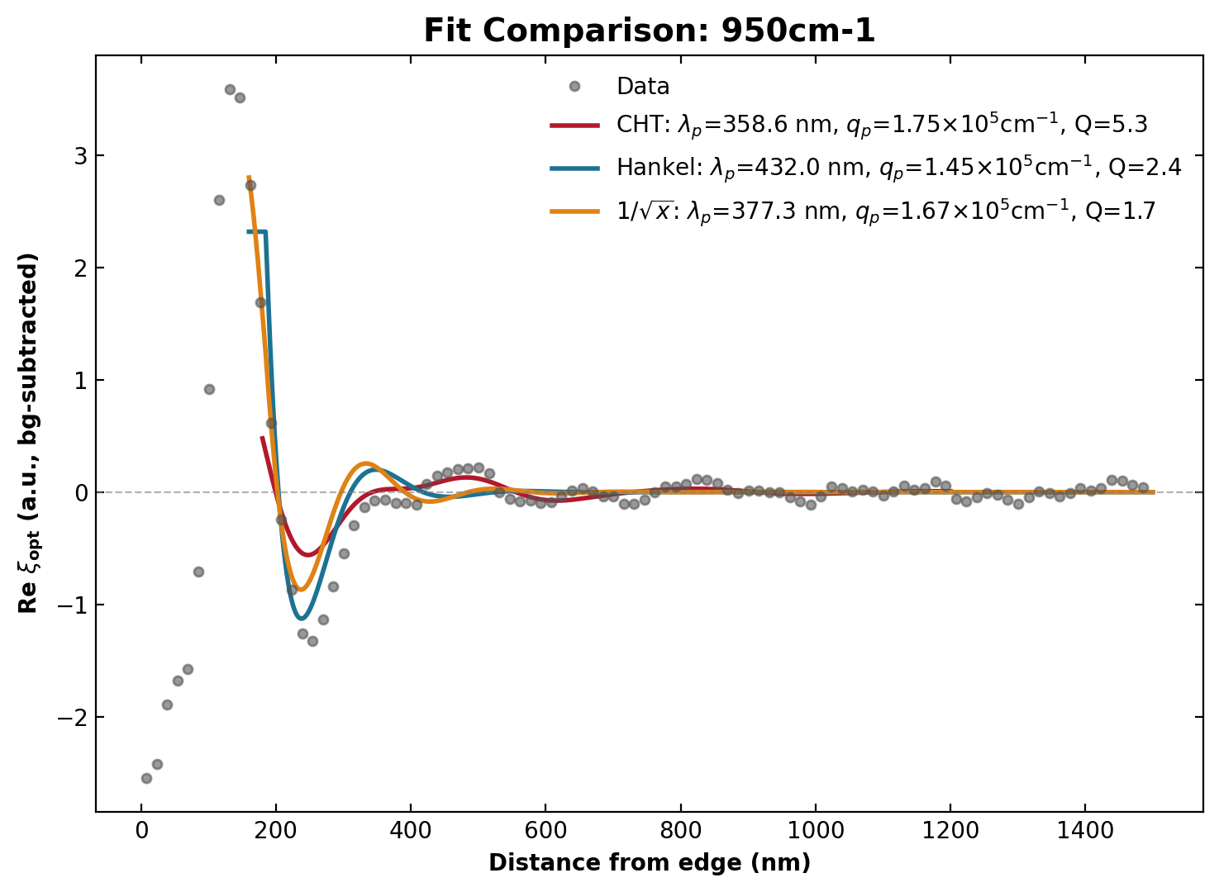
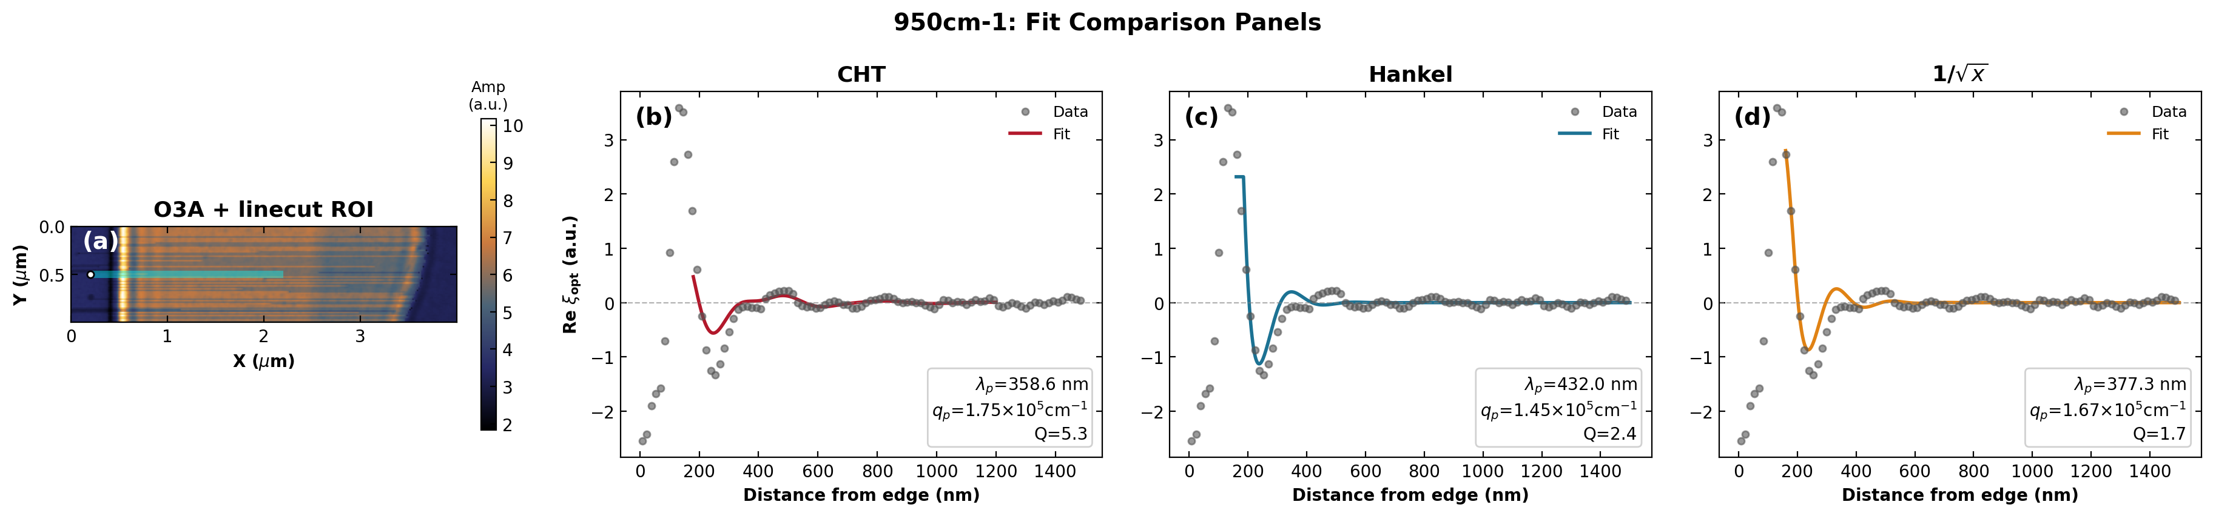
950 cm⁻¹
MoO₃(4.2nm)/Gr/SiO₂/Si — edge (lp1)

Slide 25
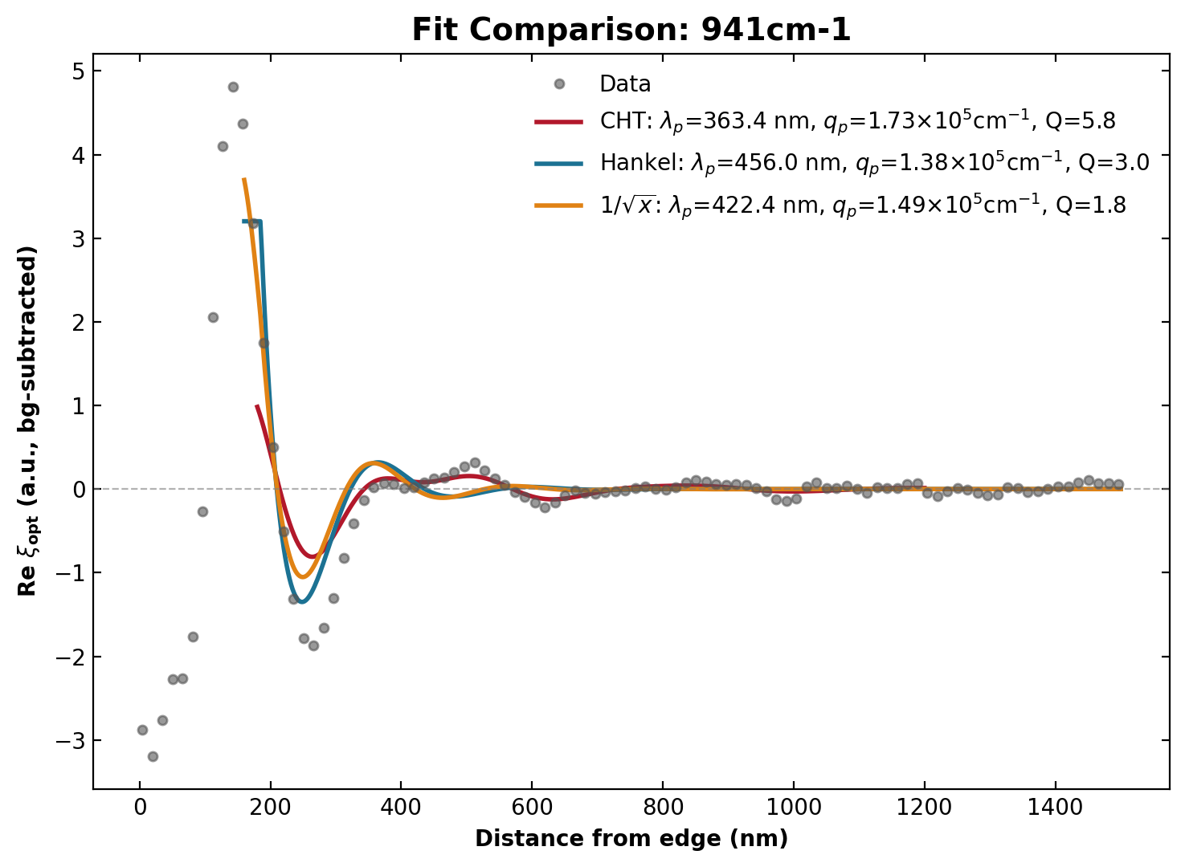

941 cm⁻¹
MoO₃(4.2nm)/Gr/SiO₂/Si — edge (lp1)

Slide 26
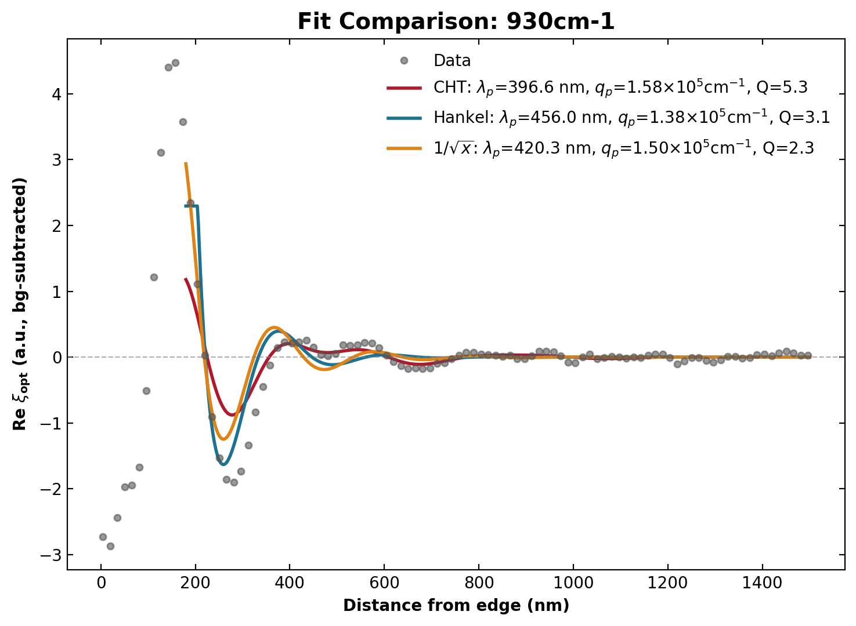

930 cm⁻¹
MoO₃(4.2nm)/Gr/SiO₂/Si — edge (lp1)

Slide 27
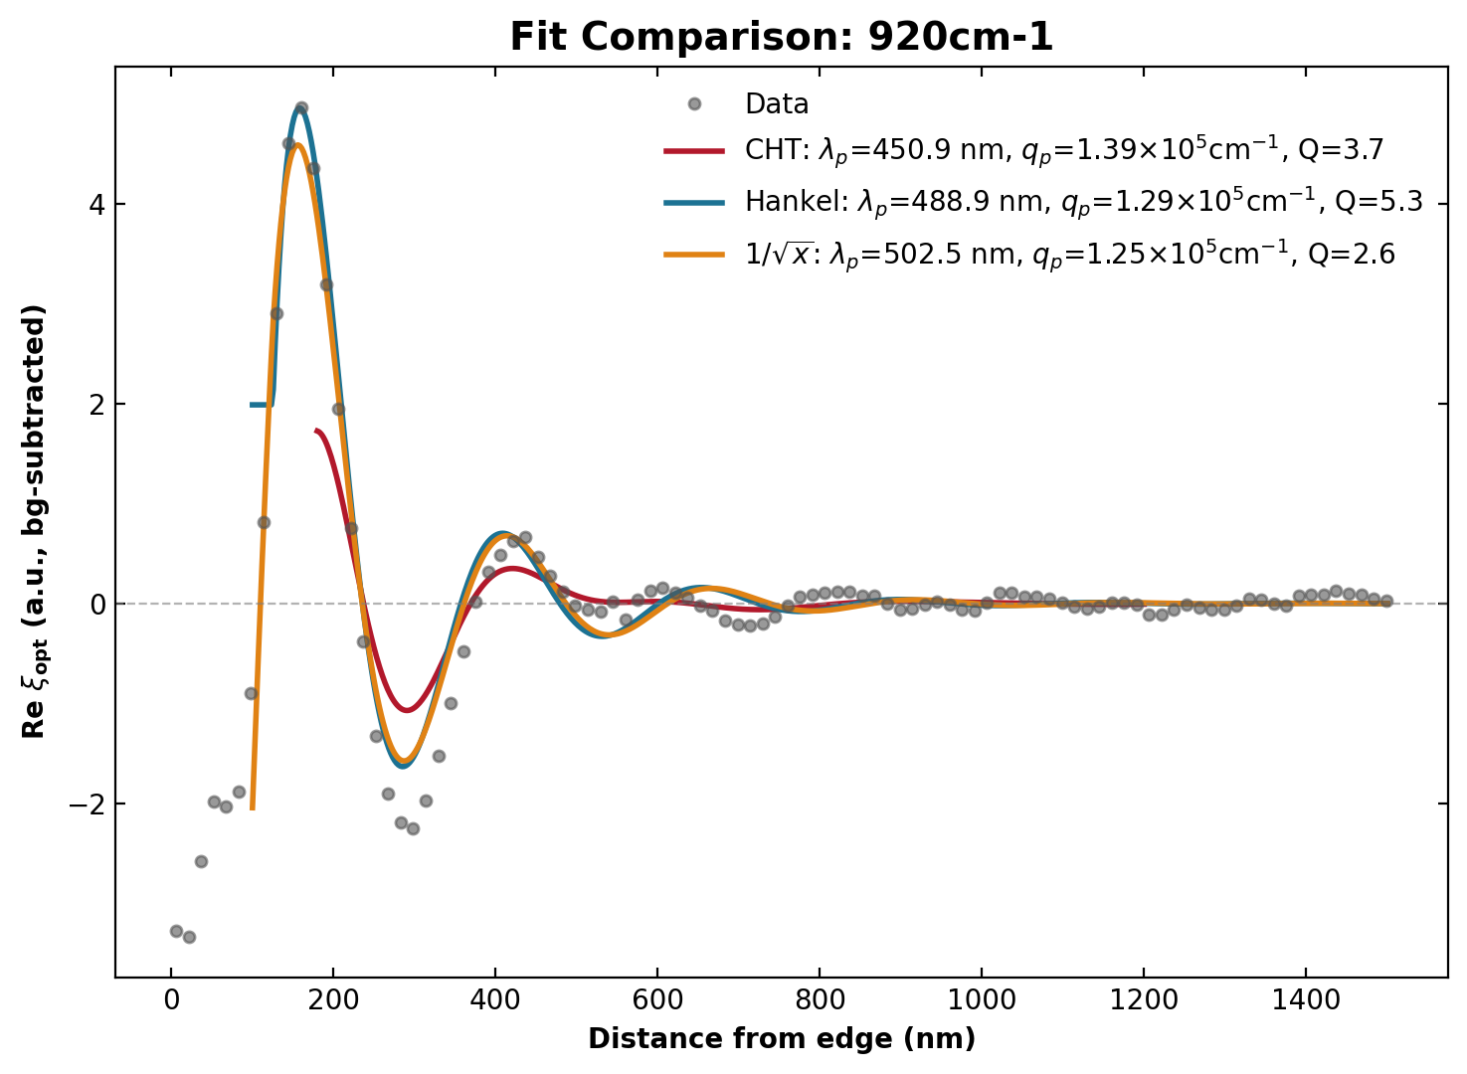
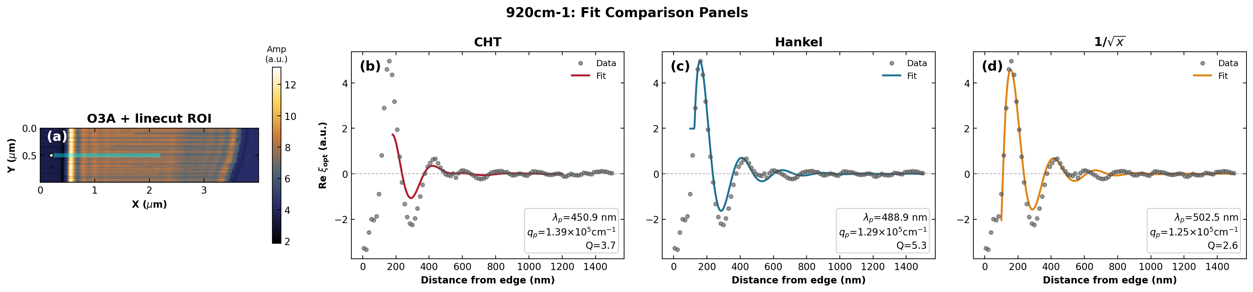
920 cm⁻¹
MoO₃(4.2nm)/Gr/SiO₂/Si — edge (lp1)

Slide 28
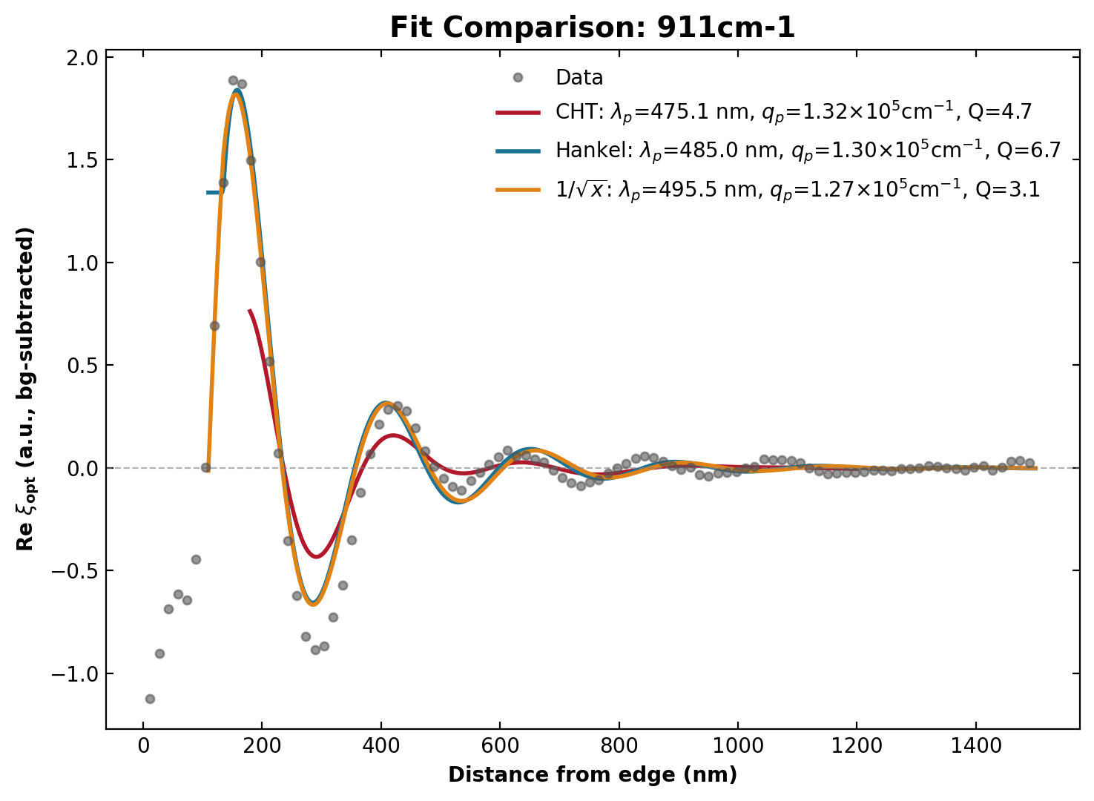
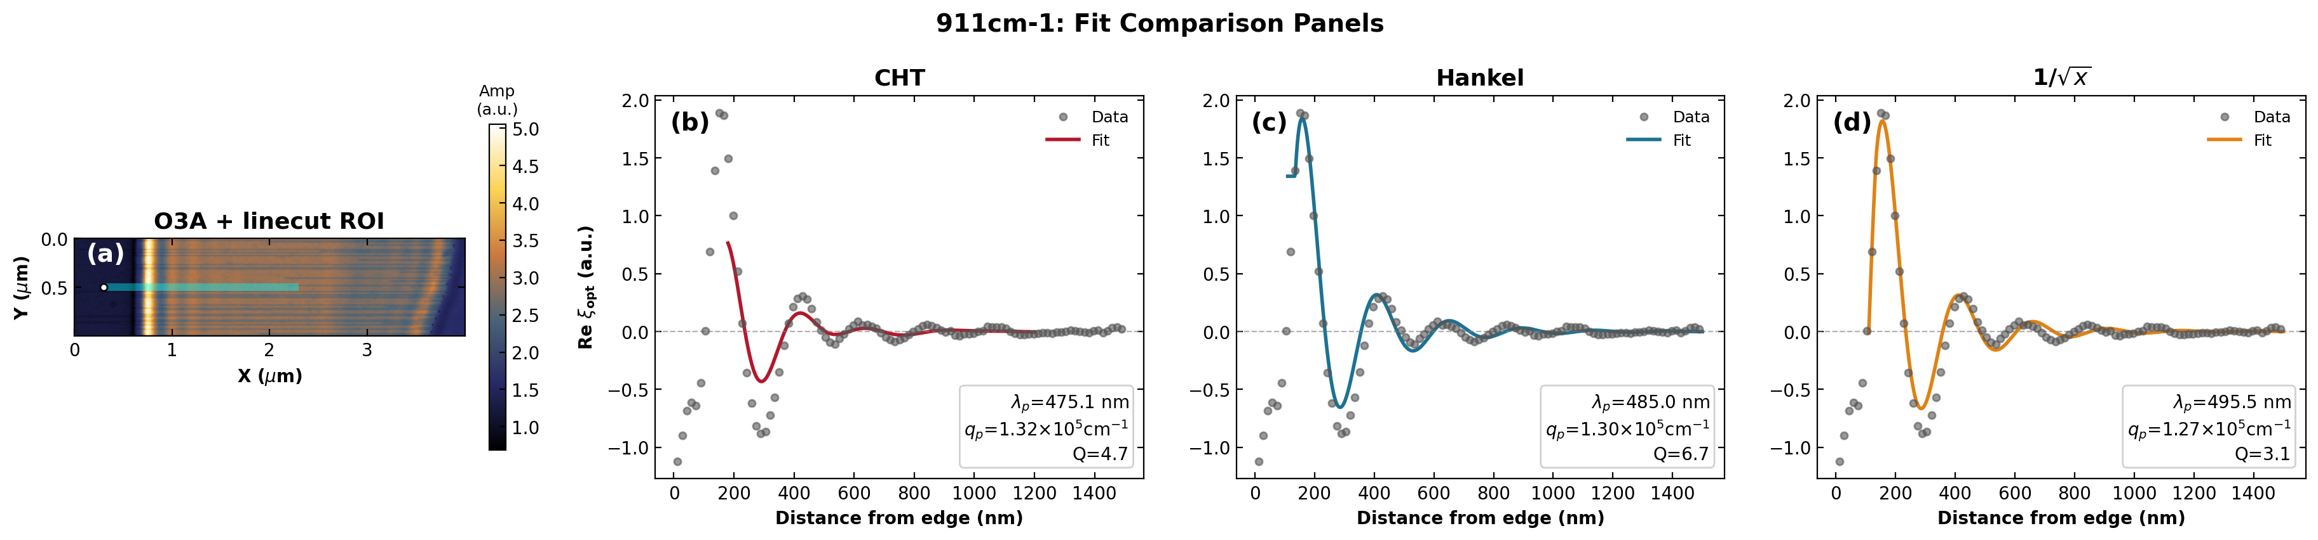
911 cm⁻¹
MoO₃(4.2nm)/Gr/SiO₂/Si — edge (lp1)

Slide 29
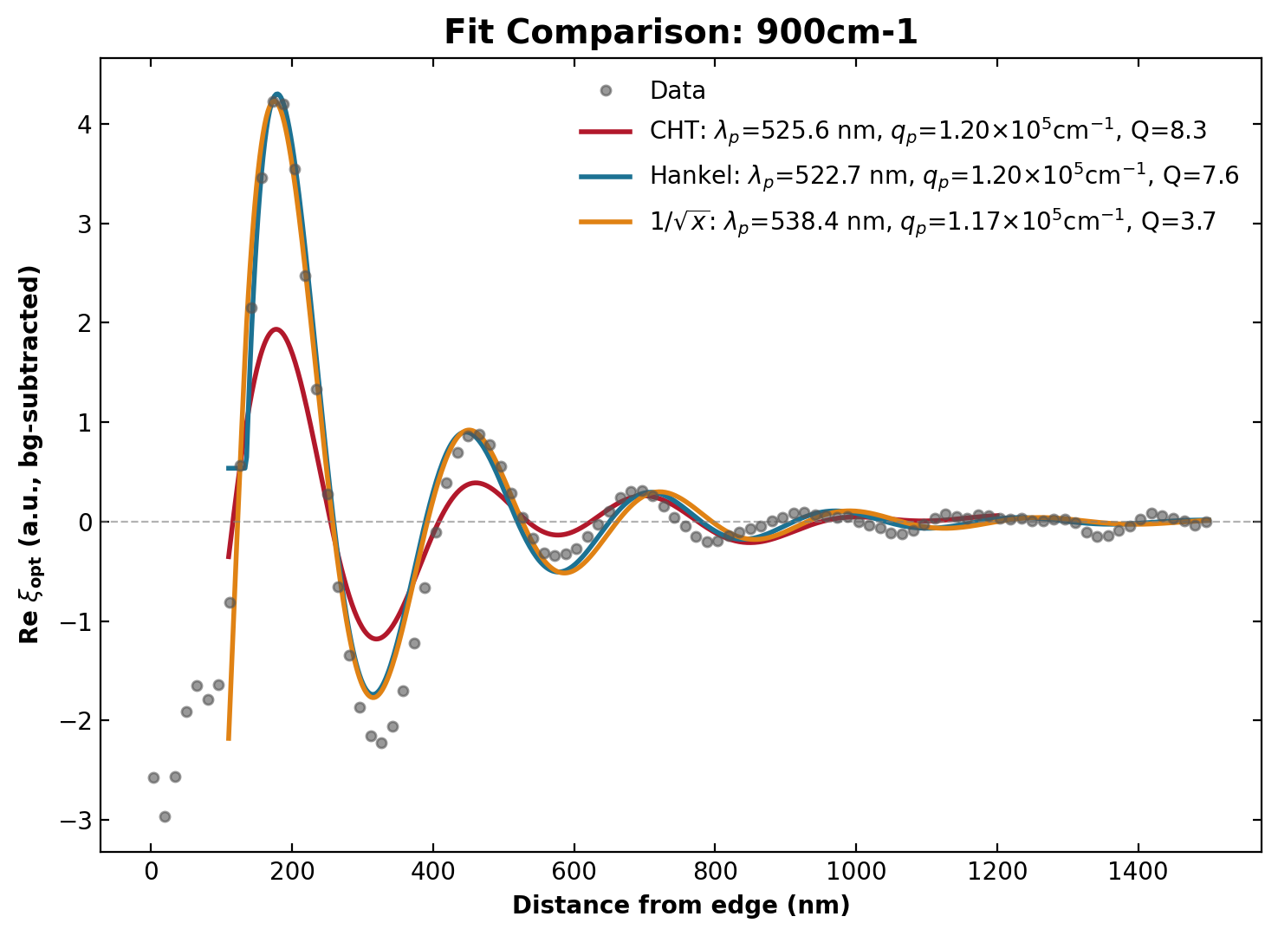
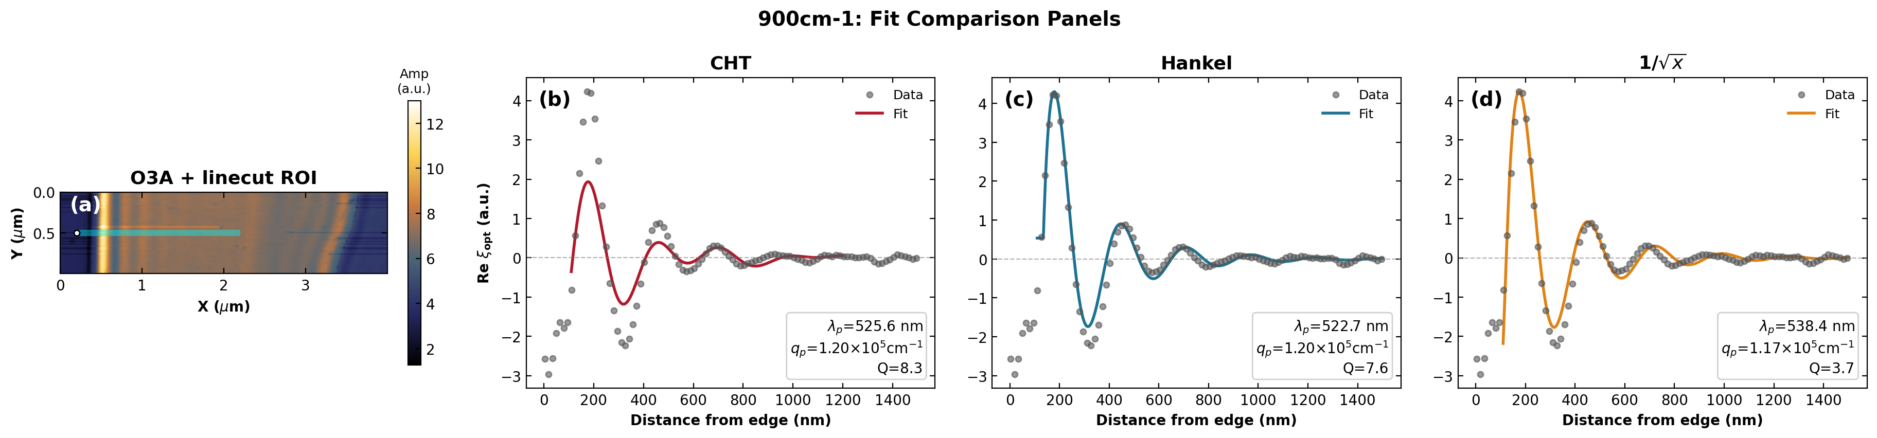
900 cm⁻¹
MoO₃(4.2nm)/Gr/SiO₂/Si — edge (lp1)

Slide 30
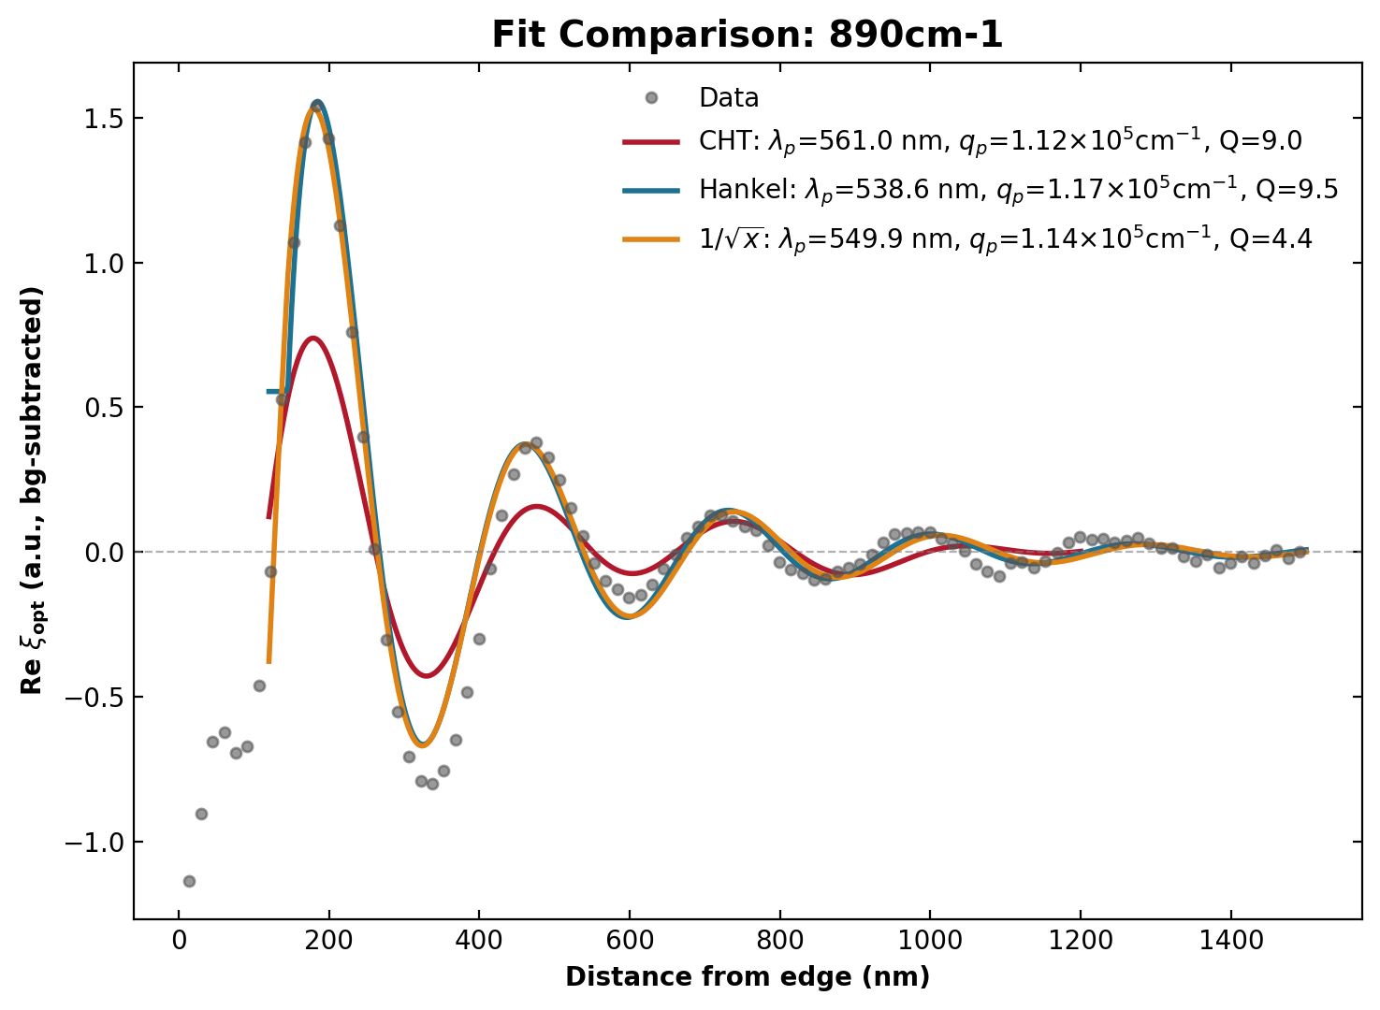
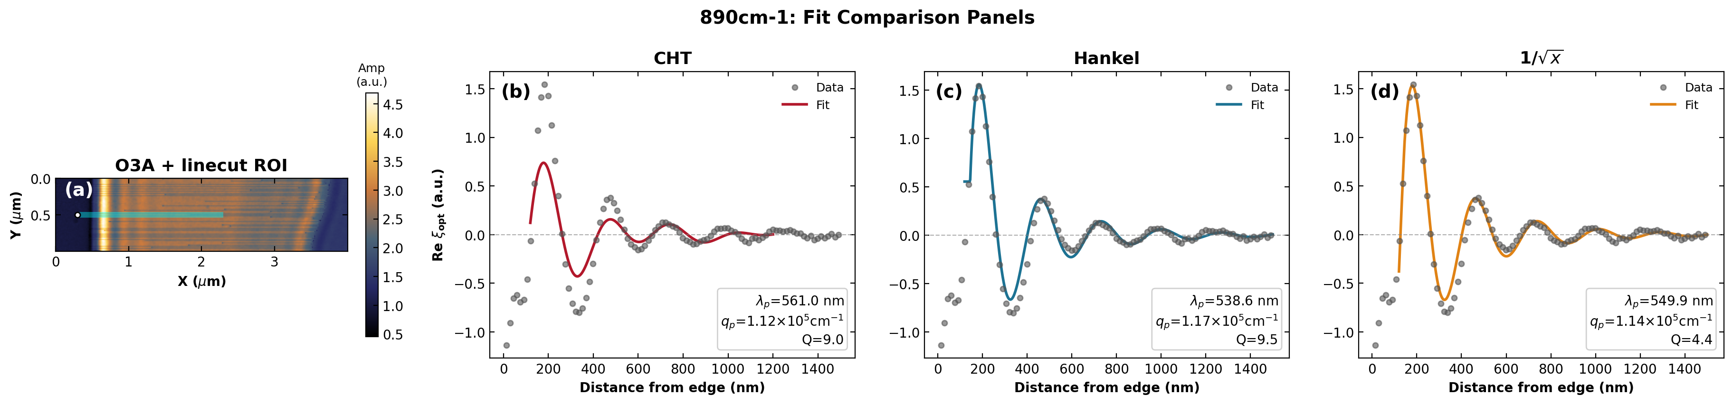
890 cm⁻¹
MoO₃(4.2nm)/Gr/SiO₂/Si — edge (lp1)

Slide 31


880 cm⁻¹
MoO₃(4.2nm)/Gr/SiO₂/Si — edge (lp1)

Slide 32


870 cm⁻¹
MoO₃(4.2nm)/Gr/SiO₂/Si — edge (lp1)

Slide 33


860 cm⁻¹
MoO₃(4.2nm)/Gr/SiO₂/Si — edge (lp1)

Slide 34
graphene_4x1_lp2 (interior)
MoO₃(4.2nm)/Gr/SiO₂/Si — interior (lp2)

Slide 35


1000 cm⁻¹
MoO₃(4.2nm)/Gr/SiO₂/Si — interior (lp2)

Slide 36


991 cm⁻¹
MoO₃(4.2nm)/Gr/SiO₂/Si — interior (lp2)

Slide 37


980 cm⁻¹
MoO₃(4.2nm)/Gr/SiO₂/Si — interior (lp2)

Slide 38


970 cm⁻¹
MoO₃(4.2nm)/Gr/SiO₂/Si — interior (lp2)

Slide 39


960 cm⁻¹
MoO₃(4.2nm)/Gr/SiO₂/Si — interior (lp2)

Slide 40


950 cm⁻¹
MoO₃(4.2nm)/Gr/SiO₂/Si — interior (lp2)

Slide 41


941 cm⁻¹
MoO₃(4.2nm)/Gr/SiO₂/Si — interior (lp2)

Slide 42


930 cm⁻¹
MoO₃(4.2nm)/Gr/SiO₂/Si — interior (lp2)

Slide 43


920 cm⁻¹
MoO₃(4.2nm)/Gr/SiO₂/Si — interior (lp2)

Slide 44


911 cm⁻¹
MoO₃(4.2nm)/Gr/SiO₂/Si — interior (lp2)

Slide 45


900 cm⁻¹
MoO₃(4.2nm)/Gr/SiO₂/Si — interior (lp2)

Slide 46


890 cm⁻¹
MoO₃(4.2nm)/Gr/SiO₂/Si — interior (lp2)

Slide 47


880 cm⁻¹
MoO₃(4.2nm)/Gr/SiO₂/Si — interior (lp2)

Slide 48


870 cm⁻¹
MoO₃(4.2nm)/Gr/SiO₂/Si — interior (lp2)

Slide 49


860 cm⁻¹
MoO₃(4.2nm)/Gr/SiO₂/Si — interior (lp2)

