Slide 1
Two-wave Hankel Fit (q + 2q)
graphene_4x1_manual lp1 (edge), wn = 900-1000 cm⁻¹
Single-wave Hankel vs. two-wave (edge-launched q + tip-launched 2q) fit, compared against the FFT's own 2-Lorentzian-peak decomposition

Slide 2
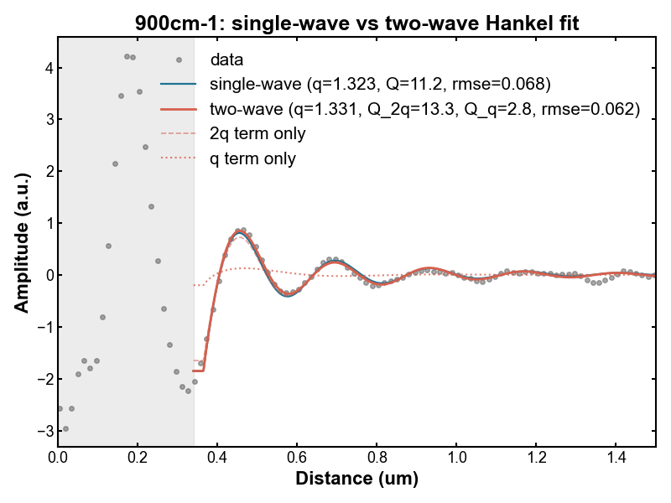

900cm⁻¹

Slide 3
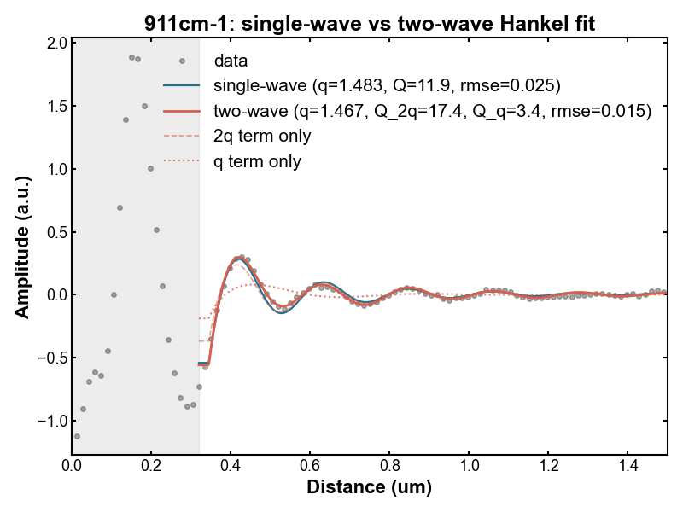

911cm⁻¹

Slide 4
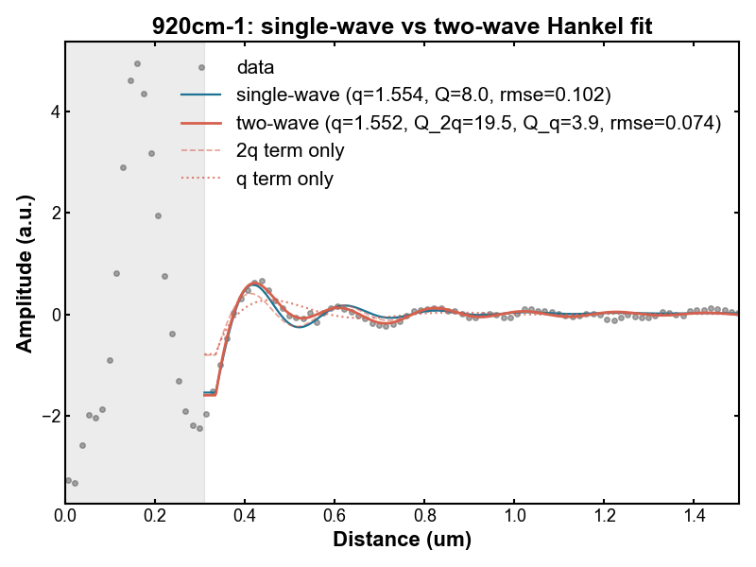

920cm⁻¹

Slide 5
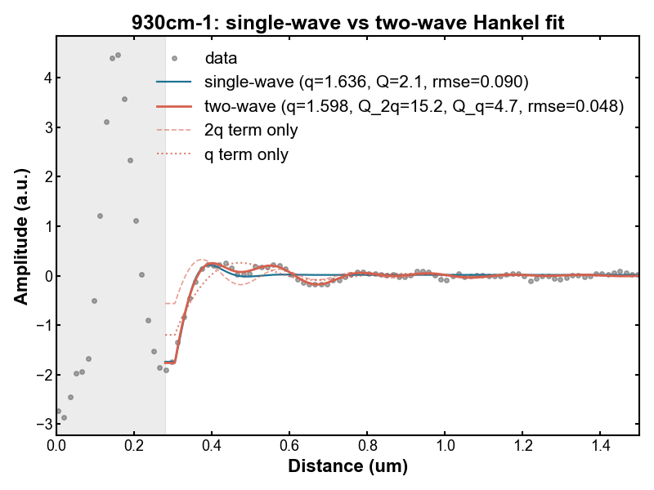

930cm⁻¹

Slide 6
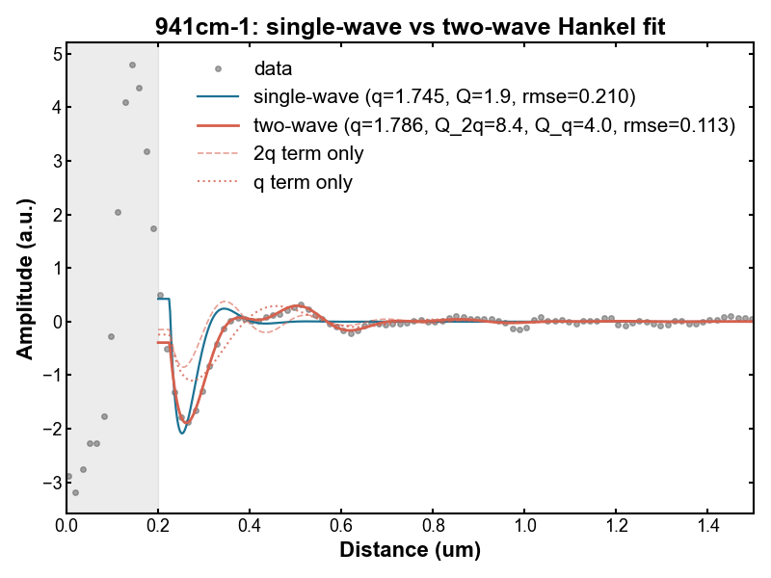

941cm⁻¹

Slide 7
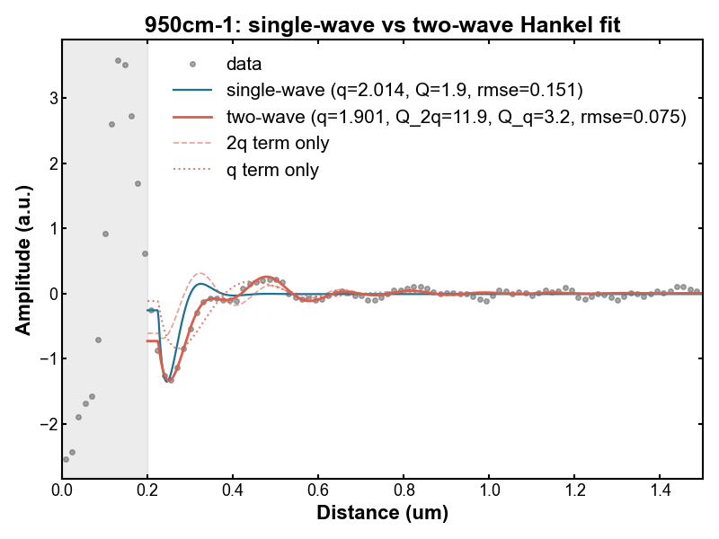

950cm⁻¹

Slide 8
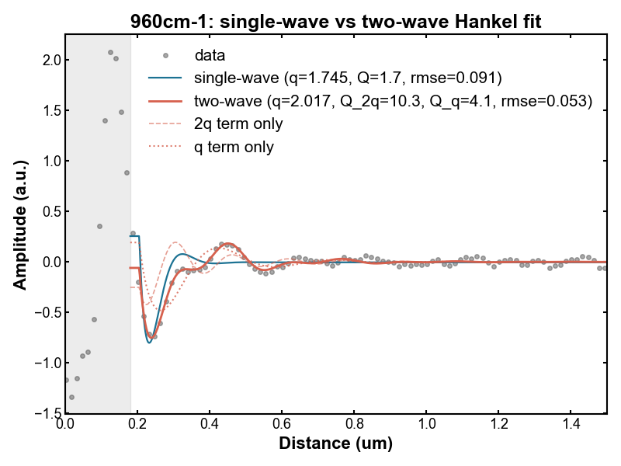

960cm⁻¹

Slide 9
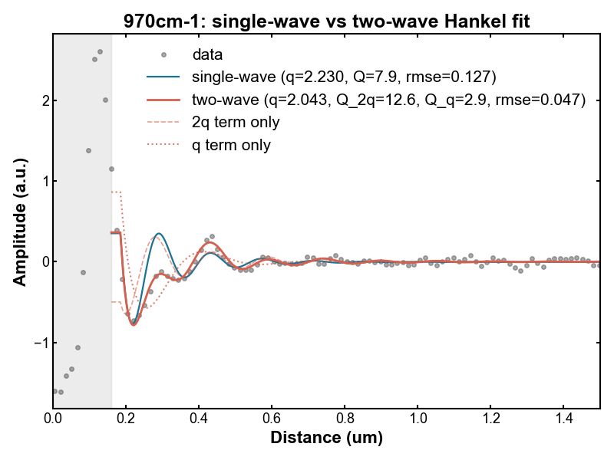

970cm⁻¹

Slide 10
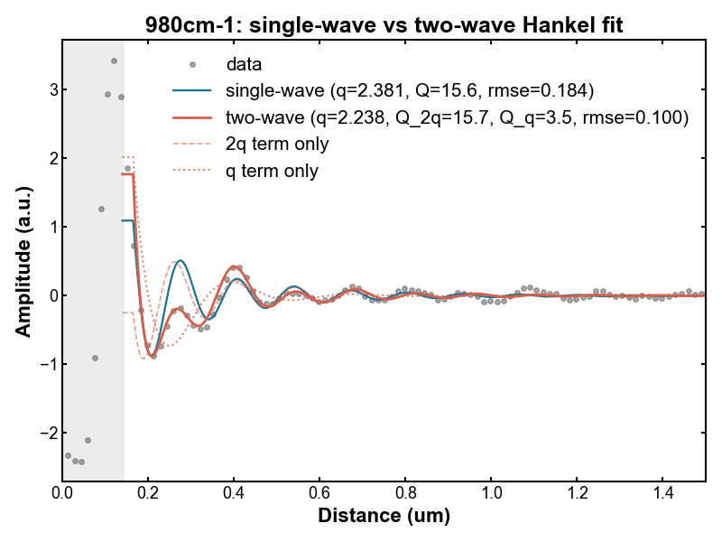

980cm⁻¹

Slide 11
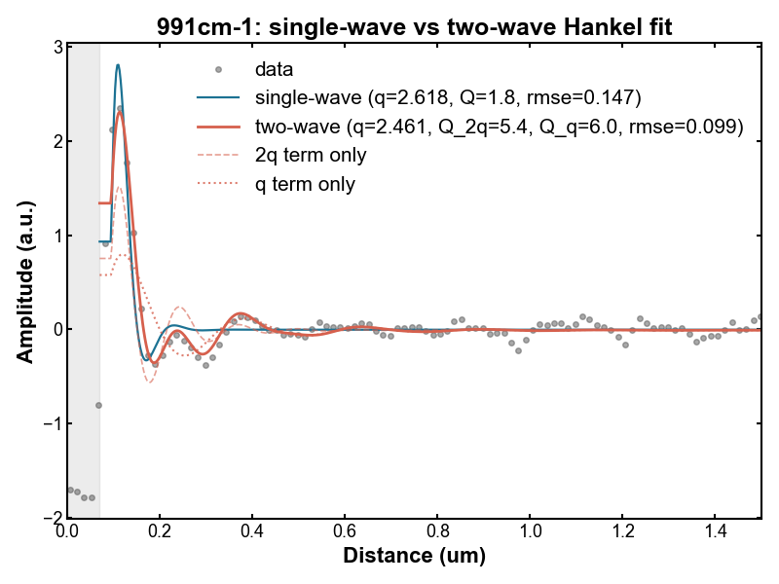

991cm⁻¹

Slide 12
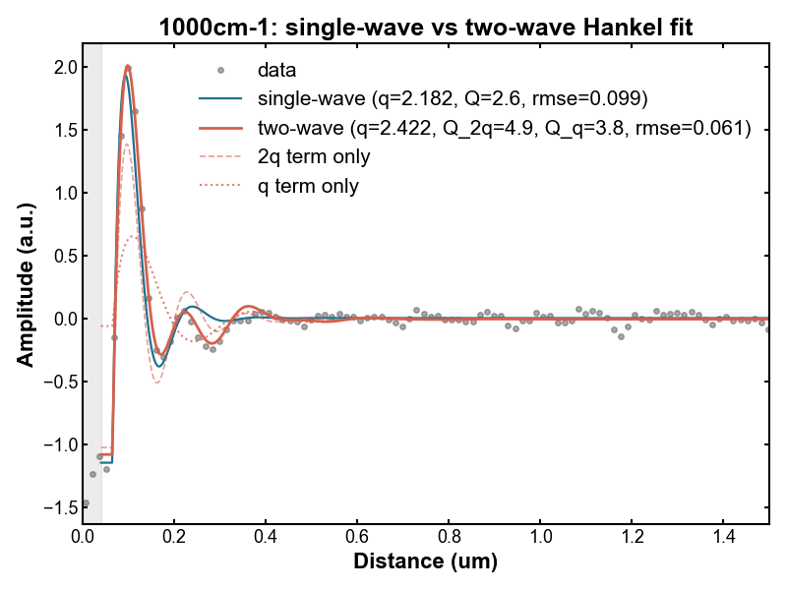

1000cm⁻¹

