Slide 1
GMG rp & fitting
Lower wn fitting and FFT (page2)
2-waves fitting for higher wns (page 9)

Slide 2
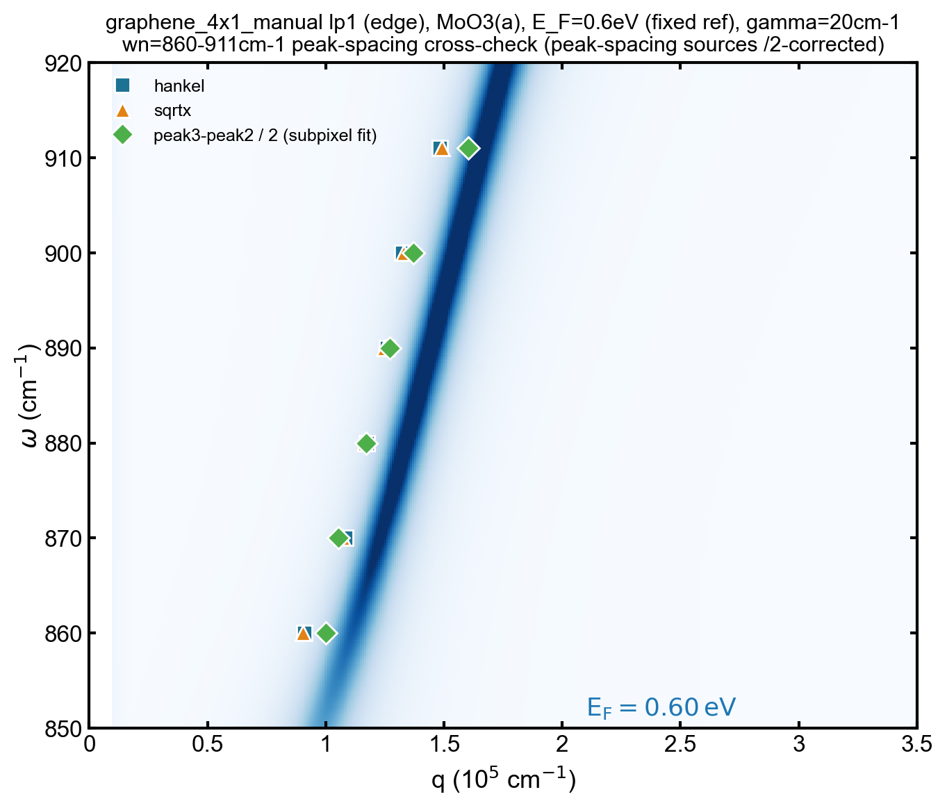
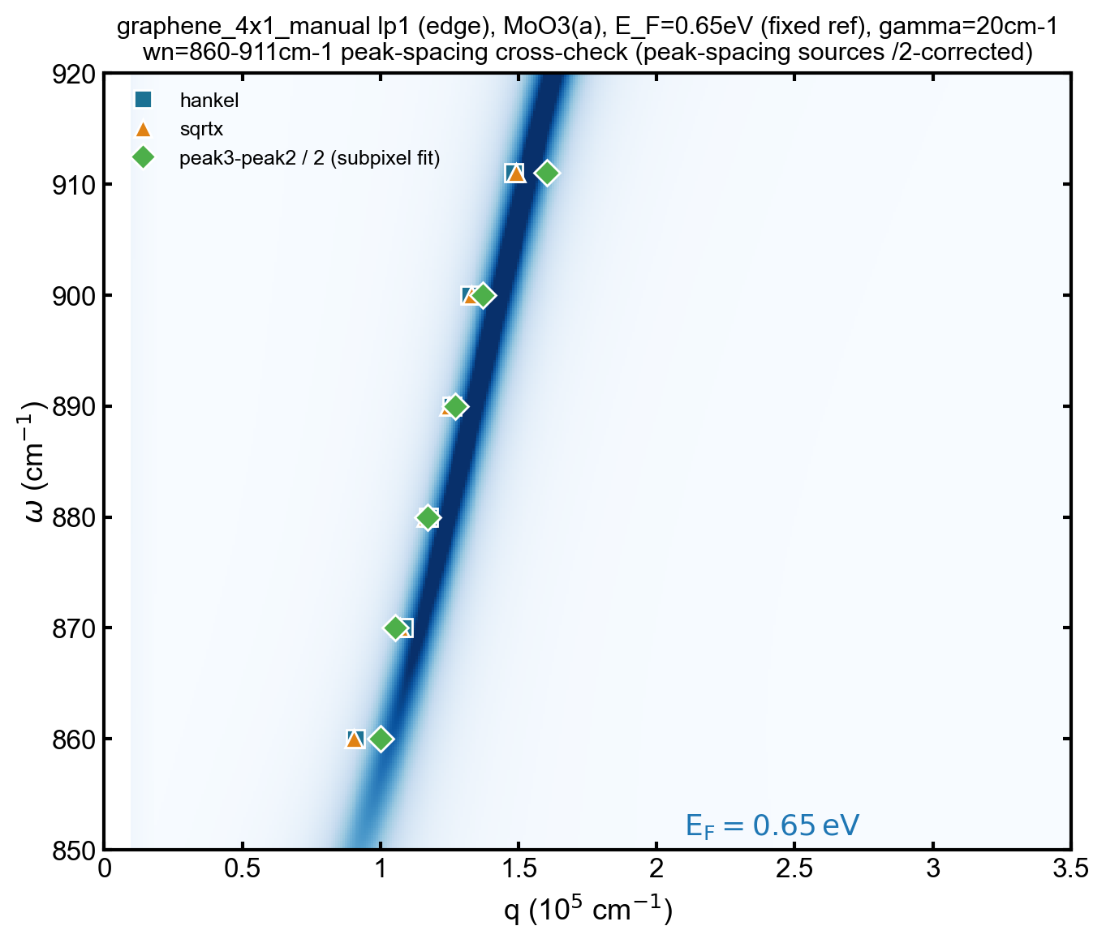
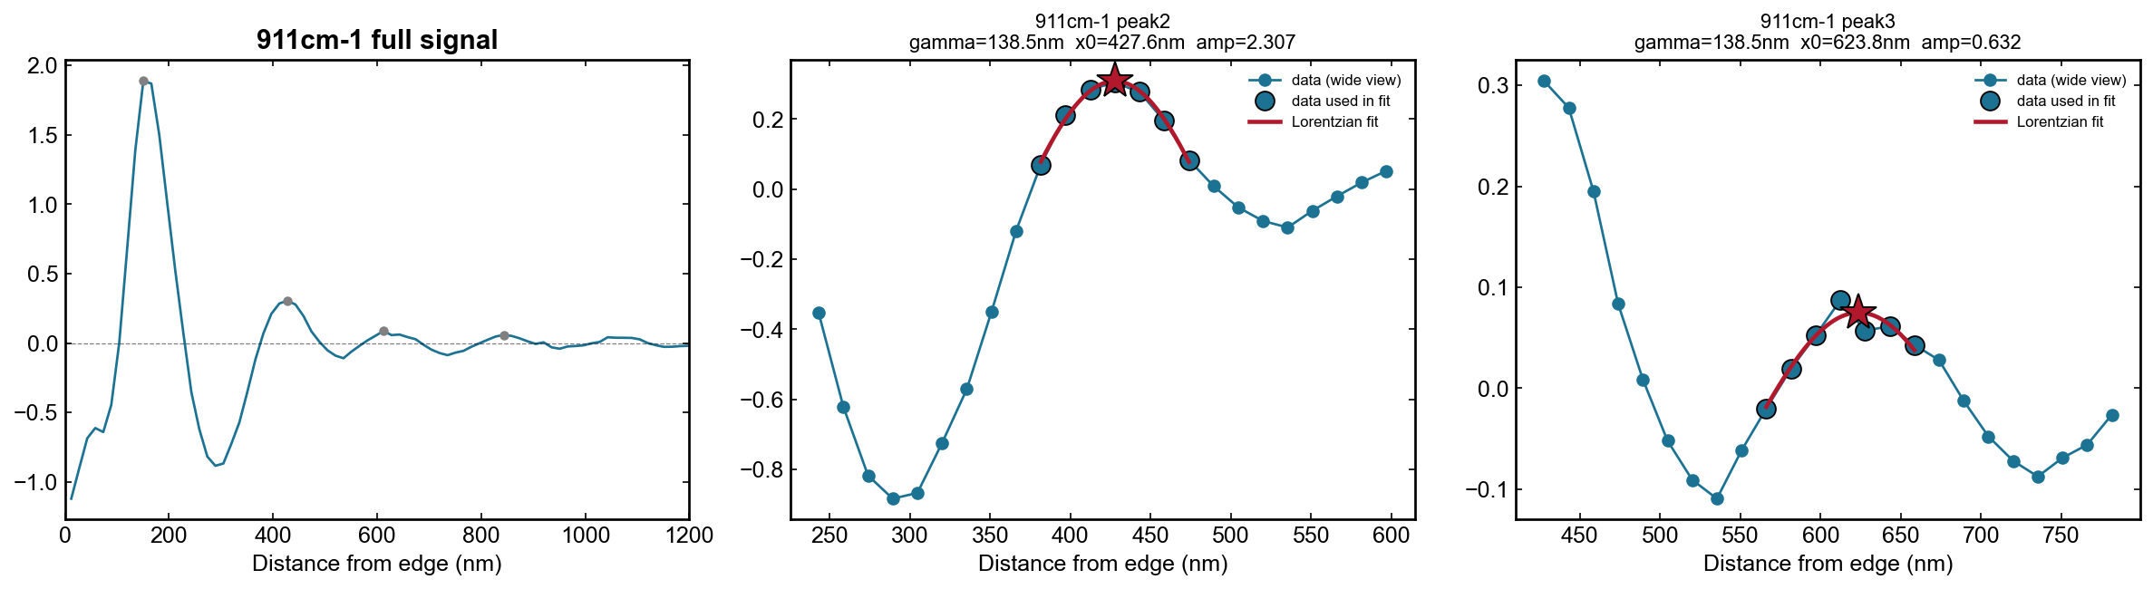
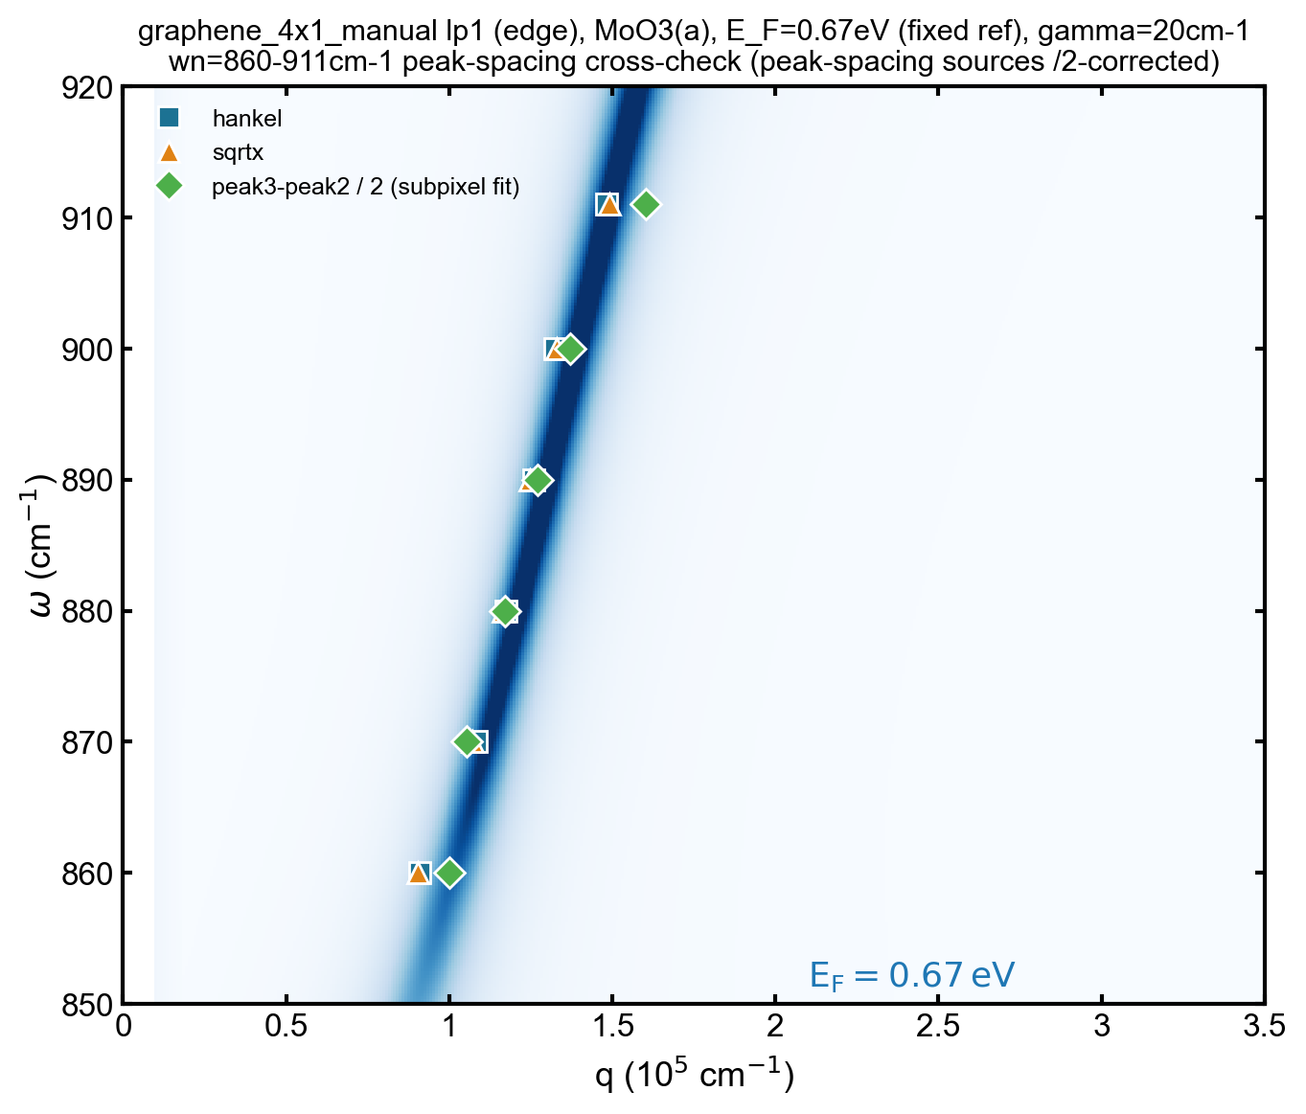
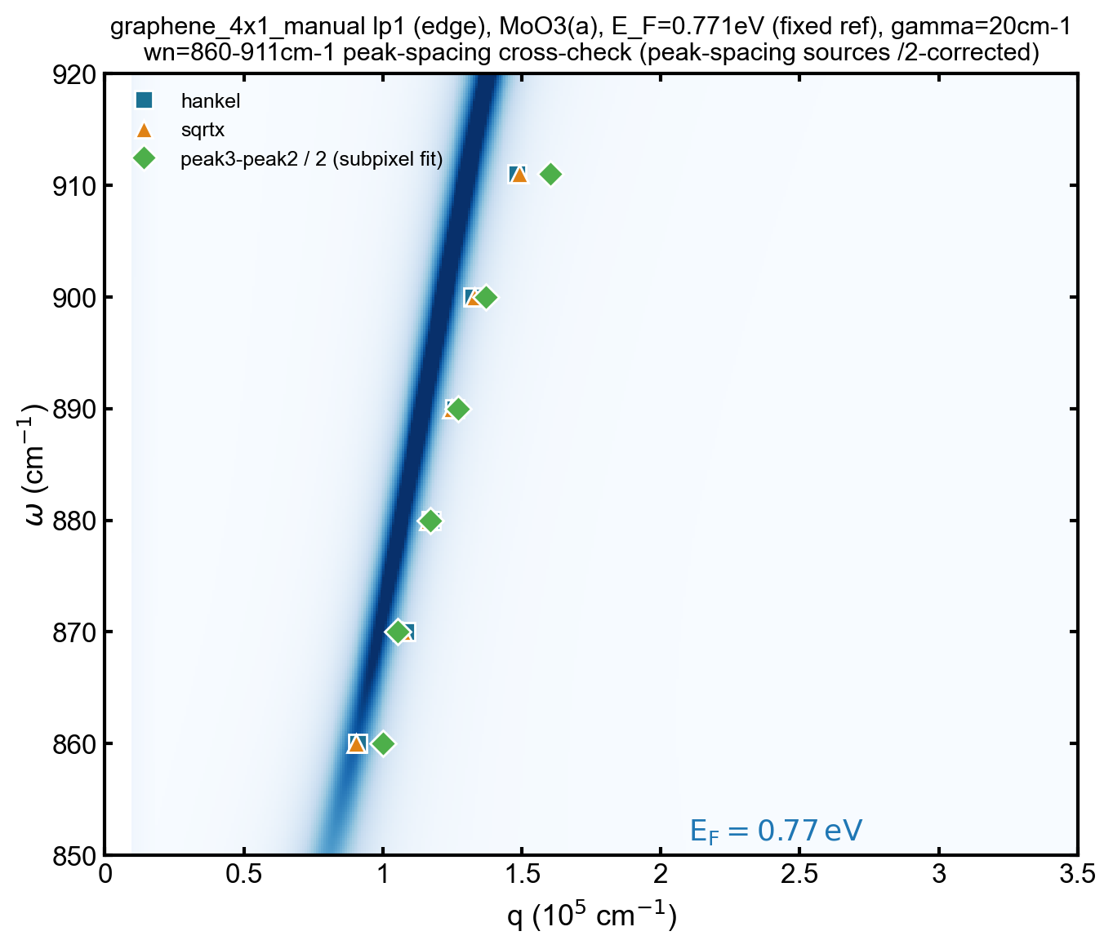
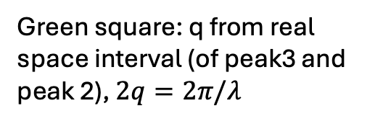
Lower wn fitting
Green square: q from real space interval (of peak3 and peak 2), $2q=2π/λ$
Already affected by edge-launched (q) wave
911cm-1 doesn’t match
Looks better

Slide 3
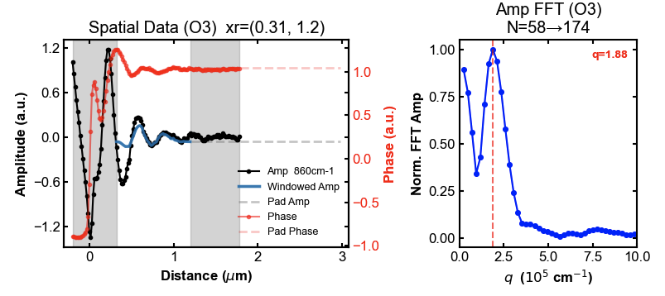
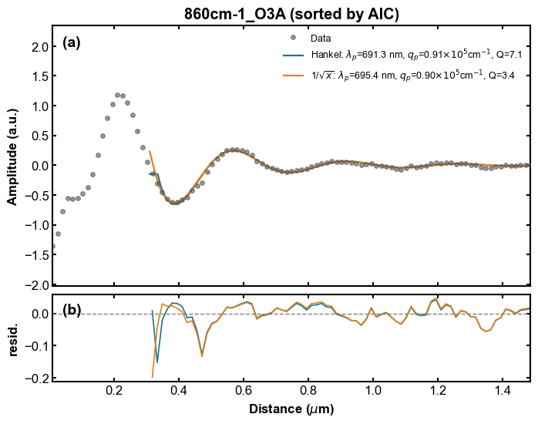
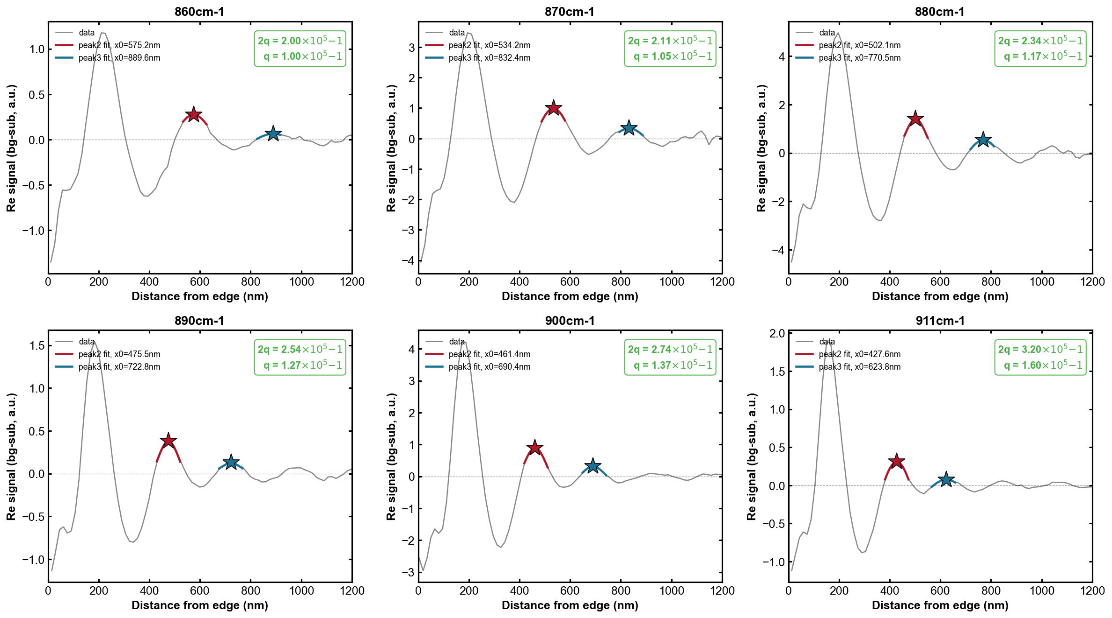
FFT comparison
860cm-1

Slide 4
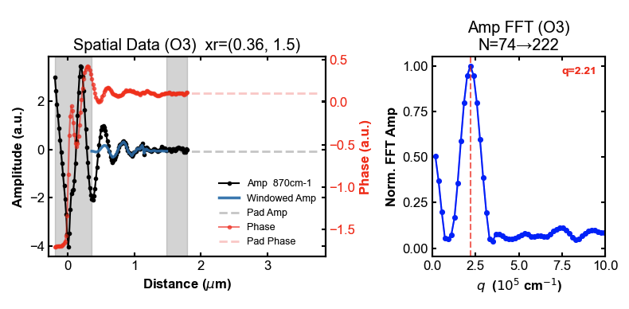
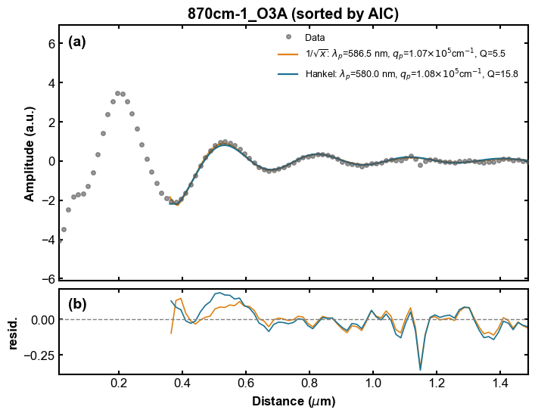

Slide 5
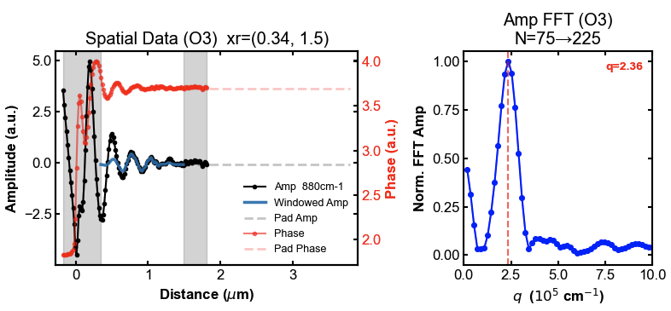
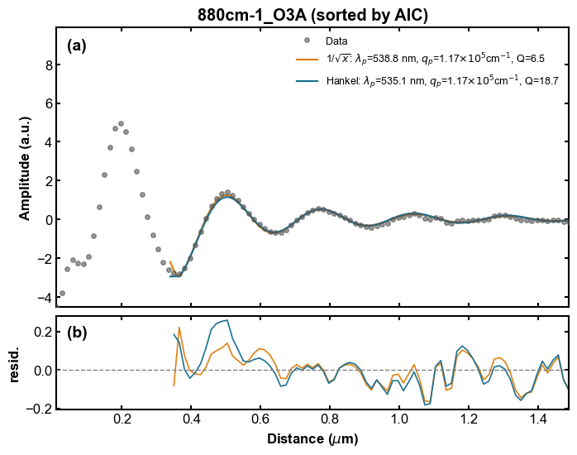

Slide 6
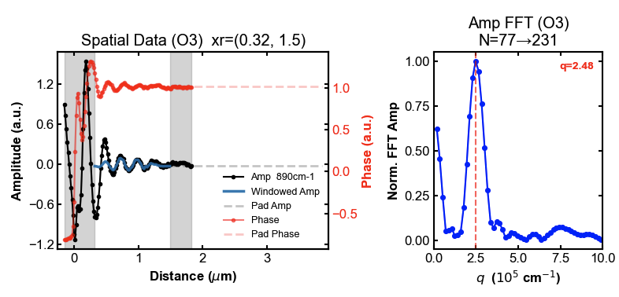
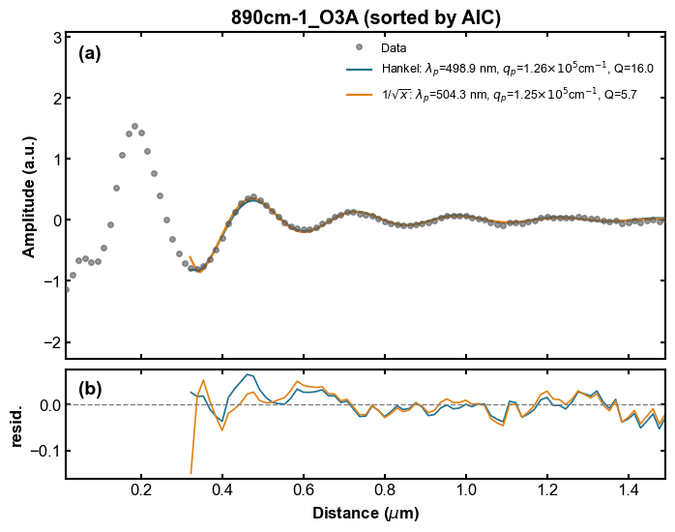

Slide 7
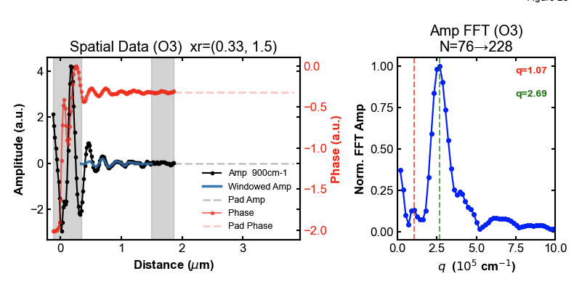
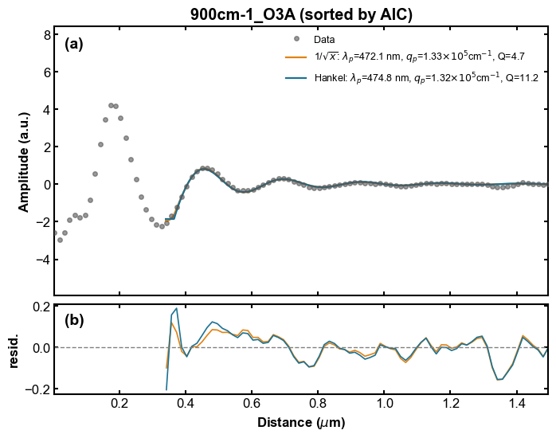

Slide 8
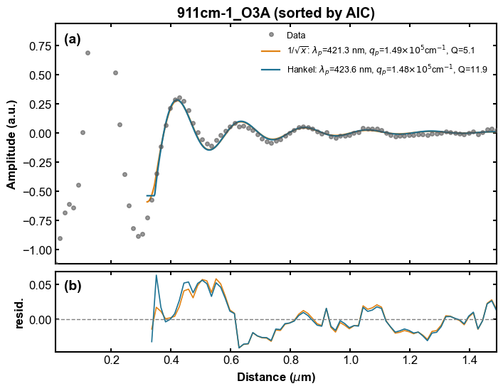
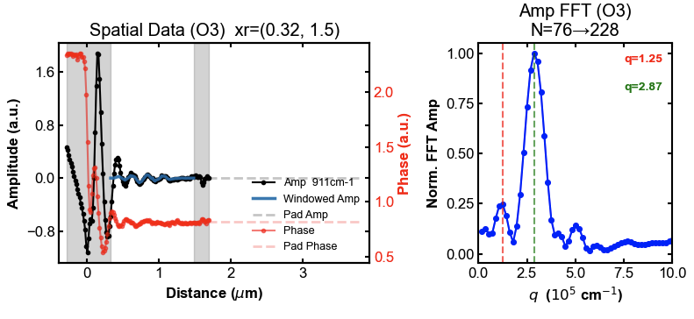
tip launched
edge launched
911cm-1 doesn’t match
Tip launched wave affects the real space interval

Slide 9
7/21/2026
Higher wn 2 peaks Lorentzian fft
2 peaks hankel/sqrt fitting

Slide 10
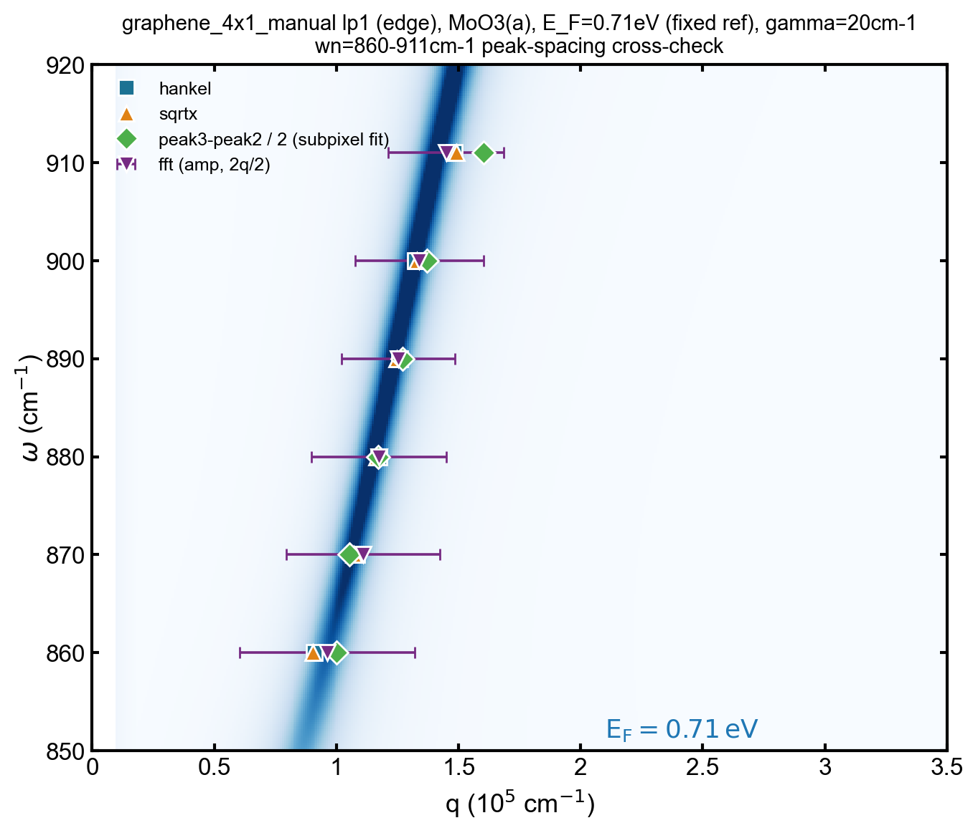
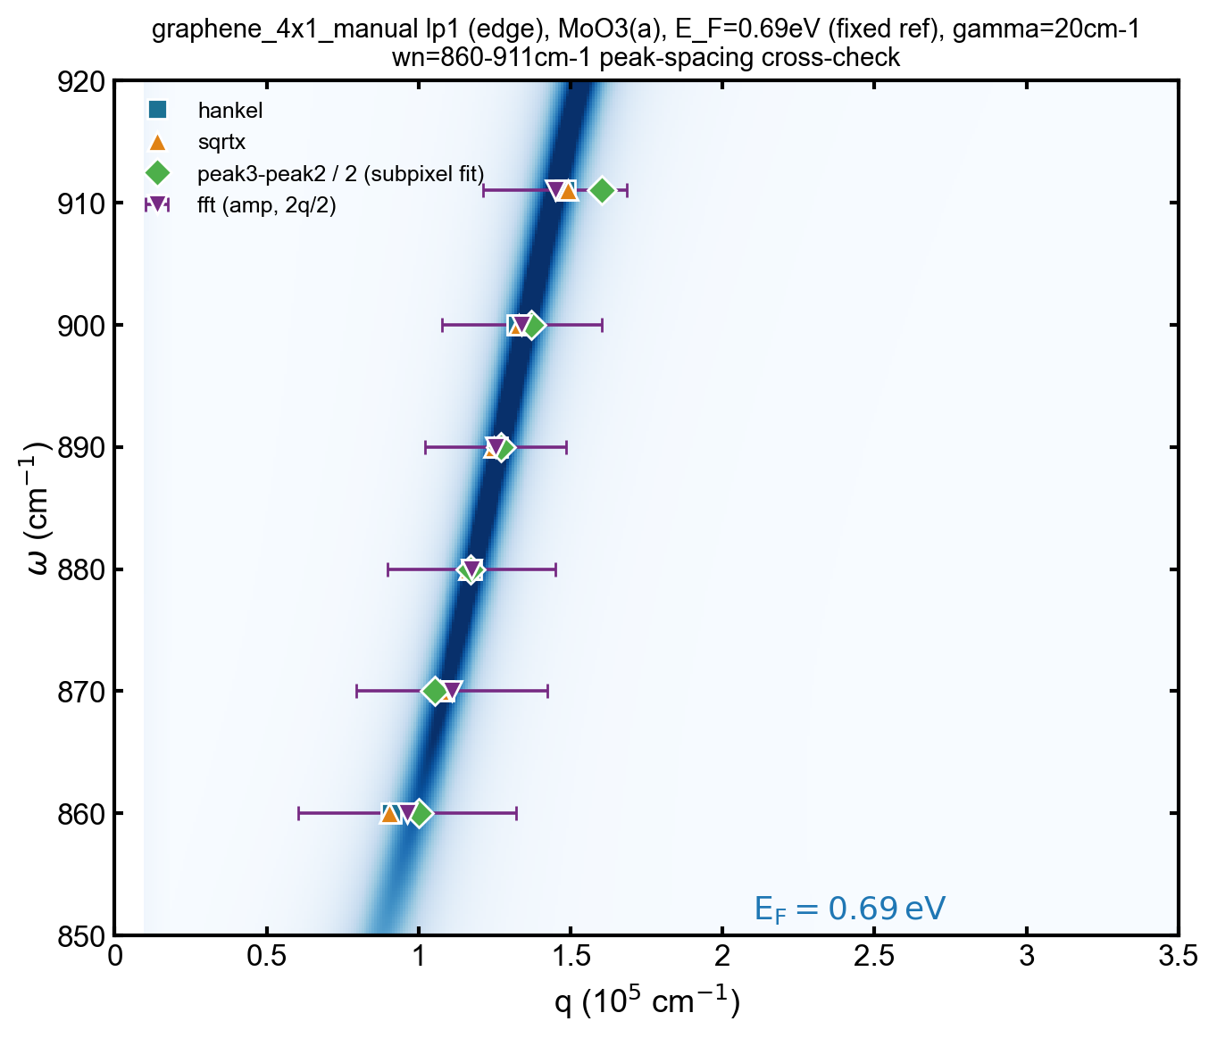
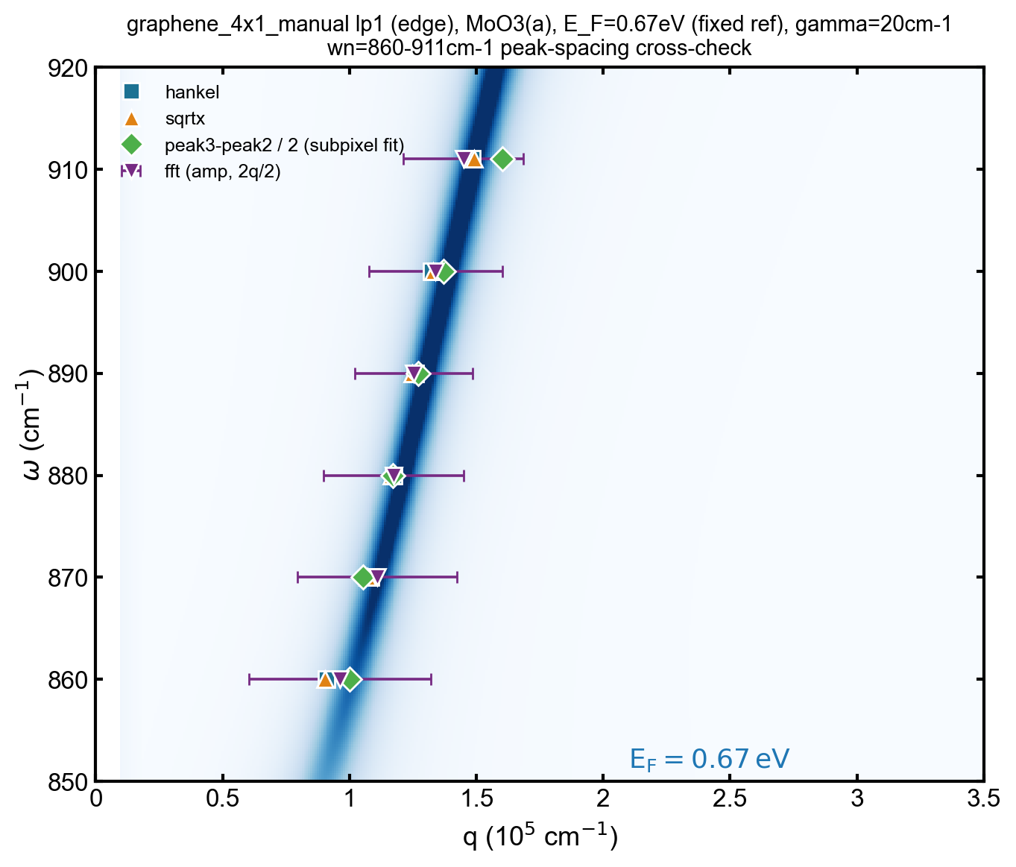
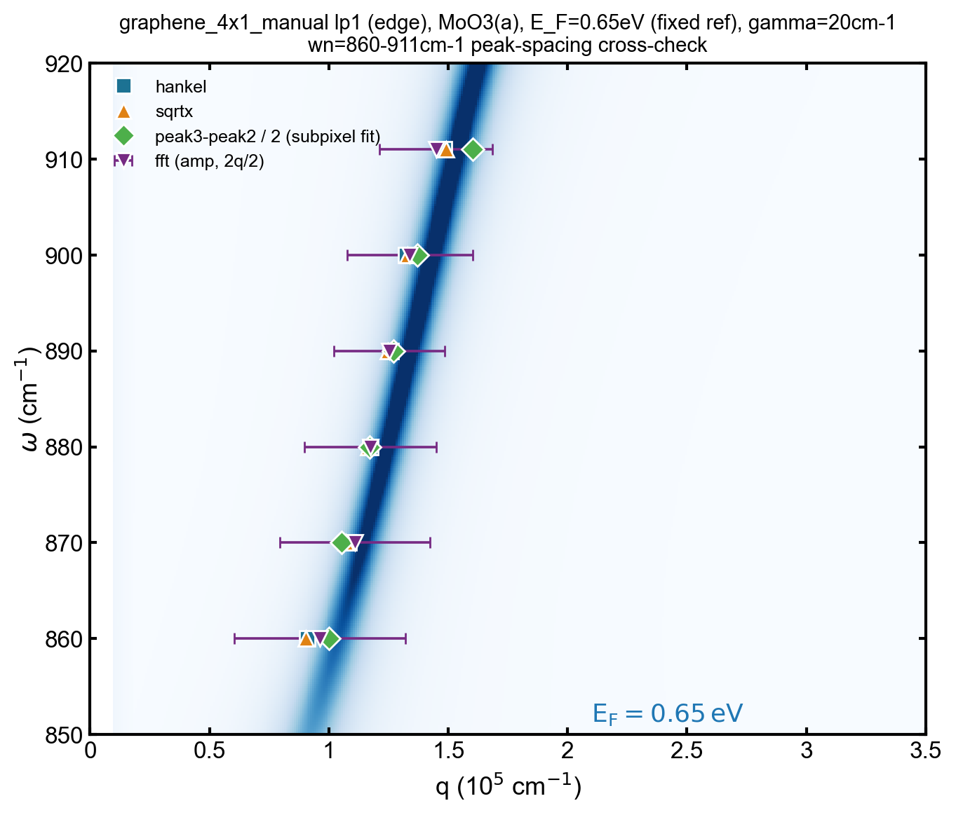
Previous lower wn (one peak dominant)
Ef=0.71eV
Ef=0.69eV
Ef=0.67eV
Ef=0.65eV

Slide 11
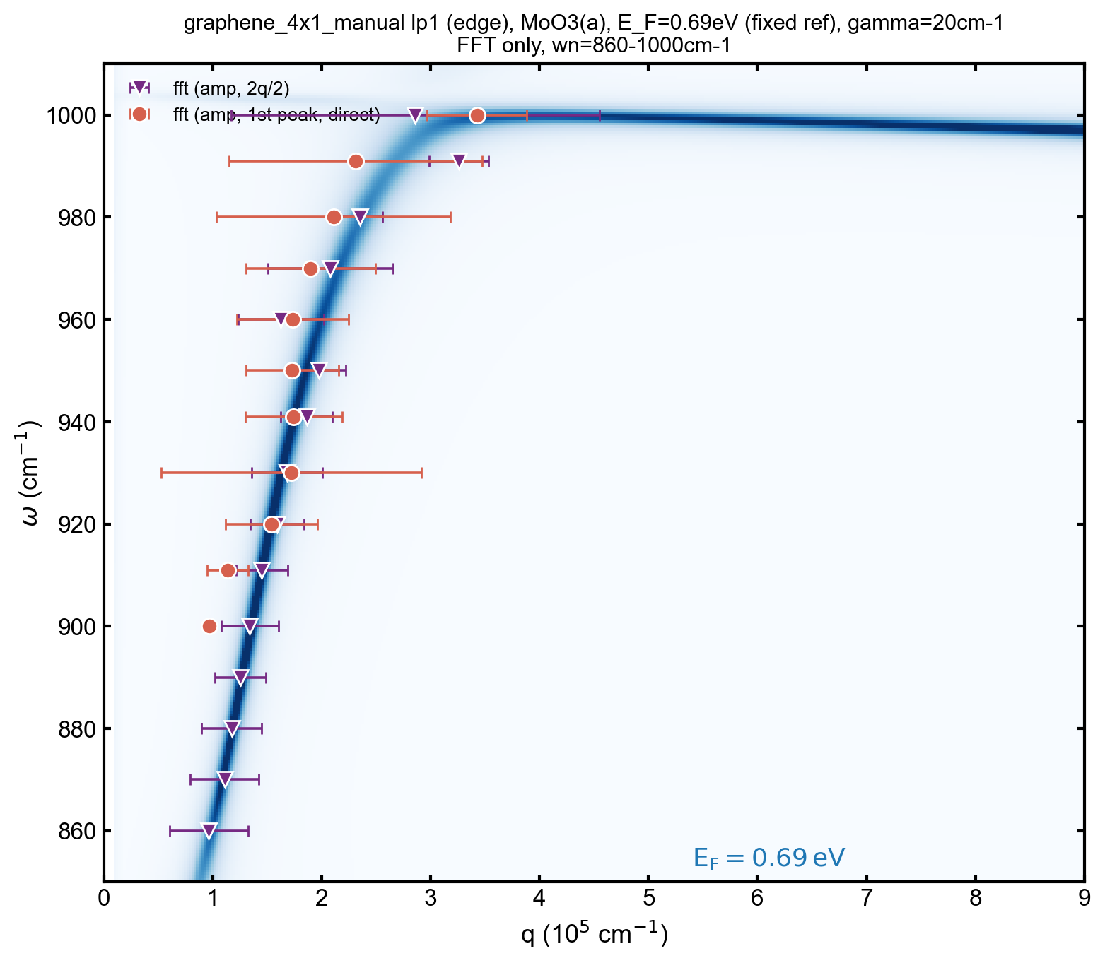
FFT 2 Lorentzian for all wns （Only FFT)
Orange: edge launched peak (q)
Purple: tip-launched peak (2q)

Slide 12
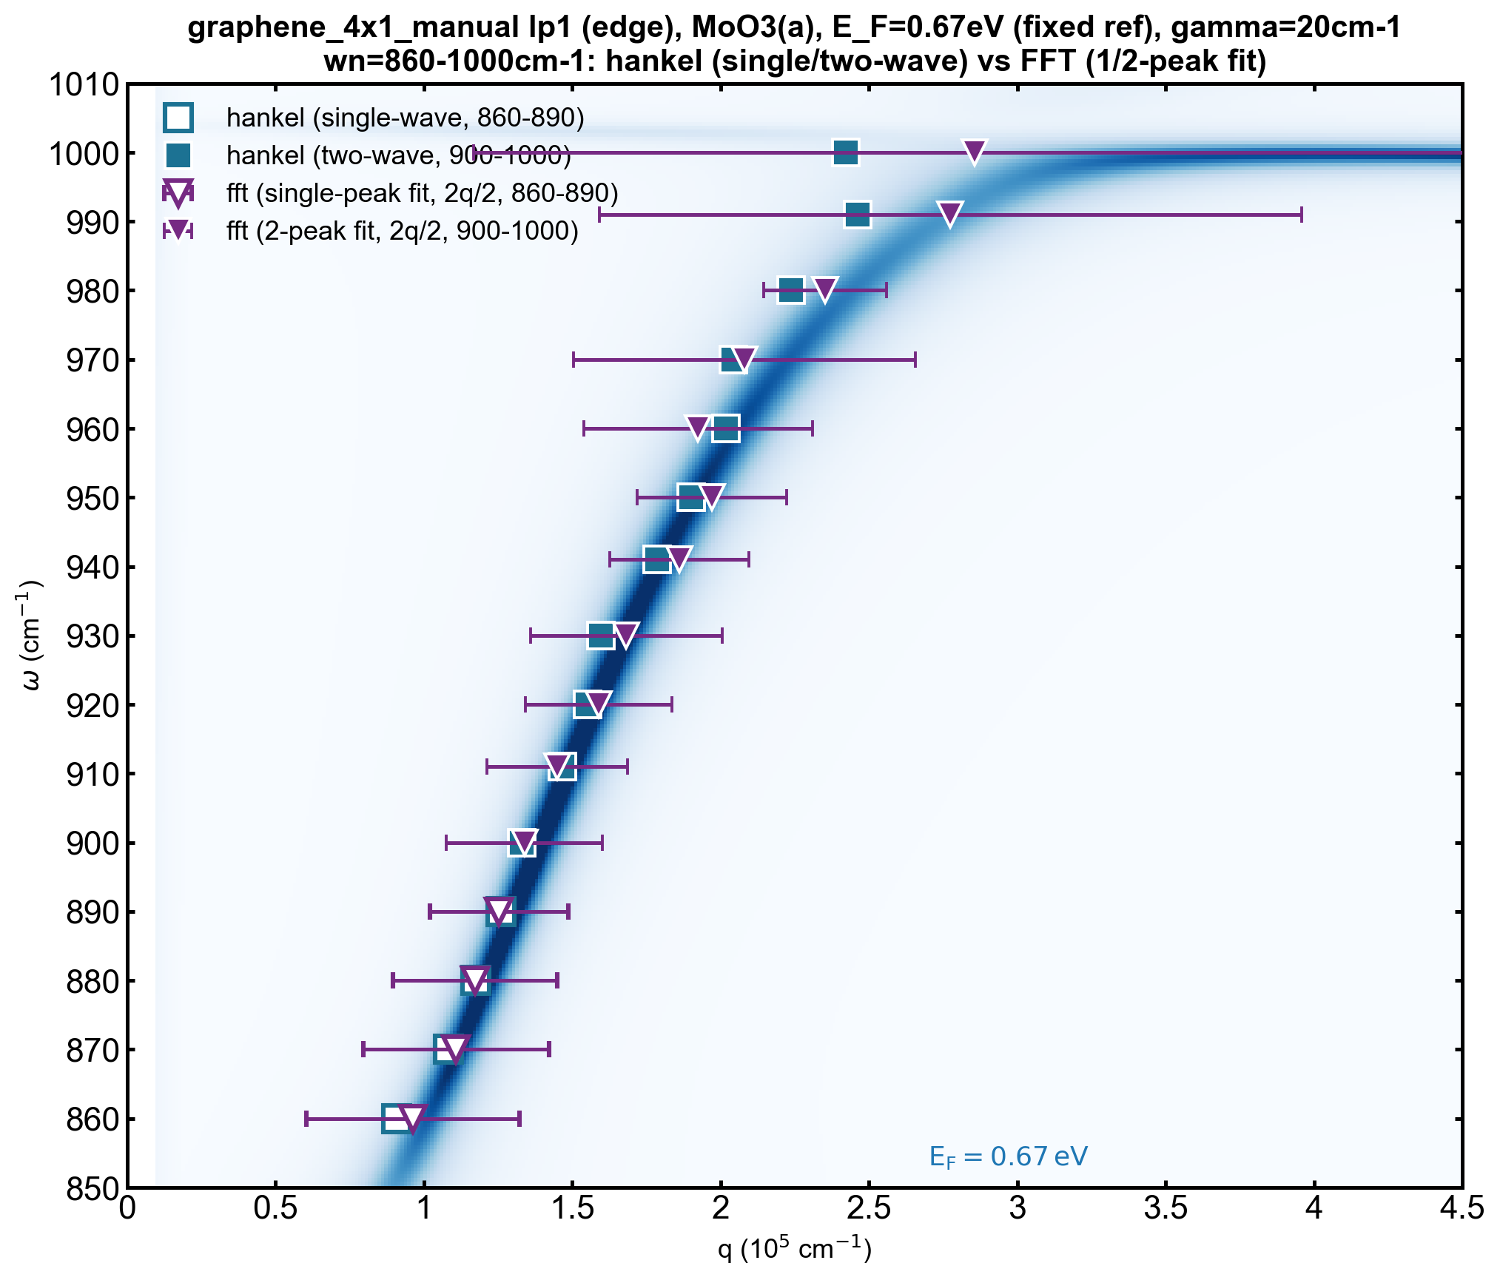
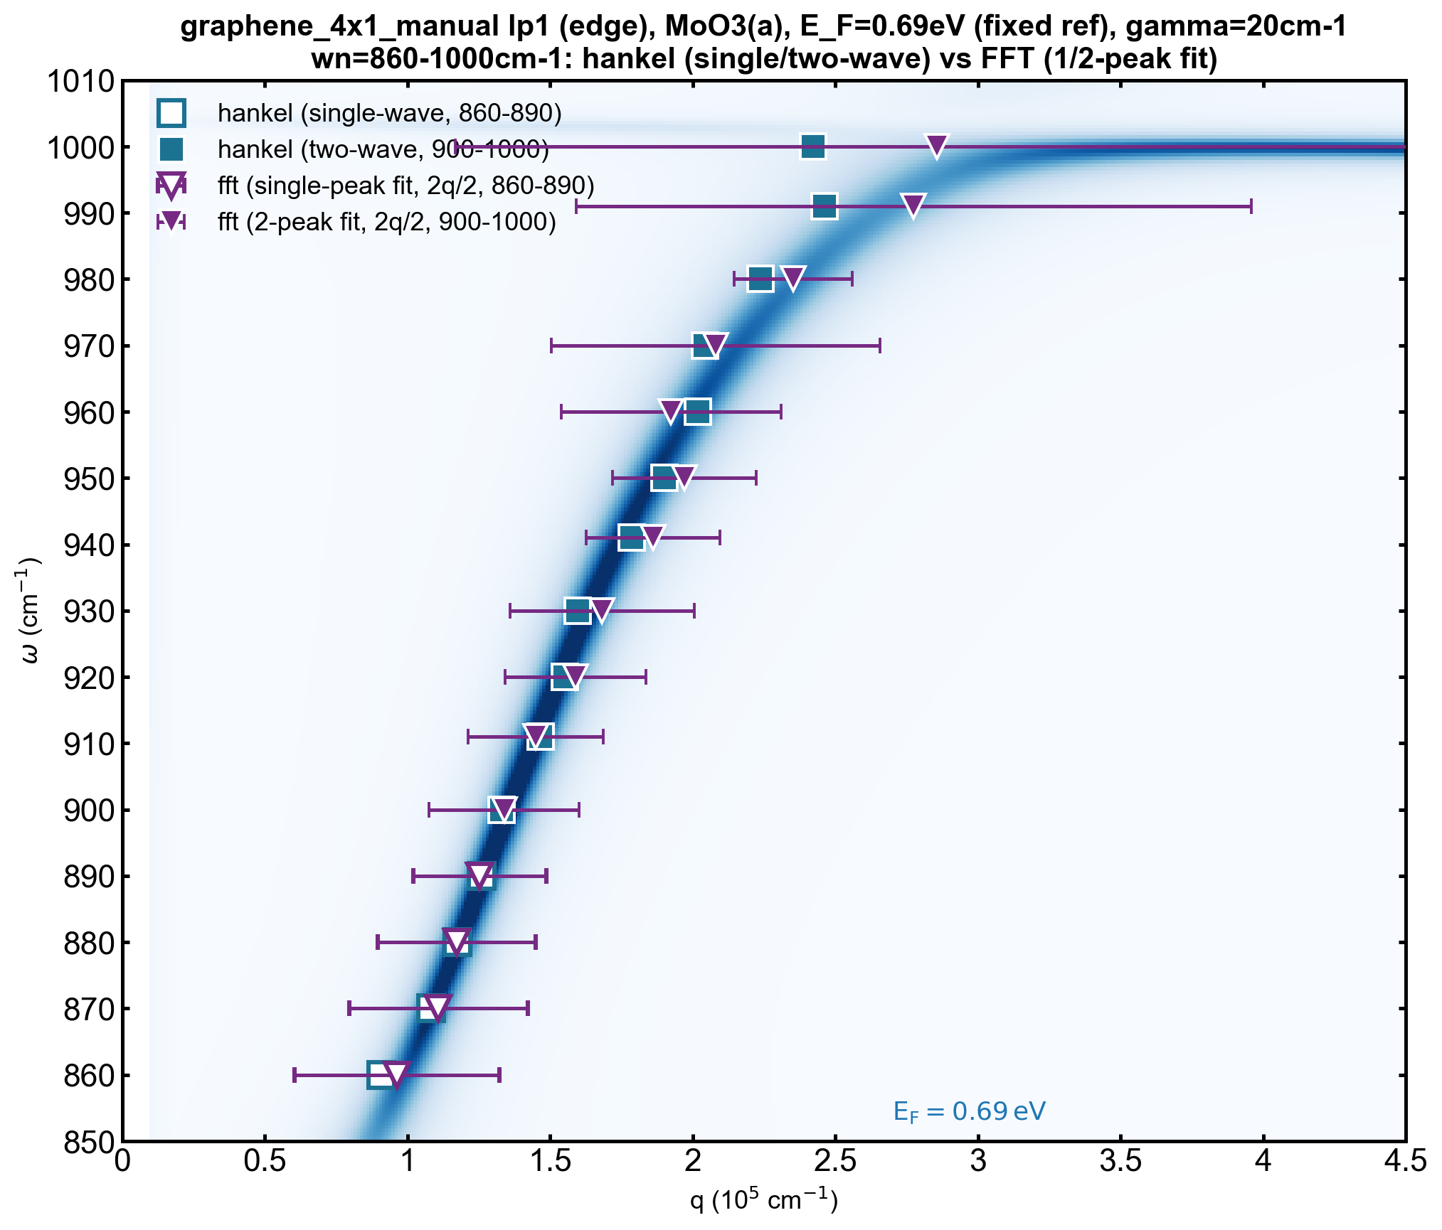
900-1000cm-1: 2-waves hankel fitting
Model: $s\left(x\right)=B+A_{2q}\text{Re}\left[e^{iφ_{2q}}H_{0}^{\left(1\right)}\left(2q_{p}^{\left(2q\right)}x_{L}\right)\right]+A_{q}\text{Re}\left[e^{iφ_{q}}H_{0}^{\left(1\right)}\left(q_{p}^{\left(q\right)}x_{L}\right)\right]$
$$q_{p}^{\left(2q\right)}=q+iq_{\text{imag},2q}, q_{p}^{\left(q\right)}=q+iq_{\text{imag},q},$$

Slide 13
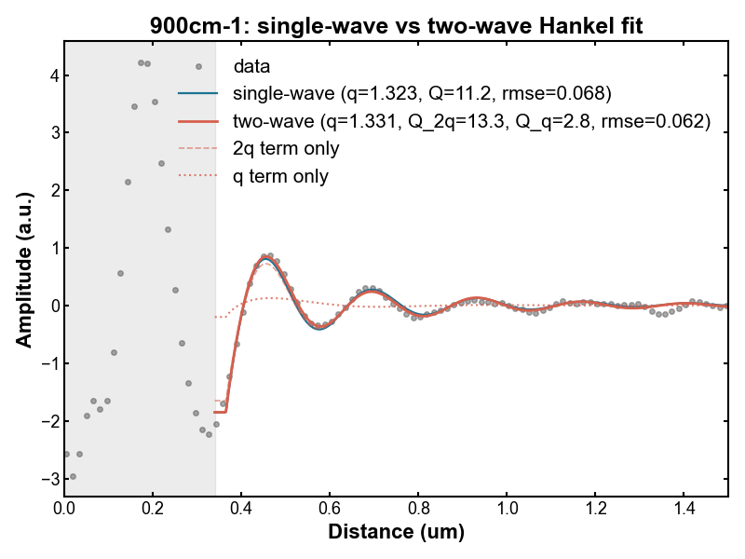
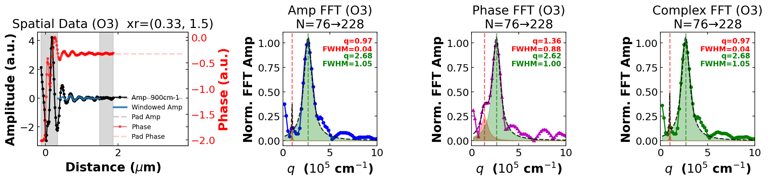
900cm⁻¹

Slide 14
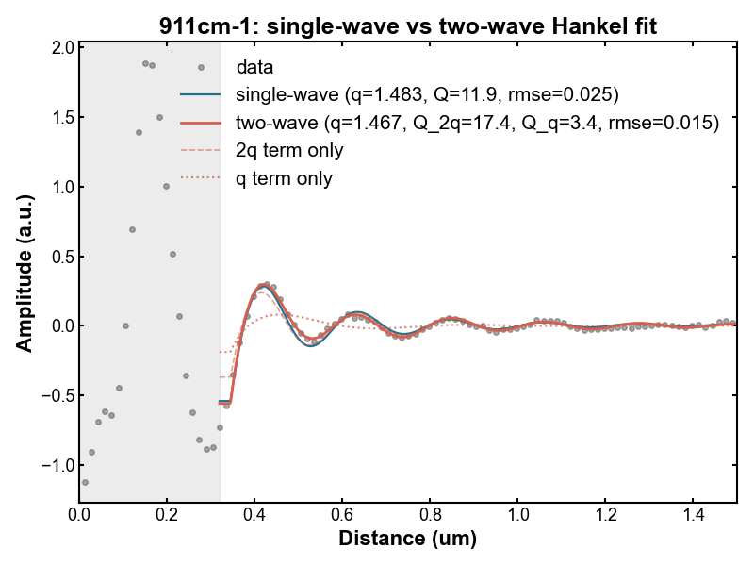
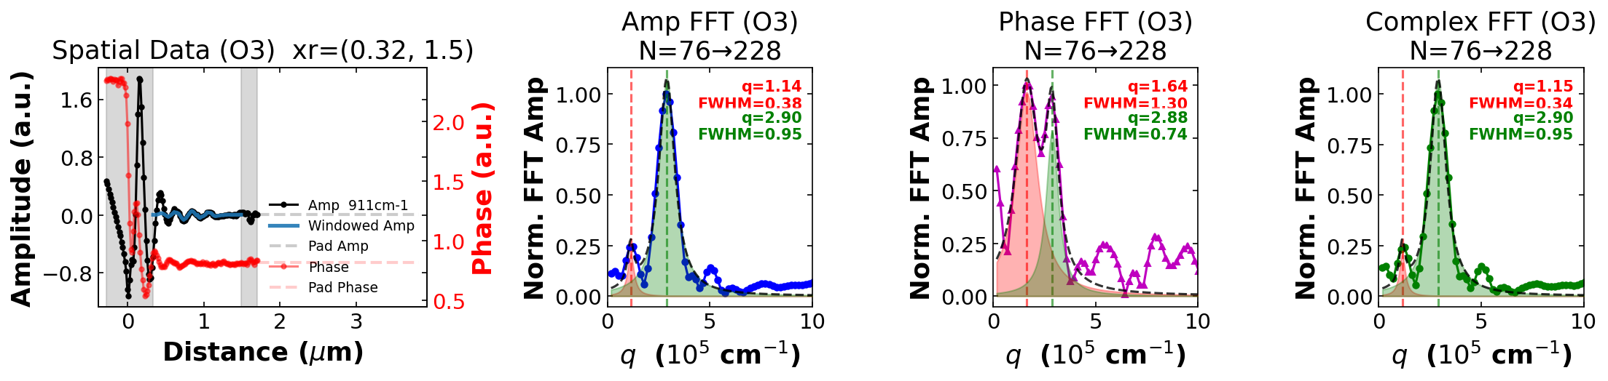
911cm⁻¹

Slide 15
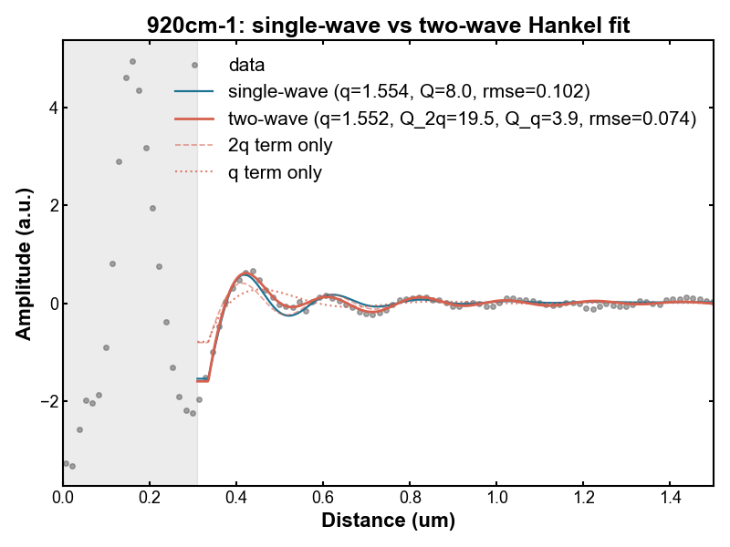
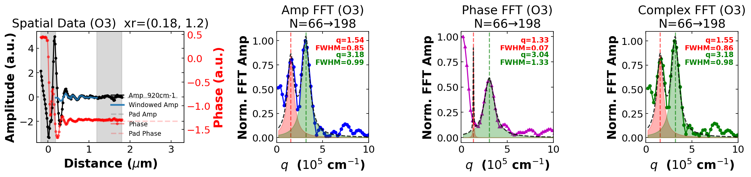
920cm⁻¹

Slide 16
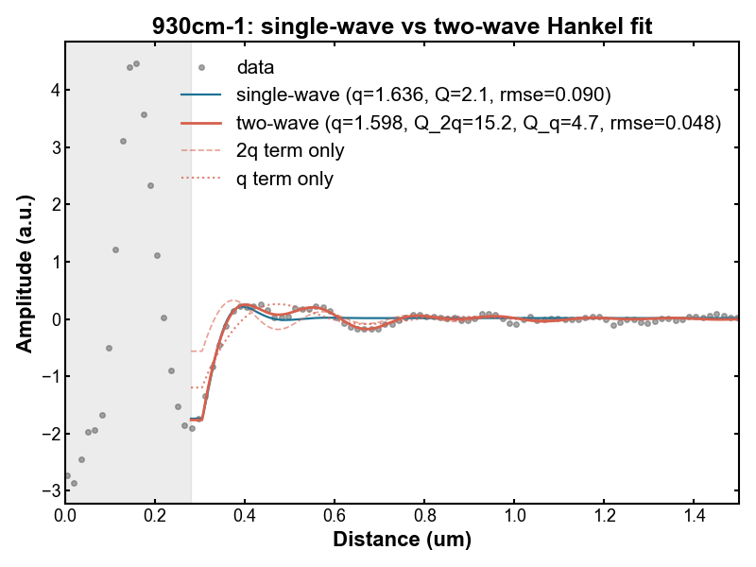
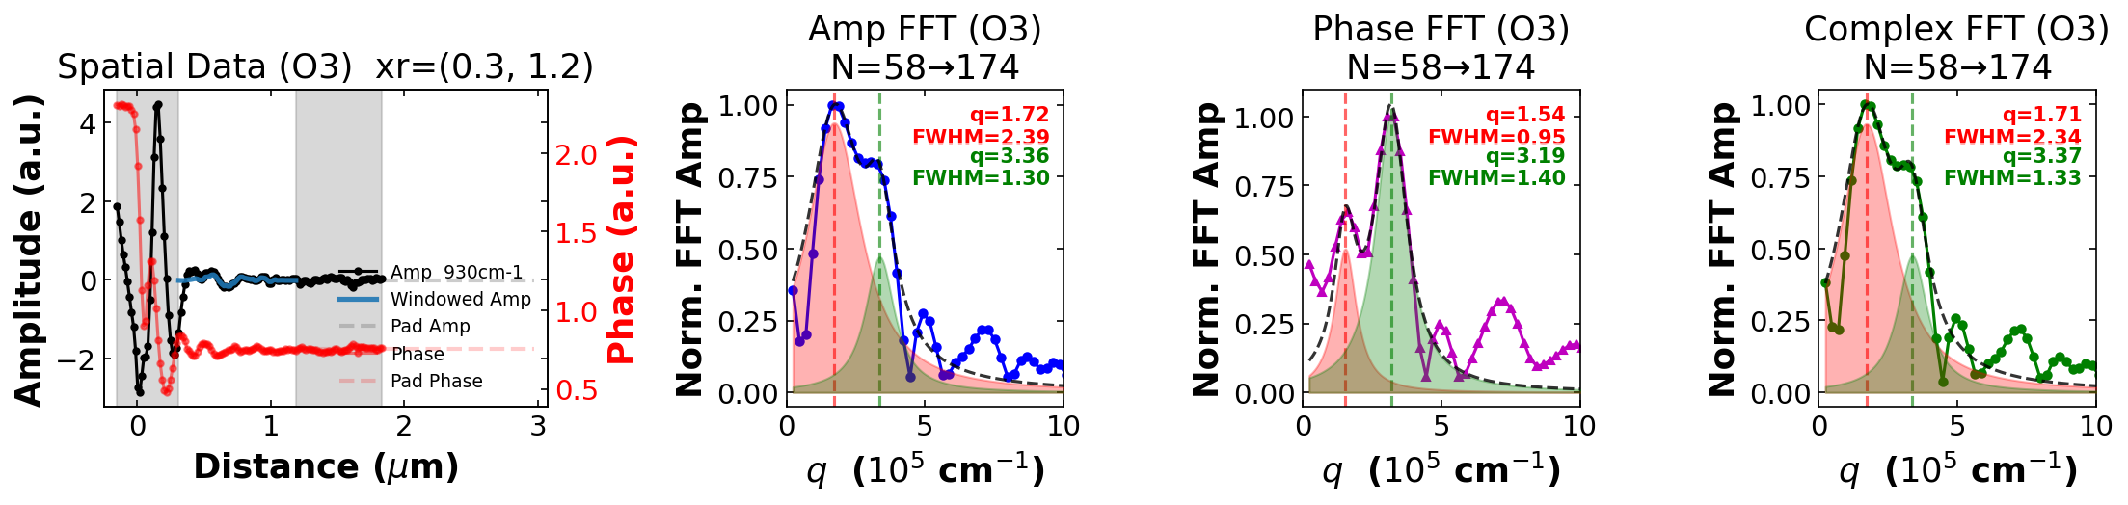
930cm⁻¹

Slide 17
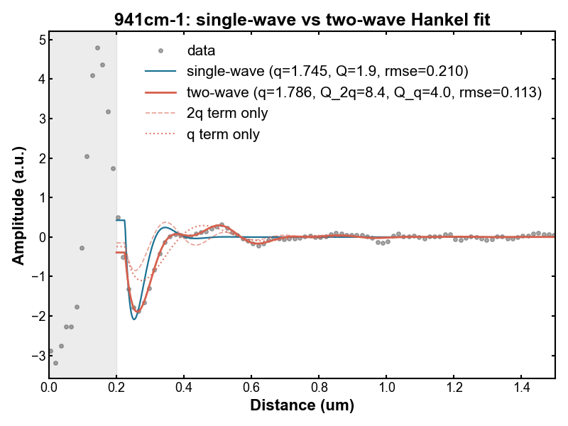
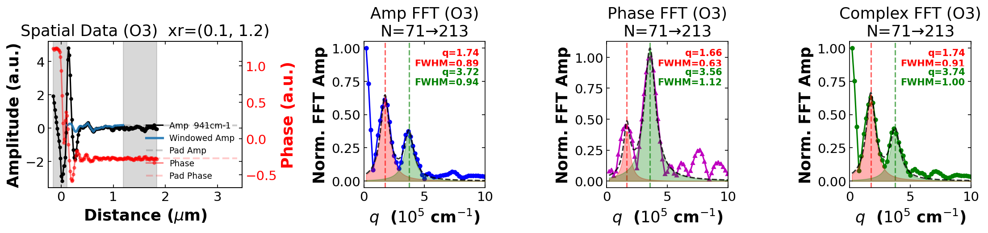
941cm⁻¹

Slide 18
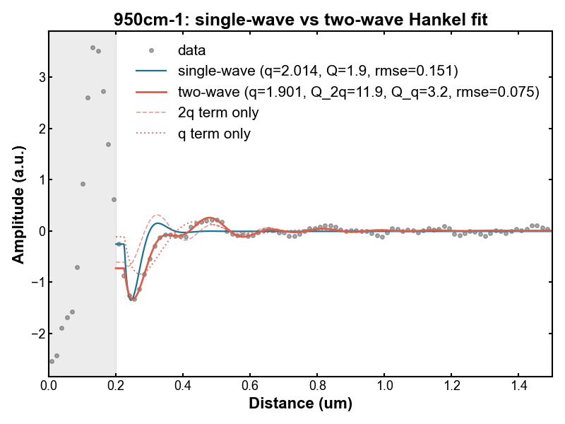
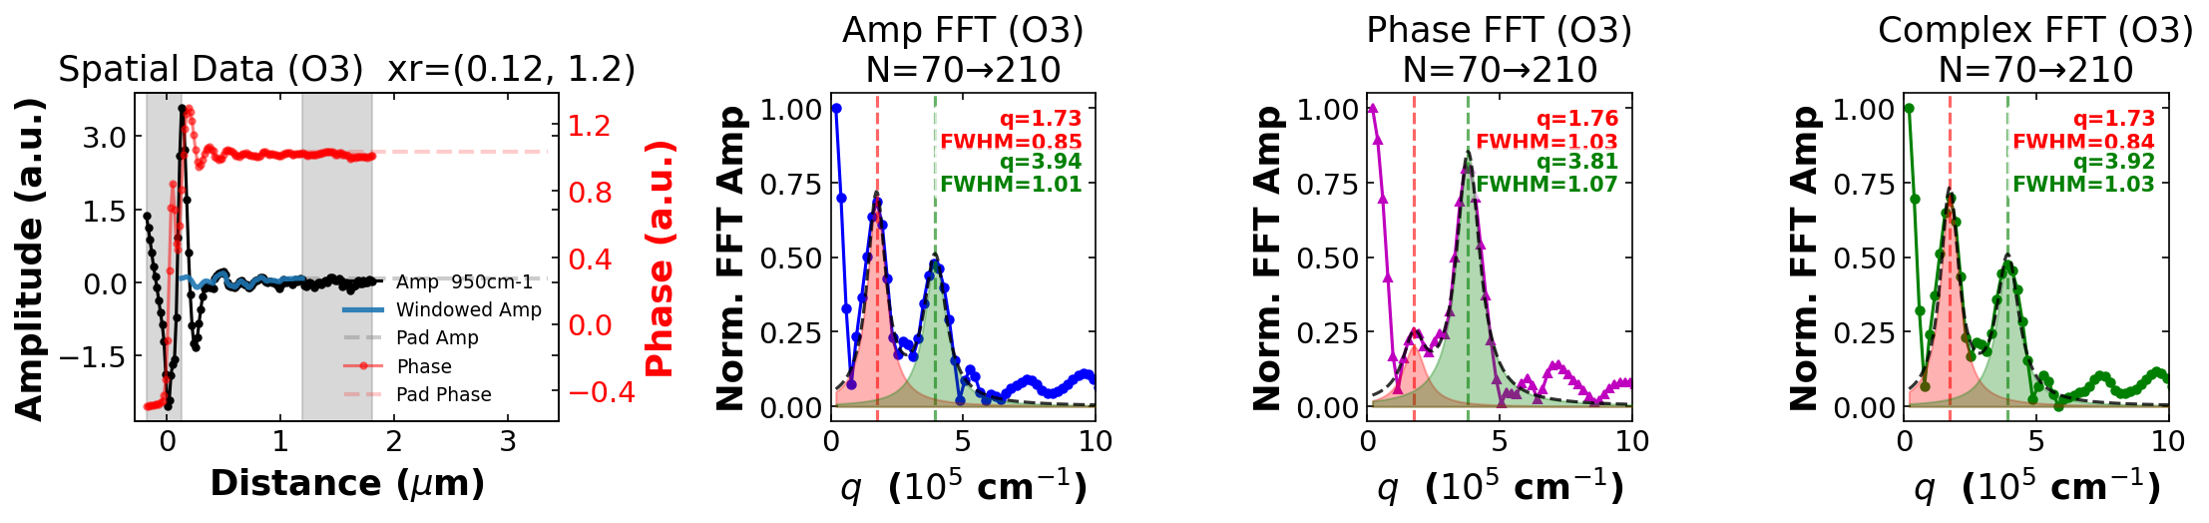
950cm⁻¹

Slide 19
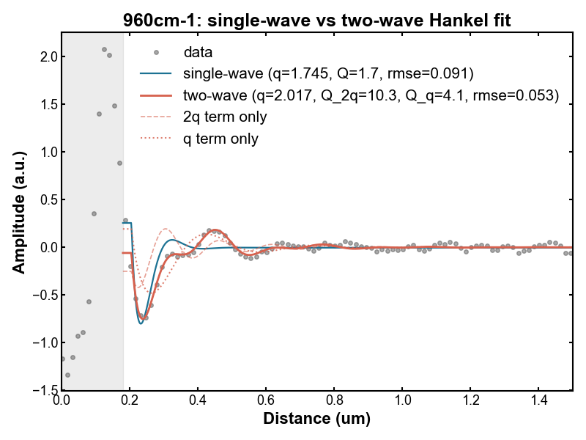
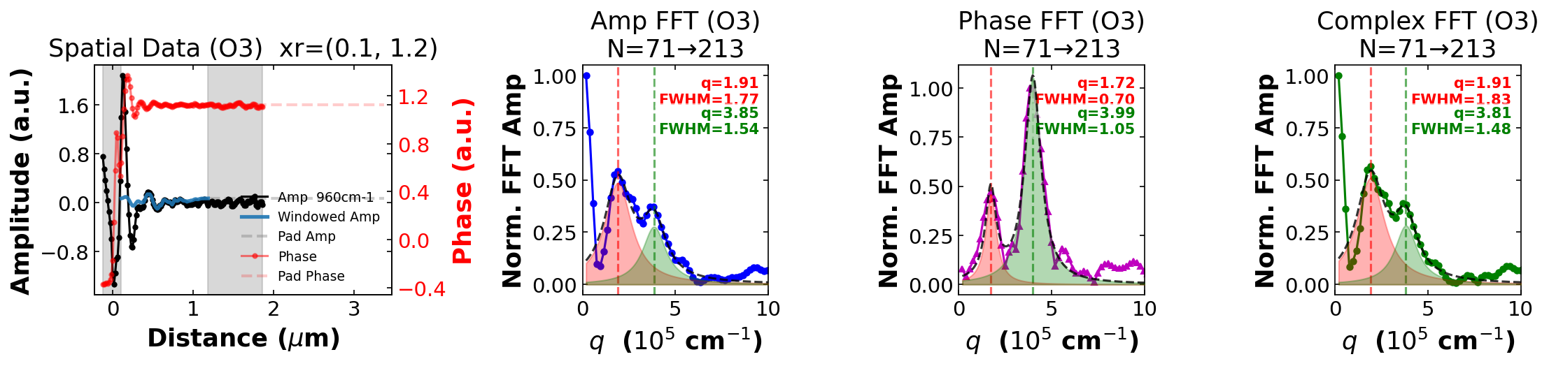
960cm⁻¹

Slide 20
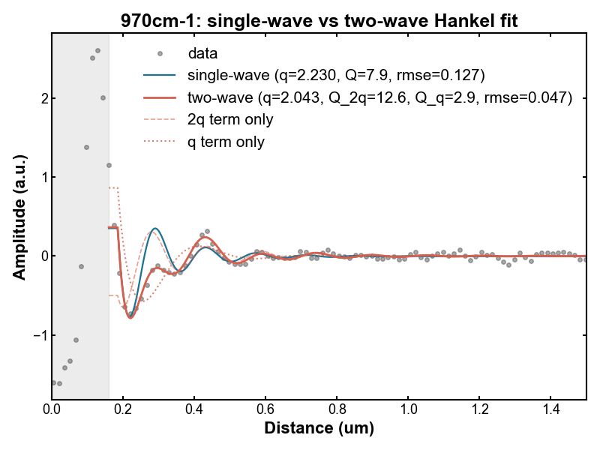
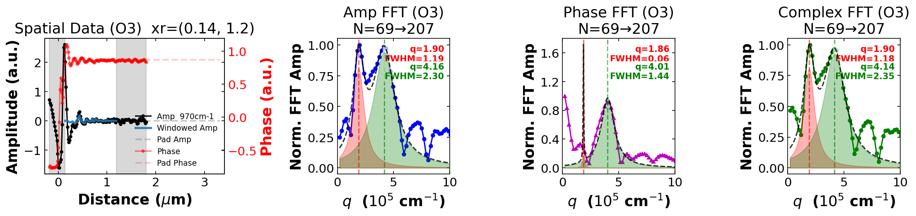
970cm⁻¹

Slide 21
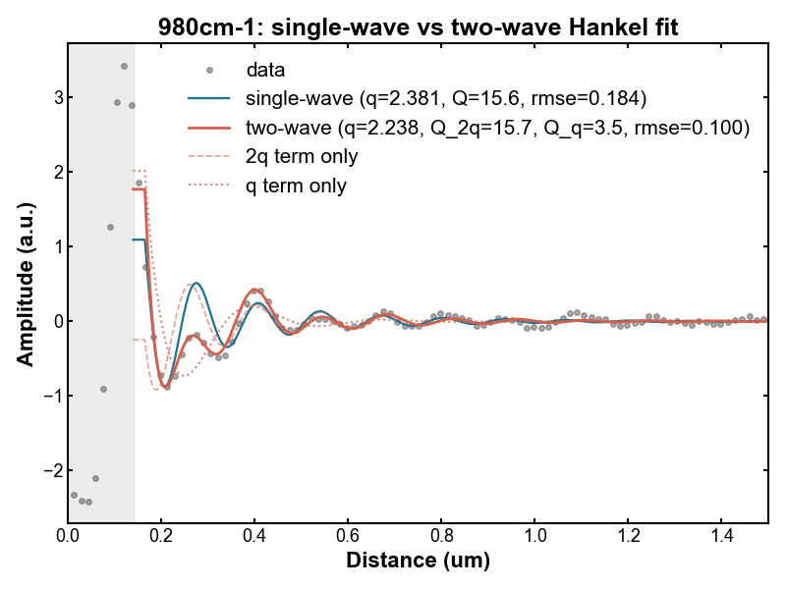
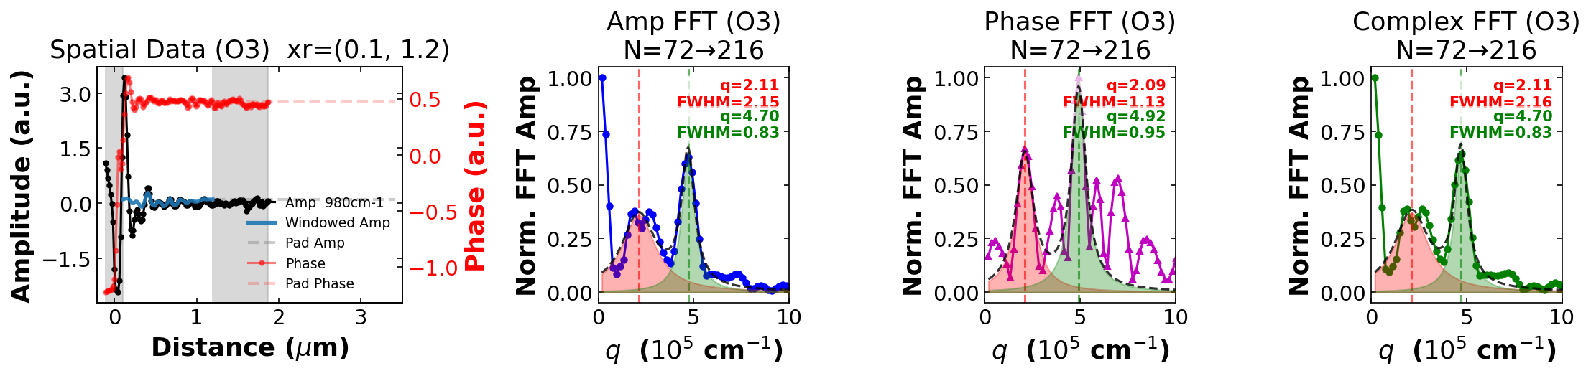
980cm⁻¹

Slide 22
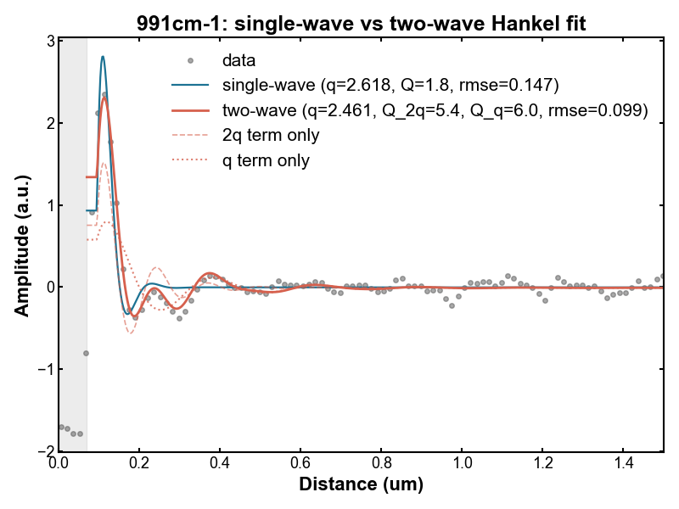
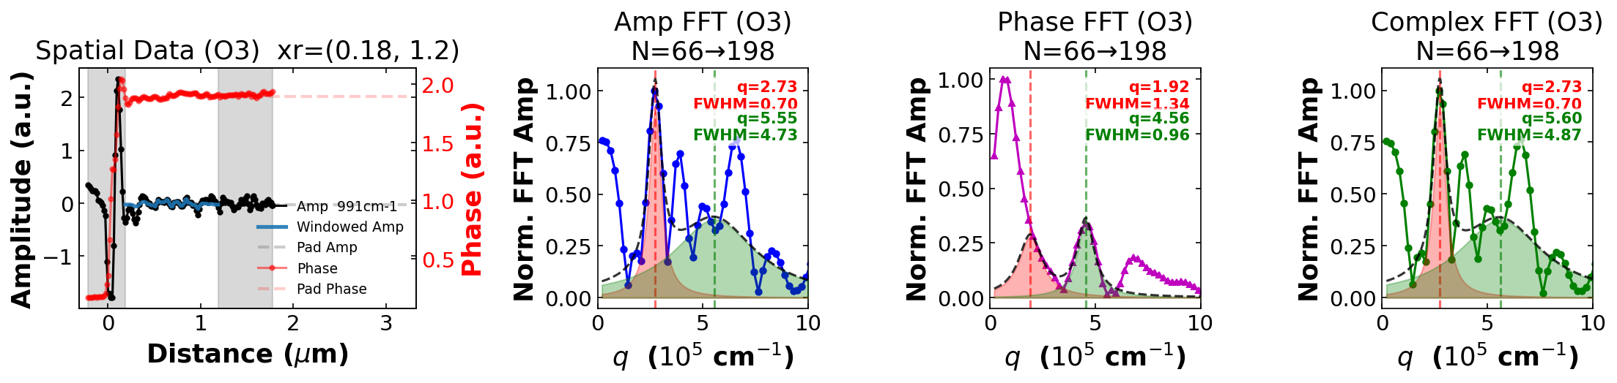
991cm⁻¹

Slide 23
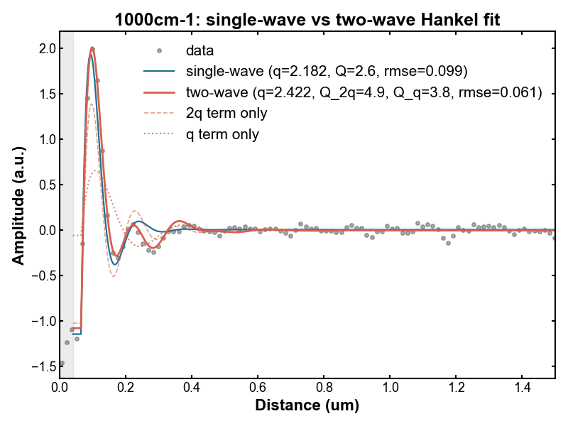
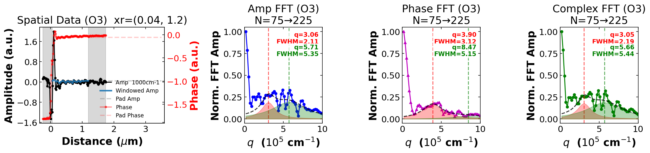
1000cm⁻¹

