Slide 1
GMG Graphene Plasmon Fitting
CHT vs. Real-Space (Hankel / 1/√x) vs. FFT — overview across 15 wavenumbers
860–1000 cm⁻¹ · nano-FTIR amplitude line profiles · graphene_4x1_manual dataset (lp2, right edge — manually-extracted+aligned linecuts from processed_4x1um/860-1000_AVG.npz)

Slide 2
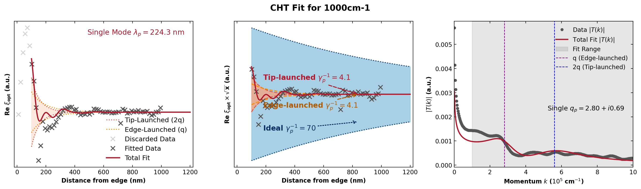
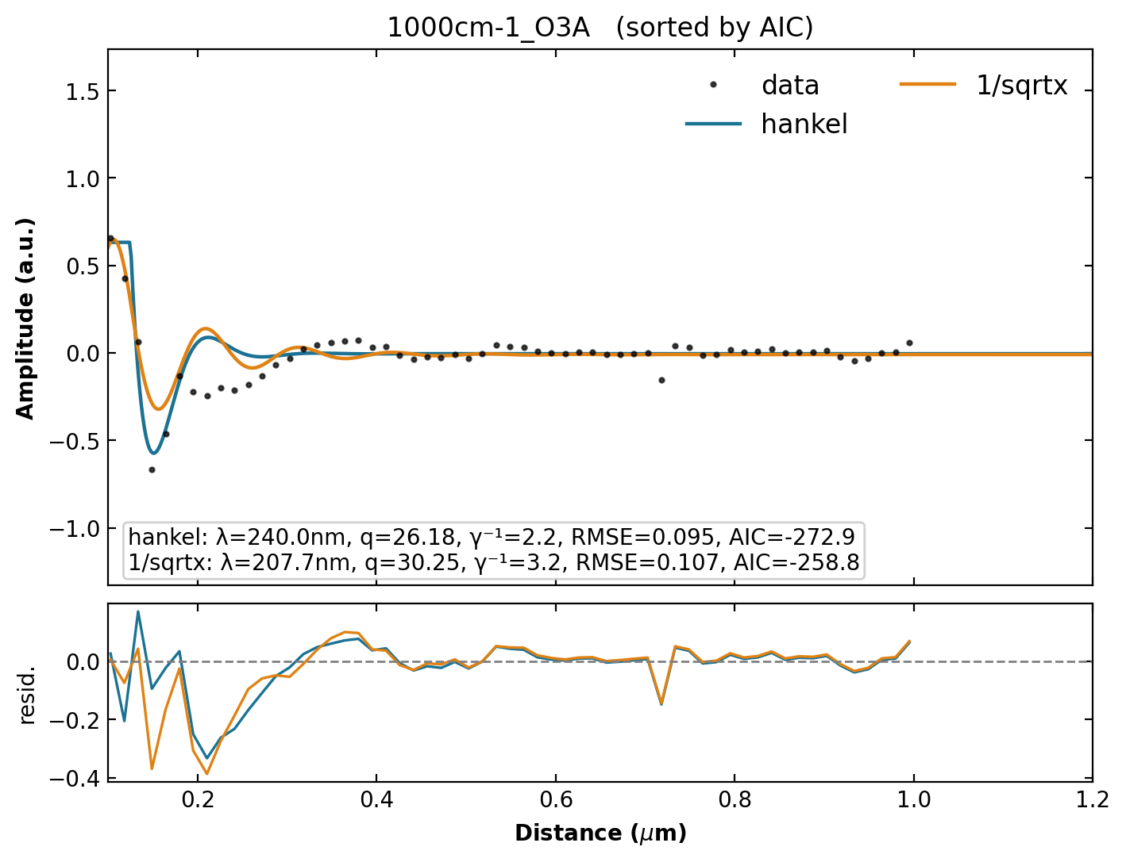
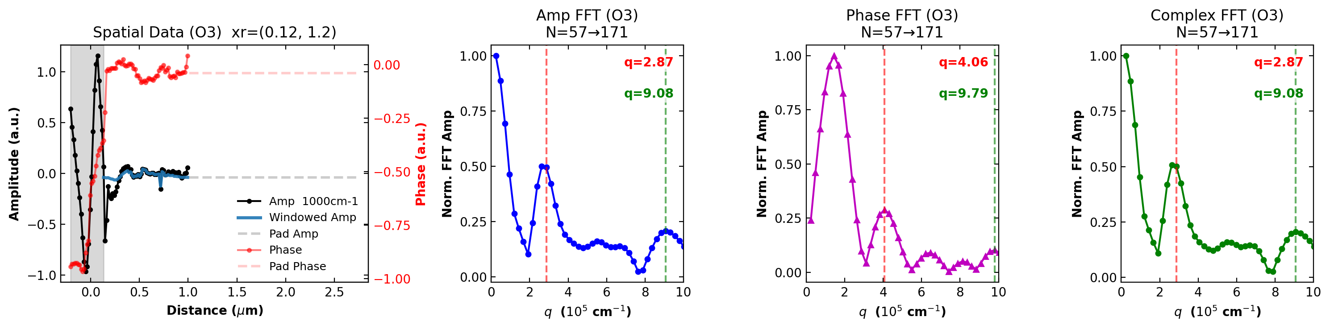
1000 cm⁻¹
CHT λₚ = 224.3 nm Hankel λₚ = 240.0 nm 1/√x λₚ = 207.7 nm Δ vs Hankel = 6.5% Δ vs 1/√x = 8.0%

Slide 3
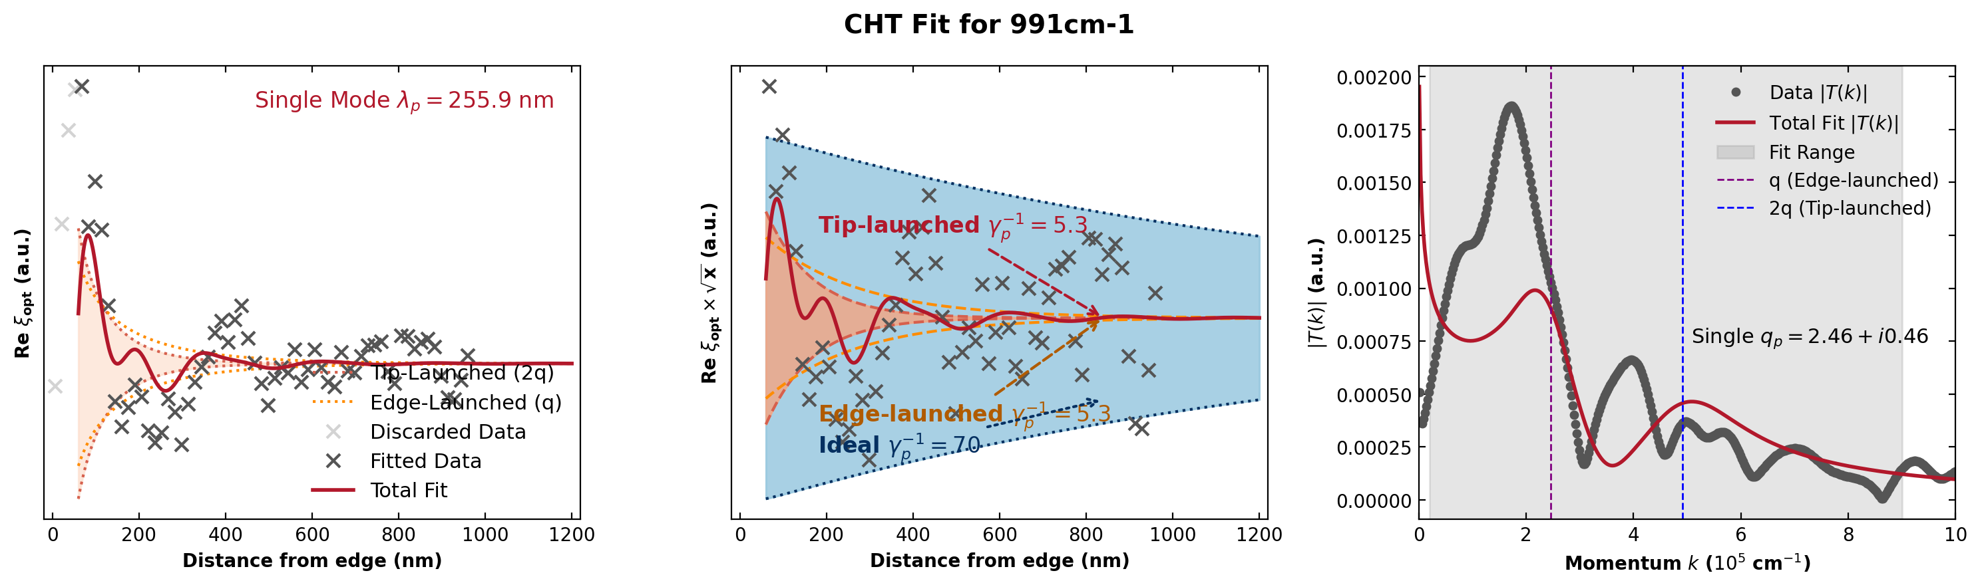
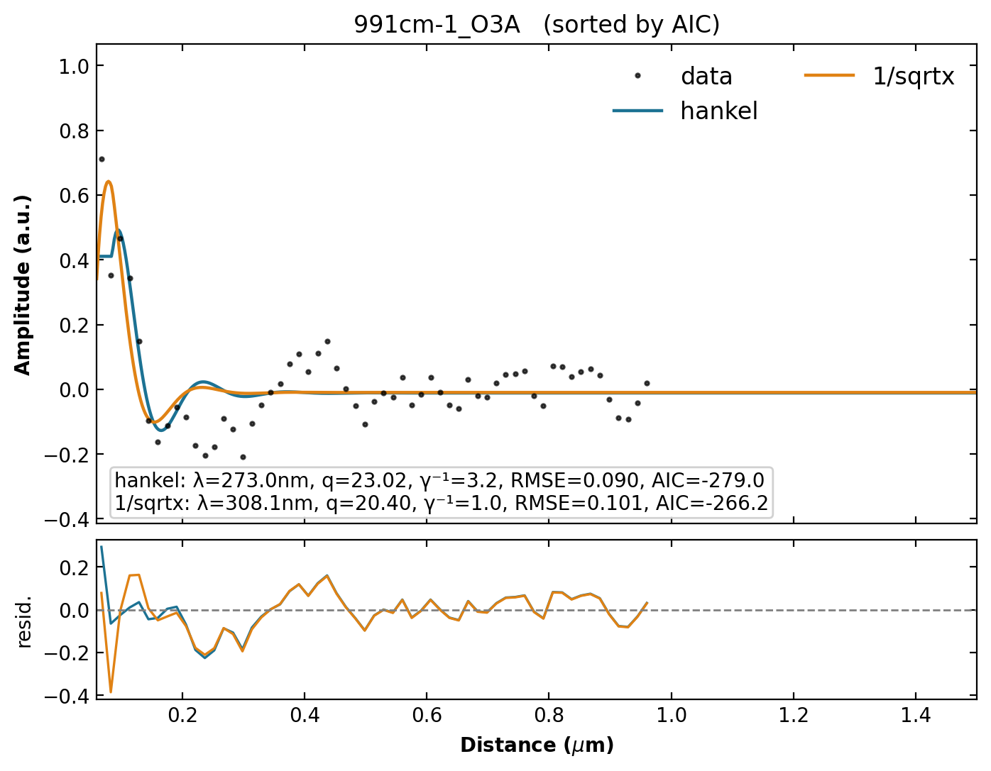
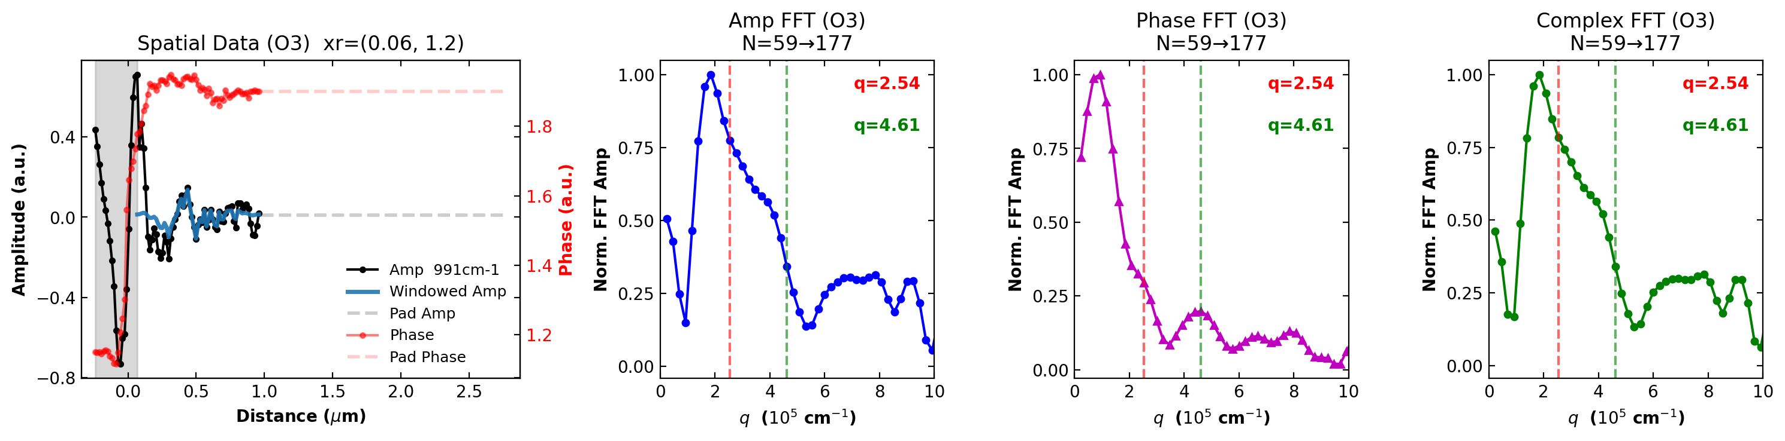
991 cm⁻¹
CHT λₚ = 255.9 nm Hankel λₚ = 273.0 nm 1/√x λₚ = 308.1 nm Δ vs Hankel = 6.3% Δ vs 1/√x = 16.9%

Slide 4
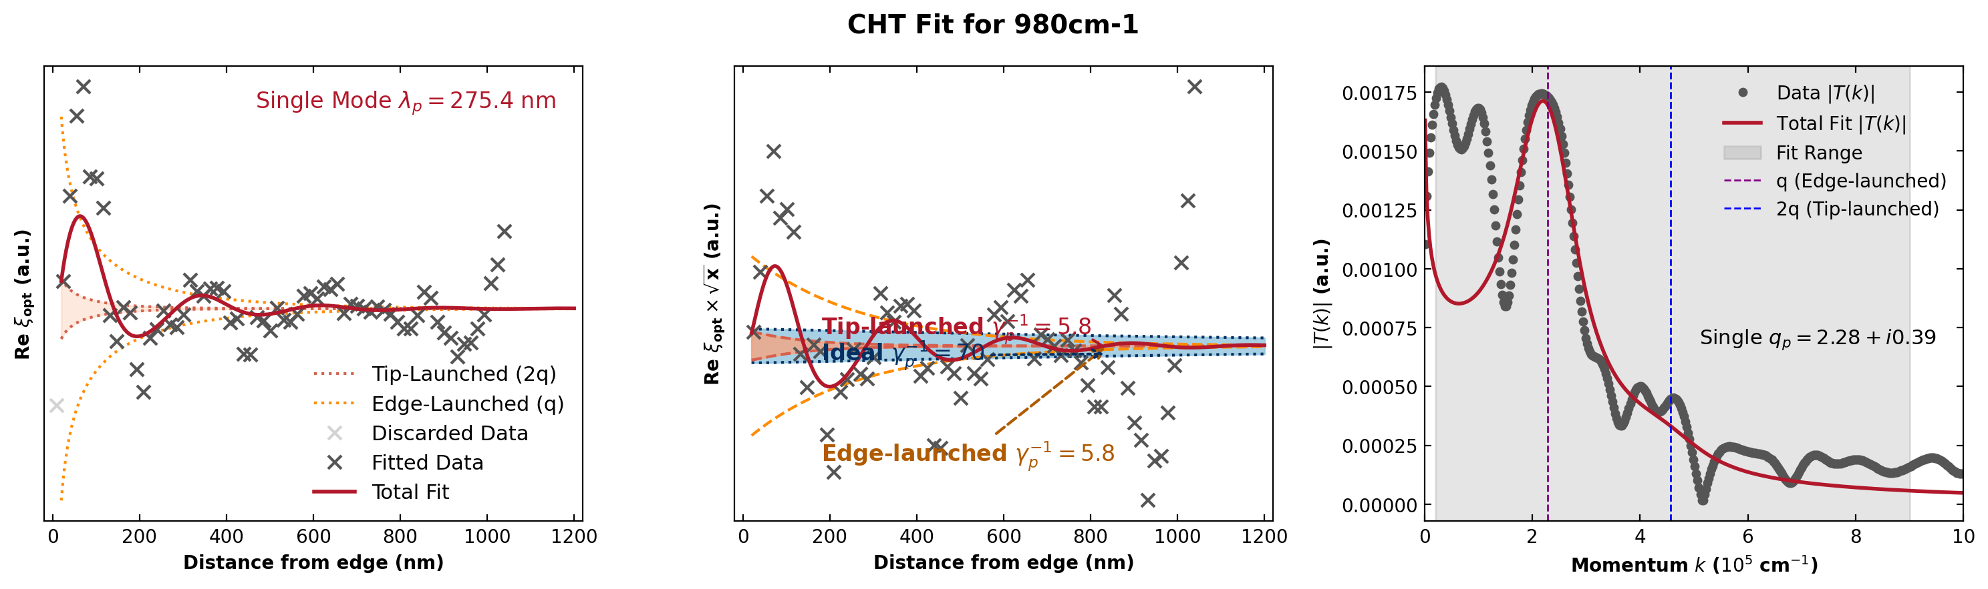
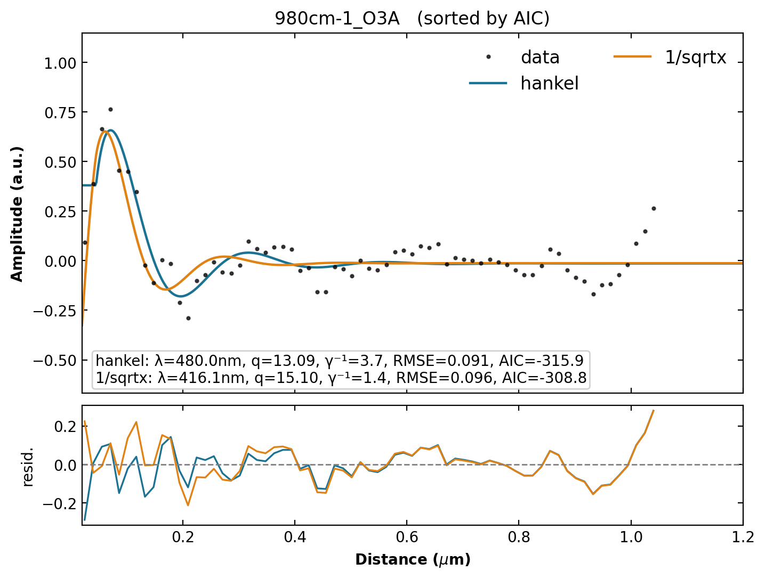
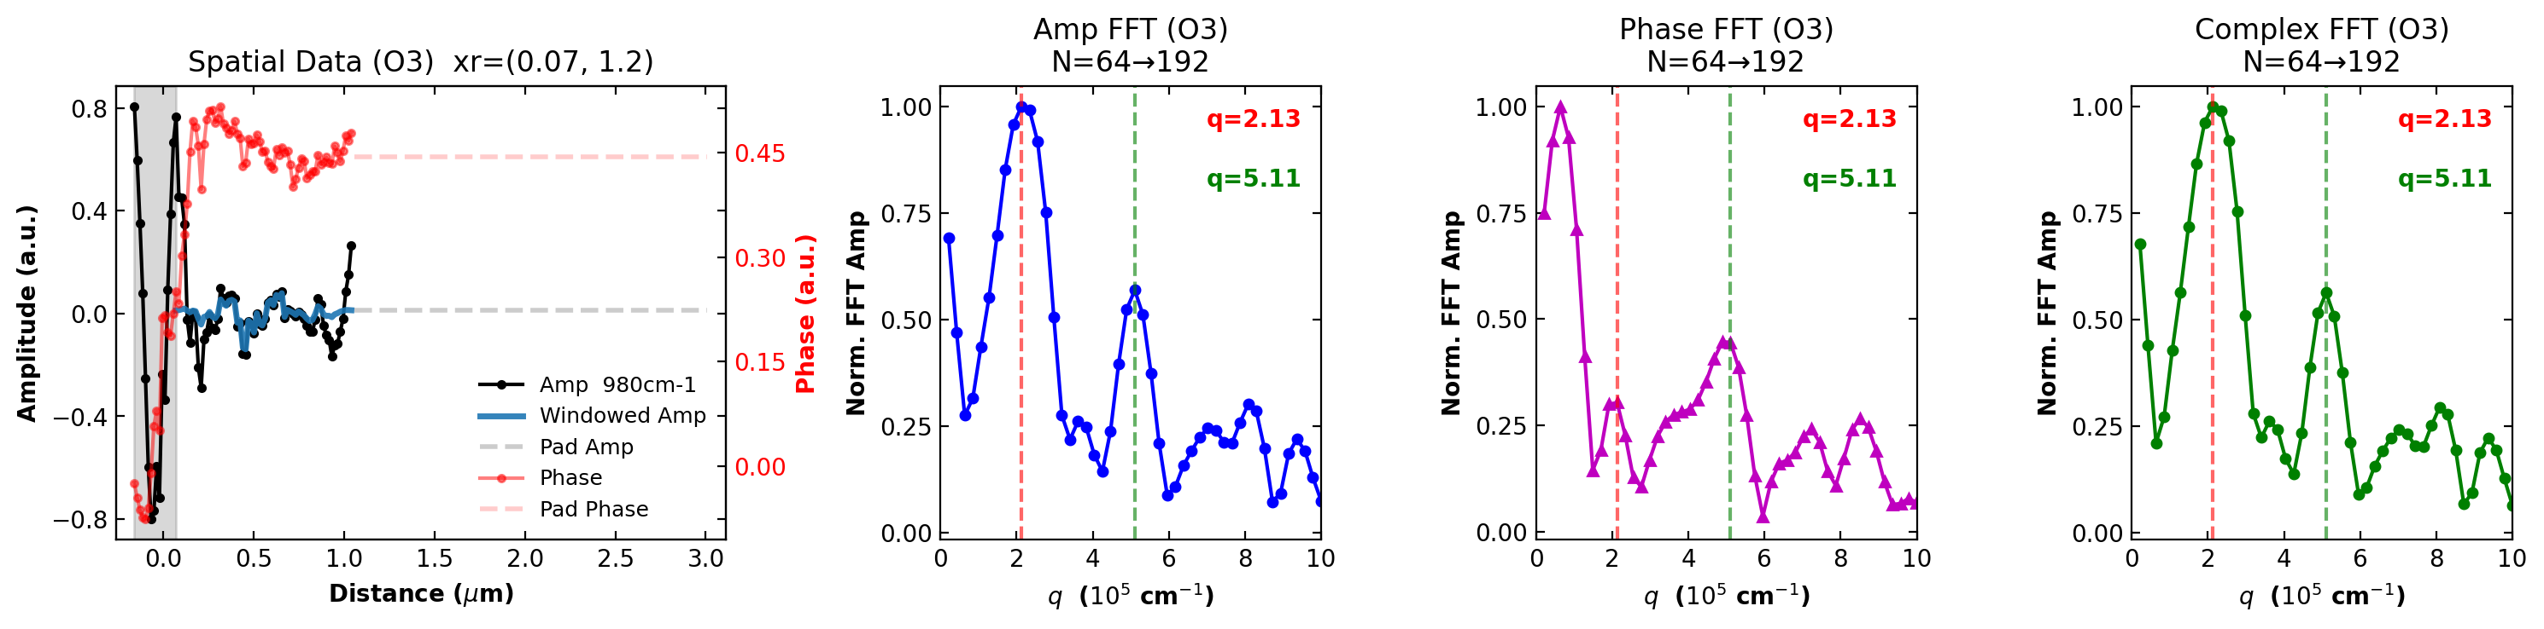
980 cm⁻¹
CHT λₚ = 275.4 nm Hankel λₚ = 480.0 nm 1/√x λₚ = 416.1 nm Δ vs Hankel = 42.6% Δ vs 1/√x = 33.8%

Slide 5
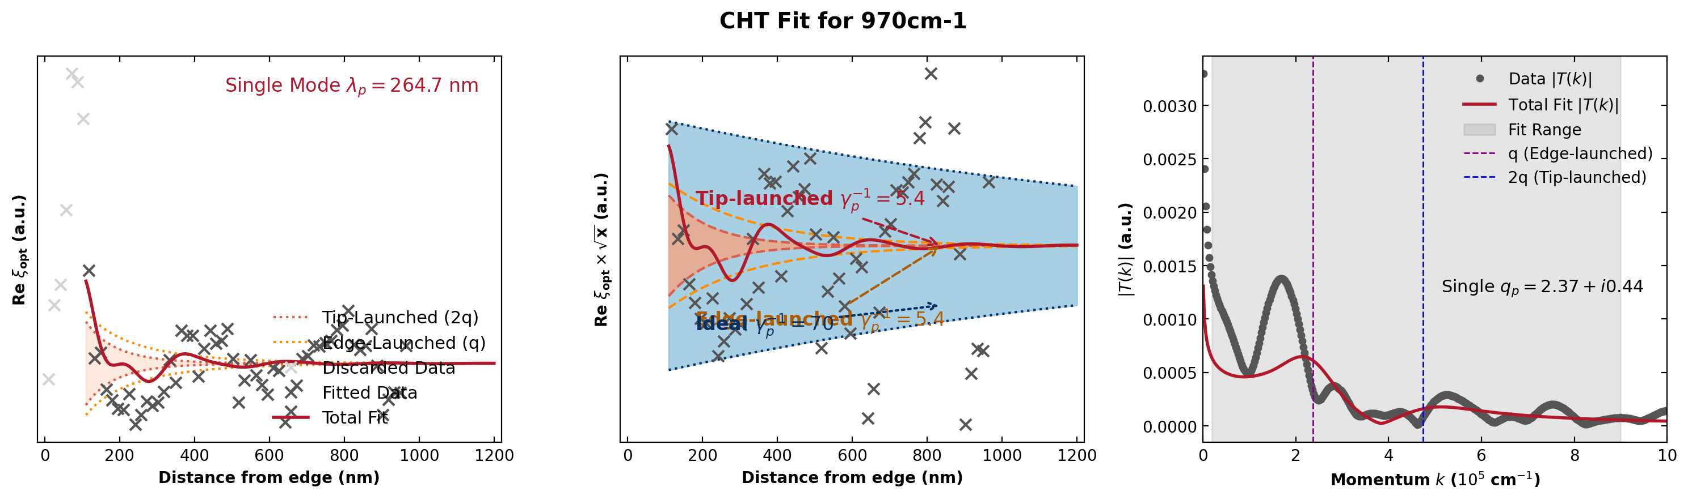
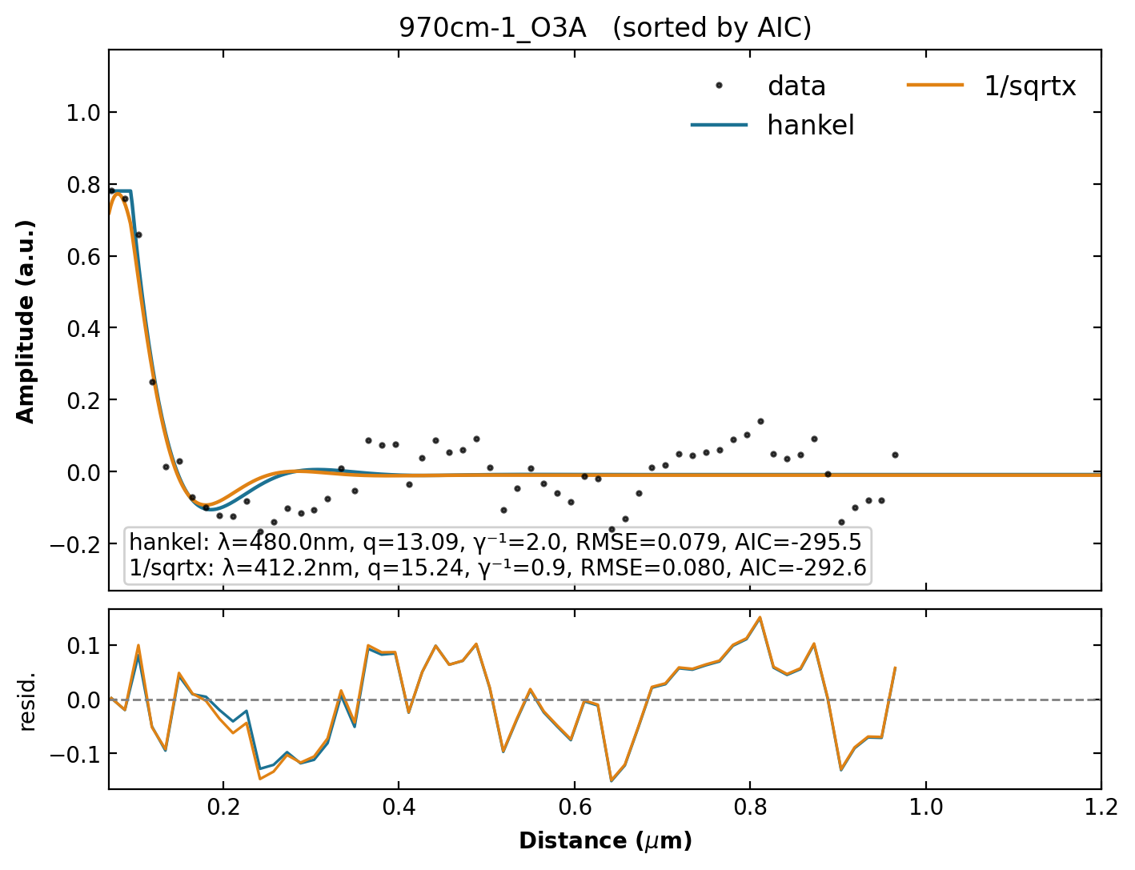
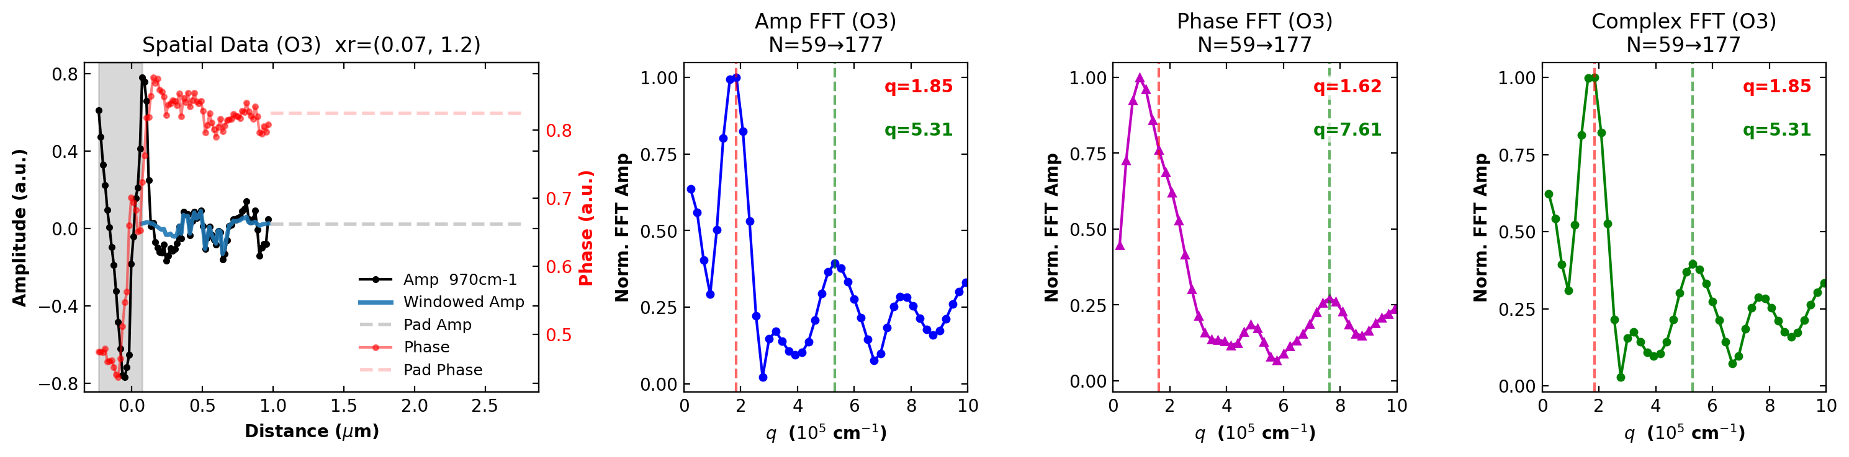
970 cm⁻¹
CHT λₚ = 264.7 nm Hankel λₚ = 480.0 nm 1/√x λₚ = 412.2 nm Δ vs Hankel = 44.9% Δ vs 1/√x = 35.8%

Slide 6
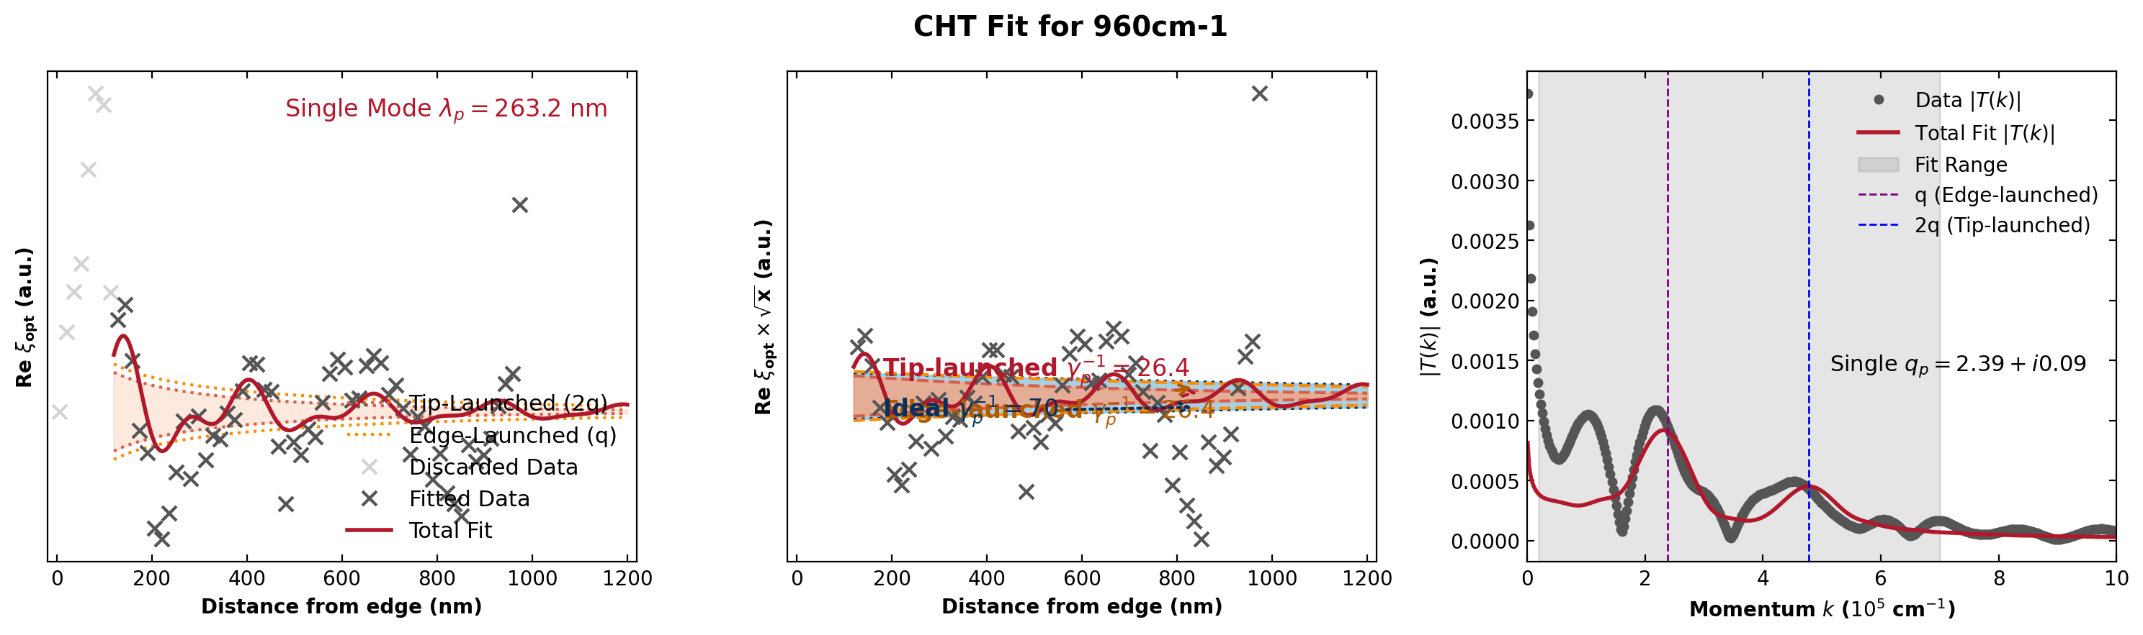
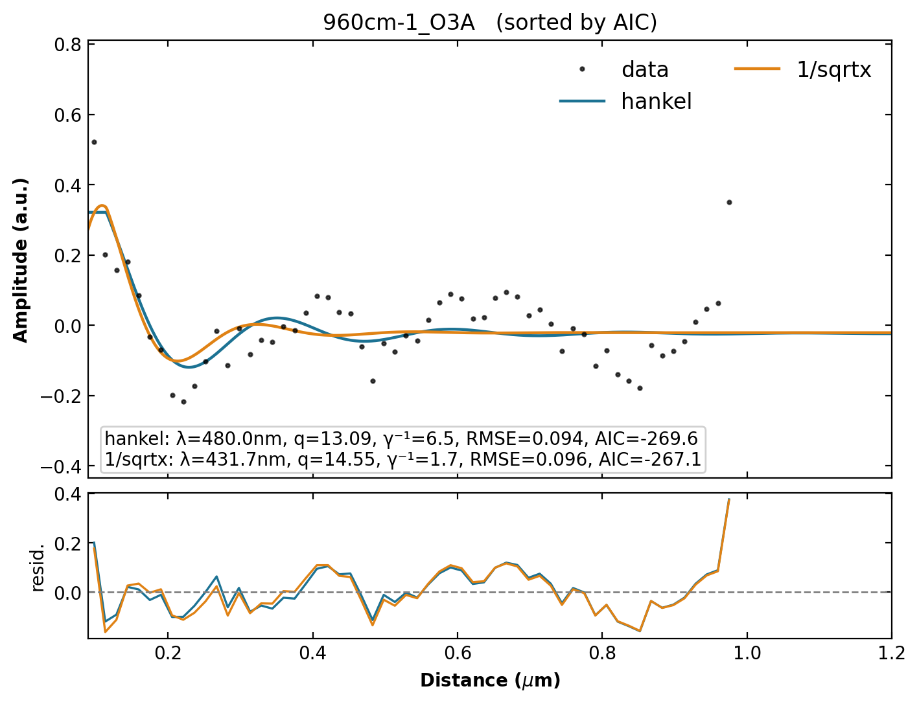
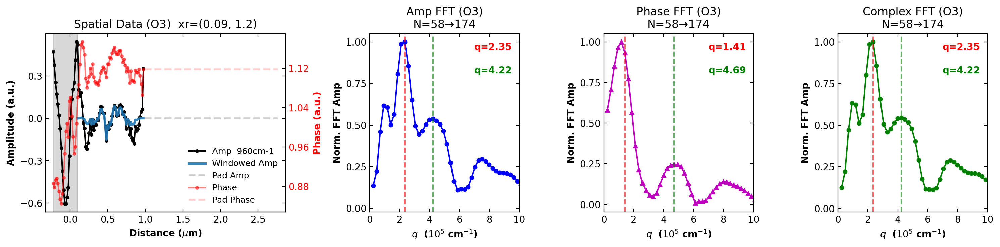
960 cm⁻¹
CHT λₚ = 263.2 nm Hankel λₚ = 480.0 nm 1/√x λₚ = 431.7 nm Δ vs Hankel = 45.2% Δ vs 1/√x = 39.0%

Slide 7
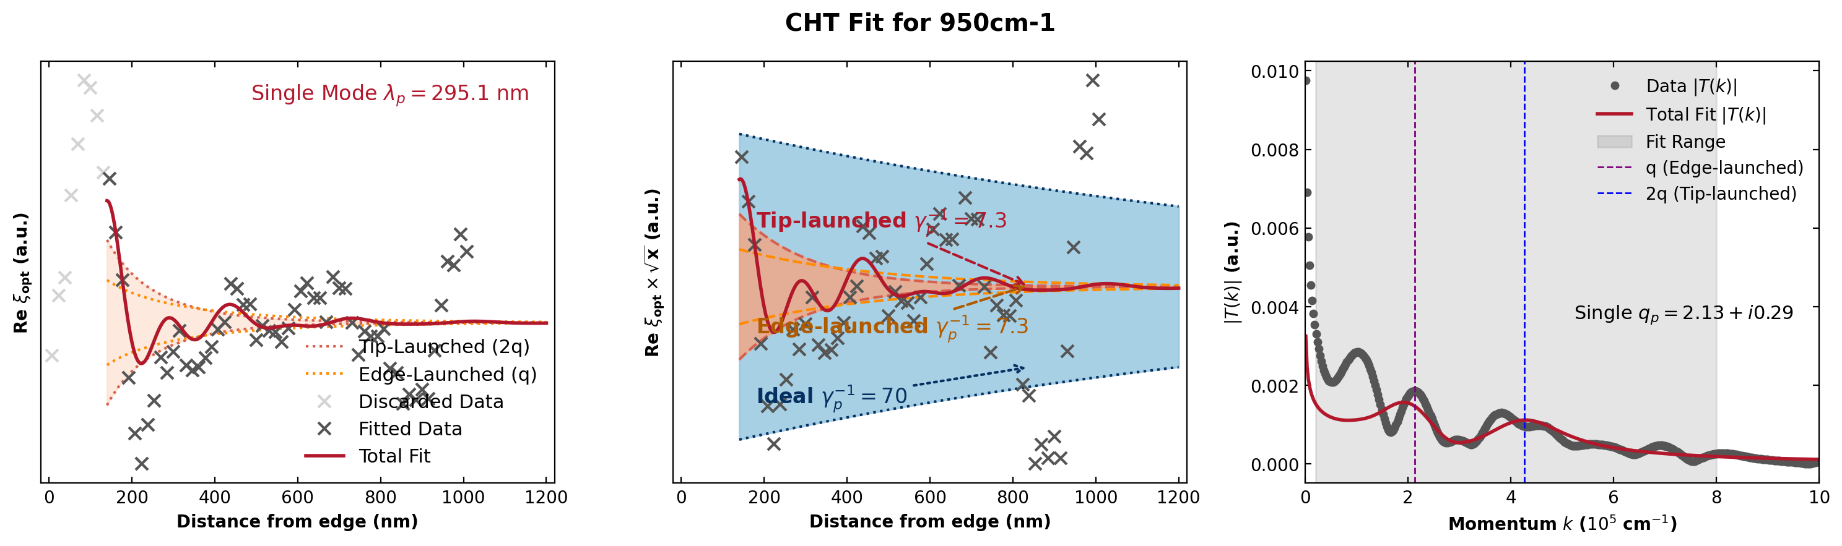
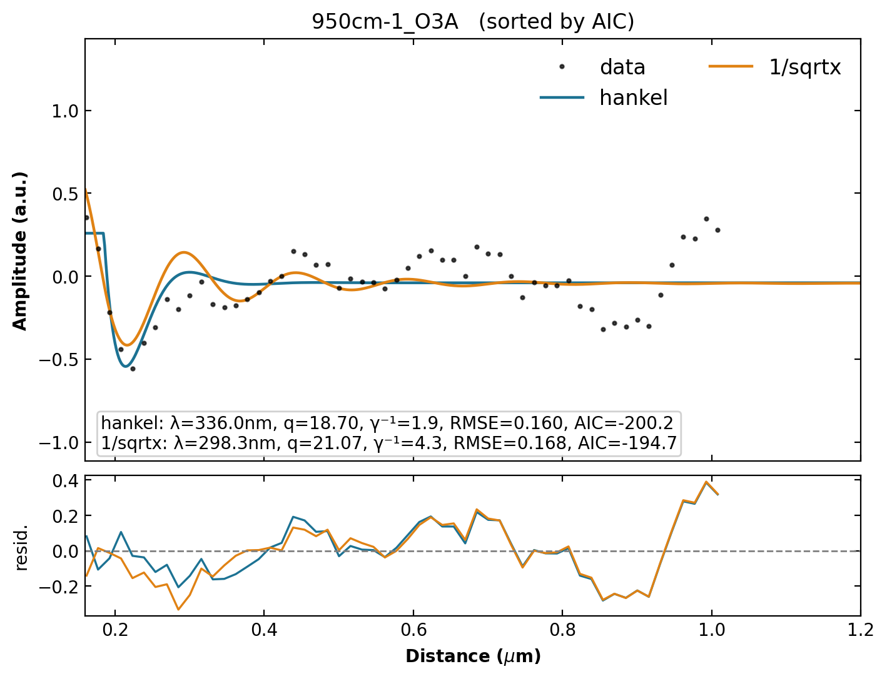
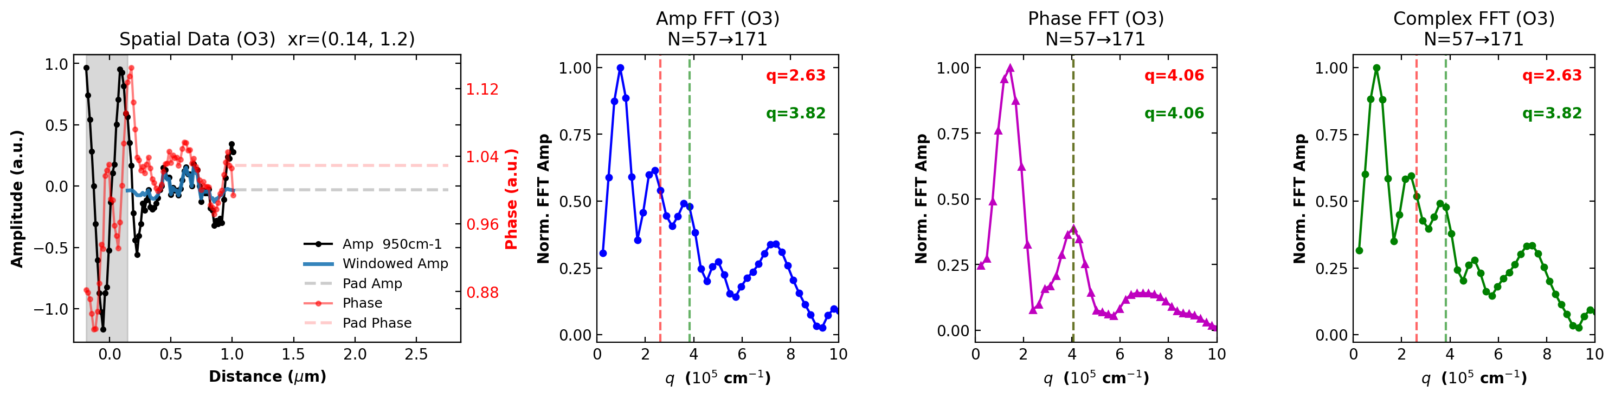
950 cm⁻¹
CHT λₚ = 295.1 nm Hankel λₚ = 336.0 nm 1/√x λₚ = 298.3 nm Δ vs Hankel = 12.2% Δ vs 1/√x = 1.1%

Slide 8
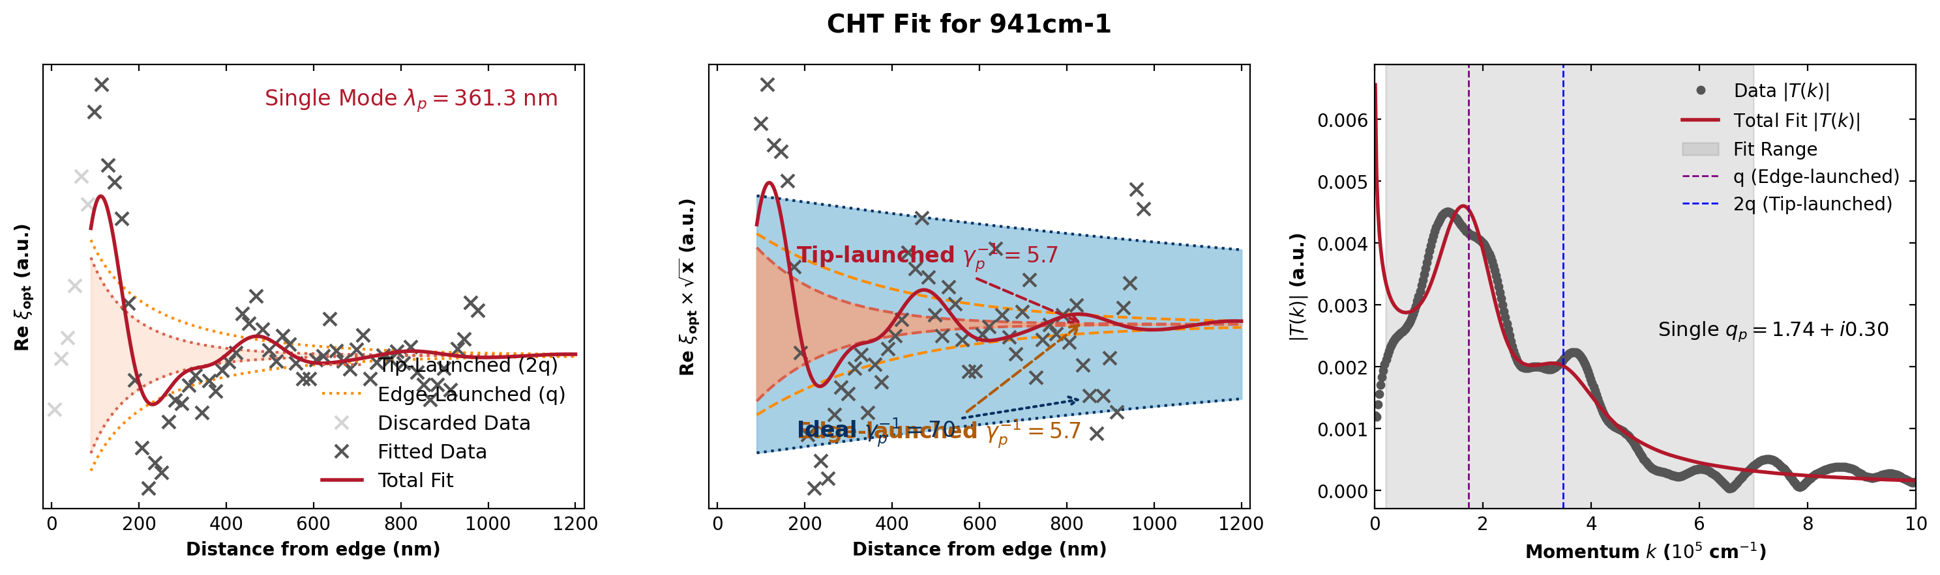
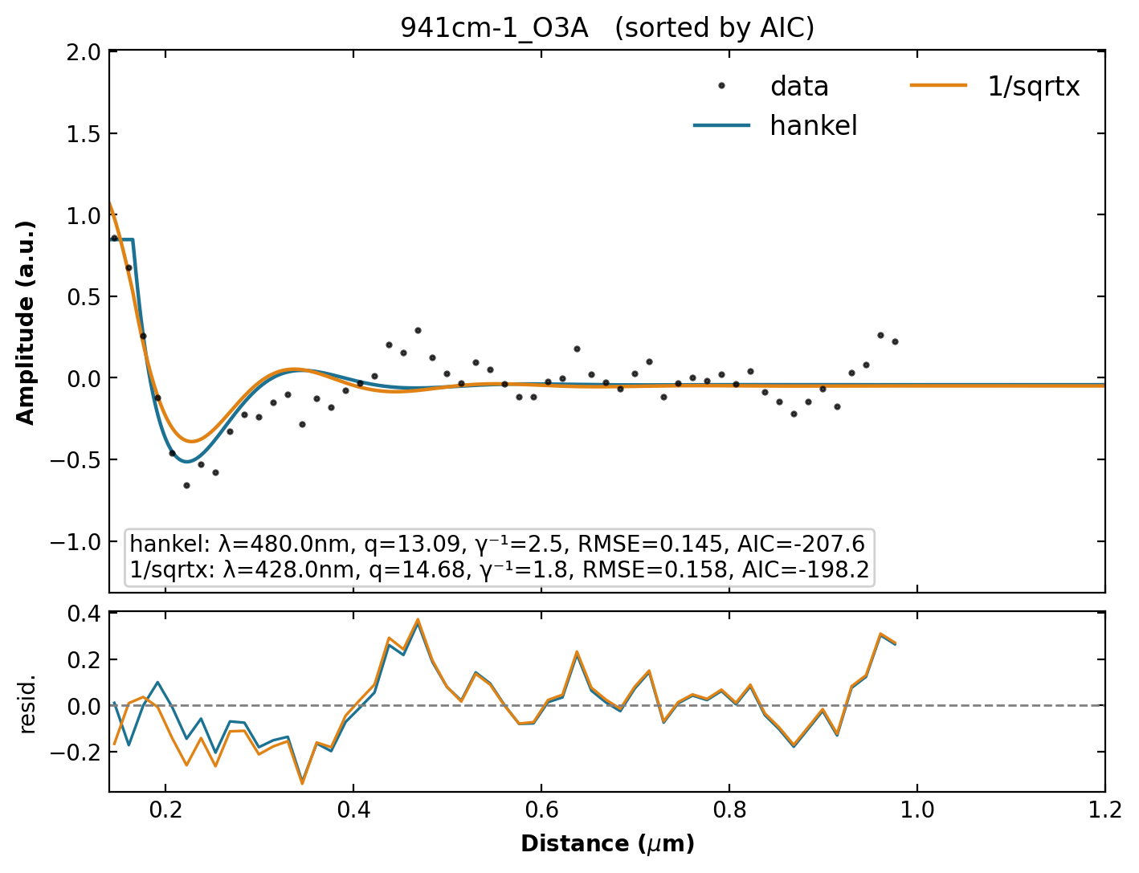
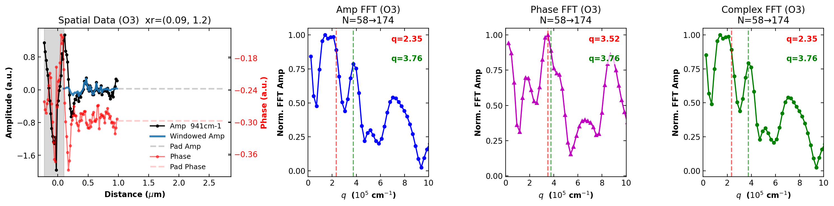
941 cm⁻¹
CHT λₚ = 361.3 nm Hankel λₚ = 480.0 nm 1/√x λₚ = 428.0 nm Δ vs Hankel = 24.7% Δ vs 1/√x = 15.6%

Slide 9
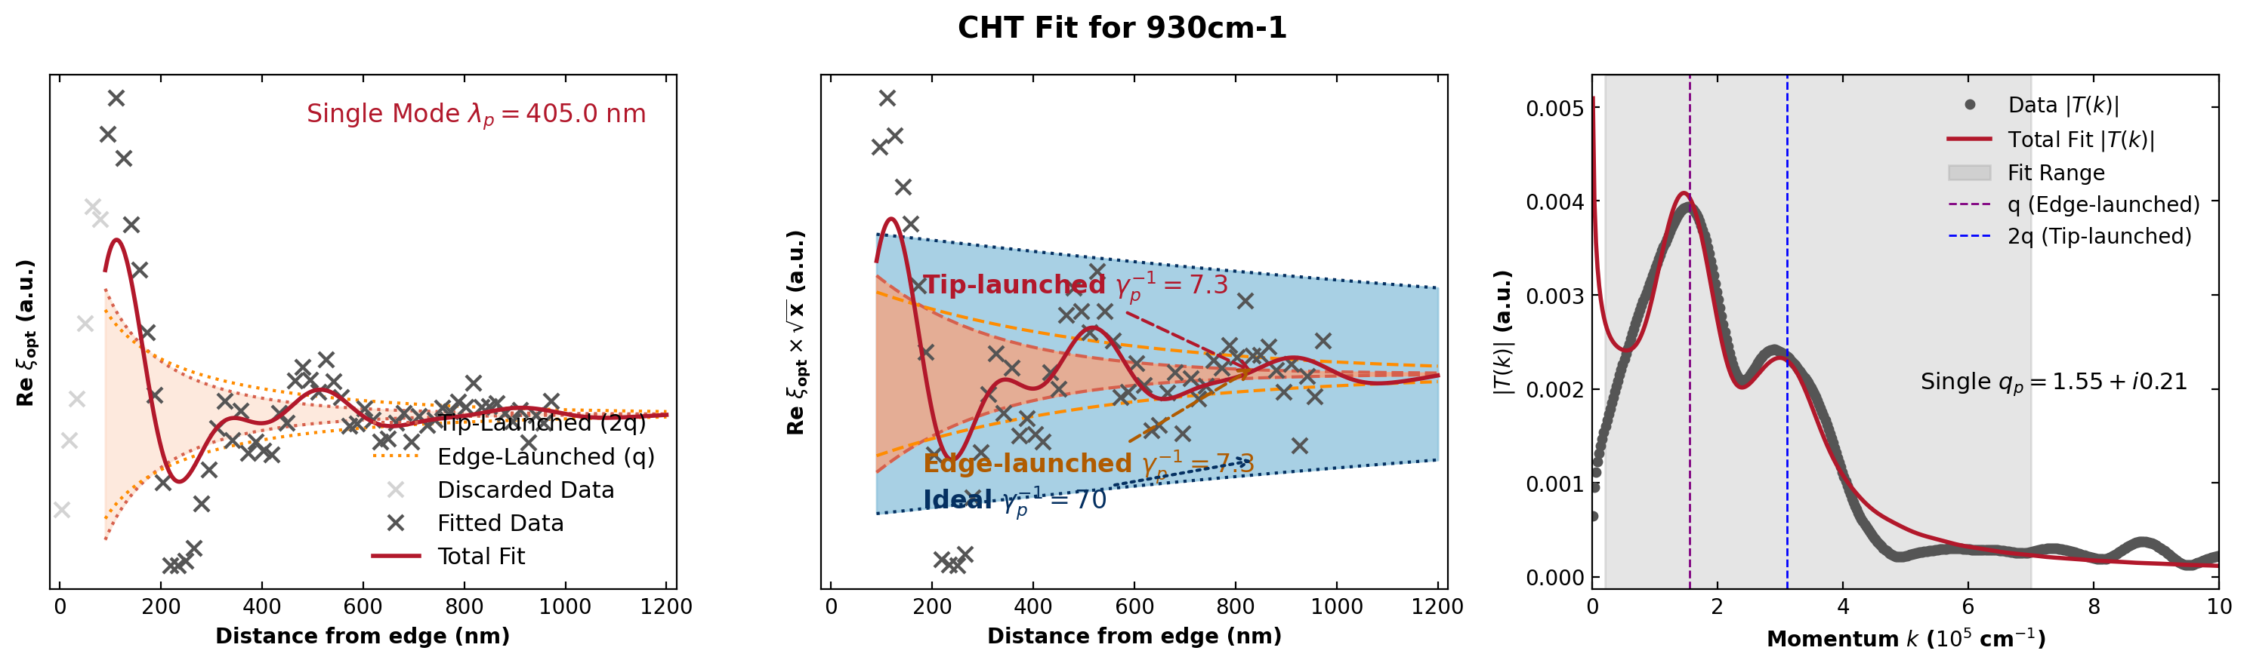
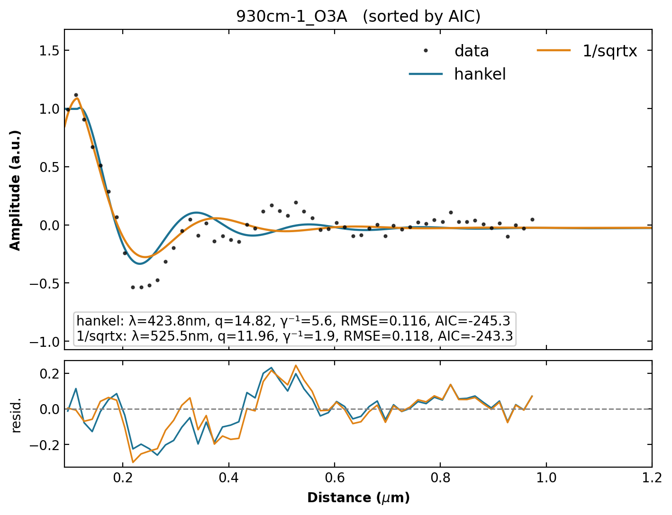
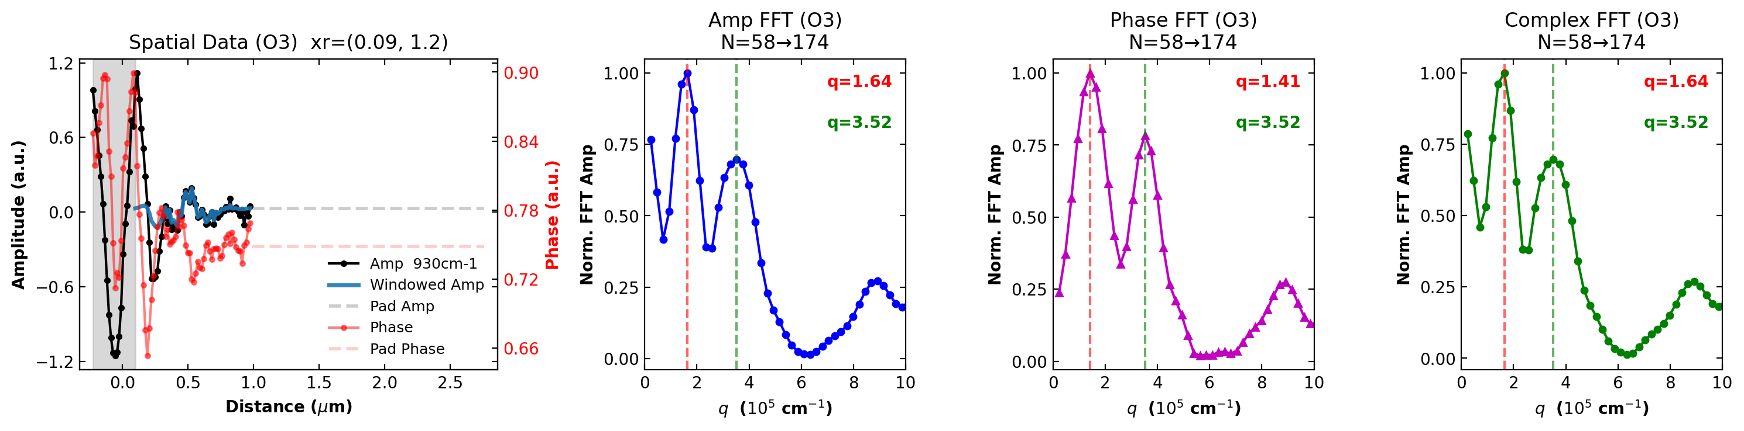
930 cm⁻¹
CHT λₚ = 405.0 nm Hankel λₚ = 423.8 nm 1/√x λₚ = 525.5 nm Δ vs Hankel = 4.4% Δ vs 1/√x = 22.9%

Slide 10
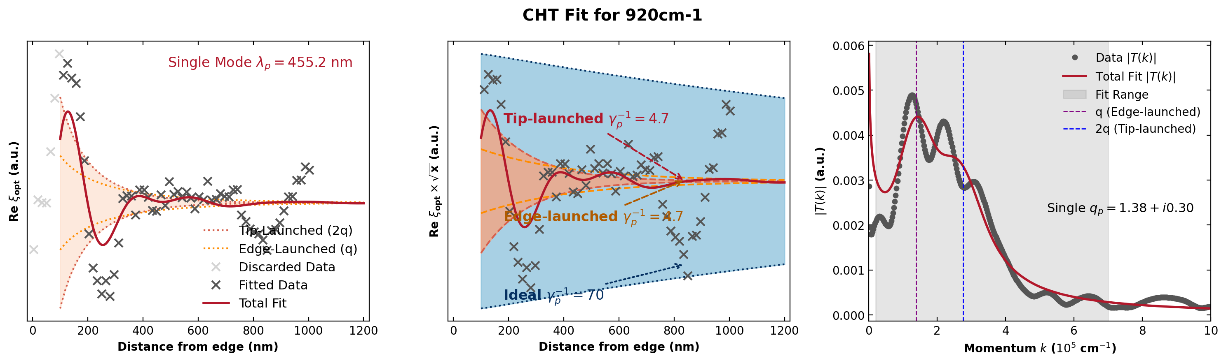
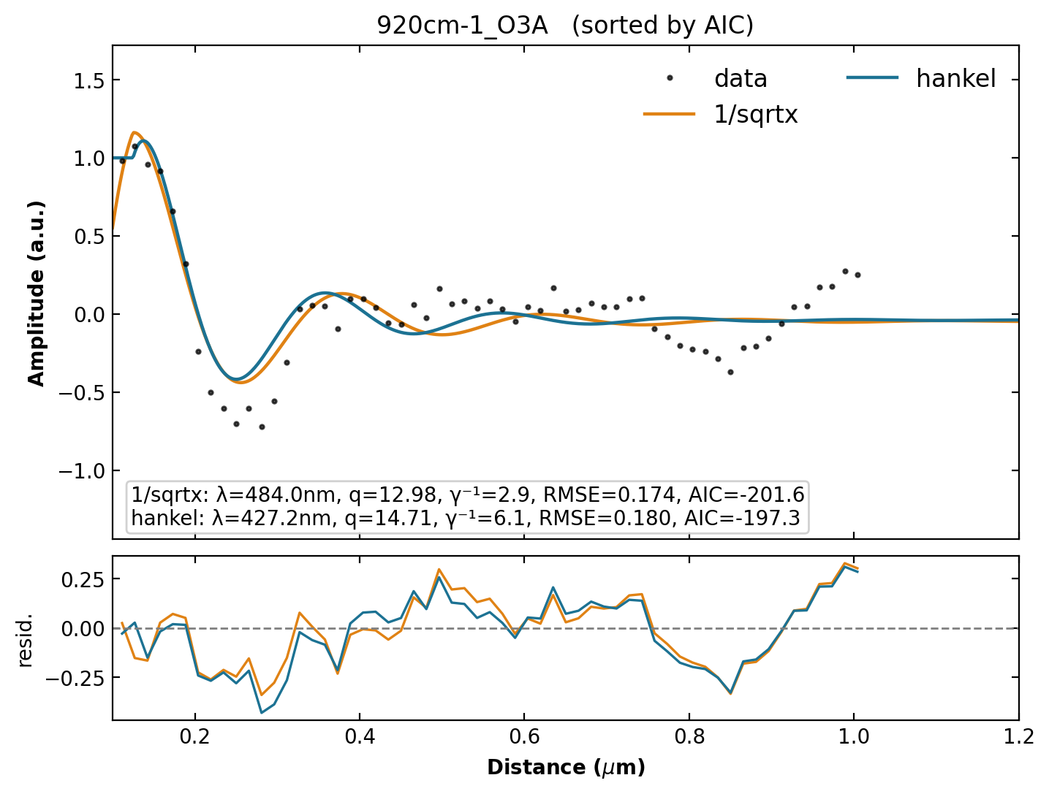
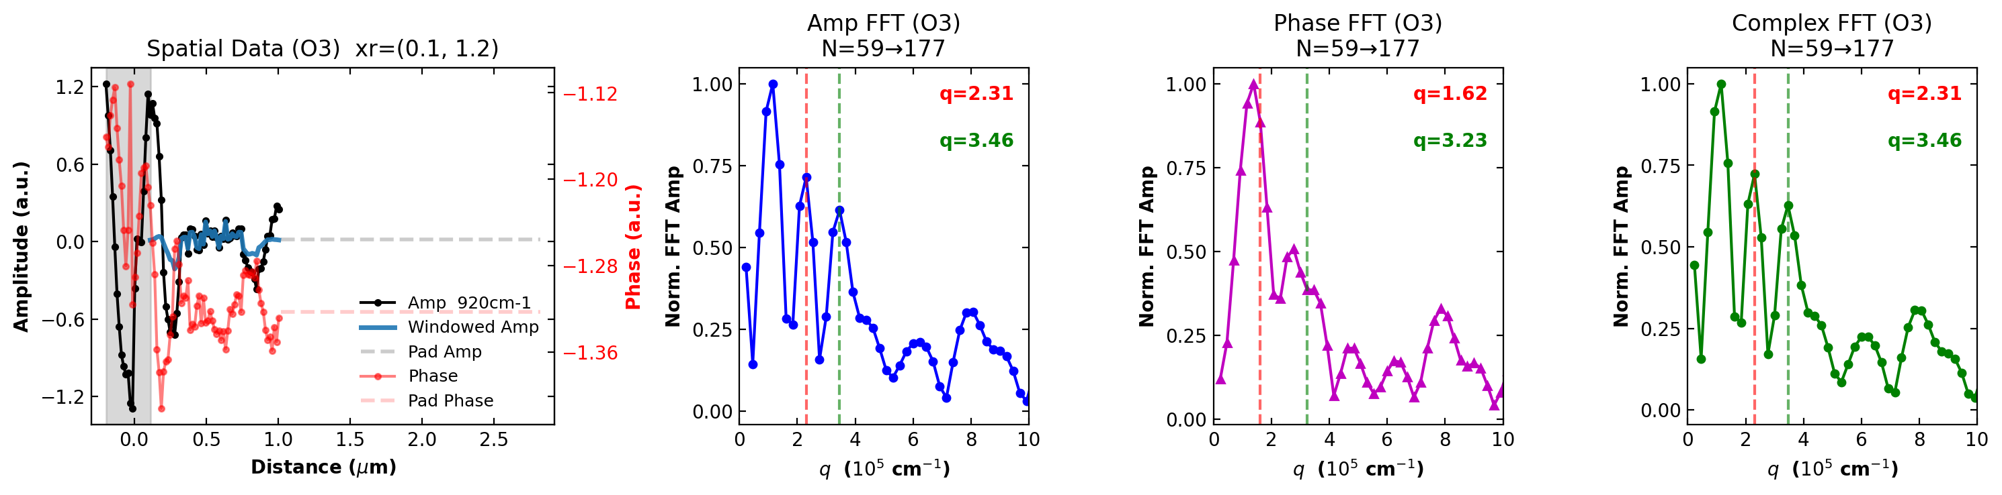
920 cm⁻¹
CHT λₚ = 455.2 nm Hankel λₚ = 427.2 nm 1/√x λₚ = 484.0 nm Δ vs Hankel = 6.5% Δ vs 1/√x = 6.0%

Slide 11
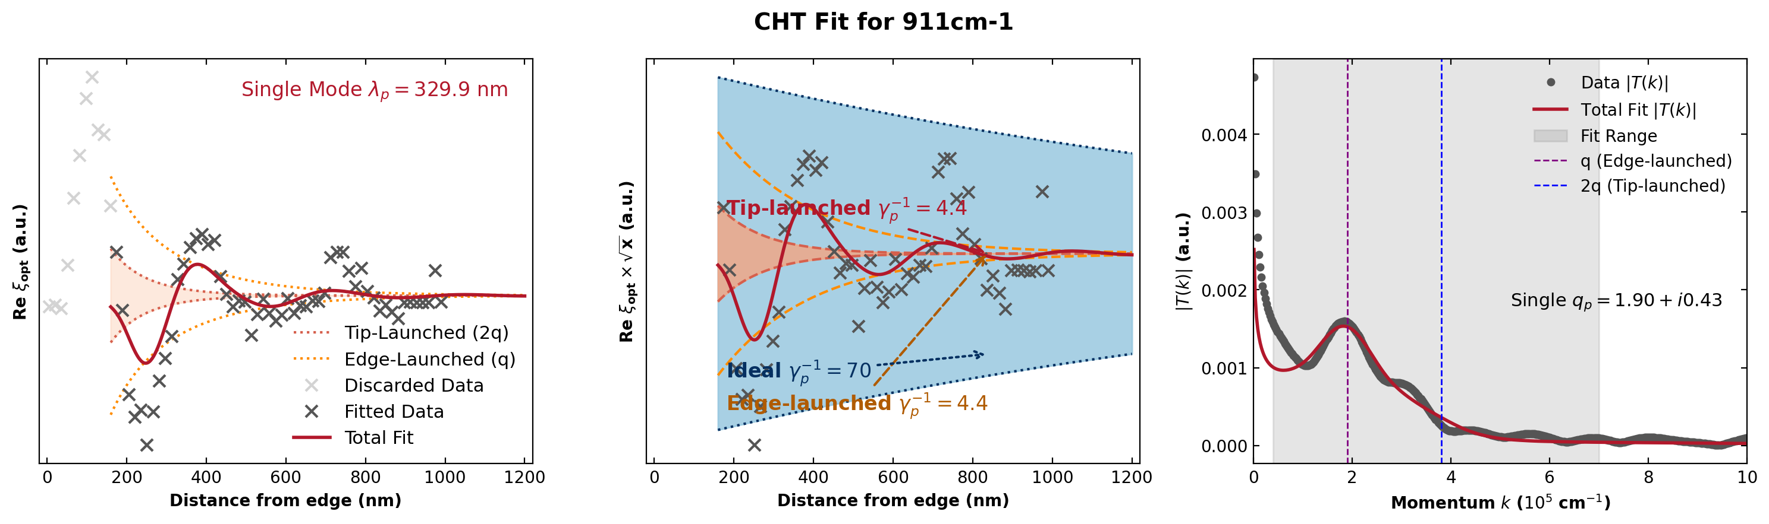
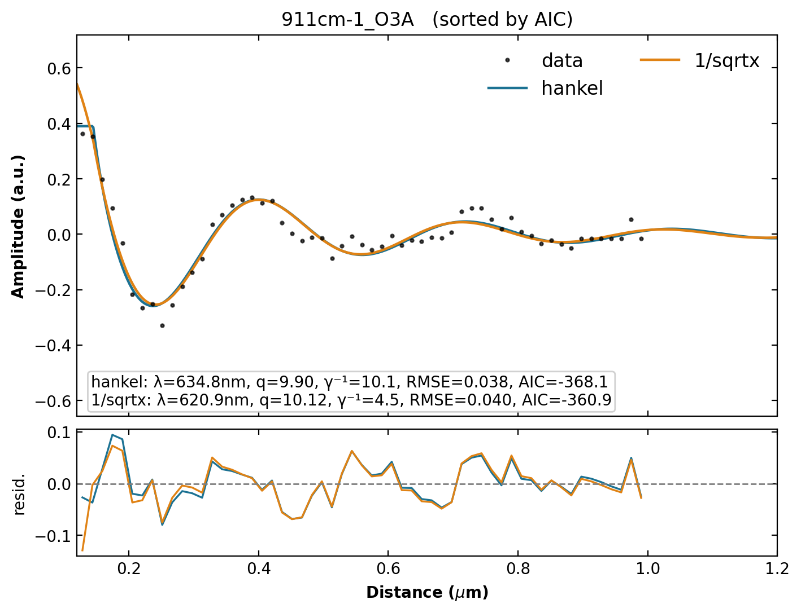
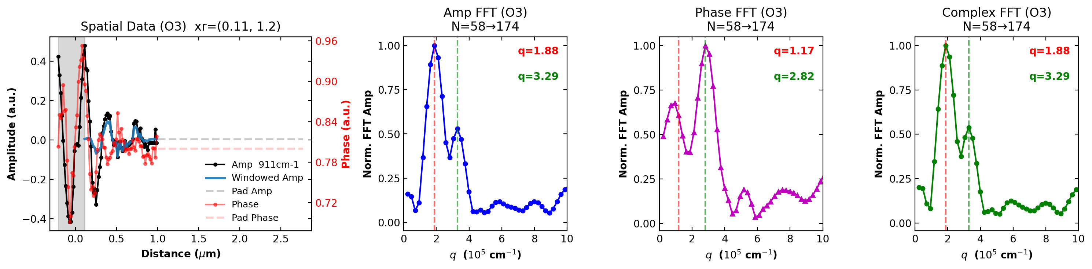
911 cm⁻¹
CHT λₚ = 329.9 nm Hankel λₚ = 634.8 nm 1/√x λₚ = 620.9 nm Δ vs Hankel = 48.0% Δ vs 1/√x = 46.9%

Slide 12
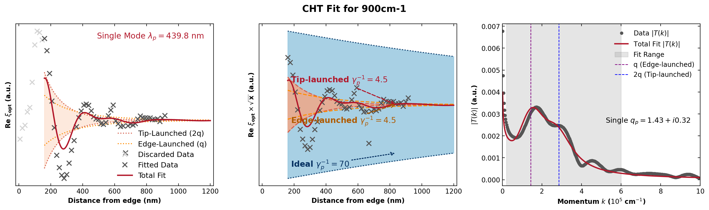
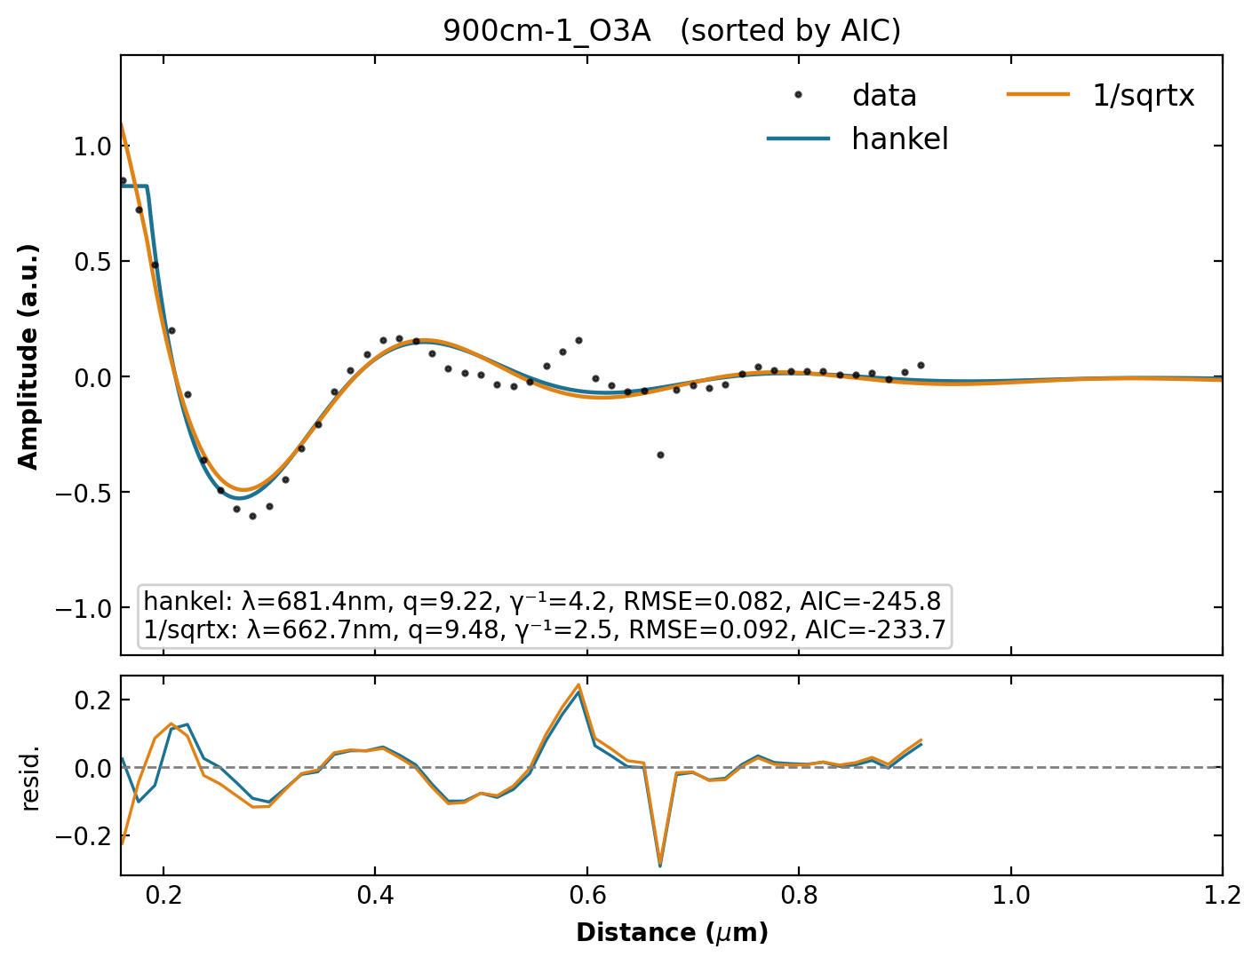
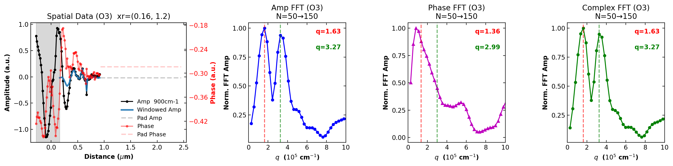
900 cm⁻¹
CHT λₚ = 439.8 nm Hankel λₚ = 681.4 nm 1/√x λₚ = 662.7 nm Δ vs Hankel = 35.5% Δ vs 1/√x = 33.6%

Slide 13
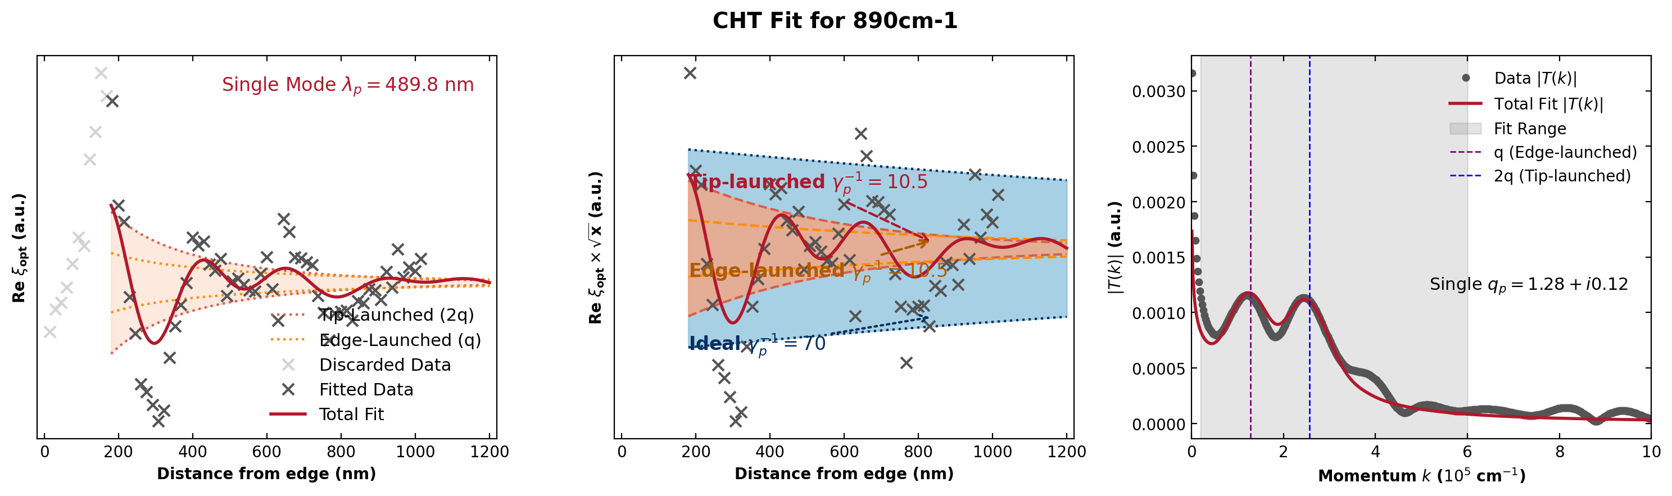
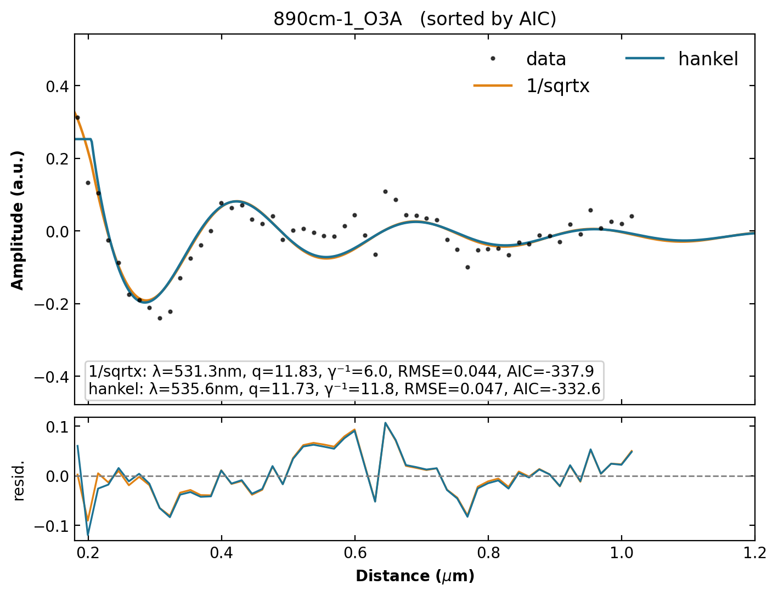
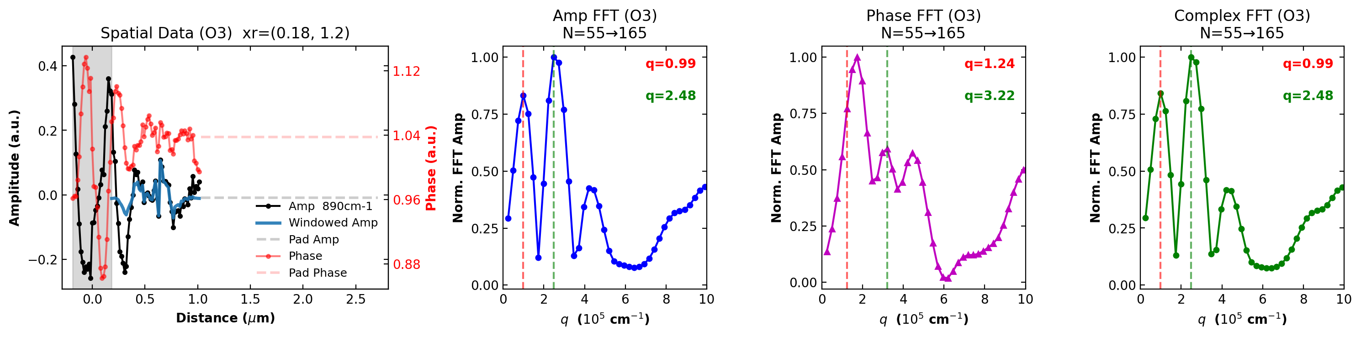
890 cm⁻¹
CHT λₚ = 489.8 nm Hankel λₚ = 535.6 nm 1/√x λₚ = 531.3 nm Δ vs Hankel = 8.6% Δ vs 1/√x = 7.8%

Slide 14
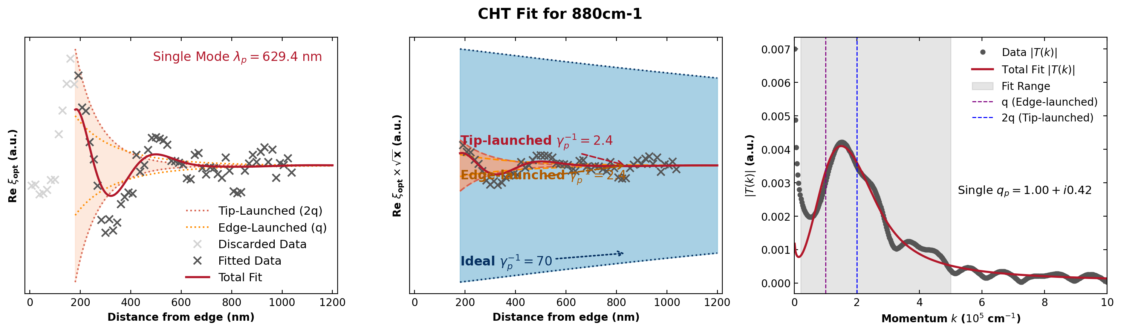
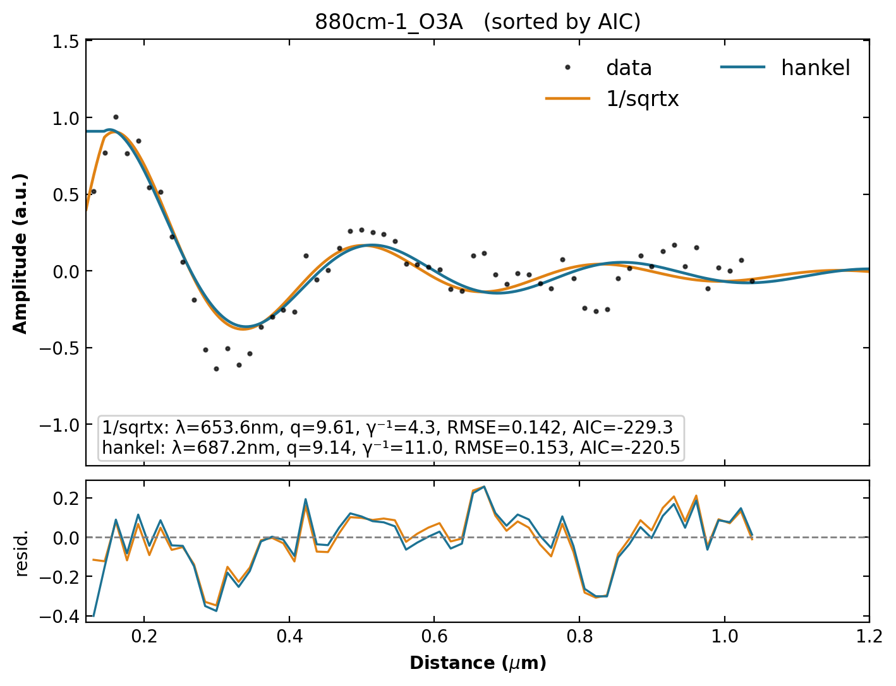
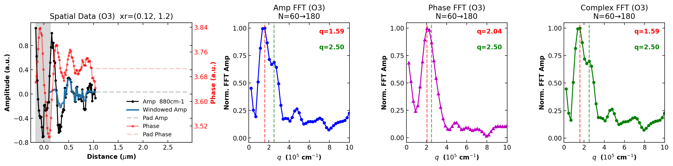
880 cm⁻¹
CHT λₚ = 629.4 nm Hankel λₚ = 687.2 nm 1/√x λₚ = 653.6 nm Δ vs Hankel = 8.4% Δ vs 1/√x = 3.7%

Slide 15
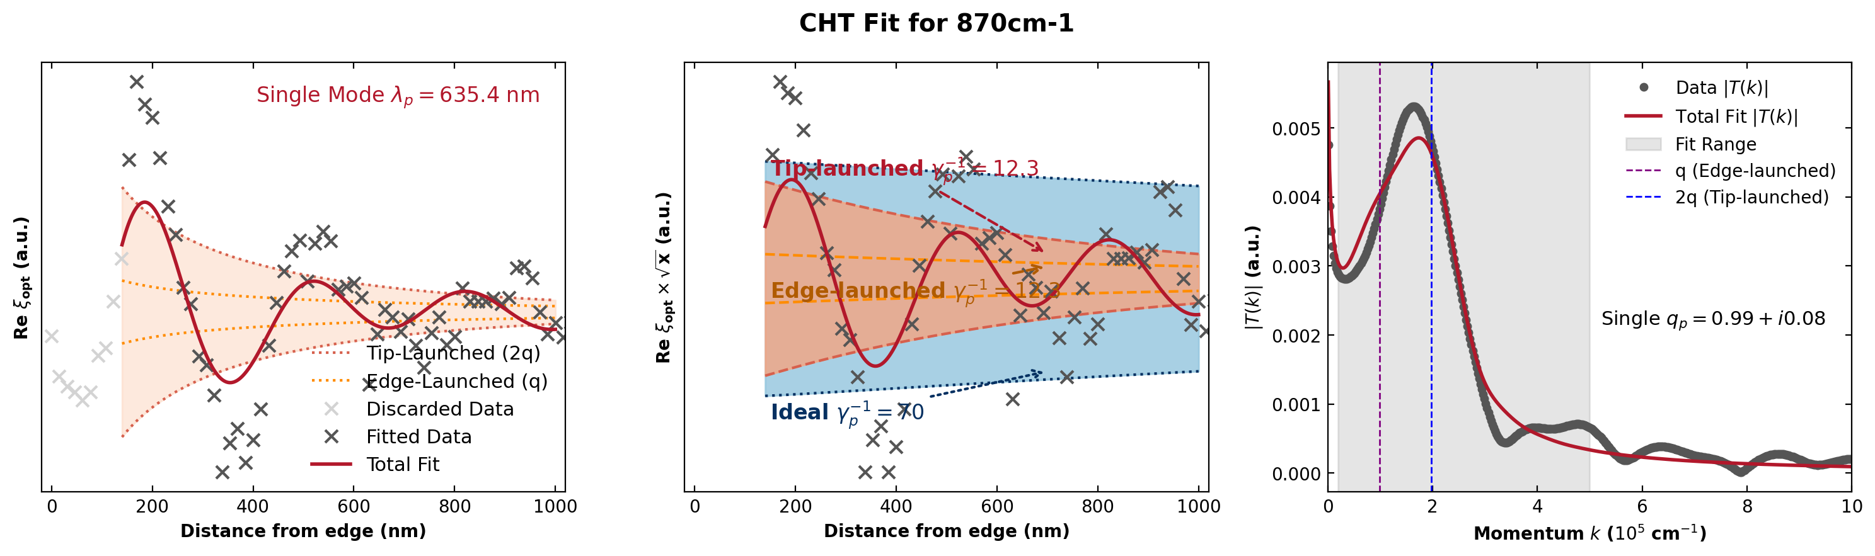
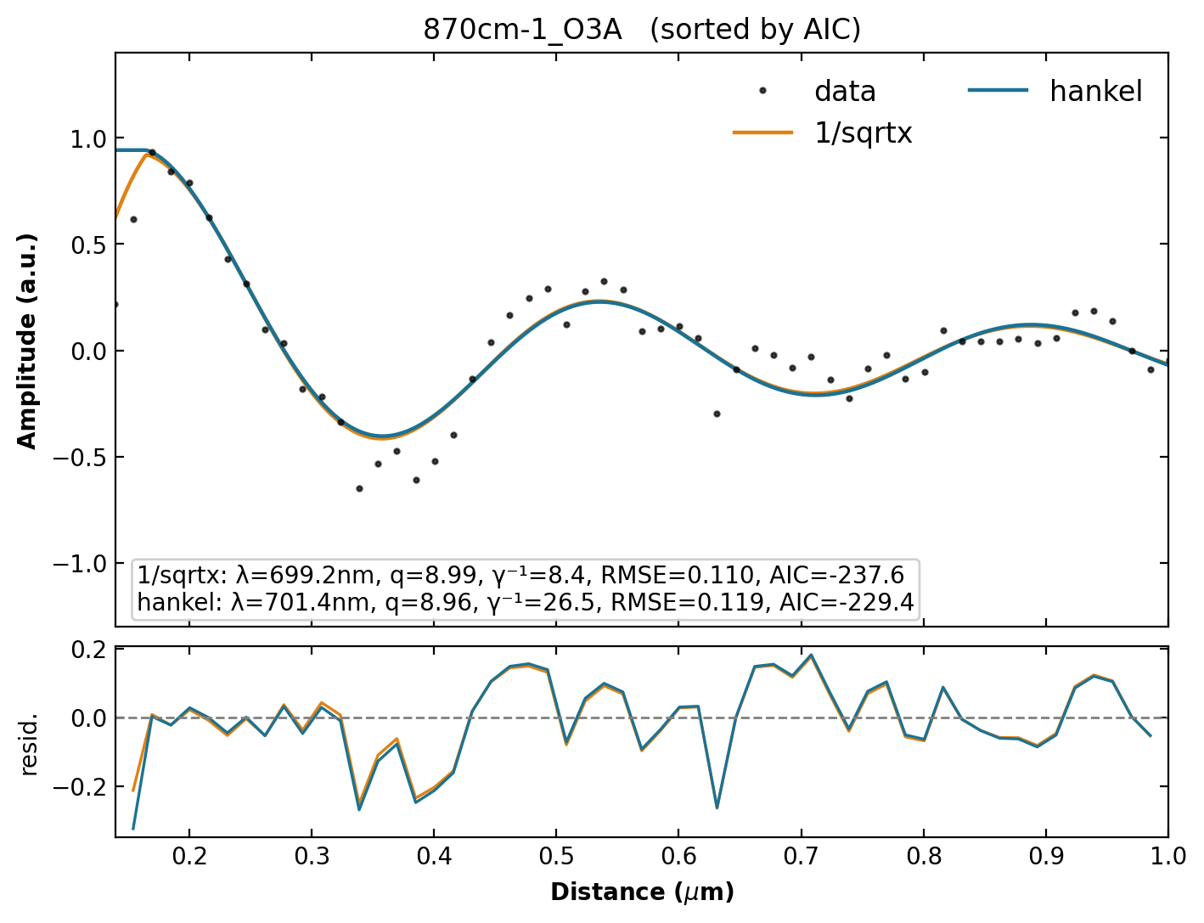
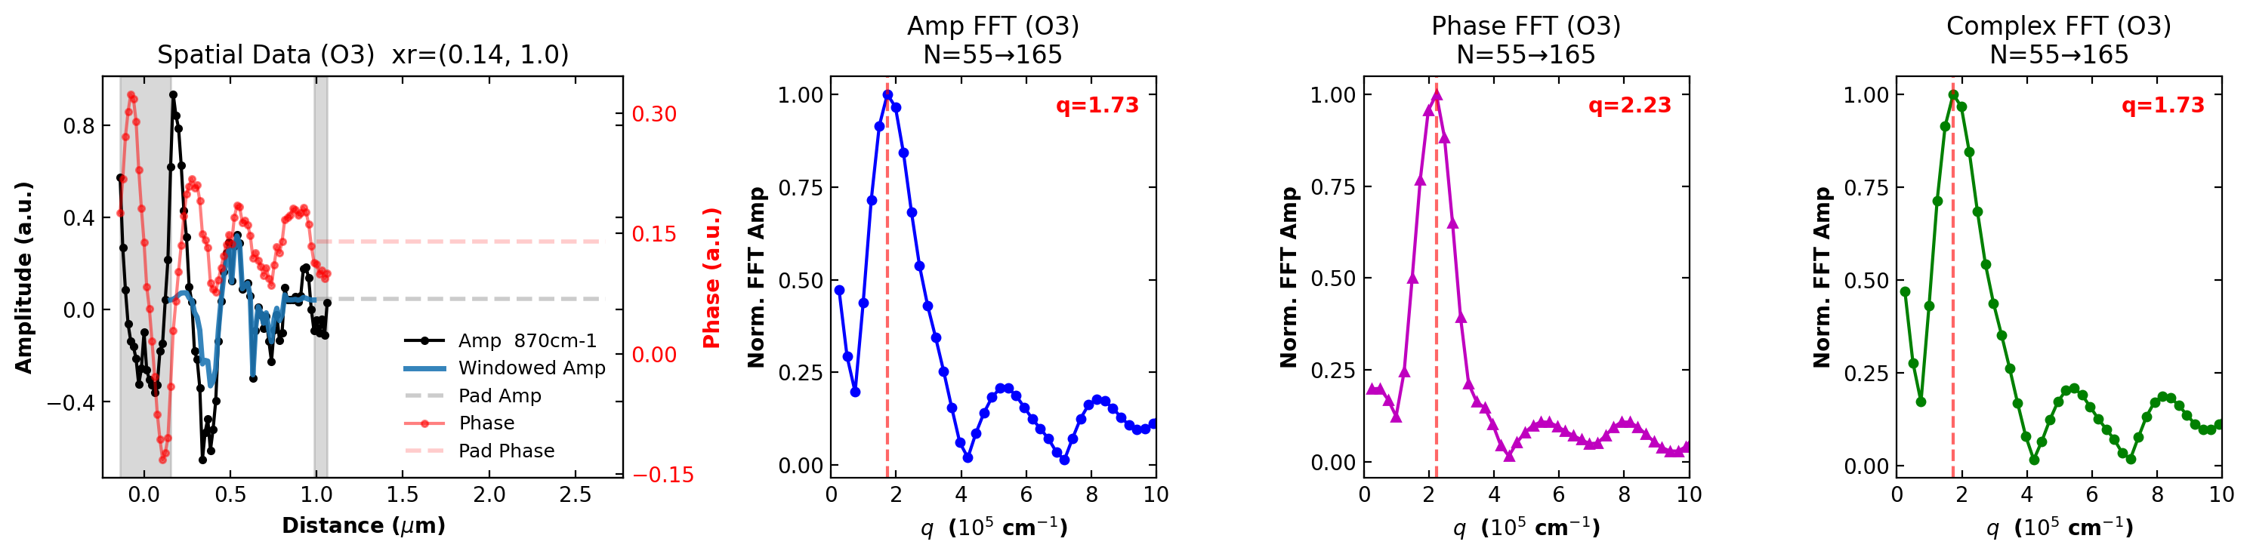
870 cm⁻¹
CHT λₚ = 635.4 nm Hankel λₚ = 701.4 nm 1/√x λₚ = 699.2 nm Δ vs Hankel = 9.4% Δ vs 1/√x = 9.1%

Slide 16
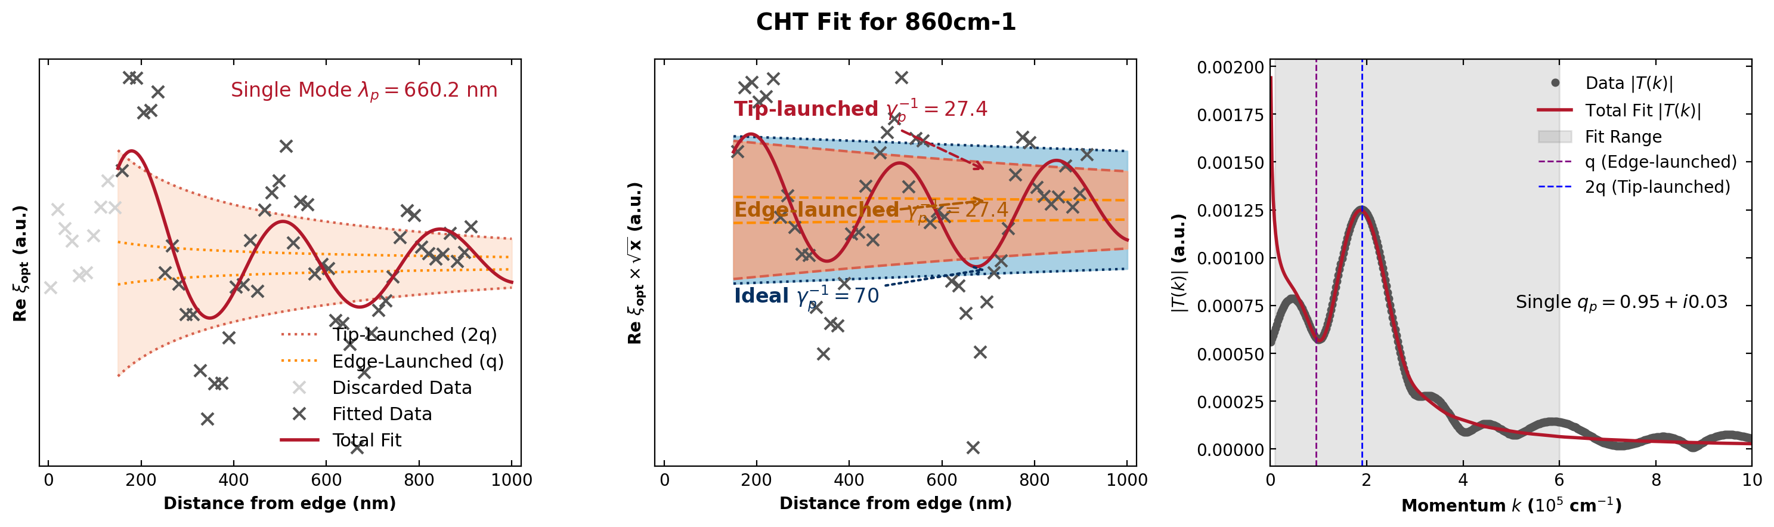
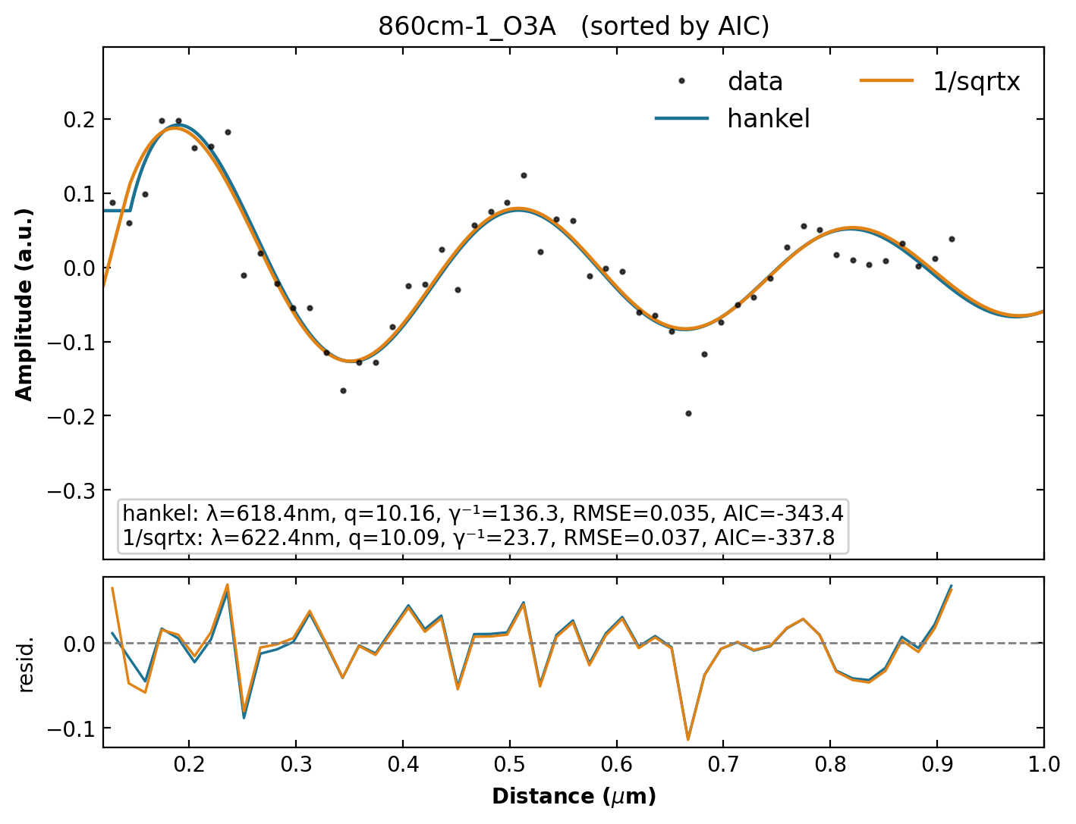
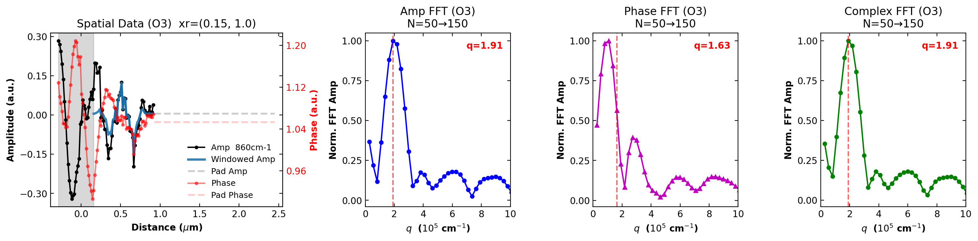
860 cm⁻¹
CHT λₚ = 660.2 nm Hankel λₚ = 618.4 nm 1/√x λₚ = 622.4 nm Δ vs Hankel = 6.8% Δ vs 1/√x = 6.1%

Slide 17
Summary: λₚ Across All Wavenumbers
wn (cm⁻¹) | λ CHT (nm) | λ Hankel (nm) | λ 1/√x (nm) | k_fit_range | Δ vs Hankel | Δ vs 1/√x
1000 | 224.3 | 240.0 | 207.7 | (1.0, 10.0) | 6.5% | 8.0%
991 | 255.9 | 273.0 | 308.1 | (0.2, 9.0) | 6.3% | 16.9%
980 | 275.4 | 480.0 | 416.1 | (0.2, 9.0) | 42.6% | 33.8%
970 | 264.7 | 480.0 | 412.2 | (0.2, 9.0) | 44.9% | 35.8%
960 | 263.2 | 480.0 | 431.7 | (0.2, 7.0) | 45.2% | 39.0%
950 | 295.1 | 336.0 | 298.3 | (0.2, 8.0) | 12.2% | 1.1%
941 | 361.3 | 480.0 | 428.0 | (0.2, 7.0) | 24.7% | 15.6%
930 | 405.0 | 423.8 | 525.5 | (0.2, 7.0) | 4.4% | 22.9%
920 | 455.2 | 427.2 | 484.0 | (0.2, 7.0) | 6.5% | 6.0%
911 | 329.9 | 634.8 | 620.9 | (0.4, 7.0) | 48.0% | 46.9%
900 | 439.8 | 681.4 | 662.7 | (0.2, 6.0) | 35.5% | 33.6%
890 | 489.8 | 535.6 | 531.3 | (0.2, 6.0) | 8.6% | 7.8%
880 | 629.4 | 687.2 | 653.6 | (0.2, 5.0) | 8.4% | 3.7%
870 | 635.4 | 701.4 | 699.2 | (0.2, 5.0) | 9.4% | 9.1%
860 | 660.2 | 618.4 | 622.4 | (0.1, 6.0) | 6.8% | 6.1%

