Slide 1
Hankel Fit + FFT Overview
graphene_4x1_manual lp2 (interior), wn = 860-1000 cm⁻¹
860-890 cm⁻¹: single-wave Hankel vs. 1/√x real-space comparison. 900-1000 cm⁻¹: single-wave vs. two-wave (edge-launched q + tip-launched 2q) Hankel fit, both against the FFT's own 2-Lorentzian-peak decomposition.

Slide 2
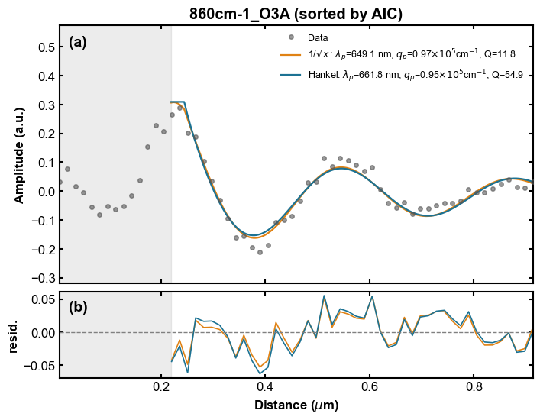

860cm⁻¹

Slide 3
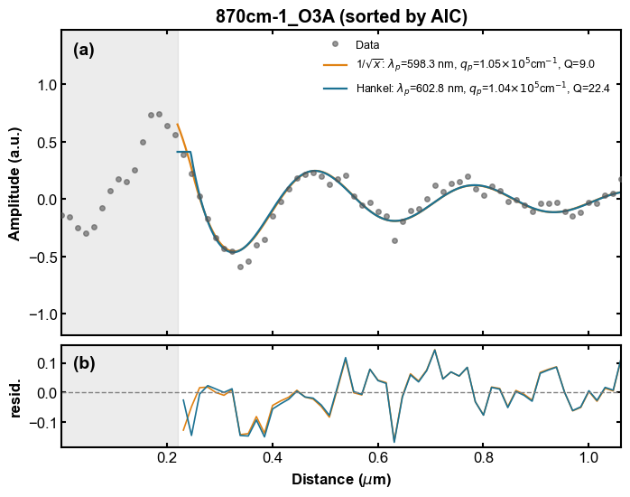

870cm⁻¹

Slide 4
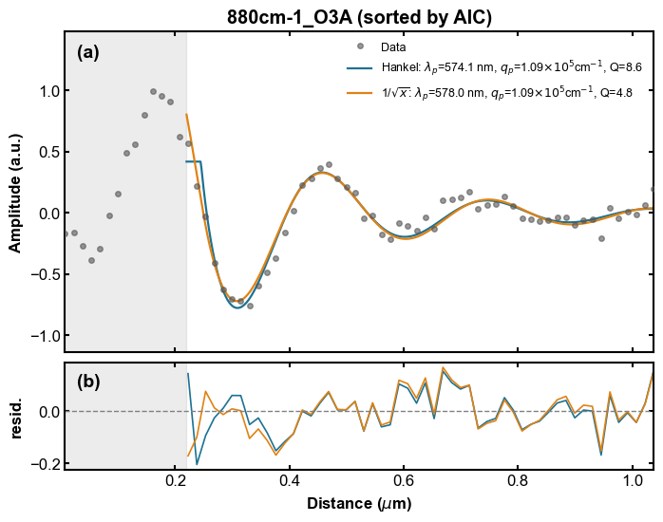

880cm⁻¹

Slide 5
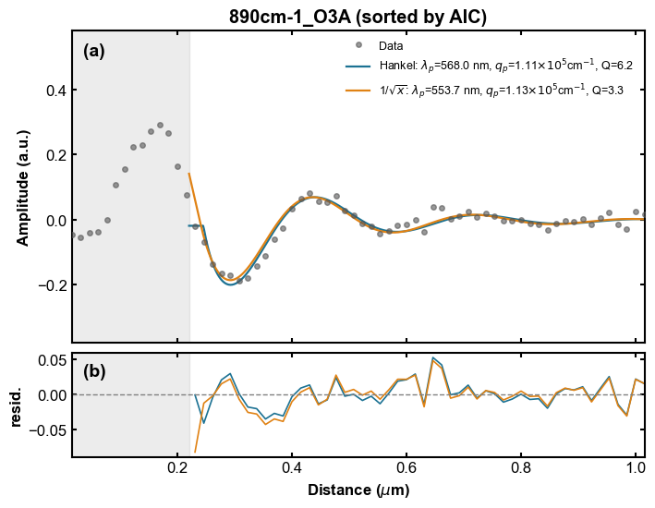

890cm⁻¹

Slide 6
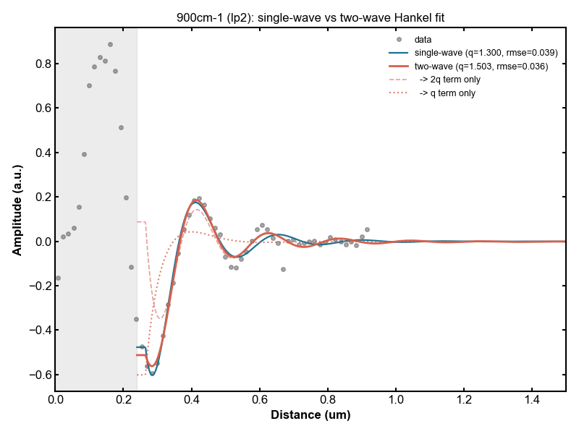

900cm⁻¹

Slide 7
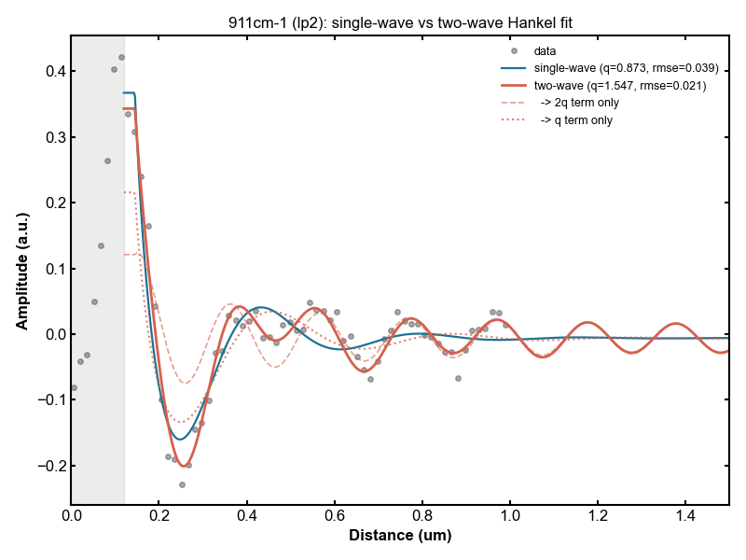

911cm⁻¹

Slide 8
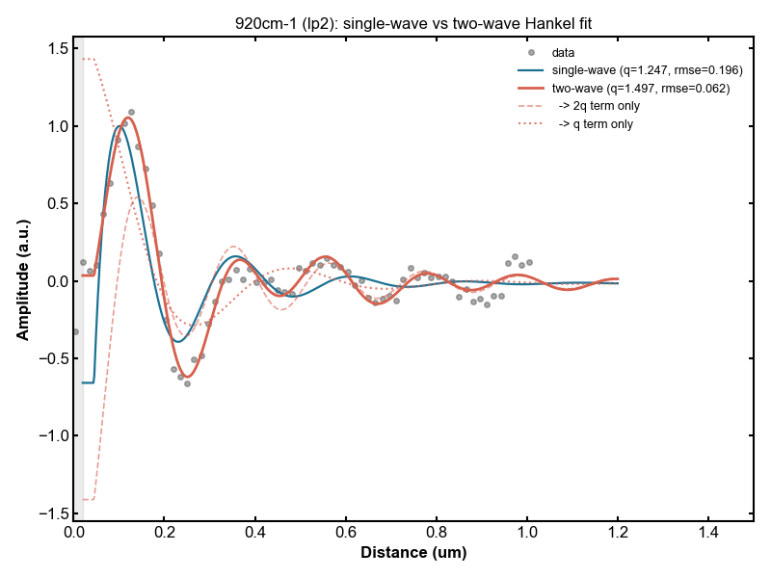

920cm⁻¹

Slide 9
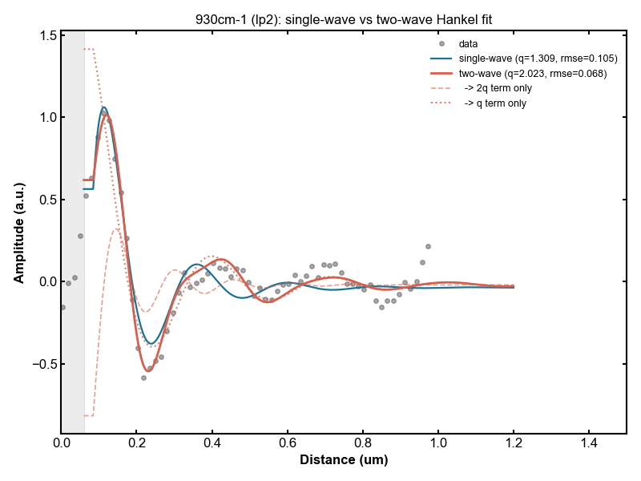

930cm⁻¹

Slide 10
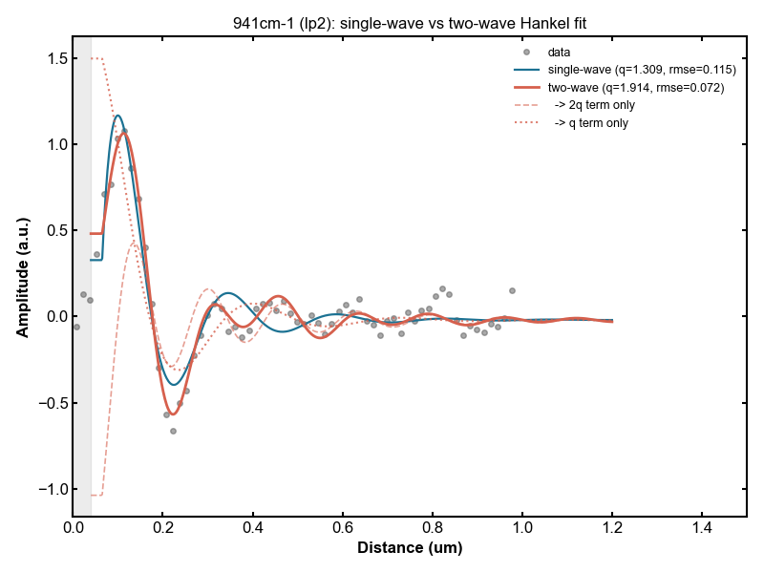

941cm⁻¹

Slide 11
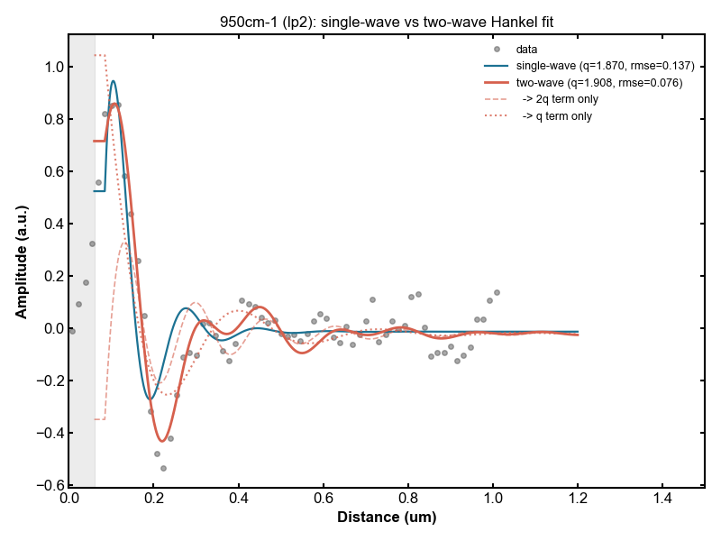

950cm⁻¹

Slide 12
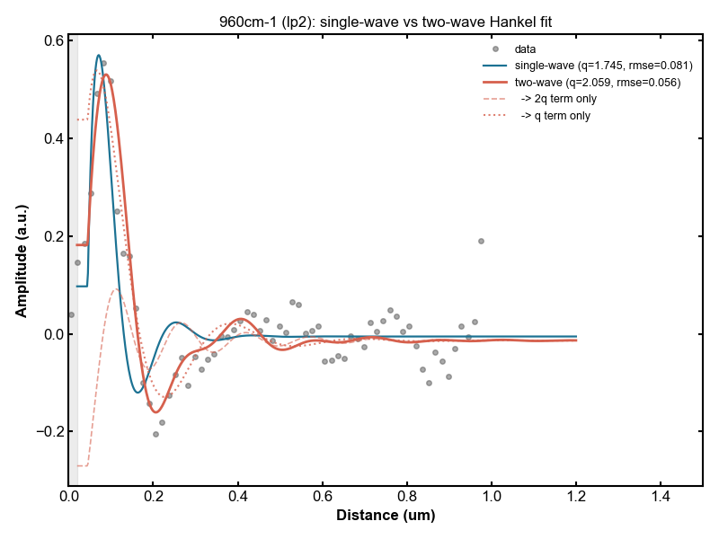

960cm⁻¹

Slide 13
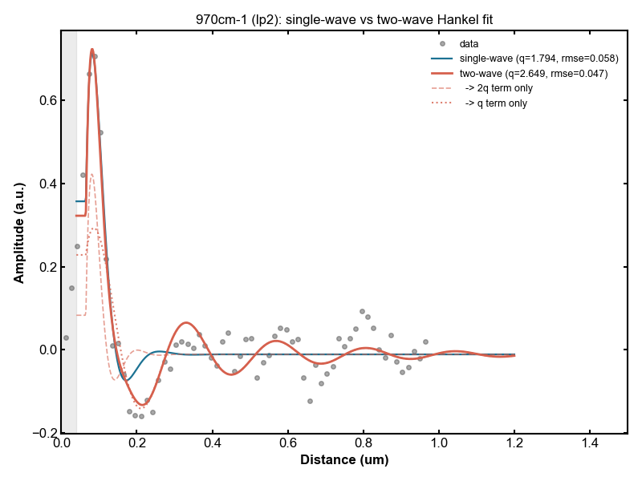

970cm⁻¹

Slide 14
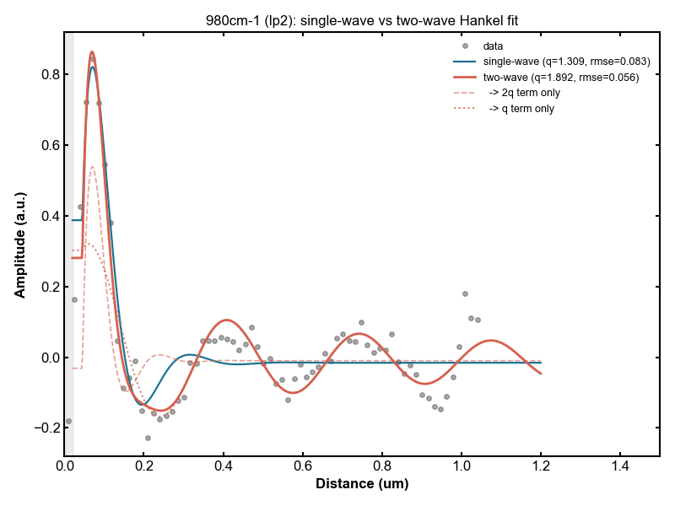

980cm⁻¹

Slide 15
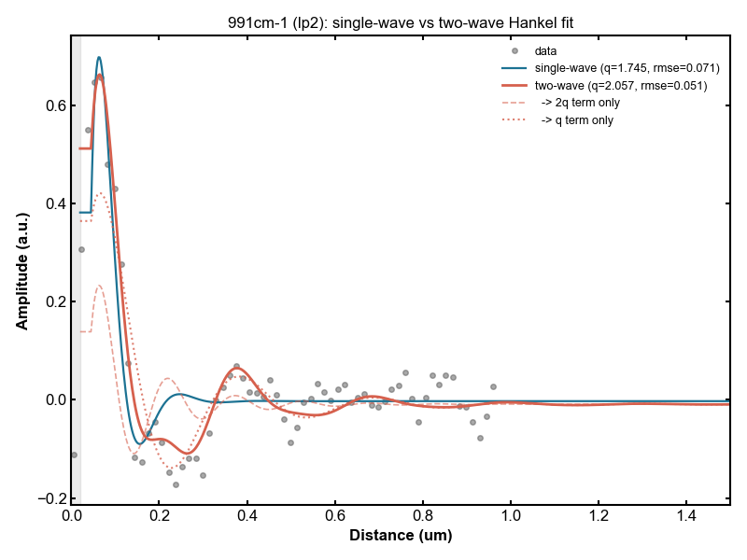

991cm⁻¹

Slide 16
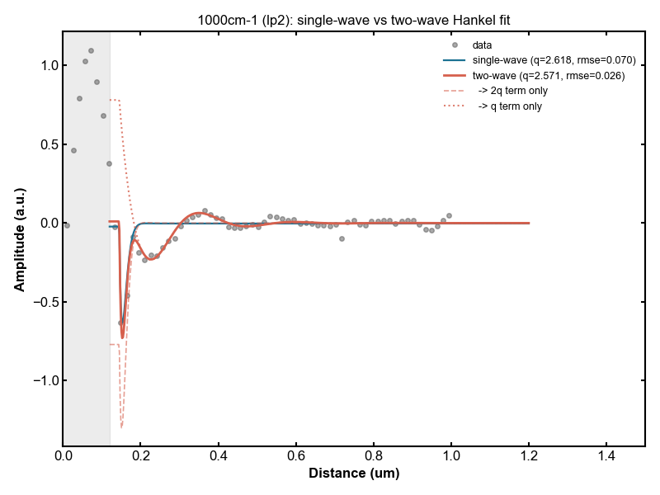

1000cm⁻¹

