Slide 1
GMG

Slide 2

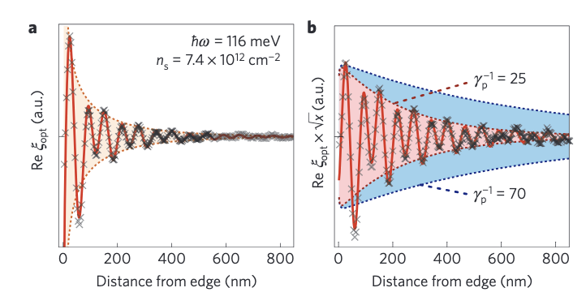


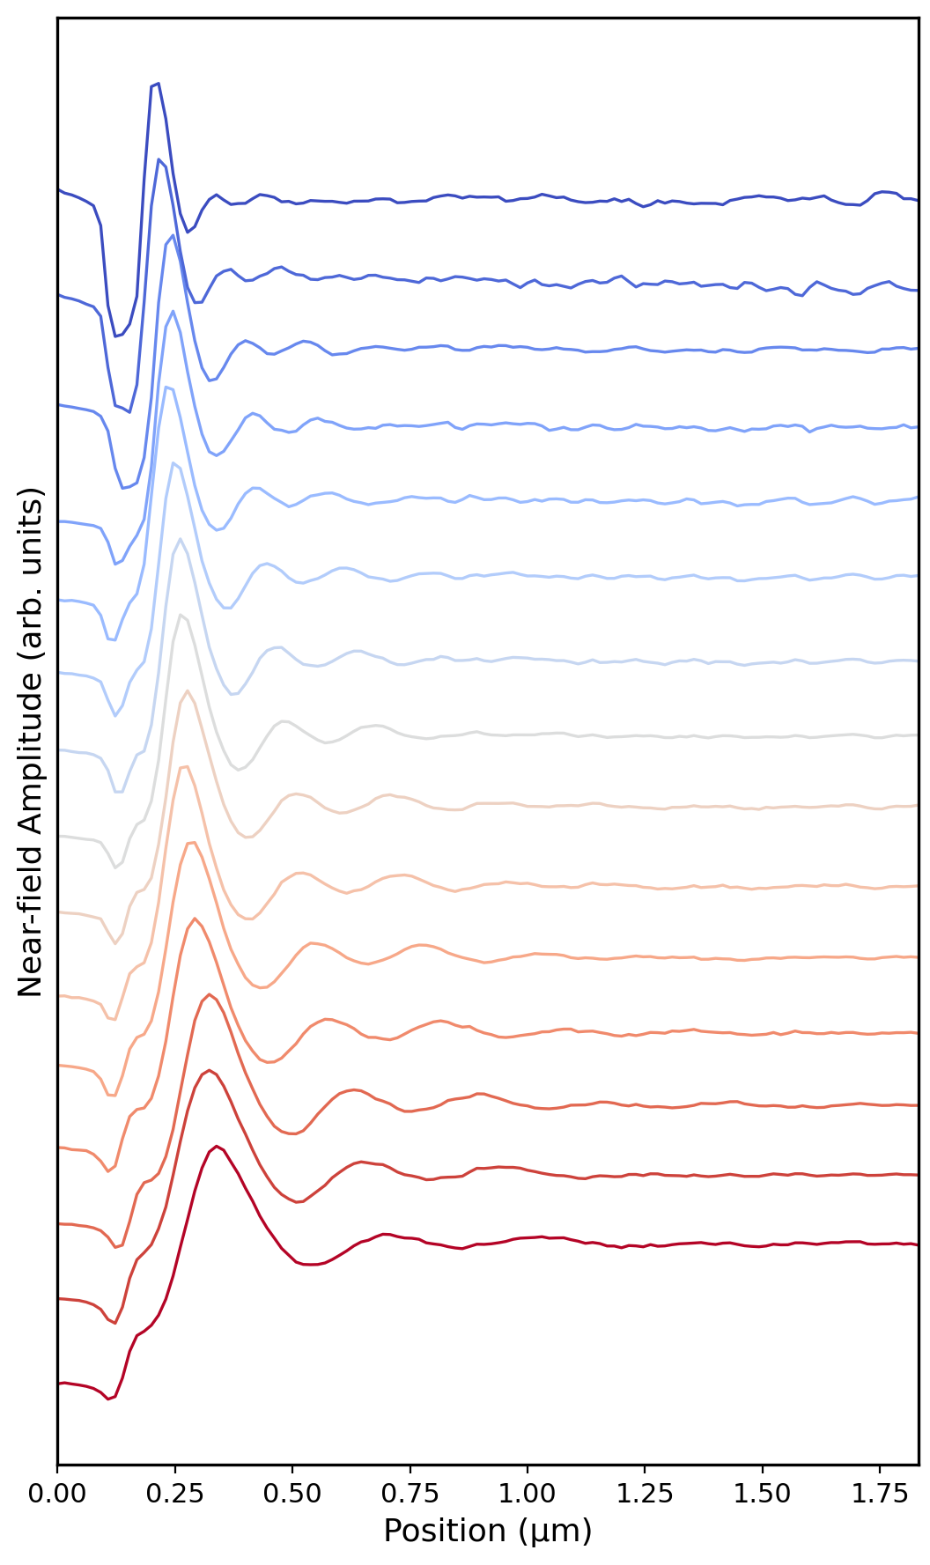
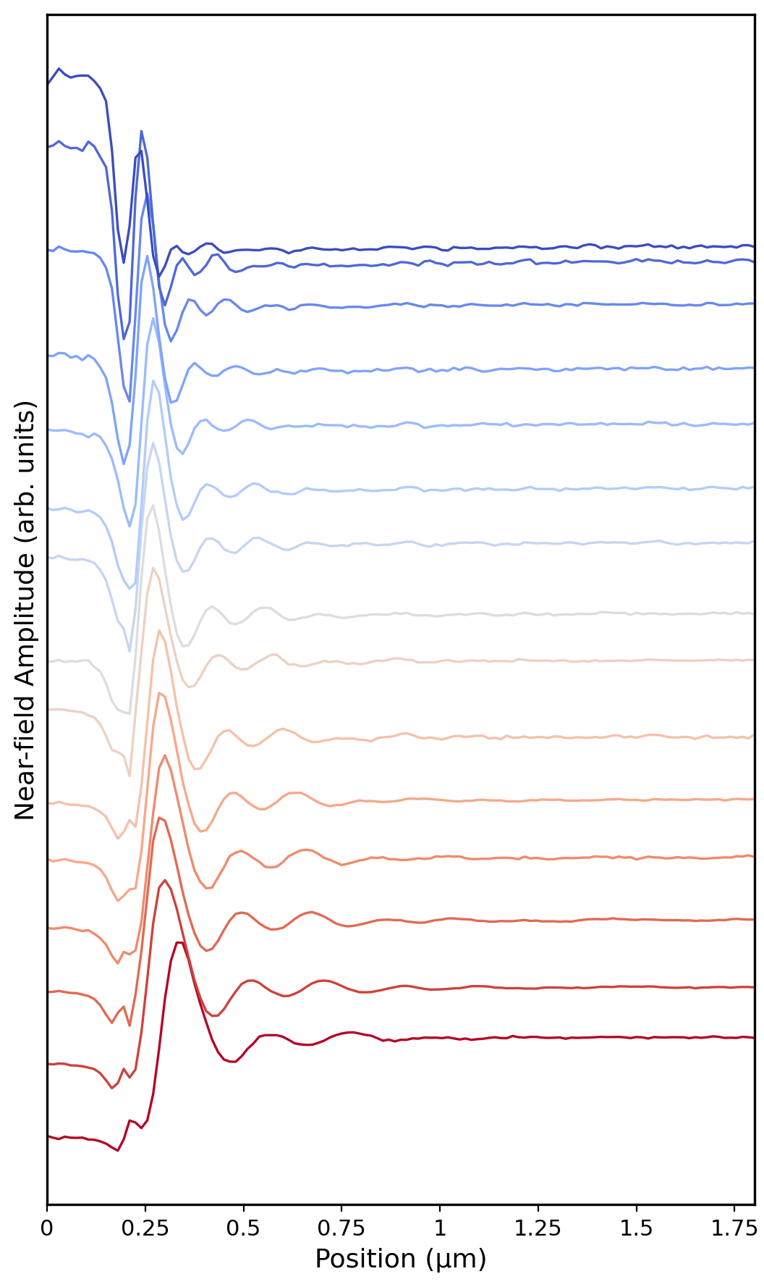
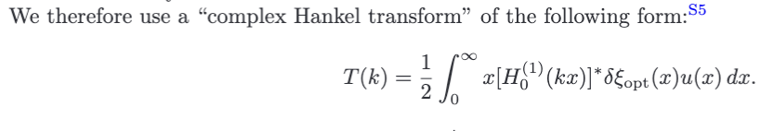
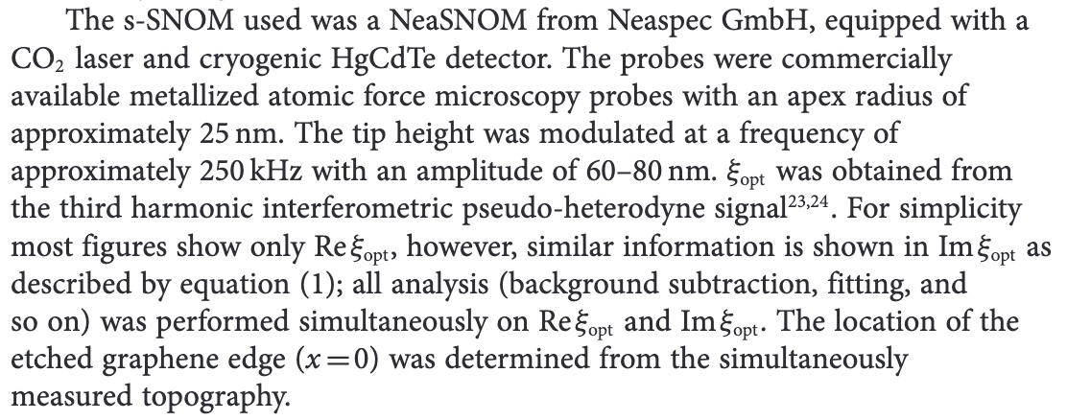




Overview
(a)
(b)
$$ω ({cm}^{−1})$$
$$ω ({cm}^{−1})$$
860
1000
860
1000
[1]A. Woessner et al., Highly confined low-loss plasmons in graphene–boron nitride heterostructures, Nature Mater 14, 421 (2015).
Graphene
Edge
$$λ_{p}/2$$
MoO₃/G
$$λ_{p}/2$$

Slide 3

Fitting logic
Theory model: circular wave
Complex hankel transformation
[1]A. Woessner et al., Highly confined low-loss plasmons in graphene–boron nitride heterostructures, Nature Mater 14, 421 (2015).
Fit in momentum space with T(k)

Slide 4
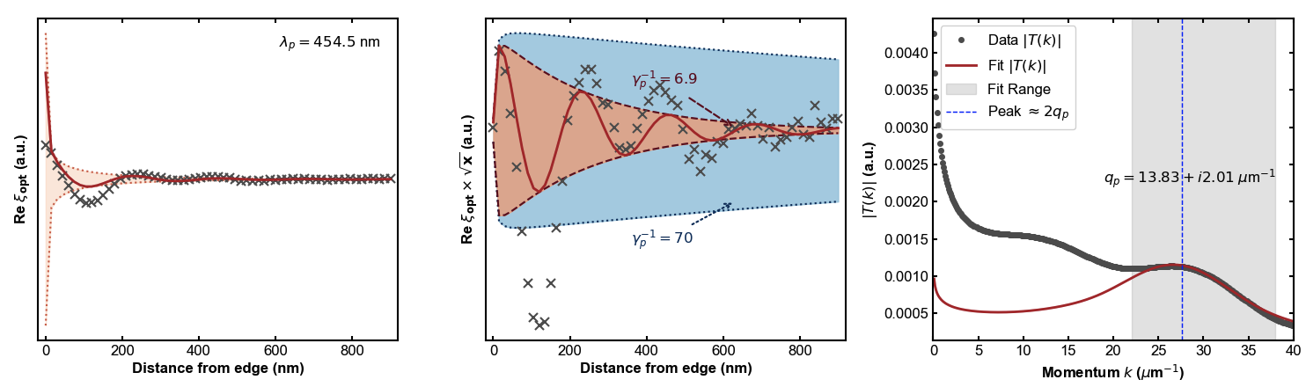

860cm-1: GMG3_graphene3x1
$$ω ({cm}^{−1})$$
860
1000
Boundary cut~0.35um

Slide 5
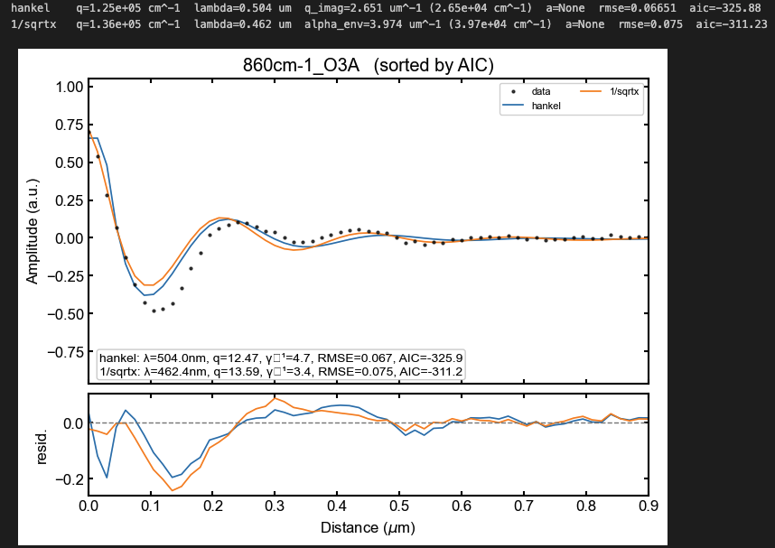
Hankel fit and 1/sqrtx fit

Slide 6
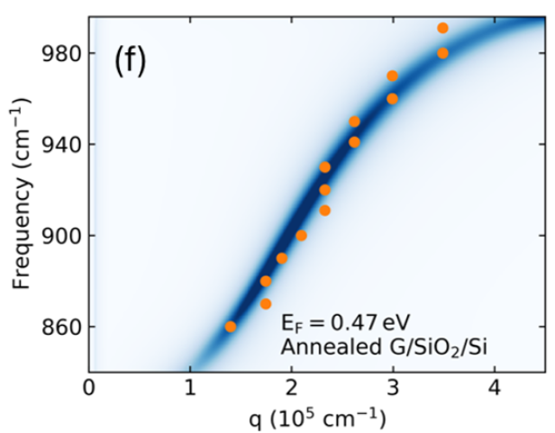
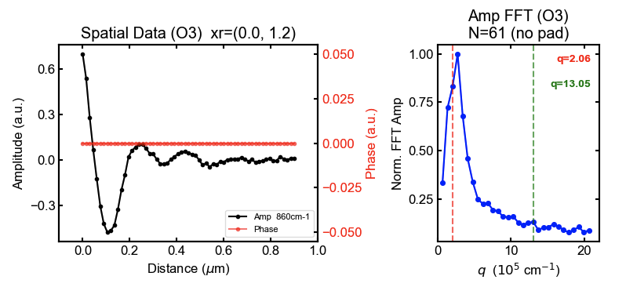
FFT verification

