Slide 1
计算机图形学
Computer Graphics
Lin Lu (吕琳)
Shandong University
http://irc.cs.sdu.edu.cn/~lulin/

Slide 2
课程安排
上课：周五 1-2节 （振声苑E201）
实验：周二 5-6节 （N3 -XXX）
总成绩=40%平时成绩+60%期末成绩
助教：许永来 李晨冉
授课：吕琳（N3-412）辛士庆
Lulin.linda@gmail.com, llu@sdu.edu.cn

Slide 3

教材
《计算机图形学基础教程（第2版）》
（孙家广、胡事民），清华大学出版社

Slide 4
Prerequisites
Good programming skills in C (or C++)
Basic Data Structures
  Linked lists
  Arrays
Geometry
Simple Linear Algebra

Slide 5
Requirements
5 Assigned Projects (To be updated)
  Simple OpenGL
  Line/circle drawing
  Interactions in OpenGL
  3D modeling and hierarchical transformation
  Polygonal mesh processing

Slide 6
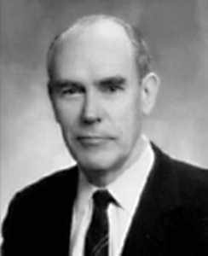
Ivan Sutherland - Father of Computer Graphics
1962年，MIT林肯实验室的Ivan E. Sutherland在他的博士论文"Sketchpad：一个人机交互通信的图形系统"中首次使用了计算机图形学"Computer Graphics"这个术语，证明了交互计算机图形学是一个可行的、有用的研究领域，从而确定了计算机图形学作为一个崭新的独立科学分支的地位。
Ivan E Sutherland, born 1938, Hartings, Nebraska

Slide 7

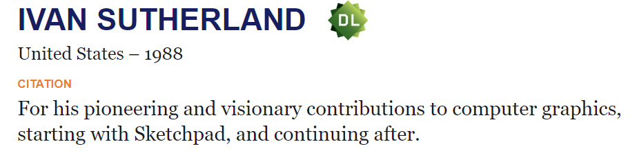
Ivan Sutherland - Father of Computer Graphics

Slide 8
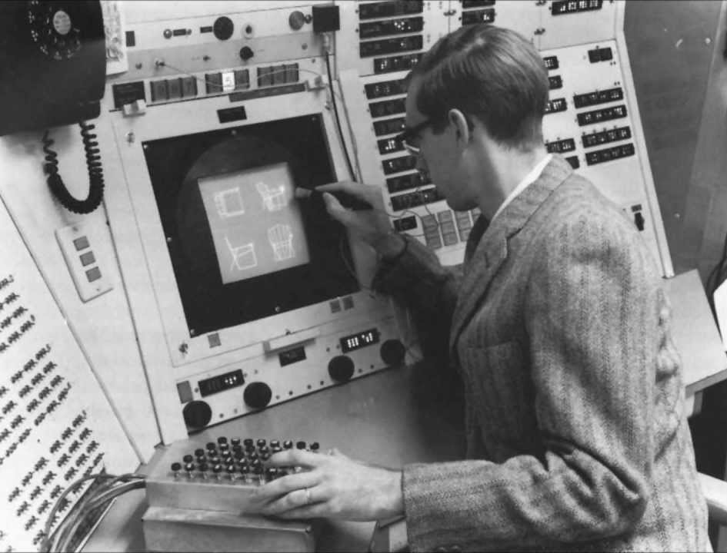

Slide 9
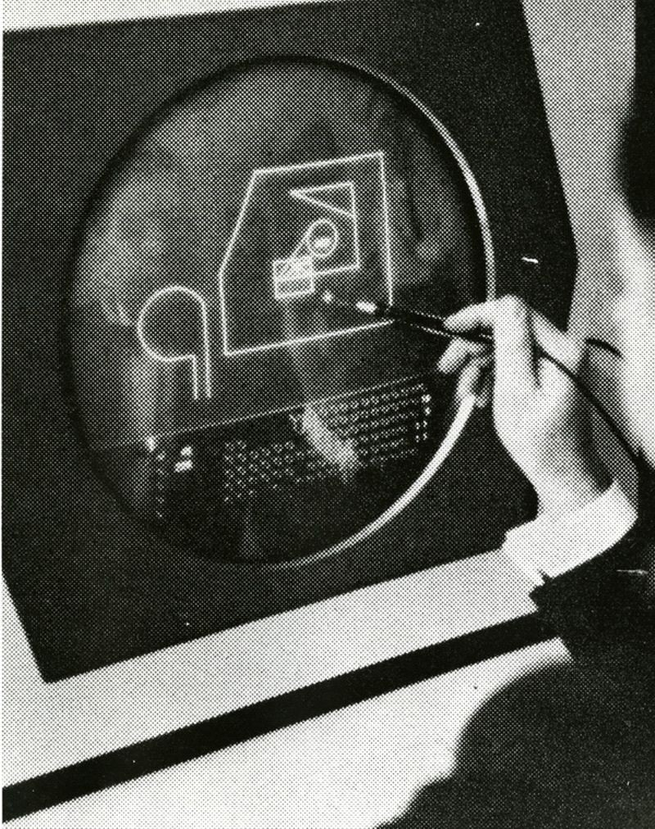

Slide 10
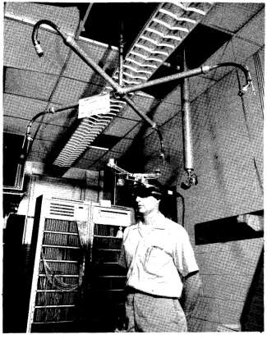
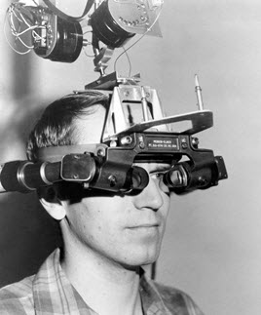
Virtual Reality
In 1966 Sutherland, while an Associate Professor at Harvard, took another huge step towards the future of computing – one that we still haven’t completed today.
The Head-mounted Display worn by Donald L. Vickers, one of Ivan E. Sutherland’s Students at The University of Utah. Photo courtesy of Ivan Sutherland.

Slide 11
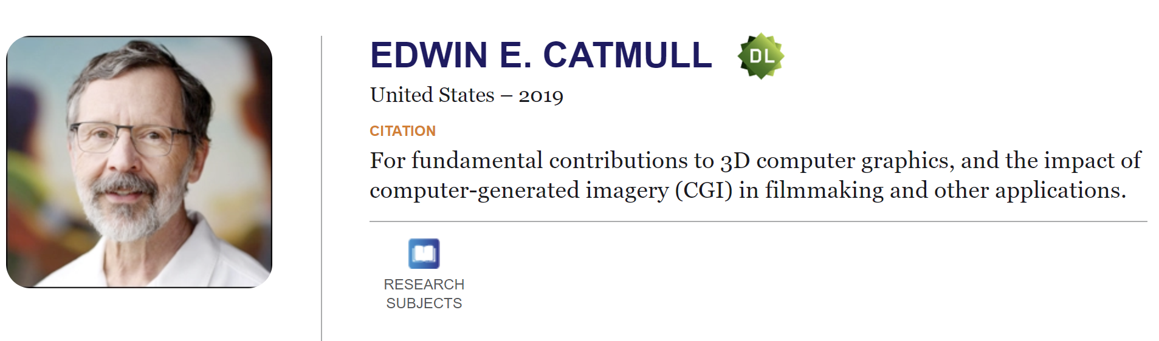
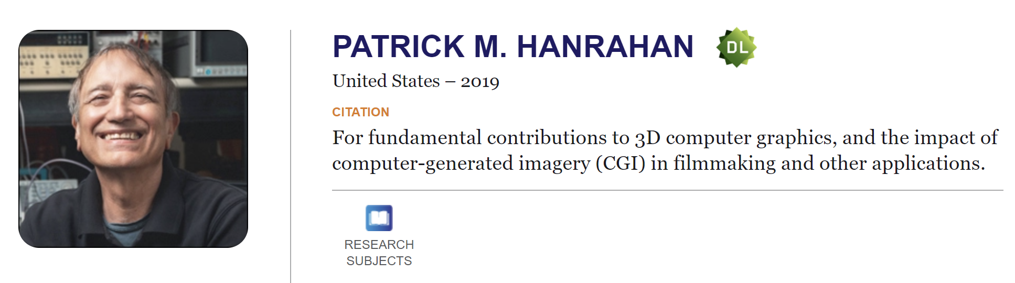
ACM A.M. TURING AWARD
2019

Slide 12

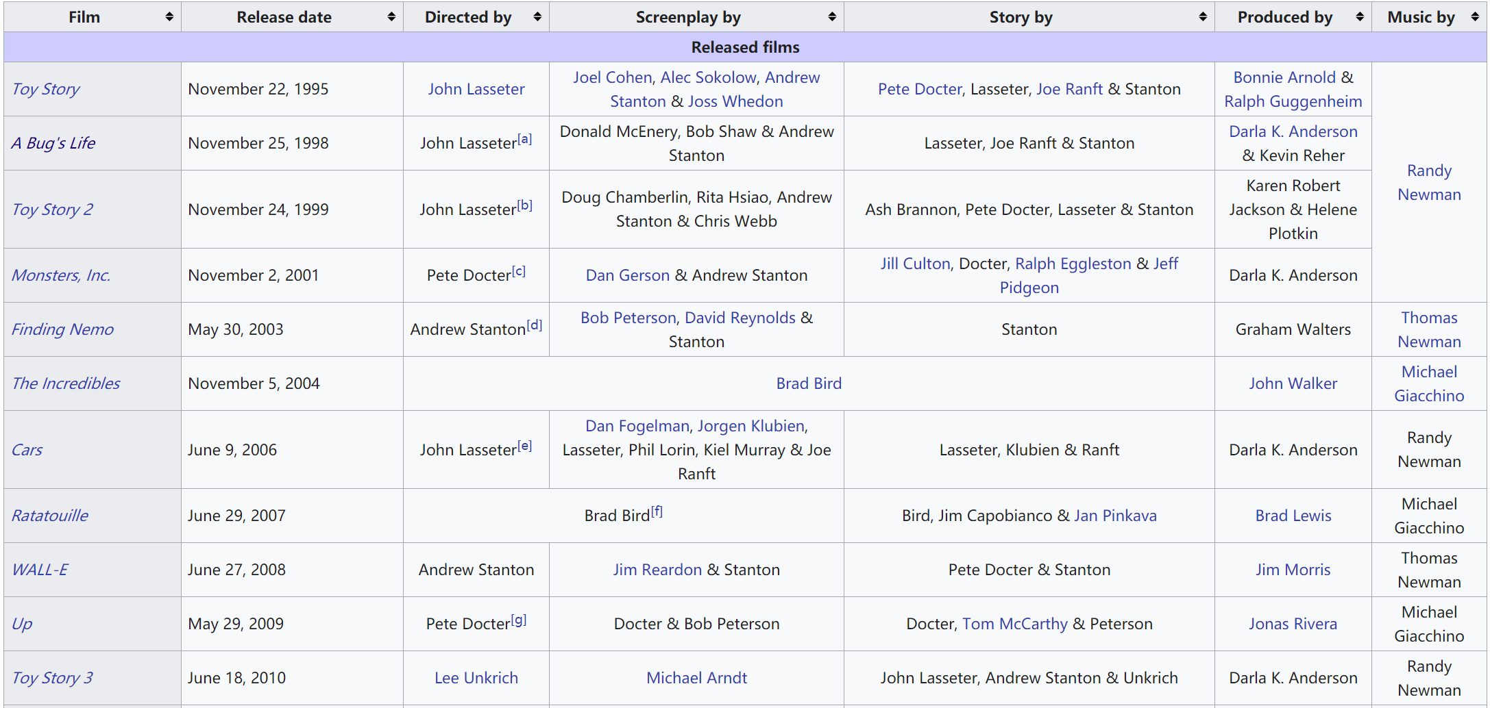
List of Pixar films

Slide 13
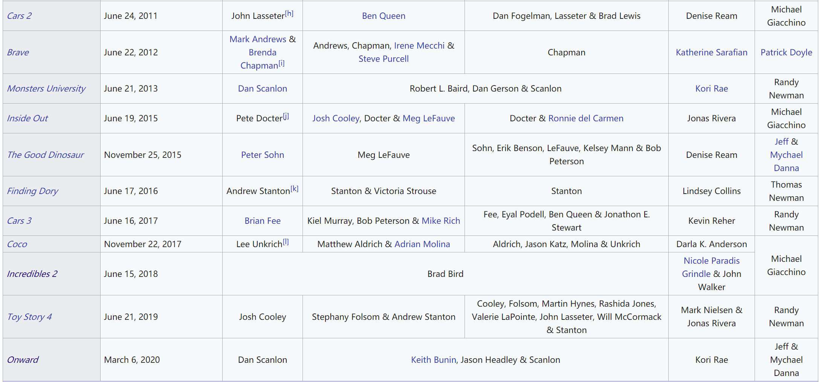
List of Pixar films

Slide 14

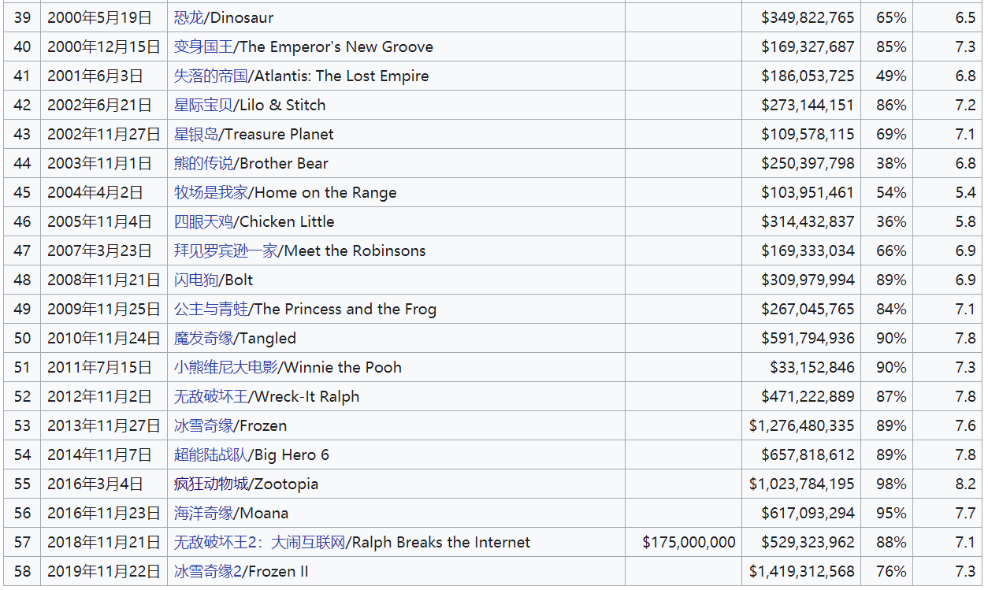
List of Walt Disney Animation Studios Films

Slide 15




优秀国产动画电影

Slide 16
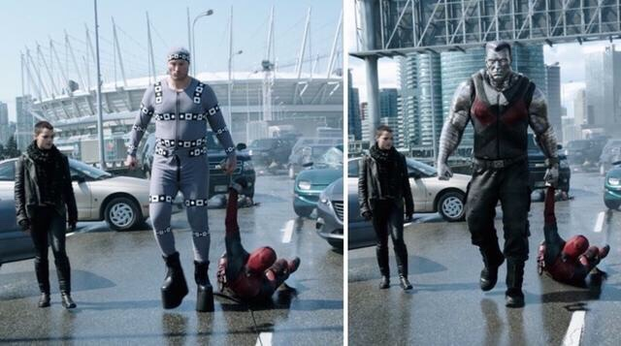
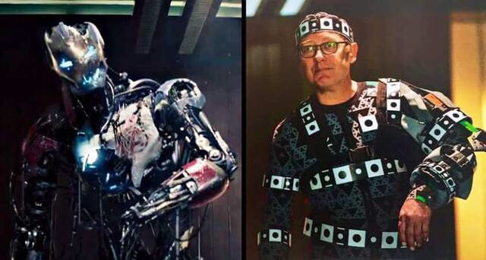
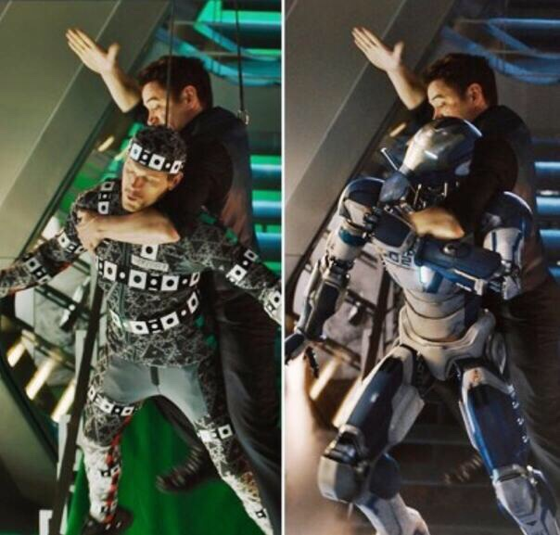
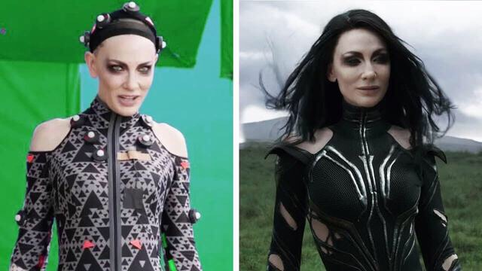
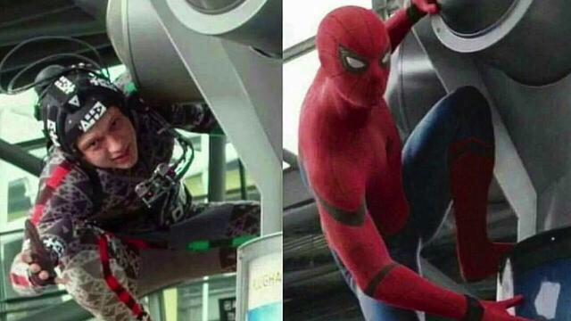

Slide 17
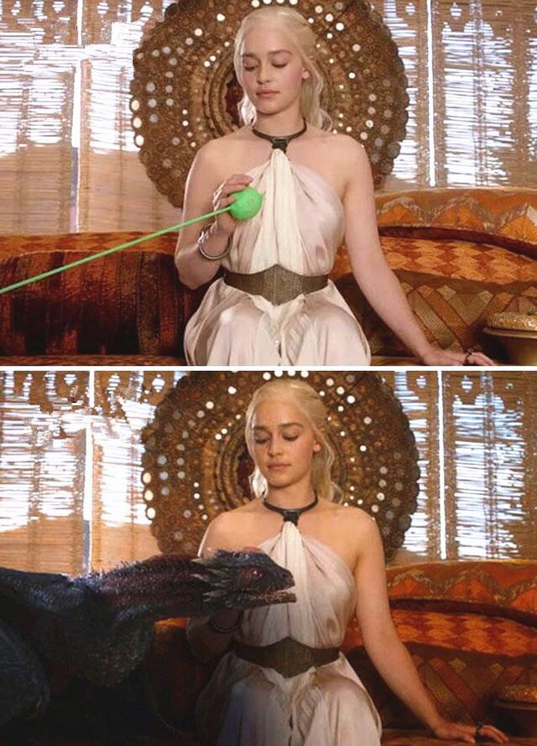
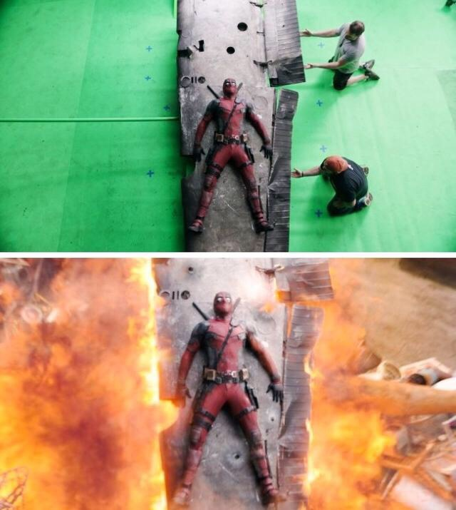
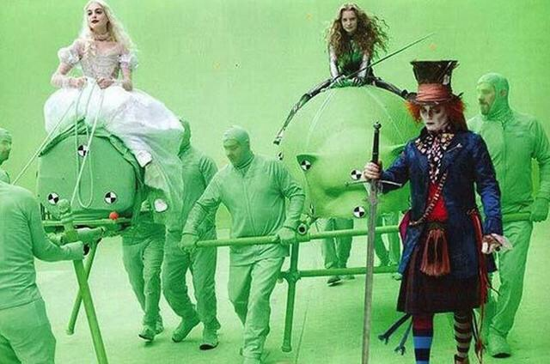
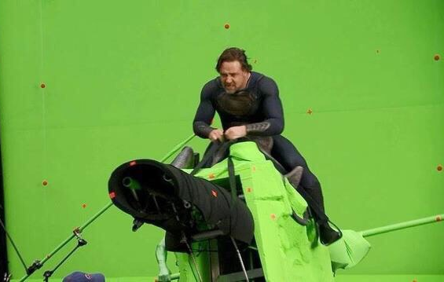
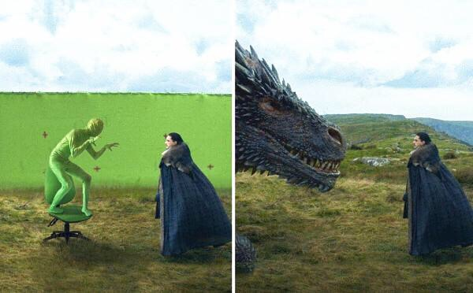

Slide 18
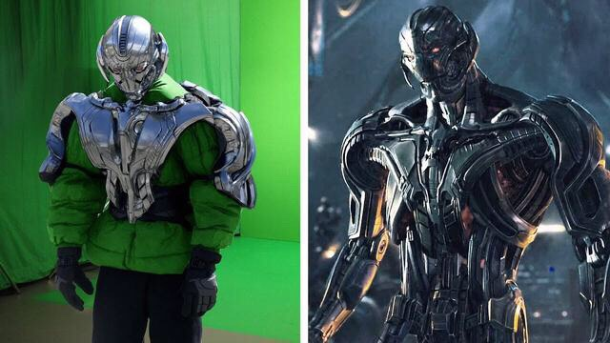
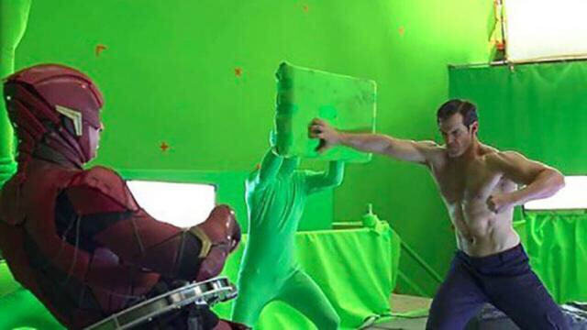

Slide 19
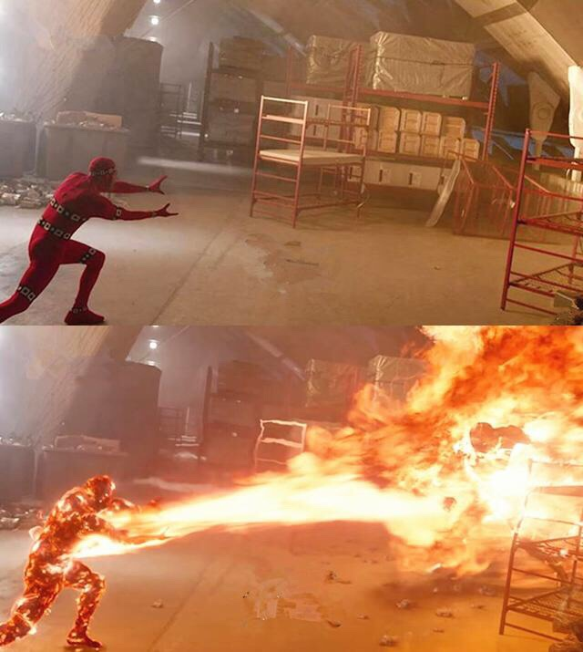
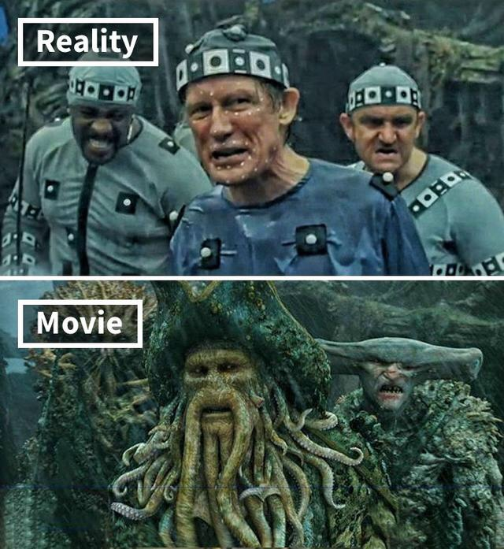

Slide 20
What is Computer Graphics?
Computer graphics is a sub-field of computer science which studies methods for digitally synthesizing and manipulating visual content.
Although the term often refers to the study of three-dimensional computer graphics, it also encompasses two-dimensional graphics and image processing.
--Wikipedia

Slide 21
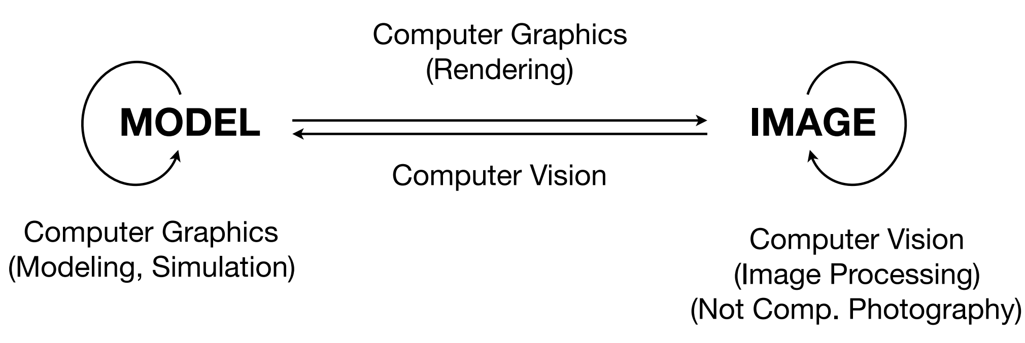
Computer Graphics vs. Computer Vision

Slide 22
可参考的网络课
主讲人：闫令琪@UCSB
课件：https://sites.cs.ucsb.edu/~lingqi/teaching/games101.html
课程录像：https://www.bilibili.com/video/av90798049

