Slide 1
Lecture 10
Minimum Spanning Tree Continued
Prim’s Algorithm
Properties of MST

Slide 2

Idea of the Generic Algorithm
It grows the minimum spanning tree one edge at a time.
  An edge set A that is a subset of some minimum spanning tree T;
  An edge (u, v) satisfying that A∪{(u, v)} is also a subset of some minimum spanning tree T’.
The edge (u, v) is called a safe edge for A if A∪{(u, v)} is also a subset of a minimum spanning tree.

Slide 3
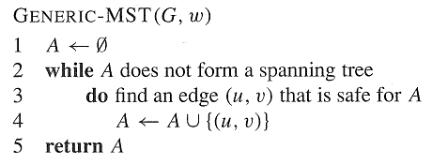
A Generic Algorithm
Kruskal’s and Prim’s algorithms are implementations of the generic algorithm on how to maintain A and find the safe edge (u, v) for A.

Slide 4
How to recognize Safe Edges for A Related Notions
A cut (X, Y) of a graph G = (V, E) is a partition of the vertex set V into two sets X and Y = V - X.
An edge (u, v)∈ E is said to cross the cut (X, Y) if u ∈ X and v ∈ Y.
A cut (X, Y) respects a set A of edges if no edge in A crosses the cut.
An edge is a light edge crossing a cut if its weight is the minimum of any edge crossing the cut.
8
7
b
c
d
9
4
2
X↑
a
11
i
14
e
↑ X
4
7
6
8
10
Y↓
h
g
f
↓ Y
1
2

Slide 5
How to recognize Safe Edges for A
Theorem 23.1 Let G = (V, E) be a connected, undirected graph with real-valued weight function w defined on E. Let A be a subset of E that is included in some minimum spanning tree for G, let (X, Y) be any cut of G that respects A, and let (u, v) be a light edge crossing (X, Y). Then, edge (u, v) is safe for A.
8
7
y
u
v
9
X↑
x
p
9
w
↑ X
8
8
Y↓
s
q
z
↓ Y

Slide 6
A better understanding
A is always acyclic.
So, G_{A}=(V,A) is a forest, and each connected component of which is a tree.
Any safe edge (u, v) for A connects distinct connected component of G_{A}.

Slide 7
A Corollary
Corollary 23.2: Let G = (V, E) be a connected, undirected graph with real-valued weight function w defined on E. Let A be a subset of E that is included in some minimum spanning tree for G, and let C = (V_{C}, E_{C}) be a connected component in the forest G_{A} = (V, A). If (u, v) is a light edge connecting C to some other component in G_{A}, then (u, v) is safe for A.
Proof: The cut (V_{C}, V-V_{C}) respects A, and (u, v) is a light edge for this cut. Therefore, (u, v) is safe for A.
8
7
y
u
v
9
X↑
x
p
9
w
↑ X
8
8
Y↓
s
q
z
↓ Y

Slide 8
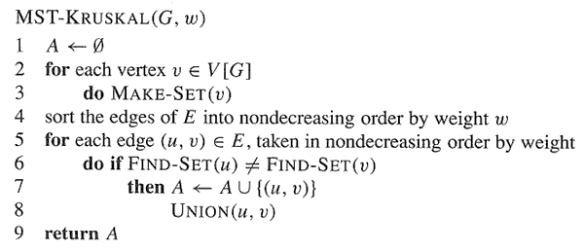
Kruskal’s Algorithm

Slide 9
Idea of the Prim
Start from a vertex r, add r to a vertex set U which is initialized to empty.
Find the least weight edge (u,v), u∈U, v∈V-U, add (u,v) to A, and add v to U.
Repeat 2 until A forms a spanning tree or U = V.

Slide 10
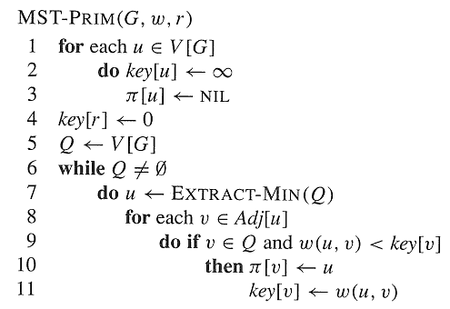
Prim’s Algorithm

Slide 11
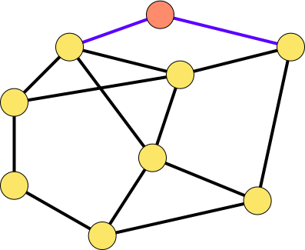
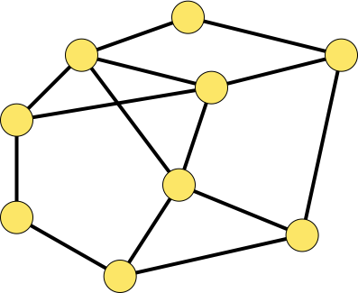
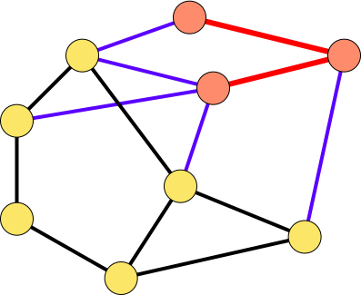
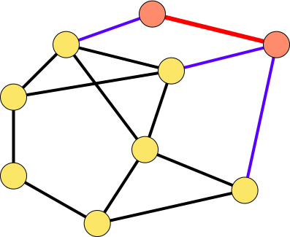
9
r
1
9
r
1
b
3
d
b
3
d
4
c
5
4
c
5
e
1
e
1
3
12
8
3
12
8
6
6
f
5
f
5
i
i
2
g
2
g
1
2
h
1
h
2
9
r
1
9
r
1
b
3
d
b
3
d
4
c
5
4
c
5
e
1
e
1
3
12
8
3
12
8
6
f
6
f
5
5
i
2
g
i
2
2
2
g
1
h
1
h

Slide 12
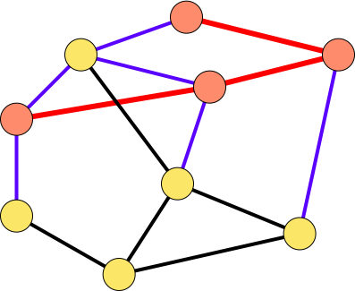
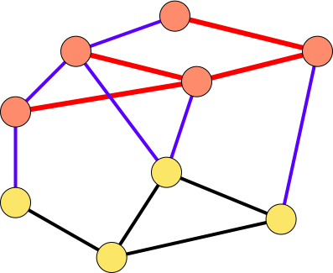
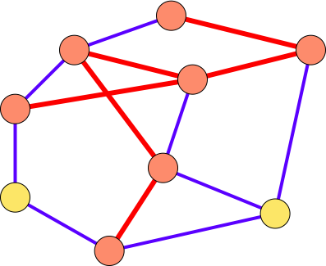
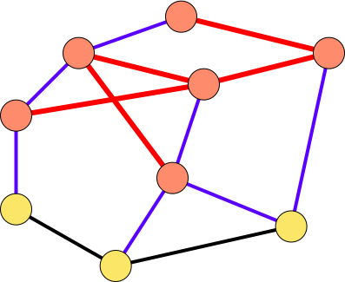
r
r
9
a
1
9
1
b
d
b
3
d
3
4
4
c
c
5
5
e
e
1
1
12
3
12
8
3
8
6
f
6
f
5
5
i
i
2
2
g
2
g
2
1
1
h
h
9
r
1
9
r
1
b
3
d
b
3
d
4
c
5
4
c
5
e
1
e
1
3
12
8
3
12
8
6
f
6
f
5
5
i
2
i
2
g
2
g
2
1
h
1
h

Slide 13
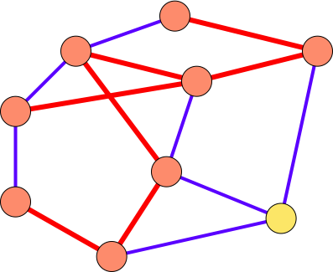
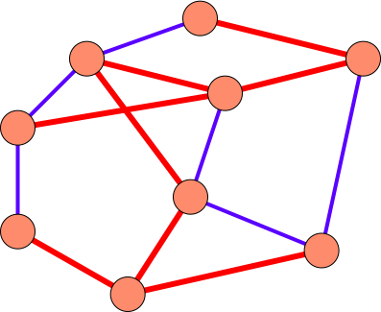
9
r
1
9
r
1
b
3
d
b
3
d
4
c
5
4
c
5
e
1
e
1
3
12
8
3
12
8
6
f
6
f
5
5
i
2
i
2
2
g
2
g
1
h
1
h

Slide 14
Loop invariant
Key[u] is the minimum weight of the edges connect a vertex u in Q to vertices in U=V-Q.
π[u] is right such a vertex in U.
The three loop invariant:
  A={(v,π[v])| v∈V-{r}-Q}
  The vertices already placed into the MST are those in U=V-Q
  For all vertices v ∈Q, if π[v]≠NIL, then key[v]<∞ and key[v] is the weight of a light edge (v,π[v]) connecting v to some vertex already placed into the MST.

Slide 15
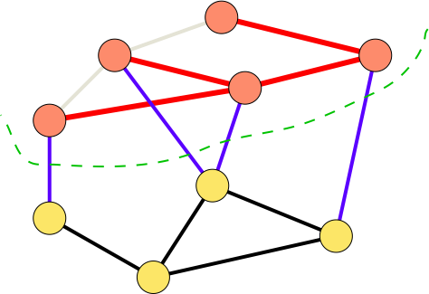
Correctness Proof
Similar to that of Kruskal’s.
1: each time we add a safe edge (a light edge crossing (U, Q)).
2: in the end, if A is not a MST, then Q is not empty, and (U, Q)
is a cut that respects A. Since G is connected, we can find a light edge
crossing (U, Q), which is safe for A. A contradiction.

Slide 16
Properties of MST
Property 1:
  Let (u, v) be a minimum-weight edge in a graph G = (V, E), then (u, v) belongs to some minimum spanning tree of G.
  Proof: Let A be the empty set of edges. Then A is a subset of some minimum spanning tree, and A does not include (u, v). Then cut (u, V-u) respects A. Edge (u, v) is a light edge crossing cut (u, V-u). According to theorem 23.1, (u, v) is a safe edge for A. Hence, (u, v) belongs to some minimum spanning tree.
  Another method: Suppose T is an arbitrary MST, and (u, v) is not in T. Then T+(u, v) contains a cycle. Let f be any edge other than (u, v) on the cycle, then T +(u, v) - f is another MST and it contains (u, v).

Slide 17
Properties of MST
Property 2
  Let T be a minimum spanning tree of a graph G, and let L be the sorted list of the edge weights of T, then for any other minimum spanning tree T’ of G, the list L is also the sorted list of edge weights of T’.
    A corollary of Property 3.
    If all the edge weights are distinct, then MST is unique.
Property 3
  Let T be a minimum spanning tree of a graph G, and let T’ be an arbitrary spanning tree of G, suppose the edges of each tree are sorted in non-decreasing weight order, that is, w(e₁)≤w(e₂) ≤… ≤w(e_{n-1}) and w(e₁’)≤w(e₂’) ≤… ≤w(e_{n-1}’), then for 1 ≤ i ≤ n-1, w(e_{i}) ≤w(e_{i}’).

Slide 18
Proof of Property 3
  (Prove by contradiction) Suppose without loss of generality that there exists an index i≥1 such that w(e₁) ≤w(e₁’), w(e₂) ≤w(e₂’), …, w(e_{i-1}) ≤w(e_{i-1}’), but w(e_{i}) >w(e_{i}’). This indicates that w(e_{n-1}) ≥ w(e_{n-2})≥ … ≥ w(e_{i})>w(e_{i}’) ≥ w(e_{i-1}’) ≥… ≥ w(e₁’). So, if we add any e_{x}’∈{ e₁’, e₂’, …, e_{i}’} onto T, then either e_{x}’ is an edge of {e₁, e₂,…, e_{i-1}}, or a cycle is formed which includes only edges in {e_{x}’, e₁, e₂,…, e_{i-1}}. Thus each e_{x}’∈{ e₁’, e₂’, …, e_{i}’} is included in a connected component of {e₁, e₂, .., e_{i-1}}. Thus if we add all the edges { e₁’, e₂’, …, e_{i}’} onto T and delete {e_{i}, …, e_{n-1}}, { e₁’, e₂’, …, e_{i}’} are still included in the connected component of {e₁, e₂, .., e_{i-1}}. Thus {e₁’, e₂’, …, e_{i}’ ,e₁, e₂, .., e_{i-1}} have the same number of connected components as {e₁, e₂, .., e_{i-1}} have, i.e., n-i+1. A contradiction, since {e₁’, e₂’, …, e_{i}’} are tree edges, they can have at most n-i connected components.

Slide 19
{e₁’, …, e_{i}’} are all included in the components of G_{i-1},
So, red edges cannot have less components.
edges in {e₁, …, e_{i-1}}
edges in {e₁’, …, e_{i}’}

Slide 20
Homework
23.1-5, 23.2-1, 23.2-8.
Problem 23-1,23-3, 23-4.(not compulsory)

