Slide 1

Lecture 12-2
Exercise and Review
BFS
DFS
Topological Sort
Strongly Connected Components

Slide 2
Review of BFS
Problem
  Input: G=(V, E), s ∈V
  Output: Shortest Paths and δ(s, ⋅)
What does it do?
  d[]
  π[]
  Predecessor Graph
    V_{π}= {u ∈ V| π[u]≠NIL}∪{s}
    E_{π}= {(π[u], u)}
Our goal
  δ(s, v) = d[v]
  s → v =s → π[v] +(π[v] , v)

Slide 3
The Breadth-First Search
(more details)
G is given by its adjacency-lists.
Initialization:
  First Part: lines 1 – 4
  Second Part: lines 5 - 9
Main Part: lines 10 – 18
Enqueue(Q, v): add a vertex v to the end of the queue Q
Dequeue(Q): Extract the first vertex in the queue Q
  BFS(G, s)
  1 for each vertex u∈V[G]-{s}
  2 do color[u]<--WHITE
  3 d[u]<--∞
  4 π[u]<--NIL
  5 color[s]<--GRAY
  6 d[s]<--0
  7 π[s]<--NIL
  8 Q<--φ
  9 ENQUEUE(Q, s)
  10 while Q≠φ
  11 do u<--DEQUEUE(Q)
  12 for each v∈Adj[u]
  13 do if color[v]=WHITE
  14 then color[v]<--GRAY
  15 d[v]<--d[u]+1
  16 π[v]<--u
  17 ENQUEUE(Q, v)
  18 color[u]<--BLACK

Slide 4
Important Properties
Lemma 22.1: G=(V, E), s ∈ V, for any edge(u, v) ∈ E, δ(s, v) ≤ δ(s, u)+1.
Lemma 22.2：G=(V, E), s ∈ V, foe each v ∈ V, d[v] ≥ δ(s, v).
Lemma 22.3：Let Q=<v₁, v₂, …, v_{r} >, then d[v_{r}] ≤ d[v₁] +1，and d[v_{i}] ≤ d[v_{i+1}], 1≤i≤r-1.
Corollary 22.4: v_{i} is enqueued before v_{k}, d[v_{i}] ≤ d[v_{k}].
Theorem 22.5： δ(s, v)=d[v]
s → v = s → π[v] +(π[v] , v)

Slide 5
Exercises
22.2-2
vertex u
r s t u v w x y
d[u]
π[u]
4 3 1 0 5 2 1 1
s w u NIL r t u u

Slide 6
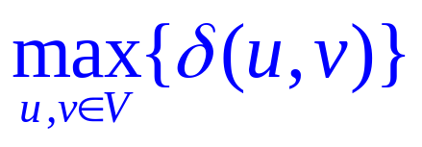
Exercise 22.2-7
The diameter of a tree T=(V,E):
idea: 以每个点v为源点,广度优先搜索,计算它到其它所有顶点的δ(v,⋅) ,计算所有δ(⋅,⋅) 的最大值.
1 for each vertex u ∈V
do BFS(G, u);
O(V(V+E))

Slide 7
A novel idea
任意选一个点u，BFS(G, u)，计算最大的δ(u,⋅)；设 δ(u,v)最大，BFS(G, v)，计算最大的δ(v,⋅)即为 树的直径。O(V+E)
对树上任意的两条简单路P₁和P₂，则P₁∩P₂要么为空要么是一条简单路。

Slide 8
引理：v是直径的一个端点。
证明：
  u在直径上。设直径为 x→u→y，无妨设δ(u,x) ≥δ(u,y)。
  则对任意的w， w→u只能与x→u或y→u之一有除u之外的公共点。δ(u,x) ≥δ(u,w), 否则 w→u→y 或w→u→y是更长的，矛盾。

Slide 9
Proof (Continued)
  u不在直径上。设直径为 x→ w→ y，其中w 是u→x出现的第一个x→y上的点。无妨设δ(u,x) ≥δ(u,y)。 则u→v必与直径相交，否则因为δ(u,v) ≥δ(u,x) ≥δ(u,y)，则δ(w,v) ≥δ(w,x) ,以致于δ(v,y) ≥δ(x,y)
  设u→v与直径相交于w→z。如果z位于w→y上，则
  x→ w→ z→v是更长的；如果z位于w→x上，则
  y→ w→ z→v是更长的。所以v必然是x，y之一，即
  z=x。

Slide 10
DFS Algorithm
DFS(G)
1 for each vertex u∈V[G]
2 do color[u] ← WHITE
3 π[u] ← NIL
4 time ← 0
5 for each vertex u∈V[G]
6 do if color[u] = WHITE
7 then DFS-VISIT(u)
DFS-VISIT(u)
1 color[u] = GRAY
2 d[u] ← time ← time +1
3 for each v ∈ Adj[u]
4 do if color[v] = WHITE
5 then π[v] ← u
6 DFS-VISIT(v)
7 color[u] = BLACK
8 f[u] ← time ← time + 1

Slide 11
Properties of DFS
Properties of the DFS
  u=π[v] if and only if DFS-VISIT(v) was called during a search of u’s adjacency list.
  v is a descendant of u if and only if v is discovered during the time in which u is gray.
  Theorem 22.7 Parenthesis theorem( three cases)
    Either nesting or disjoint
  Corollary 22.8 Nesting of descendants’ intervals
    v is a descendant of u if and only if d[u]<d[v]<f[v]<f[u]
  Theorem 22.9 White-path theorem
    v is a descendant of u if and only if at time d[u], v can be reached from u along a path consisting entirely of white vertices

Slide 12
Classification of edges
Classification of edges
  Directed graph: 4 categories.(u,v)
    Tree edges(树边): d[u]<d[v]<f[v]<f[u]
    Back edges(返回边、反向边): d[v]<d[u]<f[u]<f[v]
    Forward edges(前向边、正向边): d[u]<d[v]<f[v]<f[u]
    Cross edges(交叉边): d[v]<f[v]< d[u]< f[u]
    You should also know the color of v in each category.
  Undirected graph: 2 categories. (u,v) and d[u]<d[v]
    Tree deges: from u to v
    Back edges: from v to u

Slide 13
Exercises
22.3-2
22.3-6
9 While S≠ ∅
10 do color[S.top] ← GRAY
11 d[S.top] ← time ← time +1
12 if exists v ∈ Adj[S.top] &&
color[v] = WHITE
13 then π[v] ← S.top
S.push(v)
15 else
16 u ← S.pop()
17 color[u] ← BLACK
18 f[u] ← time ← time + 1
DFS(G)
1 for each vertex u∈V[G]
2 do color[u] ← WHITE
3 π[u] ← NIL
time ← 0
Stack S ← ∅
6 for each vertex u∈V[G]
7 do if color[u] = WHITE
8 Then S.push(u)

Slide 14
22.3.12
Singly Connected: for all vertices u,v∈V, if u→v, then there is at most one simple path from u to v.
idea:
  DFS-VISIT(u) 可以发现u可达的所有顶点,即u到这些点都有路径。
  前向边和交叉边（搜索过程中遇到黑点）意味着什么呢？u到某个点有多于1条路径。
  这只是u到其它点的情况，单连通要分析任意的顶点对，所以需要分析每个点到其它所有点的情况。即从每个点开始，都做一次全新的DFS-VISIT() 。

Slide 15
引理：单连通⇔无前向边交叉边
证明：(⇒)有前向边或交叉边，则不单连通
(⇐)不单连通，则有前向边或交叉边
  假设存在某点到另一点之间多于1条简单路。无妨设u到v有两条互不相交的路，
  P_{x}=<u,x₁,x₂,…,x_{r},v>, P_{y}=<u,y_{1,}y₂,…,y_{t},v>, r,t不同时为0
  以u为初始点进行深度优先搜索。
  如果{x₁,x₂,…,x_{r}, y_{1,}y₂,…,y_{t}}不存在v的后代，则边(x_{r},v) 和(y_{t},v)都不是返回边，而且最多有一条是树边，必有一条是前向边或交叉边。

Slide 16
  如果 {x₁,x₂,…,x_{r}, y_{1,}y₂,…,y_{t-1}}中存在v的后代顶点,设x_{i}（或y_{j}）是沿着u到v的路上离u最近的v的后代顶点。则x_{i-1}(y_{j-1})不是v的后代，则边(x_{i-1,} x_{i})（或(y_{j-1}, y_{j})）要么是交叉边，要么是前向边。

Slide 17
Modification(continued)
DFS(G)
for (each vertex u ∈V[G])
time←0;
3 do{ for (each vertex v ∈V[G])
4 do{ color[v] ← WHITE;
5 π[v] ← NIL;
6 }
7 DFS-VISIT(u)
8 }
9 Print “G is singly connected”

Slide 18
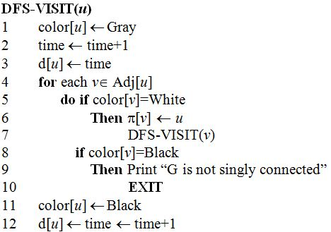
Modification (Continued)

Slide 19
Topological Sort
A topological sort of a directed acyclic graph G = (V, E) is a linear ordering of all its vertices such that if G contains an edge (u, v), then u appears before v in the ordering.

Slide 20
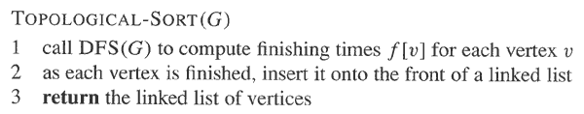
The Algorithm

Slide 21
A Property for DAG
Lemma 22.11： A directed graph G is acyclic if and only if a depth-first search of G yields no back edges.

Slide 22
Correctness Proof of the Algorithm
拓扑排序的定义：图中存在边(u, v)，则在序列中u出现在v的前方。
算法总是将后结束的点放在序列的前方。
所以只需要证明存在边(u, v)，则v比u先结束。DFS可将图中的边分为四类：
  树边： u是v的父亲，f[u] > f[v]
  前向边： u是v的祖先， f[u] > f[v]
  交叉边： u和v没关系，f[u] > f[v]
  返回边： u是v的后代， f[u] < f[v]

Slide 23
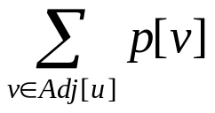
Exercises
22.4-2
输入：有向无环图G=(V,E), 两个顶点s,t.
输出：s到t的路径数。
idea：
  Topological(G)
  对每个顶点u，p[u]表示u→t的路径数，初始p[]←0, p[t]=1.
  从t 往前依次扫描每个 顶点u.计算p[u]= .

Slide 24
The Algorithm
Topologically sort all vertices in G. Assuming that the vertices are v₁, v₂, …, v_{i}, …, v_{j}, …, v_{n} in their topological order, where s = v_{i}, t = v_{j}.
Initialize p[v] ← 0, ∀v₁ ≤ v ≤ v_{n}.
p[v_{j}] ← 1.
For k ← j-1 down to i
for each v ∈ Adj[v_{k}] do
if v ≤ v_{j} according to their topological order
then p[v_{k}] ← p[v_{k}] + p[v].
return p[v_{i}].

Slide 25
Time Complexity
Step 1: O(V+E)
Step 2: O(V)
Step 4~7: O(V+E)
Total time complexity: O(V+E).

Slide 26
n
o
p
q
r
s
v
w
u
t
y
z
4
3
1
1
0
0
1
1
n
q
p
o
s
r
u
t
y
v
w
z
There are 4 distinct paths from p to v.

Slide 27
Another example
b
e
h
k
a
d
g
j
m
c
f
i
l
16
8
8
4+4
4
4
2+2
2
2
1+1
1
1
1
a
b
c
d
e
f
g
h
i
j
k
l
m
There are 16 distinct paths from a to m.

Slide 28
An Example Again
1
1
1
1+1
2
2
2+2
4
4
4+4
8
8
8+8
a
b
c
d
e
f
g
h
i
j
k
l
m
There are 16 distinct paths from a to m.

Slide 29
22.4-3
Given an algorithm that determines whether or not a given undirected graph G=(V,E) contains a cycle. O(V), independent of |E|.
DFS, stops whenever encounters an back edge.

Slide 30
22.4-5
Note:
首先要计算每个点的入度。O(V+E)
当删一个点时，其邻接点的入度要减1。 O(V+E)
记录入度为0的点.

Slide 31
22.4-5 Proof of Correctness
Induction on |V|. |V|=2, only one edge, trivial.
Suppose it is true for |V|<n.
When |V|=n. Select a vertex s of in-degree zero.(must exist. Otherwise, all vertices have non-zero in-degrees. Start from a vertex and backtrack along in-edges. Since V is limited, the procedure must end at an in-edge which leaves a vertex already encountered, thus implies a cycle ).
According to our algorithm, s will be at the most left of the list L. And the other part L’ of the list is exactly the list of the graph G’ obtained by deleting s and the edges leaving it. By induction hypothesis, all edges in G’ pointing from left to right in the list L’(thus also in L). Considering that all edges in G are either those in G’ or those leaving s, we completes the proof.
    for any (u,v)∈E, the in-degree of v can not be zero before deleting u, which implies u appears in front of v.

Slide 32
Strongly Connected Component
A strongly connected component of a directed graph G = (V, E) is a vertex induced sub-graph G’=(V’, E’) of G, such that :
  Every pair of vertices in V’ are reachable from each other in G’;
  Any other sub-graph that contains more vertices than G’ does not satisfy (1).
Given a directed graph G = (V, E), the transpose of G is the graph G^{T}=(V, E^{T}), where E^{T}={(v, u)| (u, v)∈E}.

Slide 33
The component graph
The component graph G^{SCC} = (V^{SCC}, E^{SCC}) of a directed graph G = (V, E) is defined as follows:
  Suppose that G has strongly connected components C₁, C₂, …, C_{k}
  the vertex set V^{SCC} = {v_{i} | v_{i} corresponds to component C_{i} of G, i = 1,2, …, k}
  the edge set E^{SCC} = {(v_{i}, v_{j}) | G contains a directed edge (x, y) for some x ∈ C_{i} and some y ∈ C_{j} , i, j = 1, 2 , …, k, i≠ j }

Slide 34
An important property
Lemma 22.13 :The component graph G^{SCC} = (V^{SCC}, E^{SCC}) is a directed acyclic graph.

Slide 35
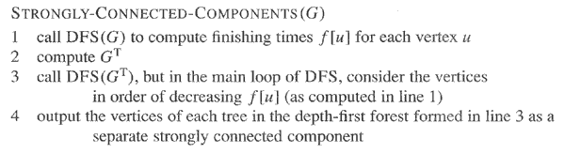
The Algorithm

Slide 36
Crucial Lemma
Lemma 22.14 Let C and C’ be two distinct strongly connected components in directed graph G = (V, E). Suppose that there is an edge (u, v) ∈ E, where u ∈ C and v ∈ C’. Then f(C) > f(C’).
Corollary 22.15：Let C and C’ be distinct strongly connected components in directed graph G = (V, E). Suppose that there is an edge (u, v) ∈ E^{T}, where u ∈ C and v ∈ C’. Then f(C) < f(C’).

Slide 37
Final Destination
Correctness Proof of the Algorithm
Theorem 22.16 ： STRONGLY-CONNECTED-COMPONENTS(G) correctly computes the strongly connected components of a directed graph G.

Slide 38
Exercise 22.5-5
下一次DFS-VISIT()时候的交叉边。

Slide 39
DFS Algorithm
DFS(G)
1 for each vertex u∈V[G]
2 do color[u] ← WHITE
π[u] ← NIL
SCC[u] ← 0
5 time ← 0; SCCnum ← 0
6 for each vertex u∈V[G]
7 do if color[u] = WHITE
then SCCnum++
NewAdj[SCCnum] ←∅
DFS-VISIT(u)
Return NewAdj
DFS-VISIT(u)
color[u] = GRAY
SCC[u] ← SCCnum
3 d[u] ← time ← time +1
4 for each v ∈ Adj[u]
5 do if color[v] = WHITE
then π[v] ← u
DFS-VISIT(v)
8 if color[v] = BLACK&&
SCC[v]!= SCC[u]&&
SCC[v]∉ NewAdj[SCC[u]]
9 NewAdj[SCC[u]].add(SCC[v])
10 color[u] = BLACK
11 f[u] ← time ← time + 1

Slide 40
Semi-connected Graph
A directed graph G = (V, E) is semi-connected if for all pairs of vertices u, v ∈V, we have u ∼∼→ v (v is reachable from u) or v ∼∼→ u (u is reachable from v) or both.
How to determine whether or not a directed graph is semi-connected? (Exercise 22.5-7)

Slide 41
An Observation
Given a directed graph G = (V, E), its strongly connected component graph is denoted as G^{SSC} = (V^{SCC}, E^{SCC}). Then G is semi-connected if and only if for any pair of vertices u, v ∈V^{SSC}, either u is reachable from v or v is reachable from u ( notice that there can not be paths in both directions).

Slide 42
A Sketch
C1
C2
C3
C5
C4
Notice that if the above is a topological sort of G^{SCC}, then
edges can only point from the left to right. So, if G is semi-connected,
Path can only point from left to right,
then C1 must reach each C2…,C5, C2 must reach each C3,…,C5,
…, C4 must reach C5. Then the red edges must exist, Vice versa.

Slide 43
The Algorithm Outline
Compute the strongly connected components of G.
Construct the component graph G^{SCC} of G.
Topological Sort G^{SCC}.
Judge whether there is an edge from C_{i} to C_{i+1}, for 0<i<m, where C_{i} is indexed by topological sort, and m is the number of SCCs.
Time complexity: O(V + E)
 2004 SDU <number>

Slide 44
Another method
In step 3, generate topological sort by using the method that each time find a vertex of zero in-degree. Then G is semi-connected if and only if in each run, exactly one vertex of zero in-degree exist.
Proof?

Slide 45
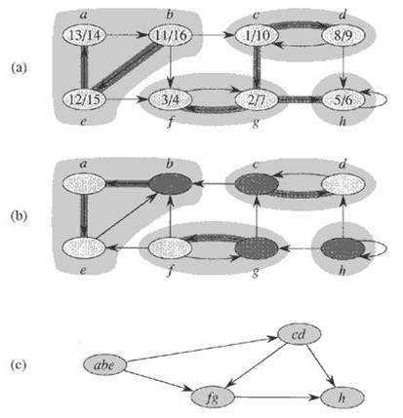
An Example
(a): The graph G with its SCCs shaded
(b): The transpose G^{T} of G with SCCs shaded
(c): The component graph G^{SCC} = (V^{SCC}, E^{SCC}) of G

Slide 46
Remarks
Until now, we have introduced
  Directed graph
  Singly connected graph
  Semi-connected graph
  Strongly connected graph

Slide 47
Problem22-3
Euler tour：traverses each edge exactly once，
it may visit a vertex more than once.
in-degree(v)=out-degree(v)
Proof: (sketch)
设C是一条欧拉回路，顶点v在C中每出现一次，其入度和出度都增加1。
反之,设p=< v₀, v₁, v₂, …, v_{k} >是最长的通路,则v₀=v_{k},否则v_{k}的入度比出度多1，而且必存在边e=(v_{k},v), e不在p上,与p最长矛盾。
若p不包含图中所有边，由G的连通性知，必存在边e=(v_{i},v_{j})∉p, 从而< v_{i}, v_{i+1}, v_{i+2}, …, v_{i} ,v_{j}>是更长的通路。

Slide 48
Search an Euler Tour
从一个顶点出发，一直往下找，一定能回到这个点。
关键是如何把找到的圈并起来.
用一个链表存储当前找到的圈;另一个链表存储已经找到的圈.

Slide 49
