Slide 1

Lecture 15
Single-Source Shortest Paths Problems
Properties of Shortest-Paths and Relaxation
The Bellman-Ford Algorithm

Slide 2
Single-source shortest path problem
Input: A weighted directed graph G=(V, E; W) and a source vertex s.
Output: Shortest-path weight from s to each vertex v in V, and a shortest path from s to each vertex v in V if v is reachable from s.

Slide 3
The technique of Relaxation
In our shortest-paths problem, we maintain an attribute d[v], which is an upper bound on the weight of a shortest path from source s to v.
We call d[v] a shortest-path estimate.
i.e., d[v] is an estimate of δ(s, v).
The term Relaxation is used here for an operation that tightens an upper bound.

Slide 4
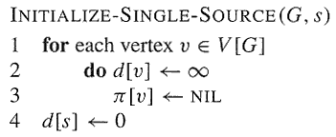
Relaxation--Initialization
The initial estimate of δ(s, v) can be given by:

Slide 5
Relaxation Process
Relaxing an edge (u, v) consists:
  Testing whether we can improve the shortest path from s to v found so far by going through u to v, and if so,
  Updating d[v] and π[v].
A relaxation step may either decrease the value of the shortest-path estimate d[v] and update v’s predecessor π[v], or cause no change.

Slide 6
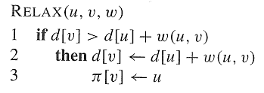
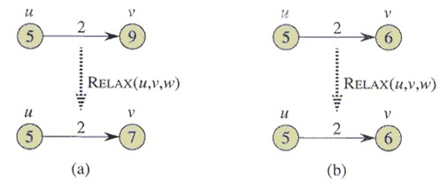
A Relaxation Step

Slide 7
Some notes about Relaxation
Note:
  Each algorithm in this chapter calls INITIALIZE-SINGLE-SOURCE and then repeatedly relaxes edges.
  Relaxation is the only means by which shortest-path estimates d[] and predecessors π[] change.
  The algorithms differ in how many times they relax each edge and the order in which they relax edges.
  Bellman-Ford algorithm relaxes each edge many times, while Dijkstra’s algorithm and the algorithm for directed acyclic graphs relax each edge exactly once.

Slide 8
Properties of Shortest Paths and Relaxation
Triangle inequality (Lemma 24.10)
  For any edge (u, v) ∈E, we have δ(s, v) ≤ δ(s, u) + w(u, v)
Upper-bound property (Lemma 24.11)
  We always have d[v] ≥ δ(s, v) for all vertices v ∈V, and once d[v] achieves the value δ(s, v), it never changes.
No-path property (Lemma 24.12)
  If there is no path from s to v, then we always have d[v] = δ(s, v) = ∞.

Slide 9
Properties of Shortest Paths and Relaxation
Convergence property (Lemma 24.14)
  If s ~→ u→ v is a shortest path from s to v in G, and if d[u] = δ(s, u) at any time prior to relaxing edge (u, v), then d[v] = δ(s, v) at all times afterward.
Path-relaxation property (Lemma 24.15)
  If p = <s, v₁, …, v_{k}> is a shortest path from s to v_{k}, and the edges of p are relaxed in the order (s, v₁), (v₁, v₂), …, (v_{k-1}, v_{k}), then after relaxing all the edges, d[v_{k}] = δ(s, v_{k}).
  Note that other relaxations may take place among these relaxations.

Slide 10
Properties of Shortest Paths and Relaxation
Predecessor-subgraph property (Lemma 24.17)
  Once d[v] = δ(s, v) for all v ∈V, the predecessor subgraph is a shortest-paths tree rooted at s.
Note: Proofs for all these properties can be found in your textbook.

Slide 11
Single-source shortest path problem
Input: A weighted directed graph G=(V, E; W) and a source vertex s.
Output: Shortest-path weight from s to each vertex v in V, and a shortest path from s to each vertex v in V if v is reachable from s.

Slide 12
The Bellman-Ford Algorithm
To solve the single-source shortest-paths problem
  The algorithm returns a boolean value indicating whether or not there is a negative-weight cycle that is reachable from the source.
  If there is a negative-weight cycle reachable from the source s, the algorithm indicates no solution exists.
  If there are no such cycles, the algorithm produces the shortest paths and their weights.

Slide 13
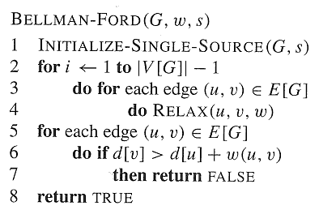
The Bellman-Ford O(VE) Algorithm

Slide 14
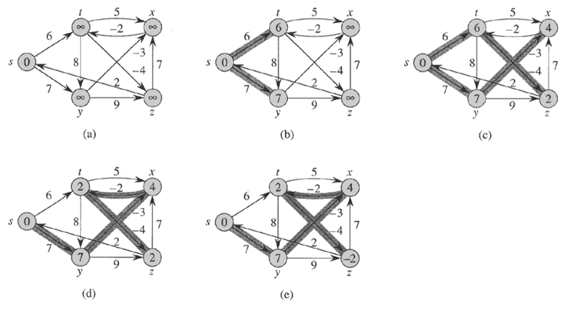
Note: each pass relaxes the edges in the order:
(t,x), (t,y), (t,z), (x,t), (y,x), (y,z), (z,x), (z,s), (s,t), (s,y)

Slide 15
Time Complexity of The Bellman-Ford
The time complexity is O(VE)

Slide 16
Correctness of The Bellman-Ford
Lemma 24.2
  Let G = (V, E) be a weighted, directed graph with source s and weight function w: E→R, and assume that G contains no negative cycles that are reachable from s. Then, after the | V | - 1 iterations of the for loop of lines 2-4 of BELLMAN-FORD, we have d[v] = δ(s, v) for all vertices v reachable from s.

Slide 17
Proof of Lemma 24.2
Proof: Consider any vertex v that is reachable from s, and let p = <v₀, v₁, …, v_{k}>, where v₀ = s and v_{k} = v, be any acyclic shortest path from s to v. Path p has at most | V |-1 edges, and so k ≤ | V |-1. Each of the | V |-1 iterations of the for loop of lines 2-4 relaxes all |E| edges. Among the edges relaxed in the ith iteration, the edge in P is (v_{i-1}, v_{i}), for i = 1, 2, …, k. By the path-relaxation property, d[v] = d[v_{k}] = δ(s, v_{k}) = δ(s, v).

Slide 18
Correctness of The Bellman-Ford
Corollary 24.3
  Let G = (V, E) be a weighted, directed graph with source s and weight function w: E→R. Then for each vertex v ∈V, there is a path from s to v if and only if BELLMAN-FORD terminates with d[v] < ∞ when it is run on G.
  Proof :Exercise 24.1-2.
  (⇒)If there is a path P=<v₀, v₁,…, v_{k}> from s to v, where s=v₀, v=v_{k}, we show by induction that after the ith iteration, d[v_{i}]<∞.
  (⇐) By the no-path property.

Slide 19
Correctness of The Bellman-Ford
Theorem 24.4
  Let BELLMAN-FORD be run on a weighted, directed graph G = (V, E) with source s and weight function w: E→R. If G contains no negative cycles that are reachable from s, then the algorithm returns TRUE, we have d[v] = δ(s, v) for all vertices v ∈V, and the predecessor subgraph G_{π} is a shortest-paths tree rooted at s. If G does contain a negative weight cycle reachable from s, then the algorithm returns FALSE.

Slide 20
Proof of Theorem 24.4
Suppose G contains no negative-weight cycles that are reachable from s.
  Prove that at termination, d[v] = δ(s, v), for all vertices v in V.
    Case 1: v is reachable from s; --> Lemma 24.2
    Case 2: v is not reachable from s; --> No Path Property
  Prove that the algorithm returns TRUE
    For each edge (u,v),
    d[v]= δ(s, v) ≤ δ(s,u)+w(u,v) = d[u]+w(u,v).
Suppose that G contains a negative-weight cycle that is reachable from s.
  Prove that the algorithm returns FALSE
    For each edge on a negative-weight cycle C=<v₀,v₁…,v_{k}>, where v₀=v_{k}
    d[v_{i}] ≤d[v_{i-1}]+w(v_{i-1},v_{i}), for 1 ≤ i ≤ k.
    Summing both sides of equations yields 0 ≤ w(C), contradiction.

Slide 21
Conclusion
Relaxation
The Bellman-Ford Algorithm

Slide 22
实验四
给定一个有向图，图中边的权重有正有负，设图中存在若干负环，设计算法找到一个负环。

Slide 23
Homework
24.1-1

