Slide 1

Lecture 16
Single-Source Shortest Paths Problems Continued
Properties of Shortest Paths and Relaxation
Single-Source Shortest Paths in Directed Acyclic Graphs

Slide 2
Shortest-Paths Tree
Predecessor subgraph G_{π} = (V_{π}, E_{π}):
  V_{π} = {v ∈V: π[v] ≠ NIL} ∪{s}
  E_{π} = {(π[v] , v) ∈E: v ∈V_{π} -{s}}
Let G = (V, E;W) be a weighted, directed graph, and assume that G contains no negative cycles that are reachable from s. A shortest-paths tree rooted at s is a directed sub-graph G’=(V’, E’), where V’⊆V and E’⊆E, such that
  V’ is the set of vertices reachable from s in G,
  G’ forms a rooted tree with root s, and
  For all v ∈V’, the unique simple path from s to v in G’ is a shortest path from s to v in G.

Slide 3
Properties of Shortest Paths and Relaxation
Assume there is no negative cycle reachable from s
Triangle inequality (Lemma 24.10)
  For any edge (u, v) ∈E, we have δ(s, v) ≤ δ(s, u) + w(u, v)
Upper-bound property (Lemma 24.11)
  We always have d[v] ≥ δ(s, v) for all vertices v ∈V, and once d[v] achieves the value δ(s, v), it never changes.
No-path property (Lemma 24.12)
  If there is no path from s to v, then we always have d[v] = δ(s, v) = ∞.

Slide 4
Properties of Shortest Paths and Relaxation
Convergence property (Lemma 24.14)
  If s ~→ u→ v is a shortest path from s to v in G, and if d[u] = δ(s, u) at any time prior to relaxing edge (u, v), then d[v] = δ(s, v) at all times afterward.
Path-relaxation property (Lemma 24.15)
  If p = <s, v₁, …, v_{k}> is a shortest path from s to v_{k}, and the edges of p are relaxed in the order (s, v₁), (v₁, v₂), …, (v_{k-1}, v_{k}), then after relax all the edges, d[v_{k}] = δ(s, v_{k}).
  Note that other relaxations may take place among these relaxations.

Slide 5
Properties of Shortest Paths and Relaxation
Lemma 24.16
  G=(V,E;W) contains no negative-cycle that are reachable from s. Then after Initialization and any sequence of Relax steps, the predecessor subgraph forms a rooted tree with root s.
Predecessor-subgraph property (Lemma 24.17)
  Once d[v] = δ(s, v) for all v ∈V, the predecessor subgraph is a shortest-paths tree rooted at s.

Slide 6
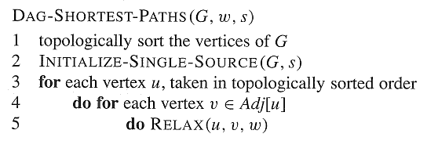
Single-Source Shortest Paths in Directed Acyclic Graphs
Time Complexity: O(V + E)

Slide 7
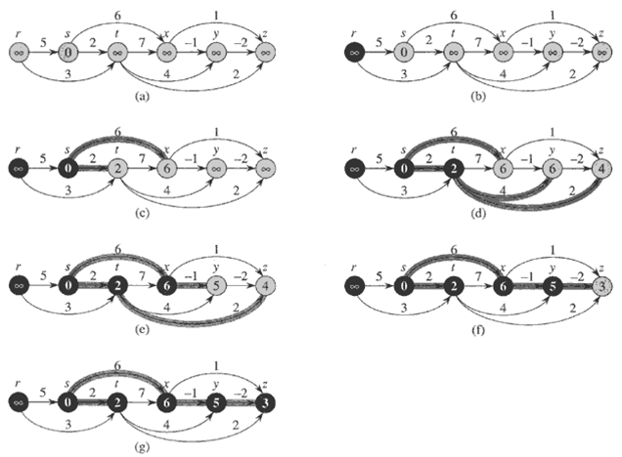

Slide 8
Correctness of the Algorithm
Theorem 24.5
  If a weighted, directed graph G = (V, E) has source vertex s and no cycles, then at the termination of the DAG-SHORTEST-PATHS procedure, d[v] = δ(s, v) for all vertices v ∈V, and the predecessor subgraph G_{π} is a shortest-paths tree rooted at s.
Proof.
  We first show that d[v] = δ(s, v) for all vertices v ∈V at the termination.
  If v is not reachable from s, then d[v] = δ(s, v)=∞ by the no-path property.

Slide 9
Proof Continued
  Now, Suppose that there is a shortest path P=<v₀,v₁,…,v_{k}>, where v₀=s and v_{k}=v. Since we process the vertices in topological order, the edges on P are relaxed in the order (v₀,v₁), (v₁,v₂), …., (v_{k-1},v_{k}).The path relaxation property implies that d[v_{i}]= δ(s, v_{i}) for all i.
  By the predecessor-subgraph property, G_{π} is a shortest-paths tree.

Slide 10
Application:
Determine Critical Path
Pert Chart:
  edges represent jobs and weights represent the times required to perform particular jobs.
  If edge (u,v) enters v and edge (v,w) leaves v, then job (u,v) must be performed prior to job (v,w).
  A path through this dag represents a sequence of jobs that must be performed in a particular order.
  A critical path is a longest path through the dag.

Slide 11
Two method
Negating the edge weight.
Replace “∞” with “- ∞” and “>” with “<”.

