Slide 1
Lecture 20
All-Pairs Shortest Paths
Continued
Transitive closure
Johnson’s algorithm

Slide 2

Transitive closure (the problem)
Find out whether there is a path from i to j and compute
G* = (V,E*),
where E* = {(i,j): there is a path from i to j in G}
ª
^{c}
^{b}
^{i}
^{j}

Slide 3
Transitive closure
One way:
set w_{ij} = 1 and
run the Floyd-Warshall algorithm
running time O(n³)

Slide 4
Transitive closure
Another way:
substitute “+” and “min” by AND and OR
in Floyd’s algorithm
running time O(n³)

Slide 5
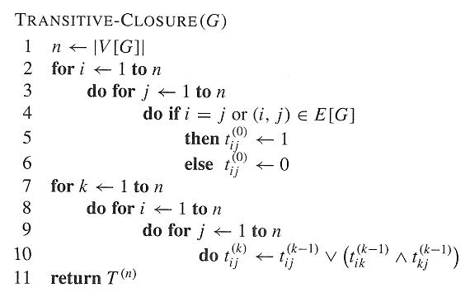
Transitive closure (pseudo-code)

Slide 6
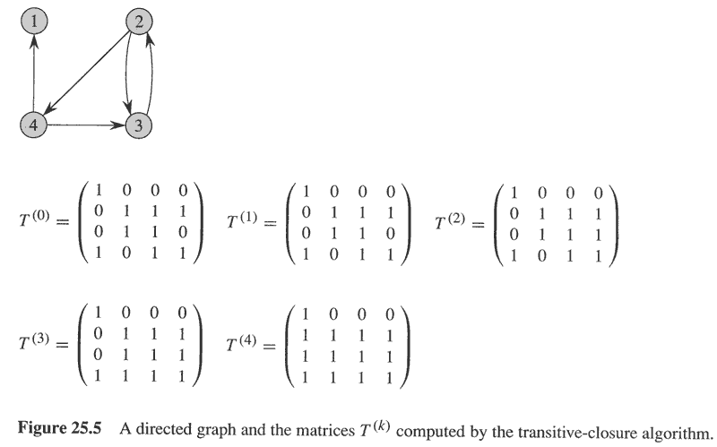
Transitive closure

Slide 7
图的平方
G’=<V,E’>, 在G中所有距离为2的顶点间填加边。
A’、D’分别为G’的邻接矩阵与距离矩阵。
G’是完全图⇔G的直径≤2
图的直径是所有顶点对间最短路长度的最大值。
A’与A²有什么关系呢？

Slide 8
计算距离矩阵
引理10.1：设Z=A²，A为G的邻接矩阵。则:
  i,j间存在长度为2的路径当且仅当Z_{ij}>0
  Z_{ij}的值为i与j间长度为2的路径的数目。
  Z_{ii}是顶点i的度d(i)。
Z可在O(MM(n))内计算得到，知道了A和Z，可在O(n²)内计算得到A’。
如果G’是完全图，则D=2A’- A。

Slide 9
A’&A²
 | 1 | 2 | 3 | 4 | 5 | 6
1 | 1 | 0 | 1 | 0 | 0 | 0
2 | 0 | 2 | 0 | 1 | 0 | 1
3 | 1 | 0 | 3 | 0 | 1 | 0
4 | 0 | 1 | 0 | 2 | 0 | 1
5 | 0 | 0 | 1 | 0 | 1 | 0
6 | 0 | 1 | 0 | 1 | 0 | 1
⁵
¹
^{A2}
²
⁴
^{A}
 | 1 | 2 | 3 | 4 | 5 | 6
1 | 0 | 1 | 0 | 0 | 0 | 0
2 | 1 | 0 | 1 | 0 | 0 | 0
3 | 0 | 1 | 0 | 1 | 0 | 1
4 | 0 | 0 | 1 | 0 | 1 | 0
5 | 0 | 0 | 0 | 1 | 0 | 0
6 | 0 | 0 | 1 | 0 | 0 | 0
³
 | 1 | 2 | 3 | 4 | 5 | 6
1 | 0 | 1 | 1 | 0 | 0 | 0
2 | 1 | 0 | 1 | 1 | 0 | 1
3 | 1 | 1 | 0 | 1 | 1 | 1
4 | 0 | 1 | 1 | 0 | 1 | 1
5 | 0 | 0 | 1 | 1 | 0 | 0
6 | 0 | 1 | 1 | 1 | 0 | 0
⁶
^{A’}

Slide 10
引理10.2：对于任意两个不同的顶点i, j，
  D_{ij}是偶数，则D_{ij}=2D_{ij}’；
  D_{ij}是奇数，则D_{ij}=2D_{ij}’-1。
这就是说，如果能知道D_{ij}的奇偶性，就可以根据D_{ij}’计算D_{ij}。

Slide 11
^{i}
^{j}
^{i}
^{j}

Slide 12
引理10.3：对于任意两个不同的顶点i, j，
  对于i的任意邻居k， D_{ij}-1≤D_{kj} ≤D_{ij}+1；
  存在i的某个邻居k，满足D_{kj} =D_{ij}-1。
实际上就是三角不等式。
引理10.4：对于任意两个不同的顶点i, j，
  D_{ij}是偶数，则对于i的每个邻居k ，D_{kj}’≥D_{ij}’；
  D_{ij}是奇数，则对于i的每个邻居k ， D_{kj}’≤D_{ij}’ ；且存在某个邻居k，满足D_{kj}’<D_{ij}’。

Slide 13
^{i}
^{k}
^{j}
^{k}₁
^{k}₂
^{i}
^{k}
^{j}
^{k}₁
^{k}₂

Slide 14
判断奇偶性
引理10.4：对于任意两个不同的顶点i, j，
  D_{ij}是偶数，则对于i的每个邻居k ，D_{kj}’≥D_{ij}’；
  D_{ij}是奇数，则对于i的每个邻居k ， D_{kj}’≤D_{ij}’ ；且存在某个邻居k，满足D_{kj}’<D_{ij}’。
引理10.5：对于任意两个不同的顶点i, j，
  D_{ij}是偶数⇔Σ_{k∈Γ(i)}D_{kj}’≥D_{ij}’×d(i)；
  D_{ij}是奇数⇔Σ_{k∈Γ(i)}D_{kj}’<D_{ij}’×d(i) 。

Slide 15
递归算法思想
如果某个图的平方是完全图，则其距离矩阵为D=2A’- A。 递归出口。
已知图的平方的距离矩阵D_{ij}’。
根据：D_{ij}是偶数⇔Σ_{k∈Γ(i)}D_{kj}’≥D_{ij}’×d(i)，
D_{ij}是奇数⇔Σ_{k∈Γ(i)}D_{kj}’<D_{ij}’×d(i) ，
判断奇偶性。
根据：D_{ij}是偶数，则D_{ij}=2D_{ij}’；
D_{ij}是奇数，则D_{ij}=2D_{ij}’-1。
计算D_{ij}。

Slide 16
G&A
⁵
¹
²
⁴
^{A}
 | 1 | 2 | 3 | 4 | 5 | 6
1 | 0 | 1 | 0 | 0 | 0 | 0
2 | 1 | 0 | 1 | 0 | 0 | 0
3 | 0 | 1 | 0 | 1 | 0 | 1
4 | 0 | 0 | 1 | 0 | 1 | 0
5 | 0 | 0 | 0 | 1 | 0 | 0
6 | 0 | 0 | 1 | 0 | 0 | 0
³
⁶

Slide 17
G的平方&A’
⁵
¹
²
⁴
^{A’}
 | 1 | 2 | 3 | 4 | 5 | 6
1 | 0 | 1 | 1 | 0 | 0 | 0
2 | 1 | 0 | 1 | 1 | 0 | 1
3 | 1 | 1 | 0 | 1 | 1 | 1
4 | 0 | 1 | 1 | 0 | 1 | 1
5 | 0 | 0 | 1 | 1 | 0 | 0
6 | 0 | 1 | 1 | 1 | 0 | 0
³
⁶

Slide 18
G的平方的平方&A’’&D’’
⁵
¹
²
⁴
^{A’’}
^{D’’}
 | 1 | 2 | 3 | 4 | 5 | 6
1 | 0 | 1 | 1 | 1 | 1 | 1
2 | 1 | 0 | 1 | 1 | 1 | 1
3 | 1 | 1 | 0 | 1 | 1 | 1
4 | 1 | 1 | 1 | 0 | 1 | 1
5 | 1 | 1 | 1 | 1 | 0 | 1
6 | 1 | 1 | 1 | 1 | 1 | 0
³
 | 1 | 2 | 3 | 4 | 5 | 6
1 | 0 | 1 | 1 | 1 | 1 | 1
2 | 1 | 0 | 1 | 1 | 1 | 1
3 | 1 | 1 | 0 | 1 | 1 | 1
4 | 1 | 1 | 1 | 0 | 1 | 1
5 | 1 | 1 | 1 | 1 | 0 | 1
6 | 1 | 1 | 1 | 1 | 1 | 0
⁶

Slide 19
 | 1 | 2 | 3 | 4 | 5 | 6
1 | 0 | 1 | 1 | 1 | 1 | 1
2 | 1 | 0 | 1 | 1 | 1 | 1
3 | 1 | 1 | 0 | 1 | 1 | 1
4 | 1 | 1 | 1 | 0 | 1 | 1
5 | 1 | 1 | 1 | 1 | 0 | 1
6 | 1 | 1 | 1 | 1 | 1 | 0
^{A’’}
⁵
¹
²
⁴
^{A’}
^{D’}
 | 1 | 2 | 3 | 4 | 5 | 6
1 | 0 | 1 | 1 | 0 | 0 | 0
2 | 1 | 0 | 1 | 1 | 0 | 1
3 | 1 | 1 | 0 | 1 | 1 | 1
4 | 0 | 1 | 1 | 0 | 1 | 1
5 | 0 | 0 | 1 | 1 | 0 | 0
6 | 0 | 1 | 1 | 1 | 0 | 0
³
 | 1 | 2 | 3 | 4 | 5 | 6
1 | 0 | 1 | 1 | 2 | 2 | 2
2 | 1 | 0 | 1 | 1 | 2 | 1
3 | 1 | 1 | 0 | 1 | 1 | 1
4 | 2 | 1 | 1 | 0 | 1 | 1
5 | 2 | 2 | 1 | 1 | 0 | 2
6 | 2 | 1 | 1 | 1 | 2 | 0
⁶

Slide 20
 | 1 | 2 | 3 | 4 | 5 | 6
1 | 0 | 1 | 1 | 2 | 2 | 2
2 | 1 | 0 | 1 | 1 | 2 | 1
3 | 1 | 1 | 0 | 1 | 1 | 1
4 | 2 | 1 | 1 | 0 | 1 | 1
5 | 2 | 2 | 1 | 1 | 0 | 2
6 | 2 | 1 | 1 | 1 | 2 | 0
^{D’}
⁵
¹
²
⁴
^{A}
^{D}
 | 1 | 2 | 3 | 4 | 5 | 6
1 | 0 | 1 | 0 | 0 | 0 | 0
2 | 1 | 0 | 1 | 0 | 0 | 0
3 | 0 | 1 | 0 | 1 | 0 | 1
4 | 0 | 0 | 1 | 0 | 1 | 0
5 | 0 | 0 | 0 | 1 | 0 | 0
6 | 0 | 0 | 1 | 0 | 0 | 0
 | 1 | 2 | 3 | 4 | 5 | 6
1 | 0 | 1 | 2 | 3 | 4 | 3
2 | 1 | 0 | 1 | 2 | 3 | 2
3 | 2 | 1 | 0 | 1 | 2 | 1
4 | 3 | 2 | 1 | 0 | 1 | 2
5 | 4 | 3 | 2 | 1 | 0 | 3
6 | 3 | 2 | 1 | 2 | 3 | 0
³
⁶

Slide 21
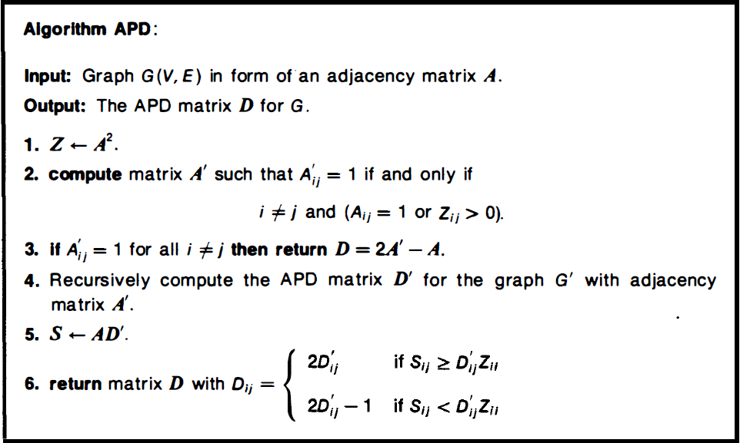
算法描述

Slide 22
时间复杂度分析
T(n,δ)：输入图含有n个顶点，直径为δ时，算法APD的运行时间。
T(n,δ)=2MM(n)+T(n, ⎡δ/2⎤)+O(n²)
T(n,δ)=O(MM(n)logn)

Slide 23
Table of running times
algorithm | running time
Dijkstra‘s | O(n2 log n+nm)
Bellman-Ford | O(n 2m)
matrix multiplication | O(n4)
improved matrix mult. | O(n3 log n)
Floyd-Warshall | O(n3)
Johnson‘s Transitive closure | O(n2 log n+nm) O(n3)

Slide 24
Homework
25.2-5

Slide 25
Johnson’s algorithm
(idea)
If { all edge weights are non-negative }
Invoke Dijkstra’s algorithm V times,
else if { there are negative weight edges but no negative weight cycles }
Reweight graph so that
      all edge weights are non-negative, and that
      shortest path does not change after reweighting
Invoke Dijkstra’s algorithm for each vertex as
source.
* Time Complexity: O(V²logV+VE) //using Fibonacci heap
* If G is sparse, better than Floyd-Warshall

Slide 26

Reweighting Technique (I)
  Lemma 25.1 (reweighting does not change shortest paths):
  Given a weighted, directed graph G=(V,E) with weight function w. Let h:V→R be any function. For each edge (u,v)∈E, define
  ŵ(u,v) = w(u,v) + h(u) - h(v)
  Let p=<v₀,…,v_{k}> be any path from v₀ to v_{k}. Then p is a shortest path using weight function w if and only if it is a shortest path using weight function ŵ. That is w(p)=δ(v₀,v_{k}) if and only of ŵ(p)= (v₀,v_{k}) . Also, G has a negative-weight cycle with w if and only if G has a negative-weight cycle with ŵ.

Slide 27
Proof
Proof: 1. For any path p from v₀ to v_{k}, we have
ŵ(p)=w(p)+h(v₀)-h(v_{k}),
so, p* is shortest with w if and only if it is shortest with ŵ.
2. Consider any cycle C=<v₀,…,v_{k}>, we have
ŵ(C) = w(C)+h(v₀)-h(v₀) = w(C),
G has a negative cycle with w if and only if it has a negative cycle with ŵ.

Slide 28
Reweighting Technique (II)
Producing nonnegative weights by reweighting
Given a weighted, directed graph G = (V, E) with w, we make a new graph G’ = (V’,E’), where V’ = V∪{s}, s is not in V, and E’ = E∪{(s,v) : v is in V}. w(s,v) is set to 0, for all v in V.
0
10
-5
10
-5
4
4
8
0
8
-6
-6
s
0
7
9
7
9
0
2
2
0

Slide 29
Reweighting Technique (III)
Producing nonnegative weights by reweighting
Suppose that G and G’ have no negative weight cycle. Define h(v) = δ(s,v) for all v in V’. By the triangle inequality (Lemma 24.10), we have h(v) <= h(u) + w(u,v) for all edges (u,v) in E’. Thus, we have
ŵ(u,v) = w(u,v) + h(u) – h(v) >= 0

Slide 30


Critical Steps
How to compute δ(s,v)?
  Bellman-Ford algorithm.
  Do you remember?
How to compute all (u,v)?
  Run Dijkstra algorithm |V| times.
  δ(u,v)= (u,v)+h(v)-h(u)

Slide 31
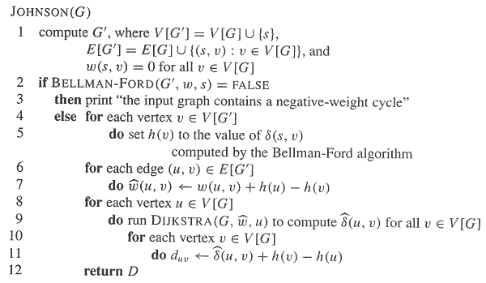
Johnson’s algorithm

Slide 32
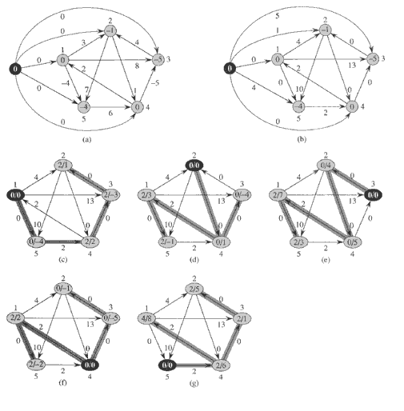
Johnson’s (example)

Slide 33
Johnson’s algorithm
Time complexity:
Compute G’: O(V)
Bellman-Ford: O(VE)
Re-weighting: O(E)
Dijkastra’s: O(VlgV+E)
Total: O(V²logV+VE)
If G is sparse, e.g., E=O(V), then better than Floyd-Warshall.

Slide 34
All-pairs shortest paths problem algorithm comparison
algorithm | running time
Dijkstra‘s | O(n2 log n+nm)
Bellman-Ford | O(n2 m)
matrix multiplication | O(n4)
improved matrix mult. | O(n3 log n)
Floyd-Warshall Transitive closure | O(n3)
Johnson‘s | O(n2 log n+nm)

Slide 35
Homework
25.3-4

