Slide 1
Lecture 21
Maximum Flow Problem
The Ford-Fulkerson method

Slide 2

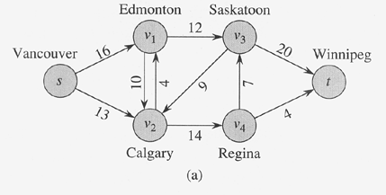
Flow Networks
A flow network G=(V,E) is a directed graph, where each edge (u,v)∈E has a nonnegative capacity c(u,v)>=0.
If (u,v)∉E, we assume that c(u,v)=0.
two distinct vertices : source s and sink t.

Slide 3
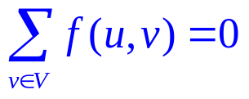
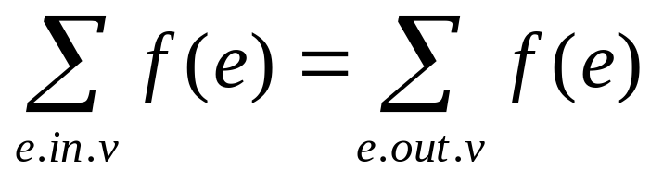
Flow
Given a flow network G=(V,E) with capacity function c. Let s be the source and t the sink.
A flow in G is a real-valued function f: V×V → R satisfying the following three properties:
Capacity constraint: For all u,v ∈V, f(u,v) ≤ c( u,v).
Skew symmetry: For all u,v ∈V, f(u,v) = -f(v, u) .
Flow conservation: For all u ∈V-{s,t},

Slide 4
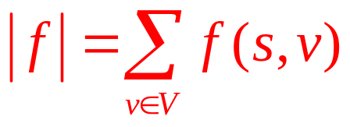
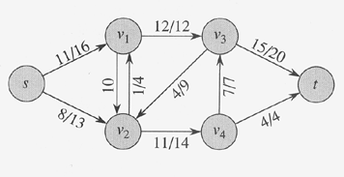
Value of a Flow
The value of a flow is defined as
  The total flow out of the source.

Slide 5

Maximum-flow Problem
Input: a flow network G with capacity function c, source s and sink t
Output: a flow of maximum value
How to solve it efficiently?

Slide 6
The Ford-Fulkerson Method
Why call it a “method” rather than an “algorithm”?
Because it encompasses several implementations with different running times.
The Ford-Fulkerson method depends on three important ideas:
residual networks, augmenting paths, and cuts.
These ideas are essential to the important max-flow min-cut theorem, which characterizes the value of maximum flow in terms of cuts of the flow network.

Slide 7
The Ford-Fulkerson Method
FORD-FULKERSON-METHOD(G,s,t)
  initialize flow f to 0
  while there exists an augmenting path p
  do augment flow f along p
  return f

Slide 8
Residual Networks
Given a flow network and a flow, the residual network consists of edges that can admit more flow.
More formally, given:
G=(V,E) --a flow network with source s and sink t
f: a flow in G.
The amount of additional flow can be pushed form u to v before exceeding the capacity c(u,v) is the residual capacity of (u,v), given by:
  c_{f}(u,v) = c(u,v) - f(u,v)
Residual network: G_{f} = (V,E_{f}), where
E_{f} ={(u,v) ∈V×V: c_{f}(u,v) > 0}: residual edge.

Slide 9
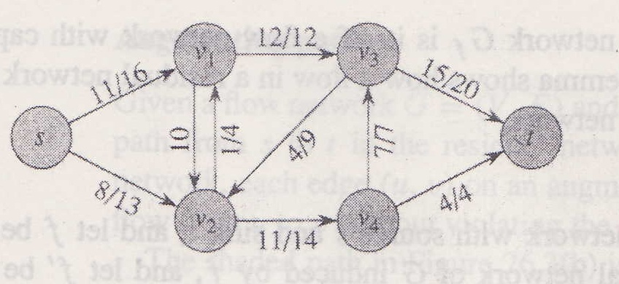
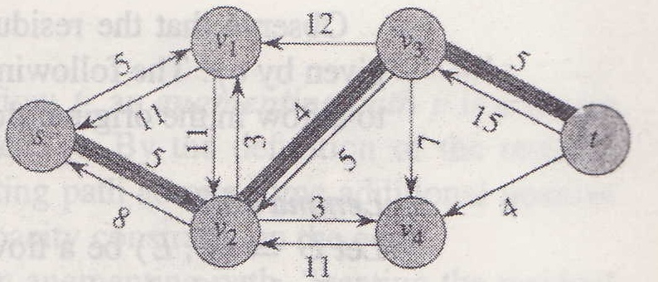
Residual Networks (example)

Slide 10
The relationship between a flow in a residual network and one in a the original network
Lemma 26.2
Let G=(V,E) be a flow network with source s and sink t ,and let f be a flow in G. Let G_{f} be the residual network of G induced by f, and let f’ be a flow in G_{f} .Then the flow sum f +f’ defined by * is a flow in G with value ⎜f+f’⎟=⎜f⎟+⎜f’⎟.
*: Given a flow network G=(V,E), let f₁ and f₂ be functions from V×V to R. The flow sum f₁ + f₂ is the function from V×V to R defined by
(f₁ + f₂ ) (u, v)= f₁ (u, v)+ f₂ (u, v) For all u, v ∈ V.

Slide 11
Augmenting paths
Given a flow network G=(V,E) and a flow f, an augmenting path is a simple path from s to t in the residual network G_{f}
Residual capacity of p : the maximum amount of flow that we can ship along the edges of an augmenting path p, i.e.,
c_{f}(p) = min { c_{f}(u,v): (u,v) is on p}.
2
3
1
The residual capacity is 1.

Slide 12
Example of an augmenting path (bold edges)
8
12
v₁
v₃
20
4
s
4
4
10
4
t
7
5
13
10
4
v₂
v₄
4

Slide 13
Augmenting Path (example)

Slide 14
Augmenting Path
Lemma 26.3
Let G=(V,E) be a flow network, Let f be a flow in G, and
let p be an augmenting path in G_{f} .Let f_{p} :V×V→R by
c_{f}(p) if (u,v) is on p
f_{p} (u,v) = -c_{f}(p) if (v,u) is on p
0 otherwose. (26.6)
Then f_{p} is a flow in G_{f} with value |f_{p}|=c_{f}(p)>0.
Equivalently， if the augmenting path is p=<s=v₀,v₁,v₂,…,v_{k-1},t=v_{k}>
Then f_{p} (v_{i-1},v_{i})= c_{f}(p) and f_{p} (v_{i},v_{i-1})= -c_{f}(p) , the flow between all other
pair of vertices are 0.

Slide 15
Augmenting Path
Corollary 26.4
Let G=(V,E) be a flow network, Let f be a flow G, and let p be an augmenting path in G_{f} .Let f_{p} be defined as in equation (26.6). Define a function f’=f+f_{p} .Then f’ is a flow in G with value |f’|=|f|+|f_{p}|>|f|.

Slide 16
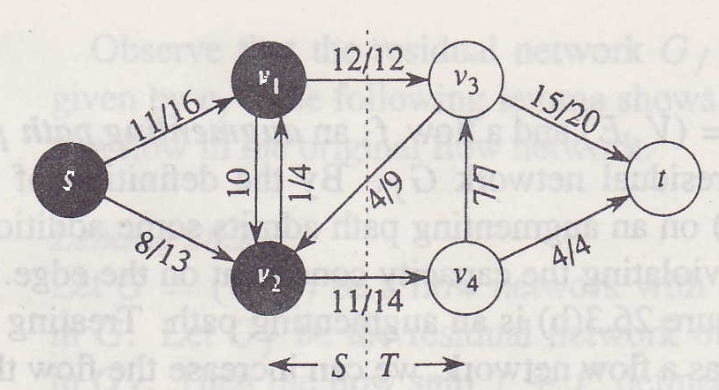
Cut
Cut (S, T): S is a subset of V, T =V-S, s∈S and t∈T.
Net flow across the cut (S,T): f(S,T)
Capacity of the cut (S,T): c(S,T)
Minimum cut of a network: a cut with minimum capacity.

Slide 17
Cut
18:18
a
16:16
19:18
5: 0
s
8: 0
4: 0
8: 5
t
3: 3
20:18
18:16
c
d
13:13

Slide 18





Cut
Lemma 26.5
Let f be a flow in a flow network G with source s and sink t , and let (S,T) be a cut of G. Then the net flow across (S,T) is f(S,T)= |f|.
Proof
  (Lemma26.1, part(3))
  (Lemma26.1, part(1))
  (Lemma26.1, part(3))
  (since f(S-s,V)=0)

Slide 19
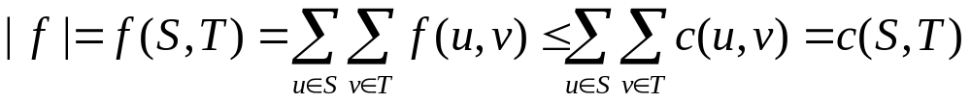
Cut
Corollary 26.6
The value of any flow f in a flow network G is bounded from above by the capacity of any cut of G.
Proof
  Let (S,T) be any cut of G and let f be any flow. By Lemma 26.5 and capacity constraints,

Slide 20
Cut
Theorem 26.7(Max-flow Min-cut Theorem)
If f is a flow in a flow network G=(V,E) with source s and sink t then the following conditions are equivalent:
  f is a maximum flow in G.
  The residual network G_{f} contains no augmenting paths.
  |f|=c(S,T) for some cut (S,T) of G

Slide 21
Proof
  (1)⇒(2): Suppose for the sake of contradiction that f is a maximum flow in G but G_{f} has an augment path p. Then, by Corollary 26.4, the flow sum f+f_{p}, where f_{p} is given by equation (26.6), is a flow in G with value strictly greater than |f|, contradicting the assumption that f is a maximum flow.
  (2)⇒(3): Suppose that G_{f} has no augmenting path, that is, that G_{f} contains no path from s to t. Define
  S={ v ∈ V : there exists a path from s to v in G_{f} }
  and T=V-S. The partition (S,T) is a cut, s∈S and t∉S. For each pair of vertices u and v such that u∈S and v∈T, we have f(u,v)=c(u,v), since otherwise (u,v)∈E_{f} , which would place v in the set S. By lemma 26.5, therefore, |f|=f(S,T)=c(S,T).
  (3)⇒(1): By Corollary 26.6, |f| ≤ c(S,T) for all cuts (S,T).
  Then |f| =c(S,T) implies f is a maximum flow.

Slide 22
The Basic Ford-Fulkerson Algorithm
Ford-Fulkerson(G,s,t)
  For each edge (u, v)∈E
  do f[u,v]←0
  f[v,u]←0
  While there exists a path p from s to t in the residual network G_{f}
  do c_{f}(p) ← min{c_{f}(u,v): (u,v) is in p}
  for each edge (u,v) in p
  do f[u,v]← f[u,v]+ c_{f}(p)
  f[v,u]← -f[u,v]

Slide 23
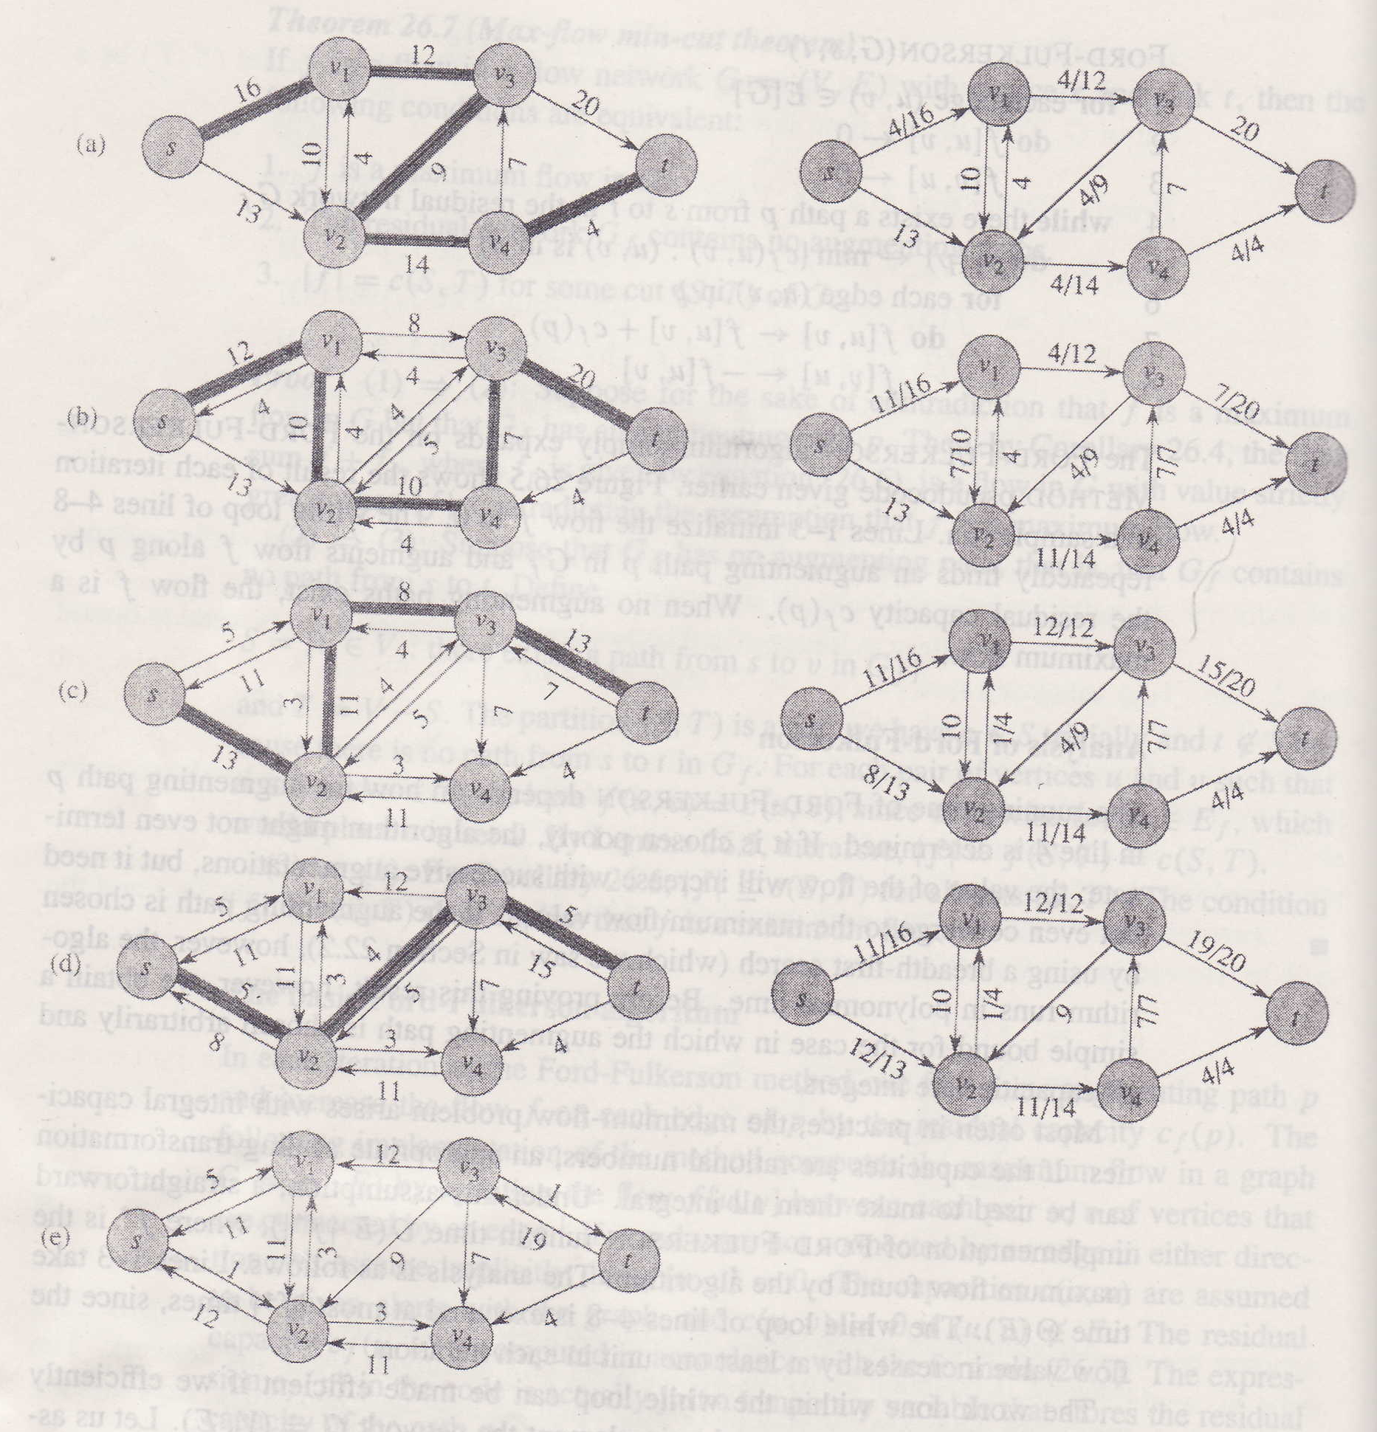
The Basic Ford-Fulkerson Algorithm

Slide 24
Analysis of Ford-Fulkerson Method
The selection of the augmenting path in this method is arbitrary.
If the capacities are irrational, the method may not terminate. If the flow does converge, however, it may converge to a value that is not necessarily maximum.
If the capacities are integers, the While loop is executed at most |f*| times, since the flow value increases by at least 1 in each iteration.
If we use either DFS or BFS, the time to find an augmenting path takes O(E) time, i.e. each iteration of While loop the takes O(E) time.
Thus, the total running time of the method is O(E |f*| ) .

Slide 25
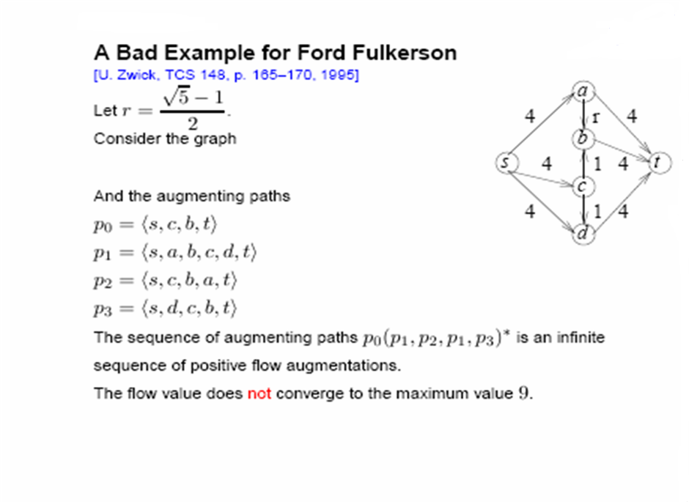
Analysis of Ford-Fulkerson Method

Slide 26
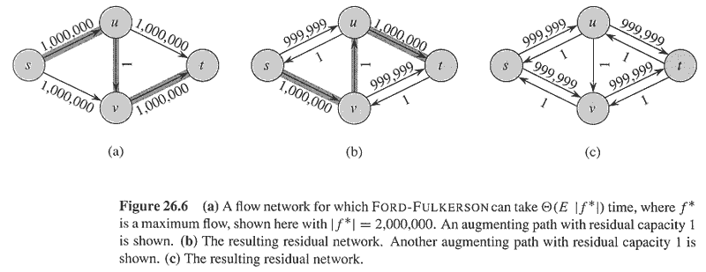
Analysis of Ford-Fulkerson Method

